Slide 1

LHC, HL-LHC and beyond
Mike Lamont
for the LHC team
Acknowledgements: Frédérick Bordry, Steve Myers, Frank Zimmermann

Slide 2
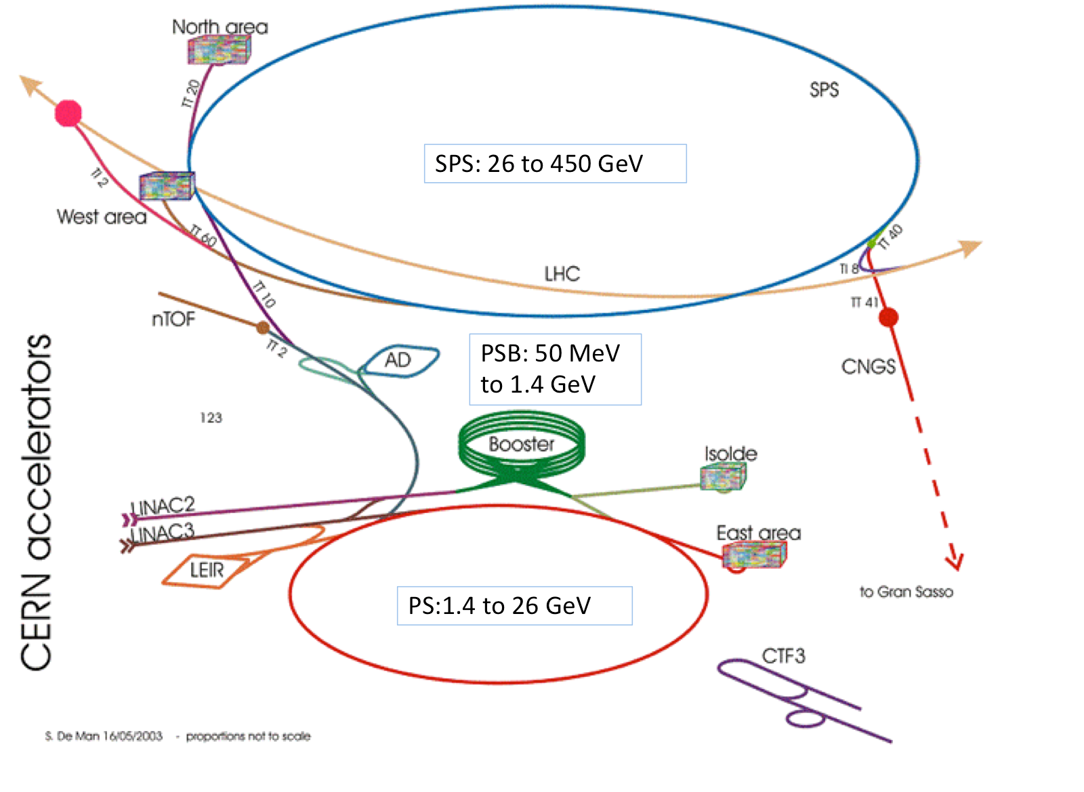

Slide 3
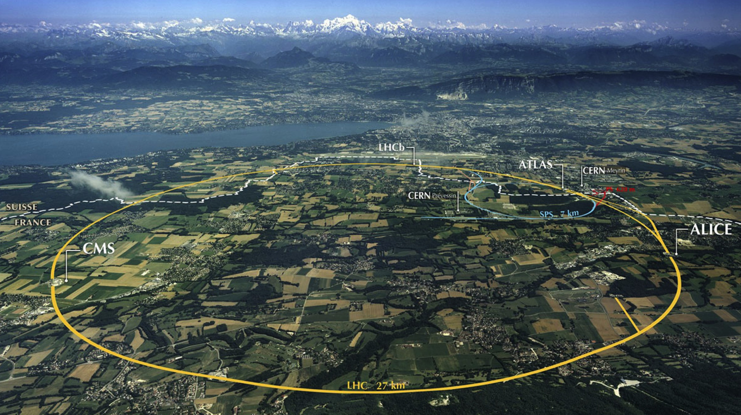
LHC: big, cold, high energy
Collimation
Injection B2
Beam dumps
Injection B1
Collimation
RF
1720 Power converters
> 9000 magnetic elements
7568 Quench detection systems
1088 Beam position monitors
~4000 Beam loss monitors
150 tonnes Helium, ~90 tonnes at 1.9 K
140 MJ stored beam energy in 2012
450 MJ magnetic energy per sector at 4 TeV

Slide 4
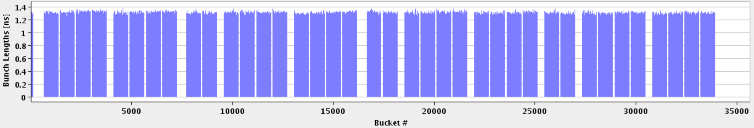
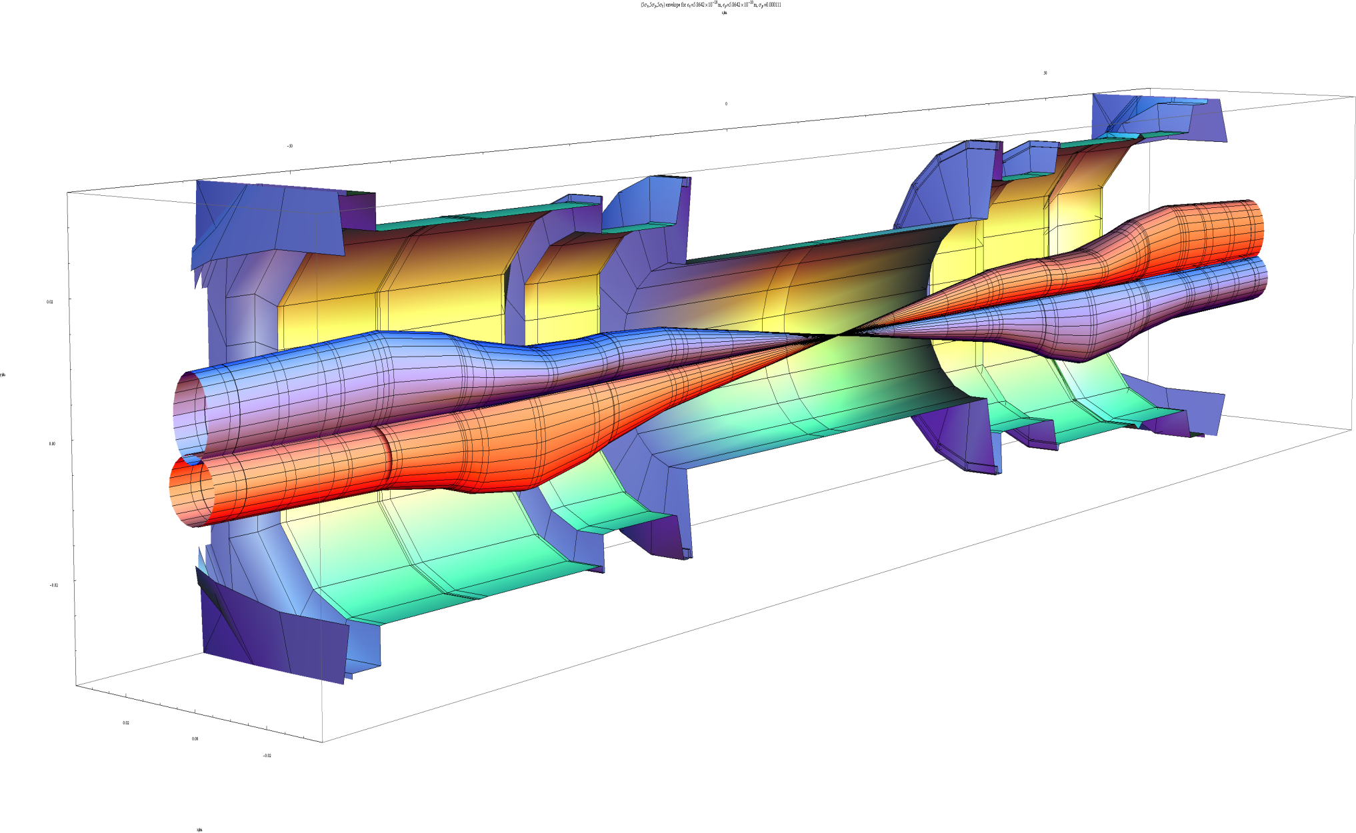
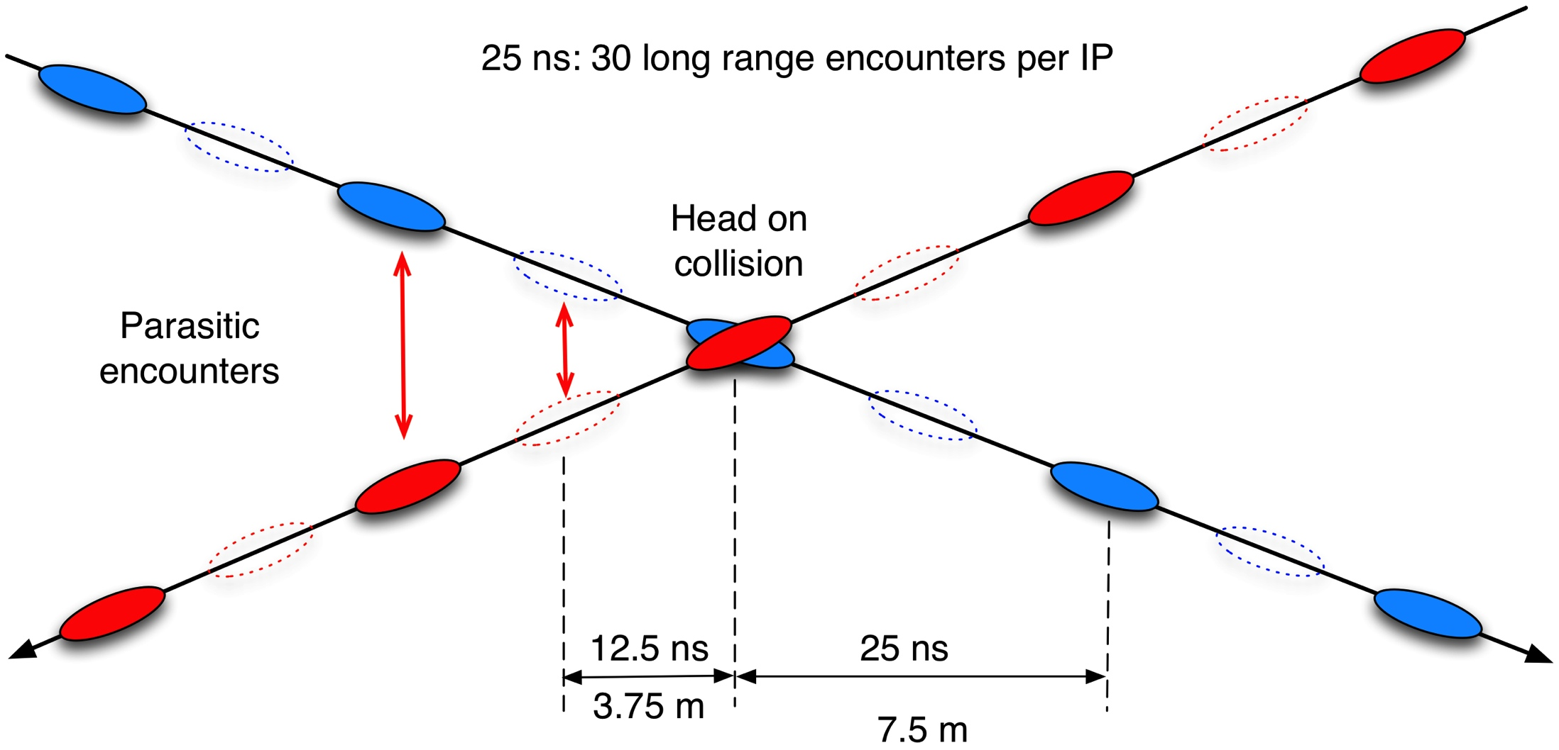
1 SPS injection
LHC bunch structure
Abort gap
27 km 1380 bunches
beta* 60 cm
beta_{max} ~4.5 km
John Jowett

Slide 5
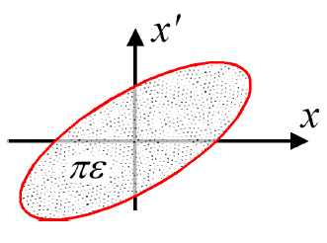
Luminosity
N | Number of particles per bunch
k_{b} | Number of bunches
f | Revolution frequency
σ* | Beam size at interaction point
F | Reduction factor due to crossing angle
ε | Emittance
ε_{n} | Normalized emittance
β* | Beta function at IP
Round beams, beam 1 = beam 2

Slide 6
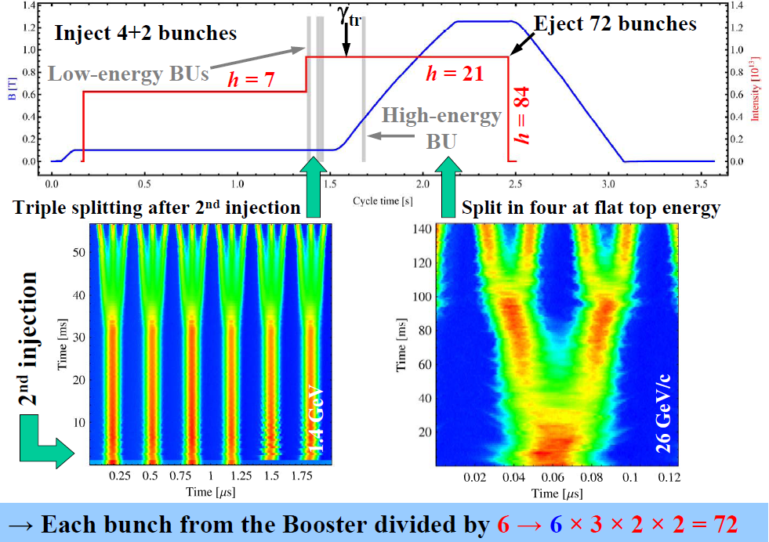
Performance from injectors 2012
Bunch spacing [ns] | Protons per bunch [ppb] | Norm. emittance H&V [μm] Exit SPS
50 | 1.7 x 10¹¹ | 1.8
25 | 1.2 x 10¹¹ | 2.7
25 (design report) | 1.15 x 10¹¹ | 3.75
Chose to stay with 50 ns:
I_{b}²
lower total intensity
less of an electron cloud challenge
High pileup as a result

Slide 7
Peak performance through the years
 | 2010 | 2011 | 2012 | Nominal
Energy [TeV] | 3.5 | 3.5 | 4 | 7
Bunch spacing [ns] | 150 | 50 | 50 | 25
No. of bunches | 368 | 1380 | 1380 | 2808
beta* [m] ATLAS and CMS | 3.5 | 1.0 | 0.6 | 0.55
Max bunch intensity [protons/bunch] | 1.2 x 10¹¹ | 1.45 x 10¹¹ | 1.7 x 10¹¹ | 1.15 x 10¹¹
Normalized emittance [mm.mrad] | ~2.0 | ~2.4 | ~2.5 | 3.75
Peak luminosity [cm⁻²s⁻¹] | 2.1 x 10³² | 3.7 x 10³³ | 7.7 x 10³³ | 1.0 x 10³⁴

Slide 8
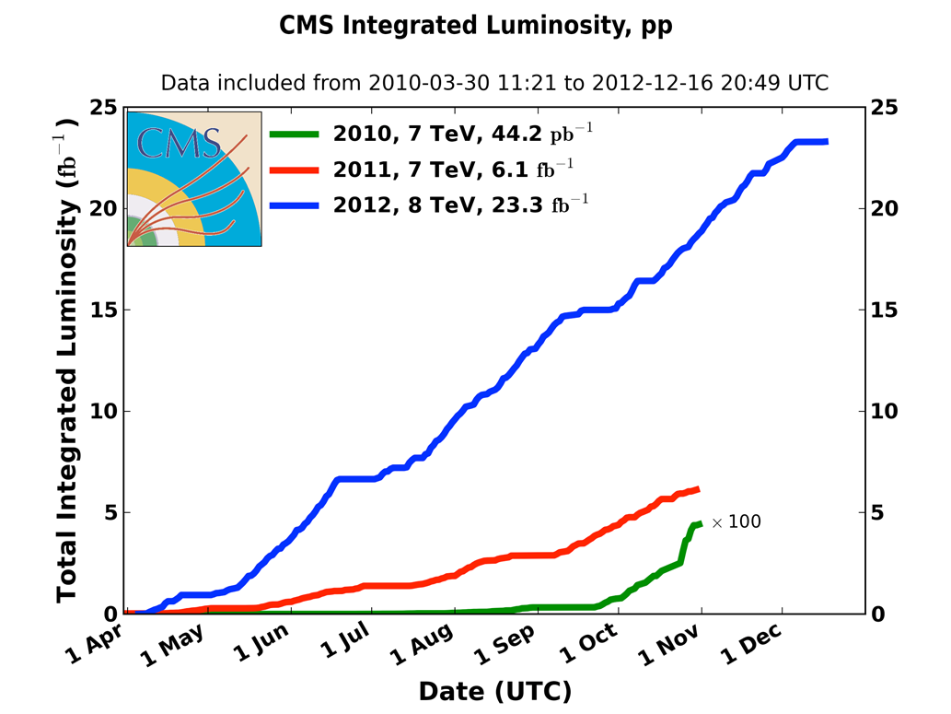
Integrated luminosity 2010-2012
2010: 0.04 fb⁻¹
  7 TeV CoM
  Commissioning
2011: 6.1 fb⁻¹
  7 TeV CoM
  Exploring the limits
2012: 23.3 fb⁻¹
  8 TeV CoM
  Production
 | 2010 | 2011 | 2012
Max. luminosity delivered in 7 days [fb⁻¹] | 0.025 | 0.58 | 1.35

Slide 9
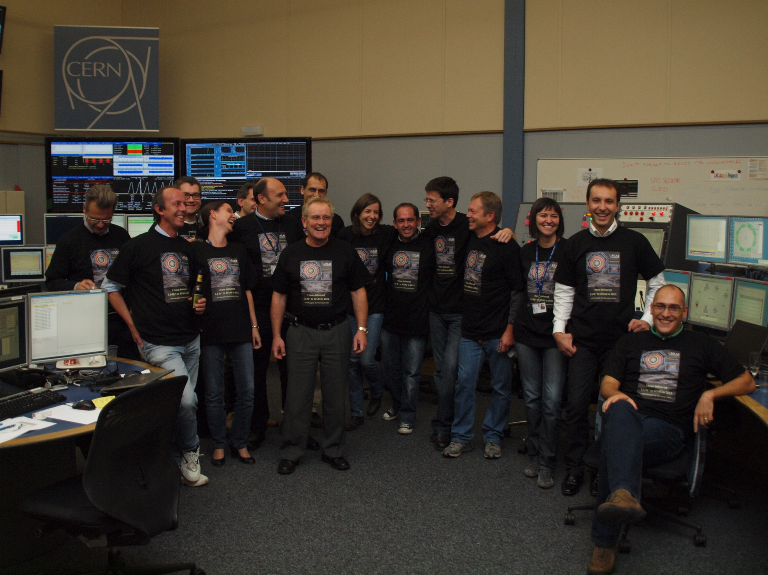
We delivered 5.6 fb⁻¹ to Atlas in 2011 and all we got was a blooming tee shirt

Slide 10
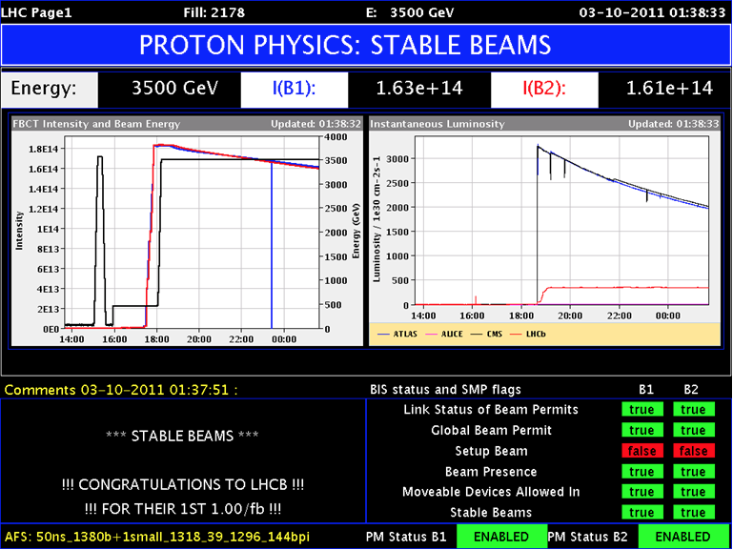
LHCb
Luminosity levelling at around 4e32 cm⁻²s⁻¹ via transverse separation
(with a tilted crossing angle)
ATLAS/CMS
LHCb
Not completely trivial!
Plus successful lead-lead (2010, 2011) and proton-lead (2013) runs

Slide 11
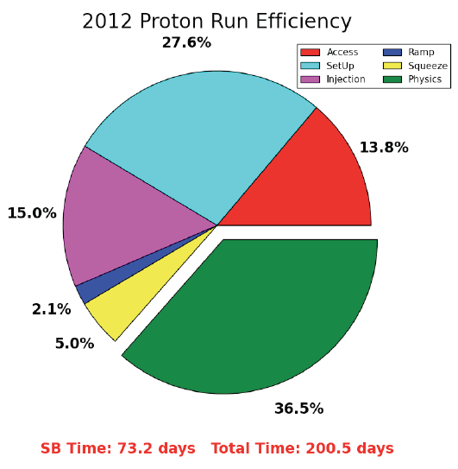
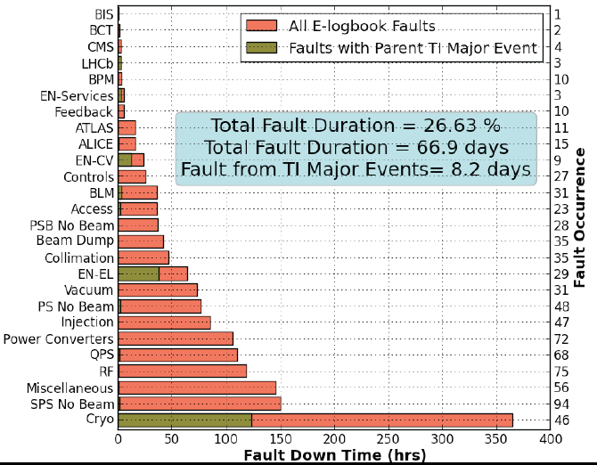
Availability
There are a lot of things that can go wrong – it’s always a battle
Pretty good availability considering the complexity and principles of operation
Stable beams
Cryogenics availability in 2012: 93.7%

Slide 12
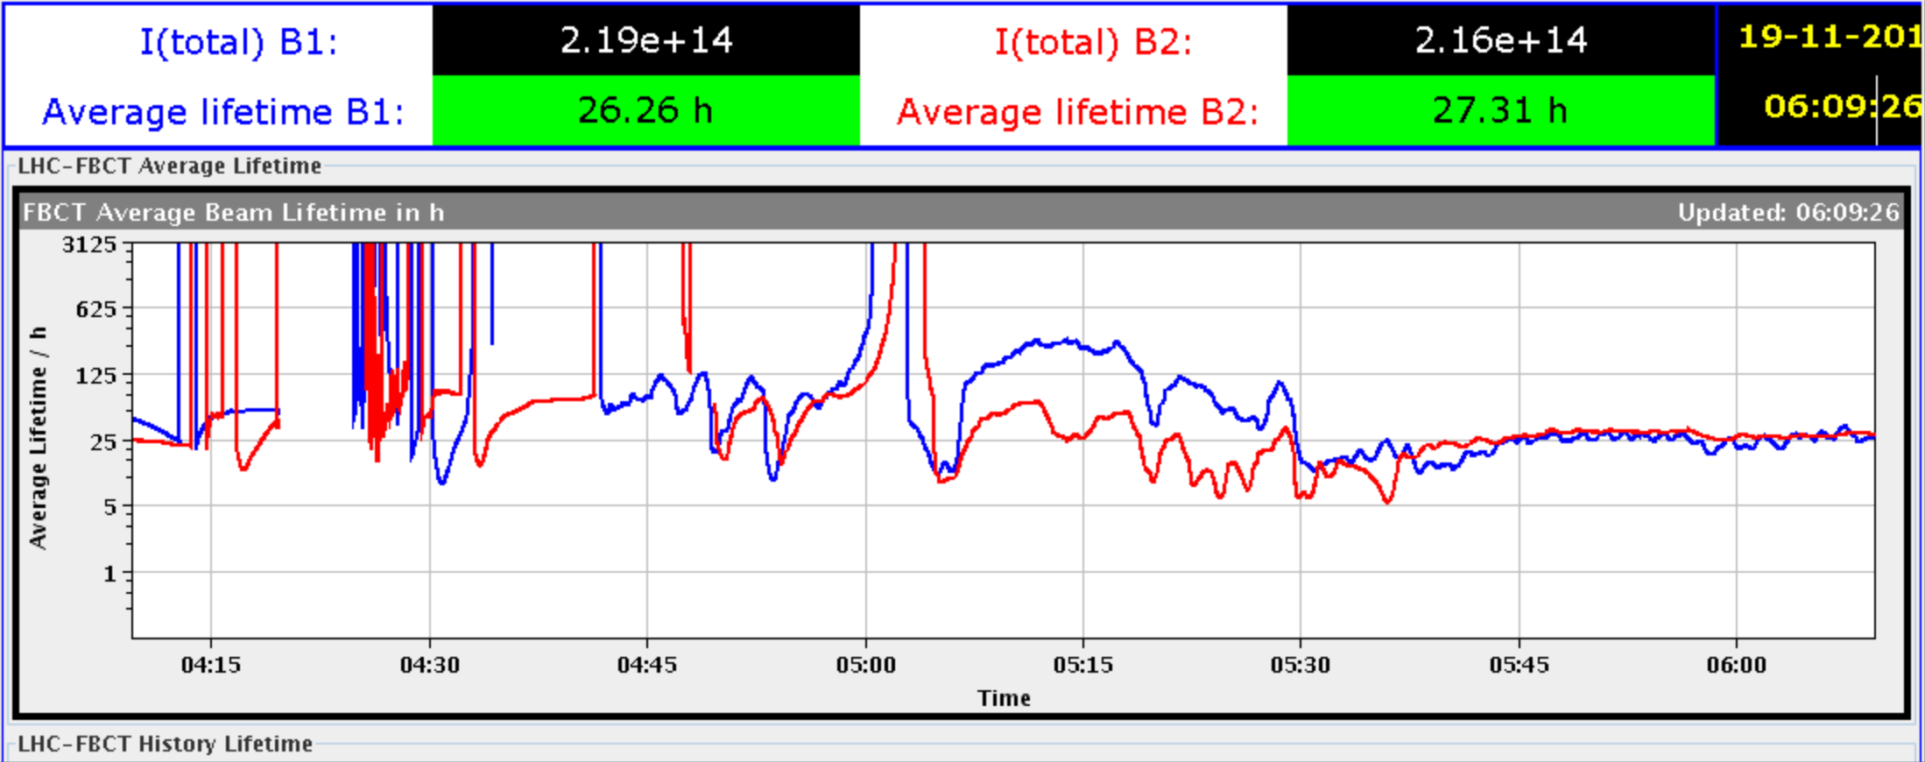
Machine behaving well (in general)
Very good magnetic model, excellent field quality
Linear optics: close to model, corrected to excellent
Better than expected aperture
Excellent single beam lifetime – good vacuum conditions
Low tune modulation, low power converter ripple, low RF noise
Start ramp
Squeeze
Collide

Slide 13
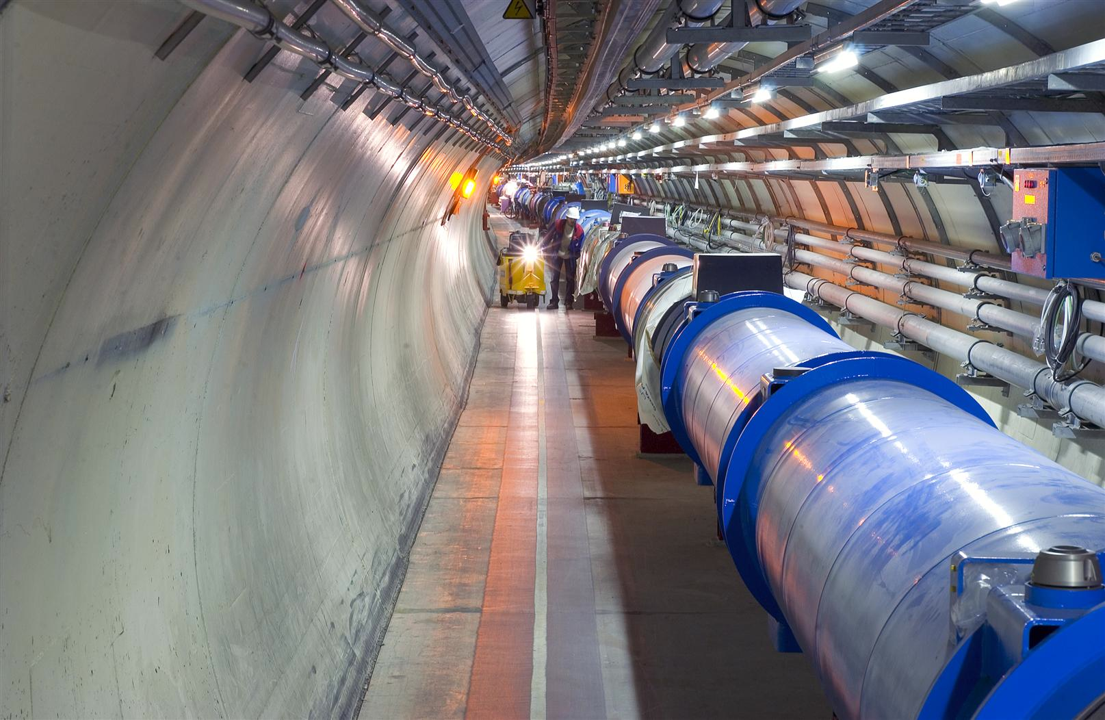
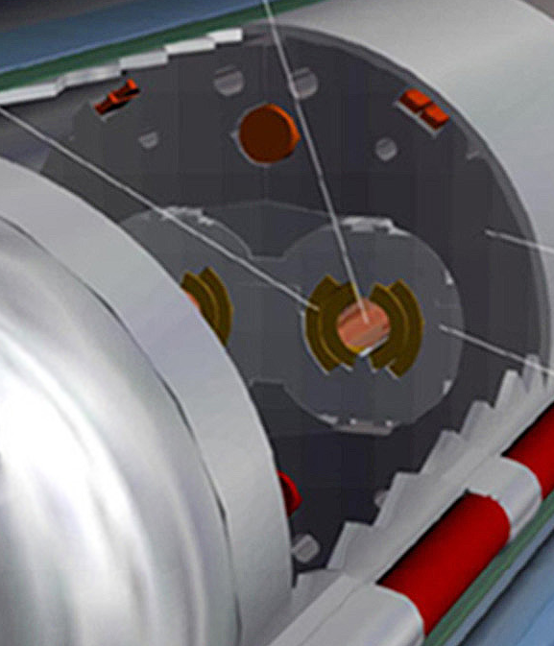
Machine protection
Beam
140 MJ
Not a single accidental beam induced quench at 4 TeV
… YET
11 magnet quench at 450 GeV – injection kicker flash-over
56 mm
SC Coil:
quench limit
15-100 mJ/cm³
Operations unpinned by superb performance of machine protection
Rigorous machine protection follow-up, qualification, and monitoring
R. Assmann

Slide 14
25 ns & electron cloud
200 eV
10 eV
2 keV
Beam screen
5 eV
25 ns
Typical e– densities10¹⁰–10¹² m^{–3}
Possible consequences:
  instabilities, emittance growth, desorption – bad vacuum
  excessive energy deposition in the cold sectors
Electron bombardment of a surface has been proven to reduce drastically the secondary electron yield (SEY) of a material. This technique, known as scrubbing, provides a mean to suppress electron cloud build-up.
Results from 2012 indicate that a scrubbing run will probably be insufficient to fully suppress electron cloud from the arcs for 25 ns beams.

Slide 15
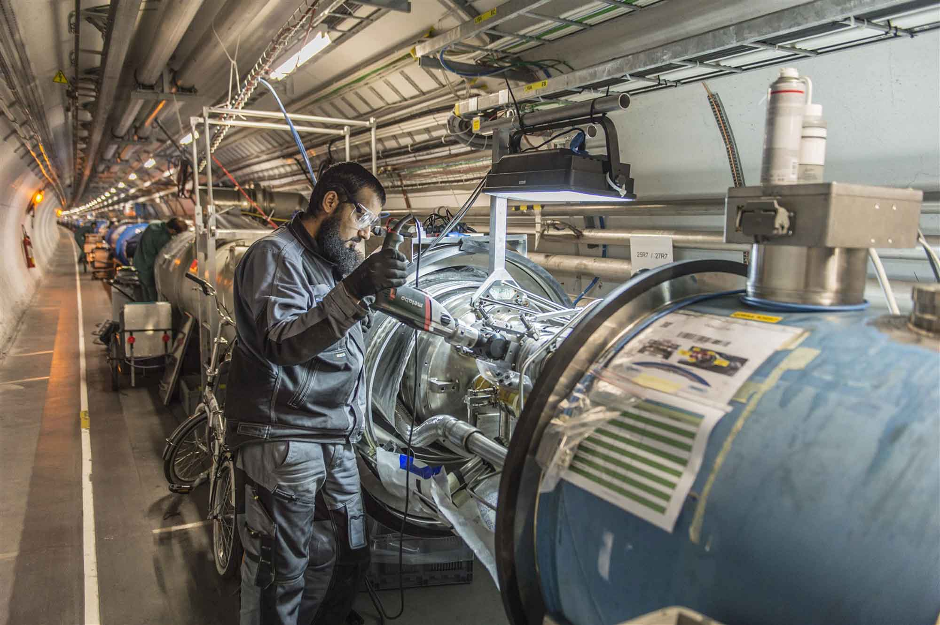

Slide 16
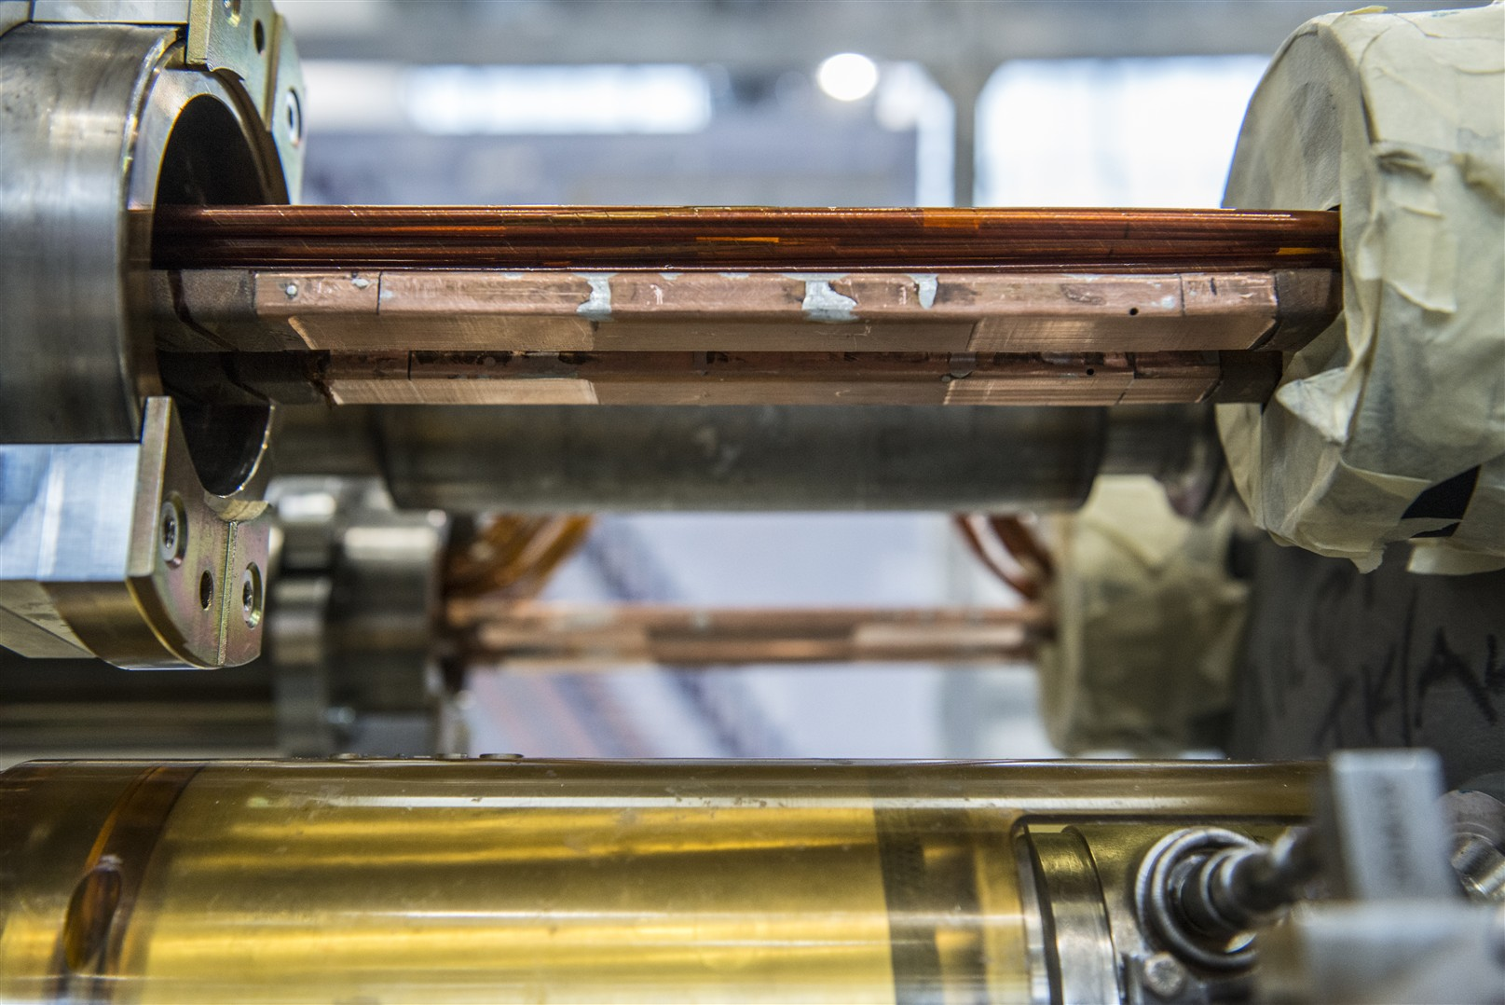
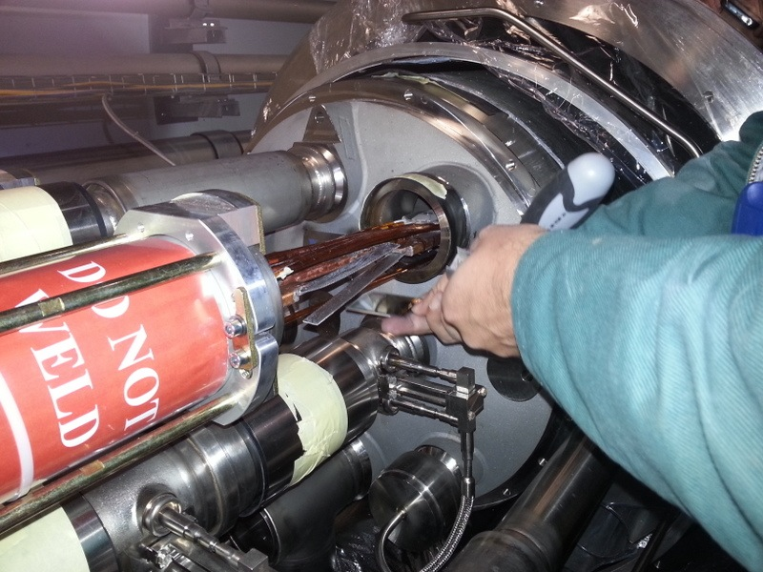
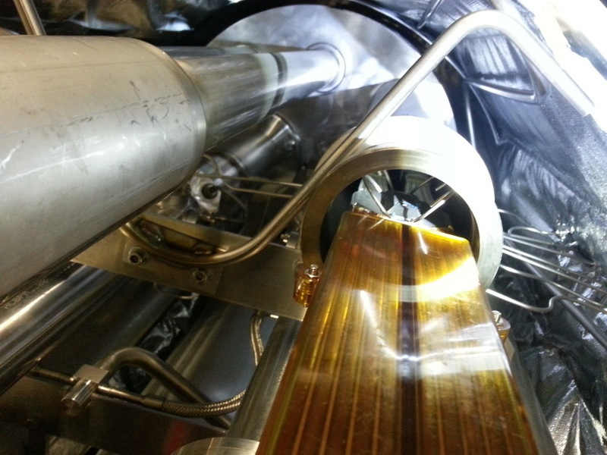
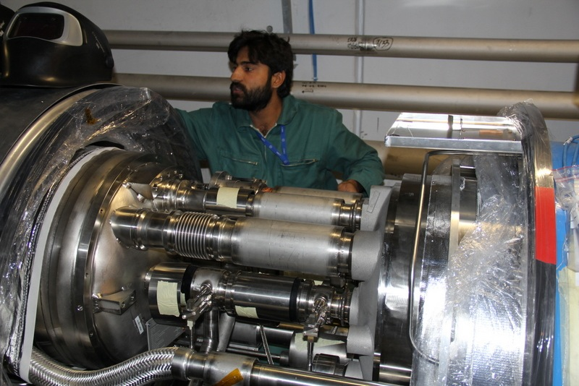

Slide 17
Physics
Beam commissioning
Shutdown
Tests
LS1
from 16th February 2013 to end December 2014
16th Feb. 2013
20th July
2013
2014
2015
F
M
A
M
J
J
A
S
O
N
D
J
F
M
A
M
J
J
A
S
O
N
D
J
F
M
A
LHC
beam to beam
SPS
PS
PS Booster
available for works
Frédérick Bordry

Slide 18
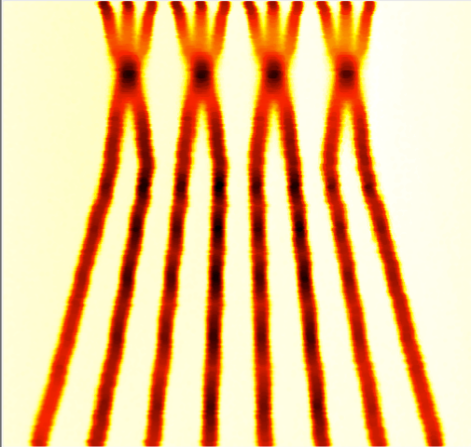
Run II – post LS1
Energy: 6.5 TeV
Bunch spacing: 25 ns
  pile-up considerations
Injectors potentially able to offer nominal intensity with even lower emittance
BCMS = Batch Compression and Merging and Splitting
 | Number of bunches | Ib LHC FT[1e11] | Emit LHC [um] | Peak Lumi [cm-²s⁻¹] | ~Pile-up | Int. Lumi per year [fb⁻¹]
25 ns BCMS | 2590 | 1.15 | 1.9 | 1.7e34 | 49 | ~45

Slide 19
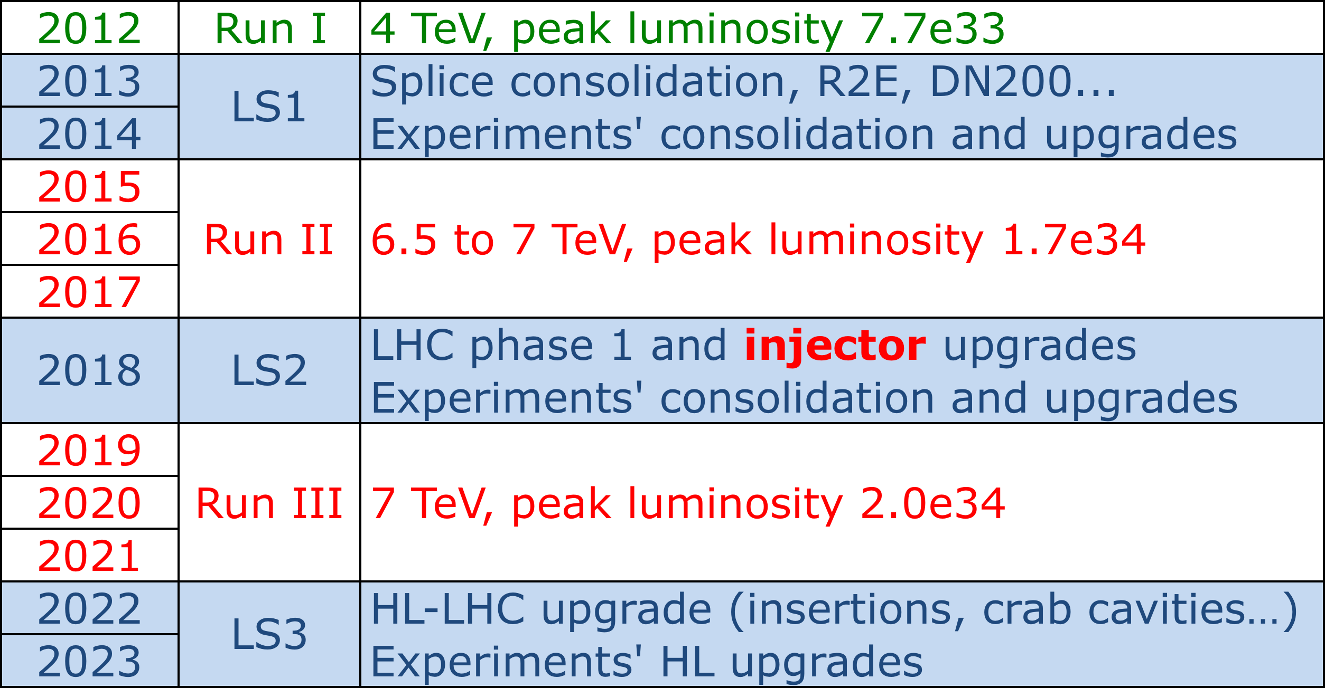
Next 10 years
Review of LHC and Injectors Upgrade Plans (RLIUP workshop) this October

Slide 20
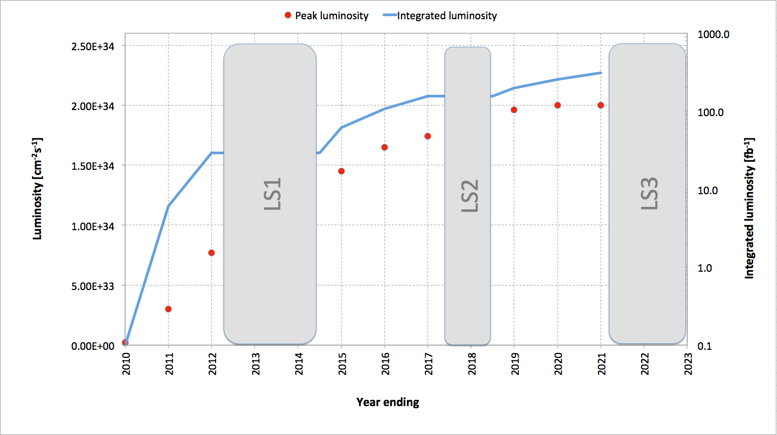
Luminosity evolution
~300 fb⁻¹
Usual caveats apply

Slide 21
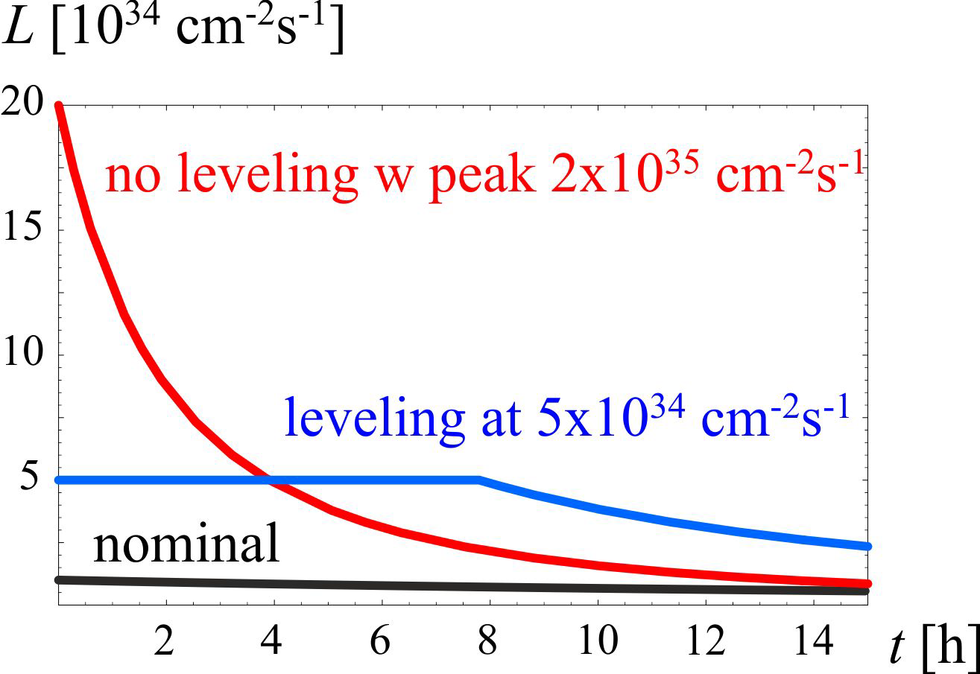
HL-LHC
3000 fb⁻¹ delivered in the order of 10 years
High “virtual” luminosity with levelling anticipated
Challenging demands on the injector complex
  major upgrades foreseen (Linac 4, Booster 2GeV, PS and SPS)
5 x 10³⁴ cm⁻²s⁻¹ levelled luminosity
3 fb⁻¹ per day
~250 fb⁻¹ /year

Slide 22
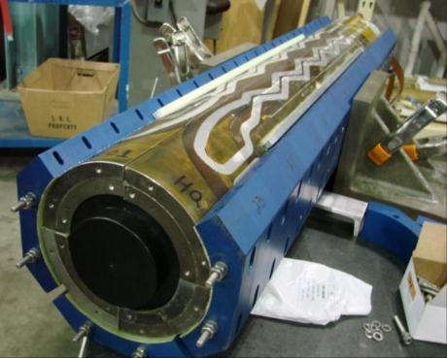
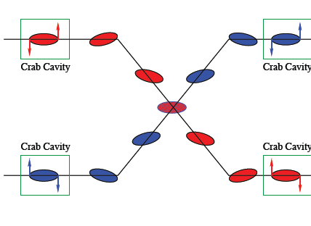
HL-LHC: main thrusts
Wide aperture Nb₃Sn quadrupoles
  Optics and layout: beta* = 15 cm
11 T Nb₃Sn dipoles
  Used to make room for collimation in dispersion suppression region
Large Aperture NbTi separator magnets
  First twin aperture magnets near interaction
Crab cavities
  Reduce the effect of the crossing angle
Enhanced collimation for 500 MJ beams
LARP: HQ02

Slide 23
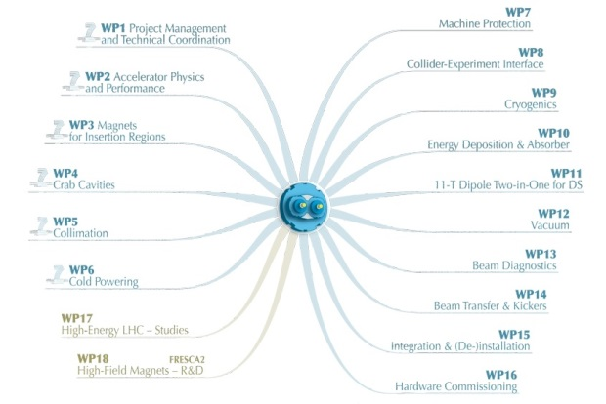

HL-LHC
Project firmly established under leadership of Lucio Rossi and Oliver Bruning
International collaboration with solid R&D program in place
Q4

Slide 24
HL-LHC: key 25 ns parameters
Protons per bunch | 2.2 x 10¹¹
Normalized emittance | 2.5 micron
Beta* | 15 cm
Crossing angle | 590 microrad
Geometric reduction factor | 0.305
Peak luminosity | 7.4 x 10³⁴ cm⁻²s⁻¹
Virtual luminosity | 24 x 10³⁴ cm⁻²s⁻¹
Levelled luminosity | 5 x 10³⁴ cm⁻²s⁻¹
Levelled <pile-up> | 140

Slide 25
BEYOND
An invitation to further reading… e.g. last Saturday’s accelerator session
The Circular Road to a Higgs Factory and Beyond Katsunobu OIDE (KEK)
Research on high-field superconducting magnets and prospects for higher-energy hadron colliders Frederick BORDRY (CERN)
An energy recovery electron accelerator for DIS at the LHC Daniel SCHULTE (CERN)

Slide 26

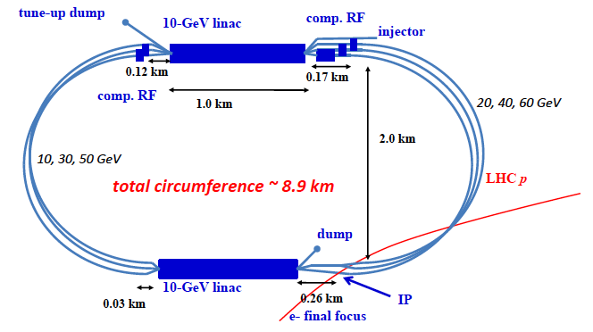
Large Hadron Electron Collider: LHeC
Foresees 60 GeV electrons on 7 TeV protons
Conceptual design report published in June 2012
Two e⁻ options: linac-ring (LR) and ring-ring (RR)
Linac-ring option: re-circulating linac with energy recovery
Oliver Bruning, Max Klein et al

Slide 27
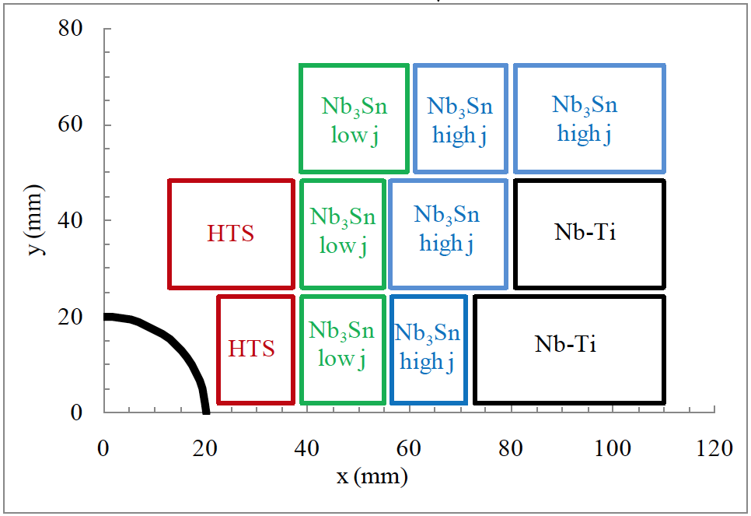

High Energy LHC: HE-LHC
Re-equip existing LHC tunnel with high field magnets
Conceptual layout of 20 T dipole magnet
(Nb₃Sn and HTS)
Intense R&D required
Circumference | 26.7 km
Maximum dipole field | 20 T
Injection energy from SC-SPS | 1.3 TeV
Maximum c.o.m. energy | 33 TeV
Peak luminosity | 5 x 10³⁴ cm⁻²s⁻¹

Slide 28
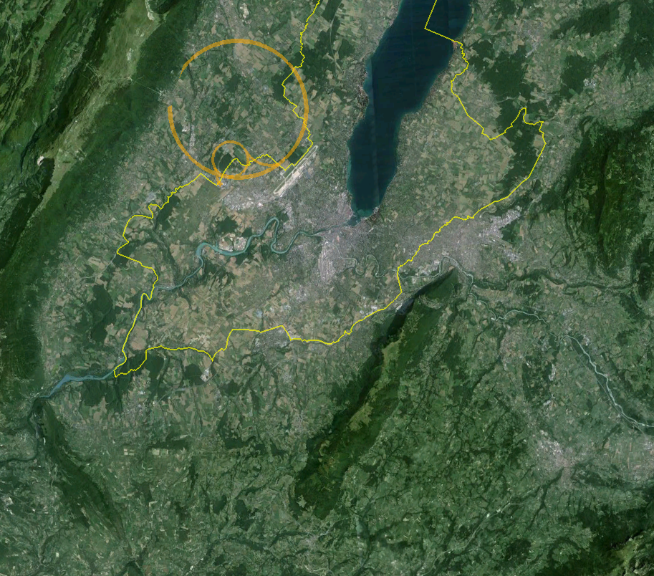
80 to 100 km Very High Energy LHC VHE-LHC
LHC
Pre-Feasibility Study for an 80-km tunnel at CERN
John Osborne and Caroline Waaijer, CERN, ARUP & GADZ
Jura
1
8
2
Geneva
7
3
Saleve
6
100 km
4
5

Slide 29
VHE-LHC
Circumference | 80 or 100 km
Maximum dipole field | 20 or 16 T
Injection energy | > 3.0 TeV
Maximum c.o.m. energy | 100 TeV
Peak luminosity | 5 x 10³⁴ cm⁻²s⁻¹
Stored beam energy | ~5500 MJ
Among the many challenges:
Synchrotron radiation heat load 33 W/m
Collimation!
IR quadrupoles
Arc quadrupoles (naïve scaling gives 1593 T/m at 50 TeV beam energy)

Slide 30
Injection into VHE-LHC
LHC
Jura
1
VHE-LHC-LER
8
SPS+
2
Geneva
7
3
Saleve
6
4
5

Slide 31
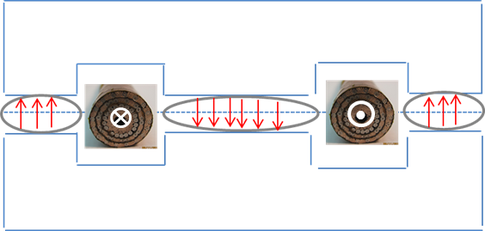
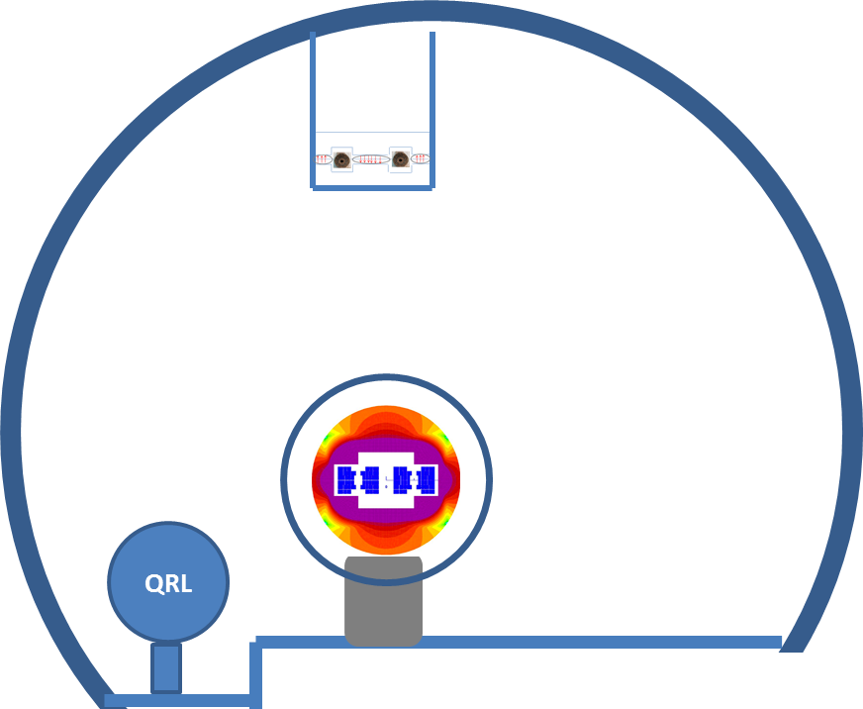
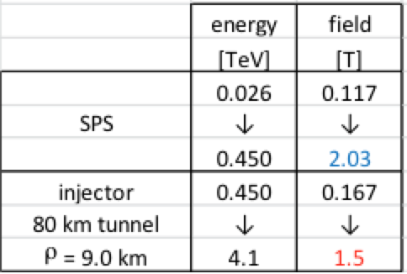
Possible VHE-LHC with LER
“Pipetron” using transmission line magnets (W. Foster, H. Piekarz)
Possible variant
Relatively cheap
Limited cryogenic power – HTS
Lucio Rossi
LER also suitable for e⁺/e⁻ …

Slide 32
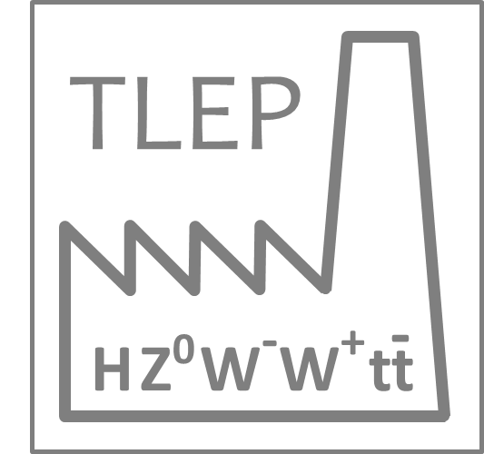
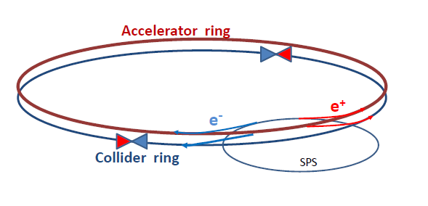
TLEP
Circular electron-positron collider in new 80 – 100 km tunnel
  Storage ring has separate beam pipes for e⁺ and e⁻ for multi-bunch operation up to 350 GeV c.m.
  top-up injection with an ancillary accelerator
  Very high luminosity at Z pole and above WW threshold with operation up to tt threshold
Using the tunnel before installation of the VHE-LHC

Slide 33
TLEP: parameters
Beam lifetime dominated by Bhabha scattering and bremstrahlung
 | TLEP Z | TLEP W | TLEP H | TLEP t
E c.m. [GeV] | 91 | 160 | 240 | 350
#bunches/beam | 7500 | 3200 | 167 | 160
Peak luminosity [x 10³⁴ cm⁻²s⁻¹] | 59 | 16 | 5 | 1.3
Beam lifetime to Bhabha [min.] | 99 | 38 | 24 | 21
Beam lifetime to bremstrahlung [min.] | > 1025 | >106 | 38 | 14
 | TLHeC |  | VHE-TLHeC
species | e± | p | e± | p
beam energy [GeV] | 60/120 | 7000 | 60/120 | 50000
Frank Zimmermann et al

Slide 34
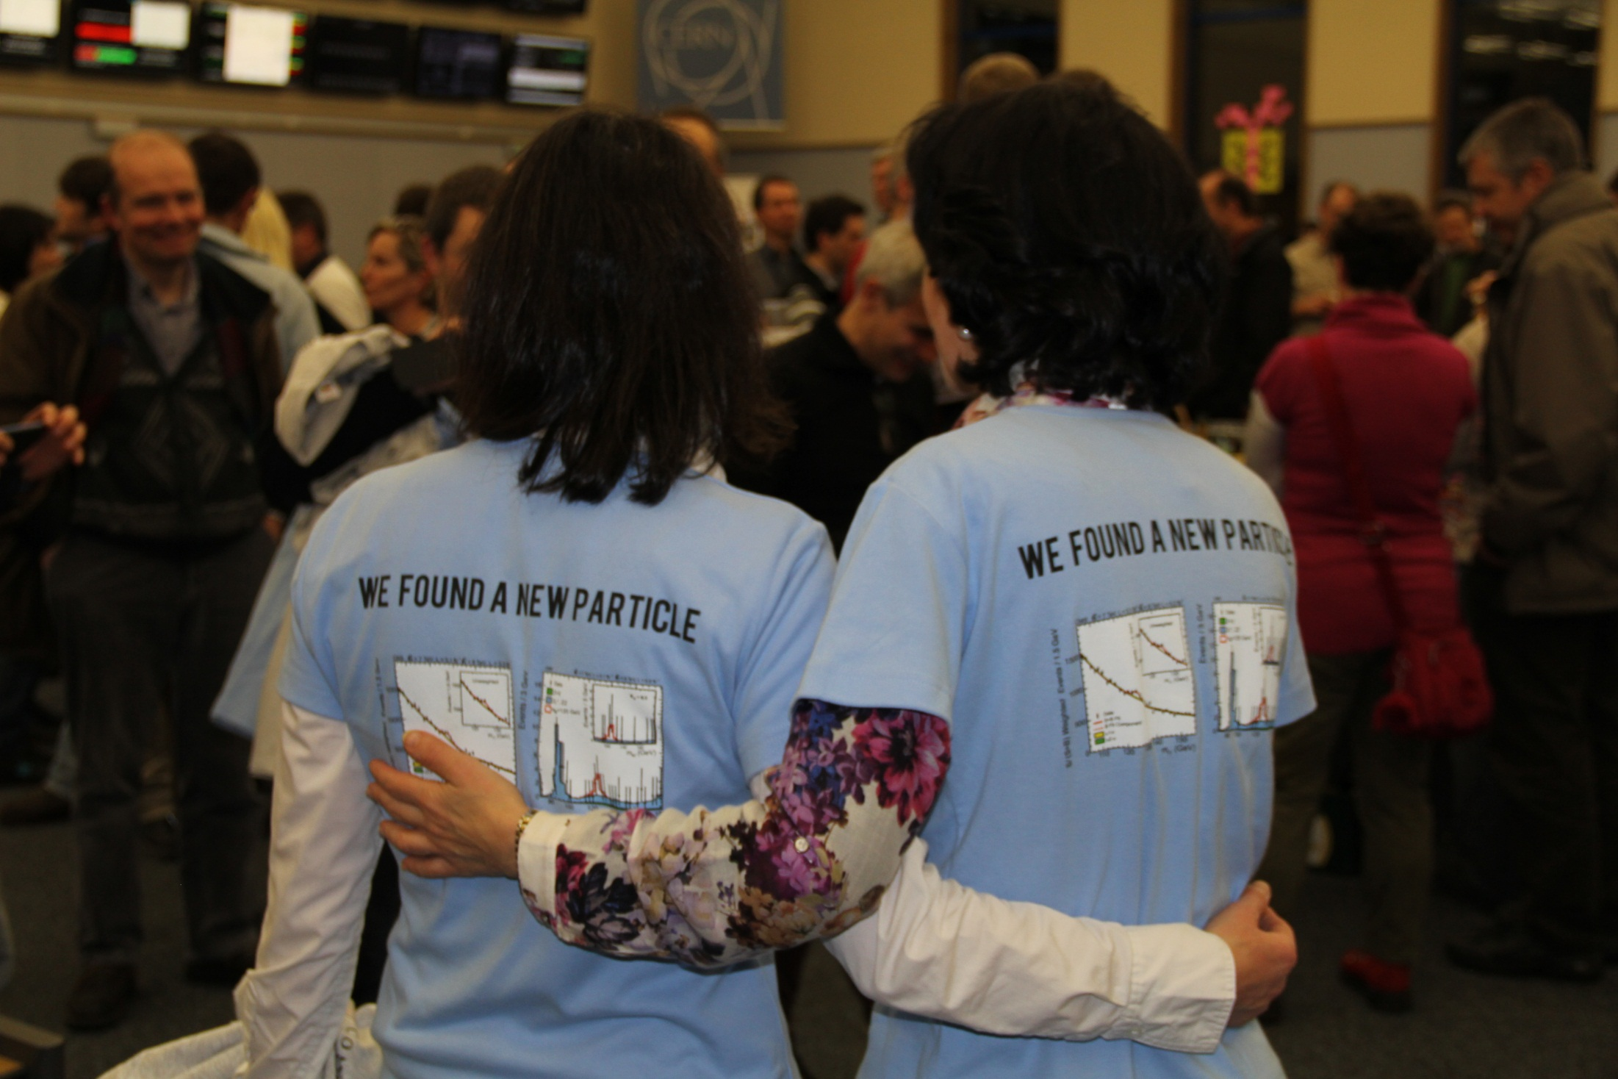
Conclusions 1/2 (LHC)
Reasonably good performance from commissioning through run I
  2 years 3 months from first collisions to Higgs
Foundations firmly laid for run II

Slide 35
Conclusions 2/2
From CERN’s Medium Term Plan 2013
A design study team will be set up during 2013 with the launch of the design study proposal.
  Pre-studies have been launched for hadron colliders (VHE-LHC/HE-LHC), lepton colliders (TLEP) and hadron-lepton colliders (VHE-LHeC).
Studies and R&D for high field magnets as well as high-gradient and high beam power superconducting RF cavities for the HL-LHC, HE-LHC, VHE- LHC (and TLEP) will enhance common efforts and exploit synergies.

Slide 36
Acknowledgements
The LHC is enjoying benefits of the decades long international design, construction, installation effort.
Progress with beam represents phenomenal effort by all the teams involved, injectors included.

Slide 37
Reserve

Slide 38
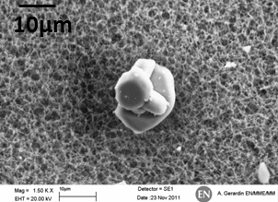
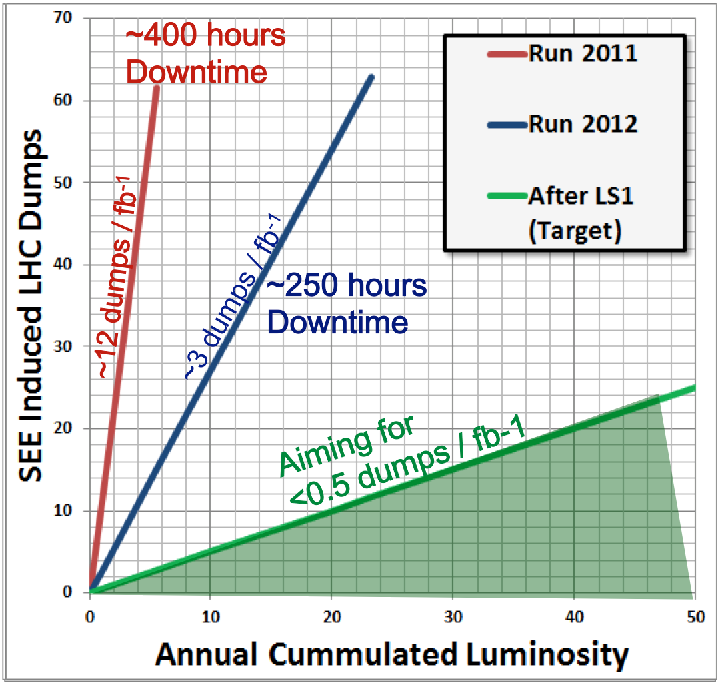
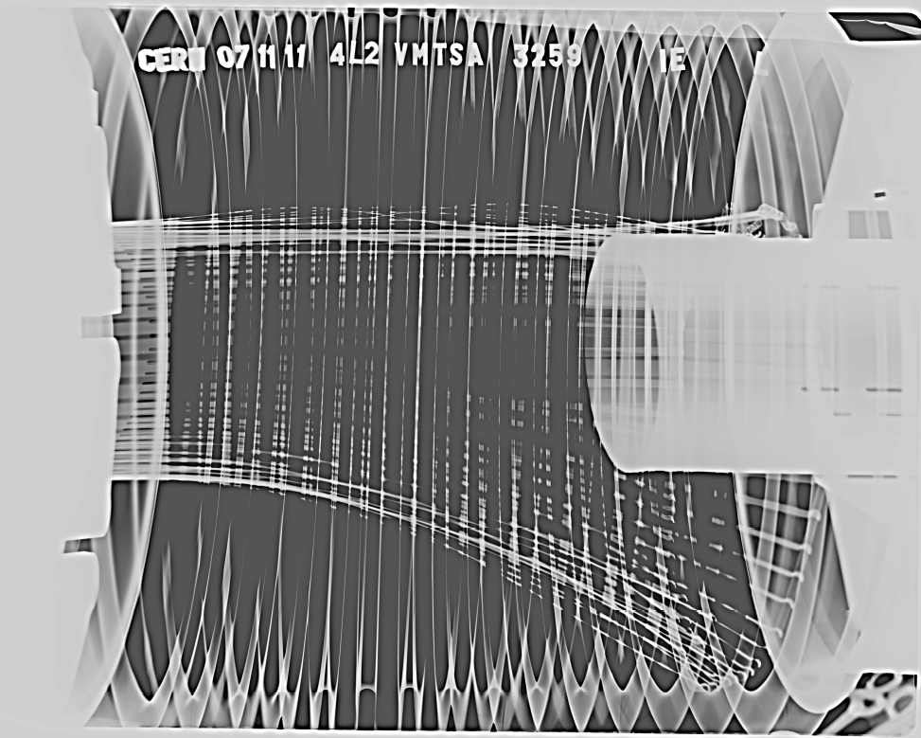
Some issues…
Beam induced heating
Local non-conformities (design, installation)
  Injection protection devices
  Sync. Light mirrors
  Vacuum assemblies
UFOs
20 dumps in 2012
Timescale 50-200 µs
Conditioning observed
Worry about 6.5 TeV
Radiation to electronics
Concerted program of mitigation measures (shielding, relocation…)
Premature dump rate down from 12/fb⁻¹ in 2011
to 3/fb⁻¹ in 2012
Al
A. Gerardin, N. Garrel
EDMS: 1162034
O

