Slide 1
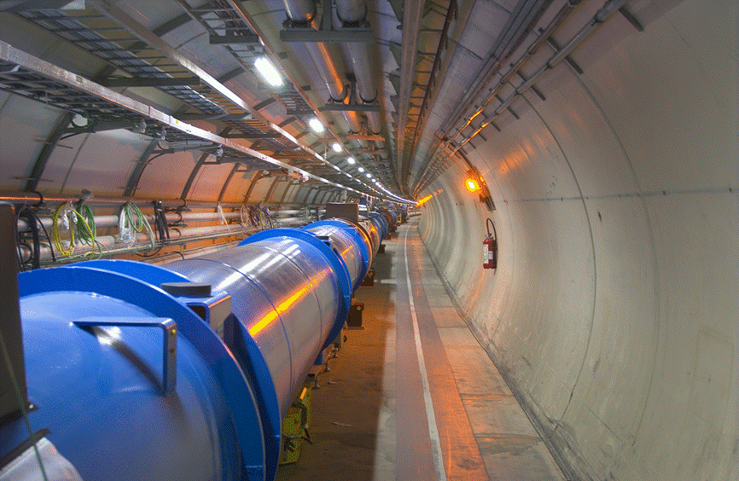
Status of the LHC
Mike Lamont
for the LHC team

Slide 2
Commissioning progress

Slide 3
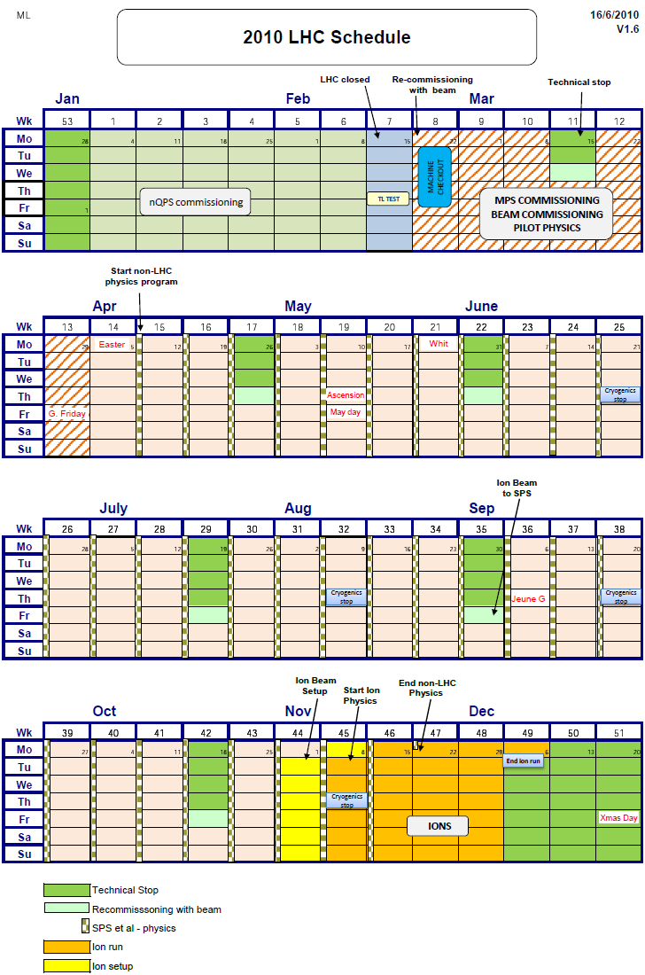
2010
  Hardware commissioning for 3.5 TeV
  Ramp beams to 3.5 TeV
  Machine protection systems qualified
  Colliding safe stable beams (2 on 2 pilots)
  Squeeze to 2m
  Low bunch currents, increase k_{b}
  Machine protection systems qualified
  13 on 13 low intensity bunches at 2m
  High bunch currents, low k_{b}
  Increase k_{b}
  Machine protection systems qualified
  50 on 50 high intensity bunches at 3.5m (Aug)
  Crossing angles on, bunch trains, Increase k_{b}
  Ions (early scheme, max 62 bunches per beam)
  Same magnetic machine as for protons
  1 week to switch
  4 weeks ion run

Slide 4
Milestones - 2010
Date | Achieved
Feb 28 | Restart with beam.
Mar 30 | First collisions at 7 TeV centre of mass. | Luminosity ~ 2 10²⁷ cm⁻² s⁻¹
Apr 01 | Start squeeze commissioning. | Regular physics runs 2 on 2 bunches of 10¹⁰ Un-squeezed 1 colliding pairs per experiment Rates around 100Hz
Apr 07 | Squeeze to 2 m in points 1 and 5.
Apr 09 | Single nominal bunch of 1.1 1011 stable at 450GeV.
Apr 13 | Squeeze to 2 m in point 8.
Apr 16 | Squeeze to 2m in point 2.
April 24 | First stable beams at 7 TeV, 3 on 3, squeeze to 2m. | Luminosity ~ 2 10²⁸cm⁻² s⁻¹

Slide 5
Milestones reached 2010 (to August)
Date | Achieved
May | Increase bunch intensity to 2 10^{10,} Increase k_{b.} | Regular physics runs
May 24 | 13 on 13, 8 colliding pairs per experiment. | Luminosity ~ 3 10²⁹cm⁻² s⁻¹
June | Increase bunch intensity to nominal, squeeze to 3.5m. | Machine development
June 25 | First stable beams at 7 TeV, 3 on 3 nominal bunch. | Luminosity ~ 5 10²⁹cm⁻² s⁻¹
July 15 | 13 on 13, 8 colliding pairs, 9 10¹⁰ / b | Luminosity ~ 1.5 10³⁰cm⁻² s⁻¹
July 30 | 25 on 25, 16 colliding pairs, 9 10¹⁰ / b | Luminosity ~ 3 10³⁰cm⁻² s⁻¹
Aug 19 | 48 on 48, 36 colliding pairs 1 5 and 8, 9 10¹⁰ / b | Luminosity ~ 6 10³⁰cm⁻² s⁻¹
Aug | Stable running period to consolidate operation and MP 50x50, 11 10¹⁰ / b | ~2-3 MJ per beam Luminosity ~ 1 10³¹cm⁻² s⁻¹

Slide 6
Commissioning recap
Magnetically and optically well understood
  Excellent agreement with model and machine
Magnetically reproducible
  Important because it means optics and thus set-up remains valid from fill to fill
Aperture clear and as expected
Excellent performance from instrumentation and controls
  Still ironing out features
Key systems performing well
  Injection
  Beam dump
  Collimation
  Machine protection

Slide 7
Commissioning recap
Routinely over-inject nominal bunch intensities
  Up to September 4 bunches per injection
  September – switch to 150 ns bunch trains
Ramp to 3.5 TeV, squeeze, bring them into collisions and deliver stable beams.
Keep them there
And do it again
A remarkably successful initial commissioning period
which is still ongoing… [NB]

Slide 8
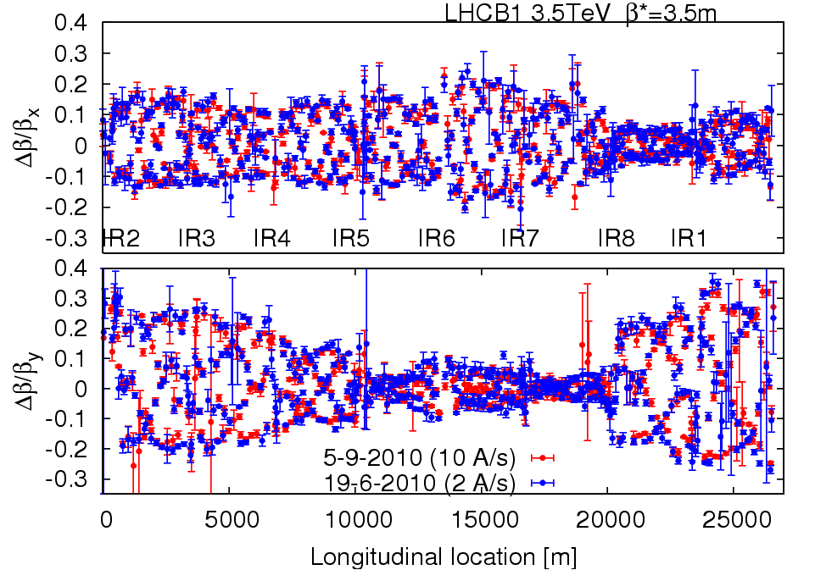
Optics
Stunningly stable

Slide 9
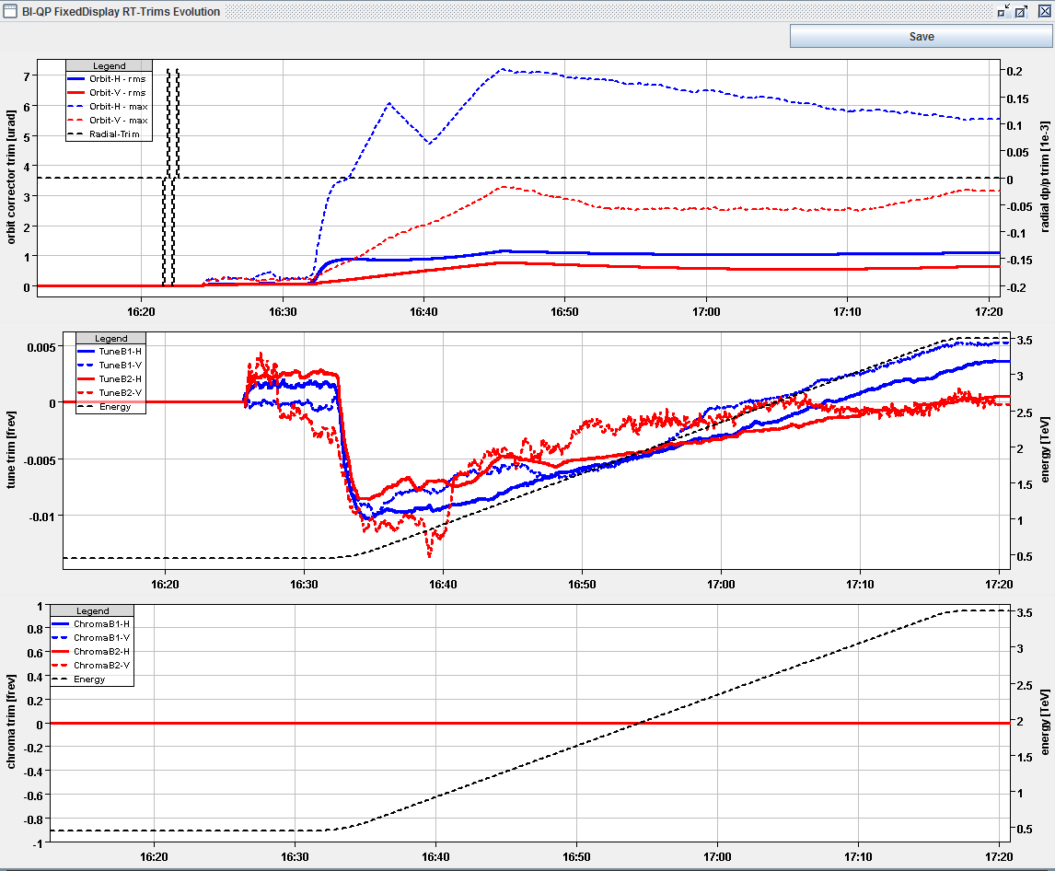
FBs in action : ramp
Fill 1309
29.08.2010
OFB trims (μrad)
QFB trims
Energy (TeV)

Slide 10
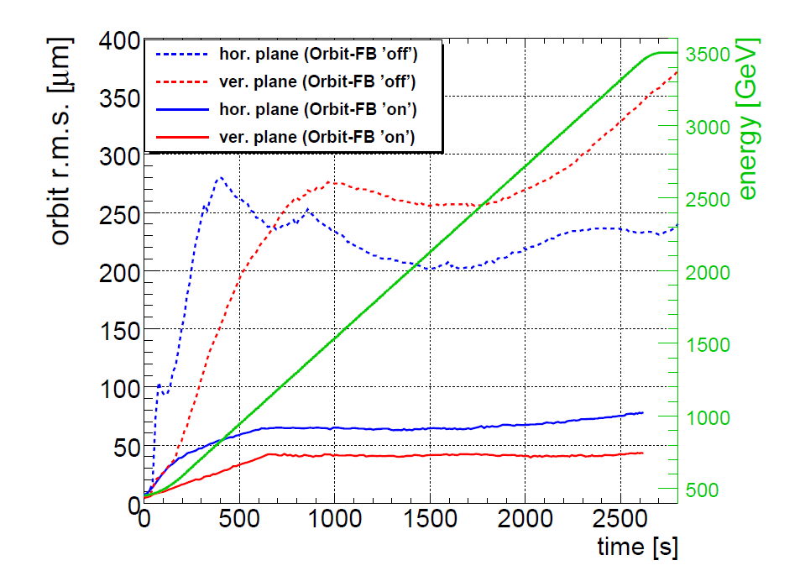
OFB performance : ramp
Orbit stability in the ramp: ≤ 80 μm rms
R. Steinhagen

Slide 11
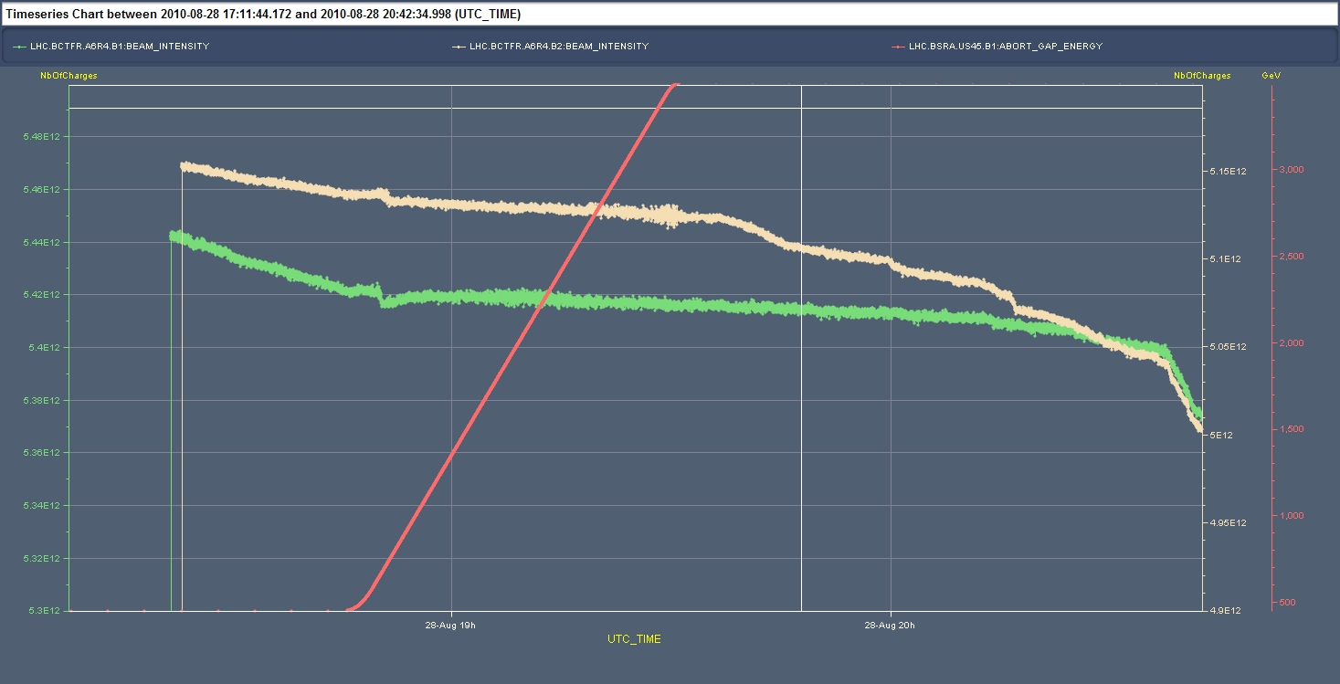
LHC and Feedbacks
The performance of the FBs is good
The LHC only operates reliably with both orbit and tune FBs (ramp and squeeze).
  Ramp and squeeze essentially without losses !!!!
Fill 1308
28.08.2010
Ramp
Squeeze
B2
B1
1%
Bunch length
artifact
Collide

Slide 12
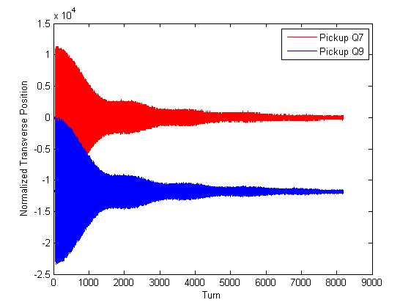
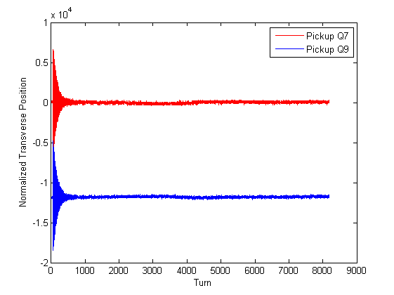
Transverse dampers
Crucial to keep emittance growth under control
OFF
ON
Already operational through the cycle – including stable beams

Slide 13
BEAM Safety
Briefly, 5 important machine things
or why we can’t deliver 1e32 cm⁻²s⁻¹ immediately
This might seem academic but it is what dominates commissioning and operations at present

Slide 14
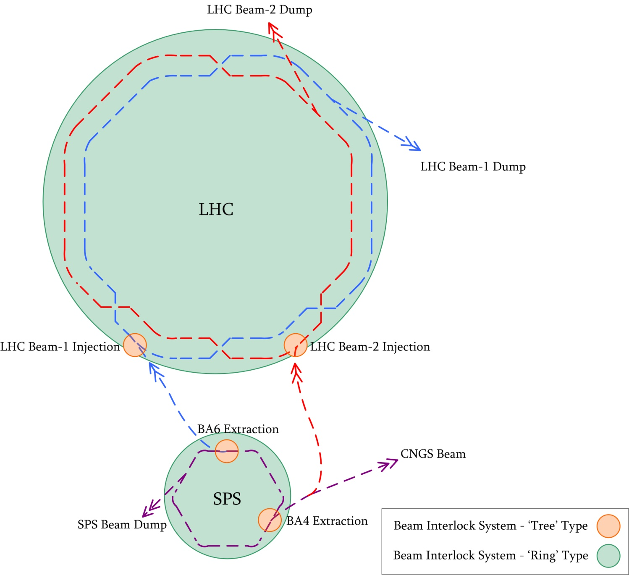
Beam Interlock System
TASK: trigger beam dump within 3 turns
User inputs include:
Experiments
Beam Loss Monitors
Powering
Fast magnets
Vacuum
Beam dump
OP

Slide 15
The beam dump
Dump block
Dilution kickers
Passive diluter
Extraction septum
Passive diluter
Extraction kicker

Slide 16
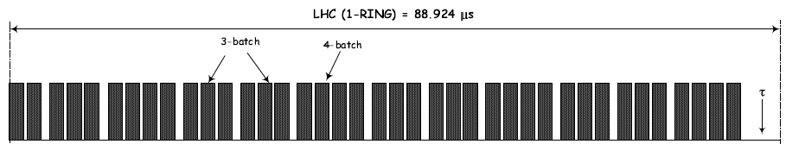
Abort Gap
dump trigger
Extraction kicker MKD deflection
LHC
Beam
3.0 μs
particle-free
abort gap

Slide 17
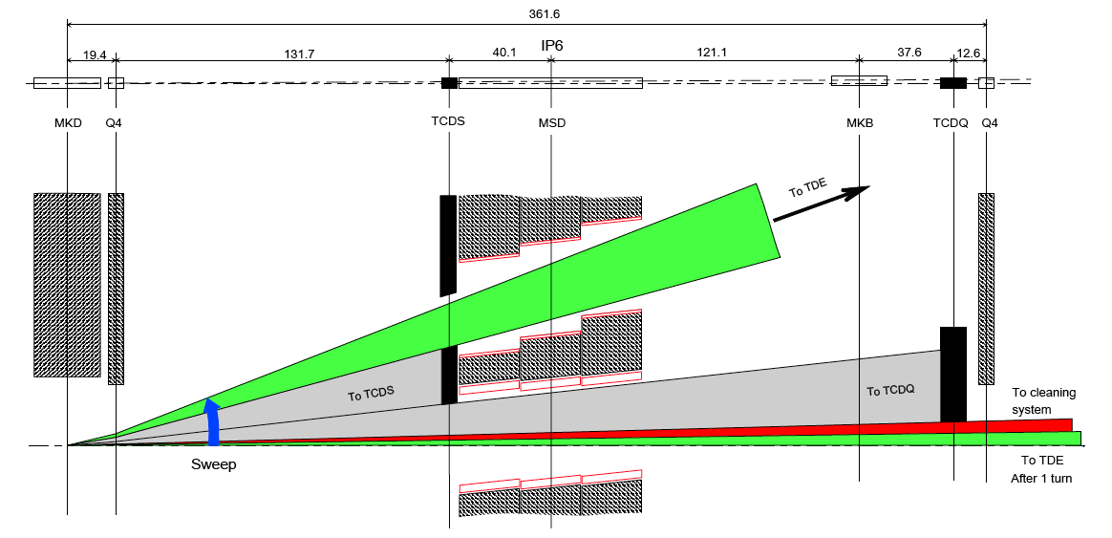
Asynchronous Beam Dump
Estimated occurrence : at least once per year,
0 events up to now!
TCDQ + TCSG to protect downstream superconducting magnets (Q4)
TCSG
TCDQ = 6 m long CFC* one-sided collimator
TCSG = 1 m long CFC* two-sided collimator
*CFC = carbon fibre compound

Slide 18
Pedagogical collimation 1
Ralph Assmann
Collimation is set up with multi-stage logic for cleaning and protection
Let’s look in normalized phase space, talking in nominal sigmas:
Tertiary
+Triplet
Tertiary
+Triplet
Secondary
Dump Protection
Primary
Dump Kicker
Closed orbit
“The hierarchy”
"The jaws of power are always open to devour…”

Slide 19
Pedagogical collimation II
Collimation is set up with multi-stage logic for cleaning and protection
Let’s look in normalized phase space, talking in nominal sigmas:
Tertiary
+Triplet
Tertiary
+Triplet
Secondary
Dump Protection
Primary
Primary beam and primary halo
Dump Kicker

Slide 20
Pedagogical collimation III
Collimation is set up with multi-stage logic for cleaning and protection
Let’s look in normalized phase space, talking in nominal sigmas:
Tertiary
+Triplet
Tertiary
+Triplet
Secondary
Dump Protection
Primary
Beam dump envelope
Dump Kicker

Slide 21
Pedagogical collimation IV
Collimation is set up with multi-stage logic for cleaning and protection
Let’s look in normalized phase space, talking in nominal sigmas:
Tertiary
+Triplet
Tertiary
+Triplet
Secondary
Dump Protection
Primary
Not robust
ROBUST
Beam dump envelope
Not robust
Dump Kicker
… but efficient …

Slide 22
Pedagogical collimation V
Collimation is set up with multi-stage logic for cleaning and protection
Let’s look in normalized phase space, talking in nominal sigmas:
Tertiary
+Triplet
Tertiary
+Triplet
Secondary
Dump Protection
Primary
Not robust
ROBUST
MARGIN
Beam dump envelope
Not robust
Dump Kicker
… but efficient …

Slide 23
Conclusions from the pedagogical break
The collimators and protection devices must be in position at all times
The hierarchy must be respected
The collimators and protection devices are positioned with respect to the closed orbit
Therefore the closed orbit must be in tolerance at all times. This includes the ramp and squeeze.
  Orbit feedback becomes mandatory
  Interlocks on orbit position become mandatory
If these rules are not respected something will get broken.
Frequent validation to make sure that the rules are respected…

Slide 24
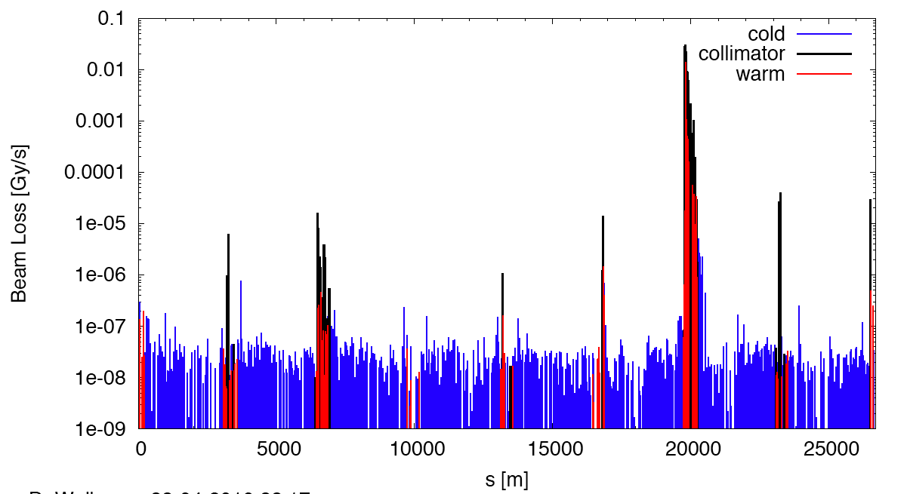
Measured Cleaning at 3.5 TeV
(beam1, vertical beam loss, intermediate settings)
Dump Protection Col.
Momentum Cleaning
IR2
IR5
IR8
IR1

Slide 25
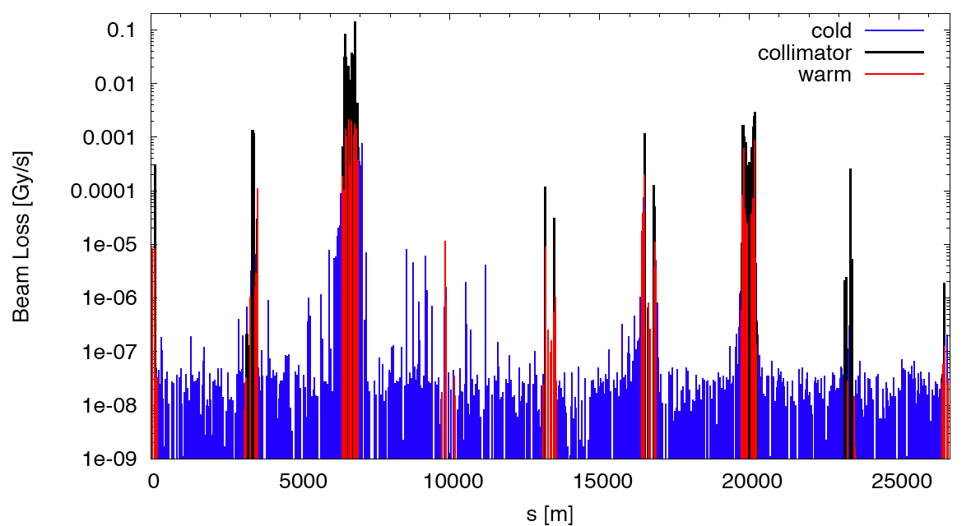
Qualification: Off-momentum collimation
Loss map for off-momentum error. All OK. See expected low leakage to experimental IR's. OK for stable beams from coll.
factor 10,000
IR2
IR1
IR8
IR5

Slide 26
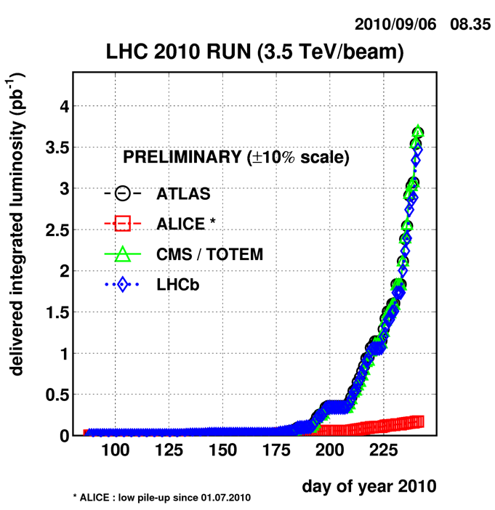
LUMINOSITY PRODUCTION

Slide 27
Surprises
We were never meant to run at 3.5 TeV
  7 TeV studied in exquisite detail
  3.5 TeV - bigger beams, less aperture, less attention
Very good single beam lifetime
  Vacuum, non-linearities, lifetimes
  Inject nominal bunch intensities, ramp, squeeze…
Beam-beam
  A lot easier than expected
  Nominal bunch intensity collisions – resolving expected problems with predicted cures. Still surprising.
Transverse emittance (read beam size)
  Too small emittance from injectors!
  Ditto longitudinal plane
Beta* = 3.5 m

Slide 28
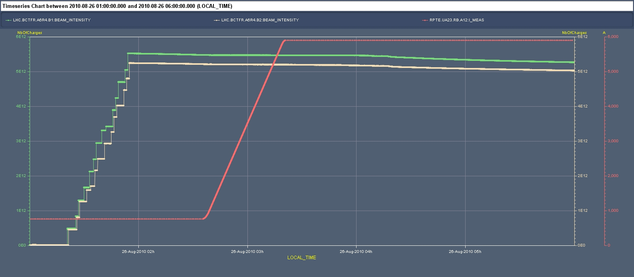
Beam current during fill 25/08/2010
Quite frankly: we’re dreaming…
“The price of freedom is eternal vigilance.”

Slide 29
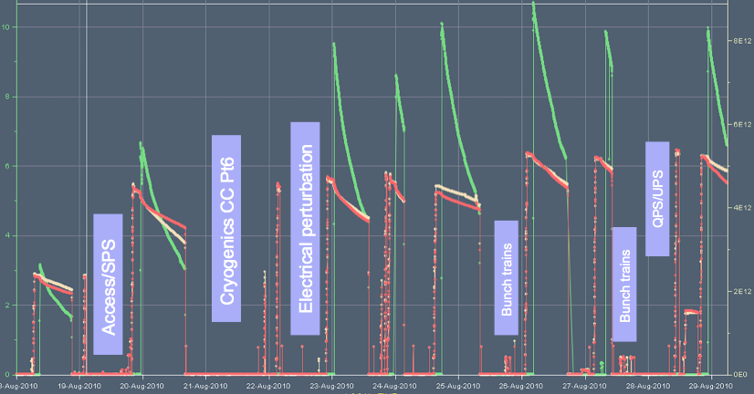
Two weeks in August
25b
48b
50b

Slide 30
W33/34
August | Fill | Bunches | Stable | nb⁻¹ | EOF
18 | 1293 | 25x25 | 12h01 | 93 | Programmed dump
19/20 | 1295 | 48x48 | 14h43 | 238 | Programmed dump
22/23 | 1298 | 48x48 | 13h07 | 280 | fast beam loss event Q22.R3.
24 | 1299 | 48x48 | 3h18 | 87 | RD1.R2 trip.
24/25 | 1301 | 50x50 | 14h17 | 345 | EOF studies
26 | 1303 | 50x50 | 13h07 | 369 | fast beam loss event Q25.R5.
27 | 1305 | 50x50 | 3h30 | 118 | EOF studies
28/29 | 1308 | 50x50 | 13h42 | 335 | Programmed dump
29/30 | 1309 | 50x50 | 11h18 | 312 | Programmed dump
& Totem

Slide 31
W34
Peak luminosity – stable beams | 1.03 x 10³¹ cm⁻²s⁻¹
Average luminosity – stable beams | 7.08 x 10³⁰ cm⁻²s⁻¹
Total stable beam time | 67.6 hours (40.2%)
Delivered luminosity | ~1700 nb⁻¹
Luminosity lifetime | ~25 hours
Hübner factor ≈ 0.29
Including some dedicated bunch train commissioning
 | Availability | Physics
W33 | 47.3% | 22%
W34 | ~85% | 40.2%
Remarkable machine availability: impressive performance of cryogenics, QPS, converters, RF, instrumentation, collimators, injectors…
Very effective use of available time

Slide 32
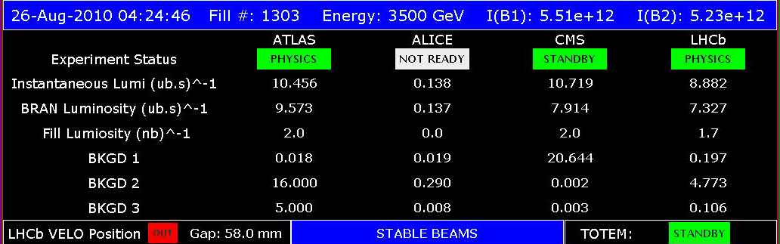
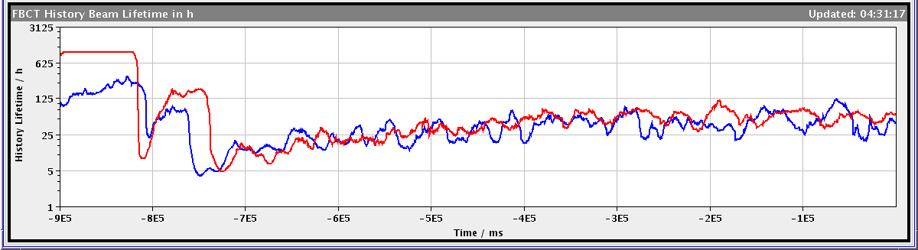
New Record Lumi

Slide 33
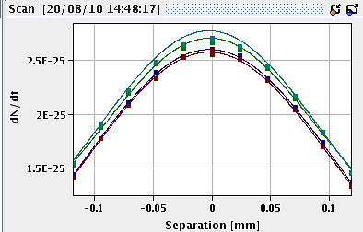
Emittance evolution during a fill
color code:
- grey for bunches colliding in 1258;
- green for bunches colliding in 158;
- red for bunches colliding in 15.
☺
Average emittances derived from scan IP1:
X : 4.4um
Y: 4.9um
Average 4.64um
growth of 10-20% over the fill

Slide 34
Tevatron Luminosity model on the LHC
The major (preliminary) conclusions for the LHC fill 1303
Luminosity lifetime – 20 hour
Intensity loss times
  Total 94 & 72 hour (Beam 1 & Beam 2)
    267 & 253 hour (Beam 1 & Beam 2) due to luminous loss (For  =90 mbarn - need a more accurate number)
    170 & 112 hour (Beam 1 & Beam 2) due to longitudinal heating and clipping
Beam loss is dominated by the longitudinal loss
  Beam-beam loss is important for some bunches but does not dominate the average
The transverse emittance growth is dominated by transverse noise at betatron sidebands: feedback and hump
Valeri Lebedev

Slide 35
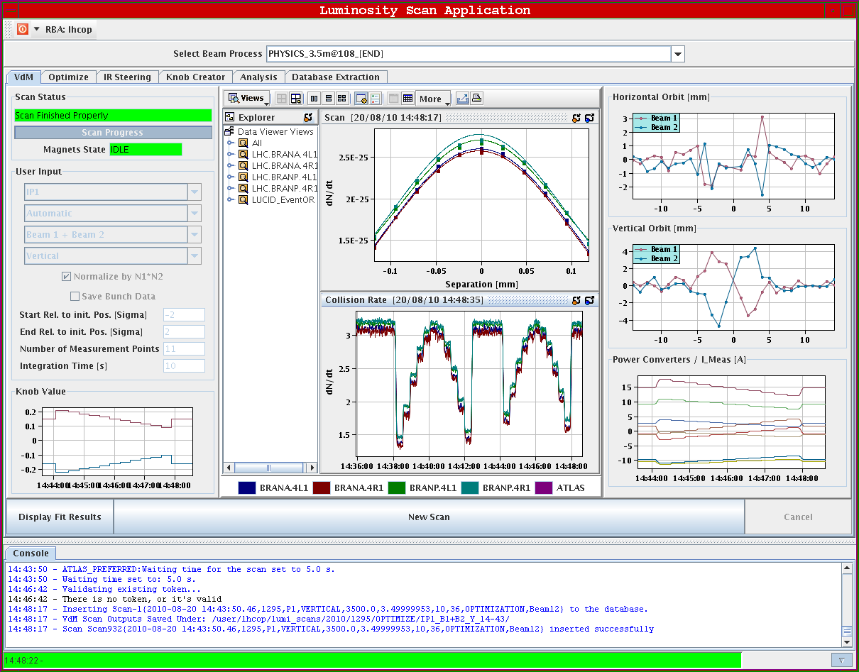
Luminosity scan
Simon White

Slide 36
2010 incoming

Slide 37
2010 – main aims
Clear priority to lay the foundations for 2011 and delivery of 1 fb⁻¹
Have performed a safe, phased increase in intensity with validation and a running period at each step so far
Gained solid operational experience of [not faultlessly] injecting, ramping, squeezing and establishing stable beams
Aimed for steady running at or around 1 MJ over the summer – around 3 weeks in the end
Followed by commissioning of bunch trains and a comparatively fast ramp up in beam intensity

Slide 38
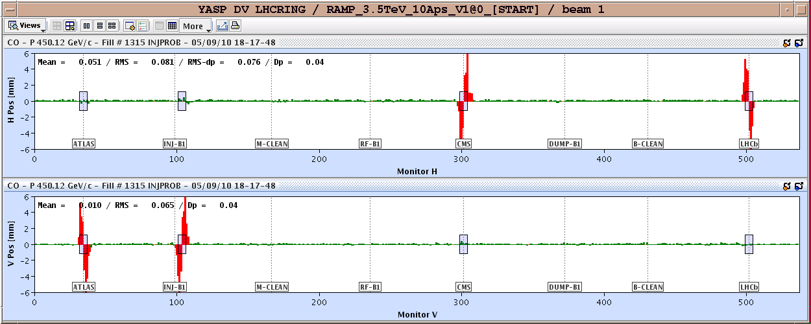
Next up - bunch trains
Step 1: bring on the crossing angles
through the full cycle and then validate with loss maps etc

Slide 39
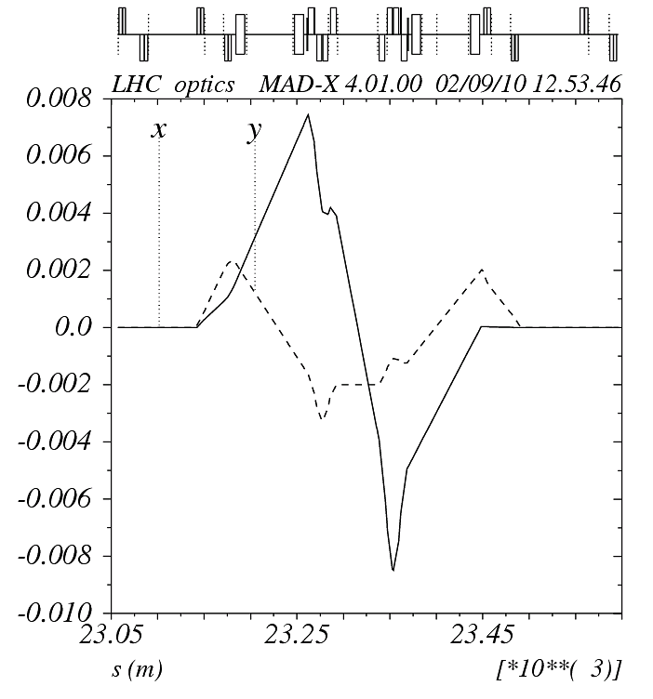
on_x8 := 1;
on_sep8 := 1;
on_lhcb := 0;
Implications for machine protection
450 GeV
Crossing angle at IP8 -170 microrad

Slide 40
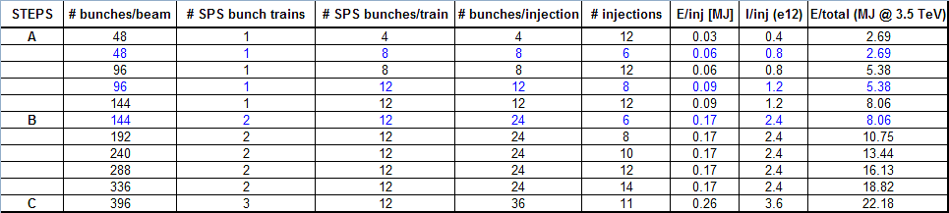
High intensity bunch trains
Bunch spacing 150 ns
Push through 4, 12, 24 bunches per beam
Monitor & adjust
  ADT
  Longitudinal blow-up
  RF
  Feedbacks
First stable beams: 3x4
Brennan Goddard, Malika Meddahi

Slide 41
Performance
Nominal bunch intensity 1.1e11
Nominal emittance
200 microrad crossing angle
Beta* = 3.5 m
150 ns bunch spacing
Number of bunches | Peak Luminosity [cm⁻²s⁻¹] | 5day@0.2 [pb⁻¹] | MJ
48 | 1.5 x 10³¹ | 1.3 | 3.0
96 | 2.9 x 10³¹ | 2.5 | 5.9
144 | 4.4 x 10³¹ | 3.8 | 8.9
192 | 5.9 x 10³¹ | 5.1 | 11.8
240 | 7.3 x 10³¹ | 6.3 | 14.8
288 | 8.8 x 10³¹ | 7.6 | 17.7
336 | 1.0 x 10³² | 8.9 | 20.7

Slide 42
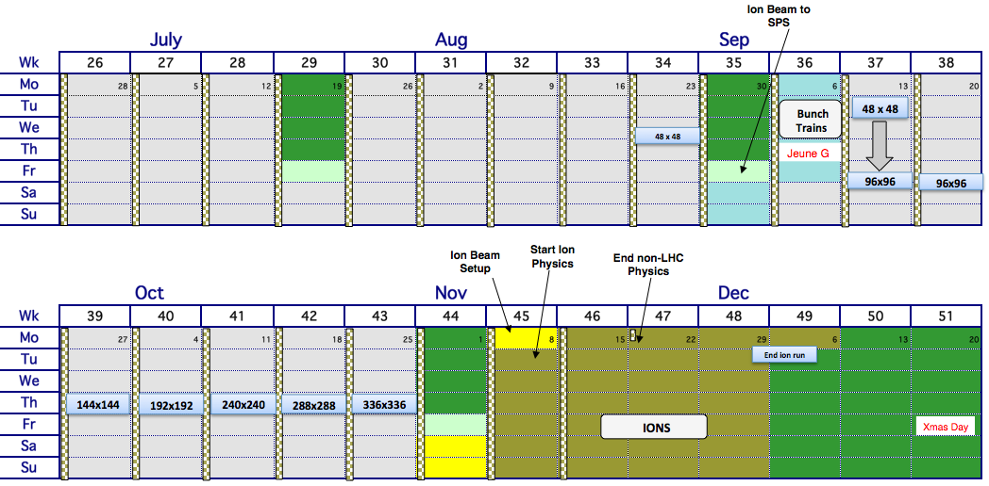
Schedule – rest of 2010
Aggressive schedule, assuming excellent machine availability

Slide 43
Early Heavy Ion Run Parameters
John Jowett
 |  | Early (2010/11) | Nominal
√s per nucleon | TeV | 2.76 | 5.5
Initial Luminosity (L₀) | cm⁻²s⁻¹ | ~10²⁵ | 10²⁷
Number of bunches |  | 62 | 592
Bunch spacing | ns | 1350 | 99.8
β* | m | 3.5 | 0.5
Pb ions/bunch |  | 7x10⁷ | 7x10⁷
Transverse norm. emittance | μm | 1.5 | 1.5
Luminosity half life (1,2,3 expts.) | h | τ_{IBS}=7-30 | 8, 4.5, 3
Initial interaction rate: 100 Hz (10 Hz central collisions b = 0 – 5 fm)
~10⁸ interaction/10⁶s (~1 month)

Slide 44
2011

Slide 45
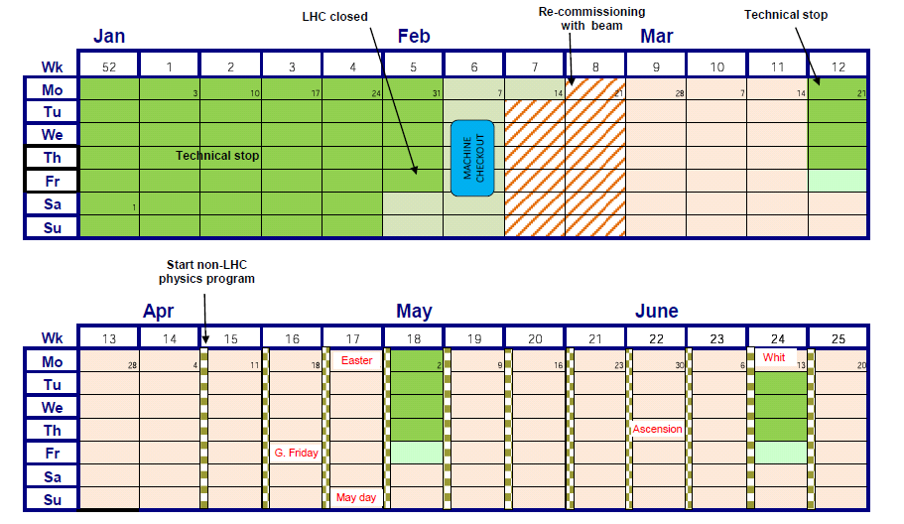
2011 Q1&2

Slide 46
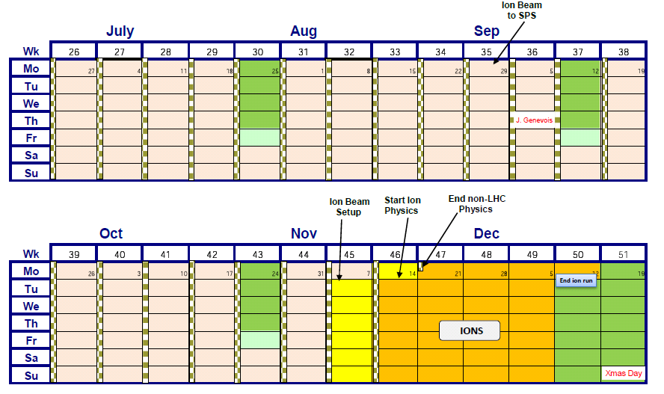
2011 Q3&4

Slide 47
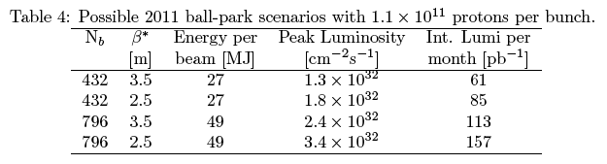
2011 – 3.5 TeV
Restart 4th February
9 months protons, 4 weeks ions
Integrated luminosity target driven – 1 fb⁻¹
Need to run flat out above 1e32 cm⁻²s⁻¹

Slide 48
Conclusions
Very successful period of initial commissioning
  5 months since first collisions at 3.5 TeV
  Commissioning is still ongoing…
All key systems performing remarkably well – some hugely complex systems out there.
  Some commissioning still required, issues still to address
Performance with beam (losses, lifetimes, luminosity, emittance growth etc.) is very encouraging.
Have bedded in the nominal cycle but it remains a complex procedure with a number of critical manual actions required – mistakes still possible
Moving towards a MJ culture.
Aggressive planning for the rest of 2010
Smooth running with 10s MJ in 2011 foreseen

Slide 49
BACKUP

Slide 50
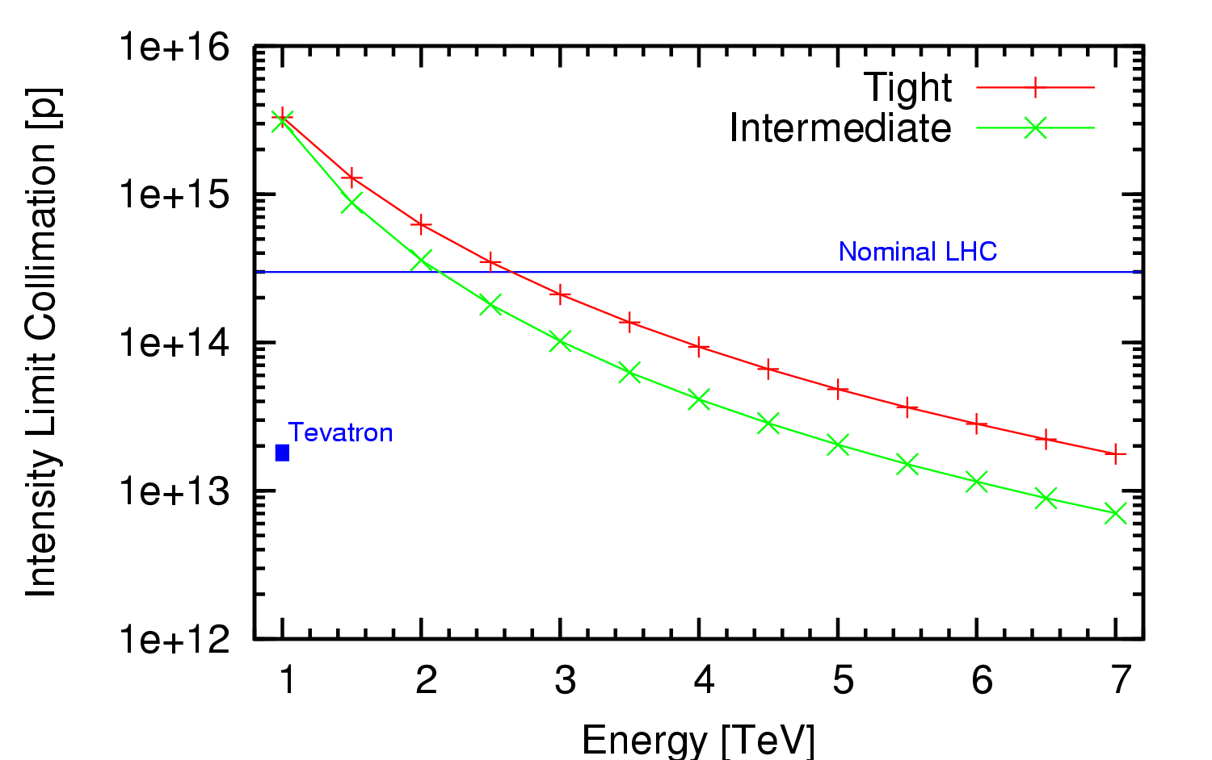
LHC Intensity limits 2010 2011
Collimation system conceived as a staged system
First stage to allow 40% of nominal intensity at 7TeV
  Under certain assumptions
    LHC lifetimes and loss rates
    0.1%/s assumed (0.2h lifetime)
    Ideal cleaning
  Imperfections bring this down
    Deformed jaws
    Tilt & offset & gap errors
    Machine alignment
  Machine stability
    Tight settings a challenge early
    Intermediate settings make use of aperture to relax tolerances
Fix I_{max} to 6 10¹³ protons per beam at 3.5TeV
(about 20% nominal intensity)
30MJ stored beam energy
0.2%/s assumed

