Slide 1
13.12.2009
-09:00: Prepared new fill
B1: Q_{X}=0.293, Q_{Y}=0.269; lifetime = 25h ✔ B2: Q_{X}=0.297, Q_{Y}=0.267; lifetime = 5h ✗
Strong 50Hz and 100hz lines on Beam1 spectrum
-13:00: Terminated fill: Beam2 intensity dropped to 1/3rd (7 10¹⁰ ➔ 2.5 10¹⁰)
-13:30: Prepared new fill but tried to inject Beam2 first
➔ accidentally took out beam with last Beam1 injection ✗
-14:00: New stable beams with correct tune values: lifetimes 25h and 5h
Transverse IP scans for CMS, LHCb and ALICE ✔
-18:30: Terminate fill when Beam2 intensity dropped to 1/3rd
➔ Try wire scanner with ‘stable beam mode’ on (CMS informed) ✔
➔ Analyzed β-beat measurement at IPs ➔ no preference for a beat ✗
➔ Try tune adjustment (ΔQ 10⁻² with ‘stable beam mode’ off) ✔

Slide 2
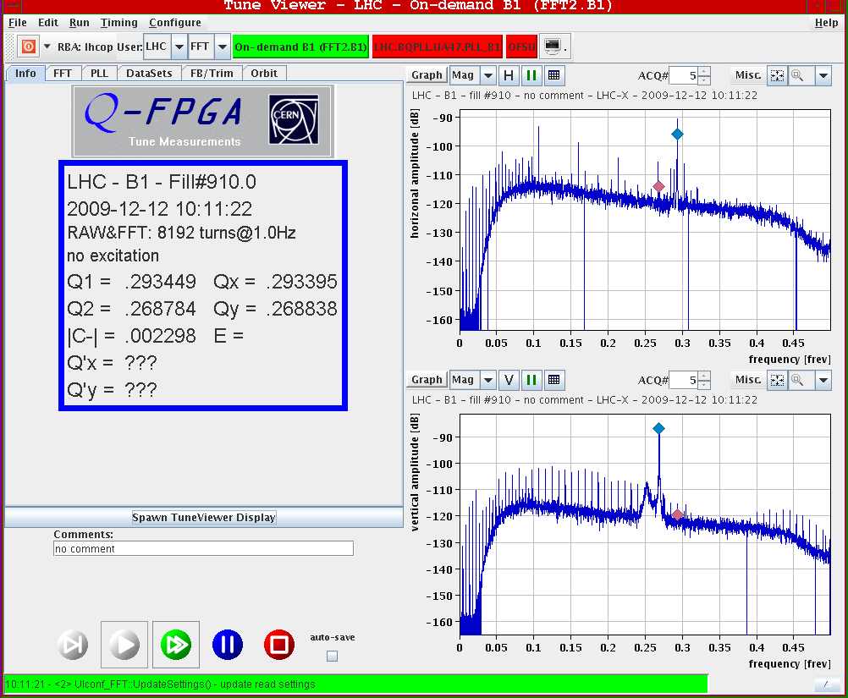
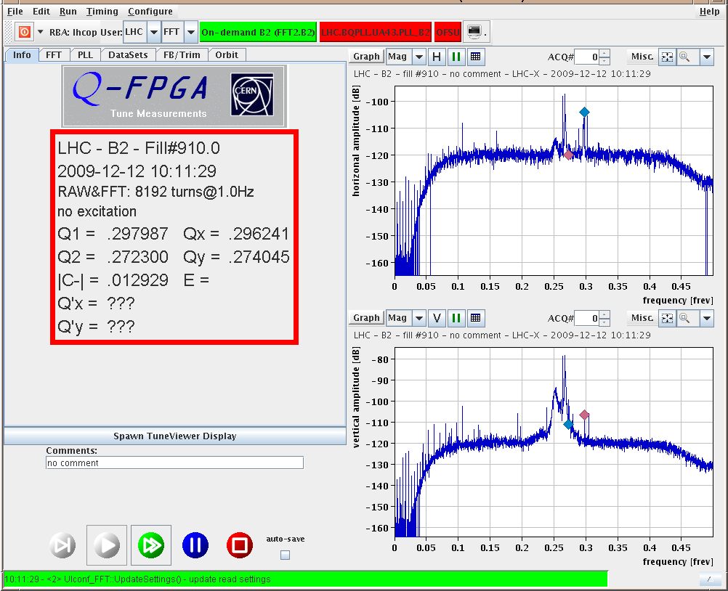
13.12.2009: First fill tunes
Strong 50Hz lines in horizontal and 100 Hz lines in vertical tune of Beam1.
Not visible in Beam2. These are not synchrotron lines
(f_{rev} = 11.2455 kHz, f_{sync} = 63.6 Hz according to RF parameters)
Beam1: Beam2:

Slide 3
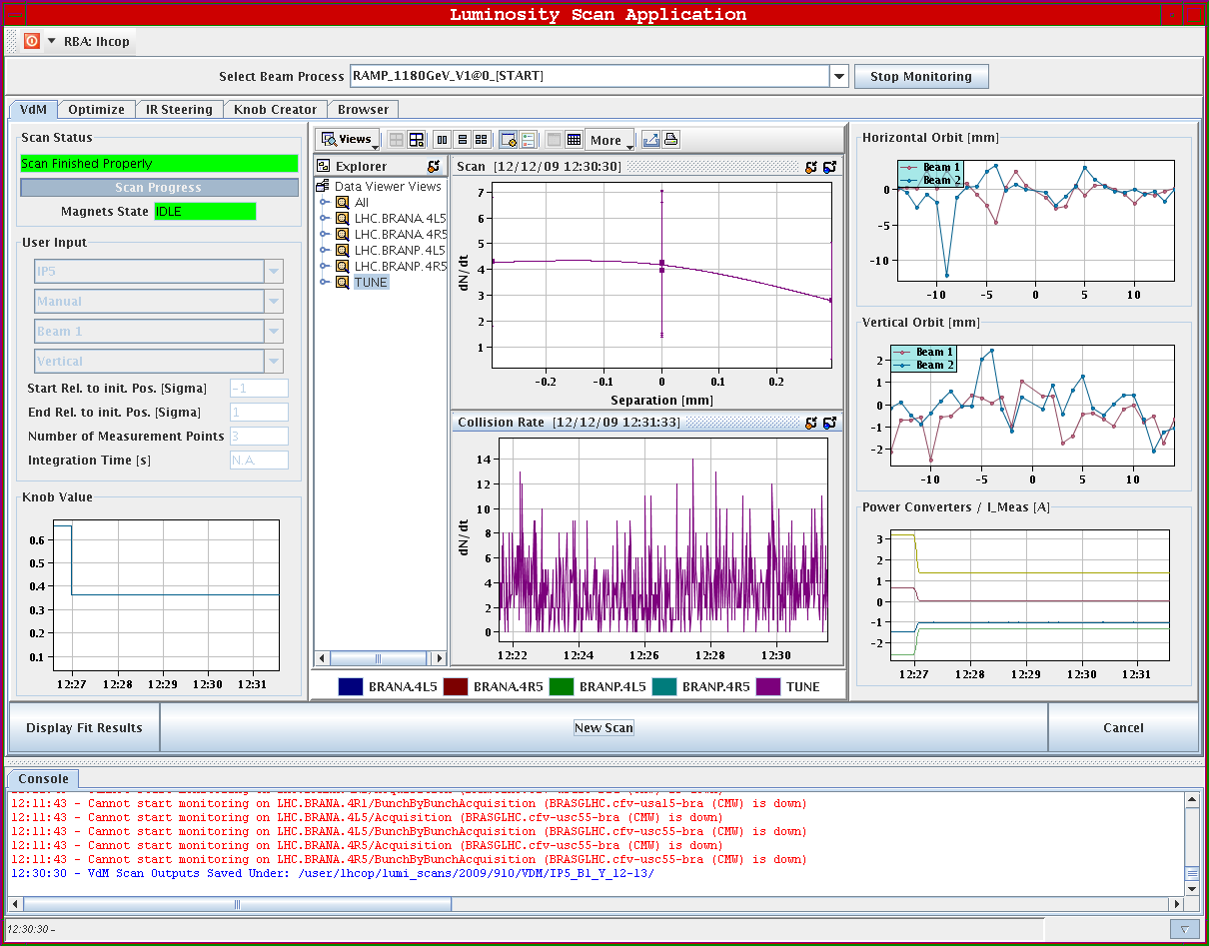
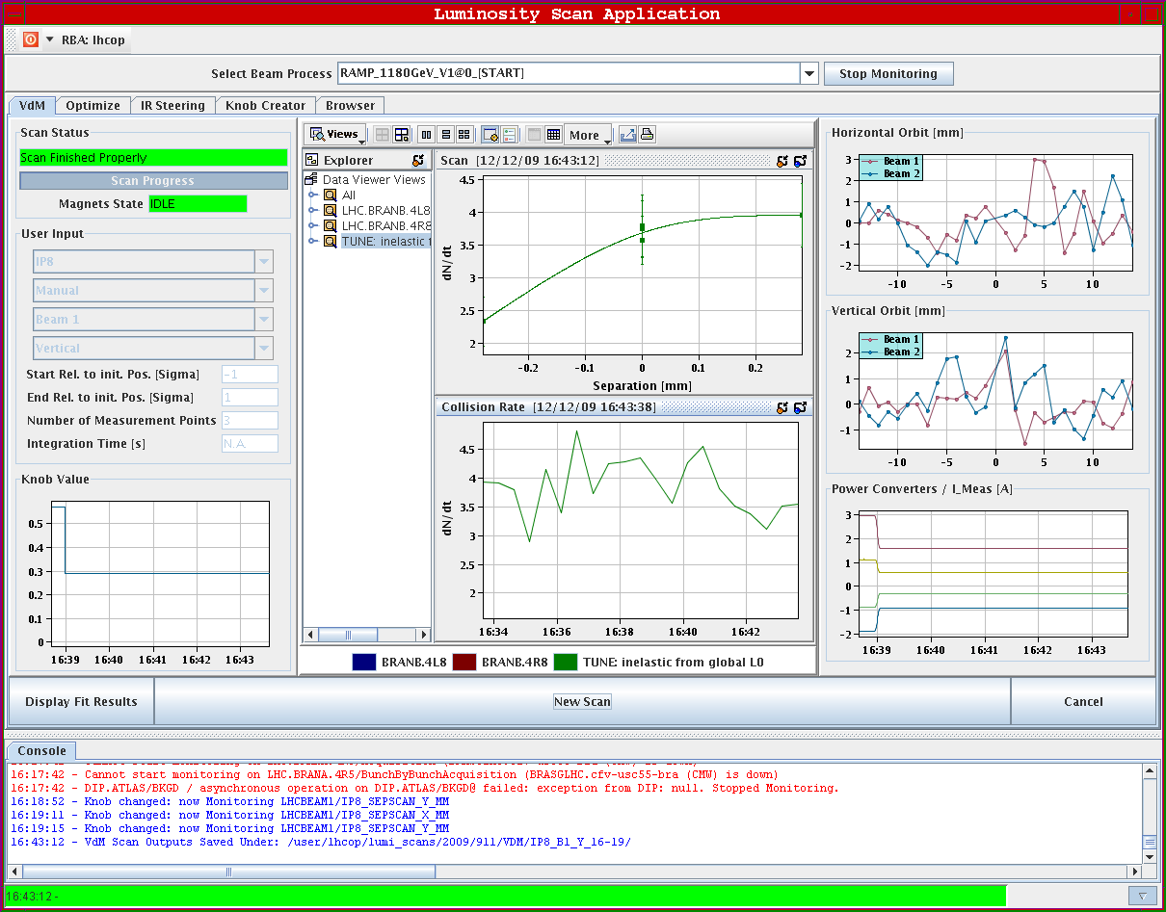
13.12.2009: Transverse IP scans
CMS: LHCb:

Slide 4
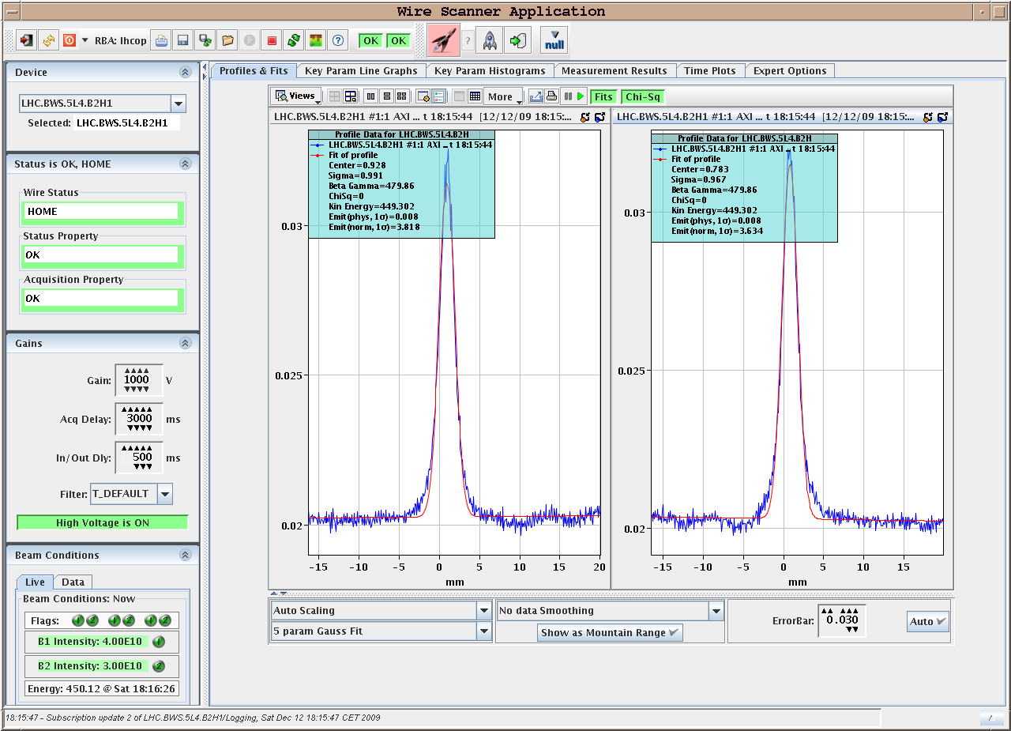
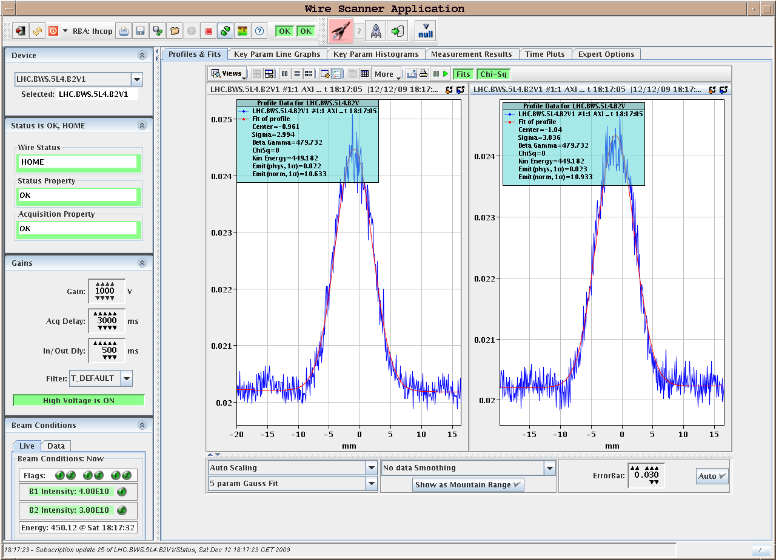
13.12.2009: Parasitic Wire Scans
Beam2 horizontal: Beam2 vertical
Comparing beam size from wire with synchrotron light monitor
Wire: σ_{x} = 0.98mm σ_{y} = 3.0mm BSRT: σ_{x} = 1.10mm, σ_{y} = 2.7mm ➔ ca factor 2 between σ_{y} and σ_{x}

Slide 5
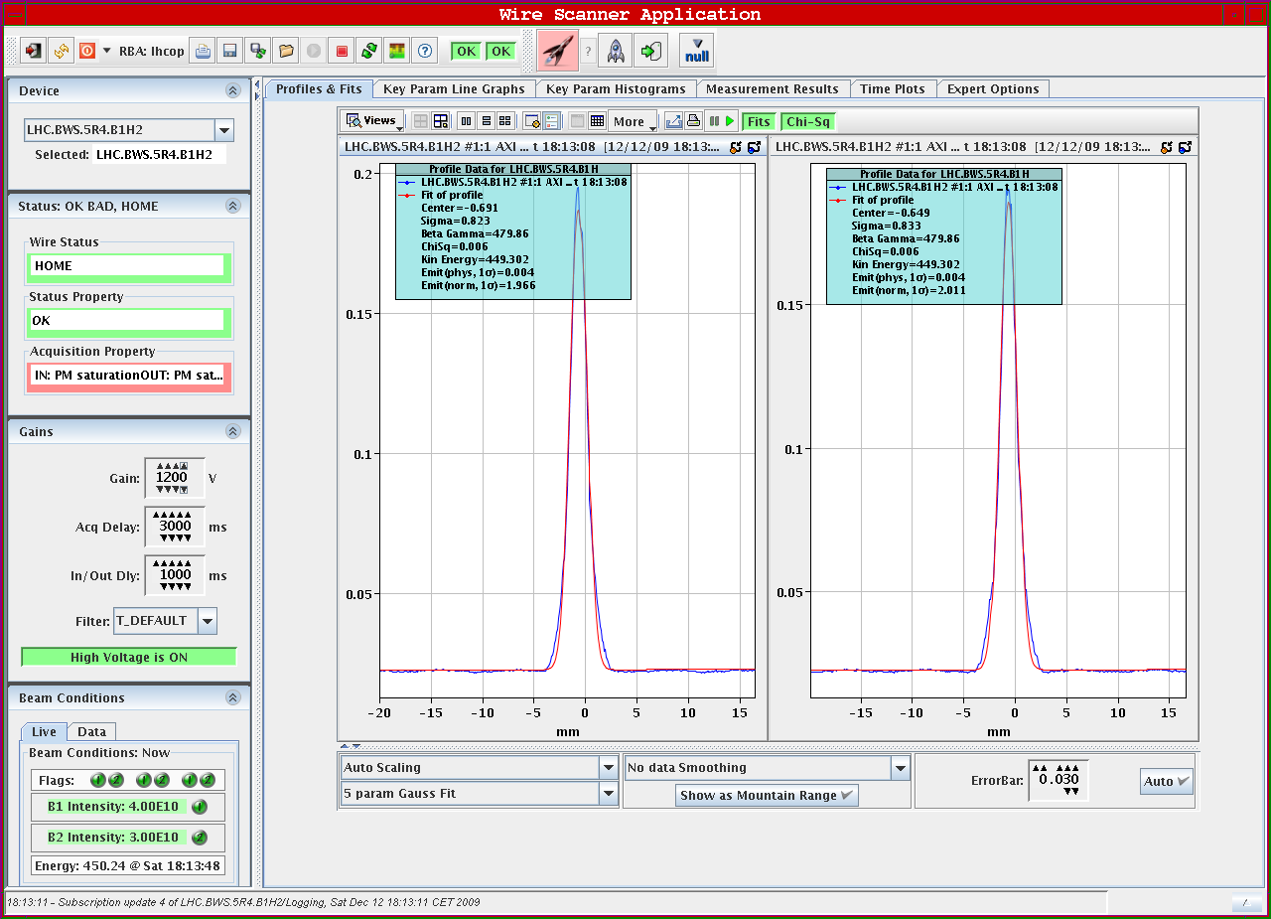
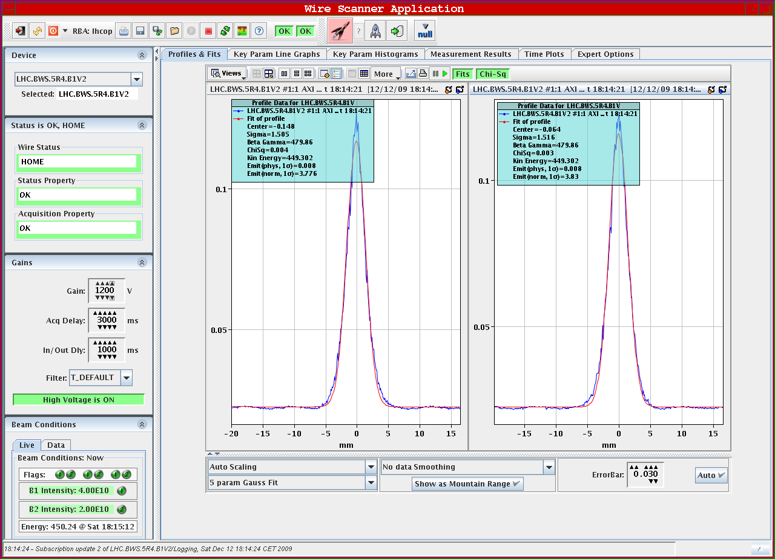
13.12.2009: Parasitic Wire Scans
Beam1 horizontal: Beam1 vertical
Comparing horizontal and vertical beam size from wire measurements:
Wire: σ_{x} = 0.82mm, σ_{y} = 1.5mm ➔ also factor 2 between σ_{y} and σ_{x}
Have not yet measurement at beginning of fill. ➔ not yet possible to conclude
or exclude blow up for Beam1

Slide 6
13.12.2009: Measured β-functions at IPs
IP | Beam1 βx [m] | Beam1 β_{y} [m] | Beam2 β_{x} [m] | Beam2 β_{y} [m] | nominal [m] | Ratio σ_{x} | Ratio σ_{y}
1 | 12.7 ± 2.5 | 13 ± 1 | 9 ± 1.5 | 16 ± 0.5 | 11 / 11 | 1.2 | 0.9
2 | 8.3 ± 0.1 | 8.8 ± 0.5 | 12 ± 1.5 | 13 ± 20 | 10 / 10 | 0.83 | 0.82
5 | 16 ± 0.5 | 12.7 ± 1 | 13 ± 1 | 9.6 ± 1.5 | 11 / 11 | 1.1 | 1.15
8 | 11.3 ± 19 | 12.3 ± 2 | 9.5 ± 2.5 | 7.8 ± 0.5 | 10 / 10 | 1.1 | 1.25

Slide 7
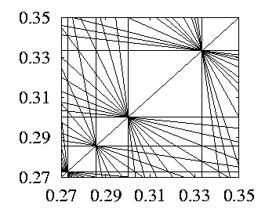
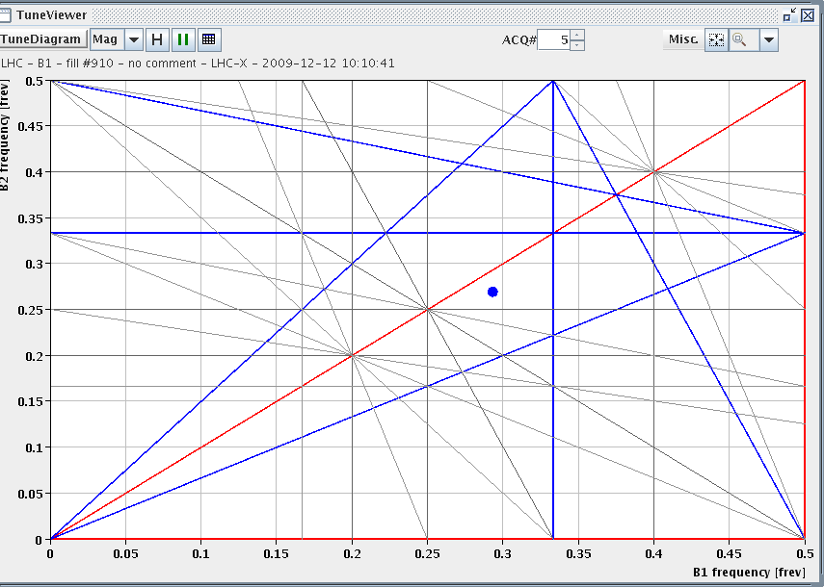
13.12.2009: Tune Adjustments for Beam2
B1: Q_{x} = 0.293, Q_{y} = 0.269; lifetime = 26h B2: Q_{x} = 0.297, Q_{y} = 0.267; lifetime = 5h
B1: Q_{x} = 0.293, Q_{y} = 0.269; lifetime = 25h B2: Q_{x} = 0.312, Q_{y} = 0.305; lifetime = 12h ✔
1/3
1/11
1/10
1/7

Slide 8
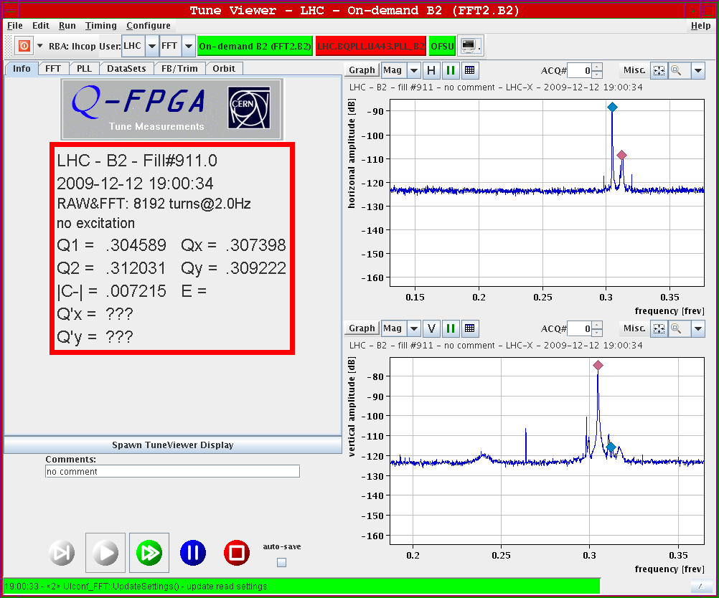
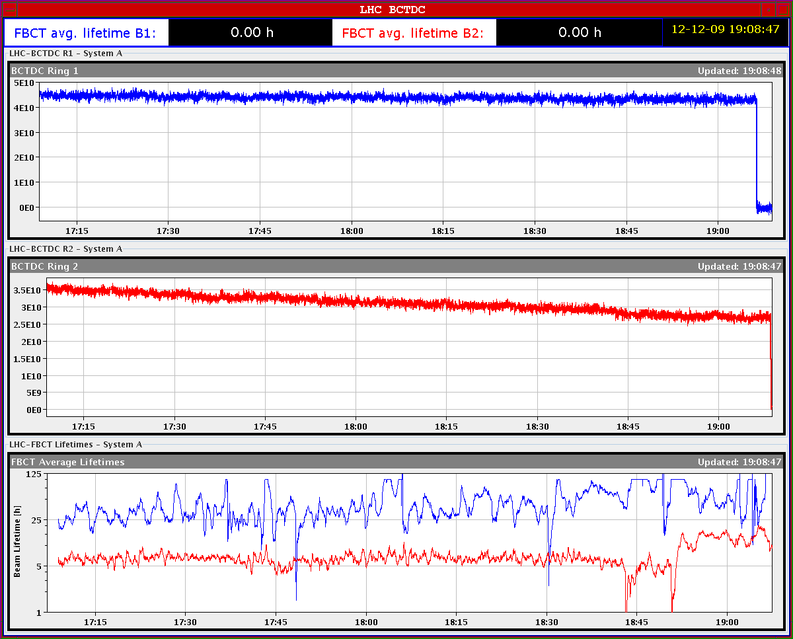
13.12.2009: New Tunes for Beam2
B2: Q_{X}=0.312, Q_{Y}=0.305; lifetime = 12h ✔

Slide 9
13.12.2009
-19:00: Dumped Beam1 before Beam2 ➔ no effect on Beam2 lifetime
-19:30: New fill new tunes for Beam2:
B1: Q_{x} = 0.291, Q_{y} =0.268; lifetime ≈ 10 h B2: Q_{x} = 0.311, Q_{y} =0.305; lifetime ≈ 10 h
-22:50: Beam lost due to cryo problem in S12
Cold compressor off in sector 12
estimated time for recovery: 12 hours ➔ 10am Sunday
➔ access ALICE
➔ RQ6.L6B1/2 tripped during switch on to STANDBY
-07:00: Cryo conditions OK preparing pre-cycle for S12
➔ problems related to QPS

Slide 10
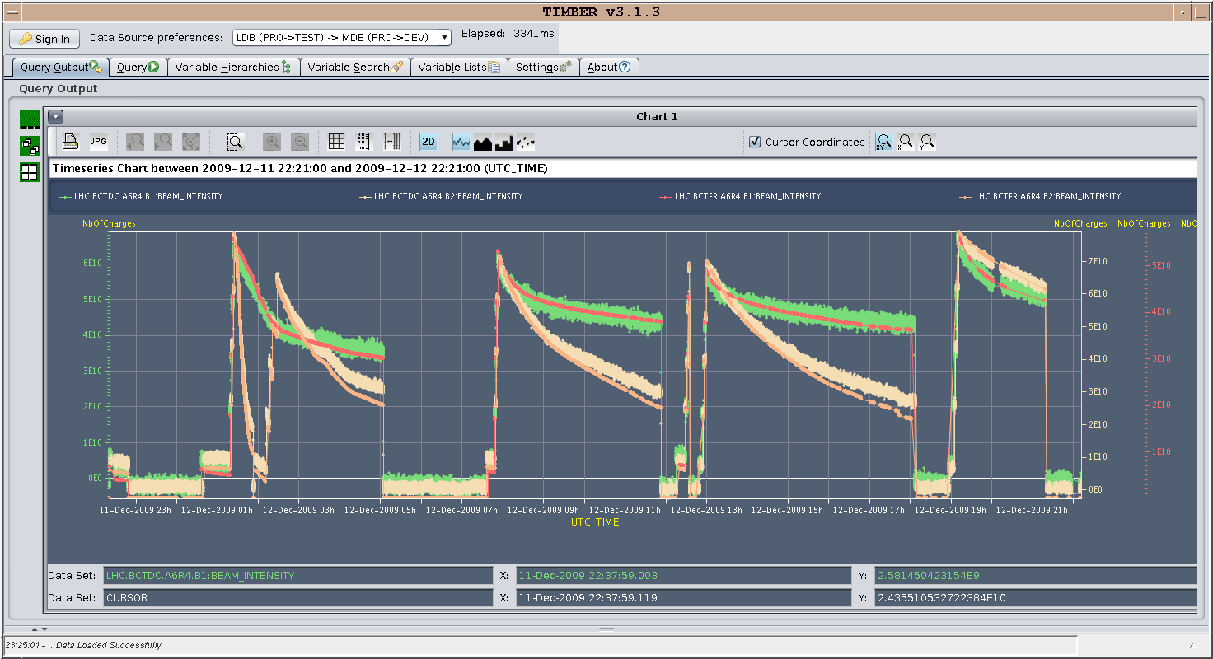
13.12.2009: Last 24 hours - currents

Slide 11
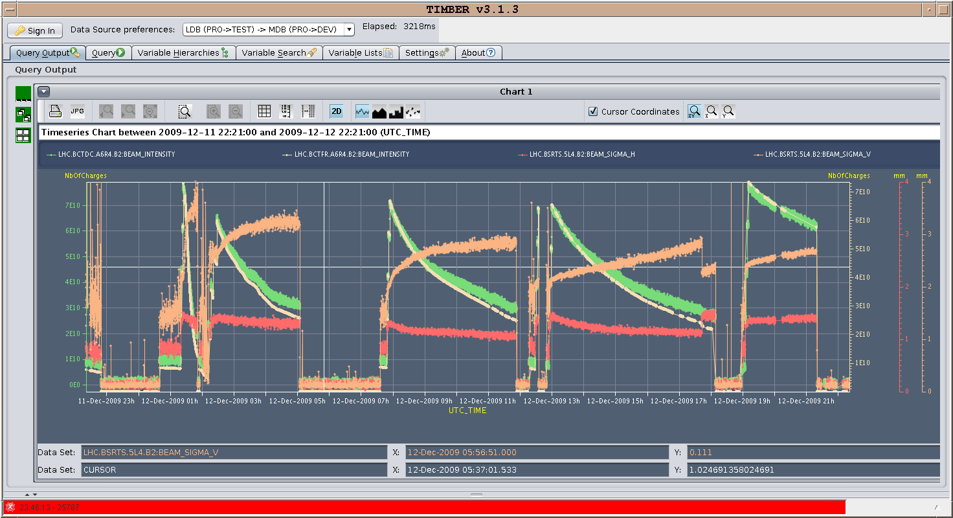
13.12.2009: Last 24 hours – light monitor
Horizontal beam size for Beam1 seems to shrink at beginning of fill (1st hour)
➔ scraping at collimators? Consistent with low lifetime at start of fill (ca. 1h)

Slide 12
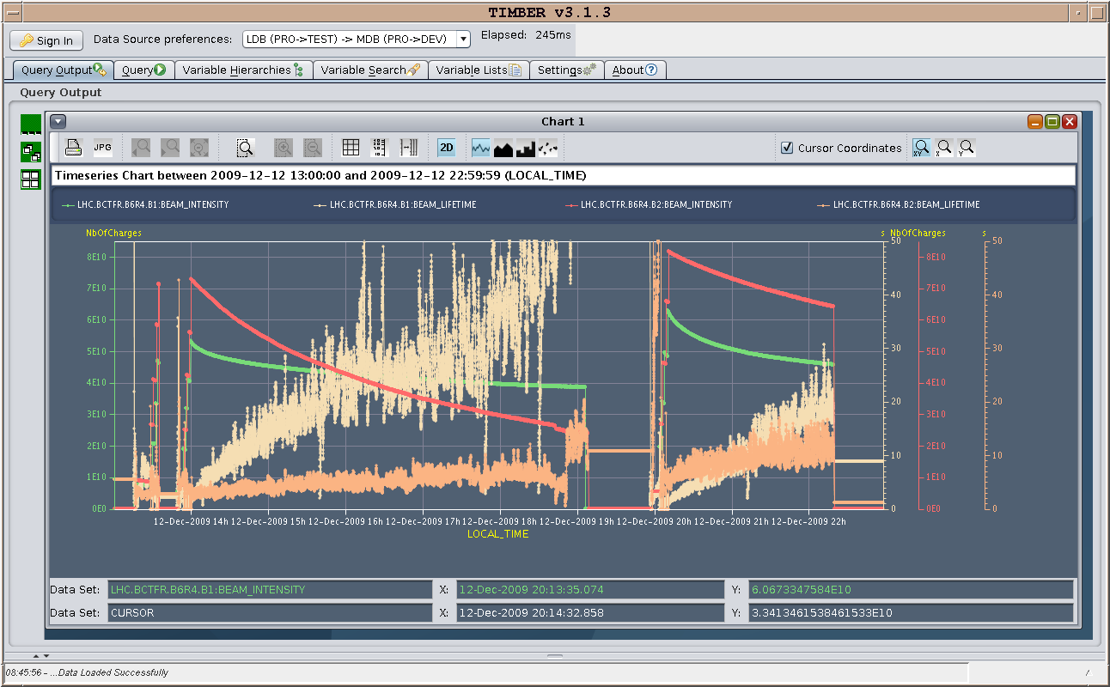
13.12.2009: Last 2 Fills Lifetimes
Lifetimes consistently bad (ca. 1h) for first hour of fills

Slide 13
13.12.2009: Plan for the weekend:
-Finish luminosity production at 450 GeV: 16 on 16 bunches?
-Tune adjustments Beam1?
-Turn separation bumps on IP by IP and look for effect on beam lifetime
-Inject with separation bumps on?
-Chromaticity adjustments and knob commissioning (end of fill)
-Orbit bumps at synchrotron light monitor (end of fill)
-fill with high intensity
-test β* knobs
-Ramp test: Orbit correction at end of ramp and optics verification
-MPS and beam dumping system at 1.1 TeV (end of ramp?)
-Protection devices and collimation system setup at 1.1 TeV
-intermediate energy dumps
-abort gap cleaner commissioning

Slide 14
13.12.2009: Plan for the weekend:
-bumps at TOTEM Roman Pots
-ATLAS aperture H re-check
Other miscellaneous work:
-finish circuit polarity checks
-finish kick response measurements
-orbit feedback commissioning
-nQPS quench threshold test with beam (bunch intensity < 2 10⁹)

Slide 15
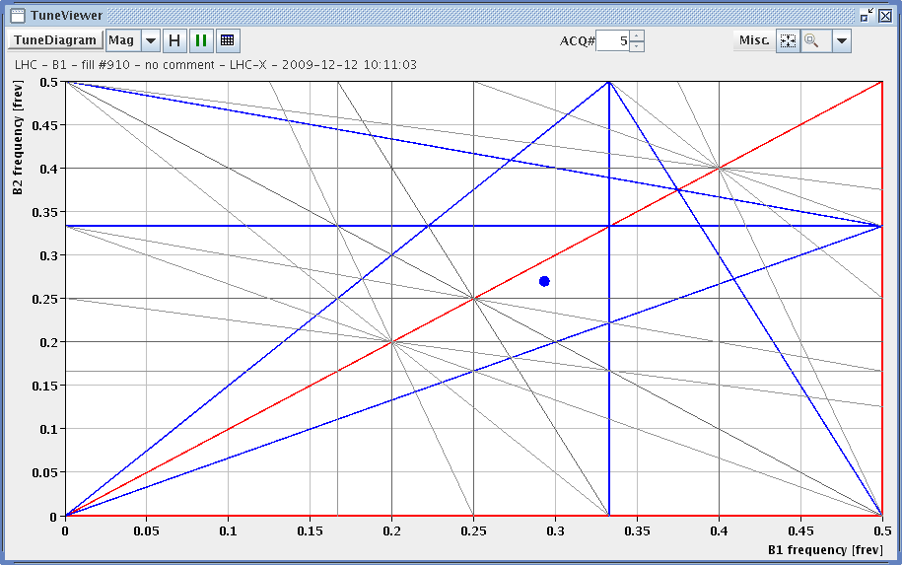
13.12.2009: First fill tunes
B1: QX=0.293, QY=0.269; lifetime = 25h B2: QX=0.315, QY=0.310; lifetime = ??h
B1: QX=0.315, QY=0.310; lifetime = ??h B2: QX=0.315, QY=0.310; lifetime = ??h
1/3
1/11
1/10
1/7

