Slide 1
12.12.2009
-10:00: Transverse IP adjustments in all experiments
-11:00: Lost beam
For preparation of next fill we decide to turn ALICE spectrometer on
➔ problem with injection interlock due to ‘non-closure’ of ALICE bump
➔ problem related to calibration curves in interlock system
-13:00: MKI.B1 generator fault and Beam 1 erratic dump
Done in parallel:
-synchrotron light monitor data versus time indicates transverse
emittance growth ➔ consistent with 8 kHz excitation in vertical plane

Slide 2
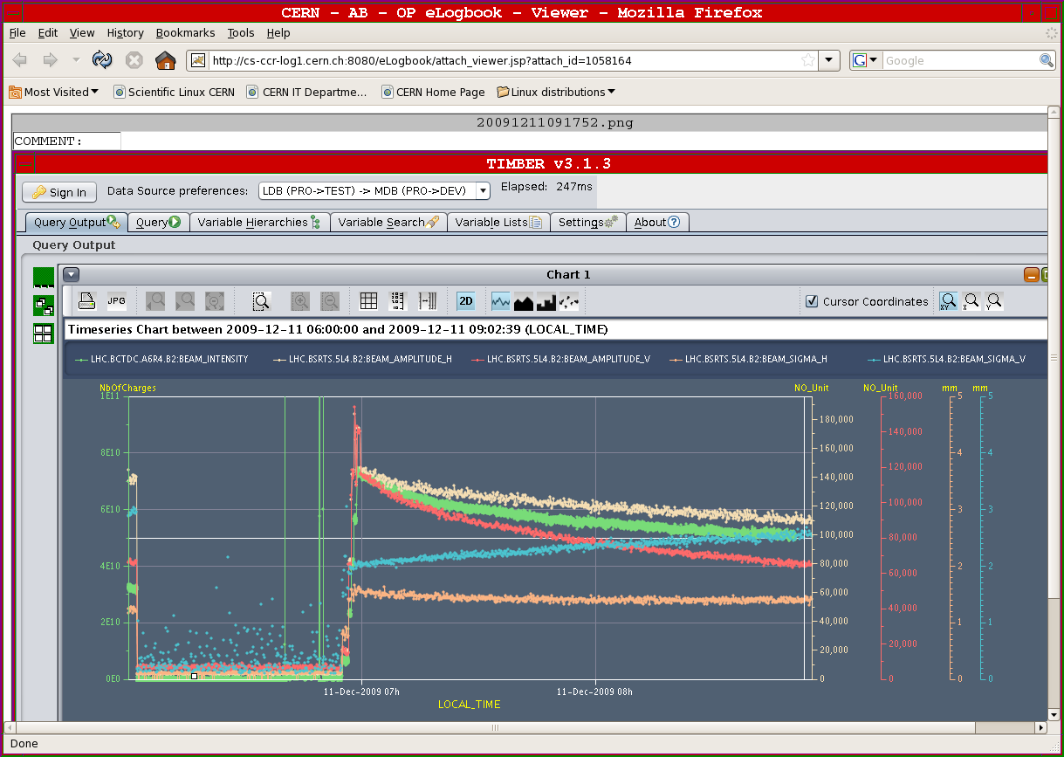
Synchrotron light monitor data versus time

Slide 3
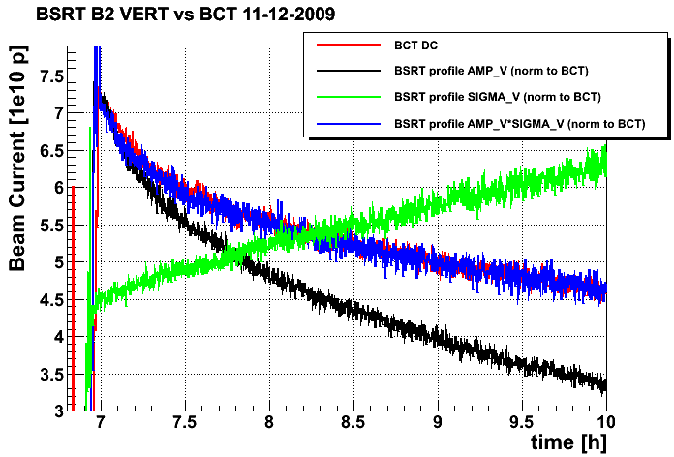
Synchrotron light monitor and CT versus time

Slide 4
12.12.2009
-13:00: Beam 2 injected ➔ chromaticity adjustments
-14:30: Both beams back, chromaticity measurement and swapping
tunes for Beam1 ➔ lifetime increases from 1h to 5h
but hard to measure Qx (many spectral lines)
-14:50: lost beams due to trip of MQTL11.L3 B2 (same as last night)
faulty DCCT (disconnected one of the two signals)
-16:30: RF Studies (2 circulating pilots)
-19:00: Continue with transverse IP adjustments (4 x 2 10¹⁰ in both beams) in
ATLAS, ALICE, CMS (LHCb done in the morning)
-21:25: Lost Beam2 due to BPM interlock in IR6
-22:30: Optimize tunes and Q’ for lifetime before preparing new fill
Beam1 lifetime ca. 3h & Beam2 lifetime ca. 1 hour before
Beam1 lifetime ca. ?? & Beam2 lifetime ca. ??hours after

Slide 5
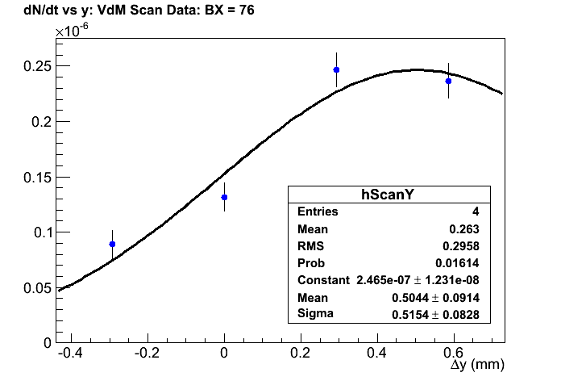
ScanY: CMS BX = 51
51

Slide 6
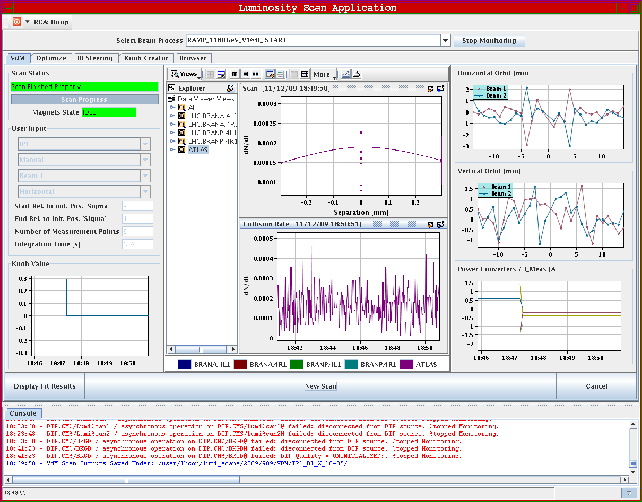
Horizontal Scan ATLAS:

Slide 7
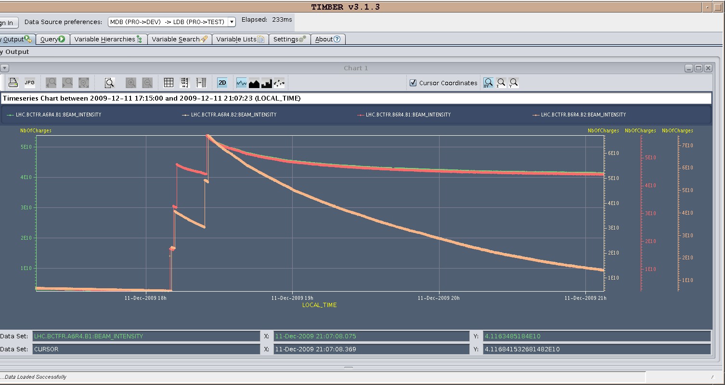
Friday afternoon fill with bad lifetime in Beam2

Slide 8
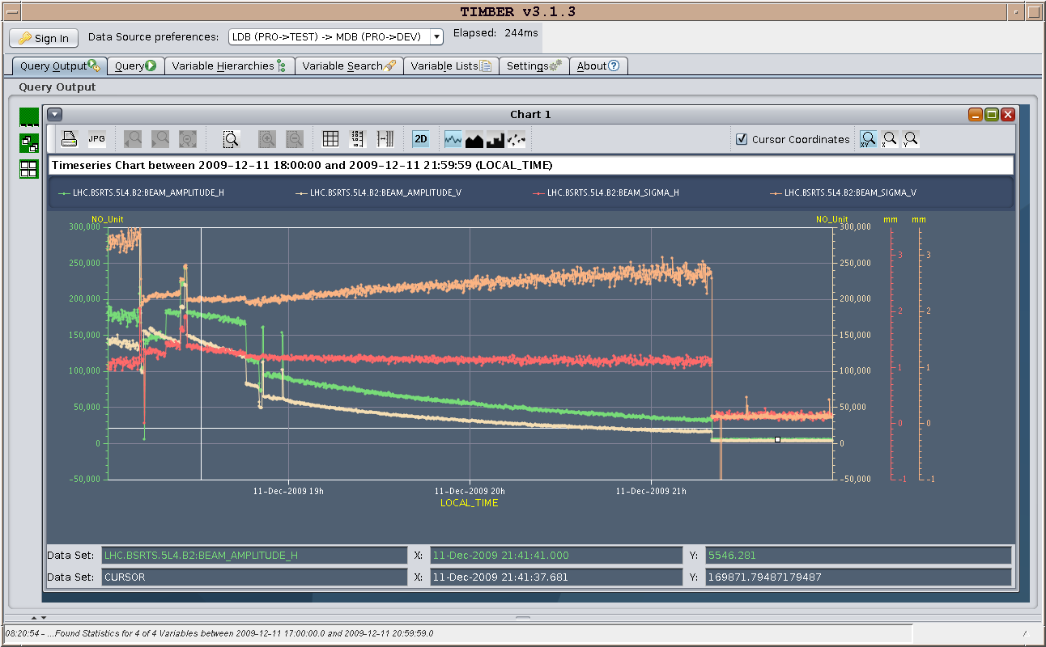
Synchrotron light monitor data versus time

Slide 9
12.12.2009
-00:00: Finished beam adjustments and preparing new fill.
Lost cryo due to faulty temperature reading in RSS in S81
-01:36: ready to re-inject: still bead lifetime for Beam2
-03:30: Beams declared stable
-06:30: Beam lost due to tripped PC (RQTF) and QPS (RQ6R8.B1)
-08:45: Preparing new fill

Slide 10
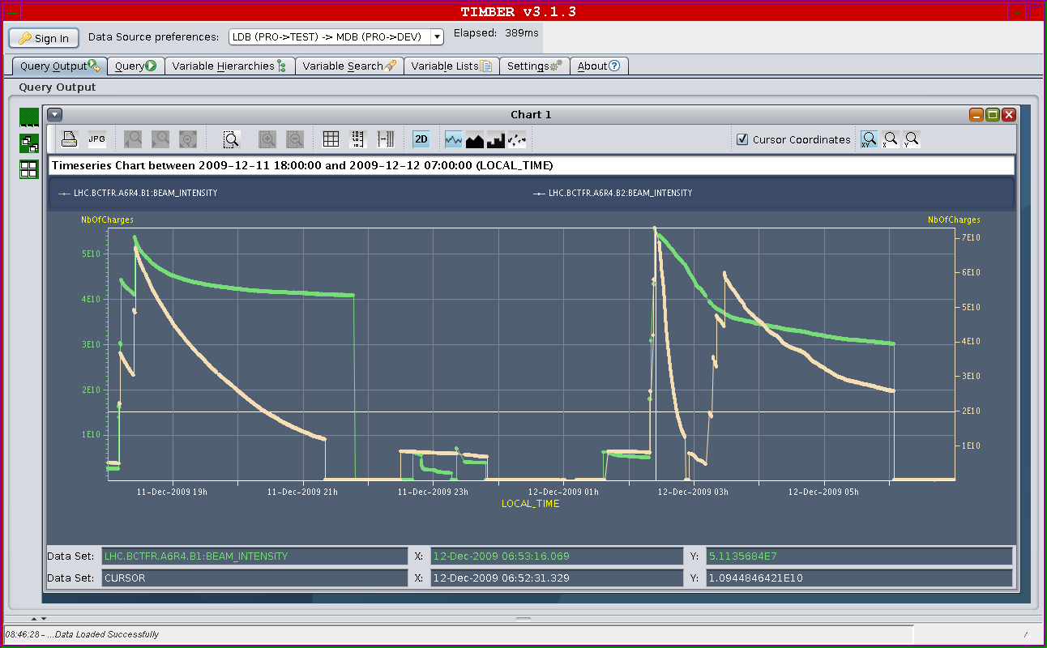
Friday night fills

Slide 11
12.12.2009: Plan for the weekend:
-Finish luminosity production at 450 GeV ➔ Sunday morning
Other tasks on the agenda from the machine point of view:
-Ramp test: Orbit correction at end of ramp!
MPS and beam dumping system at 1.1 TeV (end of ramp?)
Protection devices and collimation system setup at 1.1 TeV
Other miscellaneous work:
-finish circuit polarity checks
-finish kick response measurements
-orbit feedback commissioning
-nQPS quench threshold test with beam (bunch intensity < 2 10⁹)

Slide 12
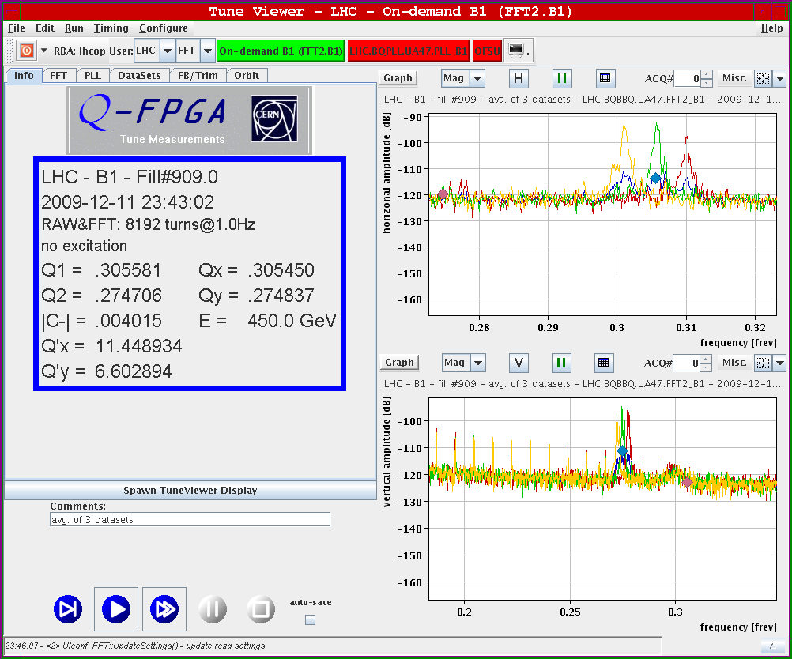
Horizontal Beam Q’: after correction

Slide 13
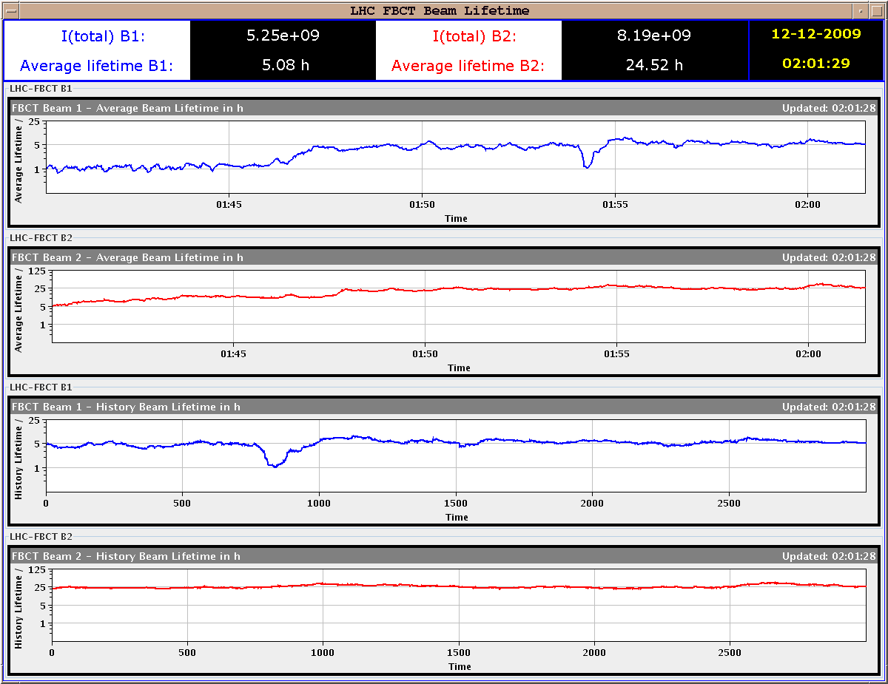
Beam life times night fill: with corrections in

Slide 14
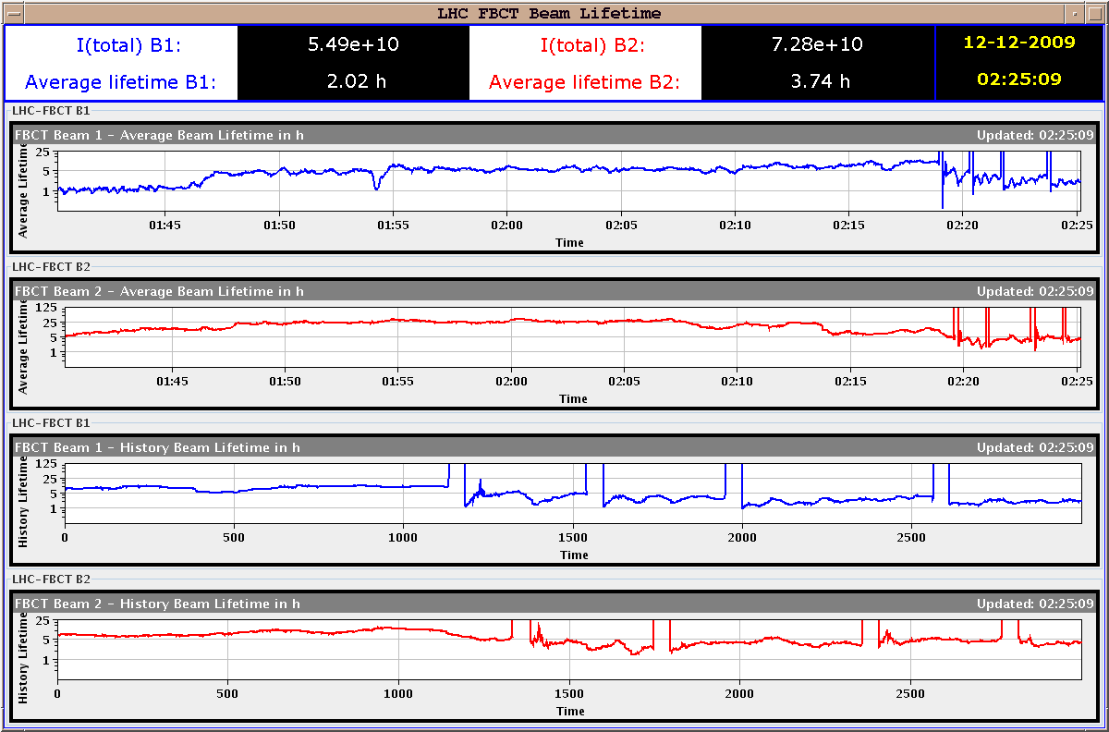
Beam life times night fill: with corrections & filled

Slide 15
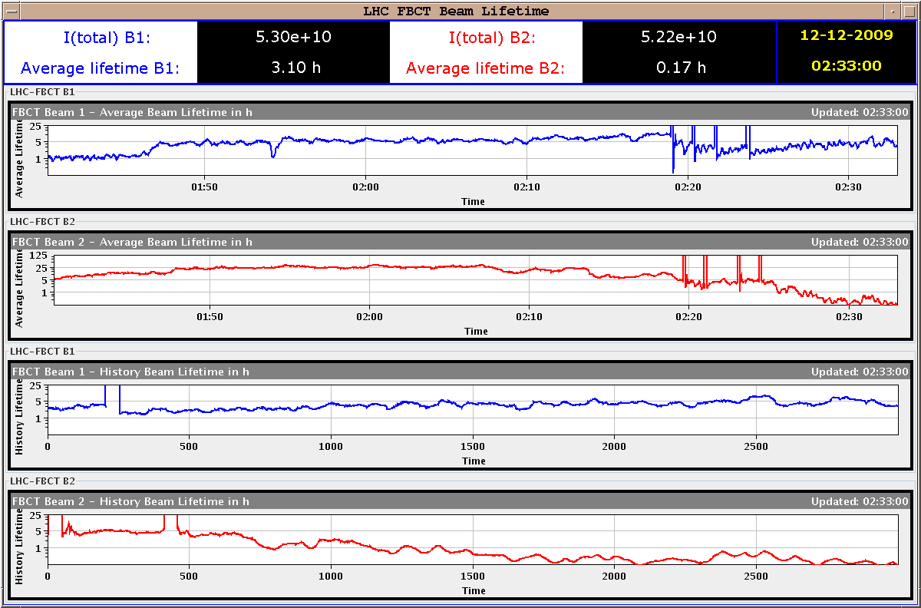
Beam life times night fill: old Q’ settings

Slide 16
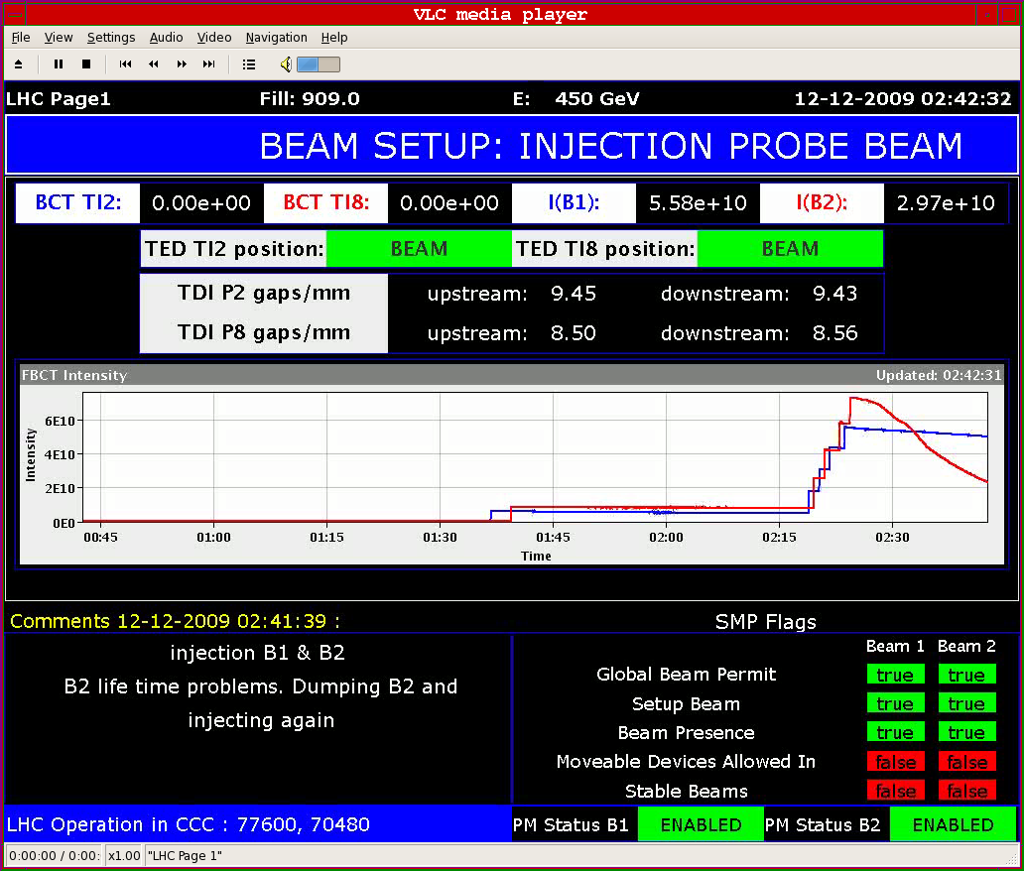
Beam life times night fill: old Q’ settings

Slide 17
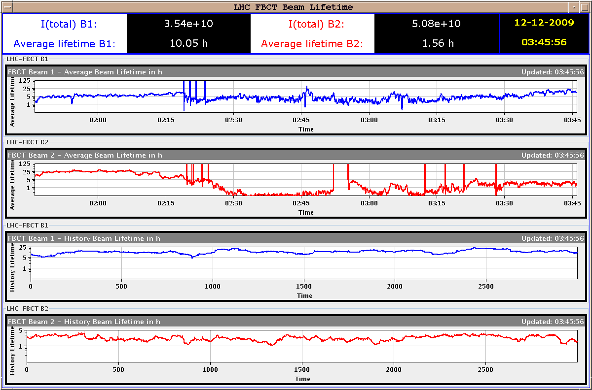
Beam life times night fill: stable beam life times

Slide 18
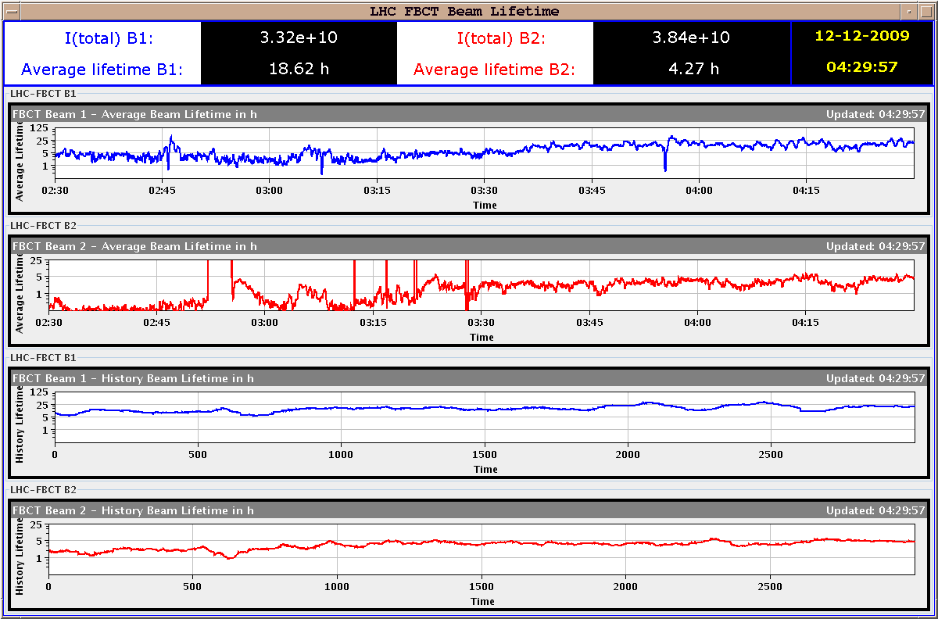
Beam life times night fill: end of night run

Slide 19
Friday evening fill after adjustments:

