Slide 1
11.12.2009
-9:00: Test IP transverse adjustment (CMS) and optics verification.
Done in parallel:
-First commissioning of Synchrotron light monitor (mirror adjustments)
➔ light for Beam2 now available!
➔ abort gap monitor
-Optics measurements – verification (good optics reproducibility)

Slide 2
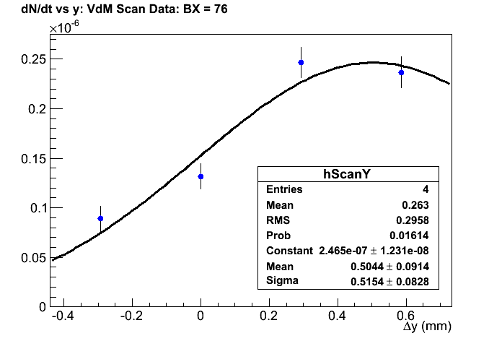
ScanY: CMS BX = 51
51

Slide 3
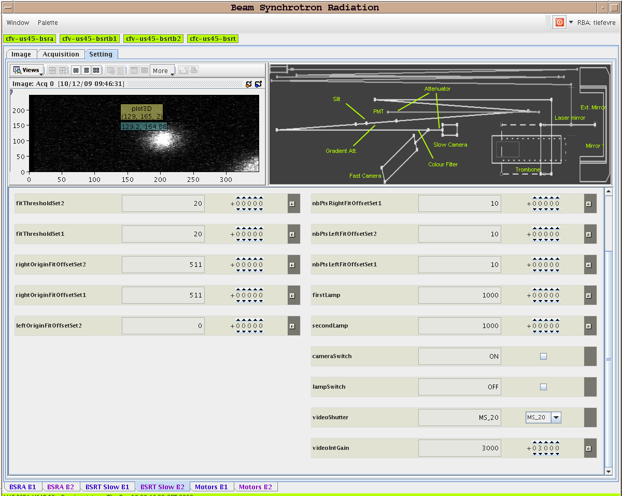
11.12.2009: Synchrotron Light Monitor
Beam 2:

Slide 4
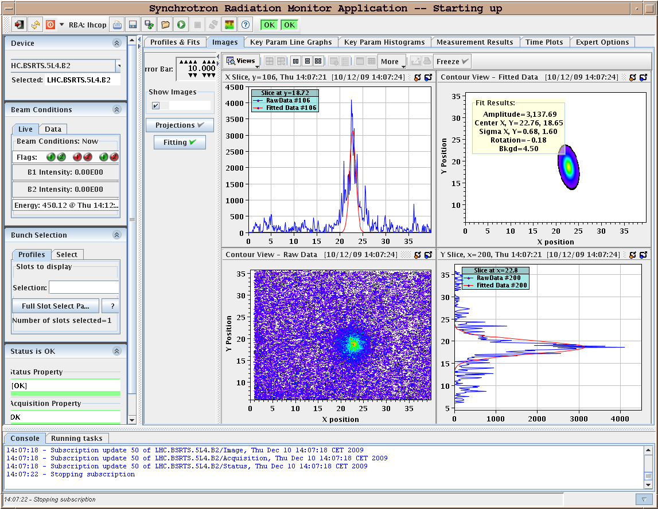
11.12.2009: Synchrotron Light Monitor
Beam 2:

Slide 5
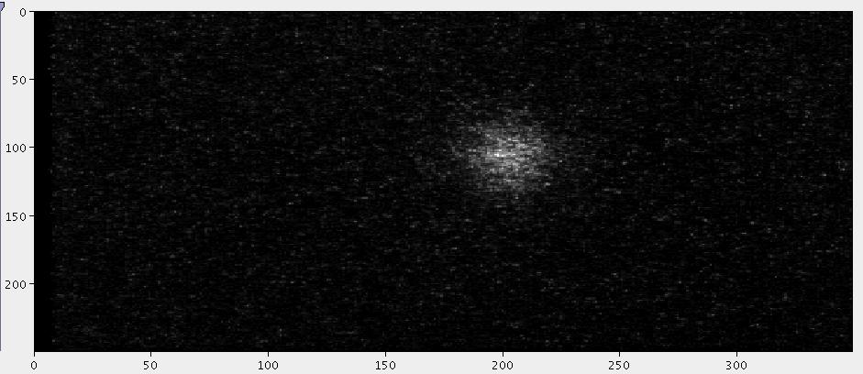
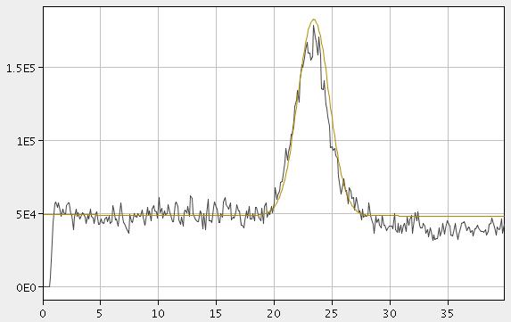
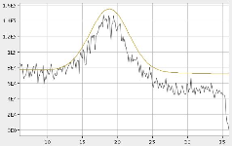
11.12.2009: Synchrotron Light Monitor
Beam 2:
Horizontal profile: Vertical pprofile:

Slide 6
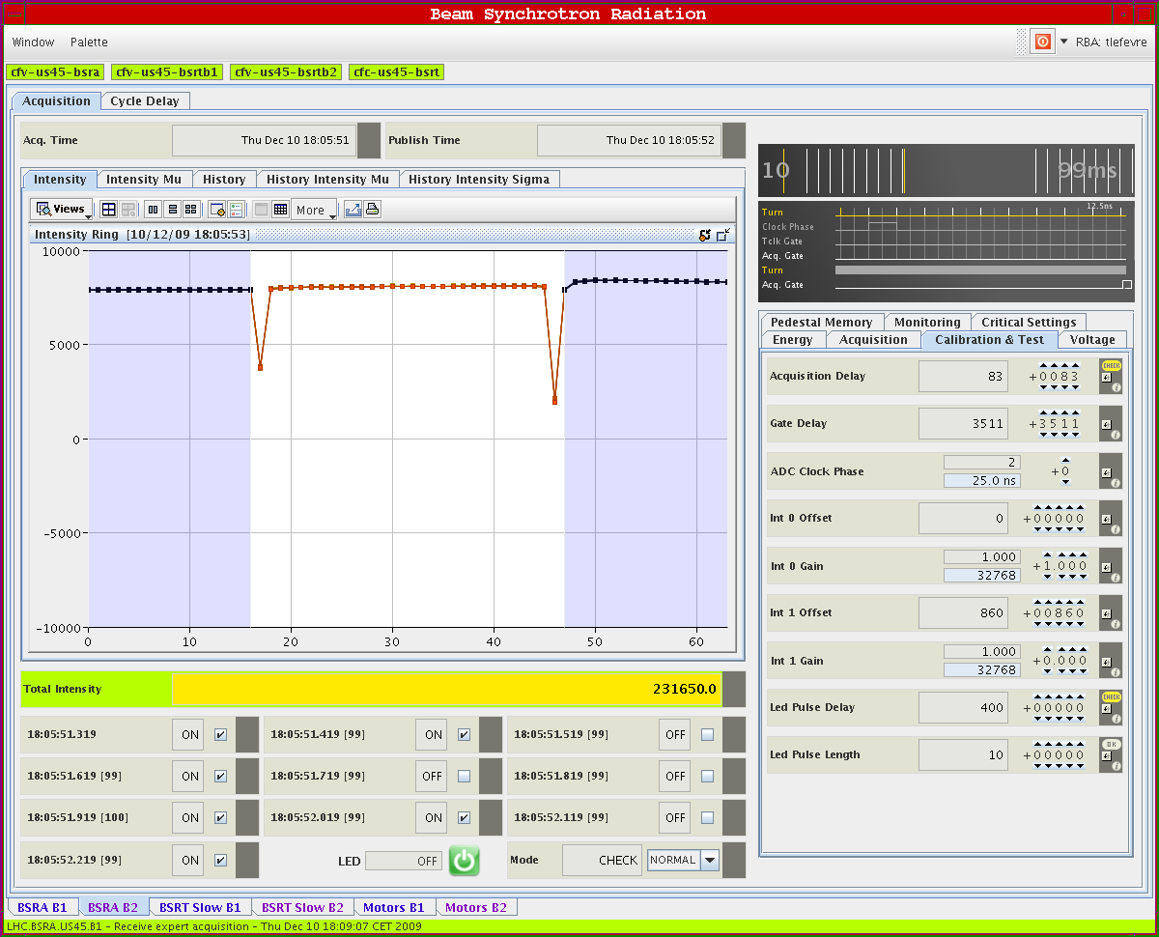
11.12.2009: Abort Gap Monitor
Beam2:
Bunch1 –
bucket 1
Bunch2 –
bucket 1201
separation
3microsec

Slide 7
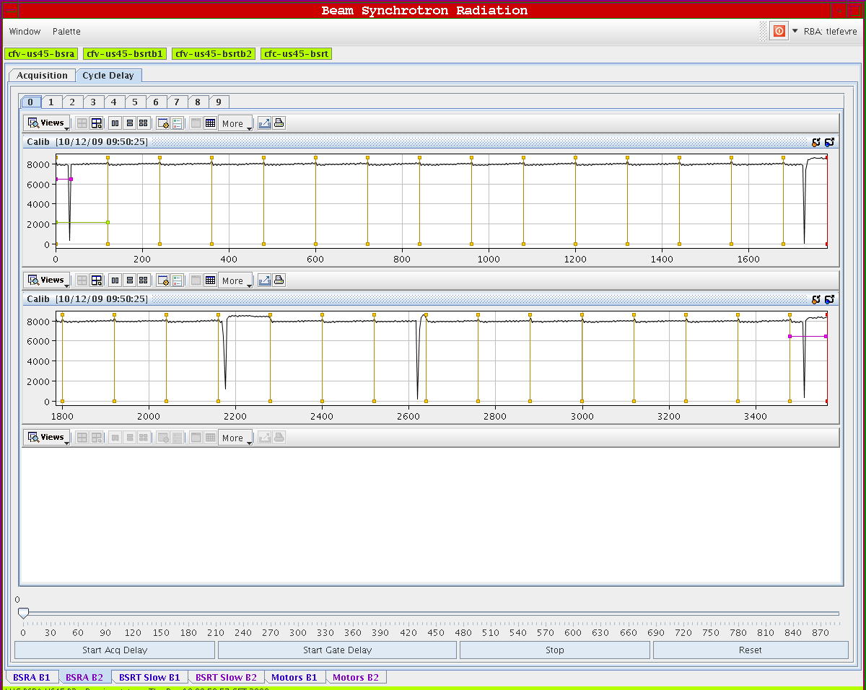
11.12.2009: Abort Gap Monitor
Beam2:

Slide 8
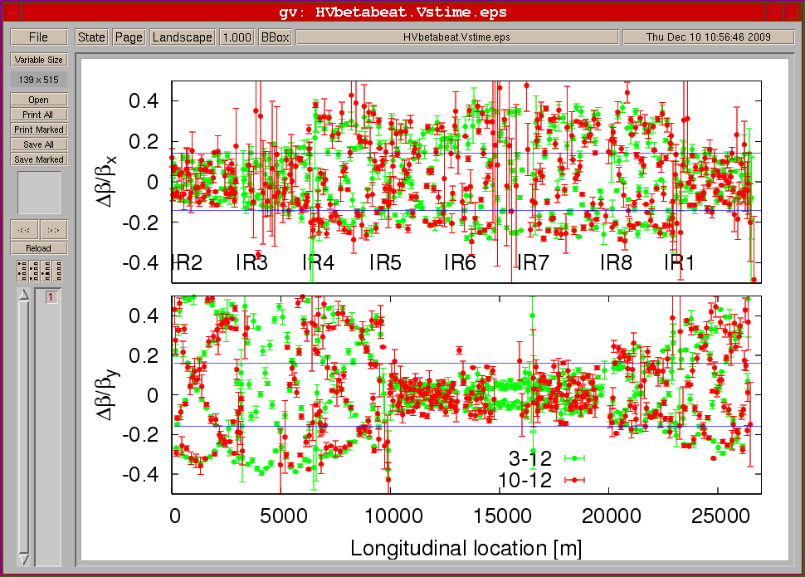
11.12.2009: Optics reproducibility 3.12 & 10.12
Top: Horizontal beta-beat Bottom: Vertical beta-beat

Slide 9
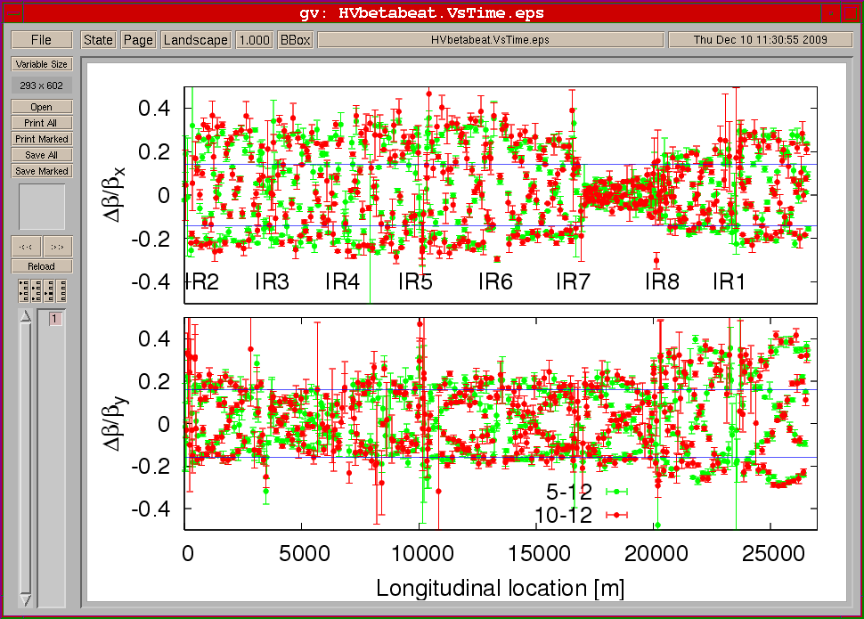
11.12.2009: Optics reproducibility 5.12 & 10.12
Top: Horizontal beta-beat Bottom: Vertical beta-beat

Slide 10
11.12.2009
-10:00: Continue beam setup for higher intensities until ca. 19:00
(TCSG/TCDQ; Transfer line collimators and TCDIs; ‘abort gap keeper’)
Done in parallel:
-Tune feedback commissioned for Beam1!
-Injection correction for Beam1.
-RF phase loop studies
-dump test with new filling scheme (‘abort gap keeper’ compatible)
-study on losses in MQXA IP8 ➔ linked to beam on TDI
-lifetime optimization Beam2 by swapping horizontal & vertical tunes
(few hours to over 25 hours)

Slide 11
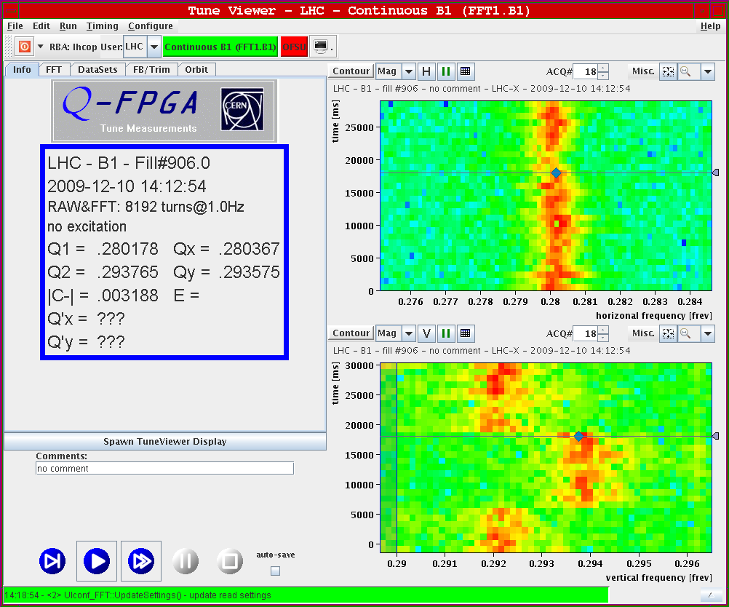
11.12.2009: Tune Feedback Beam1

Slide 12
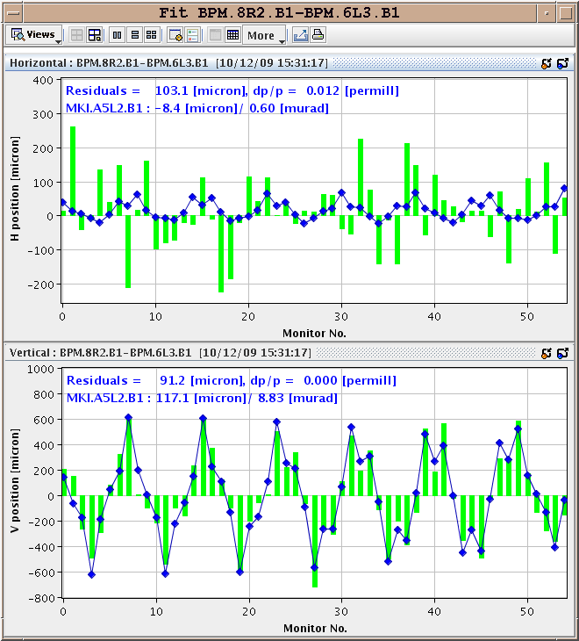
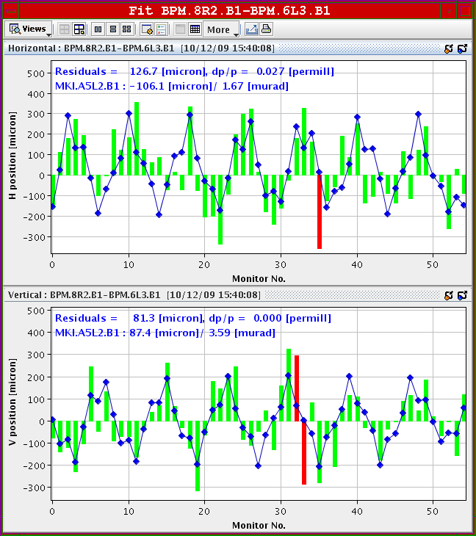
11.12.2009: Injection Oscillation Correction
Beam1:

Slide 13
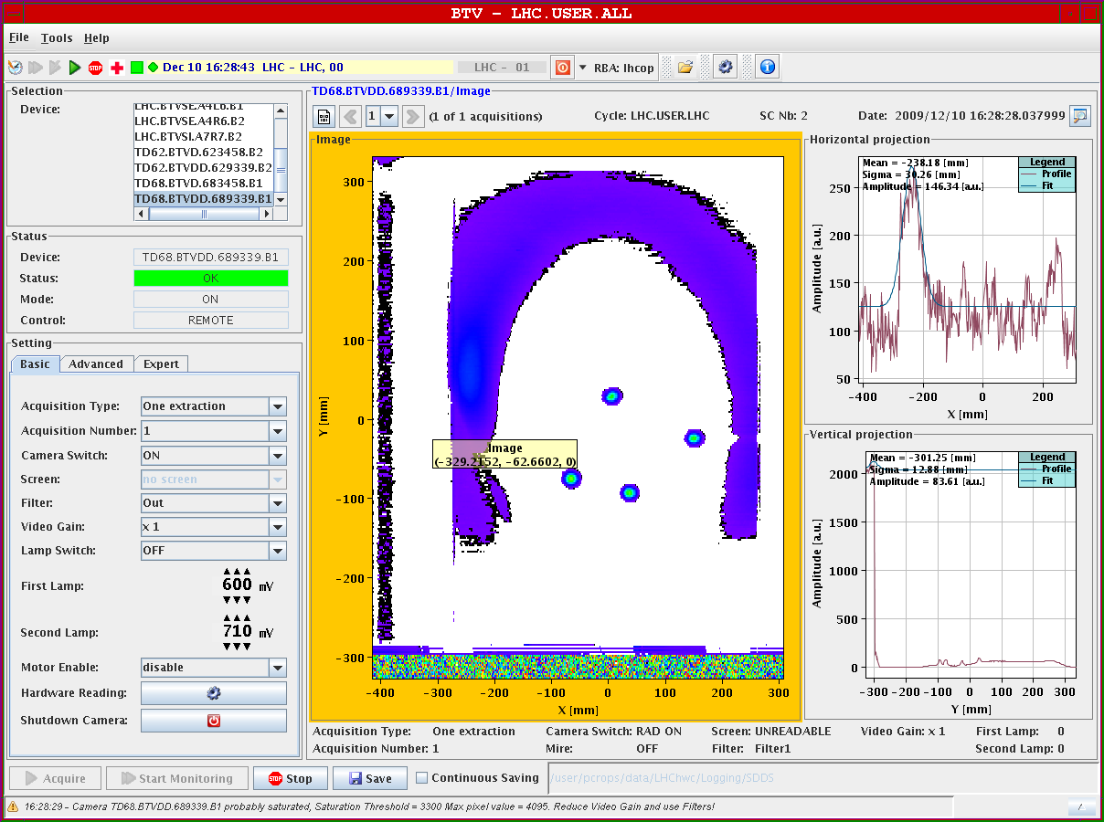
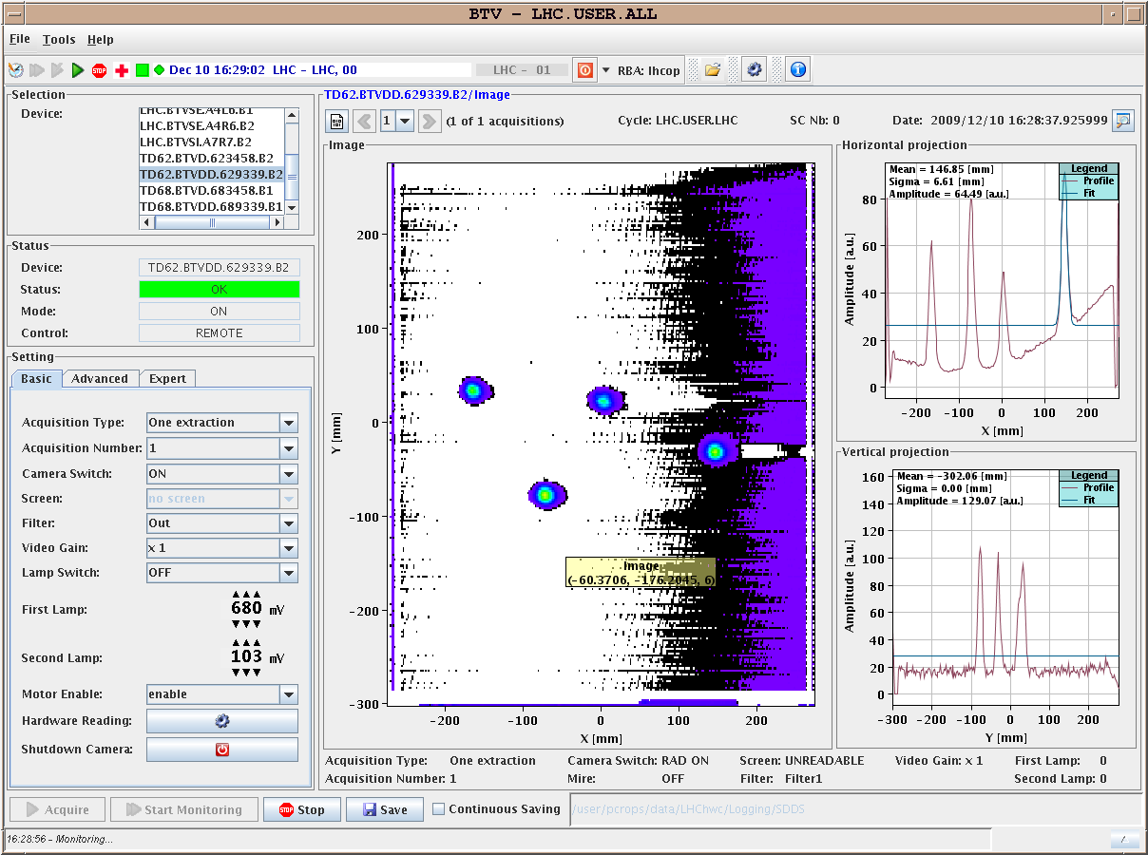
11.12.2009: Dump with new filling scheme
Beam1: Beam2:

Slide 14
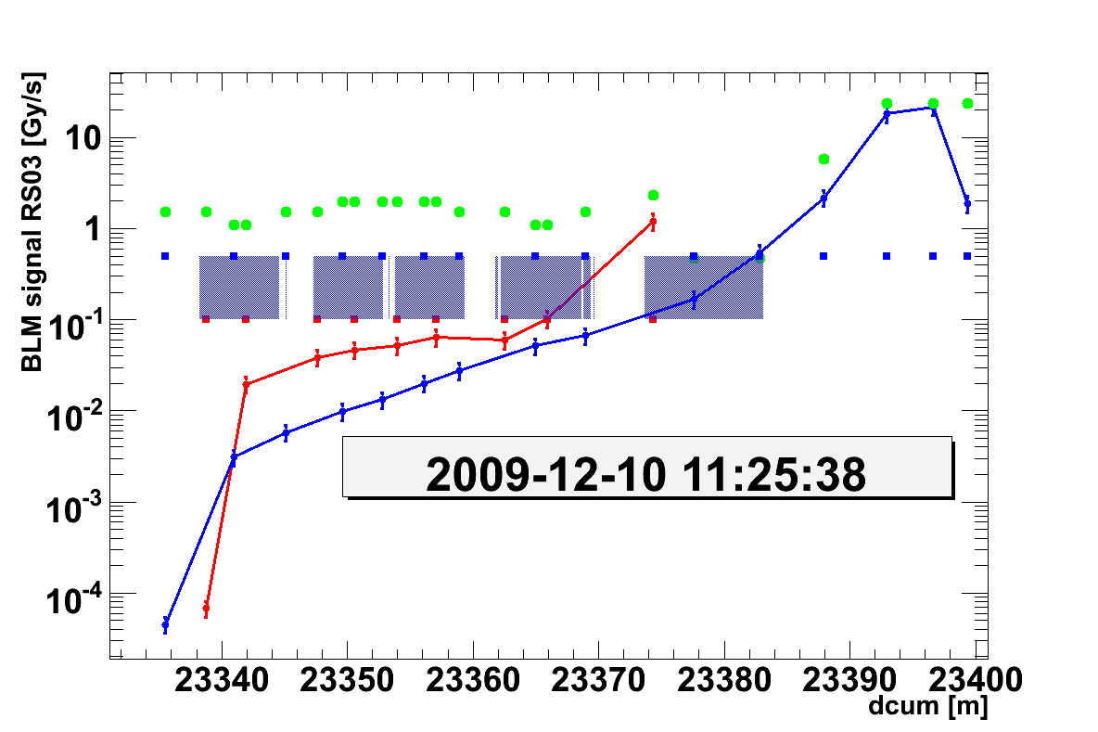
11.12.2009: Losses on MQXA in IP8
Over injection without injected beam

Slide 15
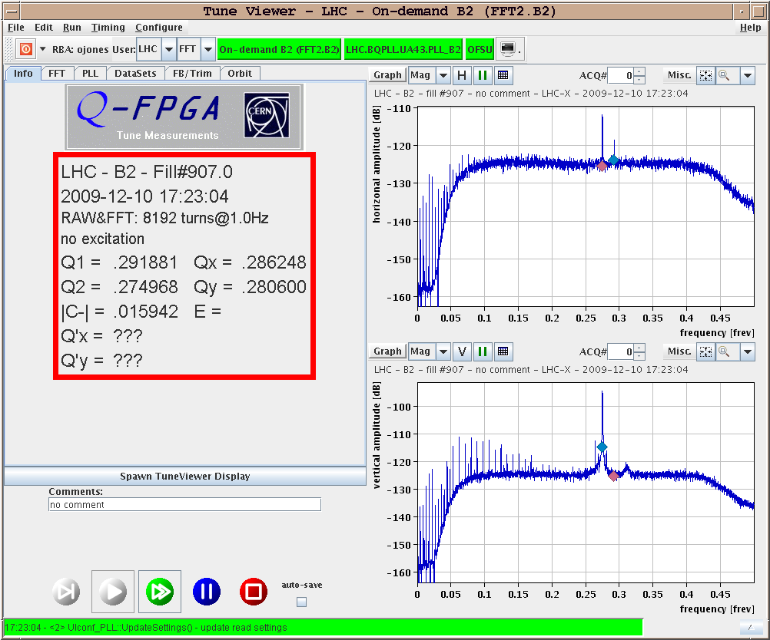
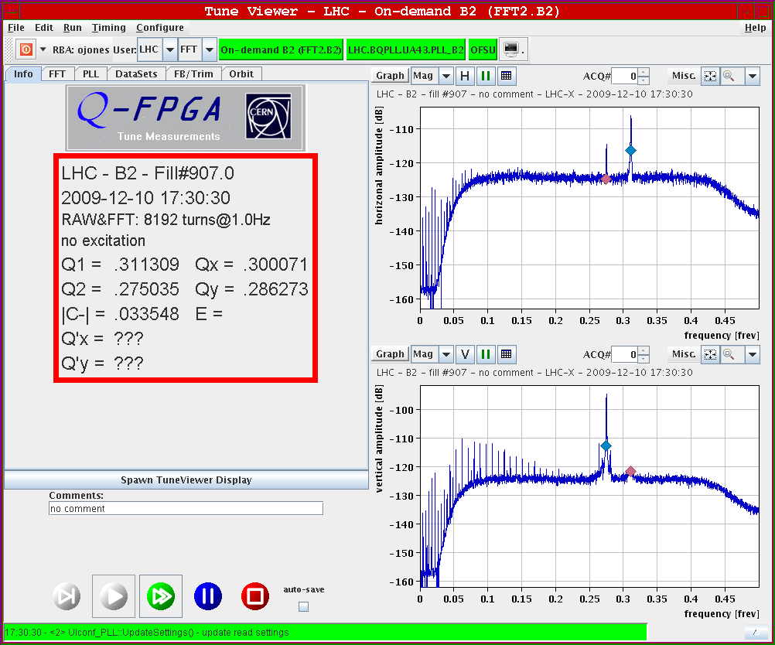
11.12.2009: Lifetime optimization
Swapping horizontal and vertical tunes in Beam2:
No lifetime drop if horizontal tune is on noise bump (consistent with 8 kHz)

Slide 16
11.12.2009
-19:45: Injection test with higher bunch intensity (single bunch).
SPS scrapers on! ➔ losses at end of transfer lines OK ✔
Dump and post mortem OK ✔
Change between high intensity - probe beam done via SPS scraper ✔
20:30: Collimator setup verification with higher intensities (2 10¹⁰ / bunch)
20:50: RF cavity loss for Beam1 (only 2 cavities running)
reset requires intervention by RF experts [up again at 21:50]
21:30: Problems injecting Beam2
21:40: RF low level loss for Beam2 in 2 cavities
22:00: RF OK again (problem related to crow bar fault)

Slide 17
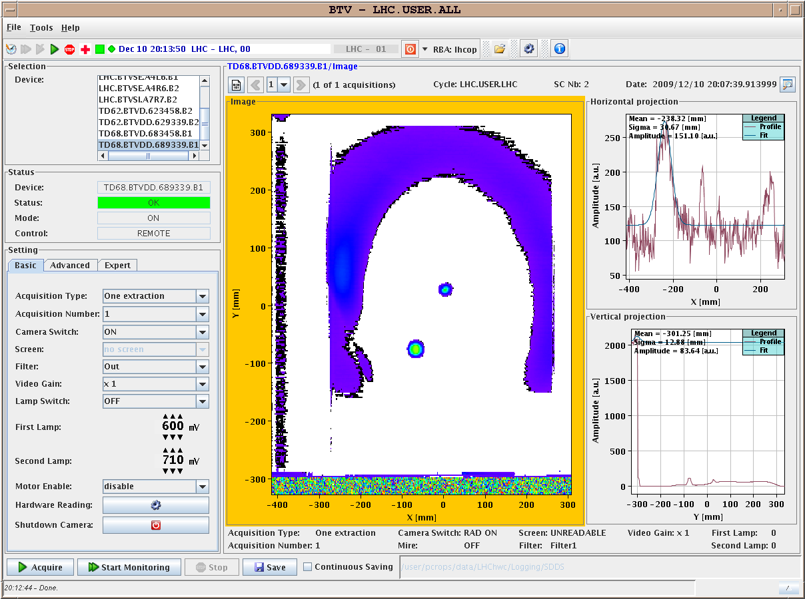
11.12.2009: Dump of high intensity Beam1
Probe beam plus high intensity

Slide 18
11.12.2009: Summary
22:30: Continuing collimator setup verification
-loss patter on 1/3 resonance
-asynchronous dump with un-bunched beam
-off momentum los studies
01:30: Stable beam collisions at 450 GeV with high bunch intensities:
➔ 4 x 2 10¹⁰ per beam (plus one probe bunch per beam)
problem of 4 bunch filling with ‘abort gap keeper’ solved with new
filling scheme: (1) – 1001 - 18821 – 22081 – 27731 Beam1
(1) – 1001 - 13141 – 18791 – 27731 Beam2
06:00: Beam lost due to a trip of the circuit RPMBA.UJ33.RQTL11.L3B2. This caused an emergency beam dump.
07:00: New fill after pre-cycle

Slide 19
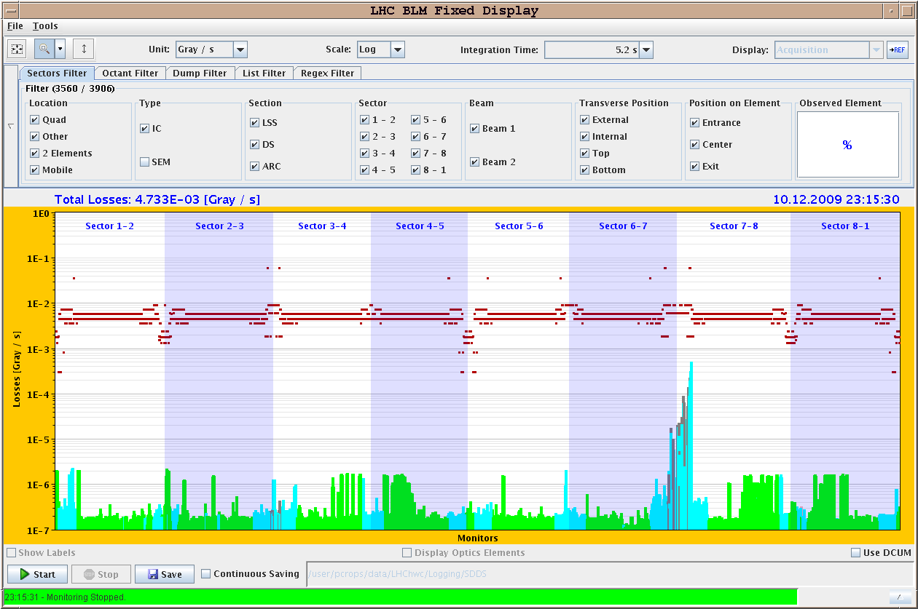
11.12.2009: Collimator Setting Beam2
Losses on 1/3 resonance

Slide 20
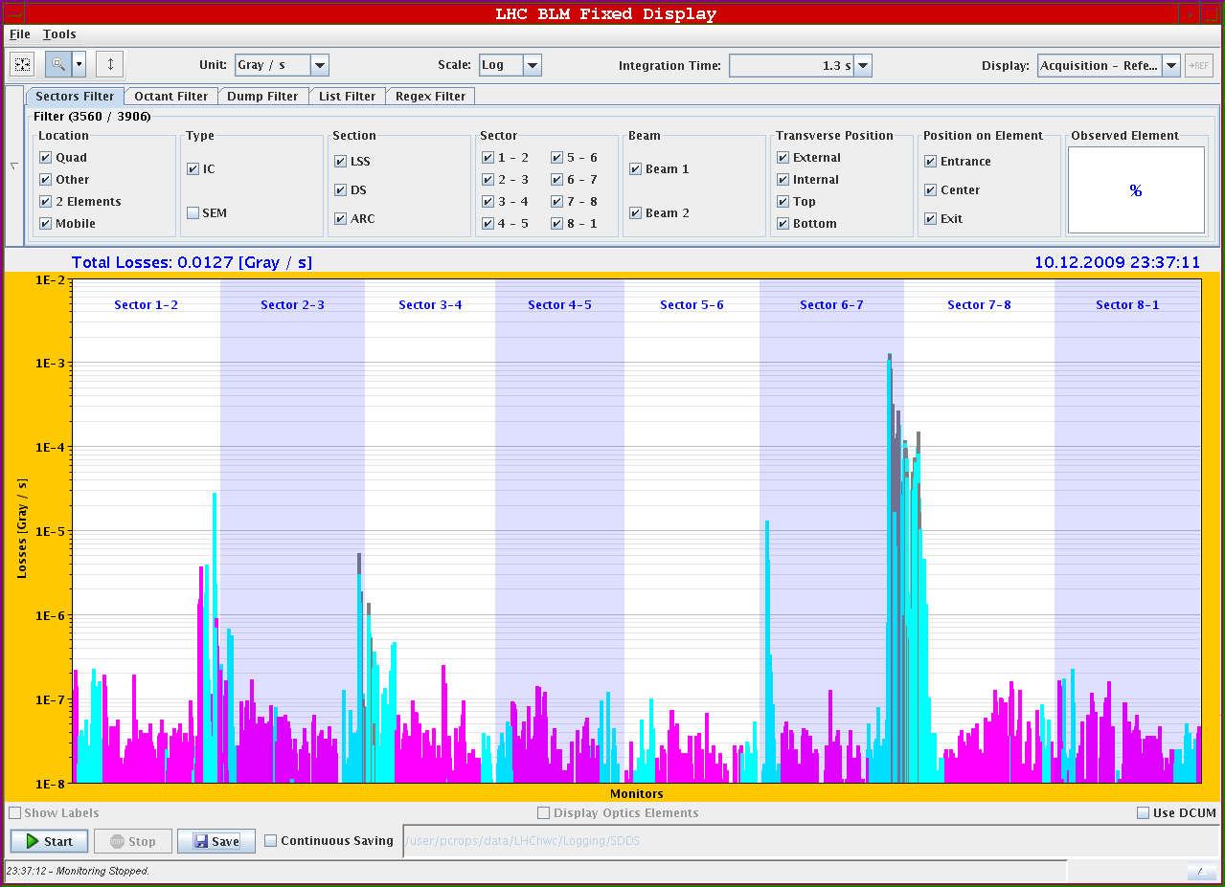
11.12.2009: Collimator Setting Beam1
Injection losses high intensity:

Slide 21
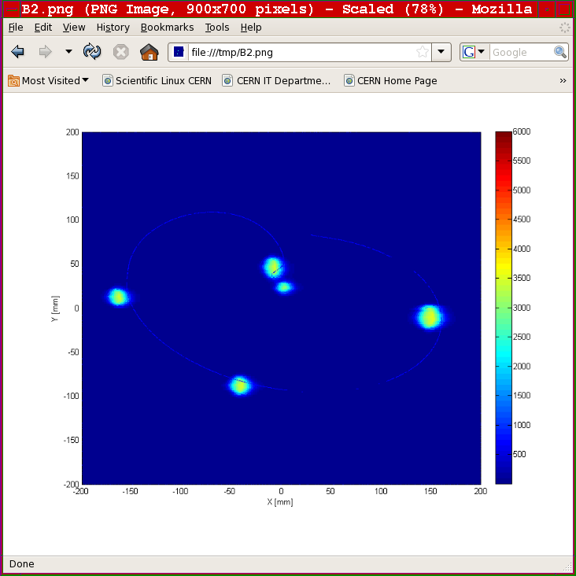
11.12.2009: Beam Dump
Beam2:
4 high intensity
bunches plus pilot:

Slide 22
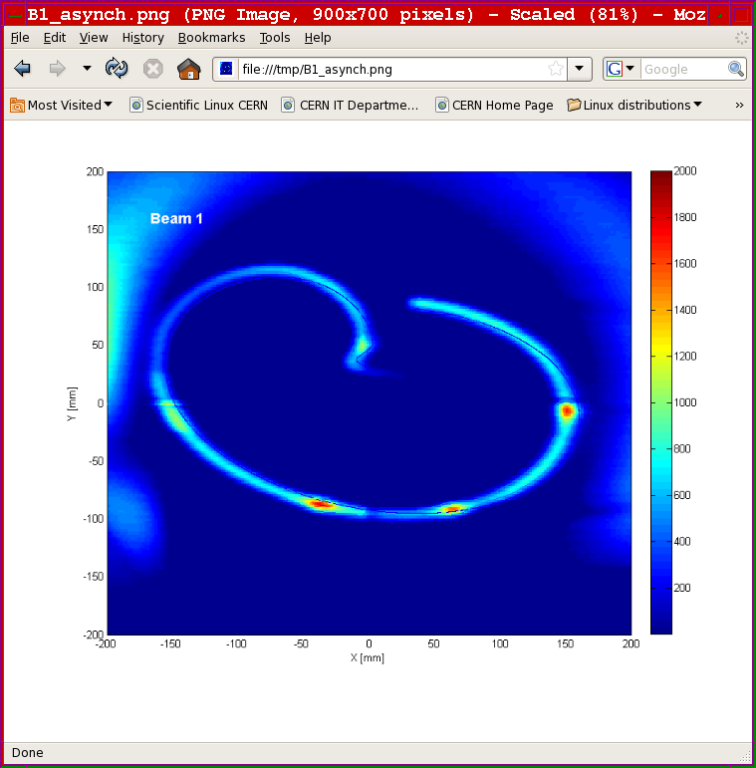
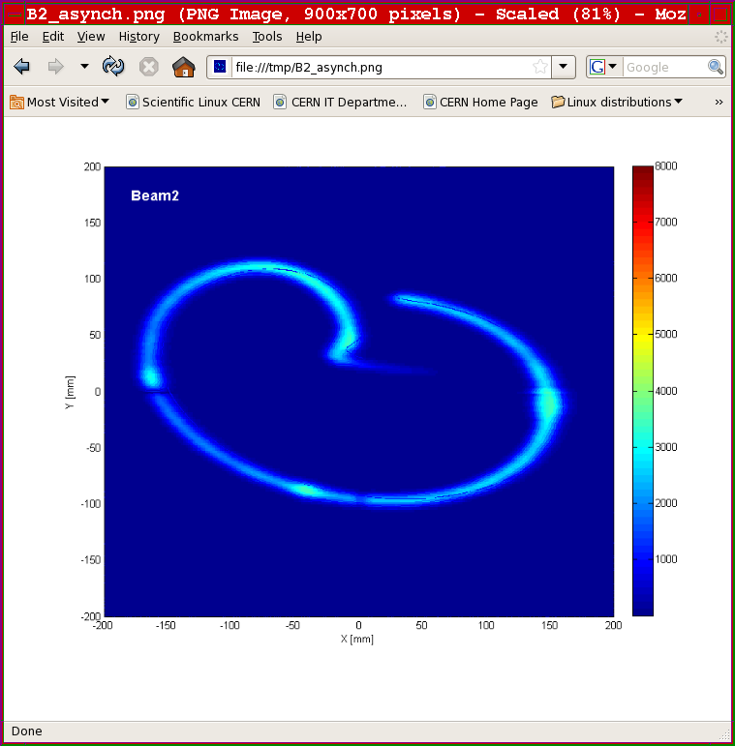
11.12.2009: Asynchronous Beam Dump
RF off – de-bunched beams - 4 high intensity bunches plus pilot
Beam1: Beam2:

Slide 23
12.12.2009: Stable Beams

Slide 24
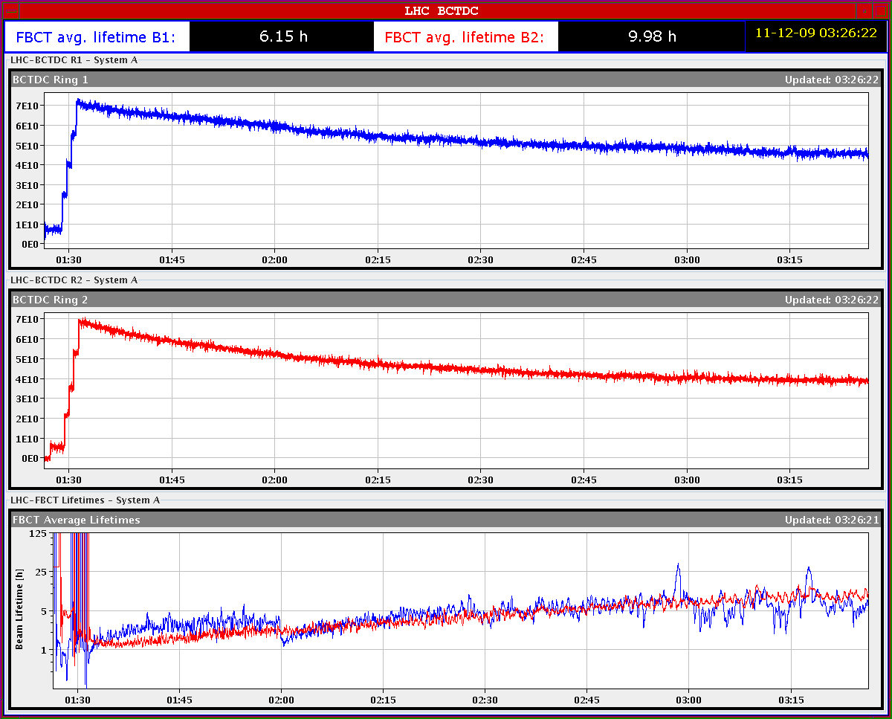
12.12.2009: Stable Beams

Slide 25
11.12.2009: Plan for the day
-test transverse IP adjustments in all IPs
-need one hour for RF adjustments
-continue high beam intensity stable beams at 450 GeV until ???
Other tasks on the agenda from the machine point of view:
-nQPS quench threshold test with beam (bunch intensity < 2 10⁹)
-Ramp test: Orbit correction at end of ramp!
MPS and beam dumping system at 1.1 TeV (end of ramp?)
Protection devices and collimation system setup at 1.1 TeV
Other miscellaneous work:
-finish circuit polarity checks
-finish kick response measurements
-orbit feedback commissioning

