Slide 1
Yesterday
Issue of injection kicker not pulsing:
Second pulse after a SoftStart is missed due to a voltage reduction issue inside kicker timing system. Voltage reference goes to 0V instead of 95% of the last pulse. Once this happens, primary cannot be recharged properly to the nomal volatge during th 1000ms before injection. First pulse is always correct.20:52
Checked B1 LBDS synch with buckets 1, 501 and 34500, after 1.5 us adjustment by Etienne. Synchronisation now OK for both dump systems.

Slide 2
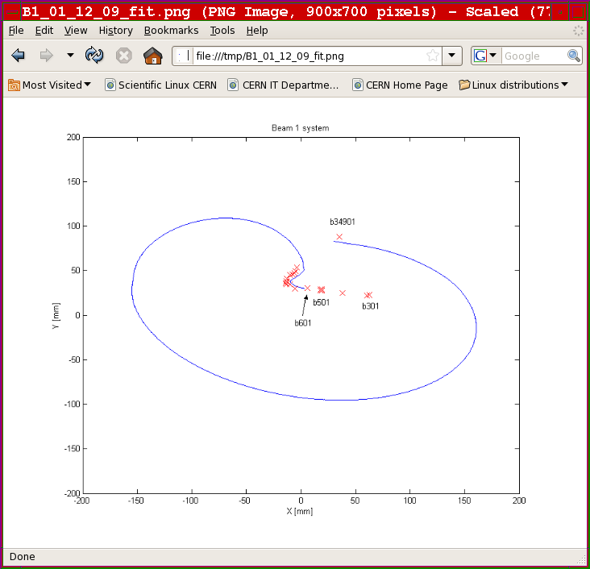
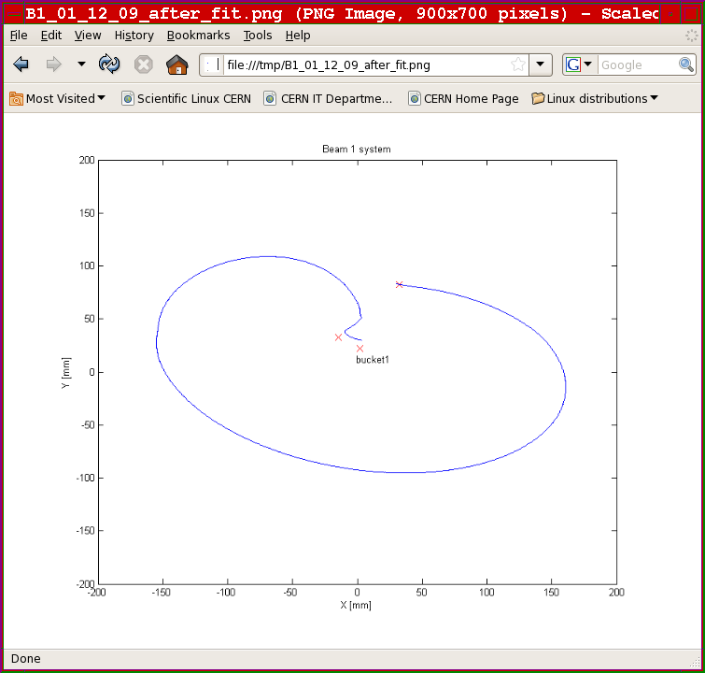
LBDS

Slide 3
RF work from 16:30 to 19:30
COGGING: move reference ring 2 by full two RF periods (5 ns). Check with CMS. Told that we were left with remaining 880ps. Move phase further by 120 degrees. CMS intersect error now 15 ps. May not stay that well centered for long....
CAPTURE: adjust gains of Phase PU chain to prepare for higher bunch intensity. So far it had been optimized for 5E9, now adjusted for 2E10 per bunch. This was first done with circulating beam in ring 1 and 2 (~ 3E9). Then we requested Circulate and Dump conditions to fine-tune capture. Finished in Ring1 by 19:30.
Waiting for handshake on Beam 2 till 20:05.
20:30 still no Beam back in ring2. Beam dump problem. We leave...
Philippe Baudrenghien

Slide 4
MPS Checks: threshold studies for BLM's at last IR7 TCLA (tungsten) collimators, IR7 primary collimators, and IR7 skew primary collimators.
Create known beam loss by scraping full beam with collimator jaw moving at 2mm/s. No very big dependence on angle.
Example for TCLAs we see a factor 2 for 600 murad angle change of collimator jaw.
01:10:36 18 kV fault at Pt 1- all FMCM triggered the BIS.

Slide 5
18 kV cut
01:23 18 kV Cell SEM12 – point 1
Short circuit - breaker
Auto-transfer not successful
SIG not available to Meyrin site
Diesels cut in OK
EL went manual on transfer
connected Meyrin to Prevessin via MP6
limited power 40 MW
LHC
Lost 6/8 sectors – external on PCs
Cryo OK
LINAC2, booster, PS dropped
SPS OK – flat lined

Slide 6
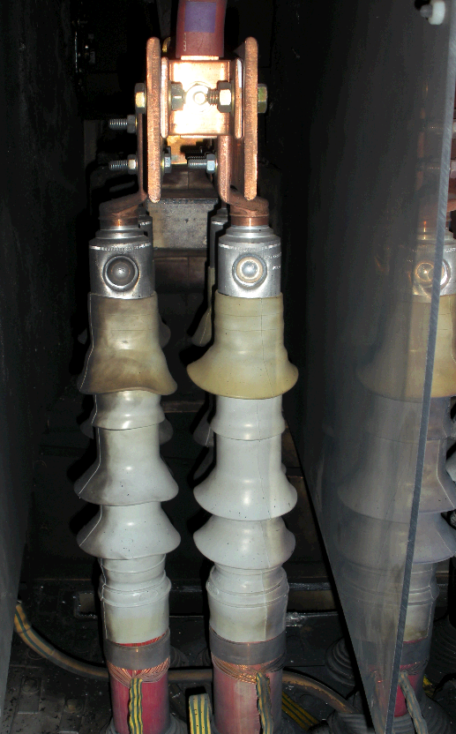
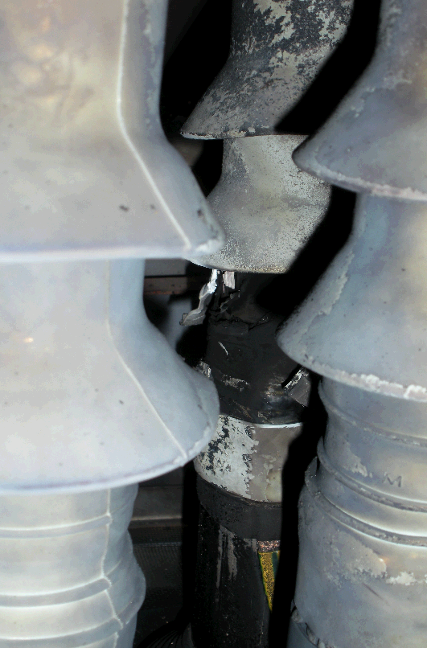

Slide 7
