Slide 1
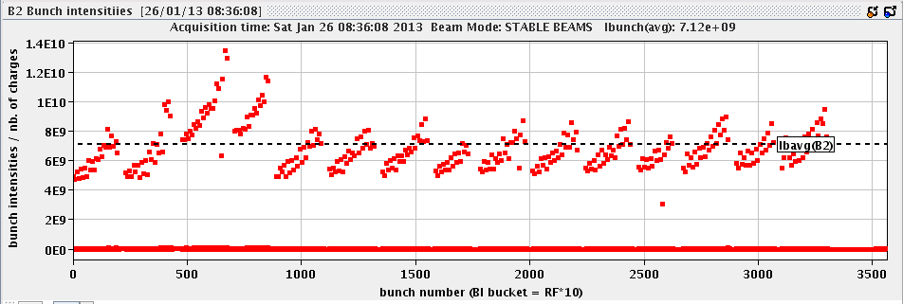
Friday 25th and night
04:30 Stable beams fill 3490 Initial lumi: 1e29 cm-2s-1
10:35 ALICE colliding head-on.
10:58 Beams dumped by BPMS. 1.4 nb-1 in 6h29m.
13:00 Injection steering and simultaneous tests of RF bbb blow-up to reduce transverse blow-up at injection
14:30 Start filling for physics... but PS POPS is down
17:30 Injecting again
19:49 Stable beams fill 3493, Initial lumi:1e29 cm-2s-1
01:06 Dump due to BPMS after 5h17m, about 1 nb-1
02:46 Injecting for physics
04:46 Stable beams fill 3494, still hanging in…

Slide 2
BPMS
Reasons of dumps
First 3 fills dumped due to noisy signal when ion intensity getting low (3 – 4 e9 charges) on BPMSA.B4R6.B2
On the BPMS increased interlock window from 500/100 to 2000/100
However, when signal becomes noisy, changing the interlock window not likely to be very effective
Dump at 22:42 of 24th January. This time it seems that the channel that triggered was a different one: the BPMSB.B4L6.B2-horizontal but with smaller bunch charges: 2.85e9p/bunch.
Dump at 10:58, 25th January, again BPMSB.B4L6.B2 – same as previous dump.
Conclusion: after increasing the interlock count, the beam has been dumped on a different BPMS, but not clear if this is by chance or due to the change.
Dump bunch intensity has gone down from 4e10 to about 3e10

Slide 3
RF batch-by-batch blow-up
At injection, to reduce increase of transverse emittance
1.4 ns target
Worked after some testing during injection steering
Observables
Initial lumi: does not seem to be match larger. Not really gained.
BSRT / BGI: needs further analysis, no absolute calibration

Slide 4
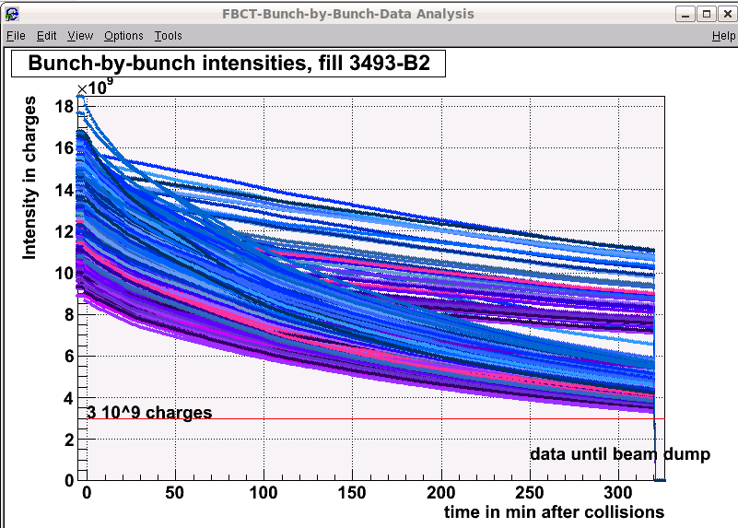
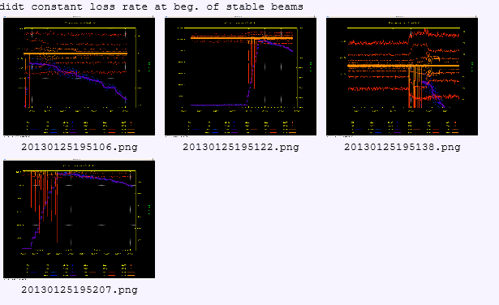
Fill 3493
RF bbb blow-up
IQC green for B1 after ‘pilot masking. B2 TL (?) latches.
Roman Pots moved in, both, with sequence
Many dI/dt plots by DB
Conclusion?
Dumped BPMS just above 3e9 intensity
?

Slide 5
Fill 3494
Some problems with the BPM calibration before injection, requiring a reboot of cfv-sr6-bpmint2
Losses MBB 9L7 and 11L7 during ramp and squeeze.
RF B2 increased to 14MV, as in previous fills, to improve lifetime
Lifetimes B2 in collision not very good
Improvement by tune trim

Slide 6
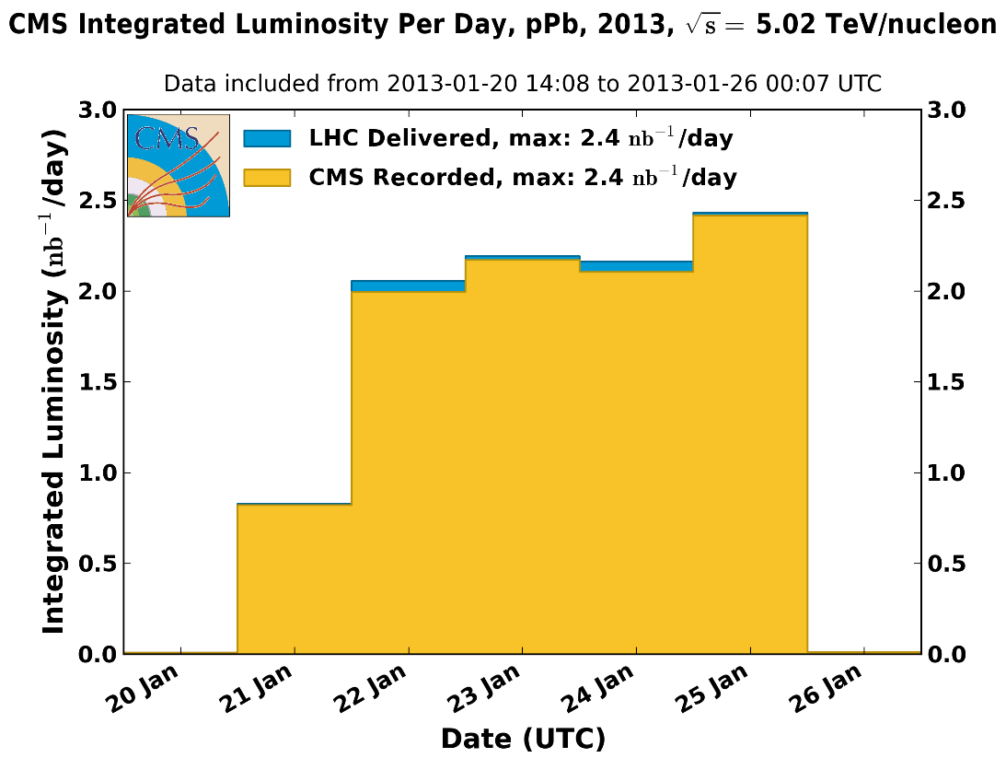
2 nb-1 per day
Will be a bit lower per fill from now on because of more burn-off by going head-on in ALICE

Slide 7
Various
Wire scanners not to be used until checked in tunnel
ALICE polarity change on Sunday
V/d Meer scans next week Mon/Tue
LHCb polarity change after V/d Meer scans

Slide 8
Access requests – getting long
Long list but none urgent
Priority to accumulate lumi before polarity change
Access requests:
Wire scanner, J.Emery, point 4, 2 hours.
Collimators UJ33, test position sensors, M. di Castro, A.Masi, 20 minutes.
“Train”, B.Feral, D. Paulic, PM56/UL55, 1 h during working hours
BGI, M.Sapinski, R4, ½ h
LHCf has a problem in a part of the frontend electronics placed in the tunnel, we would like to ask a two hours access at the next opportunity in the shadow of the other activity. Takashi Sako
Quench Test on Q6.L8 – the scope is not yet in place, 1h in the UA. Mateusz Bednarek
CMS cryogenics – filter to be cleaned
Ludovic Mourier 165232 Restore pump for QRL insulation vacuum in sector 45 (which has a leak)
LHCb – 3 hours

