Slide 1
Week 50 - Summary
Machine coordination:
Mike Lamont & Bernhard Holzer
Scrubbing/25 ns coordination:
G. Arduini, H. Bartosik, G. Iadarola, G. Rumolo

Slide 2
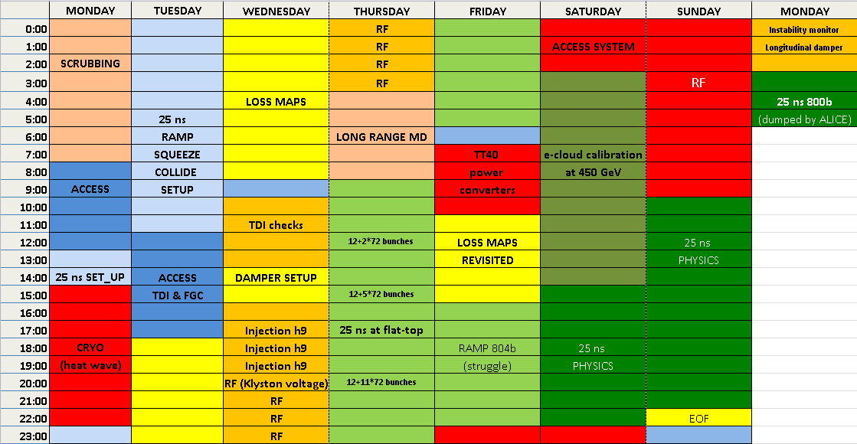
W50

Slide 3
W50
25 ns ramp, squeeze, collide to beta* = 1 m with relaxed collimator settings
including ADT and BBQ set-up
Loss maps
Loss maps revisited
25 ns tests:
Long-range MD
25 ns beam on flat top – up to 804 bunches
Scrubbing/e-cloud calibration at 450 GeV
25 ns physics (up to 400 bunches)
Unsuccessful 800 b attempt to finished
Operation development
Instability monitor; longitudinal damper;
pA MD cancelled
Giovanni

Slide 4
25 ns physics

Slide 5
25 ns physics
Low emittance PS option
BCMS (Batch Compression, Merging, and Splittings)
AKA h=9
Saturday 15:00:
12+2*48 bunches
Saturday 20:00:
12+4*48 bunches
Sunday 11:00
After a struggle with the RF clocks
12+4*96 bunches
Steve Hancock, Heiko Damerau, Simone Gilardoni et al

Slide 6
25 ns physics
Fill |  | Nb | Nc | Mean bunch current | Peak lumi | Peak <Pile-up> | Emittance
3441 | 12+2*48 | 108 | 97 | 1.03e11 | 1.7e32 | 11.38 | ~1.85
3442 | 12+4*48 | 208 | 187 | 1.04e11 | 3.44e32 | 12.02 | ~1.87
3445 | 12+4*96 | 396 | 372 | 1.02e11 | 5.83e32 6.15e32 | 10.17 10.2 | ~2.15 ~2.03
Octupoles down to 350 A at end ramp
Lifetime going into collision down to 3 hours – improved by tweaking down chromaticity/octupoles even further

Slide 7
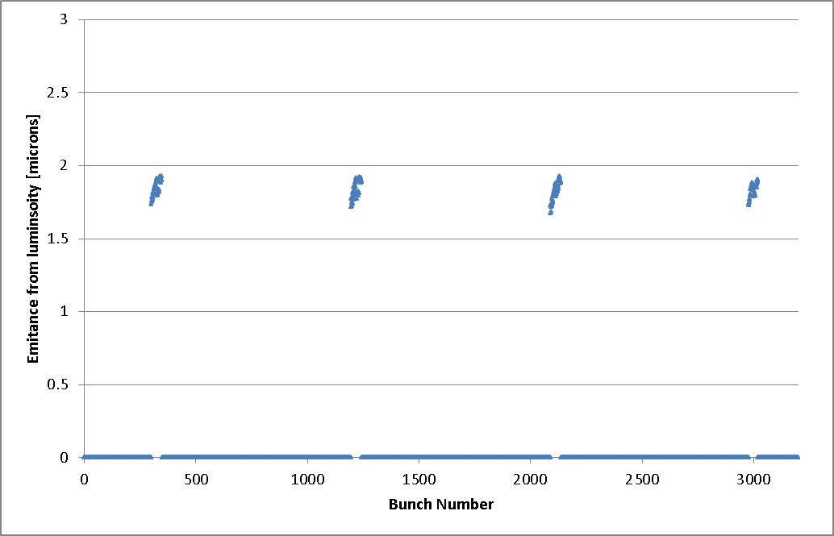
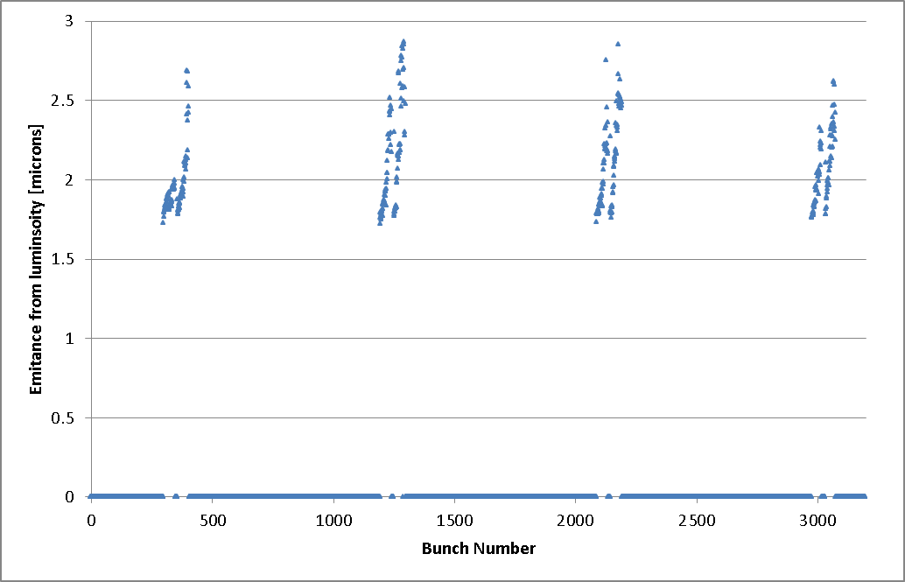
Bunch emittances: fill
Fill 3442:12+4*48
Fill 3453:12+4*96

Slide 8
ISSUES

Slide 9
Issues
Cryogenic heat wave
Understood – some aggressive 25 ns settings in place for low intensity beam
Injection of BCMS
Couple of 48b injections straight on to TDI
SPS RF reference on local for given SPS cycle
first12b on a different SPS cycle
Understood – mitigation measures in place.

Slide 10
RF issues Thursday - Friday
The first ramp was dumped by an arc in the circulator load of K6B1
The second ramp was dumped (after short while at 4 TeV) by an arc in circulator load K8B1.
These faults are linked to the increased RF power needed (160-180 kW) for 25 ns operation with nominal intensity (peaked as soon as the RF has 2 microsec batch, 25 ns spacing).
To reduce the problem on the third ramp, we reduced total voltage to 9 MV (was 10 MV), increased HV to 54 kV at start ramp (instead of 58 kV for first ramp), change QL to 50k (was 60 k). We also fine-adjusted the tuners to minimize power at 4 TeV.
Good result at 4 TeV. However the power during ramp is not smooth. That could improve after the adjustments done at 4 TeV. However the situation must be looked at by the RF power experts.
The longitudinal blow-up was not very good, but suffered probably from klystron saturation. we wait for next ramp to confirm.
Note1: The circulator loads and the klystrons are designed for operation at 300 kW CW max, but have been operated at much reduced level so far. Conditioning may be necessary.
Note2: Injecting spaced 72b batches should not change the picture. A bit more power might be necessary with 144b batch or longer. To be tested this year! An alternative solution would be to use the Cavity Phase Modulation algorithm, as done during last MD.
Themis and Philippe (at 5:40)

Slide 11
RF clock issue
Philippe Baudrenghien
The 4-buckets jump observed last night was traced to the SPS-LHC RF synchronization system (phase shifter).
To cure it a “reset” of the system was done around 6:30 this morning. This was followed by injection of pilots that showed that the SPS-LHC synchronization problem had indeed been cured. As the SPS went down we could not proceed to 12b injection till 08:38 and that resulted in the Transverse Damper driving the beam unstable.
Explanation: after the “reset” done at 6:30, all RF clocks should have been re-synchronized but I forgot and, as we had no 12b injection, I did not see the consequences.
Among these clocks is the 40 MHz bunch frequency that is thereby aligned on the bucket reference. That is essential for the ADT and Beam Control electronics. The resynchronization is normally done by the Sequencer in the task Resynchronize_RF_Beam_Control This task was not run until 10:30. That cured the problem.

Slide 12
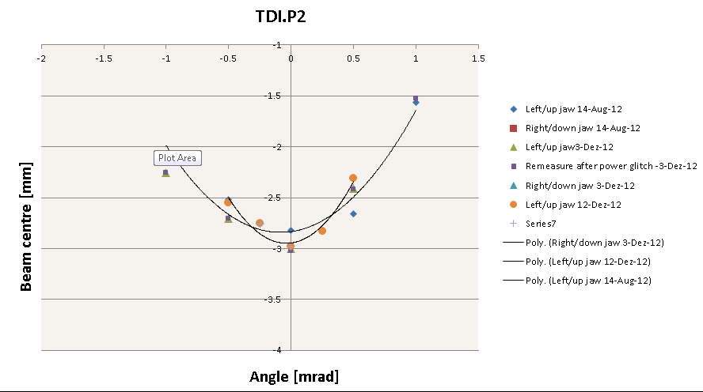
TDI realignment
Following the TDI.P2 upper jaw exceeding the inner position dump limit on 11/12/2012 and a drift of the LVDT reading over the last few days we rechecked the alignment with beam.
Settings changed by 120 um for upstream corner and 240 um for the downstream corner.
trimmed in the new settings and set the position interlock thresholds of +/- 200 um around the new values
... validation
Chiara Bracco
Wolfgang Bartmann
Jan Uythoven

Slide 13
MISC

Slide 14
Summary of multiband instability monitor tests:
The aim of this tests was to assess whether low-power excitation at 0.4, 0.8, 1.2 and 1.6 GHz create intra-bunch beam modes with sufficient amplitudes. The excitation (few Watts) were applied using the BQK strip-lines and the corresponding growth and damping signal measured using the multi-band instability monitor.
The requested bunch intensities were about 1.7-1.8e11 ppb in order to be close to the single bunch instability threshold. The measured bunch length was about 1.5 ns. The octupoles strength were changed between -0.5 and 0 to see a change in growth/damping time that are indicative of the stability margin.
Preliminary results seem to confirm that the dominant excitation is inside the bunch (i.e. intra-bunch motion being stronger than the coherent bunch oscillation). Further, some of the excited instability pattern seem to be similar to the beam driven instabilities seen during earlier physics fills. The used power levels were about sufficient to excite modes in the 400 and 800 MHz band at 450 GeV but would need to be scaled for higher order modes and particularly for the targeted use at flat-top energies.
Marek and Ralph

Slide 15
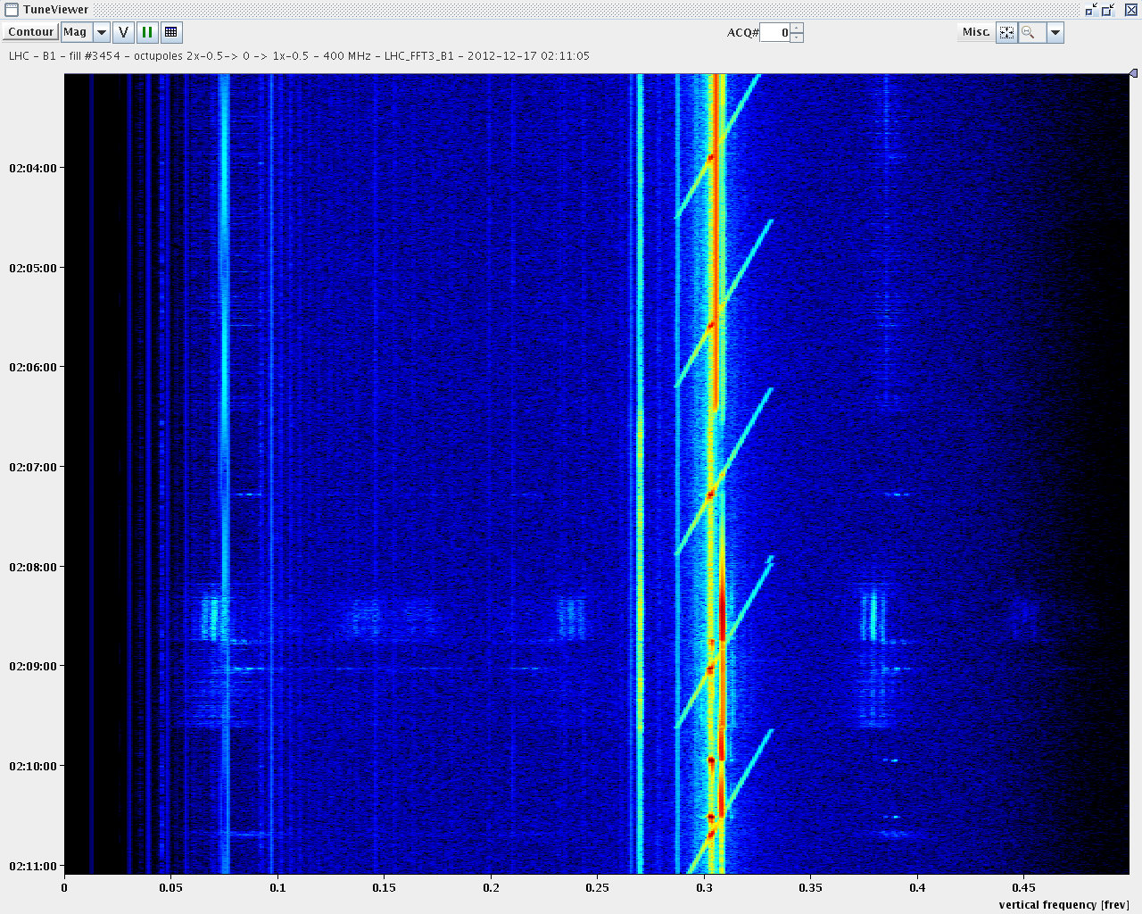
400 MHz (contour plot, top to bottom): diagonal line showing the beam-tranfer-function accross the vertical tune line, first two scans with nominal octupoles, than two scans with reduced octupoles and again nominal. The increased intra-bunch activity with the reduced octupole settings (lack of landau damping) is visible.

Slide 16
Longitudinal damper
First hour spent to align the kick with the beam in cavity1B2 first, then 2B2.
Then injected a series of 6b batches and observed transients (see plot).
Although the kicks were acting on the bunches (visible from scope), we did not measure difference in damping when inverting the gain. No time to investigate further. The reason may be insufficient kick strength as we used one cavity only. The observed damping rate must be explained. Is it just filamentation? Looks a bit fast.
Daniel, John, Themis, Phil

Slide 17
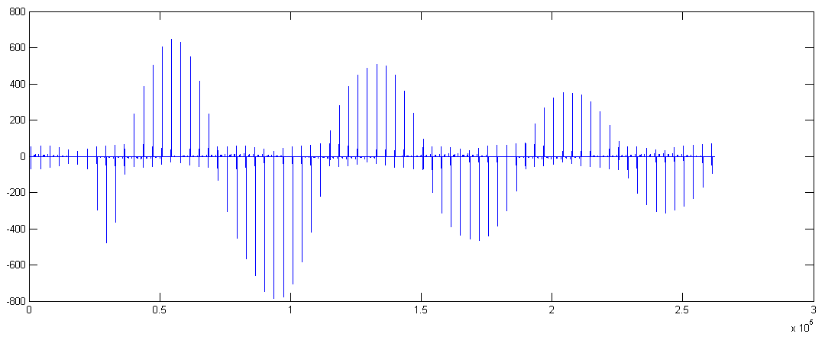
Longitudinal damper

Slide 18
