Slide 1
LHC Status Friday Morning 14-Dec
Bernhard Holzer, Mike Lamont
Planning:
 | WEDNESDAY | THURSDAY | FRIDAY | SATURDAY | SUNDAY | MONDAY
0:00 |  | RF
1:00 |  | RF |  |  |  | pA tests
2:00 |  | RF
3:00 |  | RF
4:00 | LOSS MAPS |  |  | 25 ns
5:00 |  | LONG RANGE MD |  | PHYSICS
6:00
7:00
8:00
9:00 |  |  | CYCLE
10:00
11:00 | TDI checks
12:00 |  |  | e-cloud
13:00 |  |  | 450 GeV
14:00 | DAMPER SETUP | 25 ns at flat-top | calibration
15:00
16:00
17:00 | Injection
18:00 | Injection |  | e-cloud | 25 ns | RAMP DOWN
19:00 | Injection |  | 450 GeV | PHYSICS | ACCESS
20:00 | RF |  | calibration |  | CYCLING
21:00 | RF |  |  |  | pA tests
22:00 | RF
23:00 | RF

Slide 2
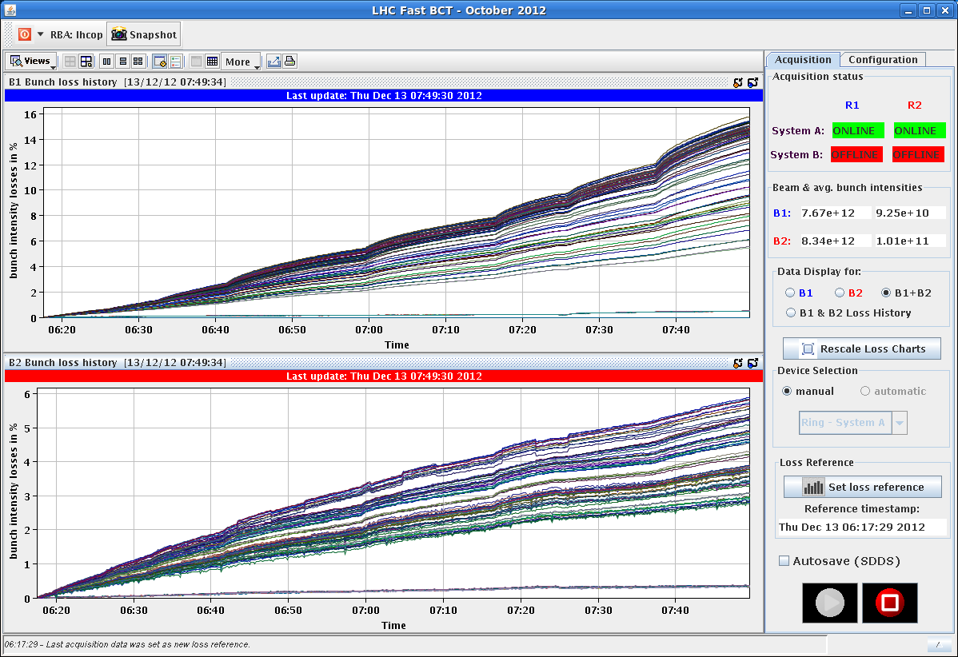
LHC Status
Thursday Morning:
... 8:30h long range beam beam in 25ns
varying crossing angle 145 μrad ... 72μrad
09:30h injection 12 bunches,
again: loss maps at flat top (strange peak observed in IR7)
10:50h beam dump, Orbit excursion interlock (BPMs in IR6)
11:50h injection for 25ns ramp & e-cloud observation
12 + 2*72 bunches
losses before ramp
losses after ramp

Slide 3
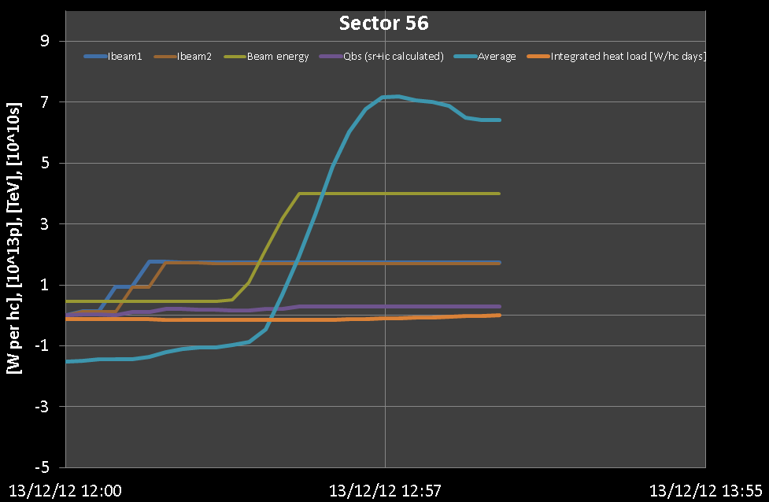
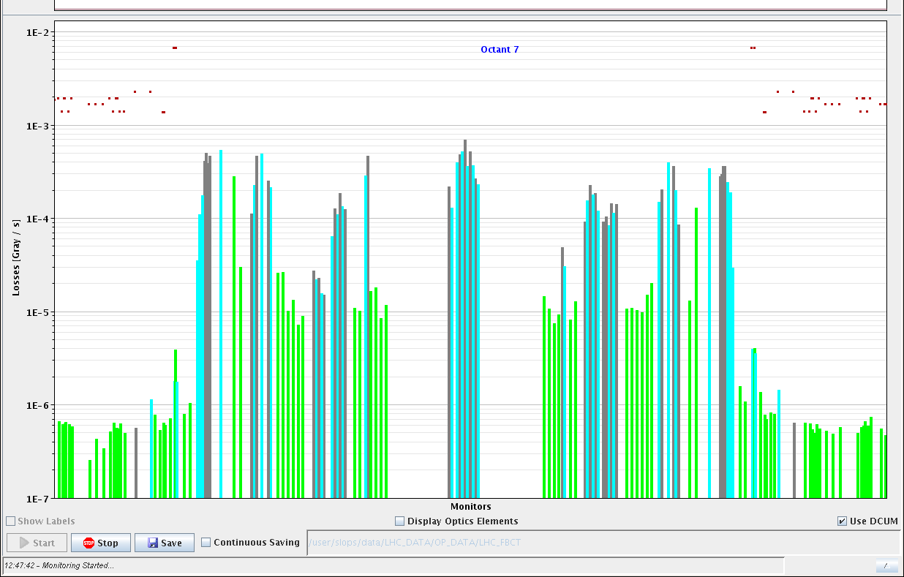
LHC Status
Thursday Morning:
12:40h 12 + 2*72 bunches: observation of vacuum
& heat load
Details: Gianluigi
13:14h go on towards squeeze
-> again problems with collimator hierarchy
-> go on towards adjust:
13:40h beam dump, PC Interlock, Supervision was not sent

Slide 4
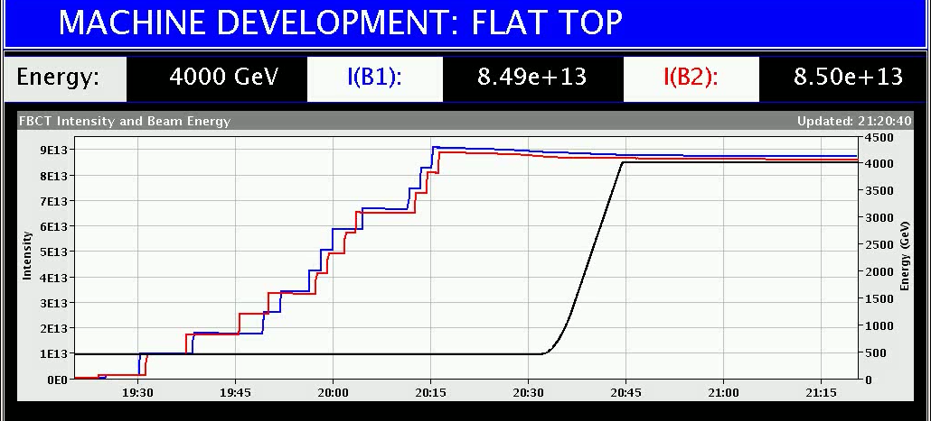
LHC Status
Thursday Late:
15:00h new injection, 12 + 5*72 bunches
15:20h ramp & stay at flat top
measure heat load & vac & losses etc etc
17:50 beam dump
19:50 injection: 12 + 4*72
waiting for cryo
injection: 12 + 8*72
waiting for cryo
injection: 12 + 11*72
20:31 ramp

Slide 5
LHC Status
Thursday Night:
... until 6:00h keep the 804 bunches at flat top for e-cloud conditoning
804 x 804
372 x 372
156 x 156

