Slide 1
Monday morning
11:00 Dump fill #3363. 167 pb-1.
Preparing for ATLAS access (with special procedure for TI2 TED).
LHCb polarity change.
During ramp down the upper jaw of TDI in Pt2 fell across the beam onto the lower jaw (on one side). A ‘goupille’ fell off and liberate the jaw from its support, probably following a large number of movement cycles.
Intervention by A. Masi, first remote, then locally in the tunnel.
The jaw positions are lost → alignment with beam required.

Slide 2
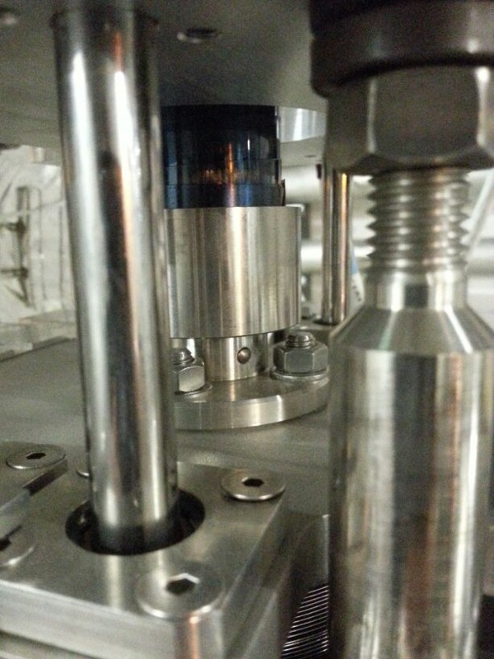
Goupille

Slide 3
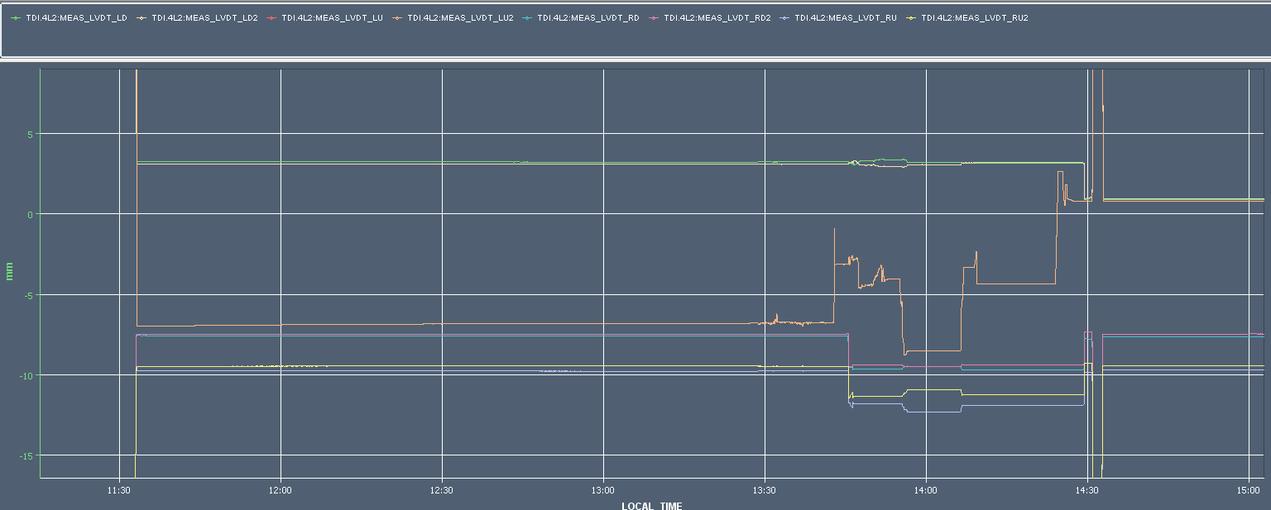
TDI
Normal injection position left up jaw
When moving to injection position, the upper jaw ‘fell through the beam’
Right up higher than normal
Beam centre
Alessandro Masi pulling out the upper jaw, bouncing around on the lower jaw
Normal injection position left down

Slide 4
Monday afternoon
Threshold change for BLMs in IR3 for 200 kW losses.
19:00 Start TDI alignment.
21:55 Electrical disturbance on 400 kV line.
5 sectors + ALICE + LHCb + RF off.
22:30 Pre-cycling.
00:00 Resuming TDI alignment.
01:30 TDI finished. All measurement points within 0.25 mm of the values recorded in August after ALICE polarity reversal.

Slide 5
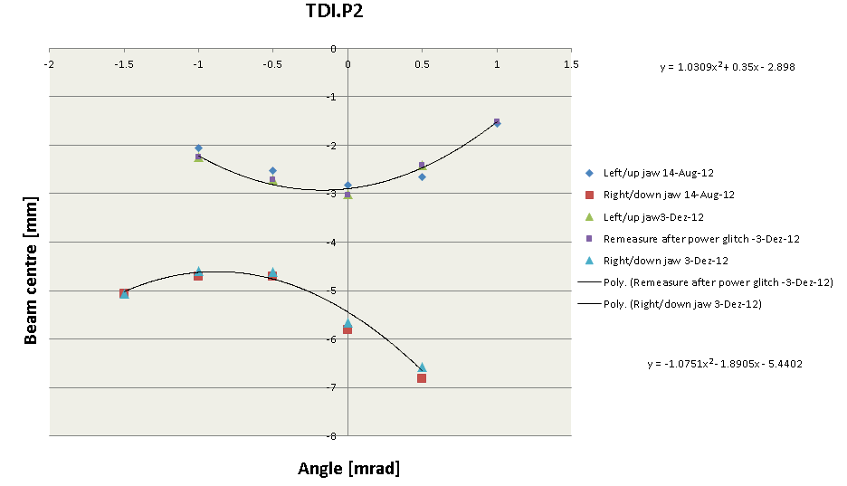
TDI alignment

Slide 6
Morning
Some steering…
04:00 Filling for physics.
05:30 Stable beam fill #3370, L ~ 6.9e33 cm-2s-1.
One ADT module offline (H1B2).
Today : H9 test late afternoon, then physics again.

