Slide 1
Summary of Week 46
Coordination:
Gianluigi Arduini & Jan Uythoven

Slide 2
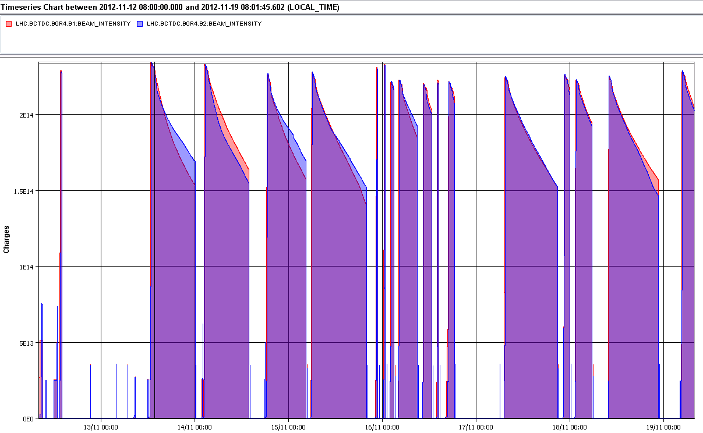
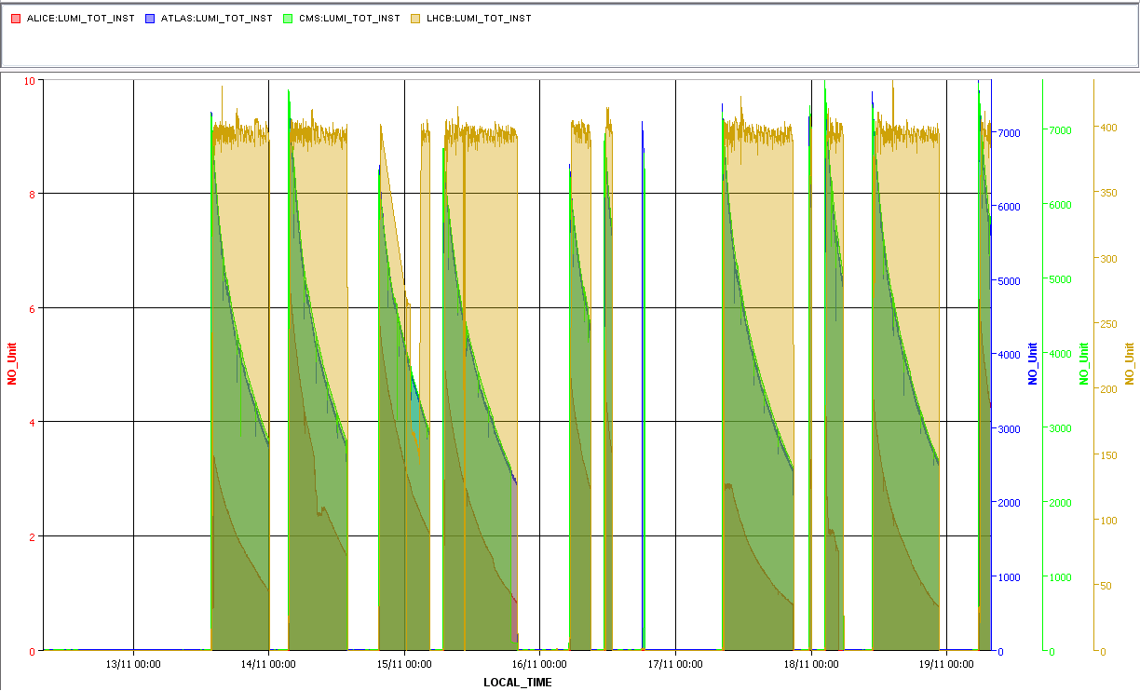
The Week – Currents and Lumi
2e14
ADT CRYO TOTEM EPC ALICE RF
7000e30 / 400 / 9
LHCb @ 400
ATLAS & CMS
ALICE @ 4 - 6

Slide 3
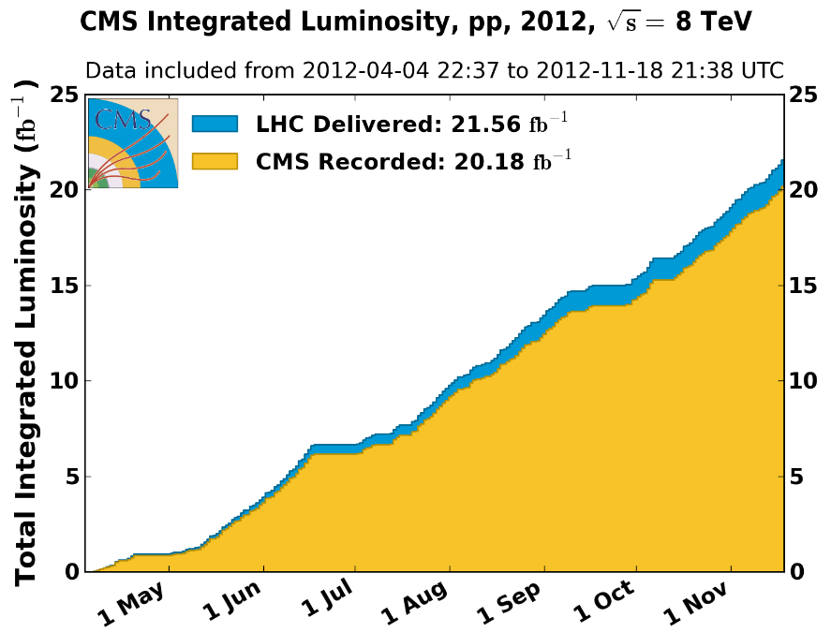
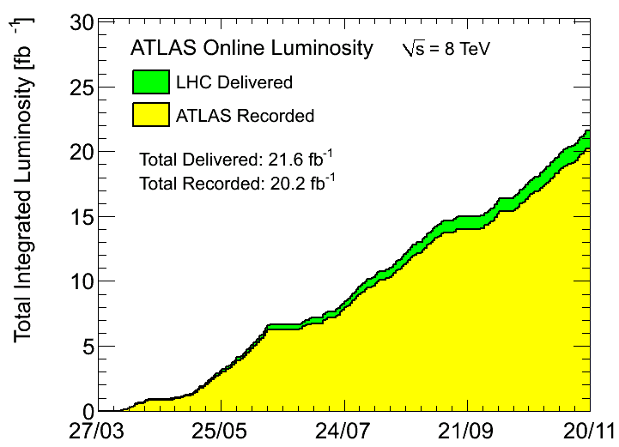
Total lumi’s

Slide 4
Fills & OP dumps !
Fill | Day | Peak L [cm-2s-1] | Stable beam [h:m] | Int L [pb-1] | Dump
3285 | 13/11/2012 | 7.10E+33 | 10:10 | 153 | OP dump
3286 | 14/11/2012 | 7.50E+33 | 10:20 | 162 | OP / TOTEM
3287 | 14/11/2012 | 6.40E+33 | 09:01 | 137 | OP dump
3288 | 15/11/2012 | 6.70E+33 | 13:04 | 176 | OP dump after TOTEM RP
3292 | 16/11/2012 | 6.50E+33 | 03:40 | 68 | SIS interlock on TCDQ
3293 | 16/11/2012 | 6.90E+33 | 01:17 | 28 | QPS trigger RQT13.L5B2
3296 | 17/11/2012 | 7.20E+33 | 12:26 | 179 | OP dump
3297 | 17/11/2012 | 7.30E+33 | 00:23 | 10 | Instability, BPMS LSS6 after increased tune split
3298 | 18/11/2012 | 7.50E+33 | 03:15 | 69 | OP dump, ALICE access
3299 | 18/11/2012 | 7.30E+33 | 11:44 | 174 | OP dump
3300 | 19/11/2012 | 7.50E+33 | 02:30 | 50 | Still in
Total lumi 1.21 fb-1
Time in stable beams 46 %

Slide 5
Downtime > 1h
Downtime | LHC | Injectors
RF ADT | 02:53
Cryo point 4 | 16:30
PSB, distributor cable | 02:45 | 02:45
PS Cooling | 01:26 | 01:26
QPS controller | 01:16
Power converter | 01:56
Power converter | 04:59
Experiments, ALICE | 01:47
RF, M1B2 last night | 04:04
Total downtime 23 % of the week, 3 % due to injectors

Slide 6
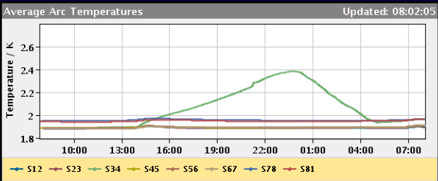
Cryogenics Point 4
Monday 12Nov’12 13h56: (1st part of ramp for physics)
Cold compressors stopped at P4-S34,
“fault” of magnetic bearings for CC1
15h: Access in cavern and strange error message
Similar “signature” as previous SEU for such HW,
but this time <1TeV……
For info: tests in North Area this week!!!
16h: Test to restore LHe level sensor (negative!)
17h: CC4 bearings fault needed recalibration (close to end of life?)
19h: restart of cold compressors (pump-down algorithm not as expected!)
24h: Full flow dedicated to sector cooling
Tuesday 13Nov’12 6:30h: Cryo conditions back
Repair: 5h - Prepare for cooling: 5h - Cooling: 6:30h
Cryo down-time: 16:30h

Slide 7
Ramps that did not make it into physics
Fill | date | Energy | Dump
3289 | 15/11/2012 | 2.8 TeV | Beam loss TOTEM
3290 | 16/11/2012 | 1.2 TeV | Beam loss TOTEM
3291 | 16/11/2012 | 4.0 TeV, adjust | Beam loss TOTEM
3294 | 16/11/2012 | 2.86 TeV | Beam loss TOTEM
3295 | 16/11/2012 | 4.0 Tev, adjust | Operator, orbit feedback
All within 24 hours
All but one due to losses after moving TOTEM Roman Pots exercise

Slide 8
TOTEM exercise (for 2012)
Wednesday 14th
End of fill, move one horizontal Roman Pot. Dump at 32 mm!
Thursday
End of fill, move the other three horizontal RP to about 2 mm (14 nominal sigma) successfully!
After separating colliding beams by 4 sigma
This is followed by four fills in the next 24 hours lost due to “slow UFO like events”, all the ramp
Time scale of seconds
Together with vacuum increase, which always takes place anyway due to beams screen temperature increase during ramp

Slide 9
Cryo load Q6.R5 up after first RP dump
Correlation roman pot movement and increased heat load on the beam screen Q6.R5? Dust? Cryo-condensation resulting from gas release?
S. Claudet

Slide 10
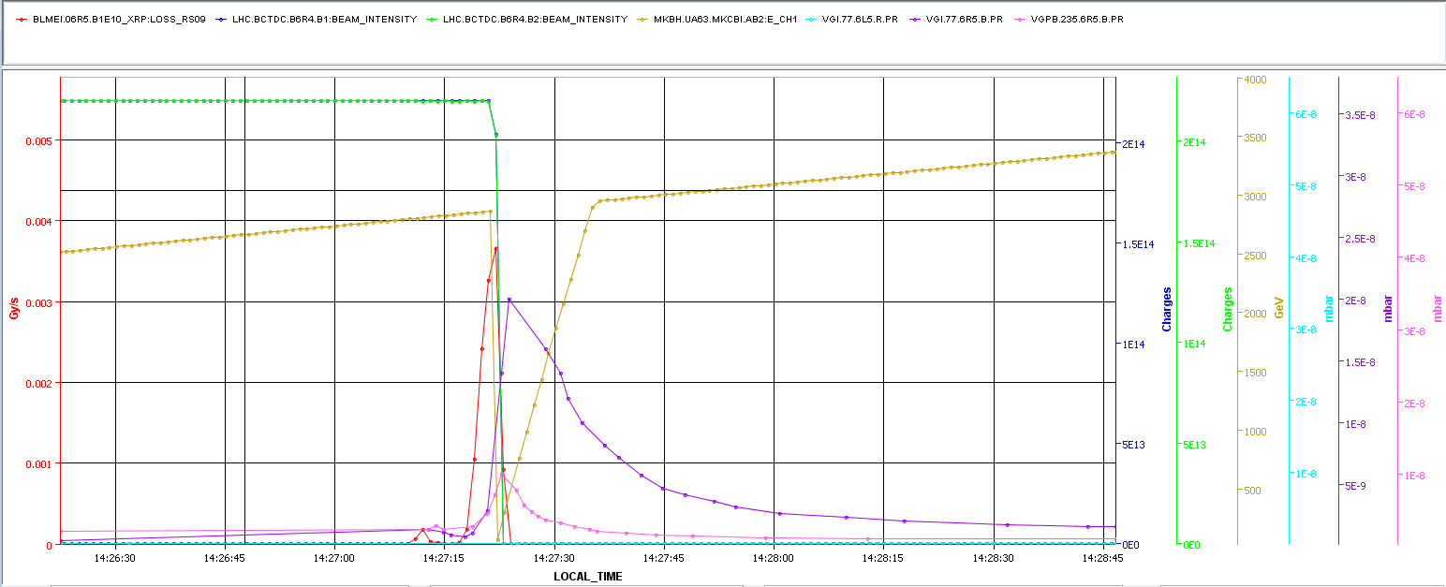
Beam dumps after moving TOTEM
Losses go together with vacuum increase
Beam dump signal goes up before vacuum increase
Time correlation tricky
BLM
VAC

Slide 11
Injection – good again !
Losses went down after
Stop satellite enhancement in the PS
Reduces losses by factor 2 – 3.
PS extraction kicker pulse length reduced
Stop batch-by-batch blow-up (might not be critical for injection but affects peak lumi)
In the previous week and in the beginning of this week the transfer lines needed to be steered for every fill
Lines have not been steered over the last 3 – 4 days
Either more stable or ‘lucky hit’ of trajectory
More details and statistics in LMC presentation this Wednesday
2 trailing bunches LHCb dump at injection. Removed by PS extraction kicker pulse length reduction

Slide 12
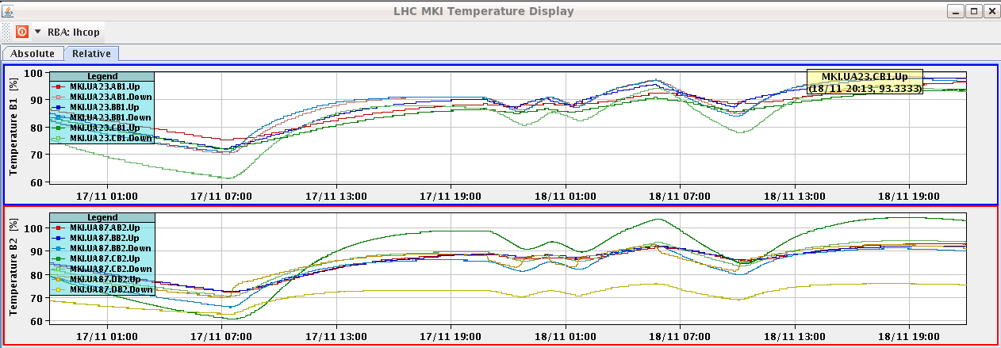
Injection kickers
Getting warm, but did not delay injection this week
MKI.8C still some strange temperature excursions

Slide 13
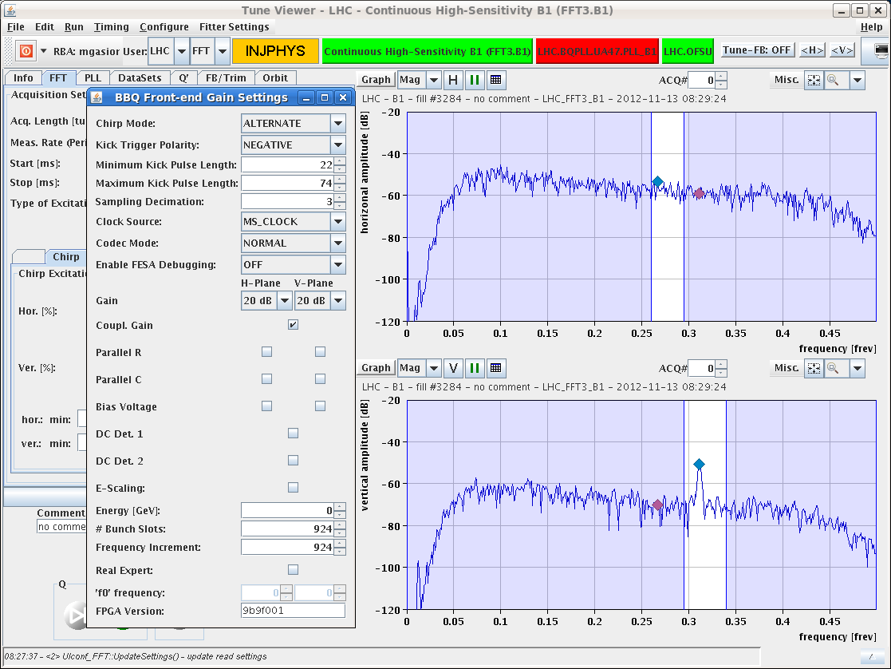
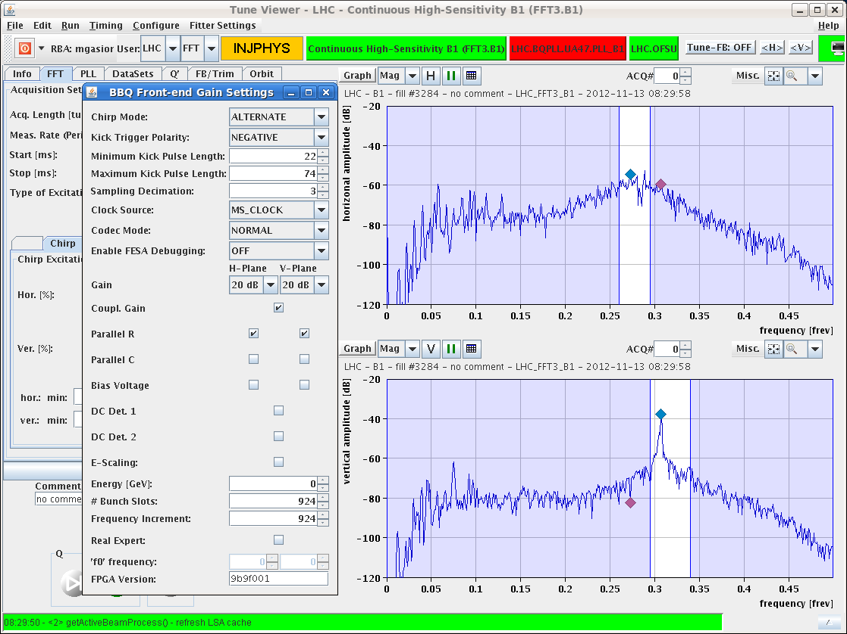
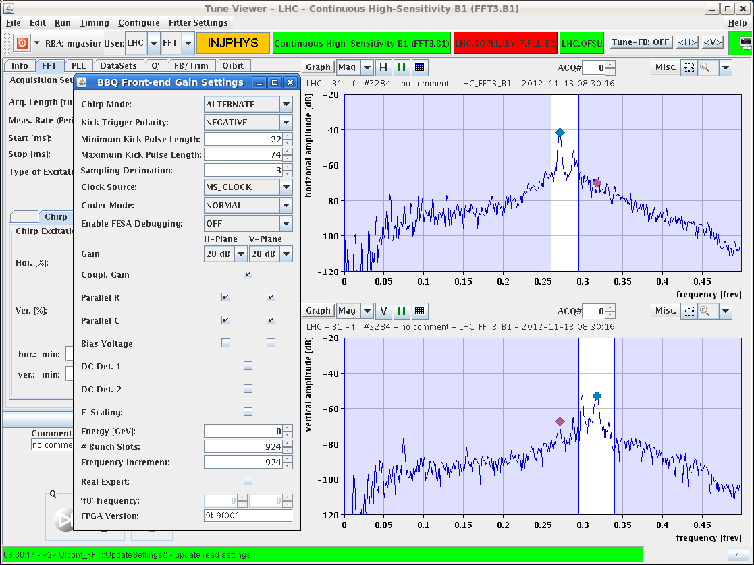
Gated BBQ B2 now also working !
Not yet ideal for all possible bunch configurations from nominal to full machine but good settings for ramp found. Ramp without chirp.
M. Gasior, R. Steinhagen

Slide 14
Peak Lumi: the knobs
Tried to recover high peak lumi at beginning of fill
Knobs
Satellite enhancement in PS: off from the start
Batch-by-batch blow-up: seems to be better when off
Damper gain during the ramp: try to minimize blow-up now that gated BBQ is operational: increased, better
Tune split during the squeeze to get rid of instability at the end of the squeeze: not too much !

Slide 15
Fill 3296bis – beam unstable end of squeeze
Clean injection and going into physics.
BSRT B1 at 1 m
BSRT B1 at 0.6 m

Slide 16
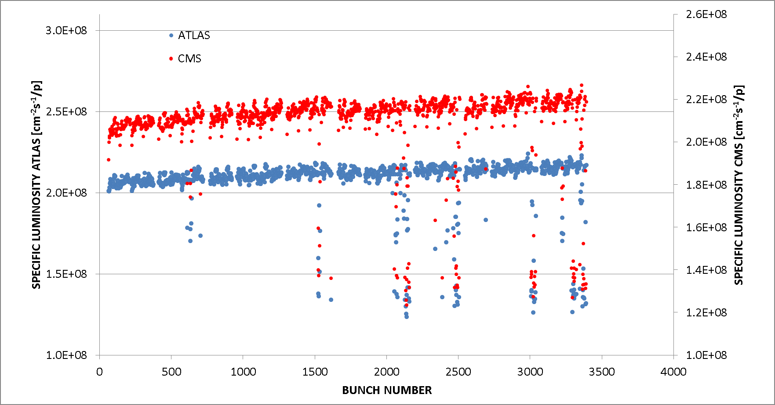
Beginning of stable beams
Specific bunch luminosity
Fill 3296
Q_{VB1}-Q_{VB2}=-0.003 squeeze
Tune split presently in
Fill 3297
Q_{VB1}-Q_{VB2}=-0.005 squeeze
Fill dumped because two bunches unstable (BPMS LSS6)
Seems fewer bunches with low lumi, but lumi reduction stronger (= bunches blown up stronger)

Slide 17
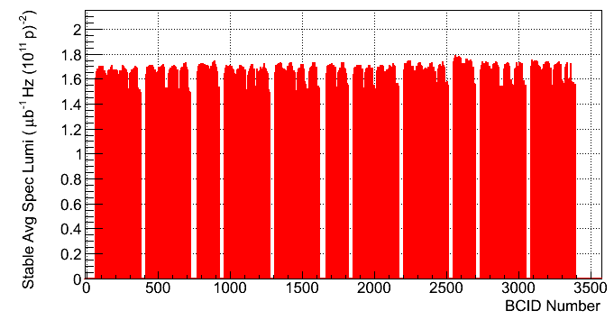
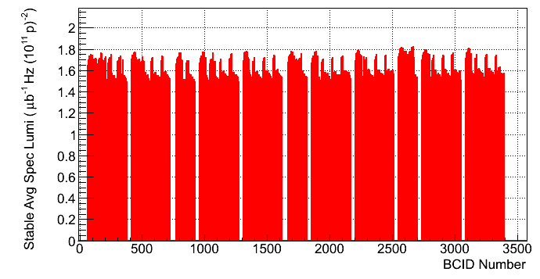
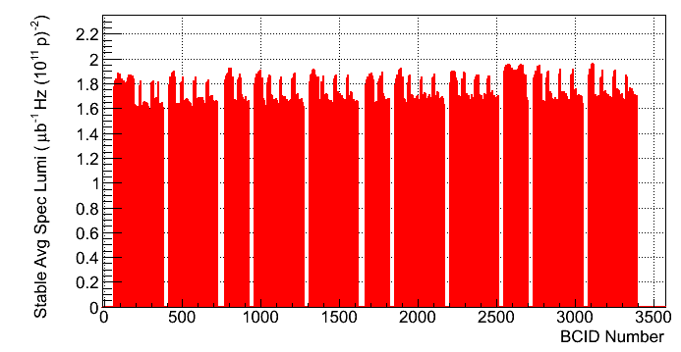
Specific Lumi (from ATLAS)
Fill 3286
No bbb blow-up
Fill 3287
With bbb
Fill 3288
With bbb

Slide 18
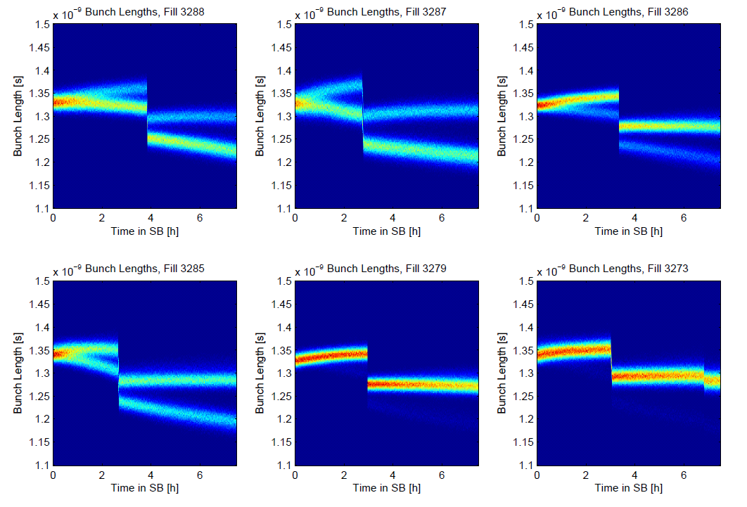
Bunch length reduction during stable beams
Beam 1 only !
Vrf increase
M. Hostettler

Slide 19
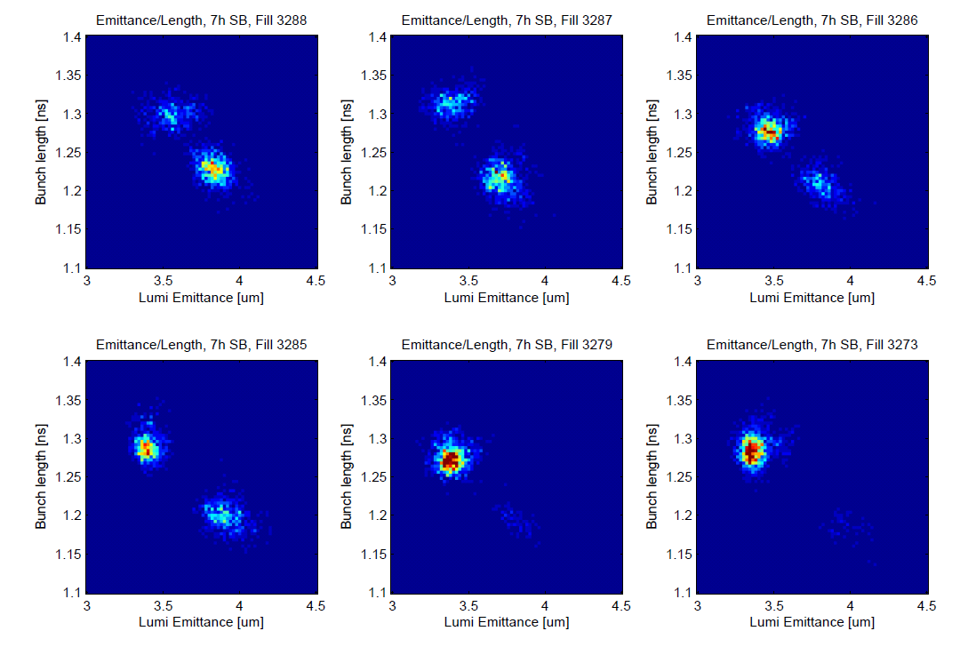
Bunch length related to emittance
Bunch length as a function of calculated emittance from Lumi
Smaller emittance correlates to longer bunch length
The small transverse beams get unstable and blow up longitudinally ???
The large transverse beams are scraped, particles with larger momentum are scraped most ???
M. Hostettler

Slide 20
Fill 3295: Orbit Feedback problem
Lumis ATLAS end CMS at end of adjust too low
Need to re-optimise a lot to get lumi’s back
Traced down to steering problems
Correctors masked for the orbit feedback system were used by the orbit feedback calculation, resulting in non standard orbit corrections
This is a bug which is not understood and appears on rare occasions.
Did not want to start the LHCb collision exercise with an orbit which is not good and maximum beam in the machine.
Decide to dump.

Slide 21
Wire scanners
Wire Scanners, early Wednesday evening
B1H1 & B2H2 have both broken wires. The breakage happened after both scanners did not come back to the home position.
It is not clear whether the 144 bunches had already been injected.
All WS have been disabled until the causes of the breakage are analyzed
Presently still disabled
Access likely later today
Get them working for V/d Meer scans Tuesday

Slide 22
The plan / outstanding
New Coordinators: Mike Lamont & Bernhard Holzer
Clear access list, likely today:
Access wire scanner requested for Monday, including tunnel (RP).
PM32 : CV to check / remove sand.
Access system
CMS (Hadronic Forward Calorimeter) > 1 h
BI: wall current monitor (1 h – point 4 RF zone)
ALICE
V/d Meers scans Tuesday, tbc
Swap first 6 bunches B1/B2
Affects gated BBQ, abort gap monitoring incl. Big Sister
Test for bipolar ADT cleaning / cleaning efficiency

