Slide 1
Monday 12th November
04:50 Beam dump, trip of RF line 4B, integrated L ~120 pb-1.
Access for RF.
07:00 Injecting. FBCT phasing. Line steering.
09:59 Beam dump LHCb on injection. Reduce satellites in PS.
10:30 Transverse damper module H2B2 down and RF lines tripped.
13:24 ADT problem fixed. Injecting for physics.
13:52 Start ramp.
13:55 Cryo problem in point 4. Cryo ok will be lost in few minutes.
14:05 Beam dumped due to cryogenics point 4. Cryo recovery.
06:30 Cryogenics back – pre-cycle.
08:00 Injecting pilots.

Slide 2
Injection
Second injection 144 b beams dumped by LHCb
Decide to stop the satellite enhancement in PS to check difference
Reduces the losses at injection by factor 2 – 3.
Not seen injection sequencer that green for a while
Average slot population about 0.1 %

Slide 3
LDM for 144 bunches
These bunches, before and after the 144 bunches, can be kicked out by the injection kicker and cause losses in LHCb…

Slide 4
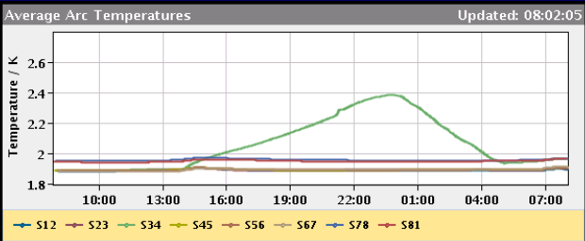
Cryogenics Point 4

Slide 5
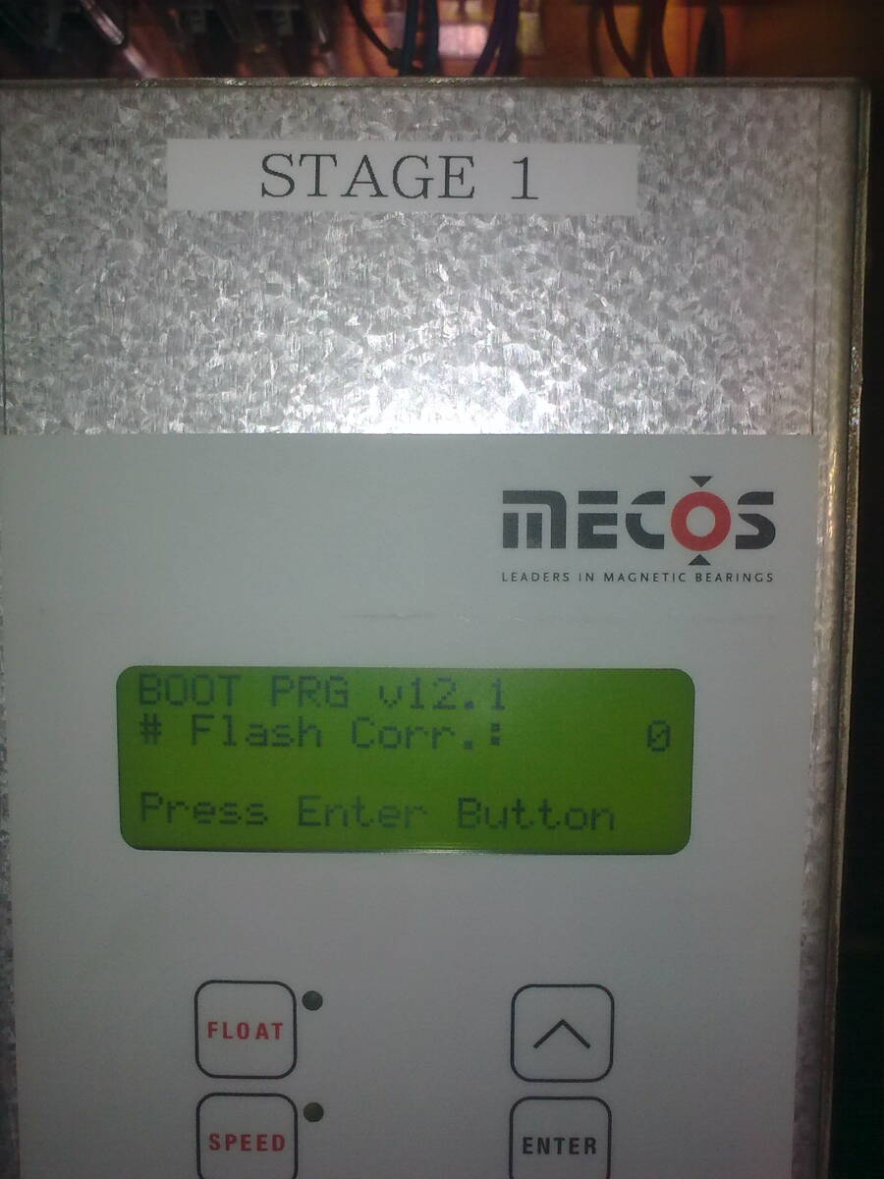
Cryogenics problem Point 4
Monday 12Nov’12 13h56: (1st part of ramp for physic)
Cold compressors stopped at P4-S34,
“fault” of magnetic bearings for CC1
15h: Access in cavern and strange error message
Similar “signature” as previous SEU for such HW,
but this time <1TeV……
For info: tests @ HiRadMat this week!!!
16h: Test to restore LHe level sensor (negative!)
17h: CC4 bearings fault needed recalibration (close to end of life?)
19h: restart of cold compressors (pump-down algorithm not as expected!)
24h: Full flow dedicated to sector cooling
Tuesday 13Nov’12 6:30h: Cryo conditions back
Repair: 5h - Prepare for cooling: 5h - Cooling: 6:30h
Cryo down-time: 16:30h

Slide 6
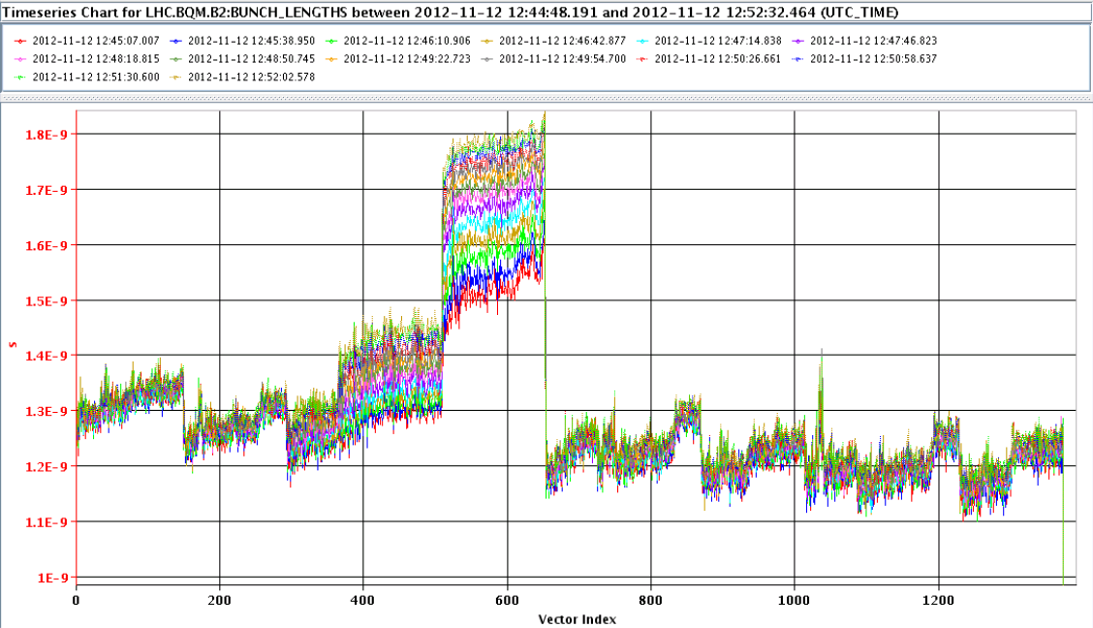
This fill
Tune split in a bit earlier
Goes in after tune-shift in the squeeze. 3e-3 B1V.
Philippe looking at the RF
Fourth injection in batch has longer bunch length
Check bbb blow-up settings
Reduced damper gain B2 as still without gated BBQ. Increase damper when gated BBQ operational
Gated BBQ B2 (this fill?)

Slide 7
Miscellaneous
Access DONE:
ATLAS, CMS, ALICE, EPC RQF.A67, BI
Compensator IP8 back in operation
LHCb ramped down and up
Test of ndiv beams from SPS (own cycle)
Outstanding
TL TCDI scraping test to check tails coming from SPS (1 h @ inj)
Gated BBQ B2 (this fill?)
Injection cleaning and damper tests
Access
PM32 : CV to check / remove sand.
Access system

