Slide 1
Monday 22.10. – Morning
L. Drosdal: Injection line TI8: IQC threshold for BPM.87604.H from 2mm to 2.5mm to avoid unnecessary latches due to variations coming from the MKE. Losses and injection oscillations still fine. No latches for last fill 3208.
Fill 3208:
Injection: emittance ~1.5 um, bunch intensity ~1.68E11
ADT set to high band-width during: ramp, squeeze and collision beam process – standard band-width in stable beams
BBQ B1 tune measurement and feed-back gated on sixth bunch of the first batch of six bunches with reduced damper gain on the first six bunches
Chirp during ramp on B1

Slide 2
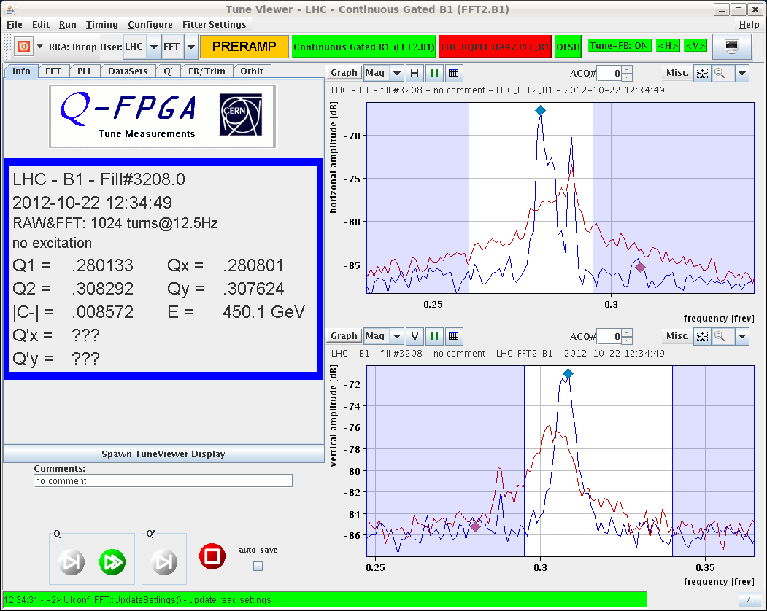
BBQ spectra B1 gated on 1 bunch (reduced ADT gain)
BBQ spectra comparison before (red) and after (blue) changing ADT gains, gated on sixth bunch of the first batch of six bunches.

Slide 3
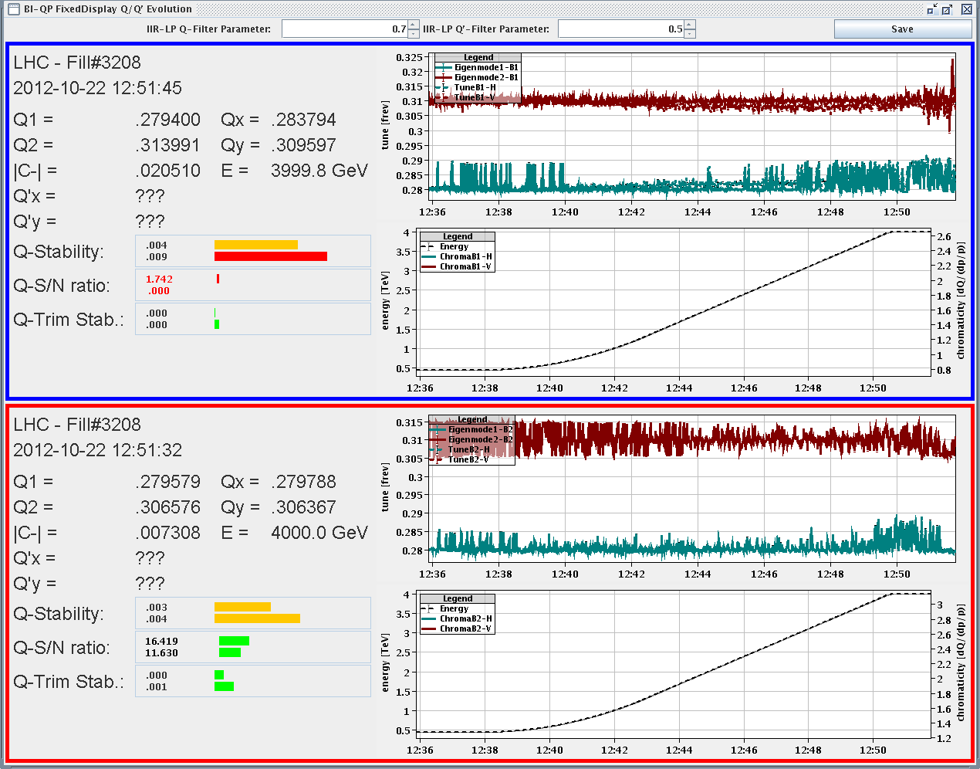
B1 tune measurement
Tune measurement of B1 still jumping to 50 Hz line at the start of the ramp and towards the end of the ramp

Slide 4
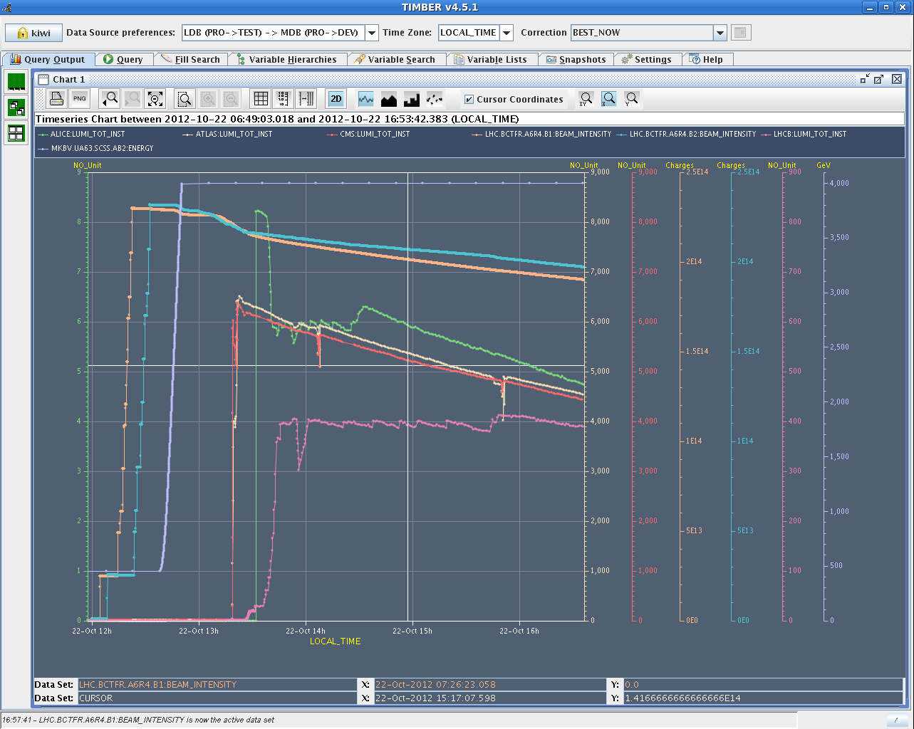
Monday cont’d
13:30 stable beams
Emittance at start of stable beams: ~2.65 um
Bunch population start of stable beams: 1.57E11
Somewhat higher losses before stable beams, and somewhat higher emittance increase than previous fill 3207
Peak luminosity ATLAS and CMS: ~6.5E33 cm-2s-1
ALICE peak luminosity: ~8.3E30 cm-2s-1
Integrated lumi in 4h11’:
ATLAS/CMS: ~74 pb-1

Slide 5
Monday Afternoon
17:41 beam dump:
RD2.L5 tripped: QPS triggered a fast power abort
S45 tripped and vacuum interlocks from L5, valves closing
CS/CM in MSL5 lost
Investigation: possibly a spurious signal on U_res_B1 → reset
cryo back 19:35
18:11 PC trips in S23 (CS/CM lost for AML3)
The temperature sensors of one 600A current lead went in fault
→ Access: cryogenics access to tunnel UA27 for verification of a temperature sensor on DFBA DLCM chimney 15 → electronics card replaced
Also access for ATLAS
22:07 RQ8.L1 tripped
22:25 all accesses finished

Slide 6
ADT setting for the last fills
Normal ADT | High BW ADT (ramp till physics) | High BW ADT (ramp till collision process)
 | 3200, 3201
3203
 | 3204
3207
3210 |  | 3208, 3209

Slide 7
From Gianluigi

Slide 8
Monday Night
ADT gain of the first 6 bunches in ‘Prepare ramp’ and ‘Ramp’, B1, was lowered to 20/127 of gain for rest of the turn (5db lower than for previous fill 3208); Daniel, Wolfgang
Fill 3209:
Injected beam similar to previous fill: Injection: emittance ~1.5 um, bunch intensity ~1.67E11
ADT set to high band-width during: ramp, squeeze and collision beam process – standard band-width in stable beams
BBQ B1 tune measurement and feed-back gated on sixth bunch of the first batch of six bunches with reduced damper gain on the first six bunches
01:22 Stable beams
Peak luminosity ATLAS/CMS: ~7E33 cm-2s-1
Integrated lumi in 2h32’: ATLAS/CMS: ~52 pb-1
3:55 Beam dump: EDF power glitch triggered FMCM of RD1.LR1

Slide 9
Tuesday Morning
5:00 injection again for fill 3210:
B1H = 1.53, B1V = 1.41, B2H = 1.7, B2V = 1.73
Standard settings for ADT and BBQ
6:35 stable beams fill 3210
Luminosity >7.3E33 cm-2s-1
Planning
Wednesday: 1000m beat* run
Thursday: LHCb polarity change

Slide 10
Operational Developments
Ongoing:
Gated BBQ tune measurement and feed-back (currently B1 only) with reduced damper gain on first 6 bunches
Broad-band ADT (fill 3208: ON during ramp. Squeeze and collision beam process – not during stable beams)
Could reduce ADT gain for broadband damping by 40% (ramp till stable beams) to have same low frequency gain as before?
Or use broad-band ADT only during squeeze and collision beam process
Pending:
Batch-by-batch longitudinal blowup at injection (Tuesday evening)

Slide 11
Access requests
Access Monday morning:
WorldFIP repeater card change in sector 81 (dump due to power converter communication fault)
Access system PAD UJ43 (S. di Luca)
ALICE: Nitrogen Alarm: leak not found. Decided with GLIMOS to monitor and this way try to find the leak location. → leak location found outside the cavern and fixed.
Pending Accesses:
LVDT TDI Pt2. Tunnel, 2 hours
LBDS MKD-F-B1: check PC and generator. UA63
Radmon installation between Q5 and Q6 at IP1. 1 hour access, few hours pre-warning. Impact 21253 / D. Macina

