Slide 1
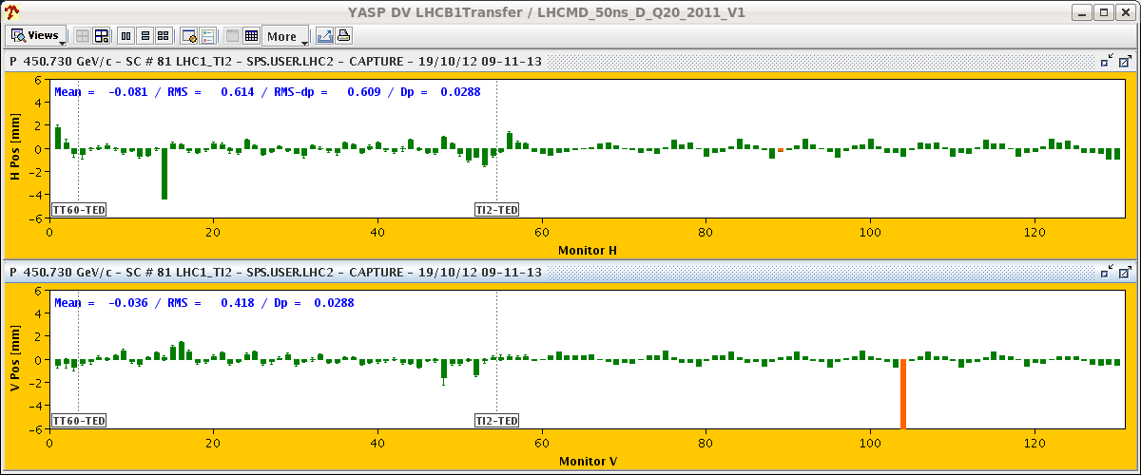
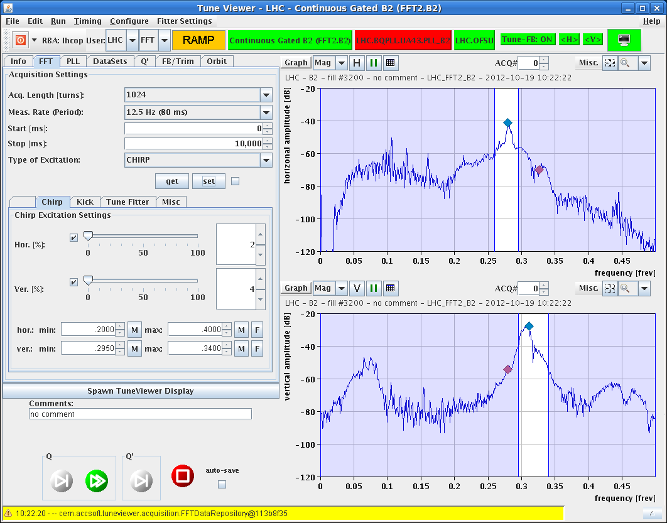
LHC Status Saturday Morning 20-Oct
Bernhard Holzer, Mike Lamont
... since 05:30h WorldFIP problem
07:14h access for WorldFIP intervention in UJ83 exchange of repeater in 78
07:50h cycling
08:50h injection ... still a bit problematic
10:20h ramp ... not without problems
broadband adt // tune spectrum

Slide 2
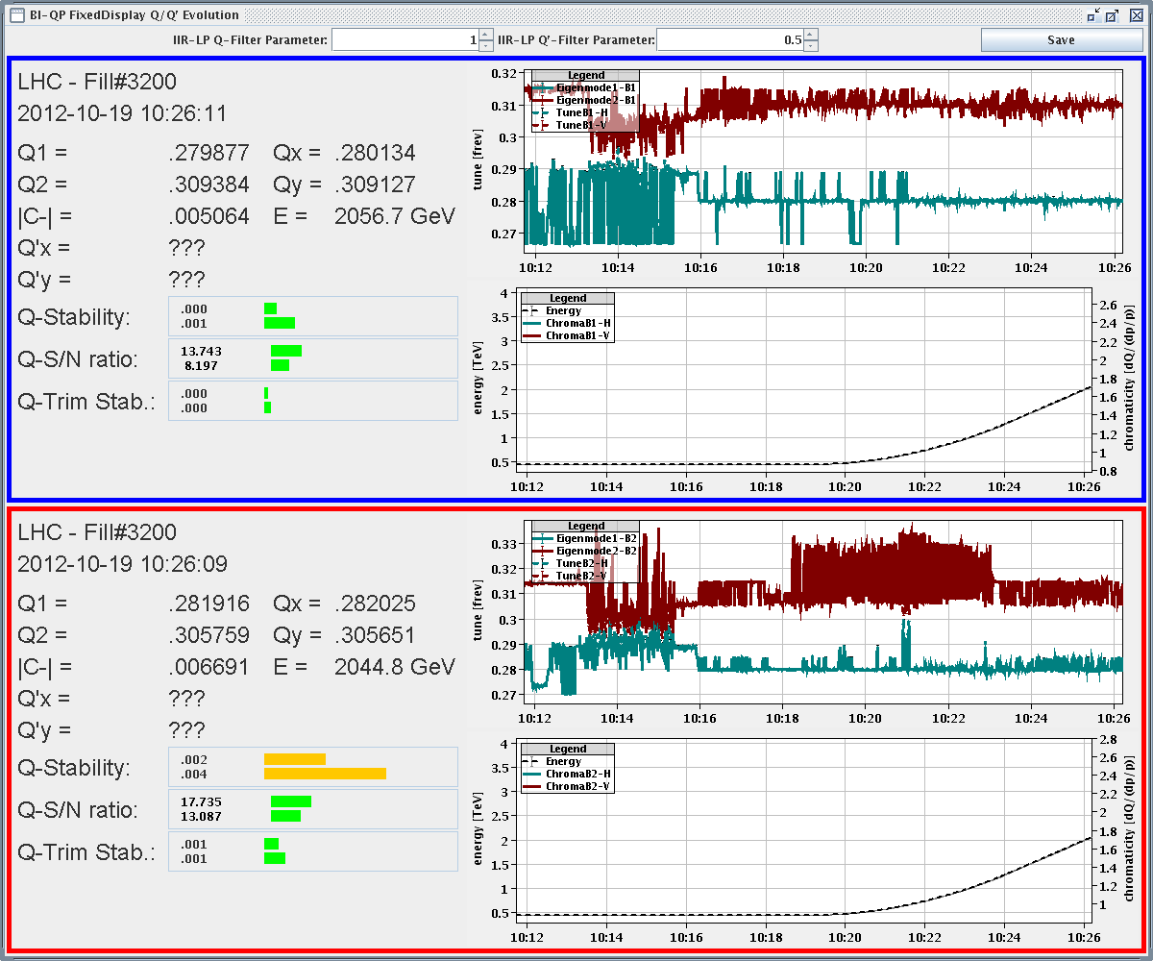
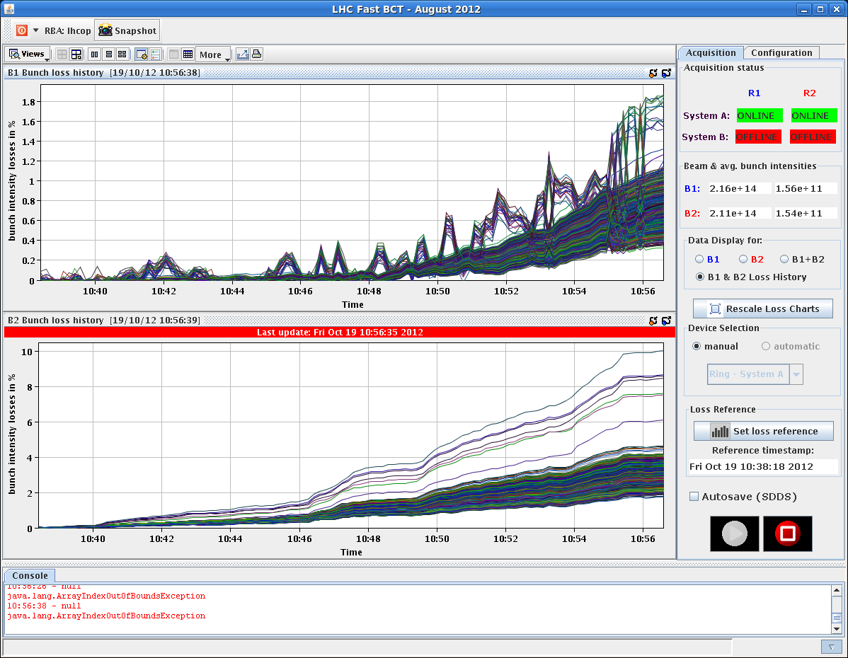
Friday Morning
tune spectrum not easy to interpret
neither the losses easy to understand

Slide 3
Friday Morning / Late
and the initial luminosity
neither (orbit problem !)
11:10h stable beams
18:20h CMS cooling problem
(“water mixer” not ok)
-> solenoid ramped down,
detector off
19:20h ATLAS: gas leak in muon system,
urgent access required

Slide 4
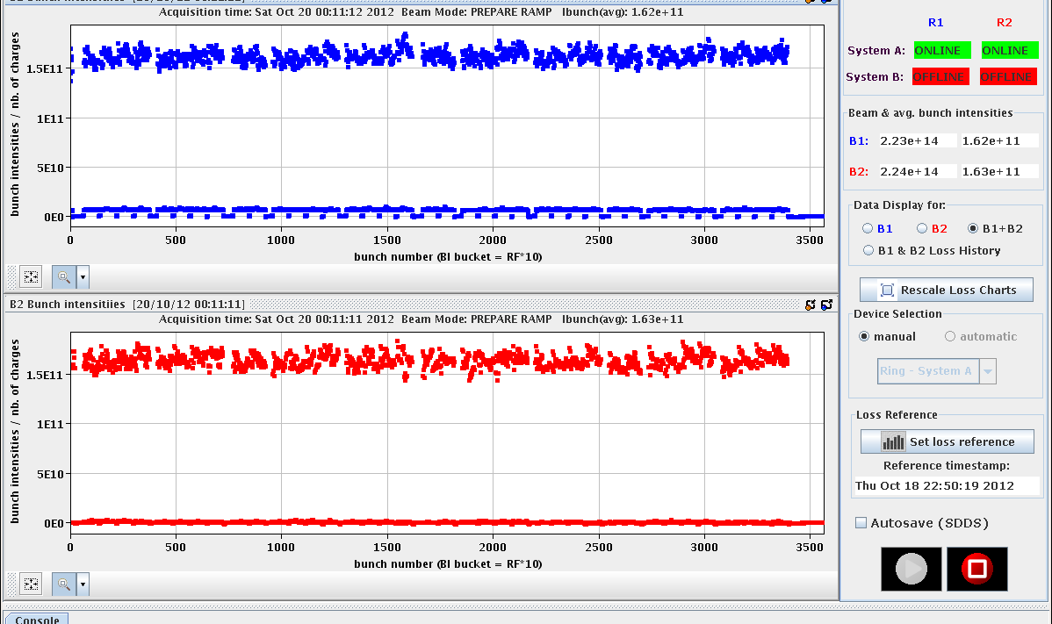
Friday Late
19:30h beam dump and access for
ATLAS & ALICE
23:00h LHC closed, cycled & ready for injection
Emittances (144 bunches)
B1H = 1.54 B1V = 1.45
B2H = 1.43 B2V = 1.48
nice narrow intensity distribution
N_{p}=1.6 e11

Slide 5
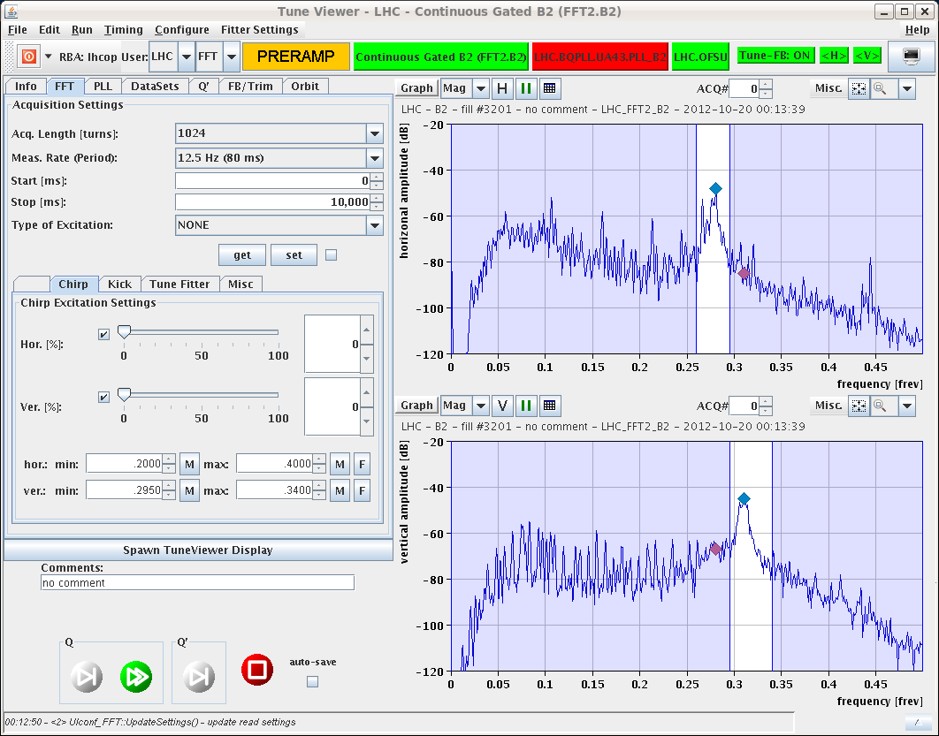
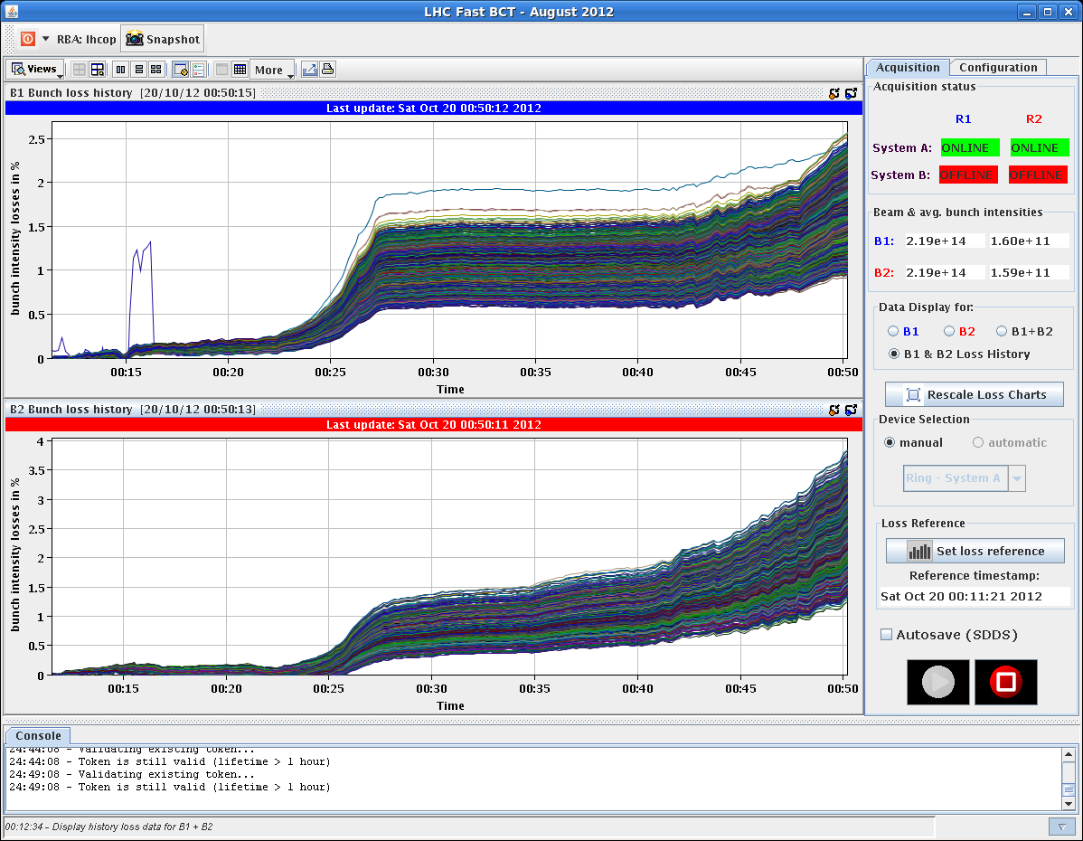
Friday Night
00:00h ramp ... with clean tune signals
00:50h squeeze & adjust
... and nice low losses
2 %
3 %

Slide 6
Friday Night
00:50h stable beams ... with good lumi ( 3 out of 4 aint bad !!)
small remark: ALICE Lumi L = 4...5
indicates better (long) beam quality
(PS beam settings with lower satellite
population)

Slide 7
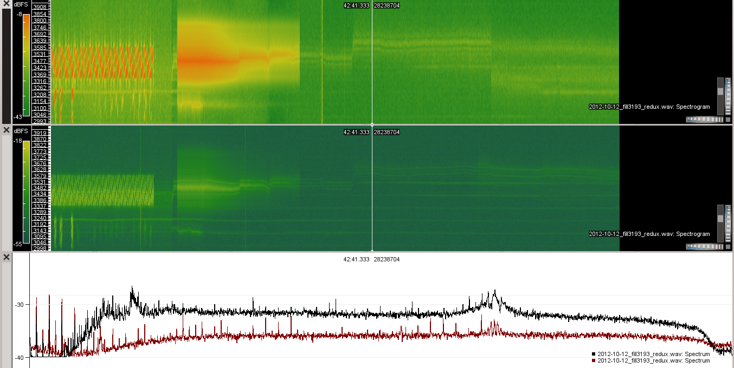
Pending operational development
Batch-by-batch longitudinal blowup at injection.
Gated tune measurement with reduced damper gain on first 6 bunches
Shorter bunches at injection with adiabatic voltage increase after filling
Fill(s) with shorter bunch length (impedance, heating…). Strategy to be defined. Ideally down to 1 ns.
RF-Tuner Optimisation
✔
1374 bunch average
6 bunch reduced adt
✔

Slide 8
Friday Night
world FIP repeater change
access ATLAS / ALICE

