Slide 1
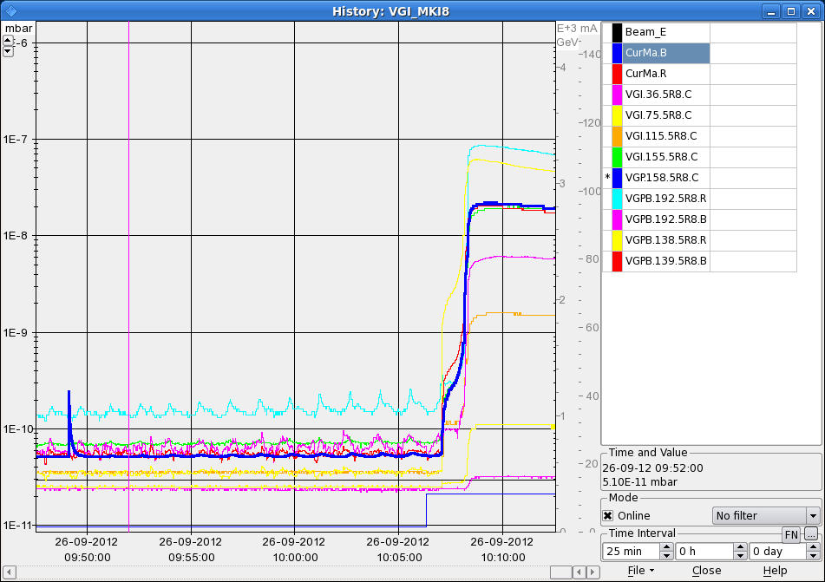
LHC Status Thursday Morning 27-Sep
Bernhard Holzer, Joerg Wenninger
7:00h restart, plan: test fill 78 x 78 for physics
10:00h first bunches (6 + 36 ) in ... but ...
vacuum problems in MKI8_D
as after 36 bunch injection the threshold is overpassed a second injection is
vetoed by the SIS
threshold for SIS 2E-9

Slide 2
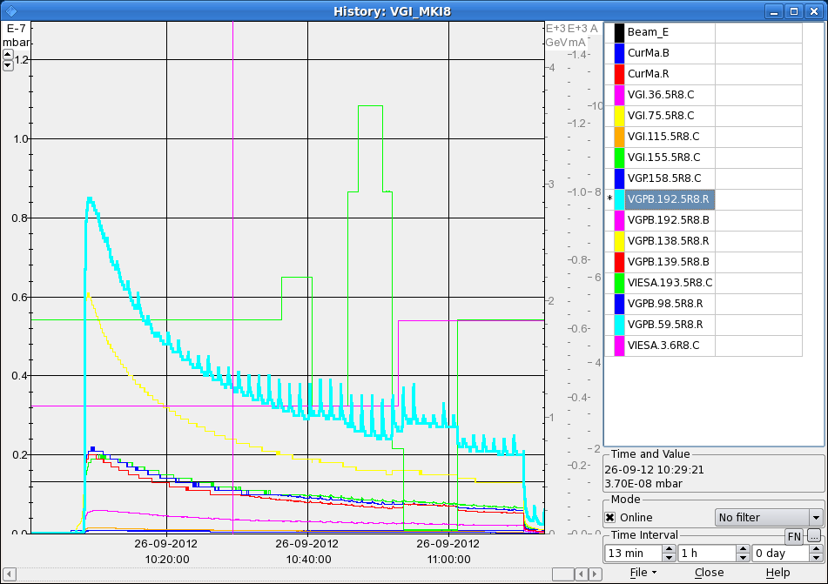
Wed Morning
different test to understand / overcome the problem: (M. Barnes)
* solenoid currents: 0 ... 3 ... 10 A -> no influence
* dump of beam 1 -> no influence
* patience .... pressure reduces exponentially
hypothesis: e-clouds in beam 2 ceramic chamber inside MKI8_D

Slide 3
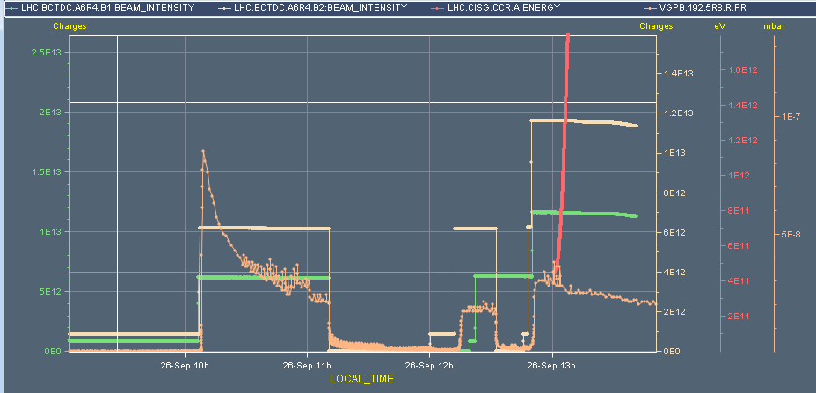
Wed Morning
12:48h preparing 78 bunch fill
two 36 injections afap before vacuum reaches interlock level
conditioning clearly visible
13:00h ramp, squeeze, adjust
13:45h stable beams
72
36
36

Slide 4
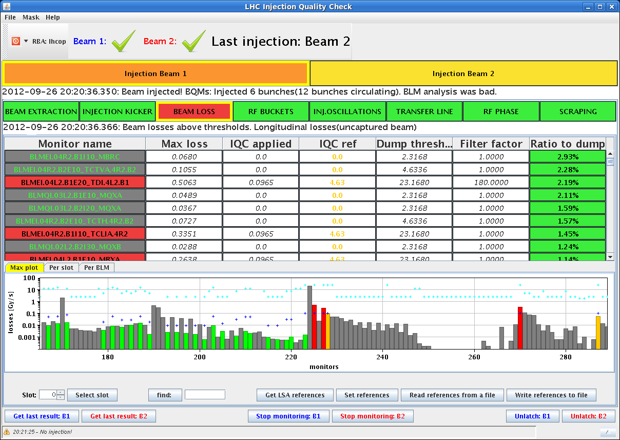
Wed Late
15:30h beam mode adjust: some end-of-fill studies
* local bumps for BSRT 2 alignment
* octupole tuning for lifetime
* β-tron loss maps in beam 1 & 2
18:00h beam dump, precycle for new fill 456 x 456
... after some conditioning of MKI8_D
steering of transferline beam 1

Slide 5
Wed Late
21:30h injection & MKI8 conditioning
2*36 bunches
1*72 bunches
... scrubbing with n*144 bunches
4E-10
2E-10
2E-9
1E-9

Slide 6
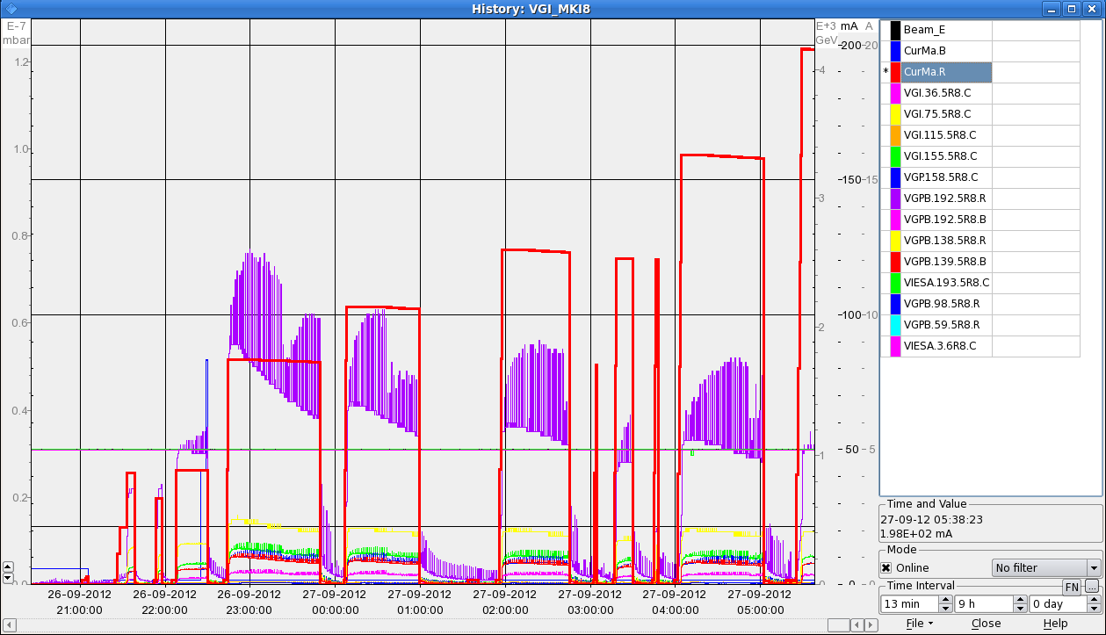
Wed Night
00:08h test for physics injection
injected 6 bunch, 144 bunch, 144 bunch, 72 bunch on beam 2 before the vacuum interlock on MKI8.
continuous injection / conditioning of up to 5* 144 bunches
05:41h cryo temperature sensor faul on DFBXG_L8 (circuit RQSX3.L8).
reset or access needed
current b2
pressure

