Slide 1
Tuesday
Loss maps in the night:
Asynch dump test not OK for B1 – not enough beam in abort gap → to be repeated.
07:00-10:30 Cycle for loss maps with 3 bunches / beam.
Found collisions in IR8 by re-using settings from last weekend.
Note that IR8 BRAN gives ~ no signal…
10:45-12:15 Loss maps with RPs.
Decided to also move in RPs for off-momentum loss maps.
ALFA & TOTEM override key put in place, P. Fassnacht in the CCC, TOTEM by CCC crew (after phone with M. Deile).
Performed H betatron loss maps and off-momentum +500 Hz.

Slide 2
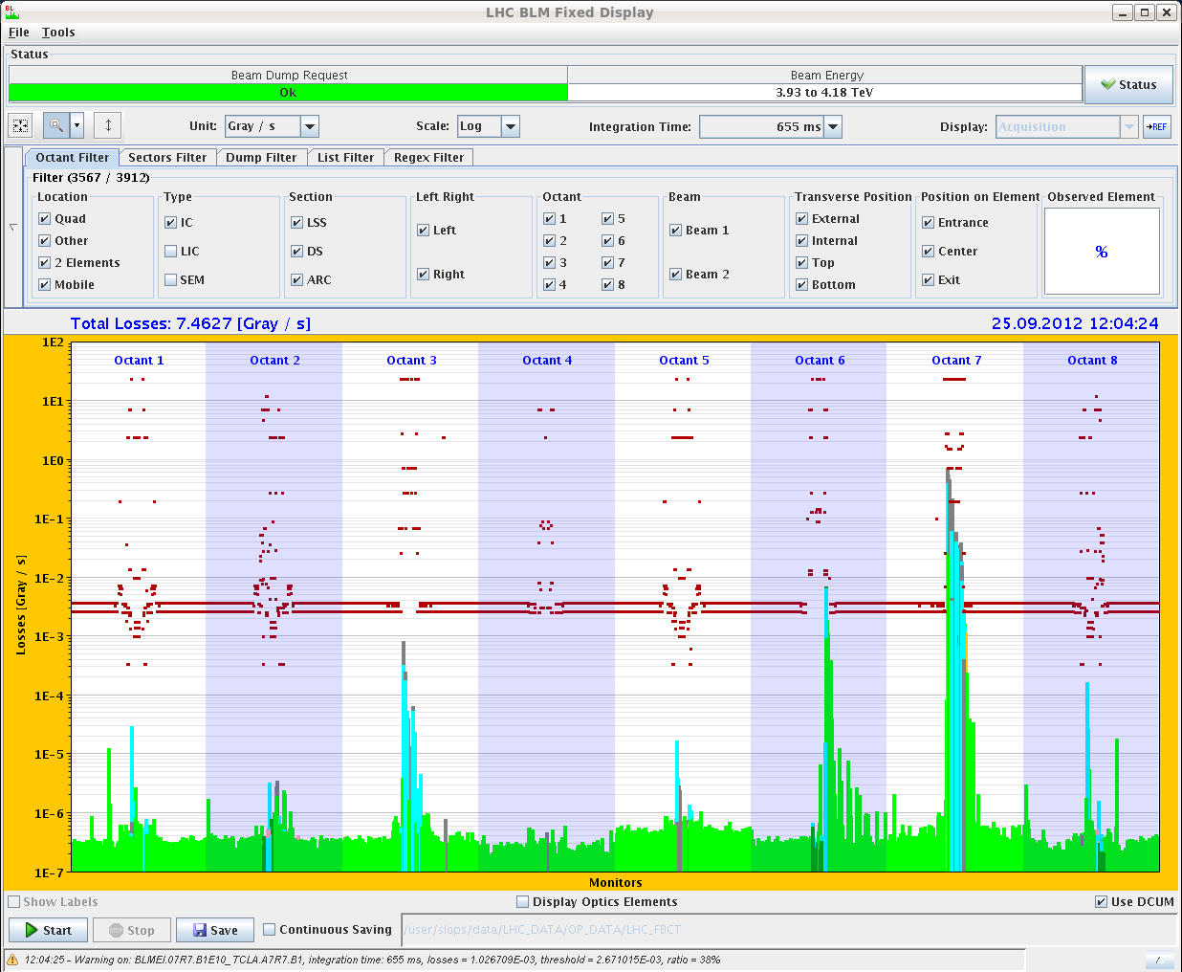
Loss map – funny features (reproducible !)
Loss spikes in cold regions (B1 only).
Not simple noise – appear only during the loss maps. Also present in the loss maps of the previous nights.
Very low (< 1E-4), but should not be there…
B1H

Slide 3
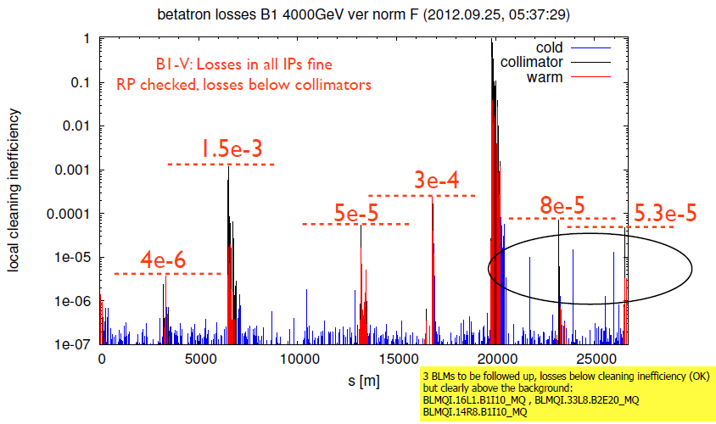
Loss map B1 V
Analysis by Belen Salvachua Ferrando

Slide 4
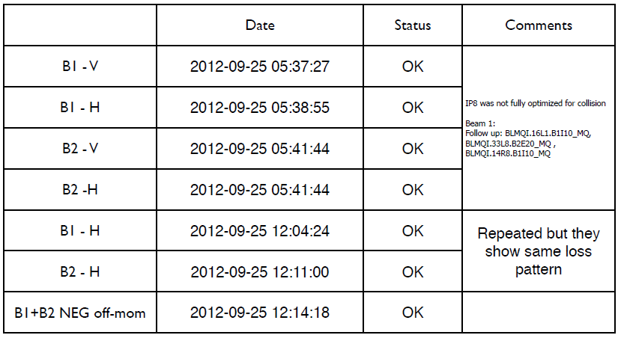
Loss map summary (Belen/Jan)
Asynch dump test B2 ok, B1 pending.
Loss maps OK:
We may actually have been optimized !

Slide 5
Strange orbit corrector settings
Problem of RT trims on common RBBX correctors partly understood.
The RT trims are indeed not applied for those CODs (blocked at FGC level), but they are visible (as if they were applied).
The orbit FB should normally never used them, unless they are explicitly activated.
Searching the logging it became clear that those trims were applied over one minute in the prepare ramp phase – then stayed constant. It also affects the other fills after TS3.
This is the moment when we send a last update of the response matrix - where those CODs should be de-selected.
Why do they seem to be selected when matrix is sent, as should be de-selected? No change in sequence, but the OFSU code was touched…

Slide 6
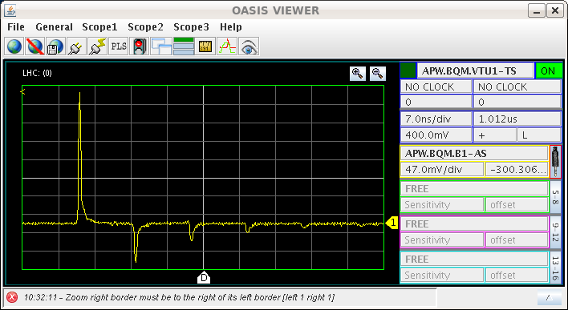
BQM B1 problem
The BQM problem during Q20 injection setup was traced to broken hardware – signal is perturbed by reflections.
Perturbs bunch identification and bunch length measurement (tbc).
Giulia adapted settings to cope with the poorer signal, but it is not sure how the bunch length measurement is affected.
Needed for longitudinal blow-up!

Slide 7
Tuesday afternoon
14:00-17:00 Access for BQM, BSRT, Headtail, ALICE, ATLAS.
No obvious HW problem visible for BQM. Exchange of a 2-way combiner.
17:00 SIG transformer manipulation.
Compensator filters Pts 2,4 and 6 off.
ATLAS toroid trip.
17:30-18:30 Start switching on filters.
Trip of compressor for cryo Pt2 → 6-10 hours recovery.
Trip of ALICE solenoid, spectrometer, undulators and a few other circuits.
When switching back on fllters in 6, compensator filter at Pt2 went off again, could be recovered without more problems.

Slide 8
Night
02:00 Cryo back – RF problem on M1B1, filament interlock on L1B1.
04:00 Filling for loss map with RPs.
Again IR8 BRAN signal a factor ~10 lower than for ALICE. But LHCb luminosity as expected.
Betatron V and asynch dump test.
06:00 Ramp down.
08:00 Injection for 78b fill.
BQM B1 fixed !

Slide 9
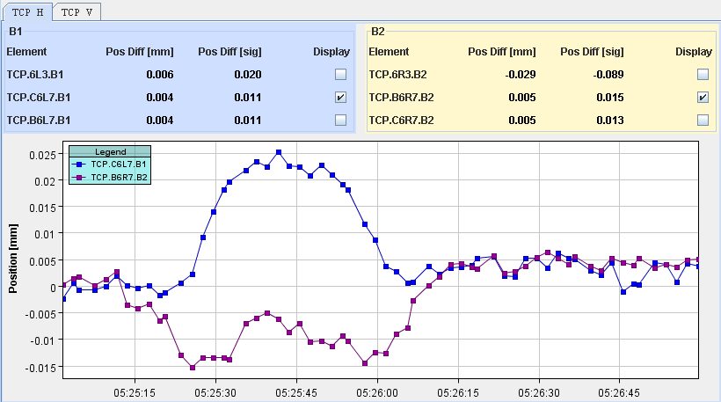
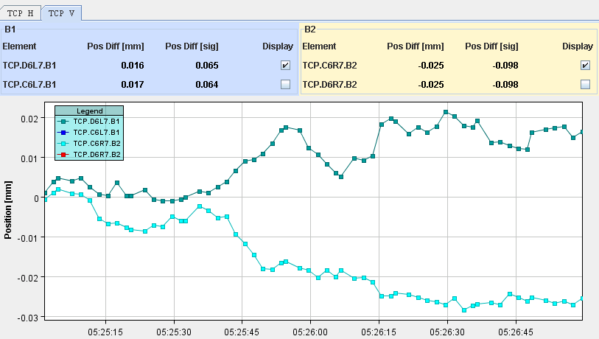
Collision BP1 – transients at TCPs
< 30 um - OK !
H
V

Slide 10
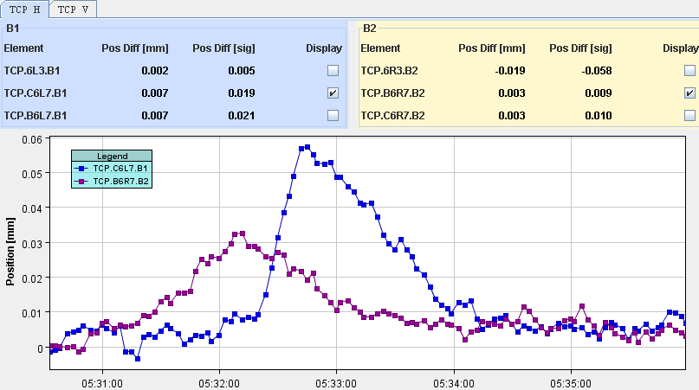
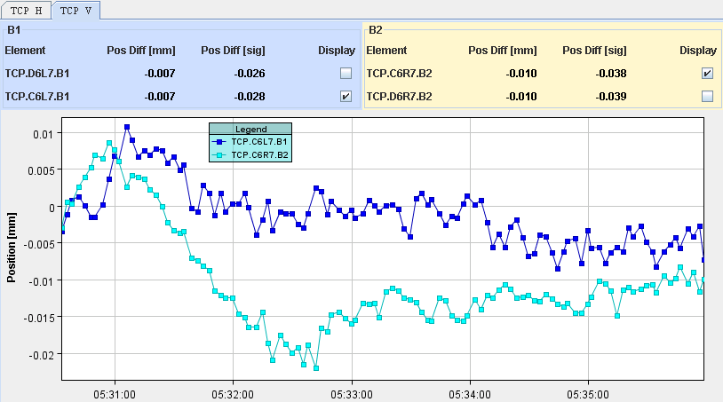
Collision BPs – transients at TCPs
B1H a bit large… during ramp down of LHCb H Xing.
H
V

Slide 11
Plan
Following the MKI8 flashover, request by MKI experts not to push the train length before it is needed.
Profit from some conditioning with beam in the meantime.
78b fill – check out cycle with 50 ns.
Prepare injection up to 108 bunches (→ 852b).
Check of orbit FB response matrix.
480b fill.
To do:
ADT bandwidth increase → tomorrow?
Abort gap monitor calibration?

