Slide 1
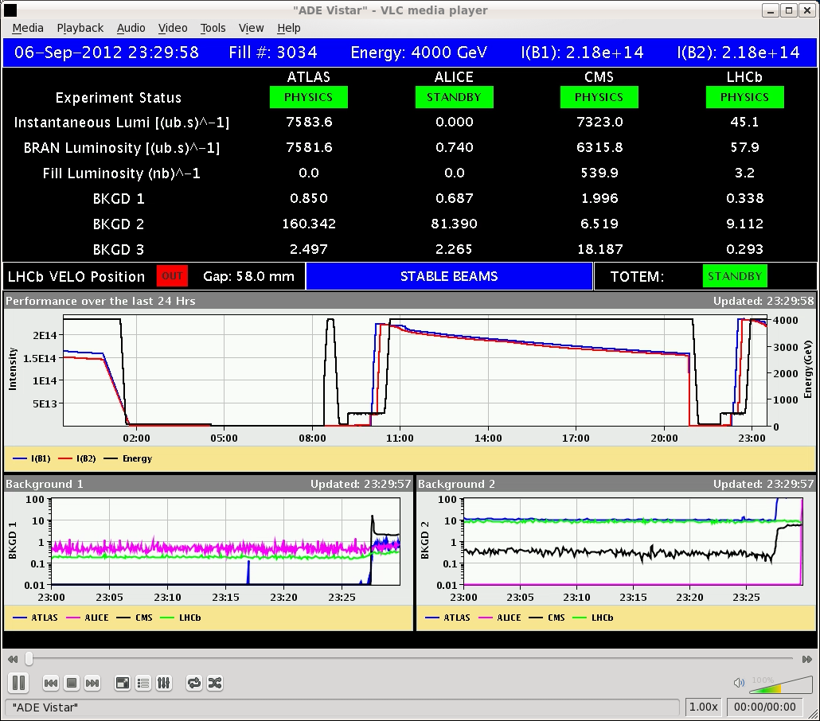
LHC Status Fri Morning 7-Sep
Bernhard Holzer, Mike Lamont

Slide 2
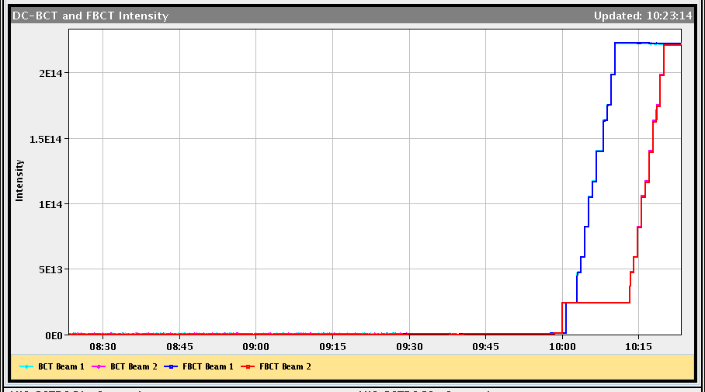
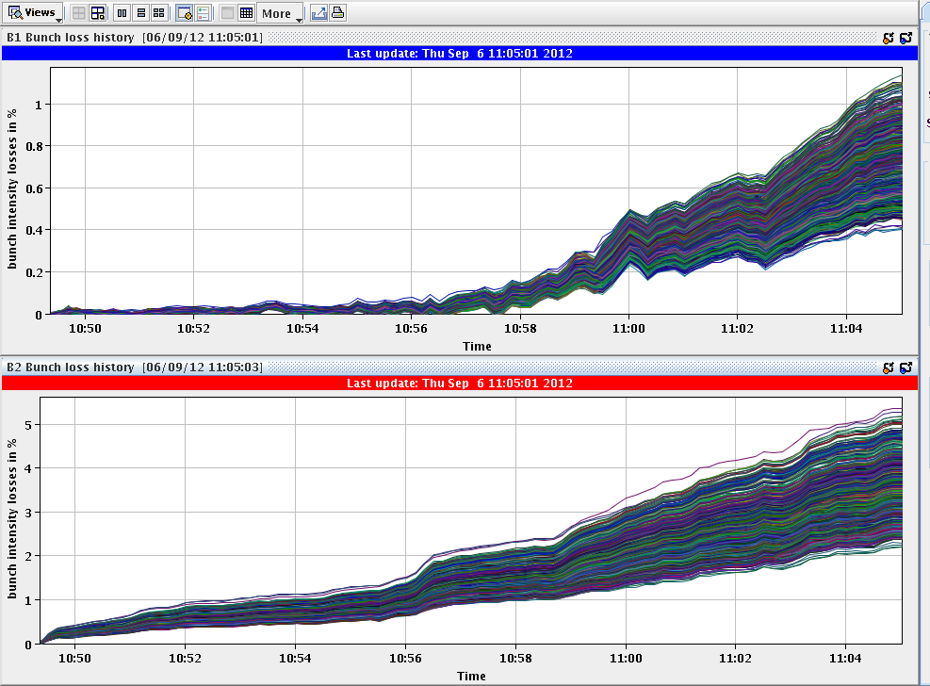
Thu Morning
8:00h restart: QPS problem in S56 solved,
precycle the machine
... OFSU down
10:00h injection: “a la Alice”
10:23h preparing the ramp,
OFSU crashed and restarted when preparing the ramp
10:23h ramp, squeeze ... no problems

Slide 3
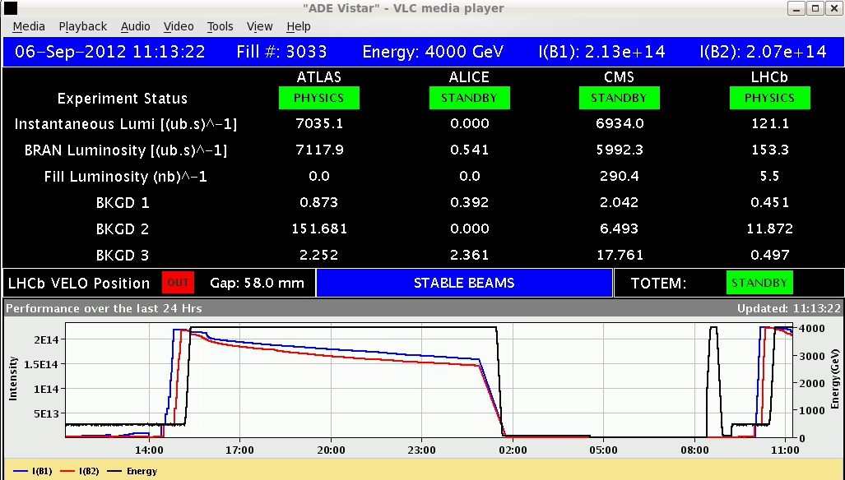
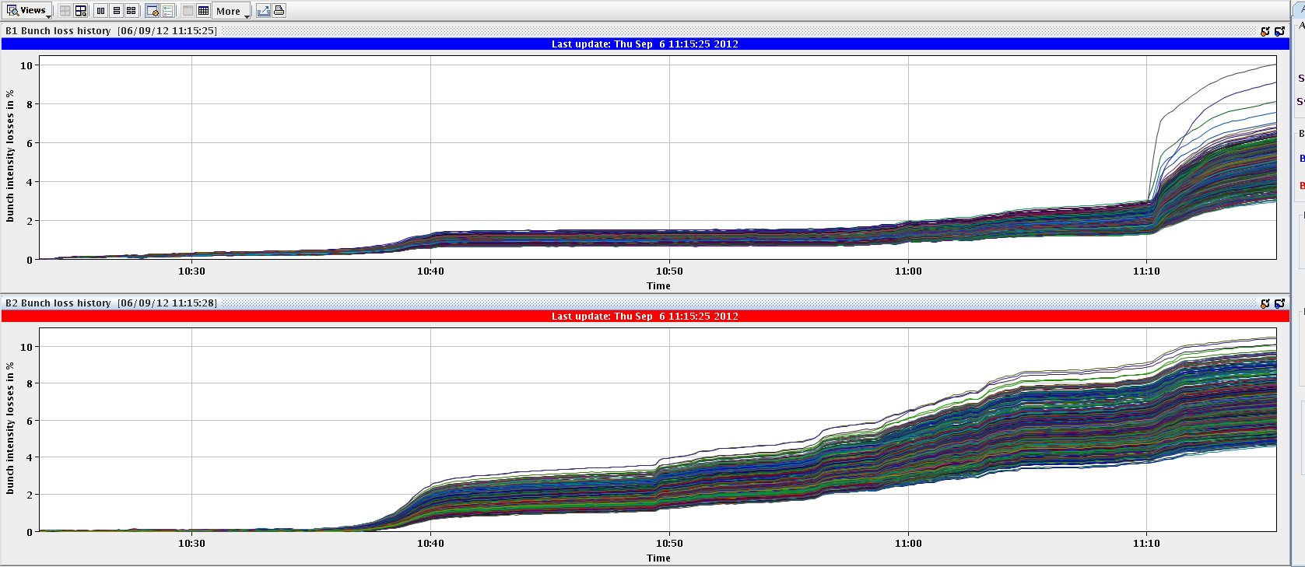
Thu Morning
11:12h adjust & stable beams
L₀ = 7 E33
single bunch intensities
10%
10%

Slide 4
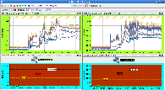
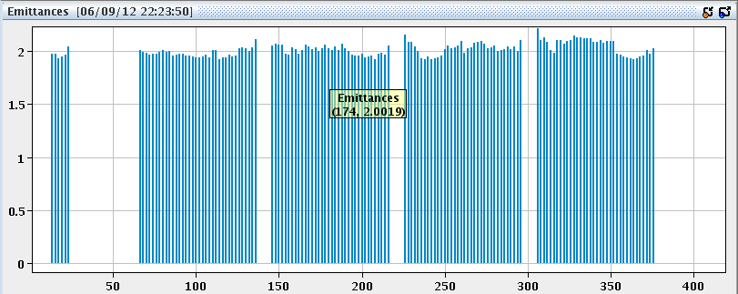
Thu Morning / Late
12:08h orbit drift observed together with a lifetime drop of B2
first investigations: sinusoidal osc, most eff corr: A5.L8
routinely: check of agp
... baby sitting
20:52h programmed dump
22:15h injection B1H = 1.87 B1V = 1.84
B2H = 1.78 B2V = 1.97
bunch intensities

Slide 5
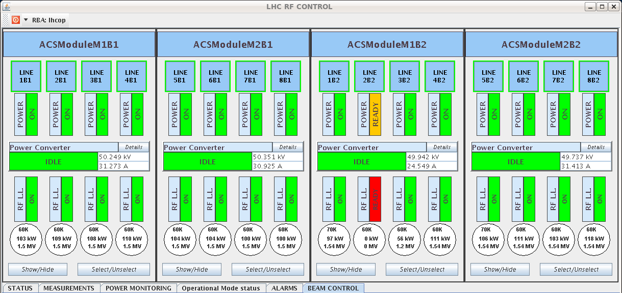
Thu Night
22:45h ramp, squeeze, adjust
23:30h stable beams L₀ = 7.5 E33
00:52h beam dump: Trip of RF line 2B2

Slide 6
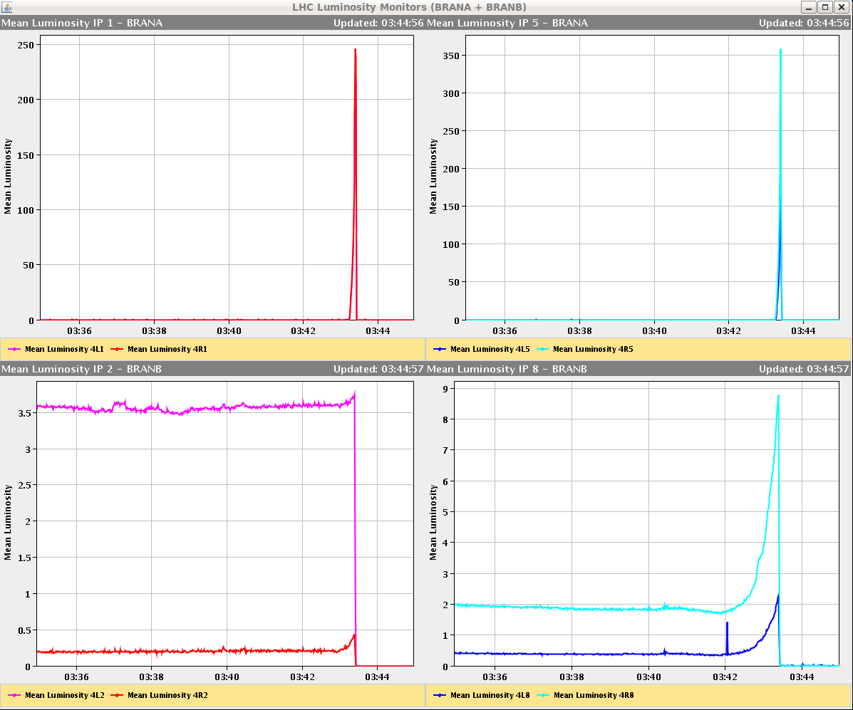
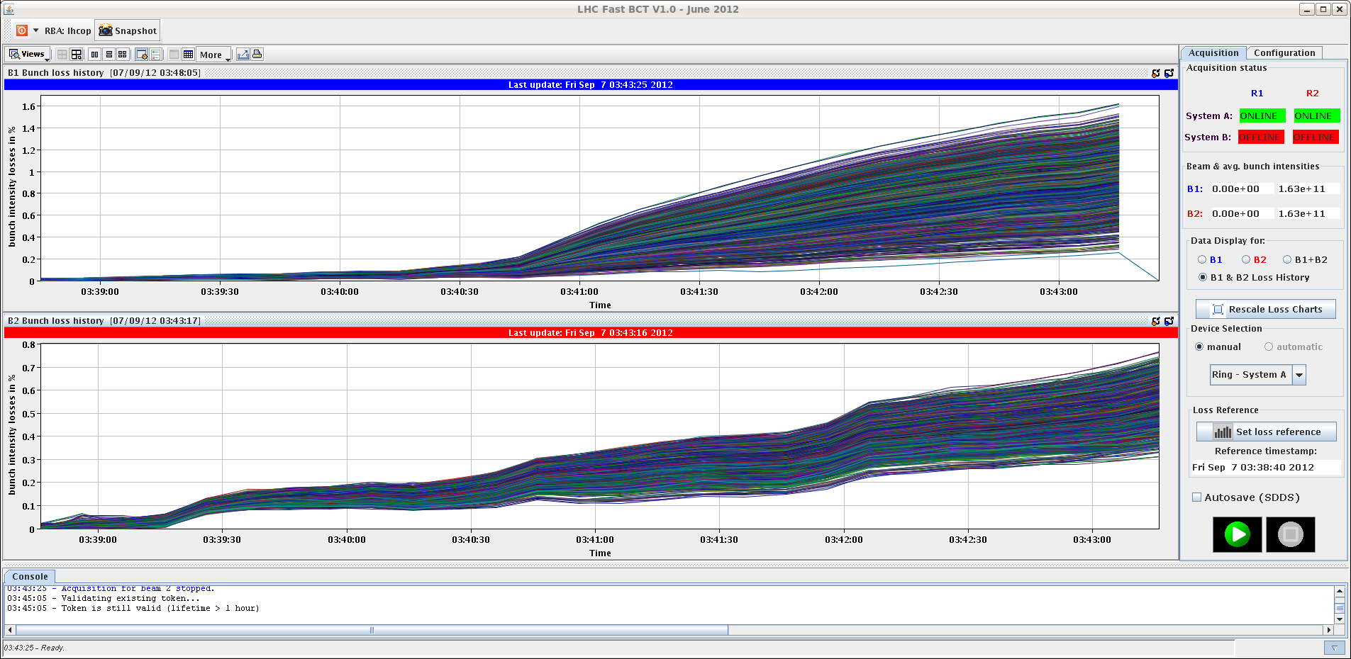
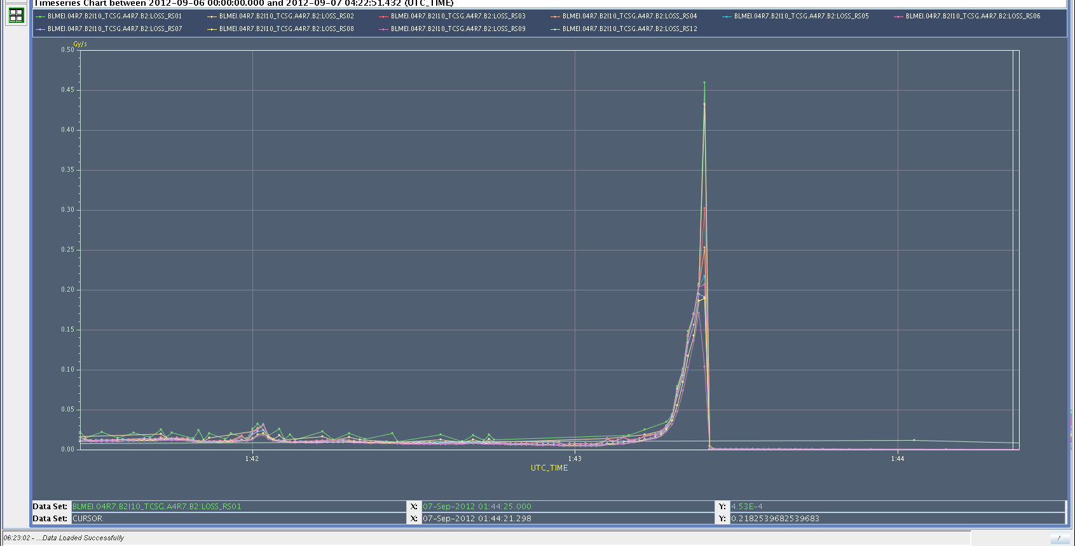
Thu Night
RF problem: no alarm, reset and restarted ok
02:04h injection
03:01h ramp
03:40h adjust & beam dump
Slow losses of B2 in IR7 at the end of collision
beam process. No sign of instability.
Losses built up in a few seconds.
1%
1%

Slide 7
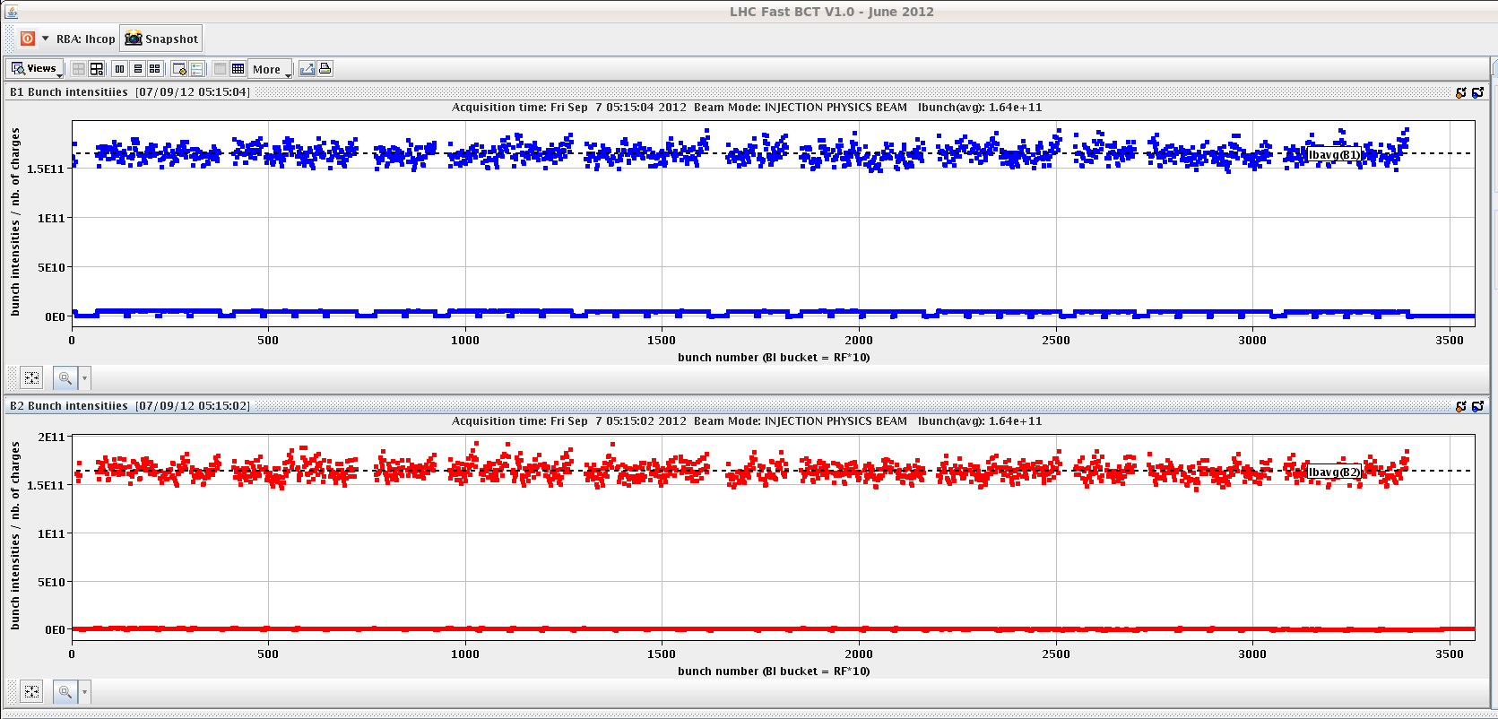
Thu Night
04:50h new injection N_{p}=1.64 (avg)
05:15h ramp, squeeze, adjust
06:00h stable beams, L₀ = 7.2 E33
small remark: again ... losses on the first 6 bunches of beam 2
12%

Slide 8
Thu summary
OP-Dump
RF
stable beams
BLM

