Slide 1
Summary of week 35
Machine Coordinators: G. Arduini, J. Uythoven
Main aims: LHCb polarity switch, Luminosity production

Slide 2
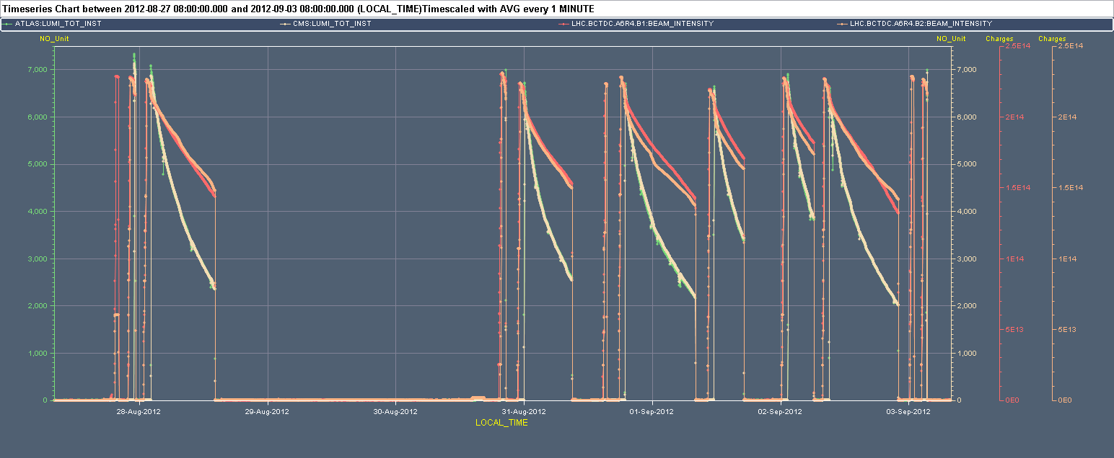
Week 35
7x10³³ cm⁻²s⁻¹
Vacuum – Pt 7
Cryo-Pt4
BSRT
L_{ATLAS} L_{CMS} I_{B2} I_{B1}

Slide 3
Last 24 hours
06:17 RQTL7.L7B2 trip (QPS –SEU?). 87 pb⁻¹ in ~5 h
07:13 Start filling
09:08 STABLE BEAMS #3021. Iitial luminosity 6.6x10³³ cm⁻²s⁻¹
Beam dump initially planned for ~20:00 delayed to 22:00 to allow MKI B1 kicker temperature reduction
22:05 OP dump (167 pb⁻¹ in ~13 h). Injection delayed due to MKI2 temperature
00:08 Injecting
00:58 OFC crashed at the beginning of the squeeze. SIS dump. Expert called. Core dump saved. More information today.
02:00 Filling and verification of the behaviour of the orbit and tune feedback.
Kept lower QH tunes (by 0.002) during the squeeze ➔ lower losses on B2
03:25 Stable beams #3023. Initial luminosities up to 7.1x10³³ cm⁻²s⁻¹

Slide 4
Last 24 hours
03:25 Stable beams #3023. Initial luminosities up to 7.1x10³³ cm⁻²s⁻¹
03:28 Lost cryogenics in sector 78. QRL vacuum gauge spurious reading and triggering closure of cryo valves on DFB
07:10 Access in point 7 for replacing vacuum PLC in IP7
Cryo conditions expected to be back not before 09:00. Then pre-cycle.

Slide 5
Main faults
Date | Duration [h] | Description
Mon 27/8 | 10.3 (14.6) | Cryo point 4, SPS Extraction septum
Tue 28/8-Thu 30/8 | 48 | BSRT, RF M2B1 (crowbar oil level), TI2 power converter
Fri 31/8 | 5.2 | Recovery from electrical perturbation (EDF), compensator point 8, SPS extraction kicker, IT.R1 power converter
Sat 01/09 | 6 | IT.R1 power converter, QPS board replacement for RQT13.R7B1
Sun 02/09 | 1 | Kicker temperature
Mon 03/09 | 4.5 | QRL vacuum gauge. Point 7.
Total | 75
Notes:
TI just informed us that there is a problem with the electrical power for the pumps cooling the compensator in PT 8. We ramped down the LHCb magnets and will wait at the bottom of the precycle while they try to fix the problem.

Slide 6
Main faults by system
System | Time [h] | Comments
Beam Instrumentation | 45 | BSRT
Cryo | 8 | Point 4 cold compressor
Injectors | 5.5 | SPS (Extraction septum), TI2 power converter
QPS | 5 | QPS board replacement for RQT13.R7B1
Vacuum | 4.5 | QRL vacuum gauge. Point 7.
Electrical network | 2.5 | EDF+Pt.8 compensator cooling
PC | 2 | IT.R1
RF | 1.5 | RF M2B1 (crowbar oil level)
Kickers | 1 | Kicker temperature (MKI-2)
Total | 75 (45 %)

Slide 7
Fills from 27/08 – 08:00
Fill | N_{b@SB start} [10¹¹] | Duration [h] | L_{int} [pb⁻¹] | Dump reason
3009 | 1.59 | 0.3 | 6.8 | UFO 5L4
3011 | 1.56 | 12.0 | 175.5 | 7OP dump
3015 |  | <1 min | 0 | RQTL7.R7B2 (QPS – SEU?)
3016 | 1.53 | 8.9 | 125.8 | Electrical network glitch
3018 | 1.55 | 13.2 | 173.2 | OP dump
3019 | 1.52 | 5.6 | 92 | RQT13.R7B1 (QPS - lSEU?)
3020 | 1.55 | 4.9 | 87.5 | RQTL7.L7B2 trip (QPS – SEU?)
3021 | 1.56 | 12.9 | 167.2 | OP dump
Total |  | 57.8 | 828
STABLE BEAMS 57.8 h (34.4 %)

Slide 8
Lost fills before stable beams (>450 GeV)
c/o Post-Mortem DB
Event Timestamp | Phase | Beam Energy [TeV] | Fill Number | Comment
30/08/2012 16:32 | ADJUST | 4000 | 3014 | LHCb pilot ramp
31/08/2012 15:33 | RAMP | 3898 | 3017 | Triplet power converter R1
03/09/2012 00:58 | SQUEEZE | 4000 | 3022 | Orbit Feedback Controller crash

Slide 9
Performance
~13.5 fb⁻¹
~1.3 fb⁻¹

Slide 10
Performance

Slide 11
Performance

Slide 12
Performance
Work ongoing in the injectors

Slide 13
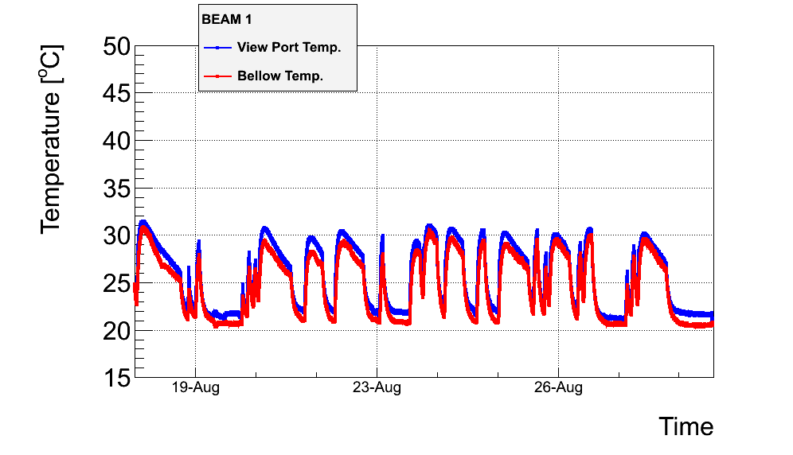
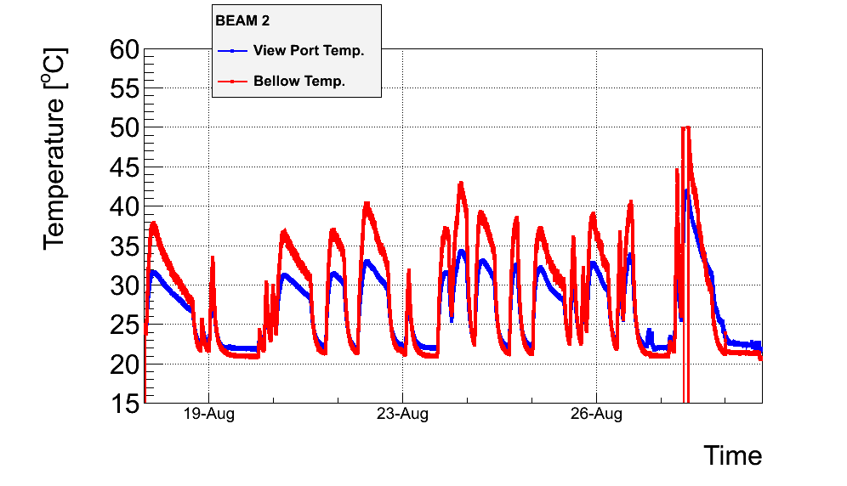
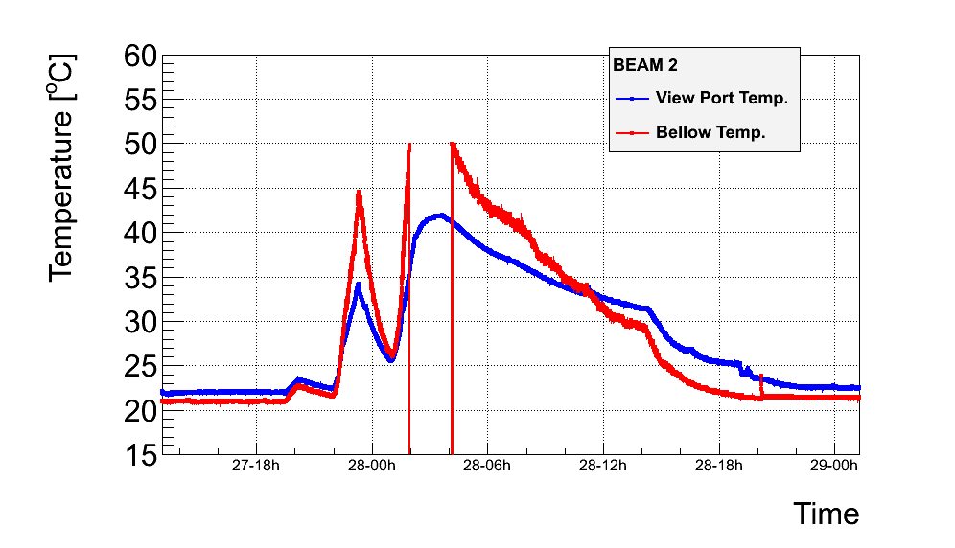
BSRT
F. Roncarolo
Observed movements of the mirrors extracting the synch. light as a result of beam induced trapped modes. Deterioration in week 34 and in particular on 28/8 for B2
Indications of permanent deformation of the system holding the mirror
Potential risk: mirror falling on beam and/or on underlying glass window port
Last two fills
+UFO activity on 27/8 - #3011

Slide 14
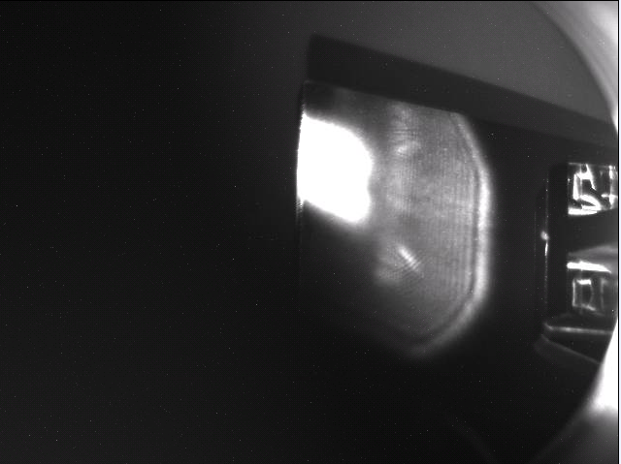
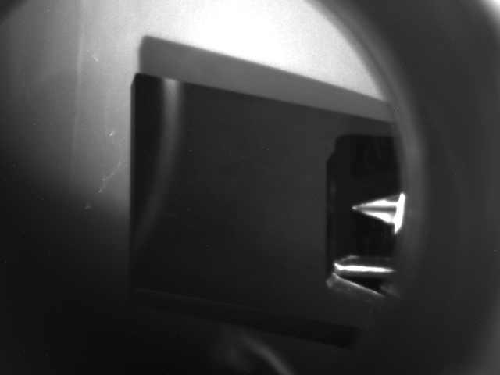
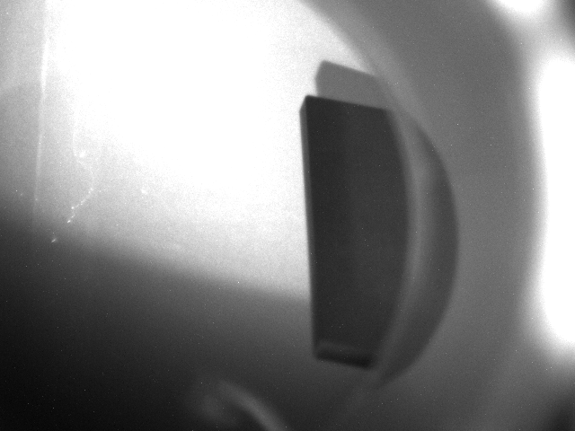
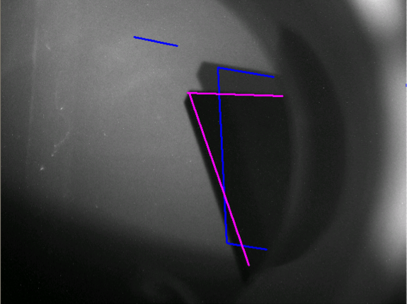
BSRT
1- Beam (spot not in the ‘right’ place vertically)
Tue 28/8: decided to retract mirror for BSRT B2
2- Beam dump
4-No beam, no motors movement, mirror moved
3- Close Vacuum sector and retract mirror to OUT
F. Roncarolo

Slide 15
BSRT
Tue 28/8:
14:00-19:00 Verifocations from CCC.
19:00-21:00 BI visual inspection and preparation of intervention for the extraction of the mirror and supporting device.
23:00-02:00 Ne injection in the area to minimize potential impact of glass view port failure and prepare for intervention
Wed 29/8:
04:00-07:00. B1 studies for MOD.A23.B1 polarity check (R. Tomas).
07:30 Access for BI, Vacuum, cryogenics, safety coordinator, RP
11:00 start pumping down

Slide 16
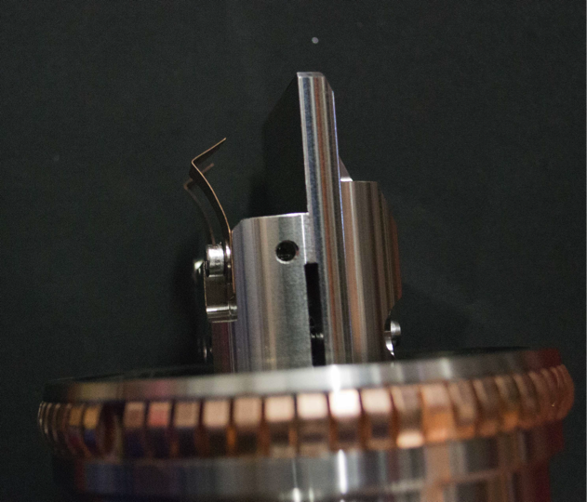
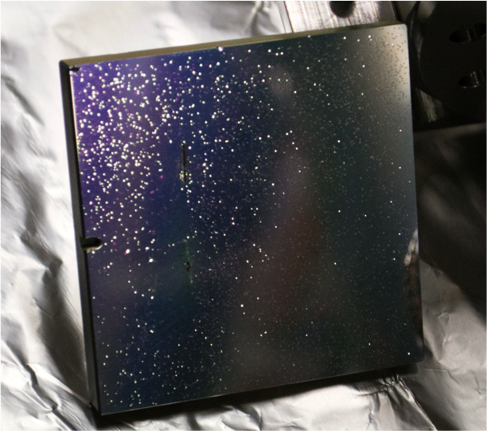
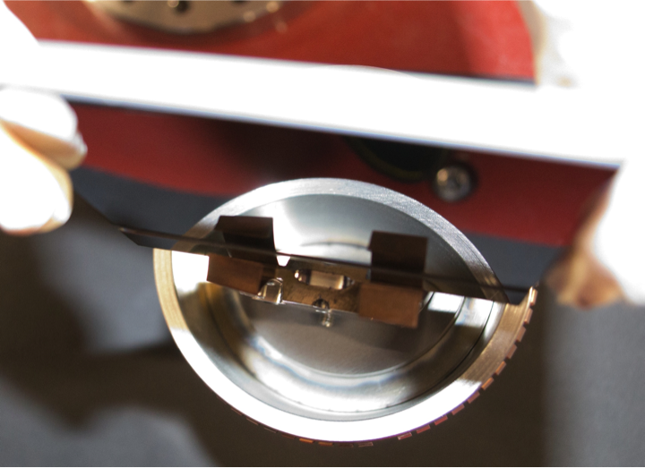
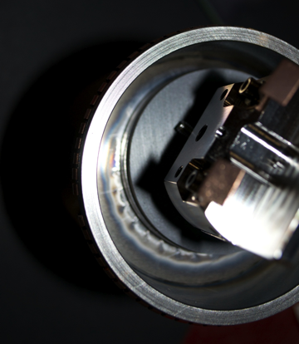
Findings
Mirror clamps deformed
F. Roncarolo
Mirror damaged (or dust)
Mirror as installed
Traces of heating at the ferrite location

Slide 17
BSRT
Thu 30/8:
11:00 Vacuum OK for beam injection
Beam 1 mirror retracted and blocked in out position
Undulators for B1 and B2 OFF
Compensatory measures for Abort gap cleaning
Many thanks to Federico for the close follow-up of the BSRT heating and to the various teams involved in the intervention
Lamp ON
3015
3016
F. Roncarolo

Slide 18
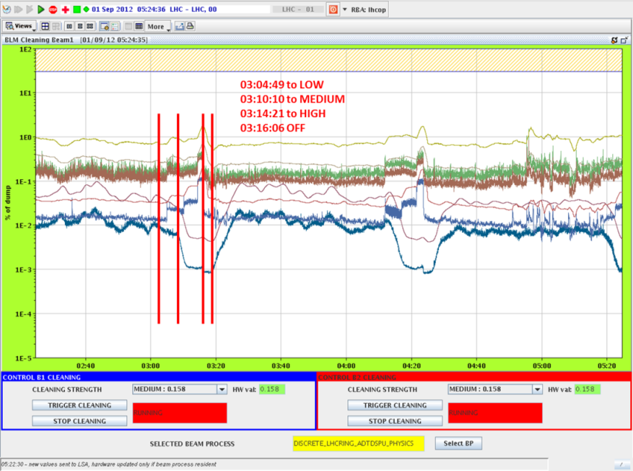
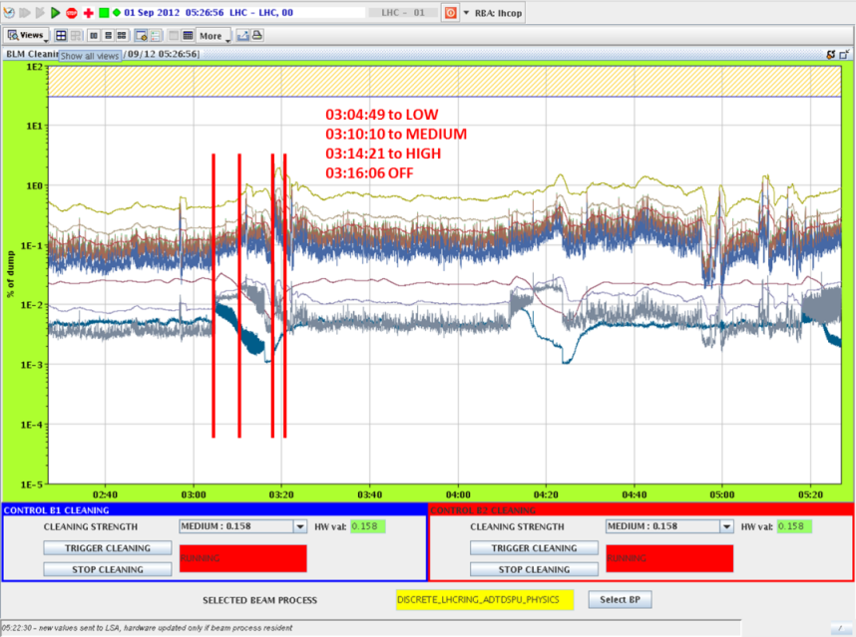
Check abort gap population by cleaning
Compensatory measures to run without abort gap monitoring
Regular abort gap cleaning exercises
Monitor losses at the collimators
Effect on measured beam loss reproducible
ALICE and LHCb investigating means to provide abort gap monitoring signals (thank you!!)
B1
B2
M. Solfaroli, L. Normann

Slide 19
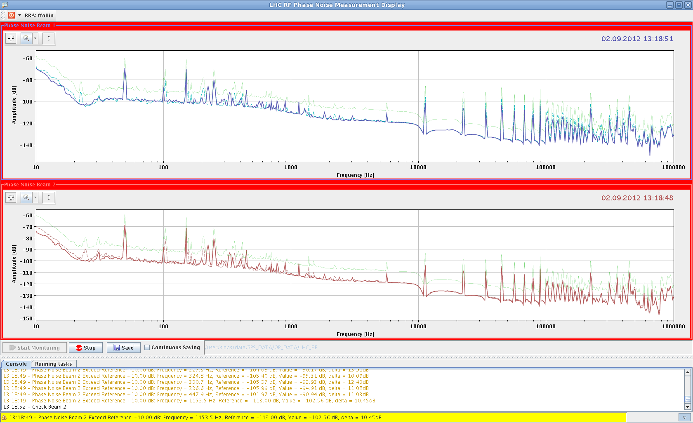
RF Monitoring for Abort Gap (P. Baudrenghien)
Monitoring of the detected RF voltage. If the difference between two consecutive readings is more than 1% amplitude or 2 degrees phase ➔ warning (Big Sister).
Supervision of the cavity sum phase noise. Updated version of the RF fixed display comparing the measured spectrum to a reference at flat-top changing of colour if difference larger than 10 dB. Version under test.
F. Follin

Slide 20
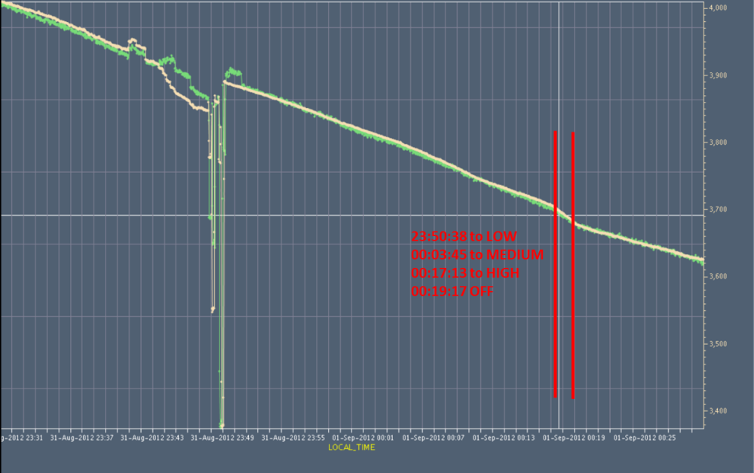
Check abort gap population by cleaning
Effect of abort gap cleaning on beam and luminosity lifetime particularly when operating at medium/high excitation
Daniel Valuch contacted to implement different settings for cleaning and monitoring to minimize effects during monitoring
L_{ATLAS} L_{CMS}
M. Solfaroli, L. Normann

Slide 21
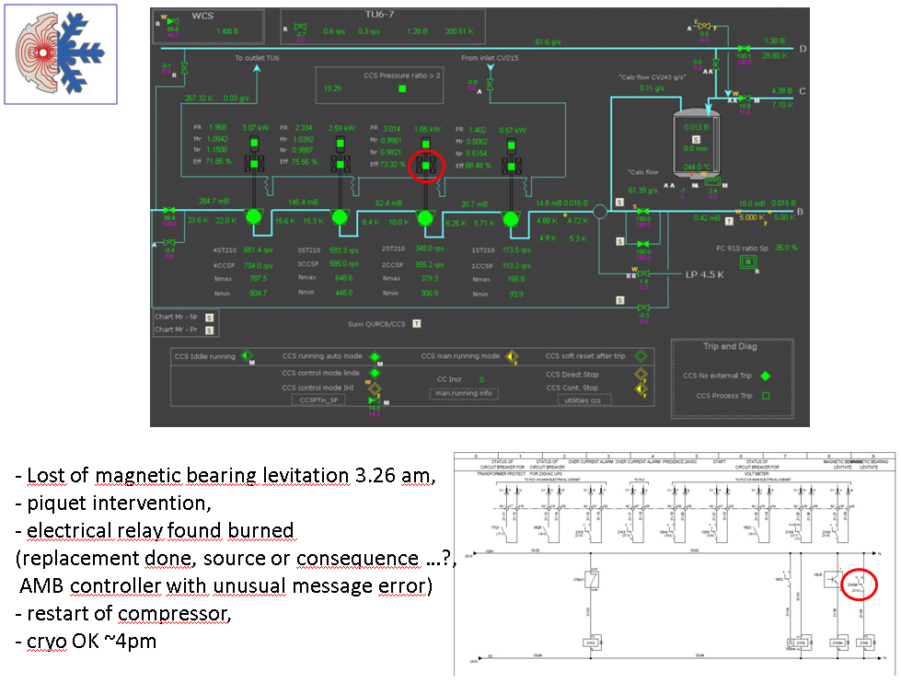
Cryogenics point 4 – Mon 27/8
K. Brodzinski
03:26 Loss of magnetic bearing levitation
Piquet intervention, electrical relay found burned
Controller with unusual error message. Suspected SEU. This could be the origin of the relay fault
16:00 Cryo OK

Slide 22
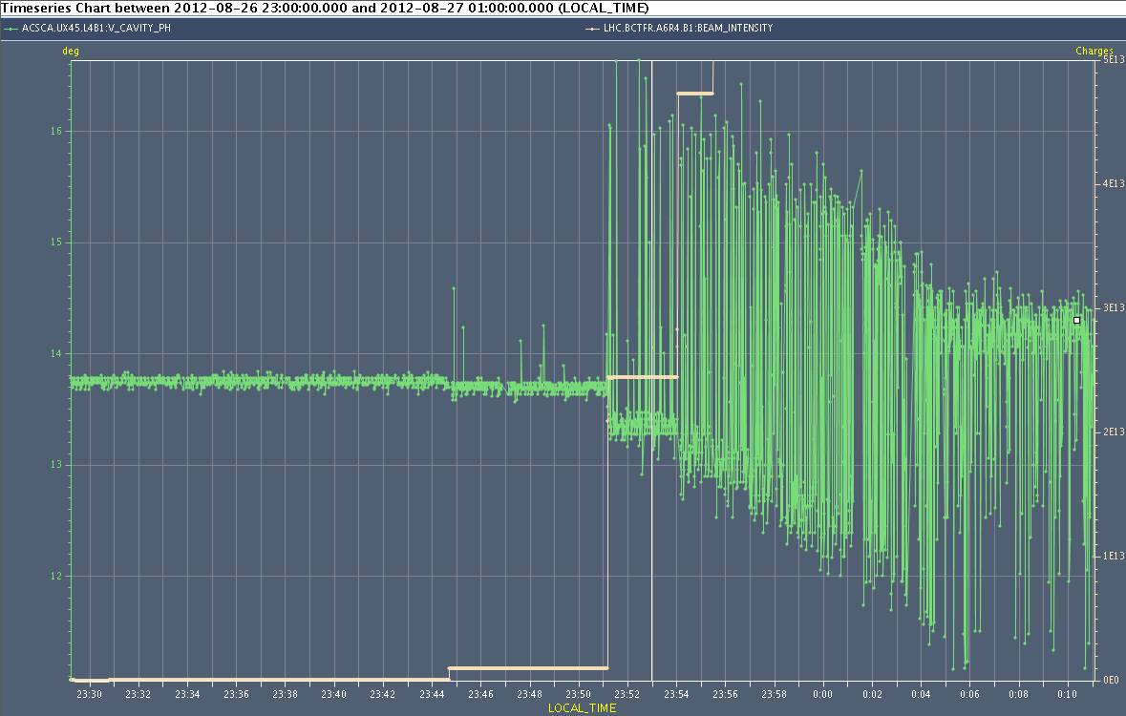
RF phase noise
Phase noise present on Cav4B1
1 turn feedback on this cavity was off
probably following the running of a Matlab script that indeed opens the switch
Problem present since at least one week, no older logging data
The 1 turn feedback generally improves RF phase noise due to beam loading by a factor of 6. This noise gets worse with increased beam intensity…
Switched back on the 1 turn feedback. Noise no more observed
Cav4B1 RF phase I_{B1}
P. Baudrenghien, G. Hagmann

Slide 23
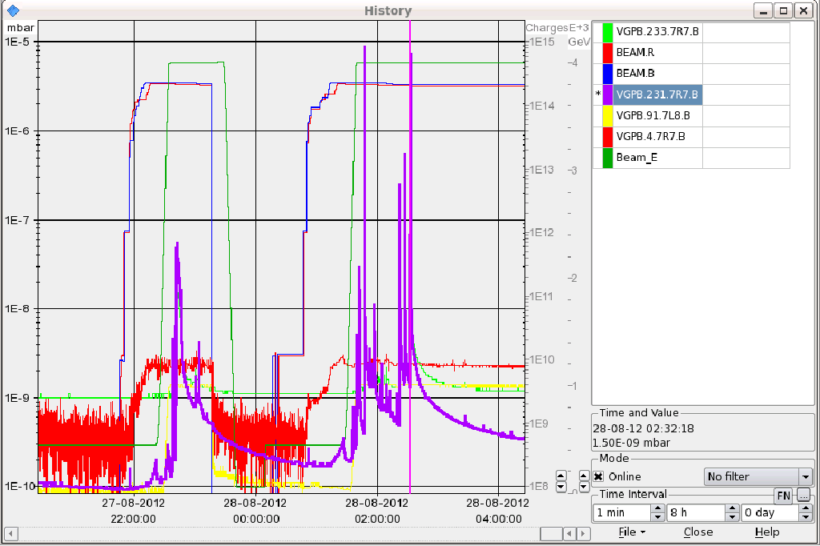
Vacuum spikes 7R7 B1
First time valves in in week 33
Came back twice in week 34
Decide to not take into consideration the most active vacuum gauge VGPB.231.7R7B
In week 35 it would have dumped again without this measure. X-ray during technical stop before scrubbing run and high intensity operation would be desirable.

Slide 24
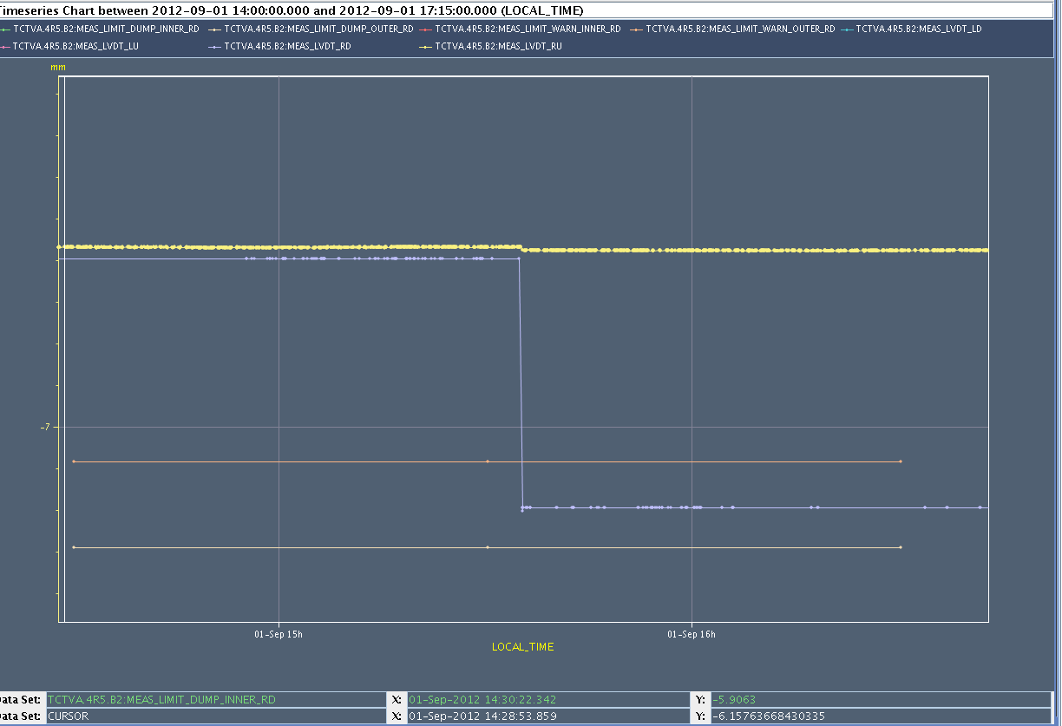
TCTVA.4.R5B2
TCTVA.4R5.B2 moving by 0.6 mm while in STABLE beams on Sat 1/9 at 15:35. Remained within tolerances. This is why the beam was not dumped.
No visible losses during the movement
Warning appeared on the collimator display but was not noticed ➔ LHC announcer?
Only Right Downstream motor moved ➔ likely SEU
LVDT-Right Upstream
LVDT-Right Downstream
Outer Warning level – RD
Outer Dump level – RD
Run several cycles ➔ no problem observed. No intervention on the driver.

Slide 25
Other problems
Compensator in Pt.2
Reason of the trip of the Static VAr Compensator in Point 2 (29/8) not found. Harmonic filter working but TCR (Thyristor controlled reactor) could not be restarted
Propose to wait for the TS3 for the restart of the TCR.
As compensatory measures, the converters of TI2 shall not pulse when the LHC is ramping or at high energy ➔when LHC above inj. energy
If supercycles without LHC cycles. TI2 can be left ON
If supercycles with LHC cycles. TI2 should be OFF
QPS trigger Q4.L1
Access during cryo problem. Nothing found but changed board. Since then no problem.

Slide 26
Plan
Cryo recovery. In the shadow (almost) IT.R1 power converter repair (until 11:00)
Intervention on 18 kV SPS cable (12-14)
LHC at injection with pilot beam for skew sextupoles and triplet octupole circuits polarity checks
Physics
To be scheduled:
Batch by batch longitudinal blow-up
TOTEM data taking (requires collimation expert for TCLA set-up)
Next coordination team: B. Holzer, M. Lamont

