Slide 1
Friday 31st August & night
00:03 Stable beams #3016. Initial luminosity ~6.7x10^33 cm⁻²s⁻¹.
08:59 Electrical network glitch - Beam dump - ~125 pb-1 in 9 hours.
Lost 3 sectors (1-4) with fast abort of the mains and trip of the dipoles of ALICE and LHCb
11:36 At the end of the pre-cycle another electrical problem appeared in point 8
Problems with the beams from the BOOSTER and a vacuum spike in the SPS extraction kicker (LSS4)
14:33 Injection physics beams
Large emittances from the injector chain, up to 2.6um for B2V.
15:33 Lost beam at the very end of the ramp (3.9 TeV)
Trip of IT.R1: the module RTQX2.R1 went in VS_fault, with an overcurrent reading. OK on the next pre-cycle.
18:55 Stable beam fill #3018, initial lumi 6.6e33 cm-2s-1
08:03 Operator dump, integrated lumi’s 173 pb-1
08:40 Trip of RQX.R1, same as yesterday afternoon – waiting for news

Slide 2
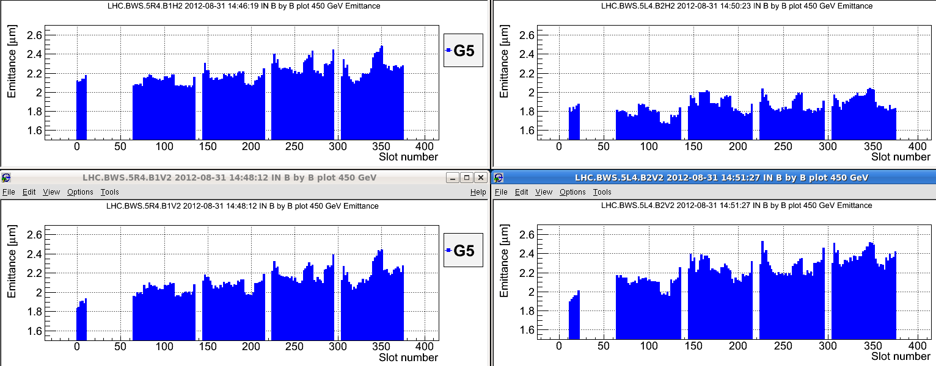
Large beams from the injectors
Very likely the cause of the losses end of ramp and the squeeze of the fills Thursday night as well.

Slide 3
Fill # 3018
Slightly better emittances from the injectors
B2 lifetime suffering during squeeze
Initial lumi’s around 6.7 / 6.5 e33 cm-2s-1: suffering from reduced brightness.

Slide 4
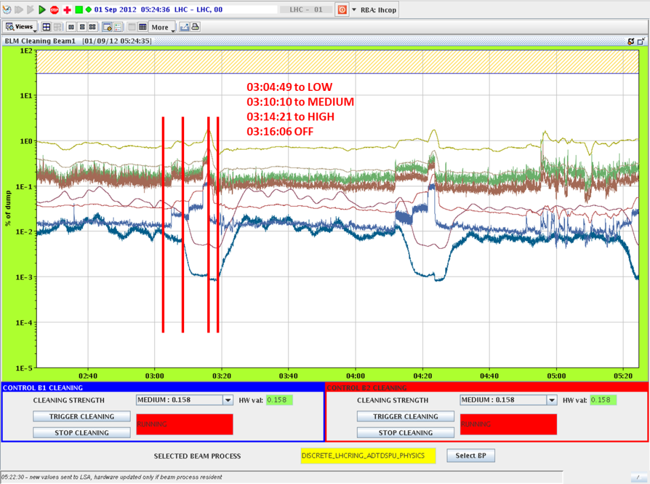
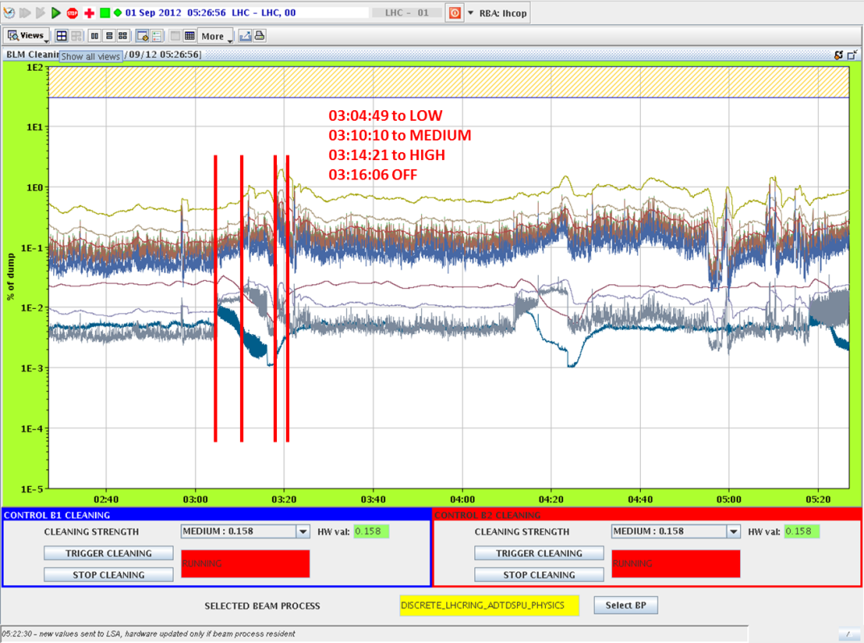
Check abort gap population by cleaning
Effect on measured BLM losses at the collimators is very reproducible
B1
Matteo & Lasse
B2

Slide 5
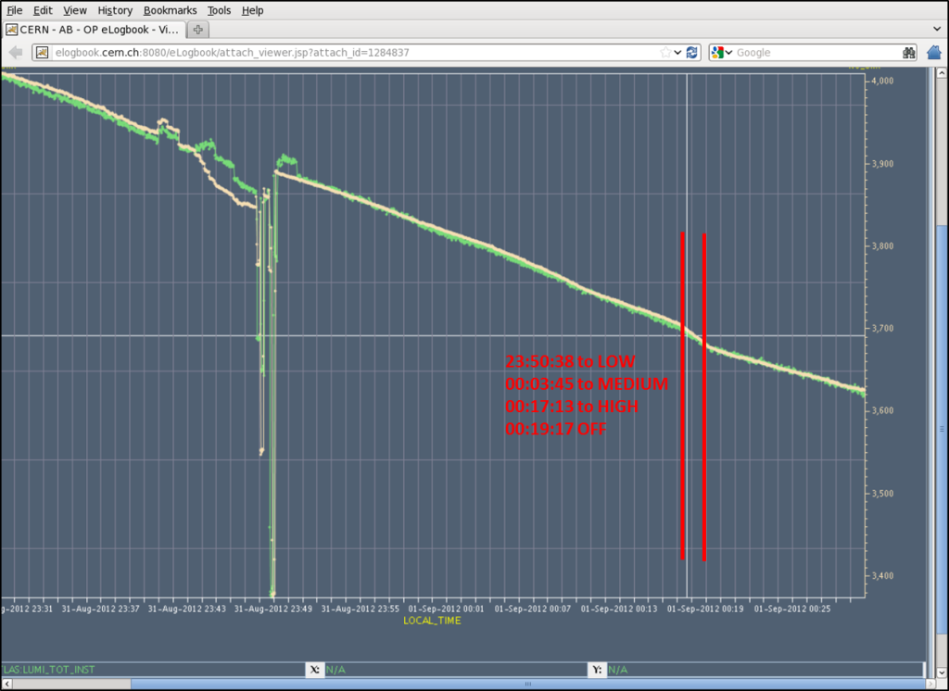
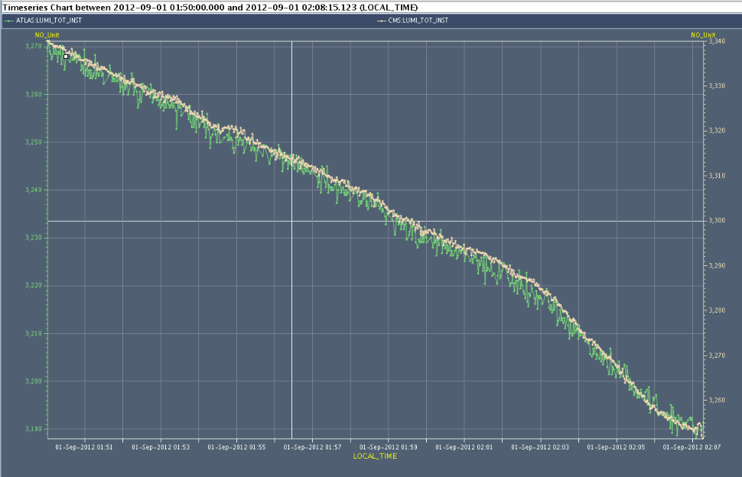
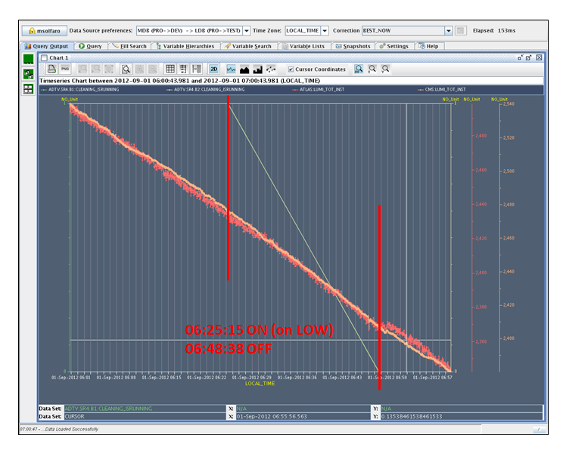
Effect on beam current & lumi
Matteo & Lasse

Slide 6
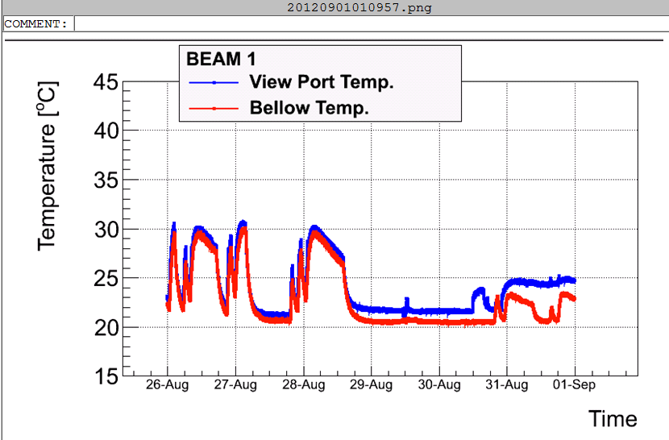
BSRT B1, out position, stays cold.

Slide 7
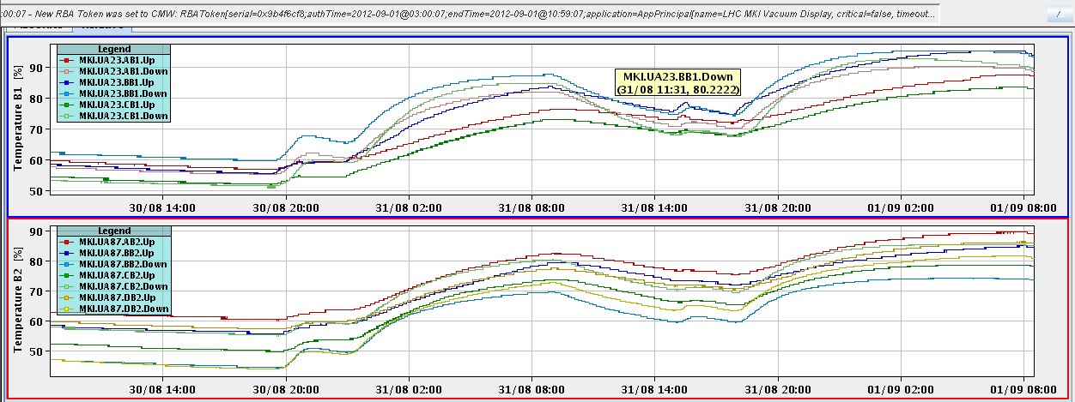
Injection kicker temperatures
Not running long enough to get the injection kickers hot, yet

Slide 8
Ahead
Physics
SPS EDF intervention
Monday morning around 9 h for about two hours
Close to CCR again – same test took computers in CCR down
Will only allow safe beams in the LHC
Candidate tests
Rogelio skew sextupole polarity
Rogelio triplet octupole correct circuit tests & polarity
On the waiting list
Totem in at end of fill
RF batch-by-batch blow-up

