Slide 1
Wednesday 8th August & night
01:25 Stable Beams fill #2927, 1374 bunches (vertical instability end of squeeze)
09:31 Operator dump. Int. lumi 103 pb-1
12:10 Stable beam fill #2928, still vertical instability end of squeeze. Initial lumi 6.2e33 cm-2s-1
14:28 Beams dumped by QPS trigger on RQSX3.R1. Probably SEU. Int. lum 45 pb-1.
20:03 Stable Beams Fill #2929. Init lumi 6.3e33 cm-2s-1, still some instability squeeze B2V at ~1.5m beta star, but starts to look better.
01:48 Beams dumped. RB energy check went false, SMP energy glitch? Integrated lumi 94 pb-1
05:35 Stable beams Fill #2932. Initial lumis 6.5e33 cm-2s-1

Slide 2
Fill #2928 (stable beams 12:10)
As the previous fill Tuesday – Wednesday had instabilities in the squeeze for this fill
Increase octupoles to 475 A end of ramp (from 417 A)
Increase vertical chromaticity in squeeze to around 7
Again stable in the ramp, but unstable in squeeze
Some small losses right in the beginning of squeeze, 1 % level, when tunes get moved. These bunches also blow-up vertical plane
More instabilities around beta of 1.2 m
After squeeze: Q’v by +3 units and Q’h by two units, both beams, beams more stable
Collision process fine

Slide 3
Fill #2928 losses during squeeze
Still, initial lumi around 6.3e33 cm-2s-1

Slide 4
During and after this fill
After lumi optimisation, ATLAS and CMS lumi no equal within 1 %
A. Masi called to warn us that the TDI.4R8 has not reached its nominal position on the right jaw. This looks like the same problem we had before.
The worrying thing is that we do not get any warning or error signal!
Later that evening: Tolerance for TDI position in the new check tasks (CHECK INJ-PROT OUT) increased to 300um
14:28, after about 2 h of stable beam, beams dumped by QPS trigger on RQSX3.R1. Probably SEU.
Turn around to next fill slowed down because
QPS reset needed on RB.A12 and on RCD.A78 and RCS.A78
Needs additional precycle after reset
ADT module V2B2 tripped, low voltage pc problem, solved after about 2 h
During next fill, at end of squeeze, the ADT module V2B2 again tripped
No beam from PS for about 30 minutes

Slide 5
In the mean time....
Coupling measurement check at injection with probes
‘We performed a test to use the injection oscillations to measure the coupling. The idea is to provide an automatic way to correct the coupling after a pilot is injected. We introduced some extra coupling which we measured and corrected using the new software. Were able to "on-line" calculate a good correction that decreased the coupling significantly. The test was only performed for beam2.’
Tobias Persson, Rogelio

Slide 6
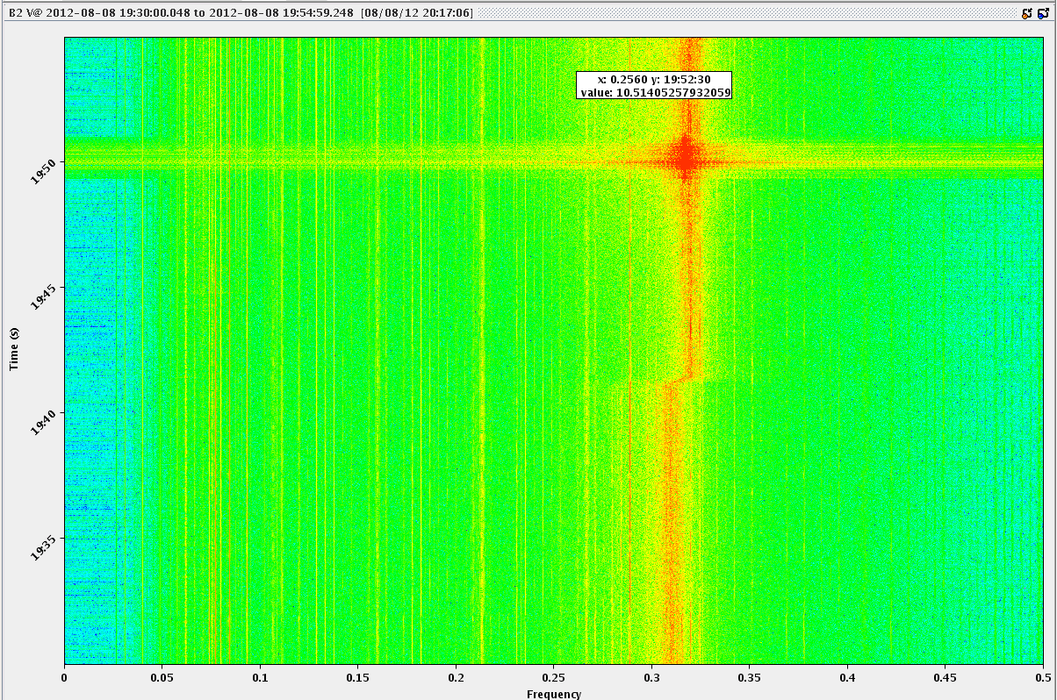
Next fill (#2929)
To try to get the beam stable in squeeze, changed:
Octupoles end of ramp up to 510 A – down to 400 A in physics
Chromaticity up +2 H and +3 V end of ramp
Instability occurred on B2V at ~1.5m beta star, like previous fill ... the instability disappeared by itself
So some improvement relative to previous fill
For the next fill we will raise the chroma in the squeeze
B2V

Slide 7
Losses less important this fill
20:03 Stable beams

Slide 8
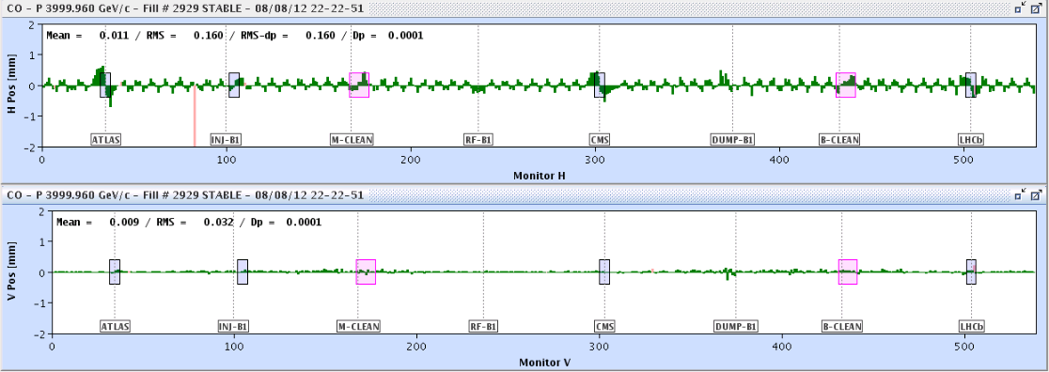
During the fill, end of the fill
20:58 trip RCBH18.L1B
Messy orbit can be corrected
Only had current of about 1 A
01:48 Beams dumped. RB energy check went false, SMP energy glitch? Nothing found in the logging
Integrated lumi 94 pb-1

Slide 9
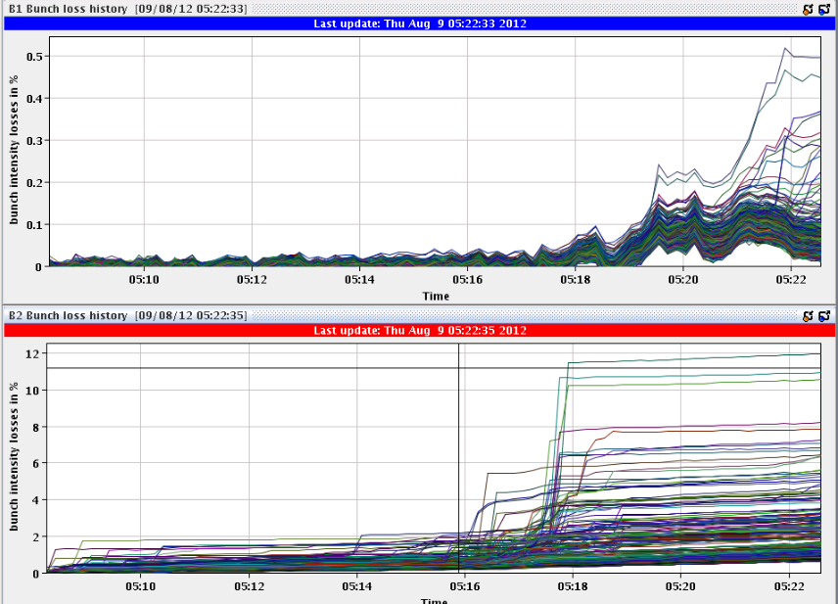
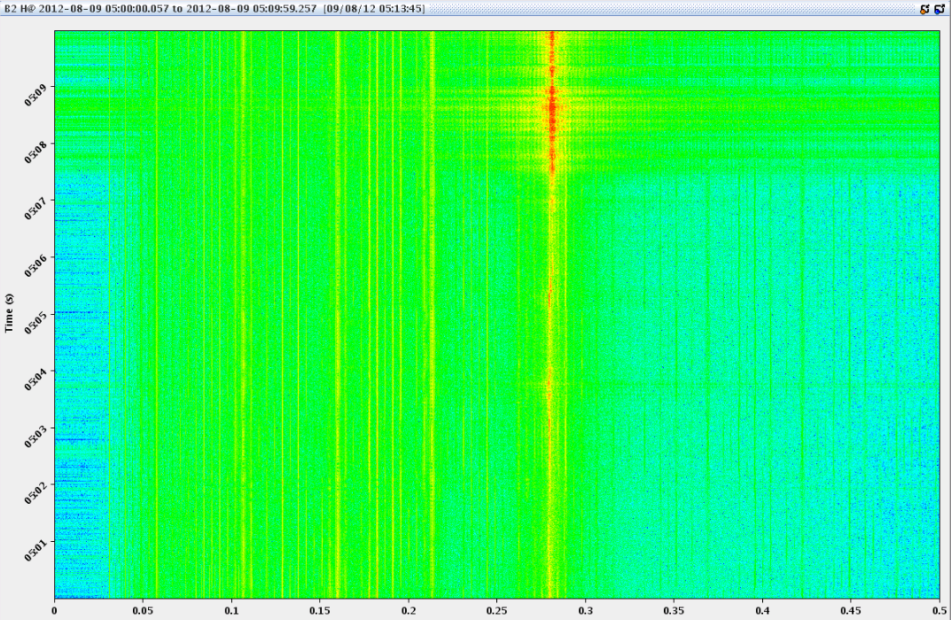
Fill #2932
Quite some injection steering
SPS in MD mode affecting the LHC cycle
At the end of the ramp trimmed the tune H (+0.001 for beam 1 and + 0.002 for beam 2)
During the squeeze unstable in B2 H
Octupoles end of ramp up to 510 A – down to 400 A in physics
Chromaticity up +2 H and +3 V end of ramp relative to prev. fill
Add end of squeeze manually trim up chroma H by + 2 units both beams
B2H

Slide 10
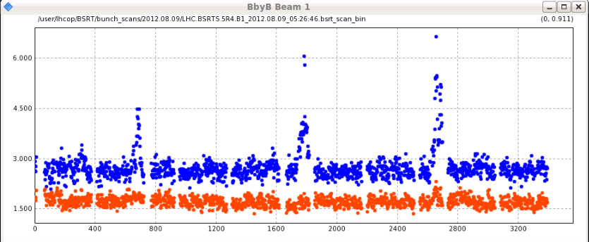
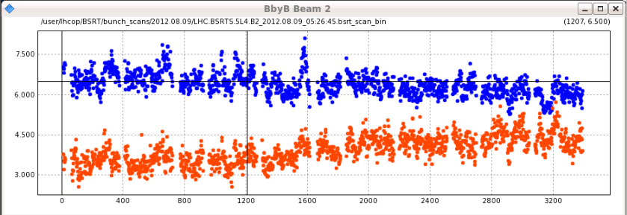
BSRT scans before going to collision

Slide 11
Good initial lumi’s
However, poor lifetime. Optimise with tune, chroma, octupole strength

Slide 12
Various
SPS intervention (EDF) Thursday 10:00 for 2-3 hours
TOTEM – move in half way through a fill to take data...
LHCb polarity change (Friday)
Octupole polarity check with beam
Further tests of tune measurements with damper
At injection and some time during fill (use LHCb test ramp?)
Access list developing
ATLAS Xenon leak – semi urgent
2 h access, preferably today
Markus Z. – point 4 – di/dt
N. Magnin – LBDS
RP – RAMSES reset
Ralph S. – UA47 and tunnel

