Slide 1
Summary Week 31
Coordination: G. Arduini, E.B. Holzer

Slide 2
Sunday 5.8.

Slide 3
Sunday 5.8.
5:23 cryo cold compressor tripped – access needed
BLM Sanity check (Jonathan Emery): change of 2 SEM monitors settings on the crate SR7.C in order to avoid almost systematic failing of this check. These 2 monitors are not connected to BIS and therefore not part of the machine protection.
Access for ALICE
afterwards trip of ALICE solenoid during ramping up
21:51 cryo recovered after 16.5 hours, start pre-cycle, ALICE solenoid still in fault
00:21 – 00:44 ALICE in supersafe mode – injecting beam to check out the machine before giving EPC piquet again time for ALICE solenoid PC investigation and repair
1:11 EPC: broken thyristor in the solenoid PC, repair would take half a day at least, since the specialist to do this intervention are not reachable. The repair will be proponed to tomorrow and we try to go without ALICE.

Slide 4
Monday 6.8.
PC interlock (software interlock) is stuck, because the ramp-down had not been played. (PC had been sent to stand-by because of the imminent loss of cryo) → server needed to be rebooted (Kajetan)
1:53 start injecting fill 2915
EPC decided to do the intervention anyway tonight, but as it will take more than 2h we go without the solenoid.
According to Jorg's wikis the effect of the missing ALICE solenoid on the orbit should be light and become negligible at high energy (1/E).
Average bunch intensity: 1.53E11
3:13 dump on instability 70 sec after the collision beam process was launched due to RS9 losses on TCTH.4R5.B2
3:52 changing the thyristor did not solve the problem with the ALICE solenoid → is staying off
4:20 SPS extraction kicker problem

Slide 5
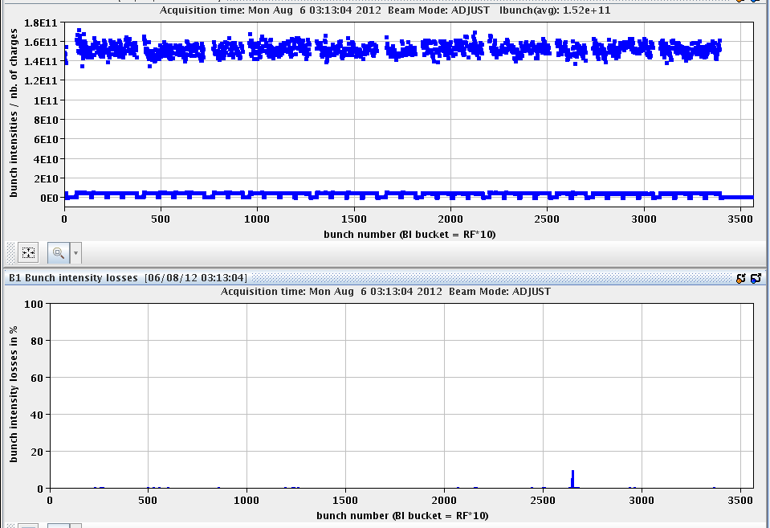
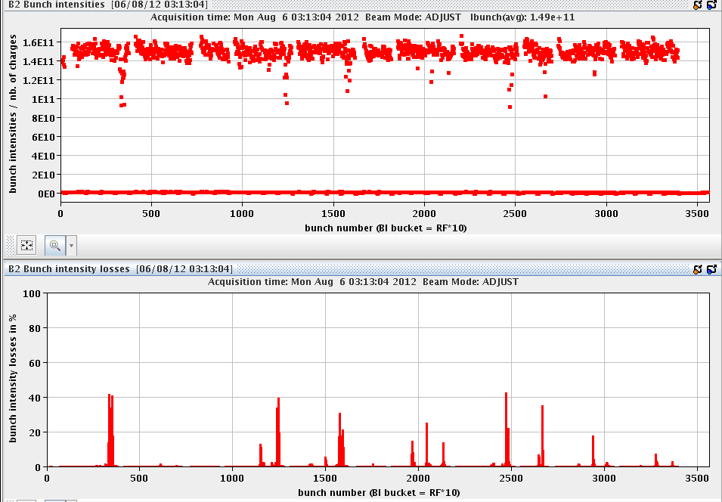

Slide 6
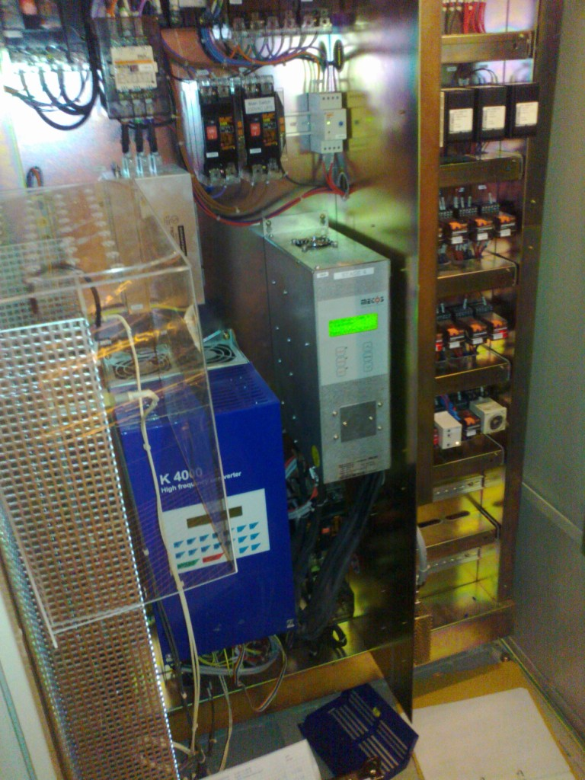
Stop of Cold Compressor (CC4) of S4-5 on Sunday 5-08-2012
Lost of CC4 of QURCB at 5:20 AM on Sunday 05-08-2012
After first investigation by cryo operators in CCC and Engineer in Best Effort, intervention needed by CRYO “Piquet” at point P4 to check CC4 calibration and electrical equipment.
Active Magnetic Bearing unit (AMB) of CC4 in default (Internal Power Supply in default)
AMB unit replaced by the similar unit available on QURCA of P8.
From Lionel Herblin
Active Magnetic Bearing unit CC4

Slide 7
Overview Week 31

Slide 8
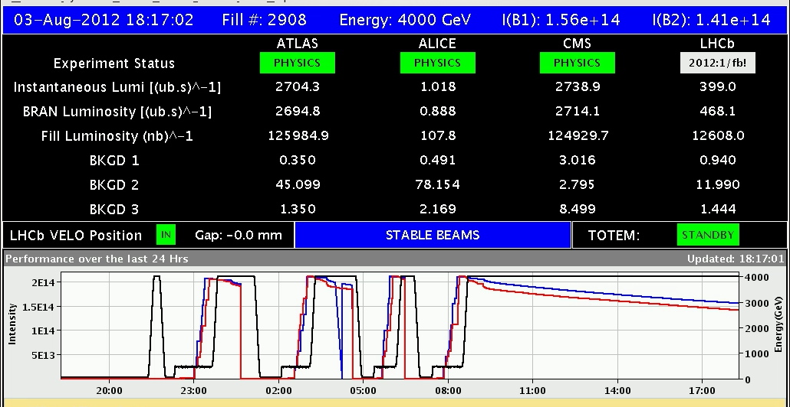
Friday: LHCb reached 1 fb-1 in 2012

Slide 9
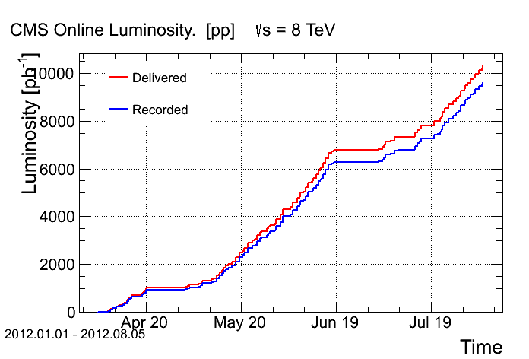
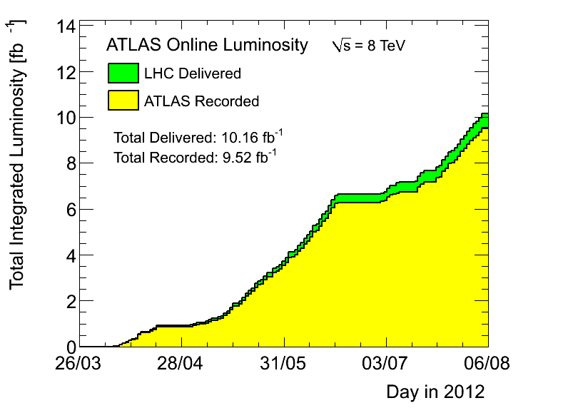
Saturday: Delivered 10 fb⁻¹ to Atlas and CMS

Slide 10
Fills with stable beams
Total: 946 pb-1 produced
41% of time spent in stable beams
Fill | Day | Stable beam [h] | Int L [pb⁻¹] | Dump
2892 | Mon 30/7 | 10 | 138 | RF trip (crowbar)
2893 | Mon 30/7 | 4.5 | 76 | BLM spurious trigger
2894 | Tue 31/7 | 1 | 20 | RCBXH1.R1 trip (QPS SEU?)
2896 | Tue 31/7 | 0.1 | 3 | RQTL7.R7B1 Trip (QPS SEU?)
2898 | Tue 31/7 | 13.3 | 161 | OP
2900 | Wed 1/8 | 3.5 | 60 | Instability/damper?
2902 | Wed 1/8 | 12.5 | 149 | OP
2905 | Thu 2/8 | 0.25 | 6 | RQ5.L8 trip (SEU?)
2906 | Fri 3/8 | 1 | 18 | UFO @ MKI2 (156% of dump threshold)
2908 | Fri 3/8 | 10 | 134 | PC trip: RCBXV1.R5
2911 | Sat 4/8 | 4.8 | 61 | OP
2912 | Sat 4/8 | 7.6 | 120 | FMCM (thunderstorm)

Slide 14
Fills lost due to beam losses before stable beams
Fill | Day | Beam process | Dump
2907 | Fri 3/8 | First part of squeeze | UFO
2913 | Sun 5/8 | Adjust: first step of separation reduction IP1 and IP5 | Fast instability B2H, some bunches
2915 | Mon 6/8 | 70 sec into adjust | Fast instability, some bunches

Slide 15
Changes
Tue 31/7 before fill 2897
Change horizontal tune back to 0.28 (from 0.282)
Tue 31/7 before fill 2898
Trimmed chromaticity during ramp and squeeze according to measurements performed on Sunday to ~+2
Investigation SPS (H. Bartosik, K. Cornelis, S. Gilardoni, Y. Papaphilippou):
Dispersion mismatch TT10/SPS found:
Re-matching might be required if results confirmed
Not clear whether this has changed recently as deterioration on 50 ns beam and h=9 50 ns beam seem to indicate
Non-gaussian tails seen at top energy, which are not present at injection
Thu 2/8 before fill 2905:
equal settings for B1 and B2 octupoles and ADT:
reduction of damper gain by 25% for B1 H
reduction of the octupoles for B2 (from -509A to -475A)

Slide 16
Changes cont.
Fri 3/8 after fill 2908
Verification of emittance in PS → all 4 PS cycles have same emittance, independent of the cycle played just before
Add empty LHC cycle in PS and PSB before the active LHC cycles
Switch off chirping B2 H after 1 TeV (and switch feed-back off if it locks on a spurious line)
→ emittances in LHC somewhat smaller (<2um) and now approximately equal among the PS batches
Sat 4/8 before fill 2912
chroma +5 both beams and planes, second half of ramp throughout the rest of the cycle (as proposed by Elias and Alexey in case of instabilities until we do not manage to reduce significantly the transverse damper gain)
PSB: improvement of the transverse emittance by 10 %
→ Very clean ramp and squeeze, Initial luminosity increased to 6.4E33 cm-2 s-1

Slide 17
Changes cont.
Sat 4/8 before fill 2913
Reduction of ADT gain squeeze and adjust
H squeeze and adjust 0.02 (instead of 0.03)
V squeeze 0.01 (instead of 0.02), adjust 0.02 (instead of 0.04)
→ Fill 2913: very few losses during ramp and squeeze, but lost in “Adjust” during first step of separation reduction IP1 and IP5: Fast instability B2H, some bunches
Sun 5/8:
Landau damping octupoles reduced to 300 A at the end of the ramp. During the squeeze they are then ramped to 417 A between 19 and 169 s (the latter point corresponding to a beta* of 9 m)
The intensity per bunch should be kept to 1.5x1011 at injection before the polarity swap of the octupoles.
No changes to damper gain or chroma with respect to last fill.

Slide 18
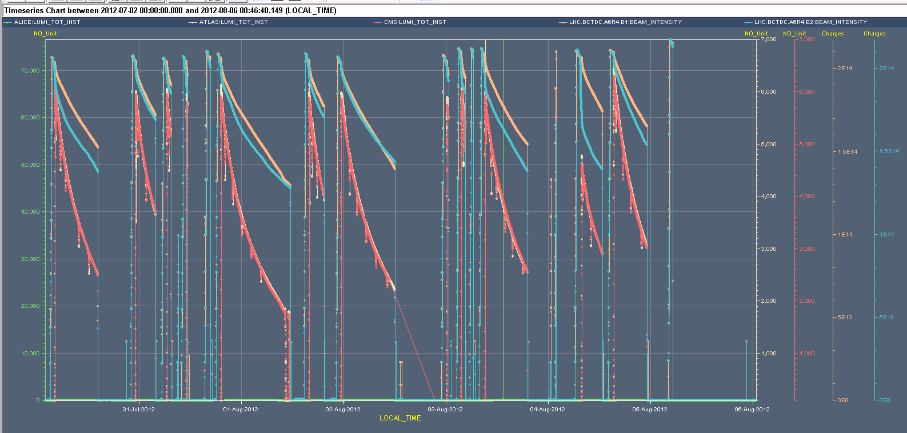

Slide 19
Main Timeouts from physics
 | Hours | Faults
Mon 30/7 | 6 | VIP visit
Tue 31/7 | 5.5 | Instability (fill lost) + BLM + Injectors
Wed 1/8 | 5 | End of fill tests for octupole polarity inversion and tune measurement with damper
Thu 2/8 | 10.5 | SPS extraction, ADT vacuum interlock, PS main power supply, QPS controller RQD.A23 (requiring access) and lost patrol in PM18 (door YCPS01=PM18)
Fri 3/8 | 10.5 | Access for power converter RCBXV1.R5, RD.34 tripping, ALICE dipole, LBDS self-trigger (AUE), SPS main power converters, CMS partly down
Sun 5/8 | 4 16.5 | Thunderstorm (FMCM, magnet trips several sectors, SPS down) cryo cold compressor down 21:51 ALICE solenoid

Slide 20
Wednesday 1.8. Octupole polarity test
end of fill study - octupole polarity inversion (Elias, Tatiana, Alexey, Georges, …):
Goal: study the effect of the opposite sign in the Landau octupoles in collision and separated beams, as this sign could lead to some lifetime degradation (larger tune footprint) and instabilities (depending on the current).
Initial luminosity of ~2E33 for IP1&5
Bunch intensities of ~1E11 p/b
Transverse emittances of ~ 3.5 microm (from luminosity)
Chromas should be at ~1.5-2 units in both planes both beams (According to recent measurements and trims)
Octupoles at -475 A for B1 and -509 A for B2

Slide 21
Octupole polarity test cont.
Scanning octupoles (~-500 to +500)
Adapting chroma according to previous measurements of chroma dependence on octupole currents
Separating beams at the IPs
→ see last weeks LMC for details
Wide range of parameters with basically the same beam lifetime
Octupoles >=+400: lifetime reduction (due to larger wings in the tune footprint?)
Octupoles at 0A, IP1&5&8 separated to 4 sigma and negative chromaticity: instabilities and losses on the 6 ‘private’ IP8 bunches developed after 4 minutes

Slide 22
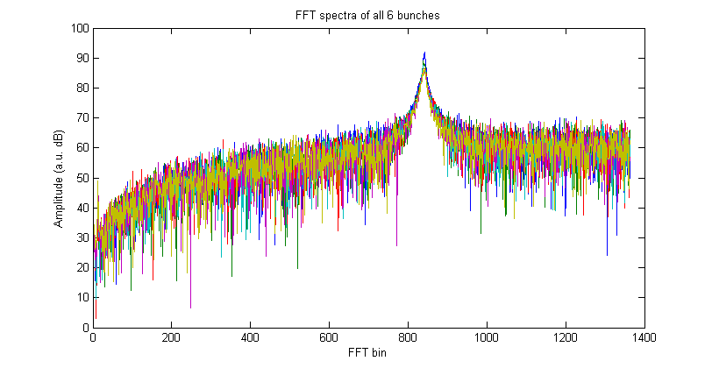
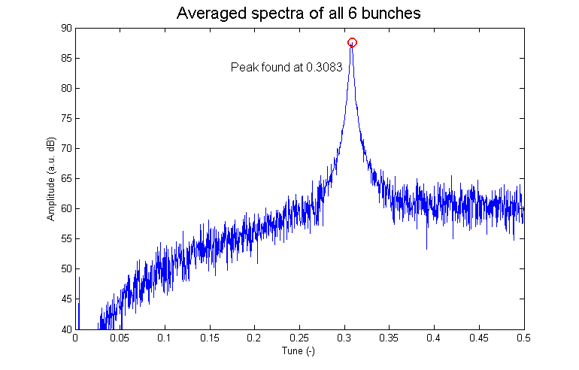
Wednesday: ADT tune measurement test
Test tune measurement by selective excitation of 6 bunches.
FFT of data for each observed bunch, average the spectra, find the peak
Very successful test. Validation during a ramp required (including emittance blow-up measurement) + operational implementation
W. Höfle, D. Valuch

Slide 23
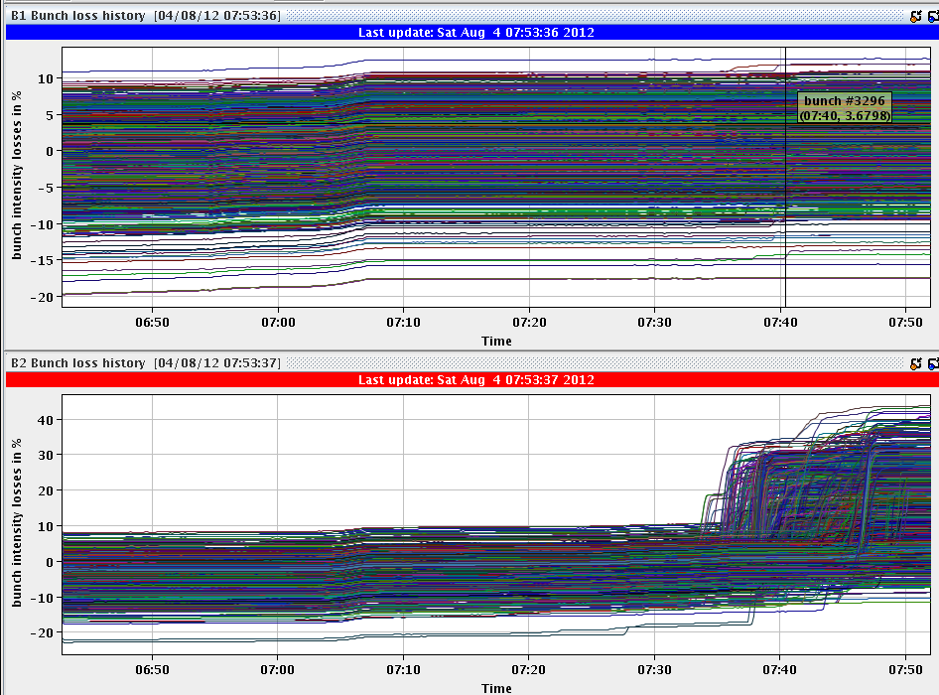
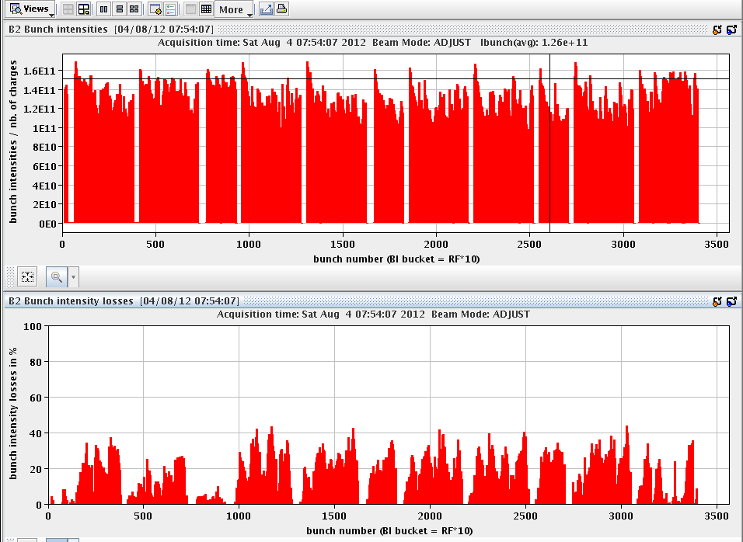
Saturday Fill 2911
Fill 2911: Average bunch intensity 1.53E11
Prepare ramp: The incorporation and regeneration tasks take very long time
Losses during ramp down again to 2-2.5%
B2 losses during squeeze

Slide 24
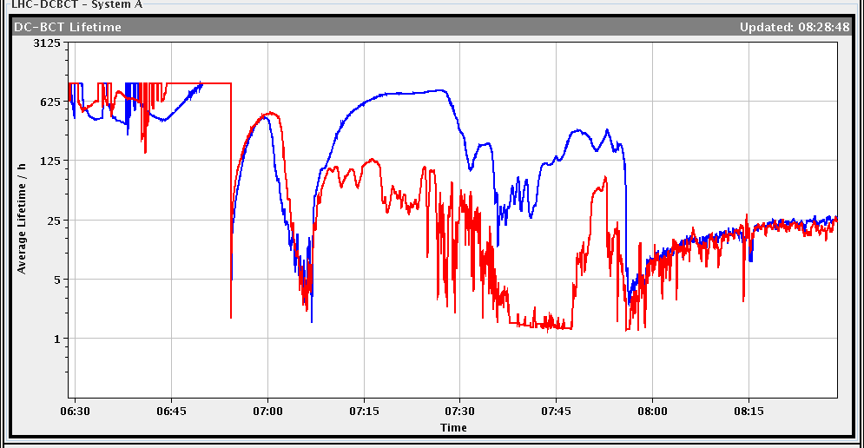
Fill 2911: Recovery of life-time by shift crew!
life time very bad for both beams at the end of squeeze. (50% loss level on BLM TCTH point 5).
7h38:52: Before going in collisions (had another 50% loss level!), we sent a trim of +3 units chroma both planes both beams (in step of 1 unit). life time stabilized but still very low.
7h39:53 We then sent again + 1 unit only beam 2 and removed it (seem to be worse).
7h40:32 We then send a trim of +0.003 on tune beam 2 H (steps of 0.001): very little improvement on life time. We tried a trim of +0.001 on tune beam 2 V.
7h48:03 Add +2 more units to chroma beam 2 both planes: finally life time recovered.
Finally removed the tune trim on beam 2 V.
Initial L ~4.6E33 cm-2s-1

Slide 25
Saturday: Chromaticity can make a difference…

Slide 26
Fill 2913
No issues have been observed during the ramp and squeeze.
The instability during the adjust process occurs when the separation in IP1 and IP5 are reduced and reaching:
IP1: 2.6 sigmas in the separation plane and kept to 16 sigmas in the crossing plane
IP5: 19.1 sigma in the separation plane and kept 21 sigma in the crossing plane 40 seconds after the adjust process is starting.
The separation is staying then constant for the next 60 s before being reduced to 6.9 sigma in IP5 while it is constant in IP1.
Finally the beams are brought in collision in the remaining 120 s.
 | Separation |  |  |  | Crossing
 | Time | Knob value [um] | Separation in sigma |  | Knob value [um] | Separation in sigma
IP1 | 0 | -650 | 31.96021103 |  | 0 | 16.41992493
 | 40 | -100 | 2.638916507 |  | 0 | 16.41992493
 | 100 | -100 | 2.638916507 |  | 0 | 16.41992493
 | 220 | -50.5 | 0 |  | 308 | 0
IP5 | 0 | 650 | 53.78058531 |  | 0 | 21.00470917
 | 40 | 0 | 19.12814632 |  | 0 | 21.00470917
 | 100 | -230 | 6.866514064 |  | 0 | 21.00470917
 | 220 | -358.8 | 0 |  | 394 | 0

Slide 27
Plans for octupole polarity change
As presented at the LMC:
Correction of the chromaticity based on measurements performed on Sun. Done: Tue 31/7
Determine maximum octupole current (inverted polarity) in collision compatible with present working point. Done: Wed. 1/8
Equalize settings for octupoles and transverse damper for B1 and B2 to the lowest values. Done: Thu. 2/8. This has required operating the machine with higher chromaticity because of the high gain of the damper. Done: Sat 3/8. Significant reduction of the losses on Beam 2 during the squeeze
Reduction of the damper gain by a factor 50% in the H plane and a factor 2 in the vertical plane during the squeeze and in adjust Done: Sat 3/8. + reduction of the octupoles during the ramp from 417 A to 300 A Done: Sun 4/8.

Slide 28
Plans for octupole polarity change
Remaining:
Reduction of the octupole current (present polarity) to 200 A during the ramp (1 fill)
Octupole polarity inversion and measurement of the chromaticity with pilot (6 hours).
Measurement after correction of the chromaticity to +7 units through ramp/squeeze and adjust (6 hours)
Test of the inverted polarity at injection with high intensity (3 hours)
Intensity ramp-up with inverted polarity

