Slide 1
MD#2 News & Plan Tue – Wed (19. – 20.6.)
Day | Time | MD | EiC | MP
Tue | 06:00 | 450 GeV → 4 TeV: Ramp for chromaticity - missed |  | A
 | 08:00 | Ramp down
 | 10:00 | 450 GeV: Large Piwinski Angle MD + precycle 2 bunches 2.4e11 – started with 3:30 h delay |  | A
 | 18:00 | 450 GeV → 4 TeV: Octupole instability threshold Single full physics beams – successful Ramp for chromaticity + octupole effect |  | C
Wed | 02:00 | Ramp down
 | 04:00 | 450 GeV → 4 TeV: Longitudinal dynamics studies |  | B
 | 10:00 | Ramp down
 | 12:00 | 450 GeV → 4 TeV: Beta* leveling 2 nominal bunches |  | C
 | 20:00 | Ramp down
 | 22:00 | 450 GeV → 4 TeV: Long-range beam-beam with high bunch intensity 84b 50 ns 1.7e11 |  | C
Giulia
Alick
Ghislain
Giulia
Mirko
Alick
Ghislain

Slide 2
Draft MD Planning Thu – Fri (21. – 22.6.)
Day | Time | MD | EiC | MP
Thu | 06:00 | Ramp down
 | 08:00 | 450 GeV → 4 TeV: High beta* (1) |  | A
 | 16:00 | Ramp down
 | 18:00 | 450 GeV: MKI UFO studies |  | C
Fri | 04:00 | 450 GeV → 4 TeV: Scraping, diffusion and Repopulation Study and fast losses (with ADT) |  | C+C
 | 12:00 | Ramp down
 | 14:00 | 450 GeV: Injection and Q20 optics |  | A
 | 22:00 | 450 GeV: RF cavity phase modulation for 25ns |  | B
Ghislain
Mirko
Alick
Ghislain
Verena
Mirko

Slide 3
Draft MD Planning Sat – Mon (23. – 25.6.)
Day | Time | MD | EiC | MP
Sat | 06:00 | 450 GeV → 4 TeV: High beta* (2) |  | A
 | 14:00 | Ramp down
 | 16:00 | 450 GeV: Transverse Damper studies
 | 22:00 | Ramp down
Sun | 00:00 | 450 GeV → 4 TeV: Collimation (impedance, nominal settings) |  | C
 | 06:00 | Ramp down
 | 08:00 | 450 GeV: Beam Instrumentation (BSRT, BGI, wire scan, BPM nonlinearities) |  | A/B/C
 | 16:00 | 450 GeV → 4 TeV: Test ramp for emittance calibration |  | B/C
 | 20:00 | Ramp down
 | 22:00 | 450 GeV: Dynamic Aperture MD |  | D
Mon | 06:00 | Technical Stop
Alick
Enrico
Mirko
Alick
Enrico
Mirko
Alick

Slide 4
longitudinal dynamics studies
Fill w/o ramp: 8 bunches of different intensity (7E10-2.4E11) with minimum possible uniform bunch length - 1.1 ns in LHC; measured: stable phase shift, peak detected Schottky, and bunch profile during almost 2 hours, giving also dependence on bunch length (1.7 ns at the end). Terminal server cerntsab35blocked for 68 min. Phase loop off after injection. At the end transverse tune measurements by kicking each bunch with ADT off (and on) and phase loop on.
Fill w ramp: first 4 bunches with different intensity; last 4 with maximum intensity and different bunch length. Ramp with phase loop off. Longitudinal blow up off. Some bunches unstable during the ramp; oscillations continued on the flat top for long time, even when switching phase loop on. Bunch length for beam 1 was growing much faster than for beam 2. Length of 1.1 ns was sufficient to stabilize beam 1. Beam 2 with 1 ns unstable till beam dump. Impedance measurements on flat top. Tune measurements at the end.
→ longit. & trans. impedance

Slide 5
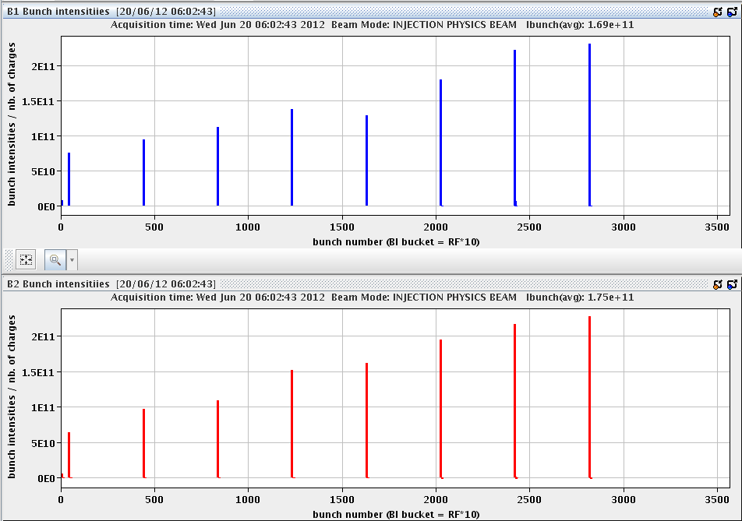
longitudinal dynamics studies
Injected 8 “indivs” with different intensities but similar bunch lengths, longitudinal measurements being taken with phase loop off (was on for injecting).
E. Shaposhnikova,
J. Esteban Muller,
R. Calaga et al
fill 1
synchronous
phase,
synchrotron
frequency,
tune shift , etc.
for different
intensity
and bunch length
lost 1 h due to
IT upgrade
at 6:30

Slide 6
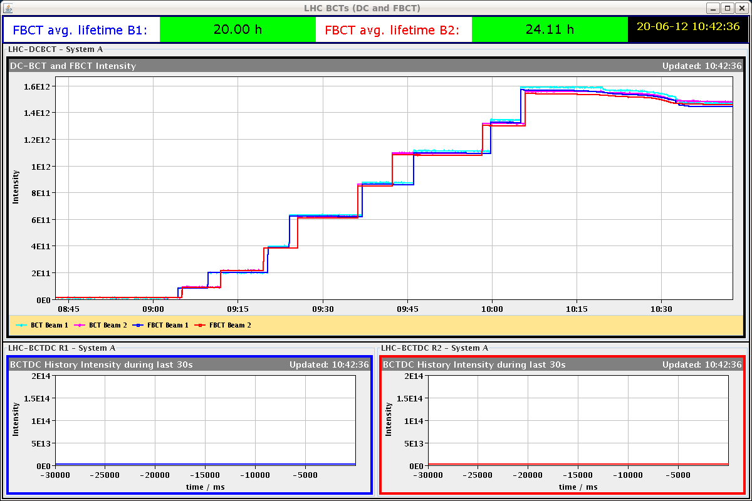
longitudinal dynamics studies
fill 2
ramp

Slide 7
beta* leveling
1. filled with pilot and two nominal bunches, ramped and squeezed to β*=3 m as normally done; then collapsed separation at IP1 and 5, and squeezed in steps down to β*=0.6 m, with lumi scans at each point. Luminosity optimization done at each step, and increased as expected. Optimization for the end of squeeze caused some beam-2 loss when optimizing in the crossing angle plane. 2. measured Q’ with beams separated; then re-optimised the collisions, and reduced octuple strength to 50%, 40%, 30%,20%, 10% and 0, with Q’ measurements ( with beams separated) at several points. Finished with zero octupole strength and beams separated by 100 μm at IPs 1 and 5. Beams were stable throughout.

Slide 8
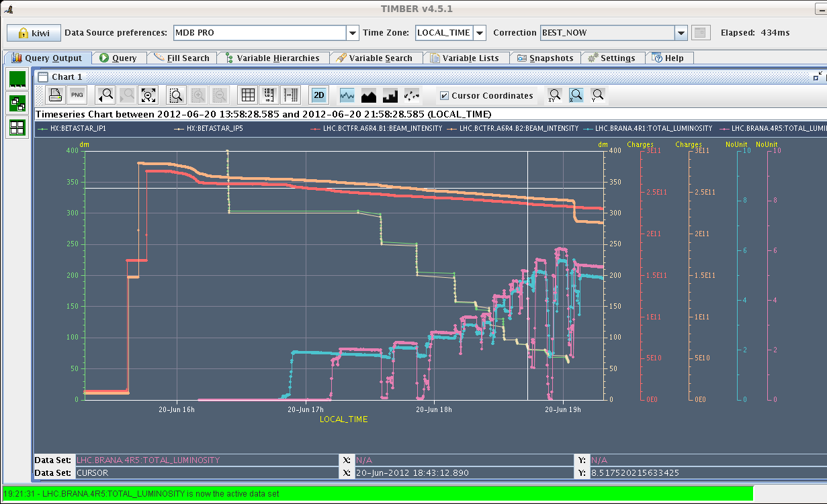
S. Redaelli,
J. Wenninger,
L. Ponce,
M. Pojer, et al
beta* leveling - overview
luminosity
increase

Slide 9
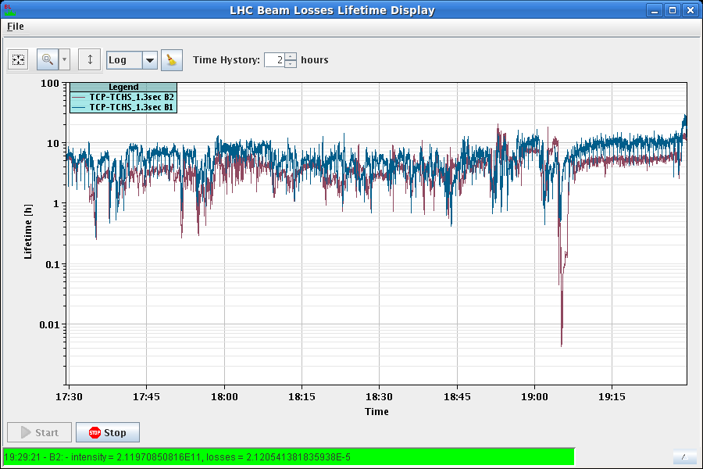
lifetime during beta* leveling

Slide 10
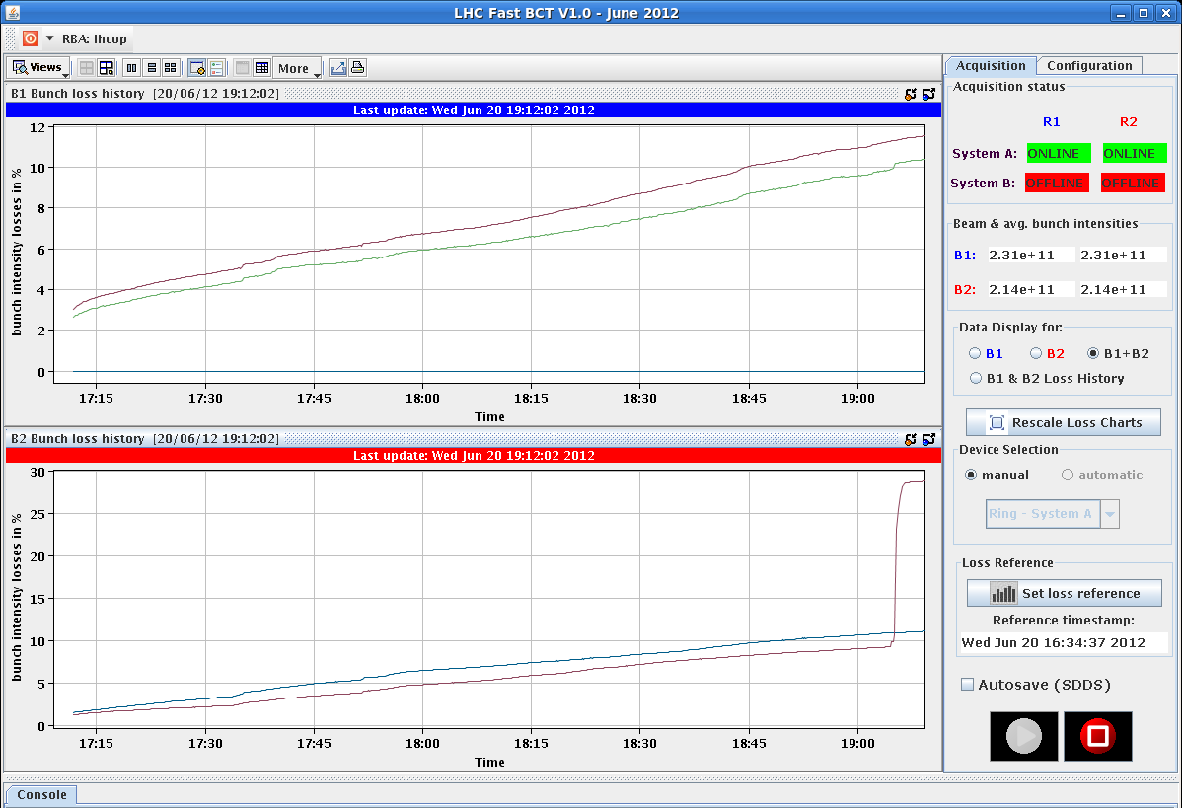
losses for bunch 1885 of B2 when doing luminosity optimization of crossing angle plane at β*=0.6 m

Slide 11
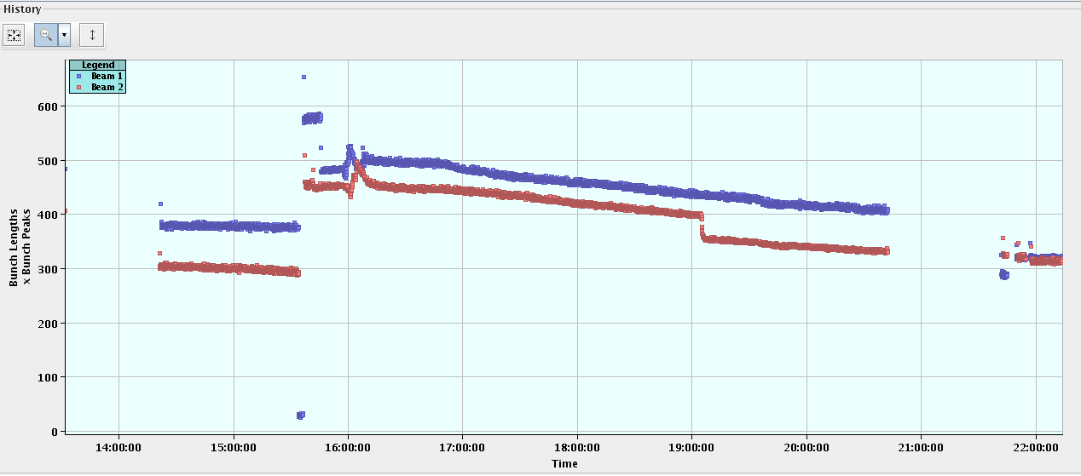
bunch length evolution during beta* leveling

Slide 12
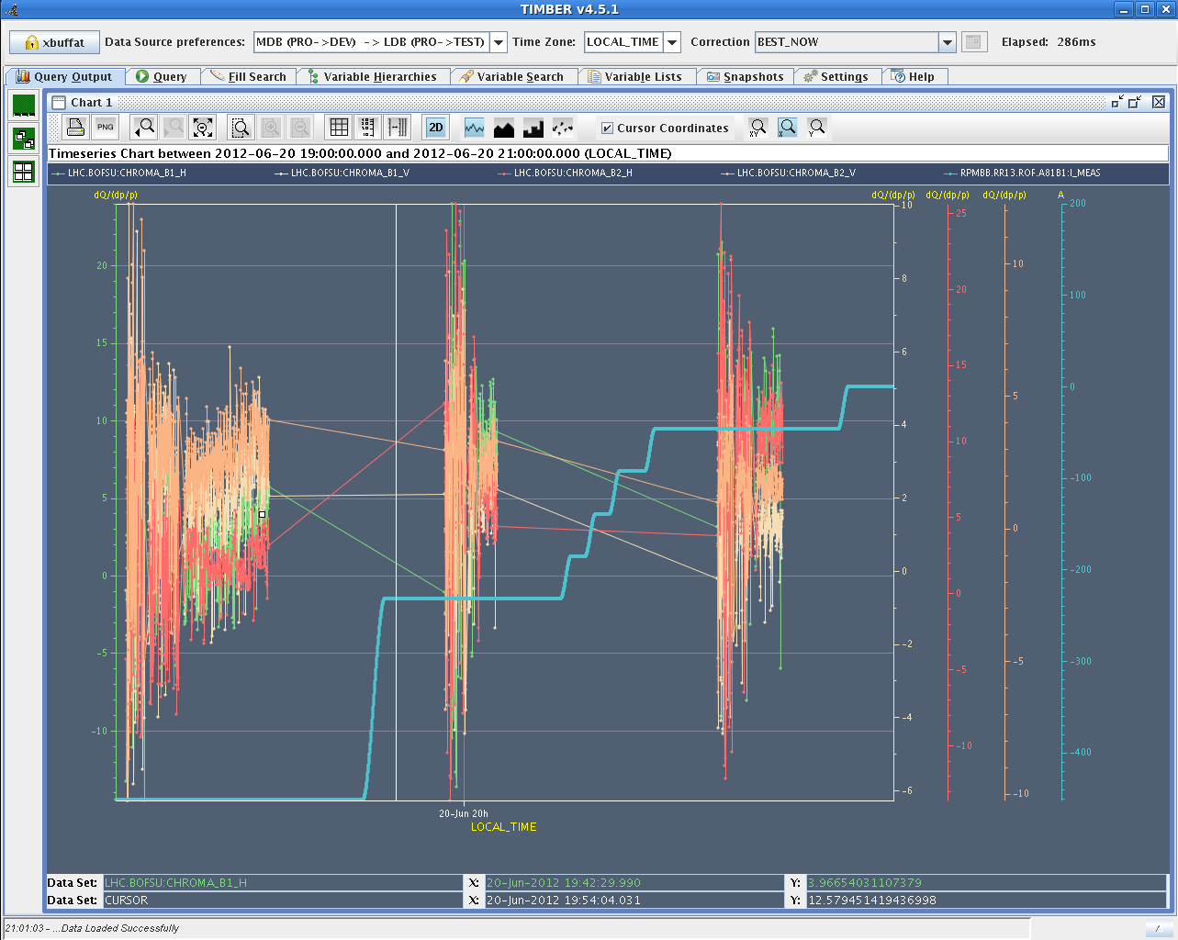
Q’ variation w. octupole current in squeeze
consistent with previous night

Slide 13
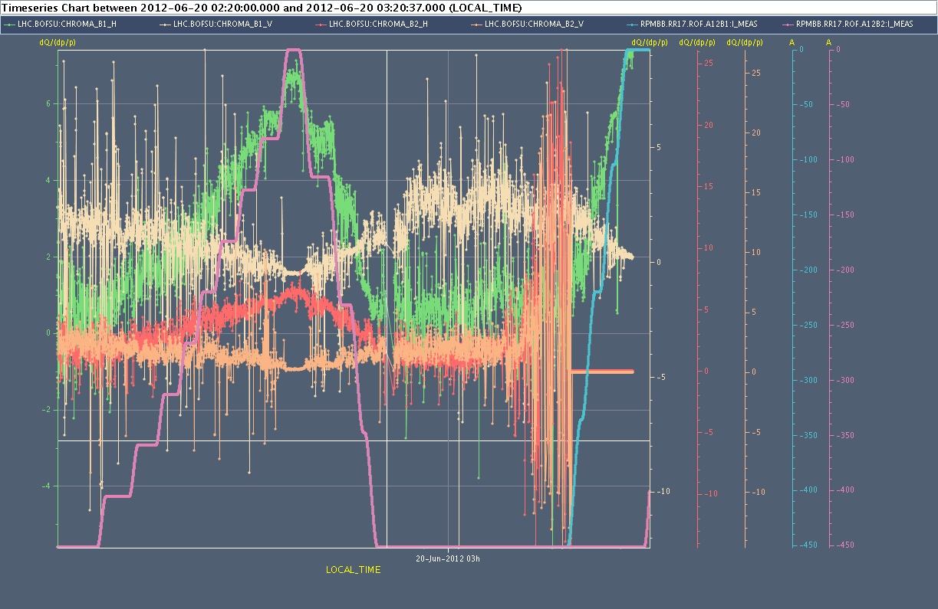
chromaticity varies w. octupoles on flat top
20 June 2012
Giulia Papotti, Nicolas Mounet, Alexey Burov, et al

Slide 14
long-range beam-beam study
first fill - long range losses with high intensities. 36 bunches, 1.6e11 ppb with ε~2micron was brought into collision. Crossing angle reduced in IP1 & IP5 first in steps of 10% starting from 145mrad. Lifetime was observed and significant losses appeared due to the reduced distances at the long-range encounters of IP1 at around 50% of the initial angle in IP1. After finding the limit IP1 reduced IP5 crossing angle till same crossing for both IPs was set.
second fill - effect of the reduced beta* with respect to 2011 and same intensity. Injected 36 bunches of 1.2e11 ppb, collide them and reduce the crossing angle of IP 1. Lifetime was observed and a reduced crossing angle of 45% nominal shows reduction in lifetime.

Slide 15
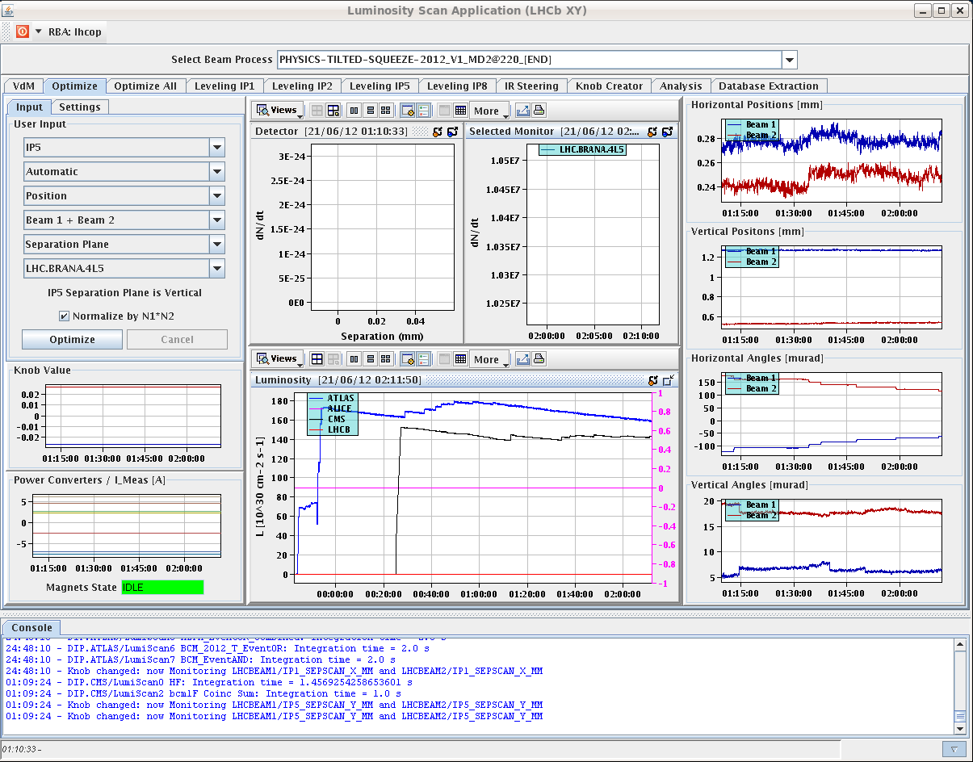
long-range beam-beam study
luminosity
increase as
crossing angle
is reduced

Slide 16
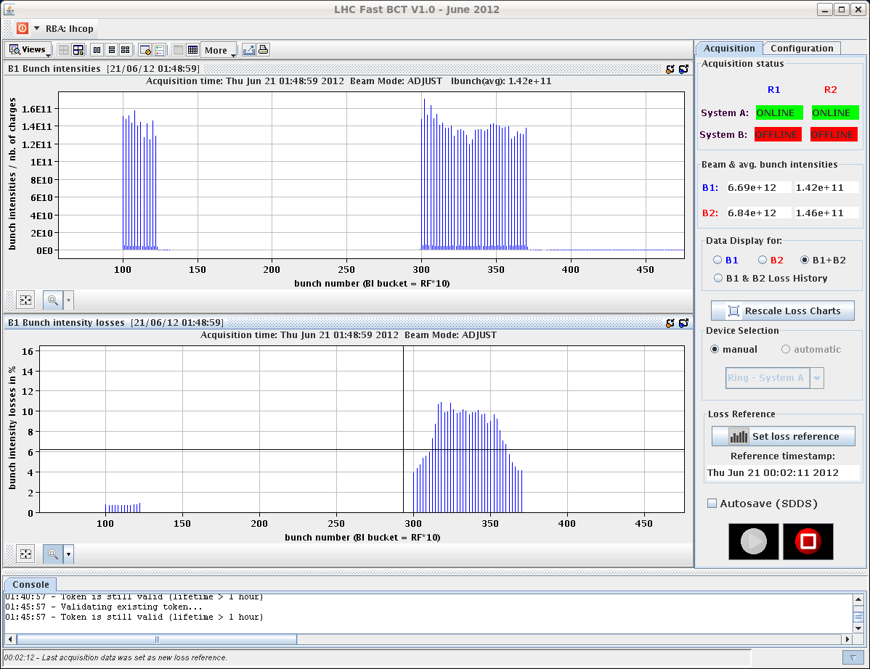
long-range beam-beam study
W. Herr,
T. Pieloni,
G. Papotti,
R. Assmann,
G. Roy,
R. Giachino
et al
losses along train
show effect of LR
encounters

Slide 17
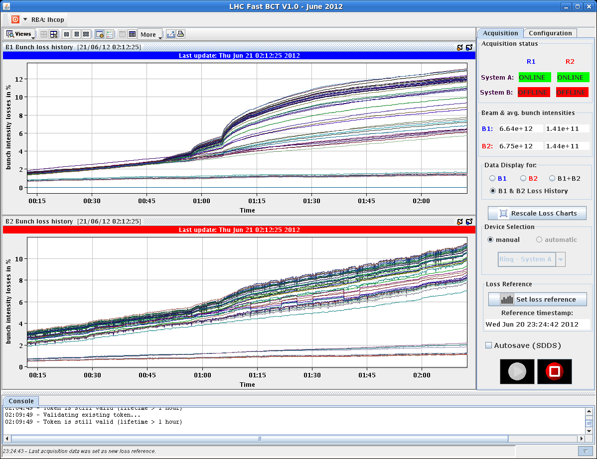
long-range beam-beam study
W. Herr,
T. Pieloni,
G. Papotti,
R. Assmann,
G. Roy,
R. Giachino
et al
fill 1

Slide 18
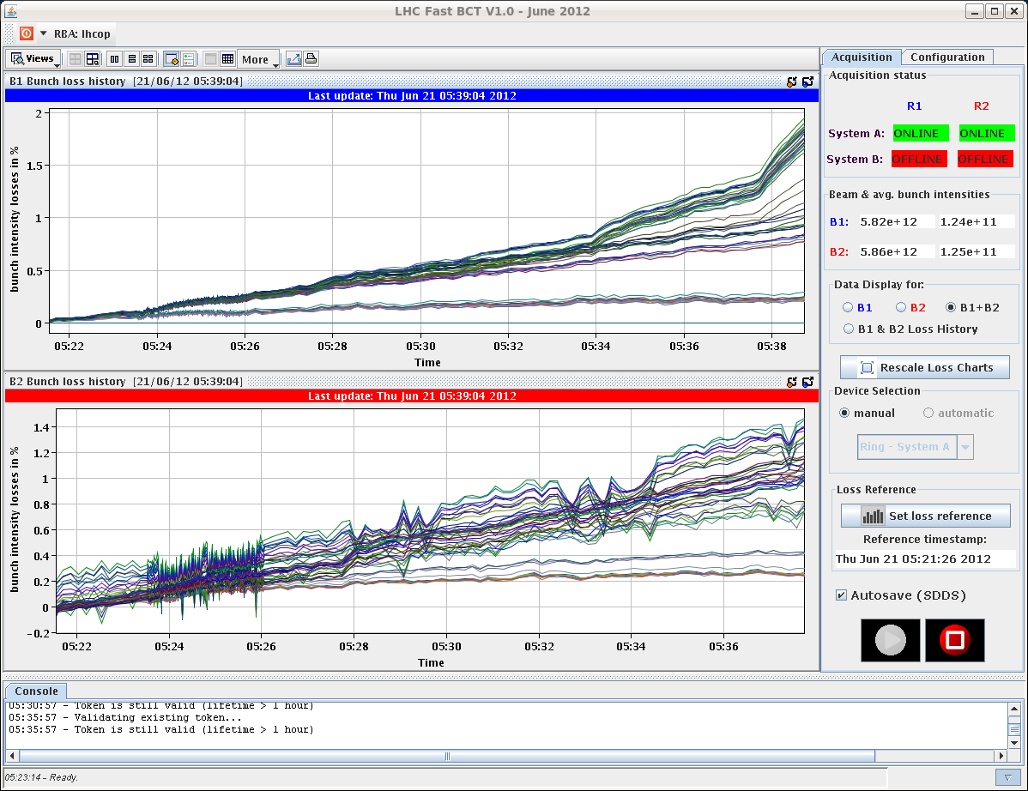
long-range beam-beam study
W. Herr,
T. Pieloni,
G. Papotti,
R. Assmann,
G. Roy,
R. Giachino
et al
fill 2

