Slide 1
MD#2 News & Plan Tue – Wed (19. – 20.6.)
Day | Time | MD | EiC | MP
Tue | 06:00 | 450 GeV → 4 TeV: Ramp for chromaticity - missed |  | A
 | 08:00 | Ramp down
 | 10:00 | 450 GeV: Large Piwinski Angle MD + precycle 2 bunches 2.4e11 – started with 3:30 h delay |  | A
 | 18:00 | 450 GeV → 4 TeV: Octupole instability threshold Single full physics beams |  | C
Wed | 02:00 | Ramp down
 | 04:00 | 450 GeV → 4 TeV: Longitudinal dynamics studies |  | B
 | 10:00 | Ramp down
 | 12:00 | 450 GeV → 4 TeV: Beta* leveling 2 nominal bunches |  | C
 | 20:00 | Ramp down
 | 22:00 | 450 GeV → 4 TeV: Long-range beam-beam with high bunch intensity 84b 50 ns 1.7e11 |  | C
Giulia
Alick
Ghislain
Giulia
Mirko
Alick
Ghislain

Slide 2
MD#2 News & Plan Tue – Wed (19. – 20.6.)
Day | Time | MD | EiC | MP
Tue | 06:00 | 450 GeV → 4 TeV: Ramp for chromaticity - missed |  | A
 | 08:00 | Ramp down
 | 10:00 | 450 GeV: Large Piwinski Angle MD + precycle 2 bunches 2.4e11 – started with 3:30 h delay |  | A
 | 18:00 | 450 GeV → 4 TeV: Octupole instability threshold Single full physics beams – successful Ramp for chromaticity |  | C
Wed | 02:00 | Ramp down
 | 04:00 | 450 GeV → 4 TeV: Longitudinal dynamics studies |  | B
 | 10:00 | Ramp down
 | 12:00 | 450 GeV → 4 TeV: Beta* leveling 2 nominal bunches |  | C
 | 20:00 | Ramp down
 | 22:00 | 450 GeV → 4 TeV: Long-range beam-beam with high bunch intensity 84b 50 ns 1.7e11 |  | C
Giulia
Alick
Ghislain
Giulia
Mirko
Alick
Ghislain

Slide 3
Draft MD Planning Thu – Fri (21. – 22.6.)
Day | Time | MD | EiC | MP
Thu | 06:00 | Ramp down
 | 08:00 | 450 GeV → 4 TeV: High beta* (1) |  | A
 | 16:00 | Ramp down
 | 18:00 | 450 GeV: MKI UFO studies |  | C
Fri | 04:00 | 450 GeV → 4 TeV: Scraping, diffusion and Repopulation Study and fast losses (with ADT) |  | C+C
 | 12:00 | Ramp down
 | 14:00 | 450 GeV: Injection and Q20 optics |  | A
 | 22:00 | 450 GeV: RF cavity phase modulation for 25ns |  | B
Ghislain
Mirko
Alick
Ghislain
Verena
Mirko

Slide 4
Draft MD Planning Sat – Mon (23. – 25.6.)
Day | Time | MD | EiC | MP
Sat | 06:00 | 450 GeV → 4 TeV: High beta* (2) |  | A
 | 14:00 | Ramp down
 | 16:00 | 450 GeV: Transverse Damper studies
 | 22:00 | Ramp down
Sun | 00:00 | 450 GeV → 4 TeV: Collimation (impedance, nominal settings) |  | C
 | 06:00 | Ramp down
 | 08:00 | 450 GeV: Beam Instrumentation (BSRT, BGI, wire scan, BPM nonlinearities) |  | A/B/C
 | 16:00 | 450 GeV → 4 TeV: Test ramp for emittance calibration |  | B/C
 | 20:00 | Ramp down
 | 22:00 | 450 GeV: Dynamic Aperture MD |  | D
Mon | 06:00 | Technical Stop
Alick
Enrico
Mirko
Alick
Enrico
Mirko
Alick

Slide 5
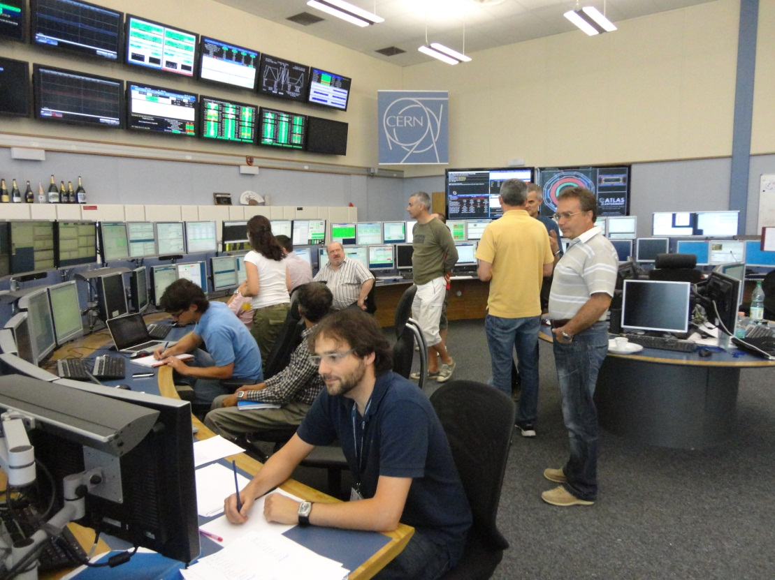
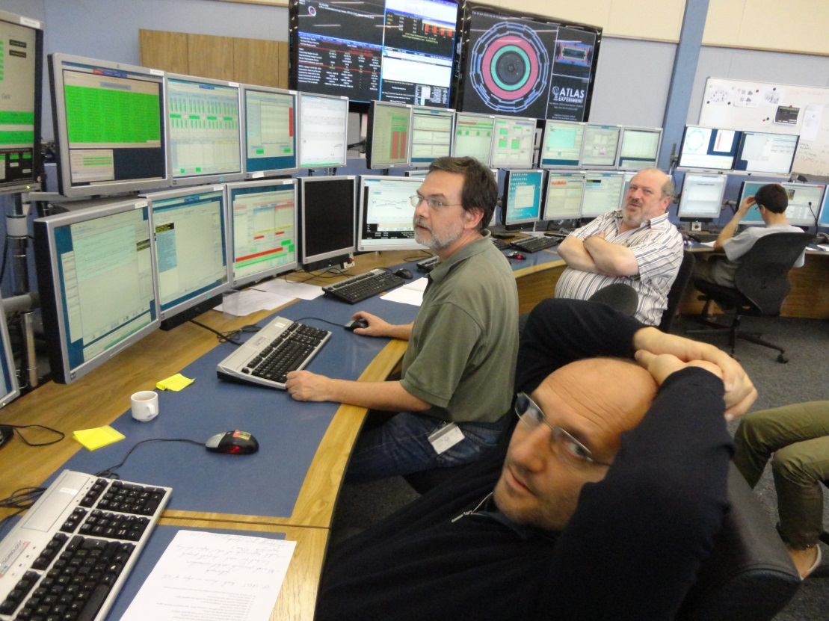
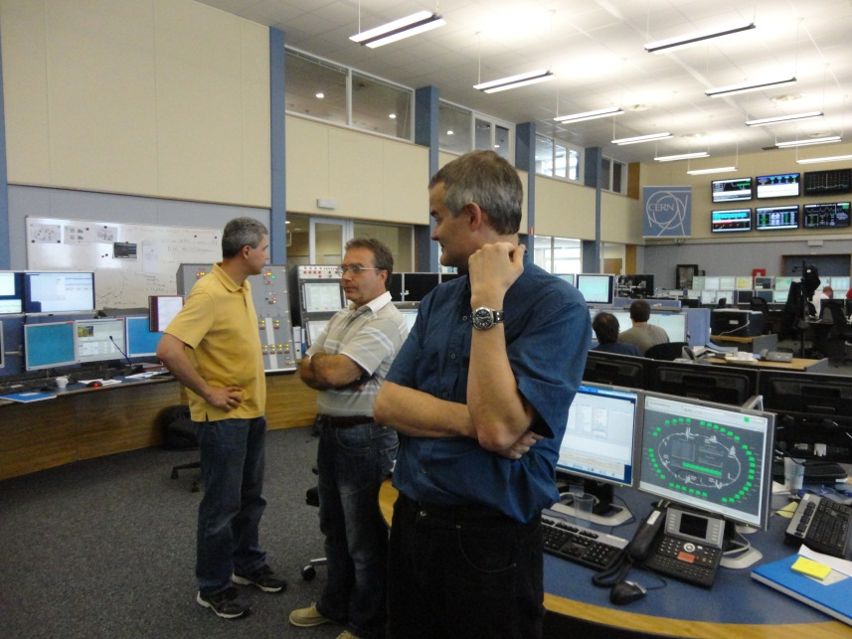
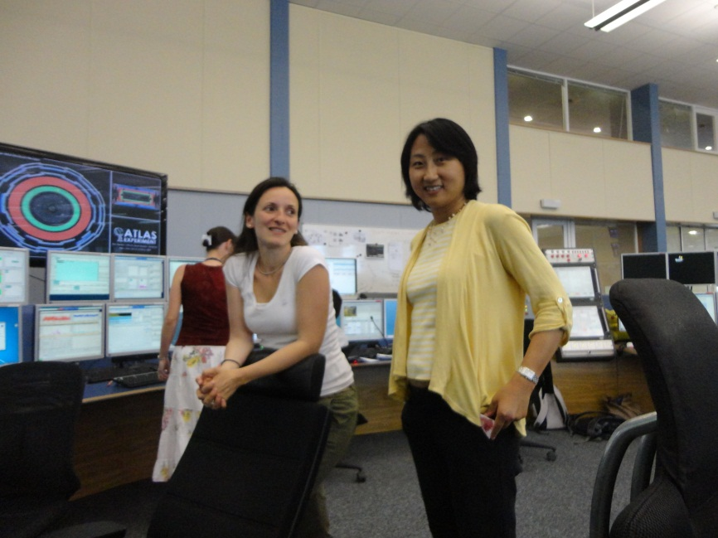
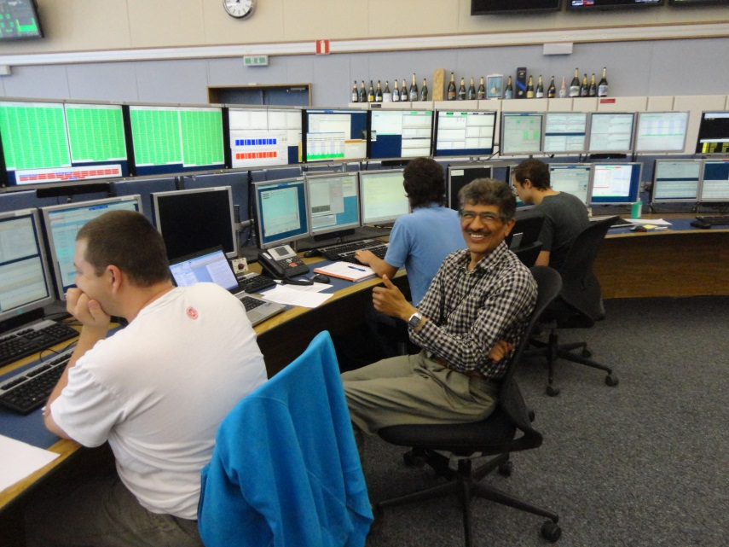
start of 2012 LHC MD block #2

Slide 6
LPA MD - history
started 3.5 hours late, then 1 h machine set up
~13:45 injected 1 pilot + 2 nominal bunches / beam
ADT off, collision tunes, TCT coarse settings, TDI out, IR angle bumps zeroed (IP 1+5), IR separation collapsed in IPS 1,5 and 8
luminosity signal in LHCb, weak signal (?) in ATLAS, no signal from CMS, dumped
~17:00 injected 1 pilot + 2 bunches of 2.4e11 / beam
clear luminosity signals from LHCb and ATLAS, no signal from CMS, optimized collisions in IPs 1 and 8
reduced spectrometer strength in two steps (-50% and -100%)
ADT work, dump, pre-cycle, spectrometer left at 0

Slide 7
LPA MD conditions
2.4e11 / bunch; 2 bunches per beam
1st bunch collides in IP 8 only
2nd bunch collides in IPs 1, 5 and 8
injection energy, 1.5 ns bunch length, e~2 mm
ADT off, orbit feedback off,
TCTs at coarse settings, IR angle bumps zeroed in IPs 1 and 5
IP8 crossing angle 4 mrad, 2 mrad, 0 (varied with spectrometer strength)
collision tunes
estimated Piwinski angles ~ 1.1, 0.6, 0
largest Piwinski angle ever!

Slide 8
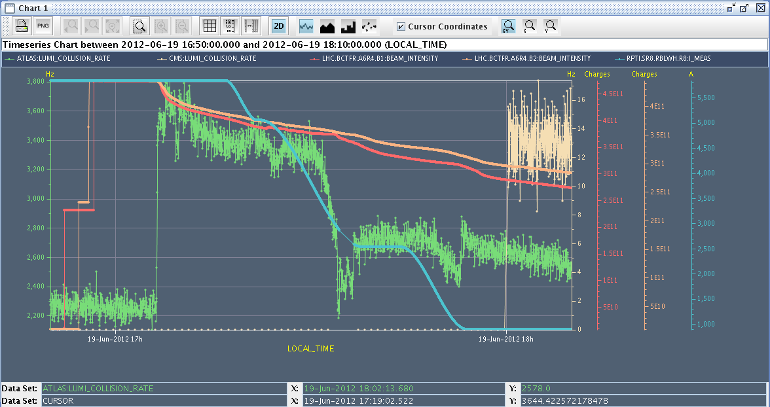
LPA MD overview
CMS lumi signal appears at last
ATLAS
lumi
signal
reduced
(steering
effect)
LHCb luminosity signal zero in the database

Slide 9
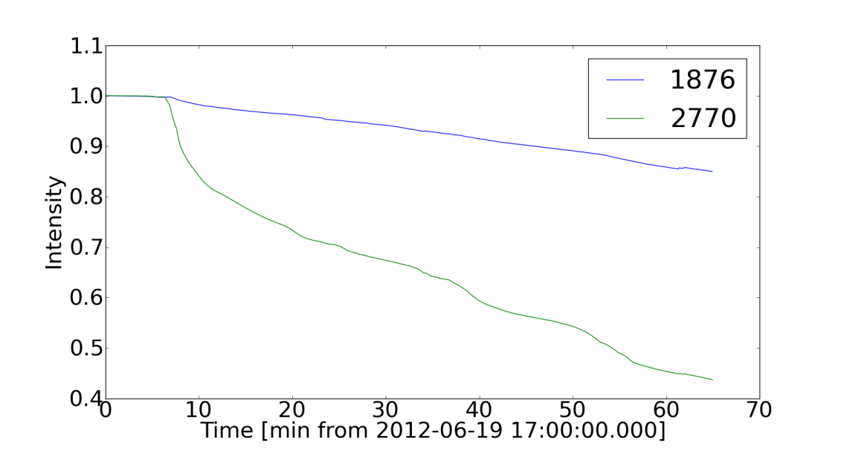
LPA MD bunch intensity
bunch with 3 collisions loses much more intensity;
steepest loss at 50% of LHCb spectrometer strength;
best lifetime at 0 strength
X. Buffat
100%
0%
100%
0%
50%
50%
qualitatively consistent with expectation
Jose Abelleira, Chandra Bhat, Xavier Buffat, Karel Cornelis, Riccardo De Maria, Rossano Giachino, Mike Lamont, Themis Mastoridis, Alick Mcpherson, Giulia Papotti, Tatiana Pieloni, Ghislain Roy, Belen Salvachua, Daniel Valuch, Frank Zimmermann, + …

Slide 10
LPA MD bunch emittance
 | EmitX beam 1 | EmitX beam 2 | EmitY beam 1 | EmitY beam 2
17:00 |  | 1.95+/-0.01 μm (1 collision) 2.07+/-0.01 μm (3 collisions) |  | 2.17+/-0.00 μm (1 collision) 2.56+/-0.02 μm (3 collisions)
17:17 | 2.7+/-0.1 μm (1 collision) 2.10+/-0.03 μm (3 collisions) | 2.0+/-0.1 μm (1 collision) 1.6+/-0.1 μm (3 collisions) | 2.17+/-0.01 μm (1 collision) 1.72+/-0.03 μm (3 collisions) | 2.11+/-0.01 μm (1 collision) 1.64+/-0.01 μm (3 collisions)
17:35 | 2.53+/-0.01 μm (1 collision) 2.0+/-0.1 μm (3 collisions) | 2.01+/-0.01 μm (1 collision) 1.56+/-0.02 μm (3 collisions) | 2.11+/-0.04 μm (1 collision) 1.67+/-0.02 μm (3 collisions) | 2.07+/-0.05 μm (1 collision) 1.53+/-0.08 μm (3 collisions)
bunch with 3 collisions shrinks

Slide 11
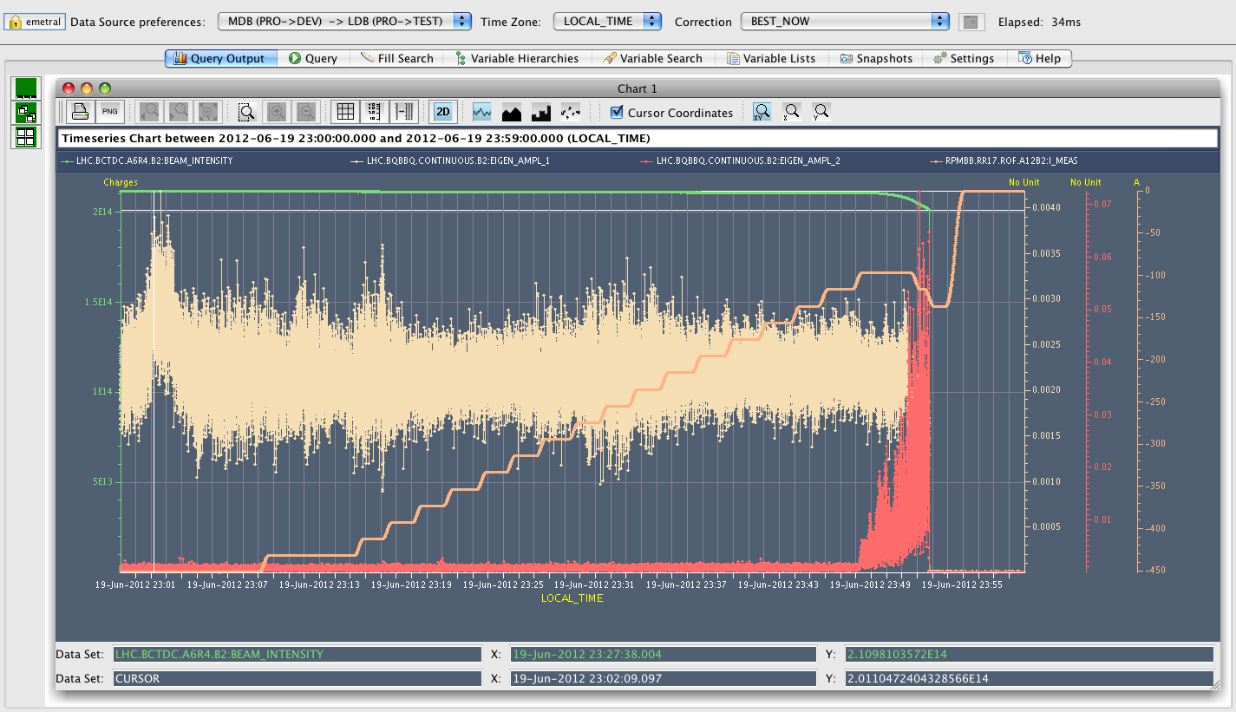
octupole instability threshold at 4 TeV
fill with beam 2
decreasing octupoles' current from ~ 450 A to 97 A (on flat-top before the squeeze) where beam losses appeared and then the beam was dumped
estimated Q’ + 5 units (trim of 3 units on top of the ~ 1-2 assumed to be in physics)
Elias Metral, Alexey Burov, Nicholas Mounet, Giulia Papotti
consistent with impedance model
to be repeated for squeezed optics

Slide 12
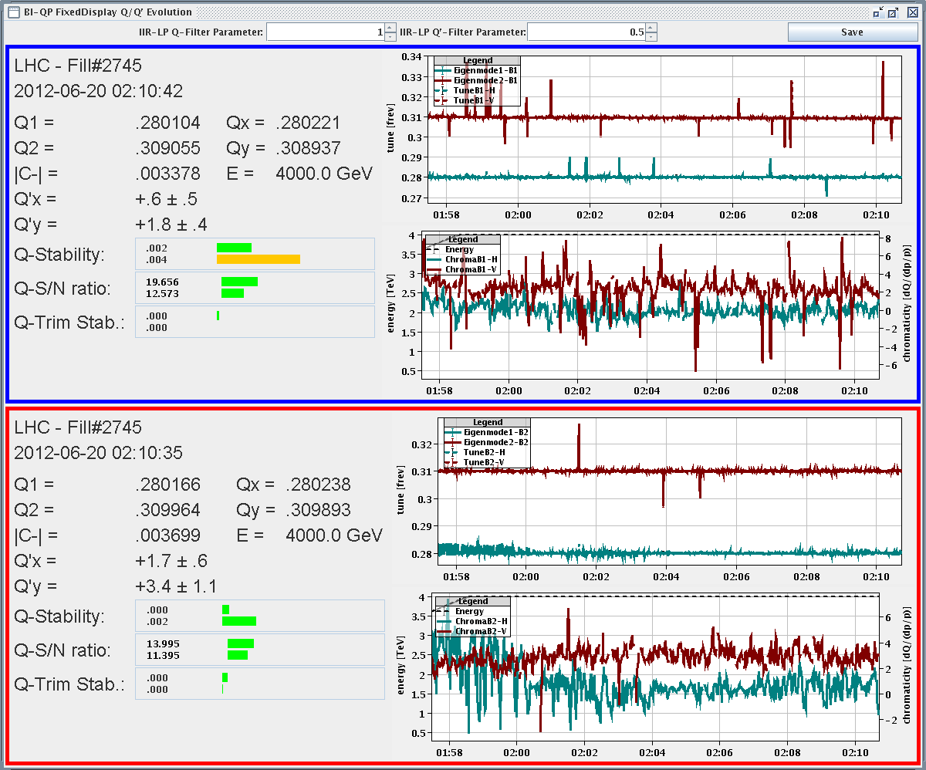
chromaticity at flat top
Giulia Papotti,
Nicolas Mounet,
Alexey Burov,
et al

Slide 13
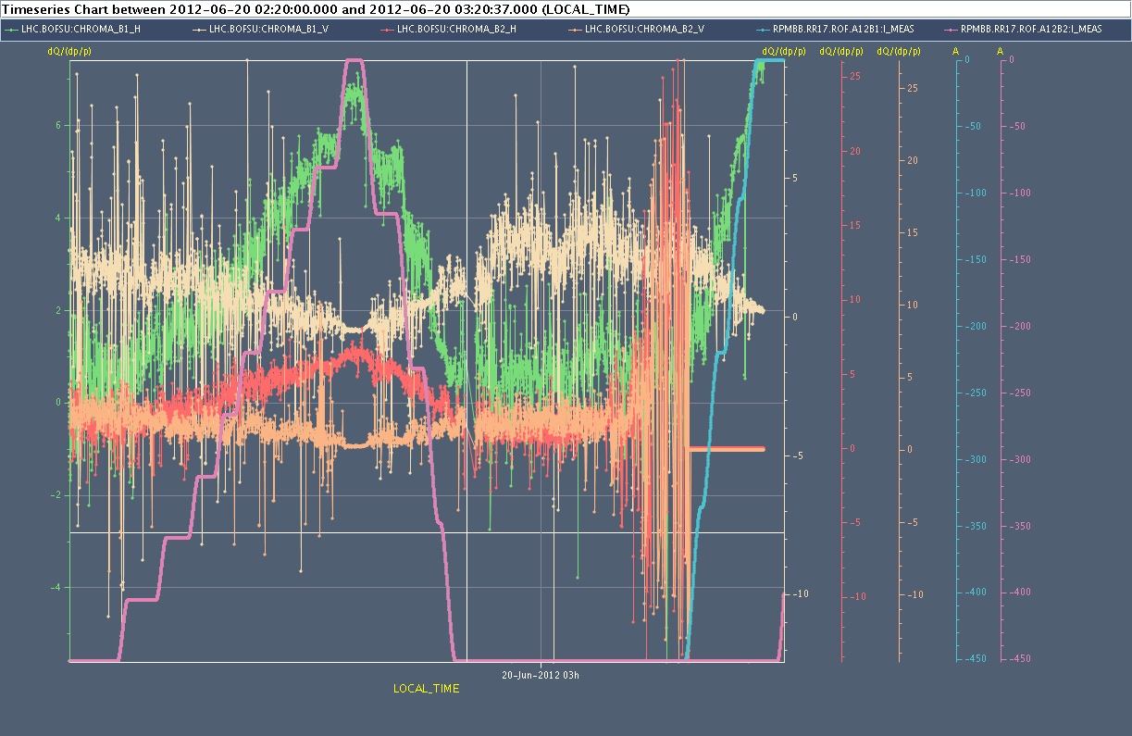
chromaticity varies with octupole strength
Giulia Papotti, Nicolas Mounet, Alexey Burov, et al

Slide 14
Giulia Papotti, Nicolas Mounet, Alexey Burov, et al
Summary of chromaticity measurement: At flat top with 450 A in the octupoles, chromaticity around 1 in horizontal, 2 in vertical (both beams). Trimming down the octupoles has a large effect on chromaticity: +4/+5 units in horizontal, -1/-2 in vertical. With zero A in the octupoles losses were observed (due to an instability ? chromaticity possibly negative in vertical and transverse feedback was off). Chromaticity was also measured during squeeze (B1 essentially, as B2 tune got very noisy at the end of the squeeze): Q'~1 in horizontal, ~2 in vertical. Reducing octupoles shows the same trends as before squeeze. Fast losses were observed in the end, probably partly due to the opening of the phase loop on B2 (too low intensity).

Slide 15
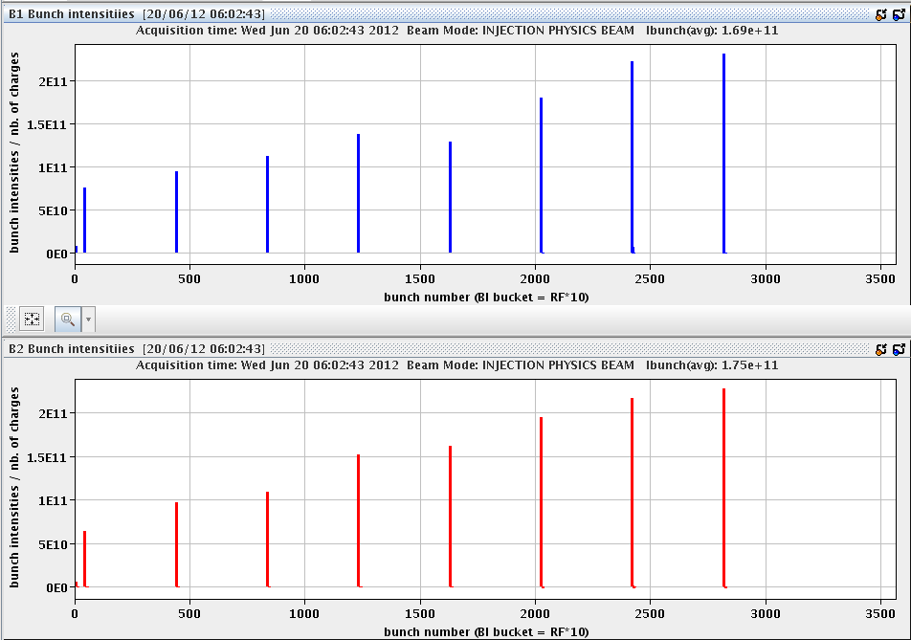
longitudinal dynamics studies
Injected 8 “indivs” with different intensities but similar bunch lengths, longitudinal measurements being taken with phase loop off (was on for injecting).
E. Shaposhnikova,
J. Esteban Muller,
R. Calaga et al
synchronous
phase,
synchrotron
frequency,
tune shift , etc.
for different
intensity
and bunch length
lost 1 h due to
IT upgrade
at 6:30

