Slide 1
Overview Week 20 Injectors, LHCb polarity, Beam-Beam
Coordinators:
Bernhard Holzer, Jan Uythoven

Slide 2
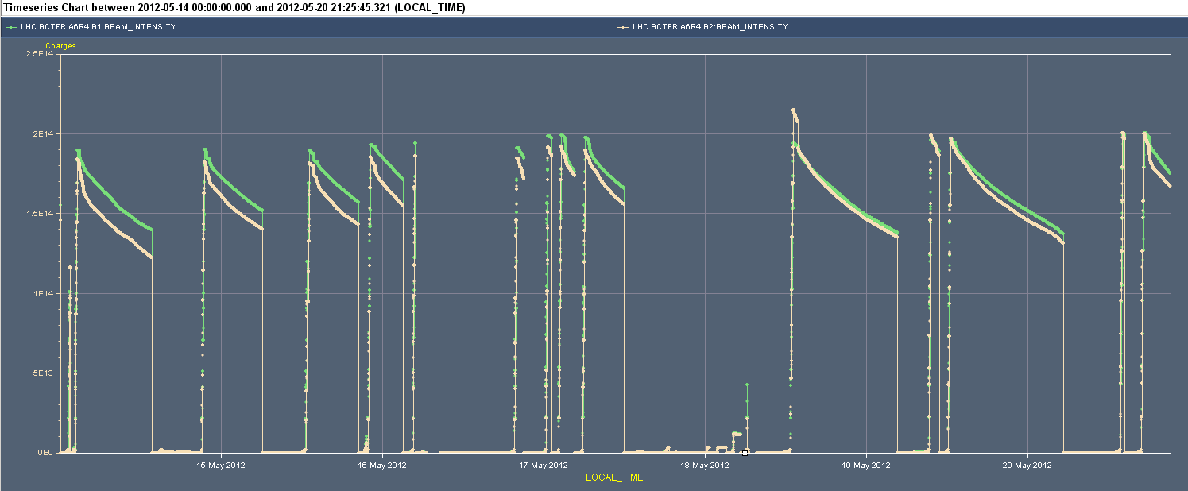
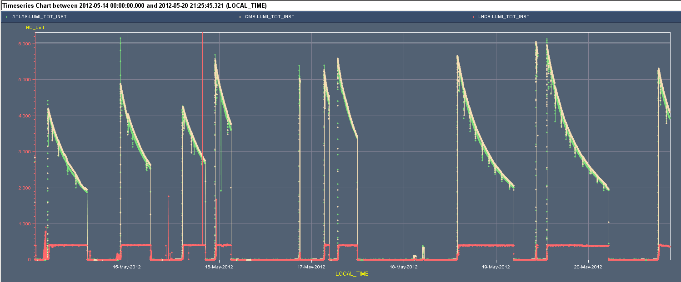
The week in beam current and lumi
BPMS IP6
New Filling Pattern
2e14
Verification LHCb collision point
RF Crowbar
Still BPMS IP6
6e33
Injectors recovered
5e33
Bunches dropping out
LHCb polarity change
170 pb-1
191 pb-1

Slide 3
The Fills
Fill # | Duration | Peak Lumi | Delivered | Dump
2627 | 10:08 | 4149 | 101.25 | Operator dump
2628 | 7:51 | 4862.5 | 97.3 | Trip of ROF.A67B1
2629 | 5:52 | 4241.5 | 70.4 | Operator dump
2630 | 4:13 | 5503.5 | 64.1 | RF fault crowbar problem on module M1B2
2632` | 0:09 | 4987 | 1.95 | Loosing bunches, BPMS interlock
2634 | 1:21 | 5211.5 | 22.75 | Loosing bunches, BPMS interlock
2635 | 5:14 | 5575 | 78.8 | Loosing bunches, BPMS interlock
2644 | 14:45 | 5645 | 173.5 | Some bunches low on intensity, long fill, BPMS interlock
2645 | 0:30 | 6024 | 10 | Spurious trigger BLM
2646 | 16:06 | 6015 | 191 | Operator dump
2648 | 5:32 | 5246 | 79.6 | Cryo, temperature sensor fault on RQTL10
Total | 2d 23:41= 43 % |  | 891 pb-1

Slide 4
The Downtime
Main Source of down time this week
RF, especially crow bar problems 16:39
Injectors not available 10:39
Collimator – BIS in TI2: fixed 06:04
Electrical Network glitch 01:22
QPS after network glitch 04:50
Beam Imminent Warning 01:59
Cryo, temperature sensor fault RQTL10 07:30… ongoing
In total about 30 % down time

Slide 5
The Records (Atlas)
A record week
Getting close to the 1 fb-1 per week

Slide 6
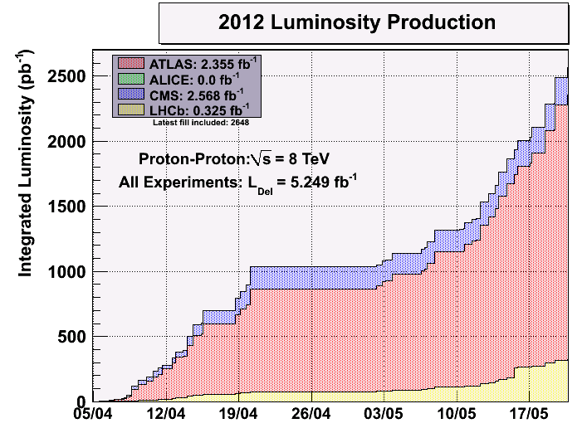
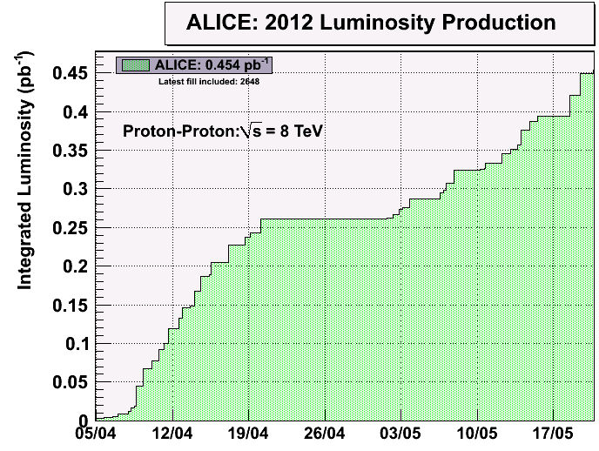
Integrated over 2012: 2.4 fb-1

Slide 7
Beam issues since Technical Stop
Beam unstable when going into collision
Not ending up fully head-on when going into collision
Solved (week 19)
Losses in the ramp and squeeze
Most likely due to septa MST and MSE, not used for LHC beams, pulsing for test purposes. Stray fields affected the beam
Affected tails and brightness
Solved
Reduced luminosity
Due to larger emittances from the injector chain
Most like due to the use of different PS dipole orbit corrector in the extraction area for MTE tests. Went back to original corrector = same bump = same trajectory through extraction septum
Solved
Very positive collaboration. Hard work in all the different islands to find a common solution

Slide 8
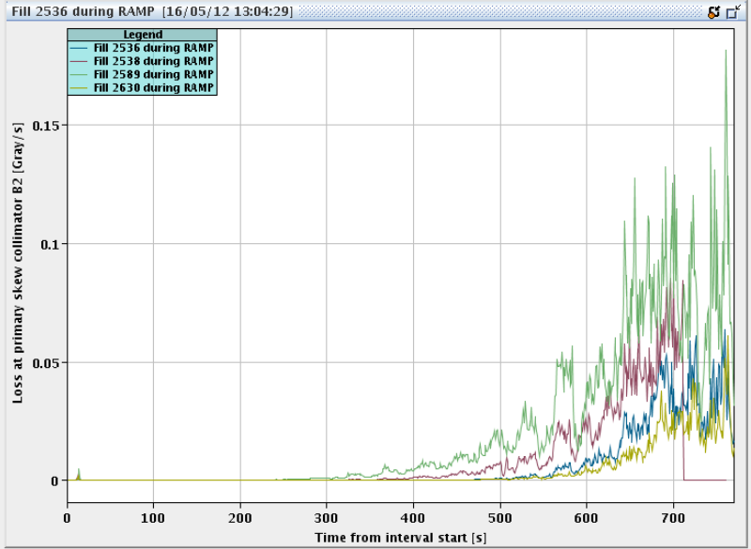
Losses during the ramp
Some deterioration already before technical stop and continued after technical stop. Effects visible during the ramp
Now better than before TS !
Fill 2536 – Before technical stop
Fill 2538 – Before technical stop, dump on BLM HV in ramp
Fill 2589 – After technical stop
Fill 2630 – Tuesday

Slide 9
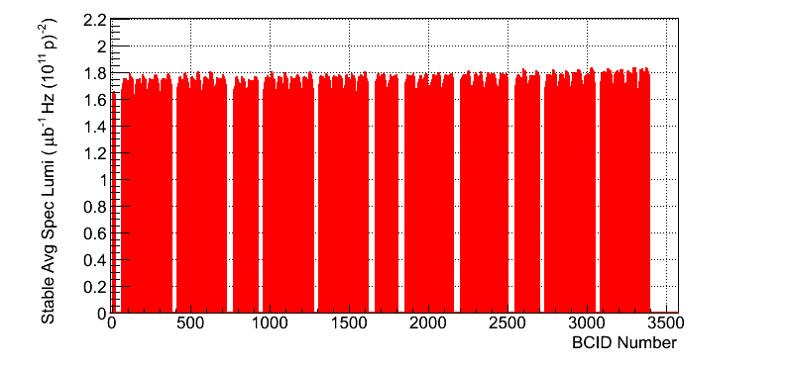
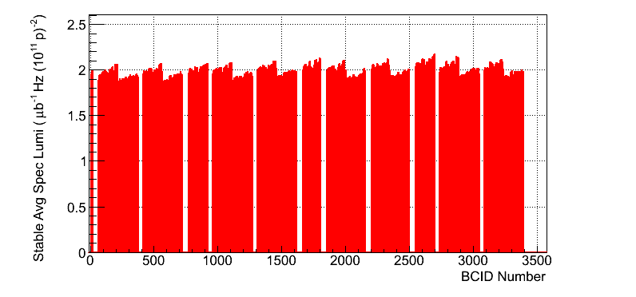
Performance – before sorting out MST/MSE in SPS
Fill 2536 – Before technical stop
Fill 2624 – Monday Morning
c/o ATLAS

Slide 10
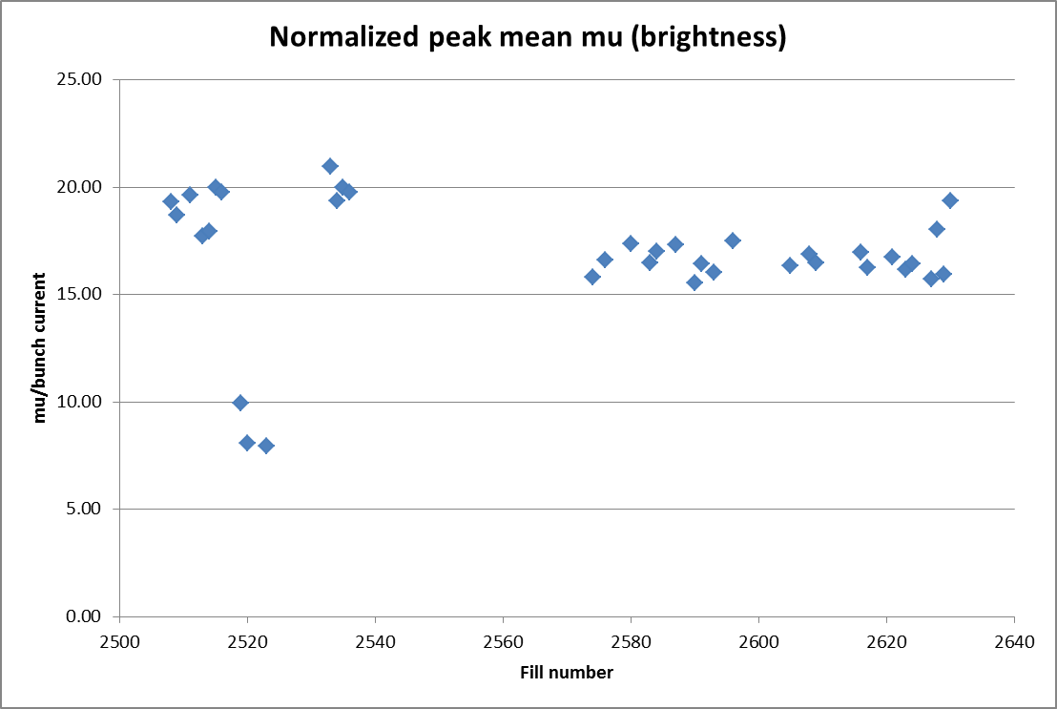
Brightness back
Slightly higher bunch intensities
#2629
Last three fills
2628 – MST/MSE off
2629 – scraping – long time at injection
2630 – PS extraction reverted
M.Lamont
Back again!

Slide 11
Scraping with TCP at injection
Main collimators h & v to 4.3 σ
To tight collimator settings used at physics before the ramp
Scraped away up to about 1 % of the beam
As the tail problem was basically solved, it didn’t show any significant differences for the next ramp
Keep it in the pocket for when the tails are back….

Slide 12
LHCb polarity change to negative
After polarity change problems with low intensity bunches
Losses when going into collision or just afterwards
Not totally sure that it is related to the LHCb polarity
Spent one night checking the head on collision in LHCb
Some adjustments made. Can only help.
crossing angle for the diagonal leveling checked,
based on BPM readings (at s = 22m)
hor: ≈ 0 μrad
vert. ≈100 μrad
Still bunches dropping out
B1: When going into collision
B2: Later during the fill
Reaching the detection limit of the BPMS in IP6: dumps

Slide 13
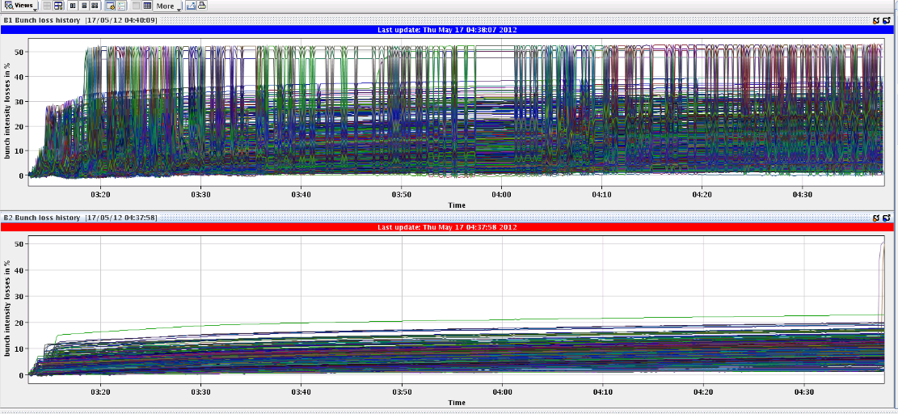
Fill #2634
The emittances of some bunches of B1 are really exploded, already at beginning of the fill
Just before the dump, we lost 50% of bunches 22761 and 22781: bunches which only collide in IP8.
50 %
B1 already lost intensity on IP8 bunches
B2 just started to lose as well
50 %

Slide 14
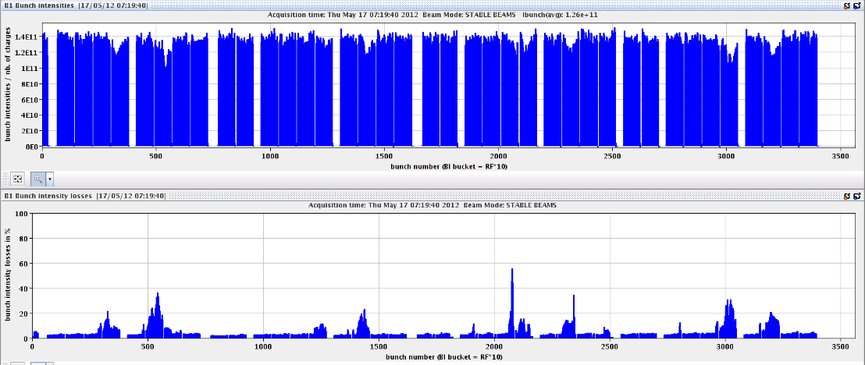
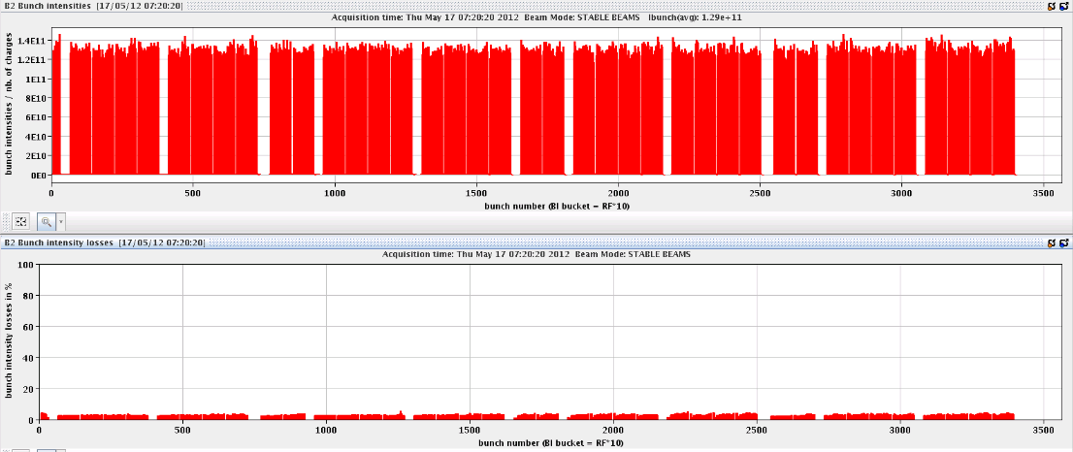
Fill #2635
50 %
5 %
bunch intensity drops to 6e10. The bunch numbers are 2075,2077,2079, which are bunches with head-on collisions only in IP8. BPMS ok up to 4e10

Slide 15
B1 bunches dropping out
Limit
careful analysis of the problem: one colleague in front of every relevant screen
* only losses in beam 1
* single bunch losses
... and only bunches affected that collide exclusively in IP8
* it happens AFTER adjust, i.e. in stable beam condition
* surprising emittance values
Created a new filling scheme to remove most of the bunches that collide in IP8 only

Slide 16
New Filling Scheme
Only 3 collisions in LHCb only, of bunches from 12 bunch train
Old filling scheme
First fill new filling scheme
Second

Slide 17
However, fill from Sunday, 15 minutes into physics
Losses this time up to 40 %
For both beams, this time
However, slightly higher bunch int. of 1.45e11
Bunches that lose seem those with a maximum number of long range interactions

Slide 18
Bunches that lose seem those with a maximum number of long
Alick

Slide 19
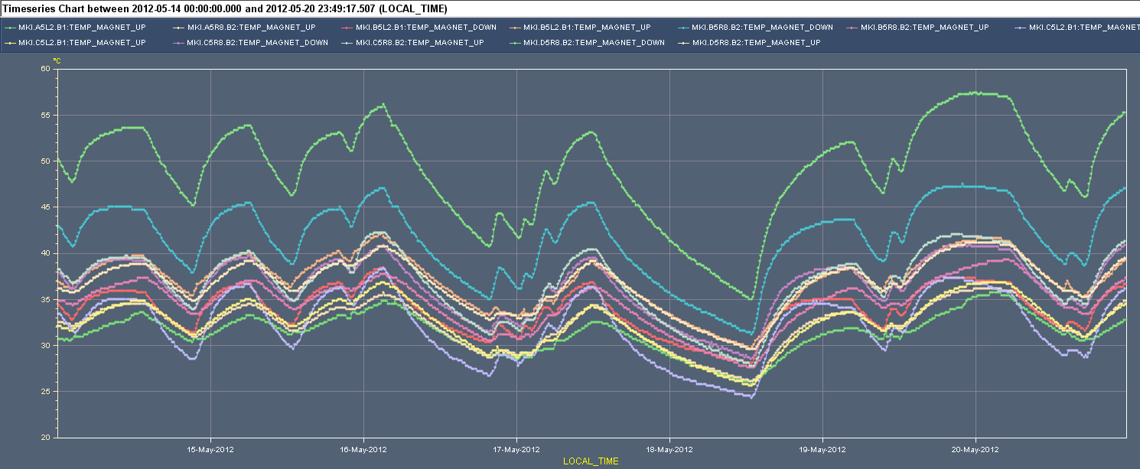
MKI is back
Reached the temperature interlock for injection on MKI beam2 for magnet C. Never above this limit, to check magnet, which allows to increase limit. Different magnet from 2011.
60
40

Slide 20
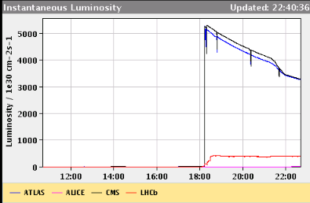
Still something wrong with the RF, Sunday
21:30 abort gap cleaning for B1 on high setting
CMS lumi going down significantly, ATLAS hardly…
???
Bunch length at injection B1. Jorg different opinion than Philippe
Clean

Slide 21
..... And at the same time
Abort gap population measurement B2 is looking very suspiciously low...
While XPOC B2 latches on BLM losses at the dump !!
???
TCDS
TCDQ
Q4

Slide 22
The Plan
Up to the new coordinators
Optimise tune / beam-beam effects
Get RF back into shape
Crowbar all sorted out?
Debunching
Injection
Physics
Need the BSRA back for B2!
Produce lumi!

