Slide 1
Monday 14th May
00:03UFO at BLMQI.06R8.B2E10_MQML. Beam dump Re-steering required for TI2
03:28 STABLE BEAMS #2627. 1.27e11 ppb, 4.11e33 cm-2s-1
13:36 Operator dump fill #2627. Physics for 10:08 hours. Int lumi ∼100 pb-1
15:19 TDI measurement - check alignment of jaws 'warm'
16:30 Optimising beam in injectors….
20:55 Injecting for physics, fill #2628
22:17 Stable beams, initial lumi’s 4.8e33 cm-2s-1
06:07 Beams dumped, trip of ROF.A67B1
Int lumi 97 pb-1
Access for power converter piquet

Slide 2
Fill #2627
Dumped by operator after 10:08 hours and about 100 pb-1
Around 8:00 start of
IP8 beam positions seem to be drifting
Drifts of luminous region position observed at IP1,5,8 (LPC)
Sharp increase of lumi in IP2 -> increase of satellites
Occasional ‘noisy RF’ requiring some gentle abort gap cleaning
Philippe investigating
OK next fill, o-night

Slide 3
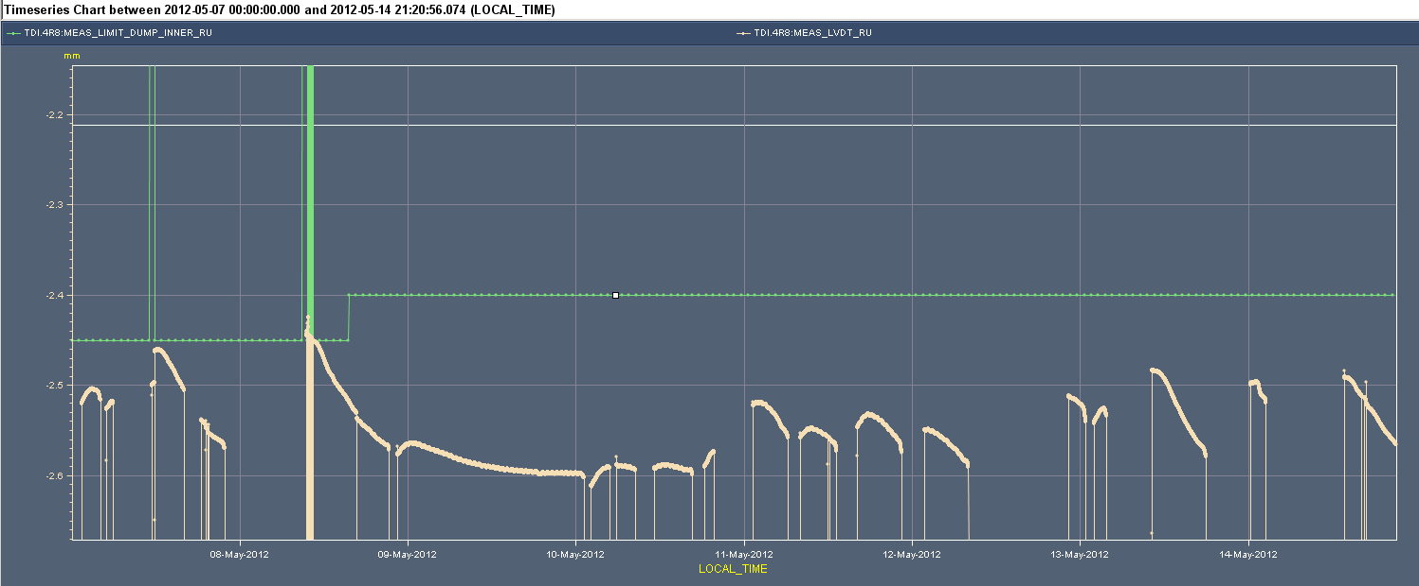
Check TDI alignment ‘warm’
No interlocks on TDI IP8 position anymore since last week
The RU LVDT interlock was increased by 50 um
During physics at 55 mm instead of 37.5 mm: less heating
Want to check alignment with beam
Lever arm effect, don’t know the real position of jaw & jumps position.
Found jaw positions for IP2 and IP8 between 6.4 – 6.6 sigma.
Setting 6.8: OK
Tuesday last week Inner limit (RU) increased by 50 um
Measurement
IL
Measured LVDT RU position
cold

Slide 4
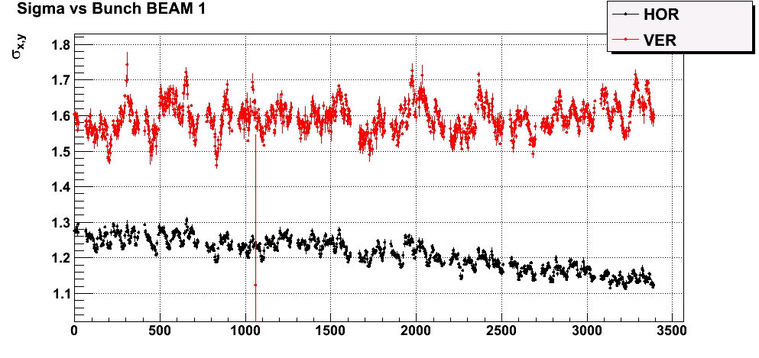
Fill #2628
Problems with beam quality in transfer from PS – SPS
Suspect extraction in PS
Could not really fix, investigations will need to continue
SPS also ‘optimised’, likely solved the difference between batches
Beam sizes at injection with BSRT in test mode: flatter
Federico Roncarolo

Slide 5
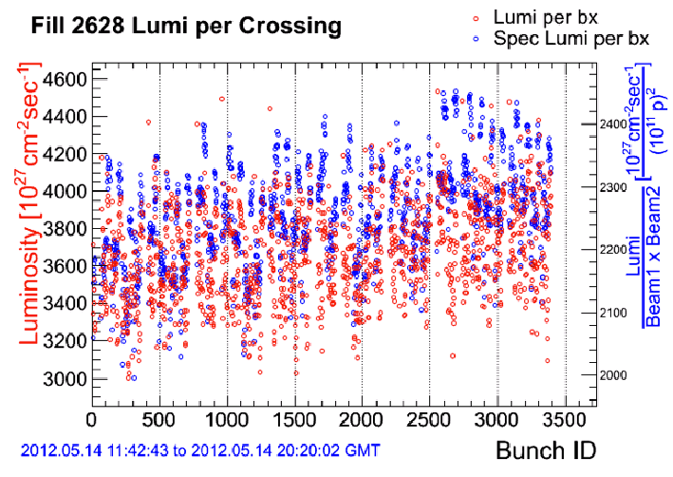
Lumi per crossing also flatter
From CMS

Slide 6
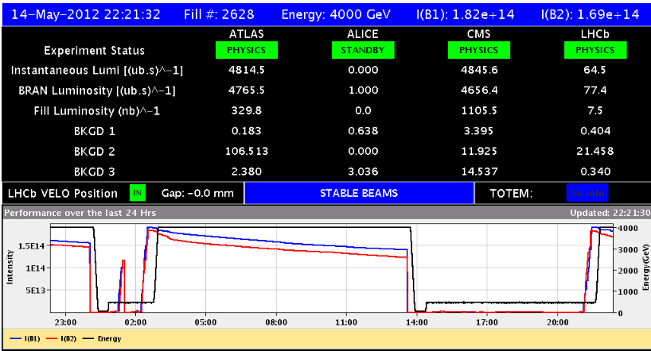
Fill #2628
During ramp TCSG.A6R7.B2, integration time: 83.8 s, losses of 34 % of dump limit
Slightly less losses then in previous fill
Higher lumi’s: around 4.8e33 cm-2s-1
Losses during physics up to 40 % of dump threshold, IP5 and IP8

Slide 7
Plan / Outstanding
Plan
Finish access for PO, ROFA67.B1 – until at least 9:30 & pre-cycle
Scraping at injection to reduce losses in squeeze
Physics
Outstanding
Continue investigations beam quality from injector chain
Orbit in collision needs to be corrected and trims incorporated (in particular point 5)
Possibly LHCb polarity change on Wednesday’

