Slide 1
Wednesday 4.4.2012

Slide 2
Wednesday
08:30 Access to reset QPS card of Q4.R8
10:30-11:40 No beam from the injectors due to unplanned intervention on RAMSES software and SPS extraction septum problem (beam 2)
Ramp-Squeeze for chromaticity measurement and verification of the beta* and energy limits of the collimators
12:34 Dumped by wrong setting of the energy interlock on the TCT position at IP8 during the squeeze. → setting corrected
Ramp with new parameters for decay and snap-back correction (FIDEL) and aperture checks with squeezed optics
Problems with FIDEL parameters, losses beginning of the ramp
→Revert back to previous FIDEL correction version (not fully successful, chroma drifting at injection)
14:28 dumped by spurious trigger of the BLMs in point 2
16:00 dumped by spurious trigger of CMS BCM → disabled faulty card from BIS (has to be reconnected before the 48b fill)

Slide 3
Wednesday cont.
16:30-21:30: Aperture verification at the end of squeeze and in collision. Aperture sufficient to run with 60 cm optics.
21:44 dumped
LHCb could not test moving Velo in "beam dump". The configuration was not standard and the override did not work.
Beams dumped by CMS BCM (switched off power supply)
23:00 Injecting
chroma drifting
problems with H tune measurement and feed-back
0:38 – 2:04 Stable Beams 3b
3:30 – 4:00 no beam from SPS
5:40 Stable Beams 47 bunches, Atlas low pile-up, Alice main-satelite
11 indivs 8-9E10 ppb
3 trains of 12 nominal bunches
Dump foreseen for 9:00

Slide 4
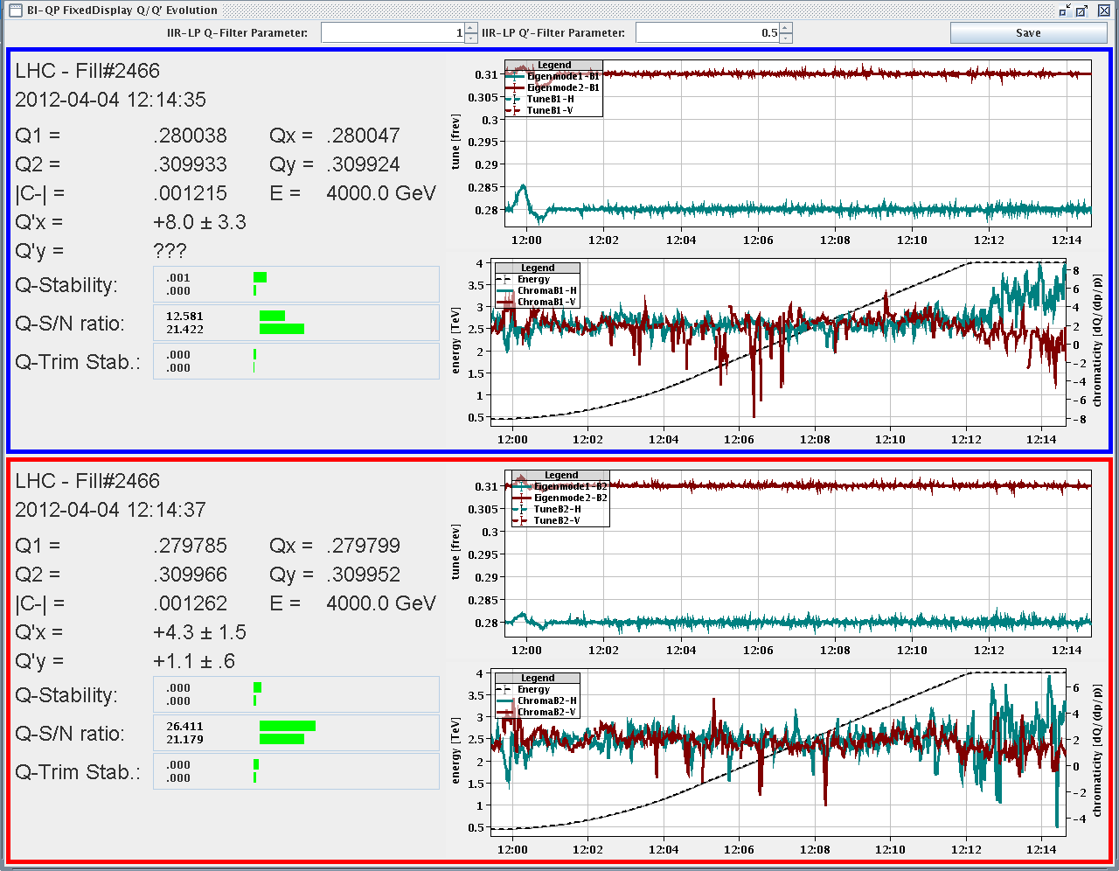
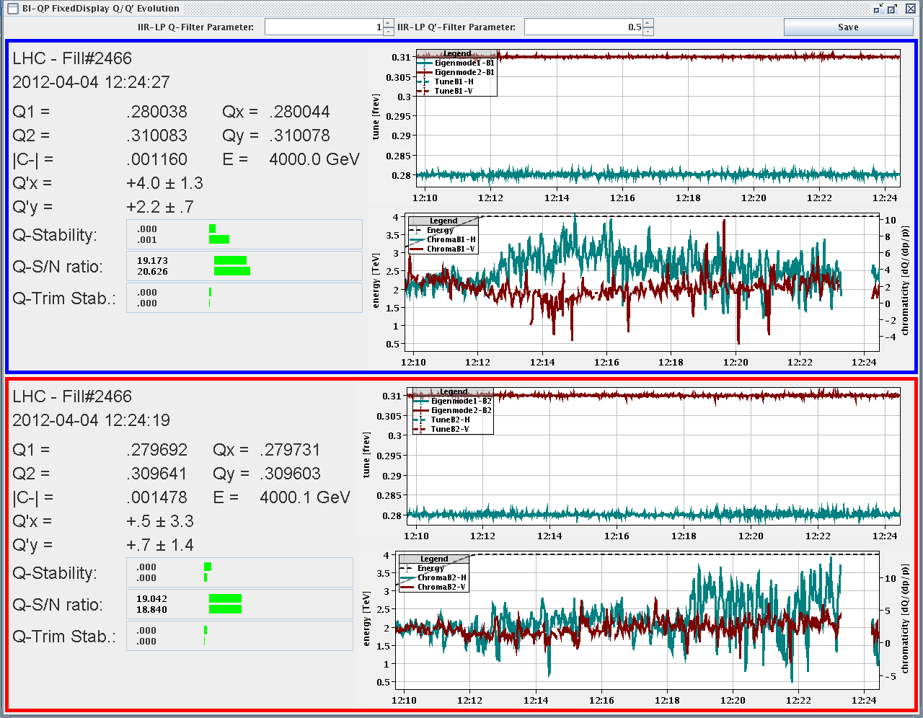
Result of corrected chromaticity
Chromaticity correction during the ramp very good.
Can be further improved at flat-top.

Slide 5
Summary of aperture checks (GA, SR, MP, JW)
Checked the aperture with squeezed beams to verify the margins between TCTs and triplet apertures in IP1/5
Ramped and squeezed one nominal bunch and 4 probes to establish a good orbit reference and then blowed away the nominal bunch with the ADT, in order to perform aperture check with safe single-bunch intensities
Opened collimators, opened TCTs, performed H and V loss maps with ADT blow-up → verify that TCTs (at 10.5-11 sigma) are still shadowing the triplet aperture (TCT nominal position with squeezed beams is 9 sigma)
Results:
Squeeze, separated: TCTs at 11 sigma shadow the triplett aperture
Squeeze, colliding: 11 sigma for B1-H, B1-V and B2-H and 10.5 sigma for B2-V (B2-V losses at the MQX-R1 at 11 sigma).
These margins are sufficient for operation at 60 cm
Note that in some cases, we had to open the TCT collimators in IP2 and IP8 even if they were at >12sigmas. We believe that they were intercepting secondary halo but this has to be confirmed by more detailed analysis.

Slide 6
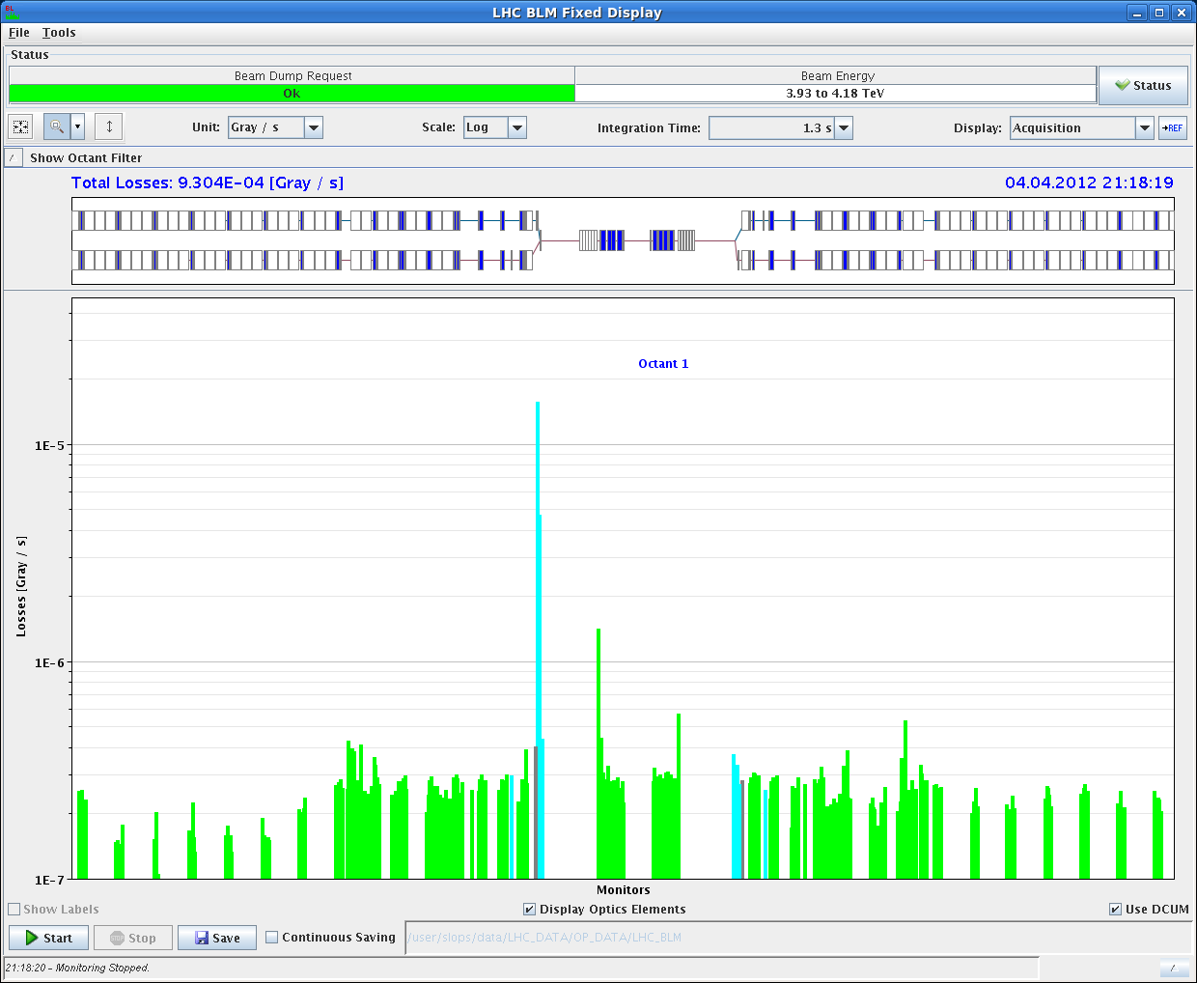
Example Loss map with TCTs at 11 sigma

Slide 7
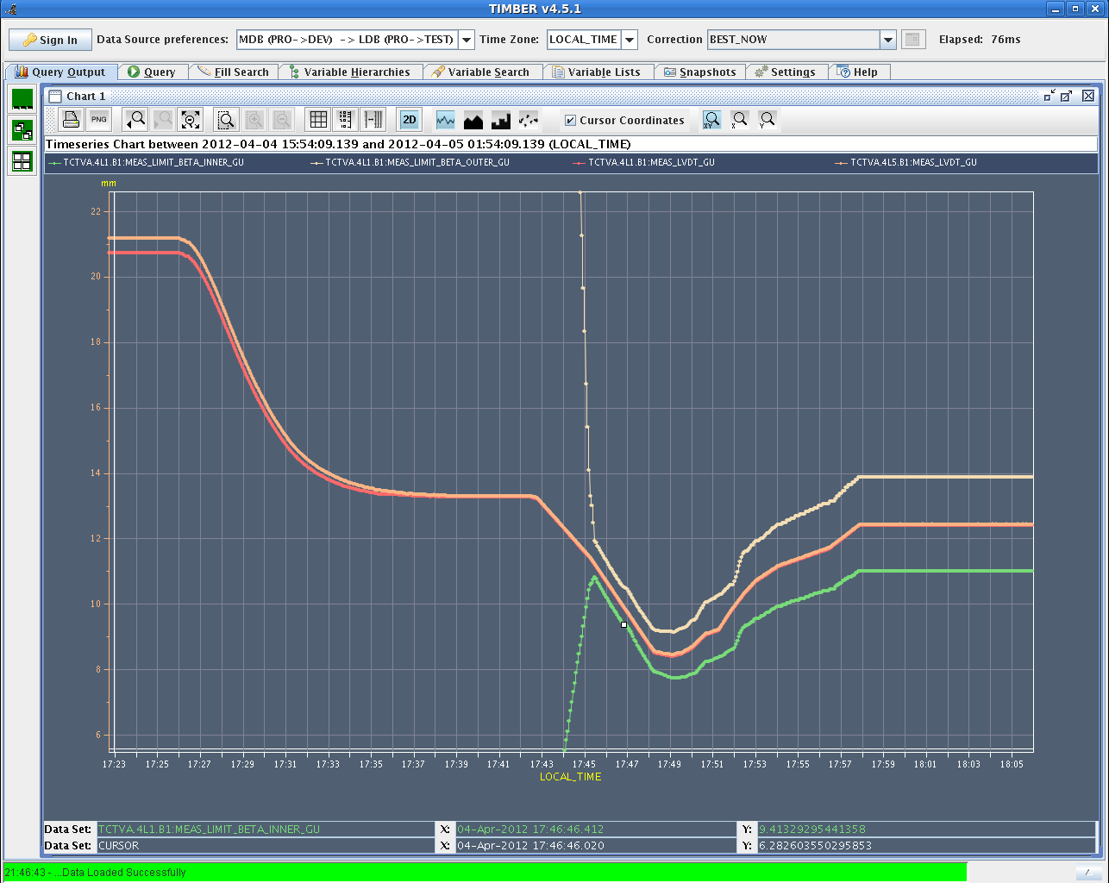
Collimator limits versus beta* verified
Example of collimator movement and position limits during ramp and squeeze

Slide 8
First stable beams 2012 (0:38 – 2:04), 3 bunches

Slide 9
CMS event recorded at sqrt(s)=8 TeV

Slide 10
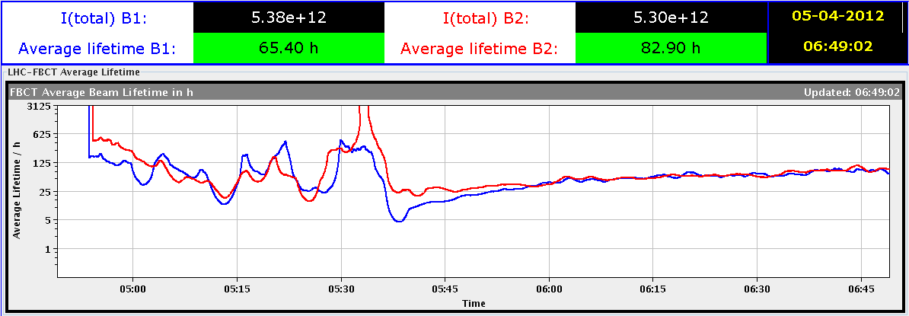
Stable beams (5:40) 47 bunches
Atlas: low pile up
Alice main-satelit collisions

Slide 11
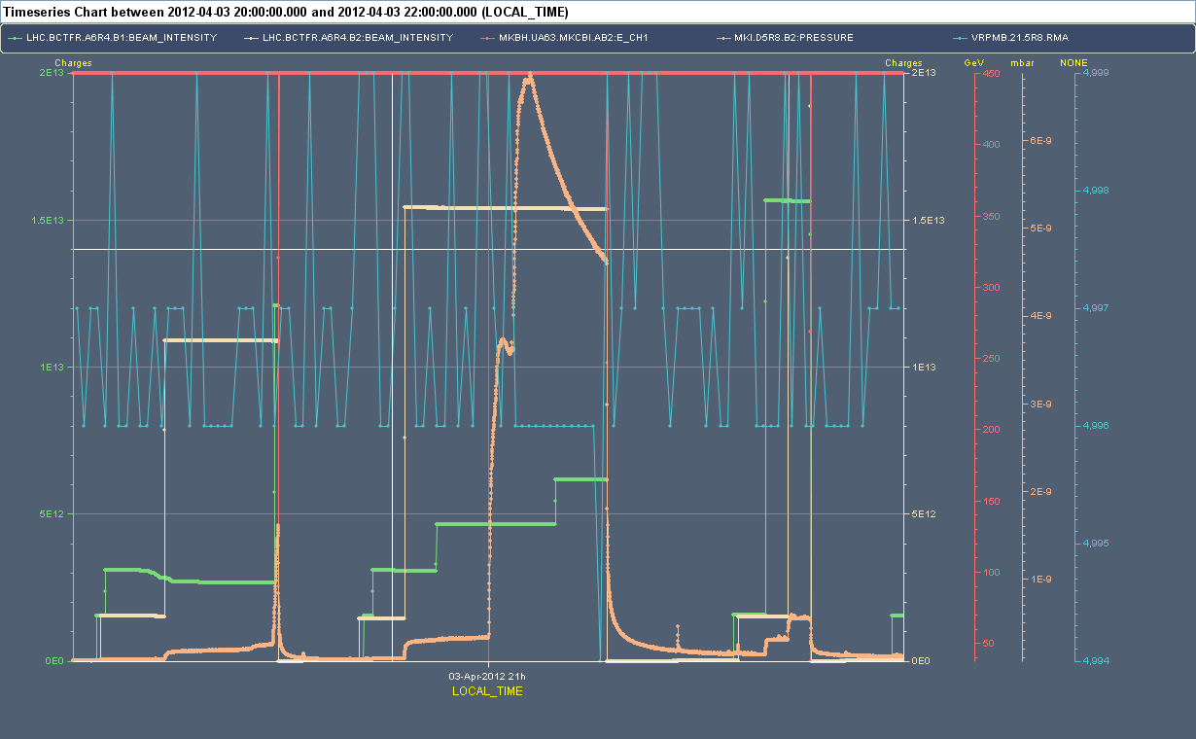
Vacuum activity IP8, injecting 144 bunches (Tuesday)
M. Barnes:
Vacuum spike at MIK of up to 7e-9 mbar not correlated with injection of B1 nor B2
The MKI8D vacuum is VGPB.138.5R8.R: it reaches a peak of ~7e-9mbar. However the gauges VGPB.98.5R8.R and VGPB.176.5R8.R (right of MKI8D) show very large excursions at 21:00hrs (greater than 4e-8mbar).
Thus I believe that the vacuum spike originated on the Q5 side of MKI8D.
MKI8 ecloud coils were on (VIESA.193.5R8.C) at 21:00hrs, the ecloud coils VIESA.3.6R8.C were off.

Slide 12
Others
Logbook does not show all entries (automatic messages missing)
Problem with Lumi optimization for Atlas:
Witold: “The default DIP publication should be moved to BCM_OR (lumi-scan 6). Right now it points to LUCID with is saturated for this kind of beams”
Optimize-all never worked on IP1, not even on BRAN signal which looks fine on OP displays;
Inst lumi IP1 and 5 quite different, probably some recalibration needed
ATLAS sees the BPM reading flickering for BPMSW.1R1.B1, should be fixed before the vdM scan
Chroma at injection
Horizontal tune measurements and feed-back (need to increase chirp?)
Undulator RU.L4 was reset
CMS BCM status?

Slide 13
Planning

Slide 14
Planning
Friday till Monday the morning meeting will be at 9:00
Tuesday 8:30 summary of the week
WED | N | 8 | STABLE beams with 48 bunches and low-pile-up for ATLAS
THU | M | 8 | STABLE beams with 48 bunches and low-pile-up for ATLAS
THU | A | 8 | STABLE beams with 84 bunches
THU | N | 8 | ADT set-up 1.4E11
FRI | M | 8 | STABLE beams with 84 bunches (LHCb field off)

Slide 15
Intensity ramp-up
2-3 fills and 4-6 hours with 48b, 84b, 264b and 624b (cycle validation)
3 fills and 20 hours with 840b, 1092b, 1380b (intensity/lumi related problems)
MP checklists after 84b, 624b, 840b, 1092 bunches
Regular MP checklists every two weeks when operating with 1380b
Bunches | Max number of bunches injected | Alice
3 | 1 | Main-main
48 | 12 | Main-satellite
84 | 36 | Main-satellite
264 | 36 | Main-satellite
624 | 72 | Main-satellite
840 | 108 | Main-satellite
1092 | 108 | Main-satellite
1380 | 144 | Main-satellite

