Slide 1
Fri 6/4
07:30 – 10:30 Asynchronous dump test with Beam 2. No issue found.
FIDEL update. Now chromaticity decay corrected.
12:13 Beam dump due to problem in the storage of the reference for the orbit feedback.
14:53 Stable beam #2479. (84 on 84 bunches): Initial luminosity: 3.2x10³²cm⁻²s⁻¹
19:00-00:00 Fills (2480 and 2481) with 264 bunches/beam and bunch intensity close to 1.5x10¹¹ p/b.
Losses during the squeeze, Instability observed when going in collision, Issues with the skew scheme in LHCb
02:00 Fill #2482 STABLE BEAMS (1.3x10¹¹ p/b) and 264 bunches with initial luminosity of >0.9x10³³ cm⁻² s⁻¹.
05:30 End of fill #2482
08:00 Again problem with OFB. Beams dumped at the end of the squeeze

Slide 2
Chromaticity decay correction (FIDEL)
Parameters for the decay correction have been corrected (Mike+N. Aquilina).
Chromaticity correction now OK at flat-bottom.
Snap-back to be revisited

Slide 3
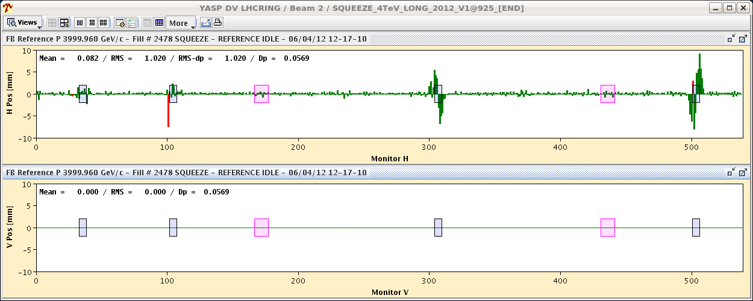
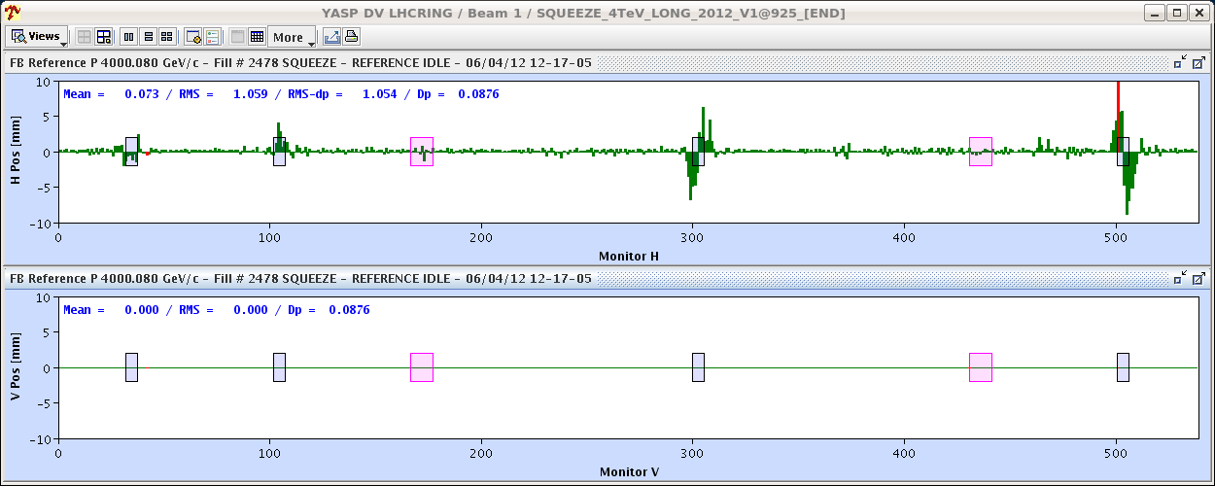
Beam dump #2478
Vertical reference in the OFC zeroed in V-planes for both beams. Origin not known (expert analyzing). Occurred already on 21/3 at 00:59 at that time the reference was zeroed in the horizontal plane

Slide 4
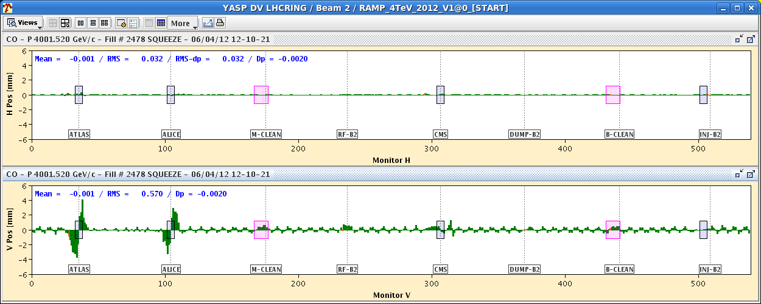
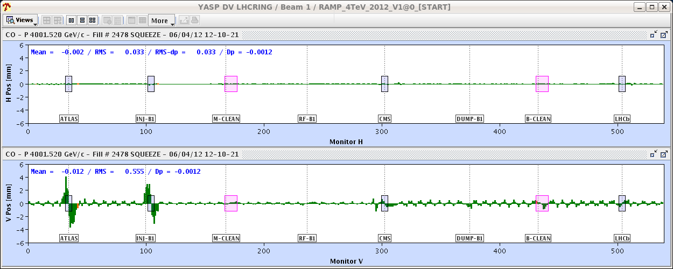
Beam dump #2478
Orbit feedback suppressed the crossing angle in point 1 and 2 in approximately 170 s. BLM caught the event and dumped properly.

Slide 5
Actions
Test without beam of the squeeze sequence for the orbit feedback ➔ no problem
Following fill (#2479): closely monitoring of the status of the reference orbit
Implementation of a SW interlock dumping the beam if a reference orbit with zero positions is loaded. Deployed and tested by Joerg.
OK from rMPP to go to 264 bunches
Problem occurred again at 8 AM this morning. Well caught by the SW interlock ➔ expert called to diagnose the problem.

Slide 6
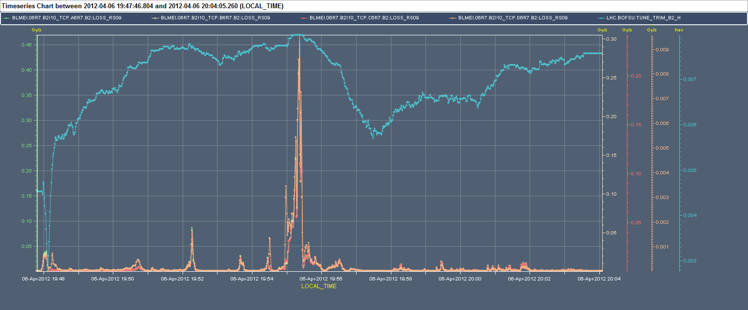
Fills with 264 bunches (2480)
Fill with N_{b}~1.5x10¹¹ p
Low lifetime in the squeeze (~2m β*) for Beam 2.
Observed trims by TFB HB2 in correspondence of the losses

Slide 7
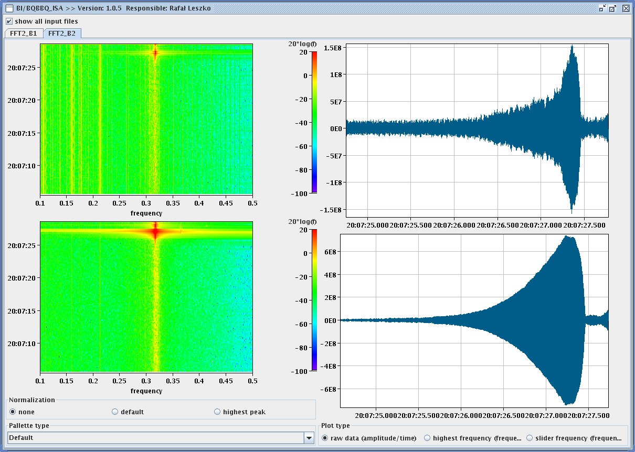
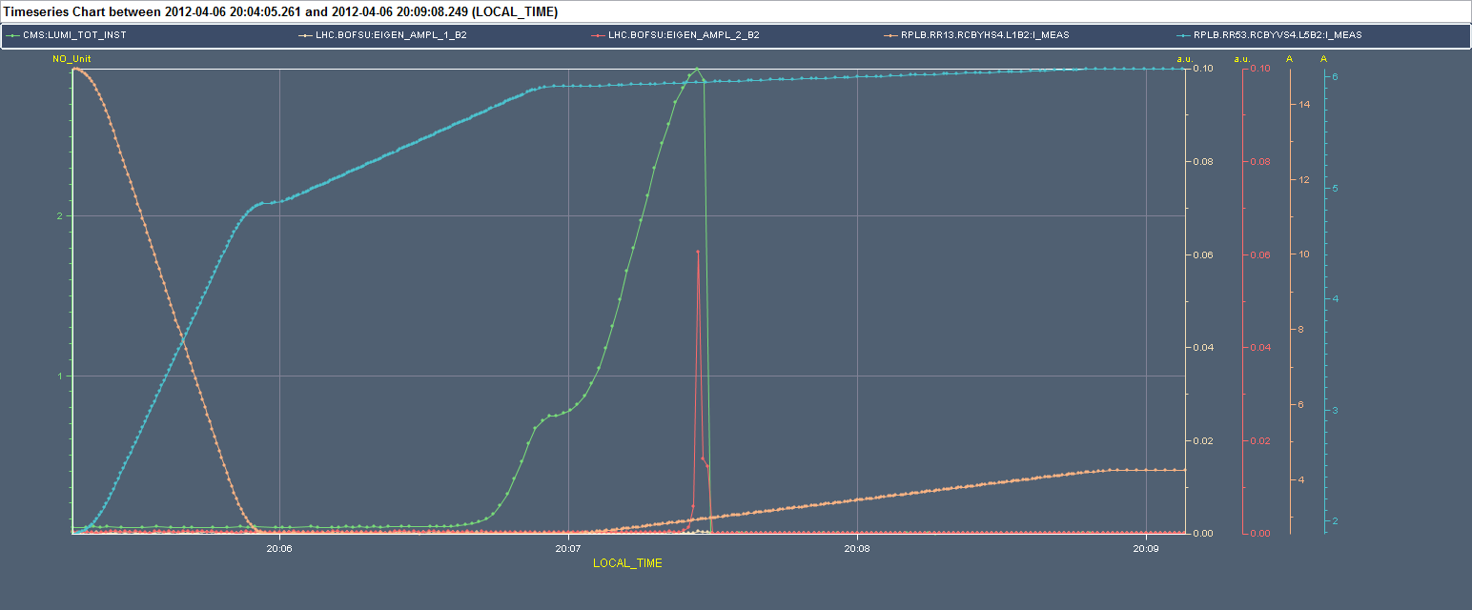
Fills with 264 bunches (2480)
Instability observed when going in collision (mostly vertical) but still far from head-on

Slide 8
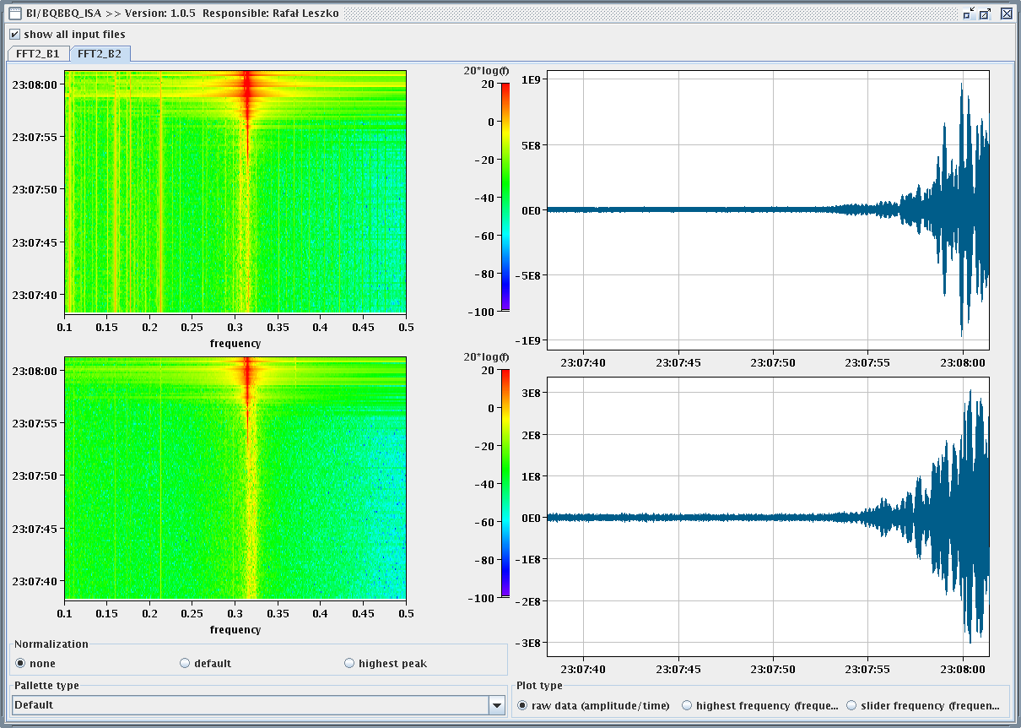
Fills with 264 bunches (2481)
Squeeze without tune feedback. Significant reduction of the losses.
Adjust:
Reduction of chromaticity before going in collision (2 to 1 unit)
Increase of the damper gain in the vertical plane
Still instability observed (mostly in the H-plane)
Observed also head-on collisions during the “rotation” of the LHCb crossing plane

Slide 9
Fills with 264 bunches (2482)
Found out that the sign of the horizontal separation in LHCb not correct ➔ inverted sign
Increased the gain of the transverse feedback
Decreased bunch intensity to 1.3x10¹¹ p/b
Finally managed to go in STABLE BEAMS#2482 with >0.9x10³³ cm⁻²s⁻¹
Need to verify whether dominant contribution is the reduced bunch intensity

Slide 10
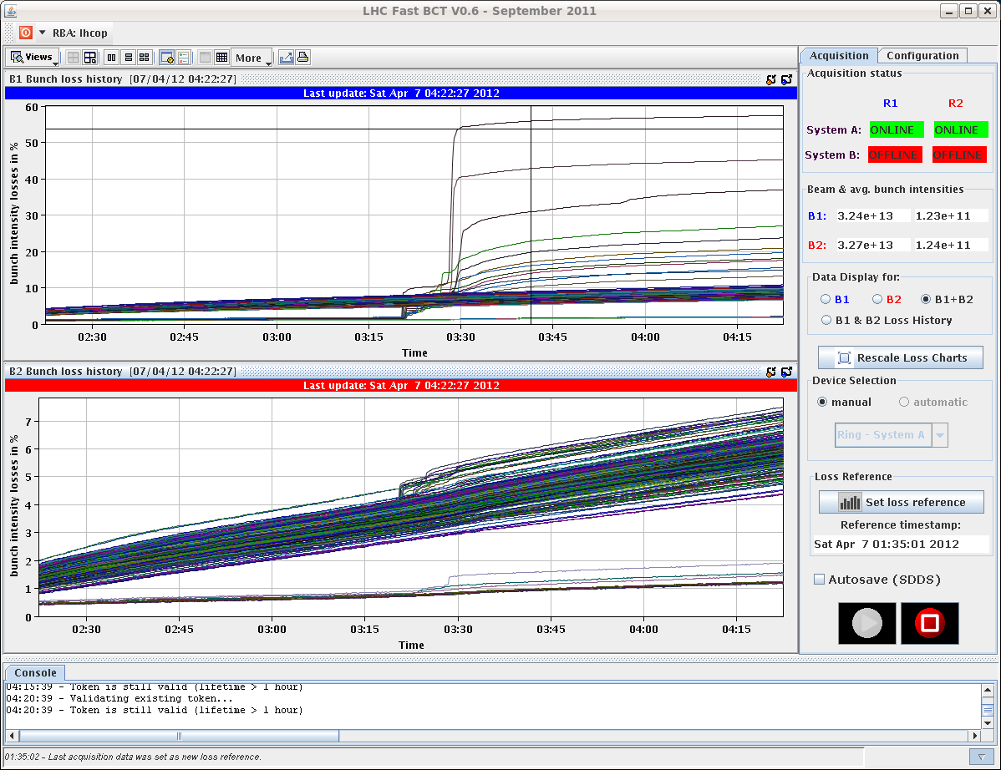
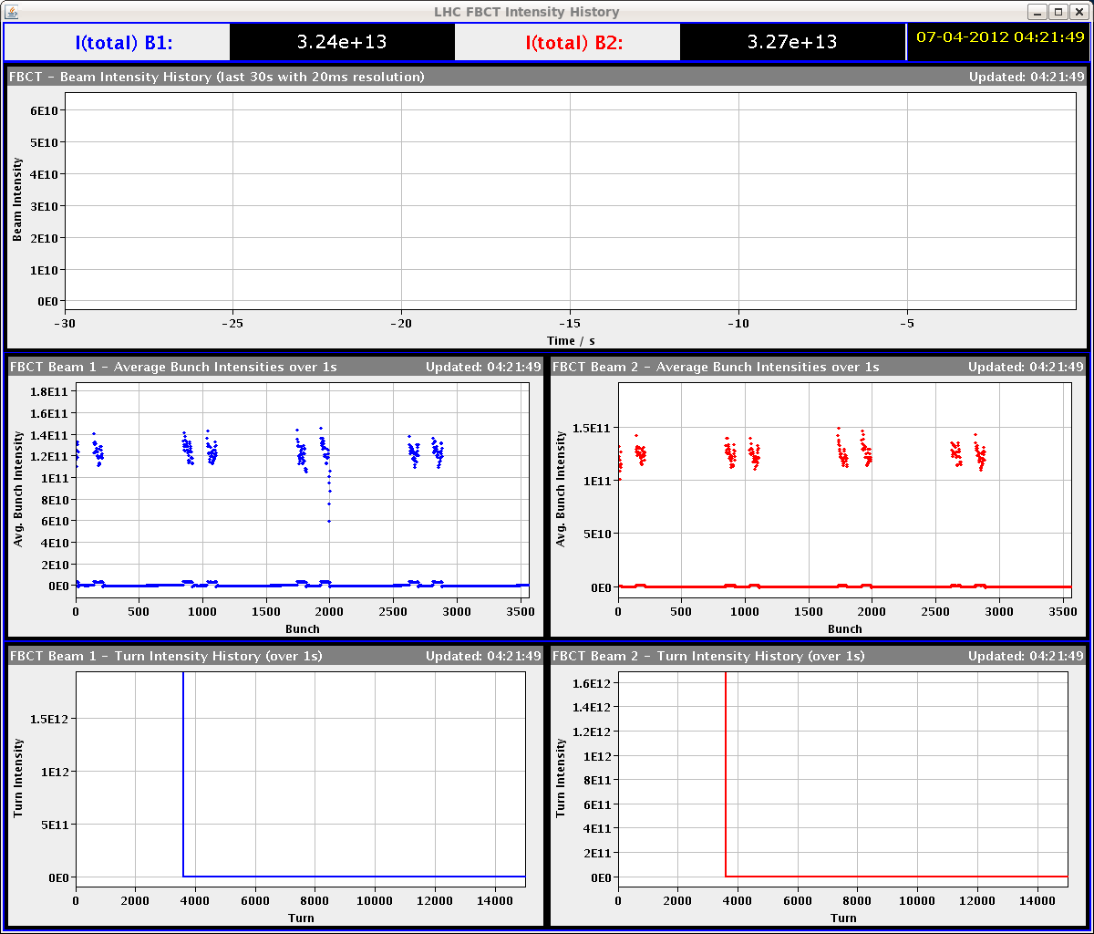
Fills with 264 bunches (2482)
Sudden losses observed in some bunches. Patterns being verified (colliding in IP8)

Slide 11
Issues
Application for luminosity optimization crashing and slowing down communication with FGC (acquisition of the PC currents) ➔ CO+OP follow-up. For the moment minimize the number of applications open
VdM scan application: cannot enter integration time ➔ CO+OP follow-up
Damper post-mortem (update required). Fixed display for injection oscillations (HB1)
Orbit feedback loading zero reference

Slide 12
Plan
Investigations on the issue of the OFB
Revisit LHCb crossing-angle tilt with small number of bunches to understand better the observed behaviour
Stable beams 268 on 268 after having understood the various issues.
No additional step in number of bunches today

Slide 13
Intensity ramp-up
2-3 fills and 4-6 hours with 48b, 84b, 264b and 624b (cycle validation)
3 fills and 20 hours with 840b, 1092b, 1380b (intensity/lumi related problems)
MP checklists after 84b, 624b, 840b, 1092 bunches
Regular MP checklists every two weeks when operating with 1380b
Bunches | Max number of bunches injected | Alice
3 | 1 | Main-main
48 | 12 | Main-satellite
84 | 36 | Main-satellite
264 | 36 | Main-satellite
624 | 72 | Main-satellite
840 | 108 | Main-satellite
1092 | 108 | Main-satellite
1380 | 144 | Main-satellite

