Slide 1
Sat morning
Until 12:40:
Loss maps at injection
Analysis of high losses in IR6 for B1H: Showed that TCSG.4R6.B1 set up too tight
Repeat of IR6 TCSG collimation setup at injection Results: center beam size ratio TCSG.4R6.B1 +0.150 99% TCSG.4L6.B2 -0.318 94% previous alignment from 2012.03.21 center beam size ratio TCSG.4R6.B1 +0.110 92% TCSG.4L6.B2 -0.185 94%

Slide 2
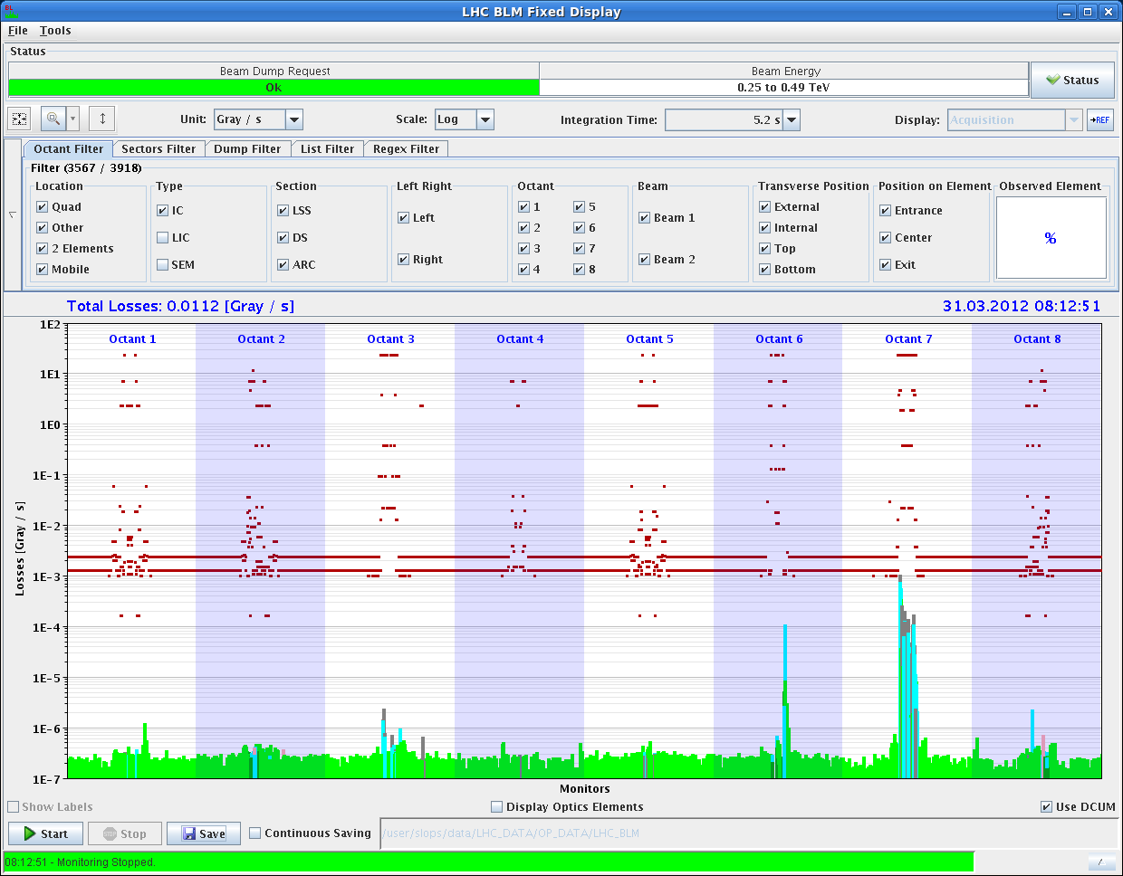
B1H loss map – IR6 → 20% leakage

Slide 3
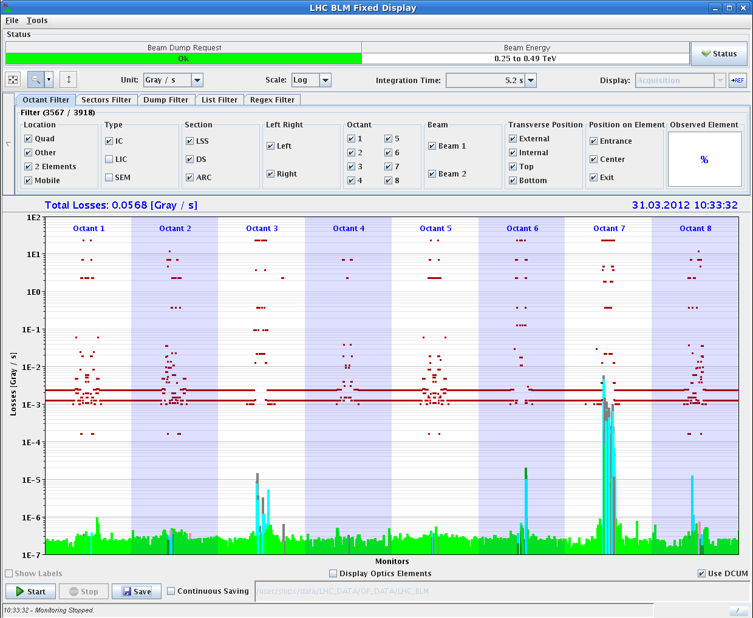
TCSG.4R6.B1 out → less than1% leakage

Slide 4
Sat afternoon
Some time lost with PS and SPS problems (POPS, dump kicker, …).
17:20 Ramp 2 nominal bunches
Some problems to see tune → chirp B2
Sudden lifetime drop in B2 some time after end of squeeze (as seen before)
18:45 Collimator (TCT) setup at end of squeeze
Beam not very stable, complicating setup
Finally all achieved
21:36 TCT setup completed: 2012 Collimation Setup done!
22:04 Setting up for RP alignment → collision
22:51 Dump
Attempt to open the limits of XRPV.A6L5.B2 via the menu button "Set Thresholds to HW limits" which is incorrectly configured, such that it sets the outer limits inside the RP home position. Thus the RP sitting at HOME violated the outer limit and caused the dump.

Slide 5
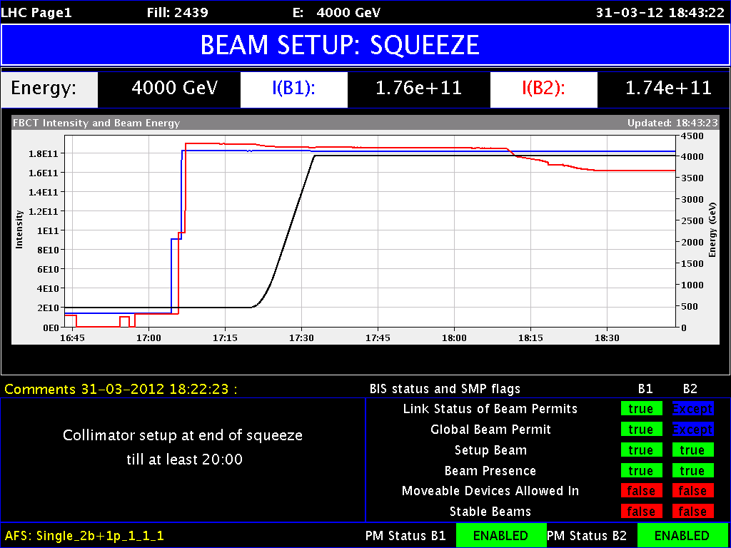
Intensity

Slide 6
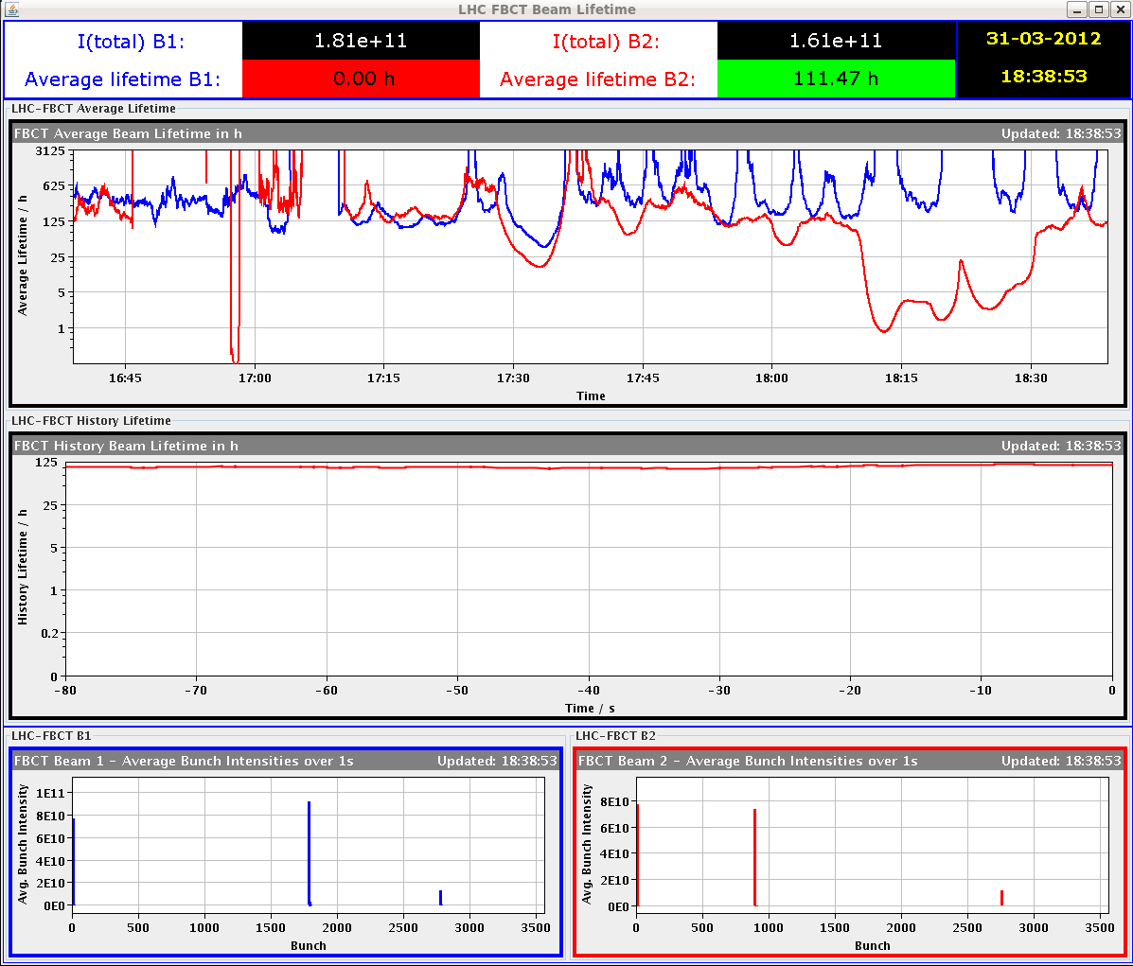
Lifetime drop after end of squeeze

Slide 7
Beam Stability
Issues in beam stability:
For the squeeze we turned on the chirp for B2, and squeezed without problem, but just after the squeeze (FBs still on) we again had significant losses for B2, after the tune peak on B2H jump to a 2nd peak. the resulting instability caused losses and only stabilized with reduced intensity and minor coupling trims. ( this was exactly like the fill of yesterday afternoon). Note that we checked chrom and bunch length evolution and all seemed OK.
During the setup, it was observed that the 2nd bunch of B1 (bucket 17851) was blown up by in the transverse by at least a factor 3. We stablized losses by adding a few units of chroma. We also optomised the coupling to try to improve the spectra.

Slide 8
TCT Setup and Issues
All completed!
Horizontal TCTs proved much more difficult, since the background was noisy and spikes not caused by the collimator movement, of the same order of magnitude as the spikes we were looking for, were often showing up and making it hard to see if the jaws were touching the beam or not.
Often one step caused a clear spike, but then the next few steps didn't cause any losses. Could this be caused by off-momentum halo and spurious dispersion?
In particluar, TCTH.4R5.B2 took a long time to setup and showed in the end a beam size ratio of 79%. The effective beta beat at this collimator should maybe be checked.
Roderik, Gianluca, Luisella

Slide 9
Saturday Night into Sunday morning
Nice fill with 2 bunches into adjust mode.
3:23 Setting up collisions.
Issues to find collisions in CMS.
Joerg: “I found the problem : the lumi knob incorporation rule was not correct, it was propagating back constant and not decay-out, as a consequence the corrector settings are also constant, and they are 'eradicated' by a subsequent incorporation from the squeeze.
Simple cure:
We zero the lumi knob settings in the collision BP function (they have been zeroed anyhow at the lower level),
Then we move back to the lumi knob settings of the start of this fill (or end of fill on friday) in the actual BP, and re-incoporate with the correct rule.”
6:11 Collisions found in IR5. Start of RP alignment.

Slide 10
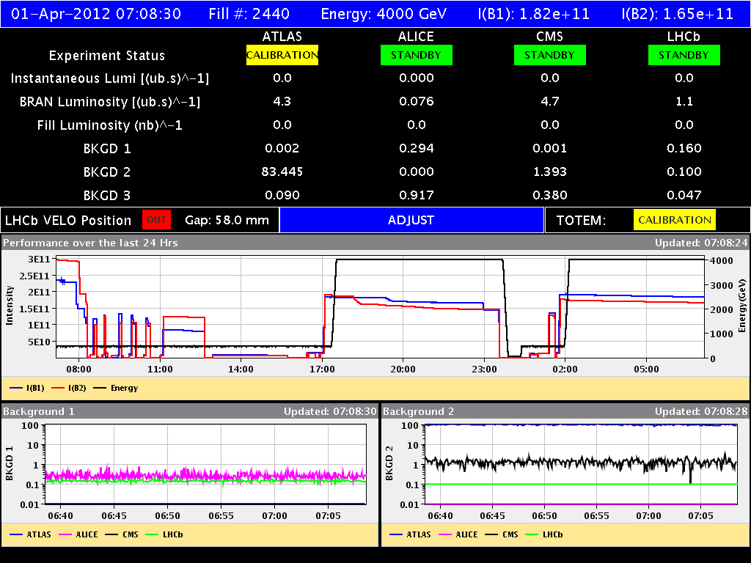
Fills Saturday until Sunday
Minimal losses, no lifetime issue, no instability, …

Slide 11
Today
Sunday
Continuing RP alignment?
12:00 Injection and dump work
20:00 BI setup with nominal bunches at 4 TeV

