Slide 1
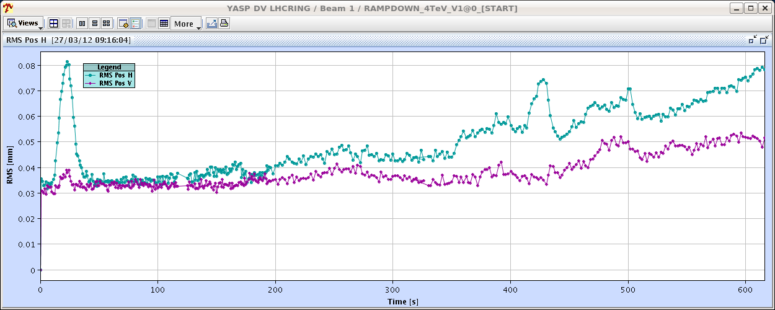
Tuesday morning
08:30-09:00 Squeeze with probe.
Very nice and stable orbit – only one ‘spiky’ excursion in the fist part of the squeeze. New parabolic rounding of correctors involved in Xing and separation bumps seems to pay off.
Small RT corrections after a few iterations of feed-forward (each at the level of ~60%).
Trim by hand
610 out of 925 seconds

Slide 2
Morning - access
09:00 Just as we wanted to move to collisions, beam dump from access system in Pt8 – shielding wall seen open.
Beam gone, 3 sectors OFF from SIS access interlock.
Investigation by GS – problem was traced to a cable fault inside a LASS rack.
During the investigations, lost all patrols in Pt8.
EIS Pt8 seen in bad state during repair → no access possible in the ring.
13:00 New dry test of 90 m un-squeeze. Trip of Q4.R5.
Have to lengthen the functions a bit more…
14:00 Machine patrolled.
Many thanks to EN/MEF for help with the patrols !

Slide 3
Afternoon
15:00 Another access in Pt6 for vacuum (pressure sensor).
Pre-cycle, beam back just before 18:00.
18:00: TCDQ angular alignment.
Not minimum found for B2 on angle. Decide to remain with ‘0’ angle.
B1 TCDQ angle -60 urad, compatible with -100 urad found previously. Apply -100 urad angle.
>> new function needed and test ramp.
22:00 TCDI validation prepared (→ tonight).
Calibration of losses behind collimators.

Slide 4
Night
23:00 Test ramp and squeeze dumped in ramp – lost S56 & S67, Valves closed, LBDS off due to 400V problem in UA63/67.
Cause of trip is not understood.
00:40 400 V back, switching on again.
02:00 Problem with TCSGs in Pt6 – lost steps.
STI piquet could reset.
03:30 Ramp finally starting…
04:00 Beam lost in the squeeze, apparently on TCTs in IR8 – collimator functions?
Worse than before when the collimator were left in place.

Slide 5
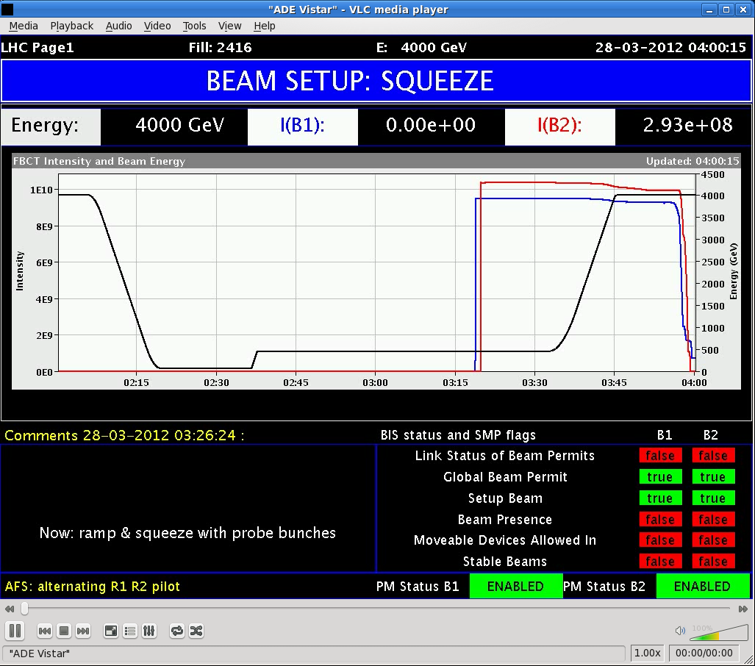
We can do better..

Slide 6
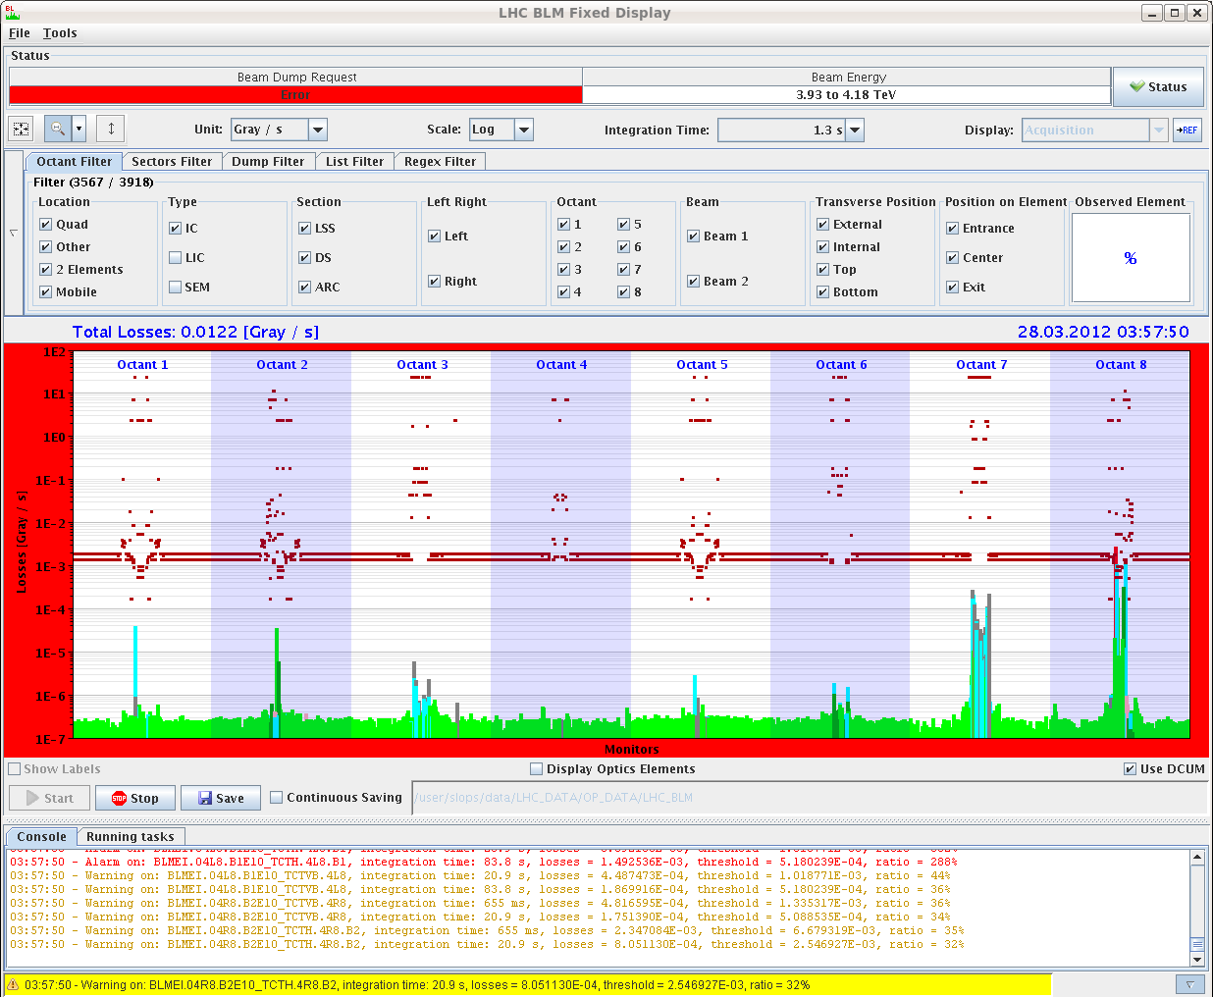
Squeeze

Slide 7
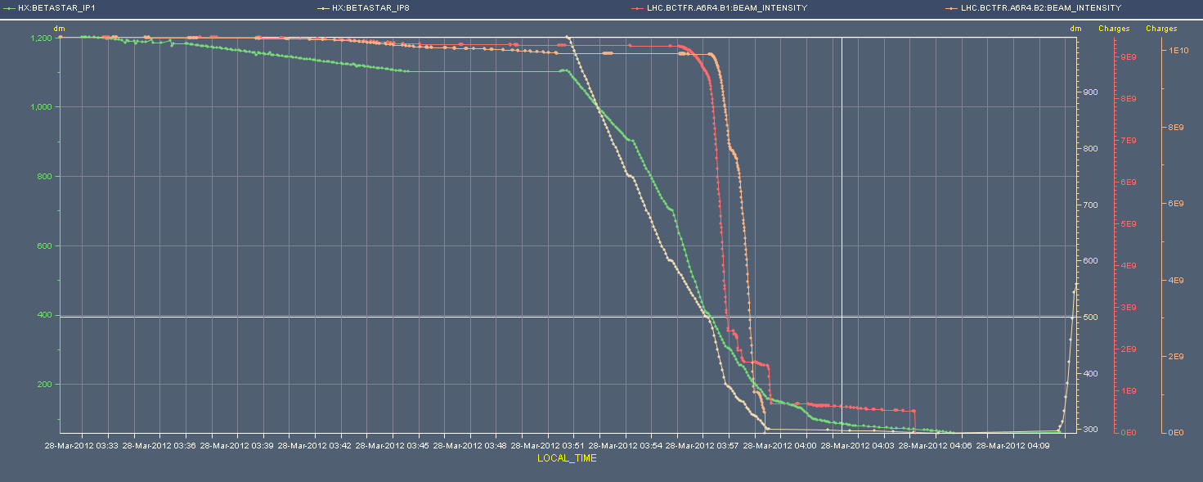
Losses start ~6m (IR1/5), become massive ~3m (IR1/5)

Slide 8
Early morning
05:40 S78 trip. Cause unclear…
Access needed to restore communication to QPS controller.
Next:
Collimator setup at 4 TeV (→evening)
Injection protection validation (night)
Thursday: collisions with nominal bunch – only after squeeze problem is understood (another test with probe).

