Slide 1
Thursday 22nd March
00:20 – 02:40 on longer squeeze function, orbit and chroma correction at 4 TeV
2:40 – 5:30 second cycle with long squeeze
5:46 – 7:00 TI8 stability check
08:00 – 15:00 Check of b* at 0.7 m and 0.6 m
15:00 - 16:00 Splashes for ATLAS
16:00 - 17:00 energy feedback on orbit feedback successful (left operational)
17:39 Lost ramp, for crossing checks, at 3.8 TeV
20:58 Dump of beam after squeeze executed for the first time with nominal crossing and separation to the end
21:45 – 7:30 TCDQ and injection protection set-up
08:00 – 11:00 Access

Slide 2
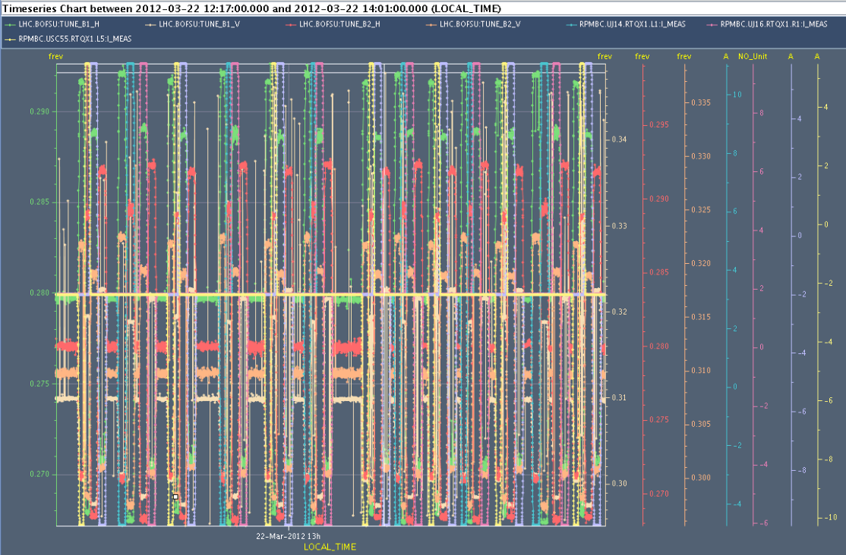
Check of beta* at 0.7 m and 0.6 m
Beta-beat checked at beta* = 0.7 m
the beta beat was slightly worse than at beta*=60 cm
Use k-modulation at 0.6 m
Procedure now works, but online calculation for beta* is not yet correct
Results to come

Slide 3
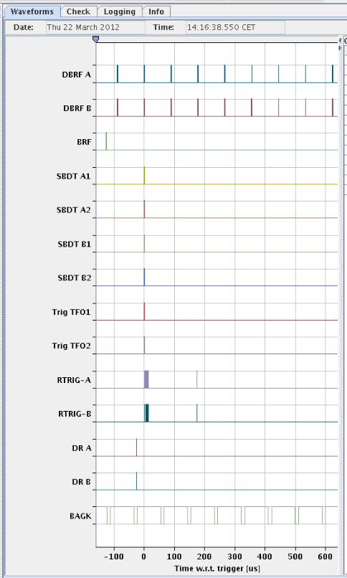
Machine Protection test
Missing f-ref
Triggered the dump of B1 by cutting the RF frequency to the LBDS: OK
LBDS – TSU – IPOC: LHC Beam Dumping System – Trigger Synchronisation Unit – Internal Post Operational Check
Dump Triggers

Slide 4
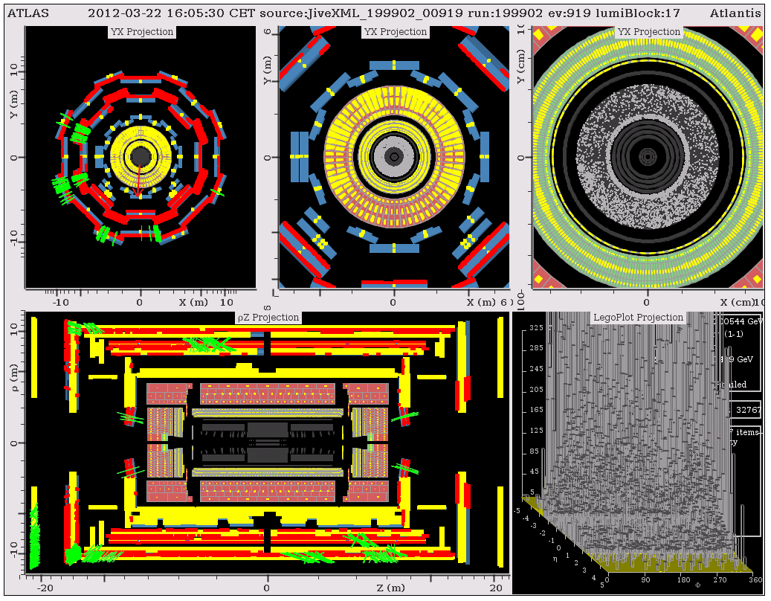
Splashes for ATLAS
“As you can see, the calorimeters and muon detectors were nicely illuminated, which allows us to time-align them.”

Slide 5
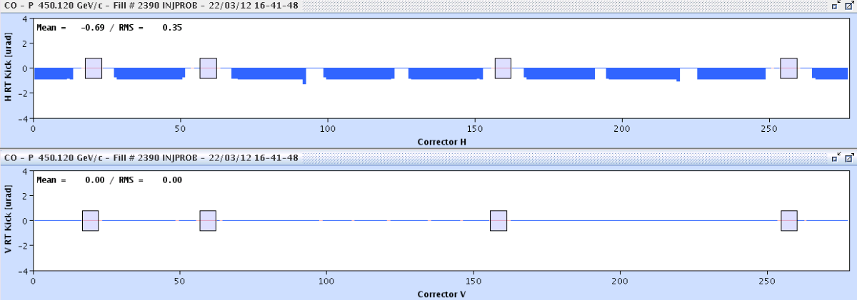
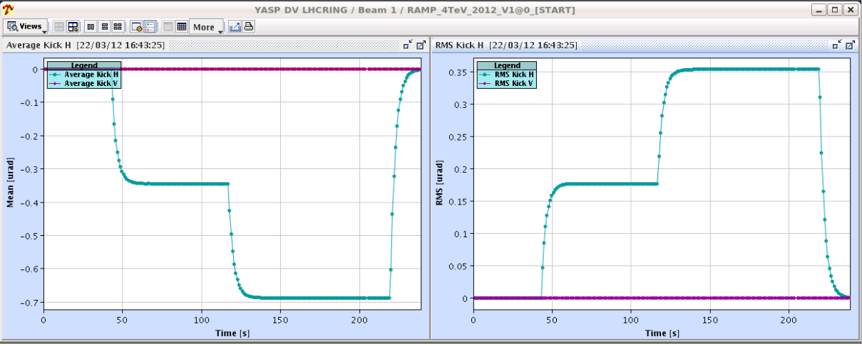
Energy Feedback on Orbit: Working
Left on for normal operation

Slide 6
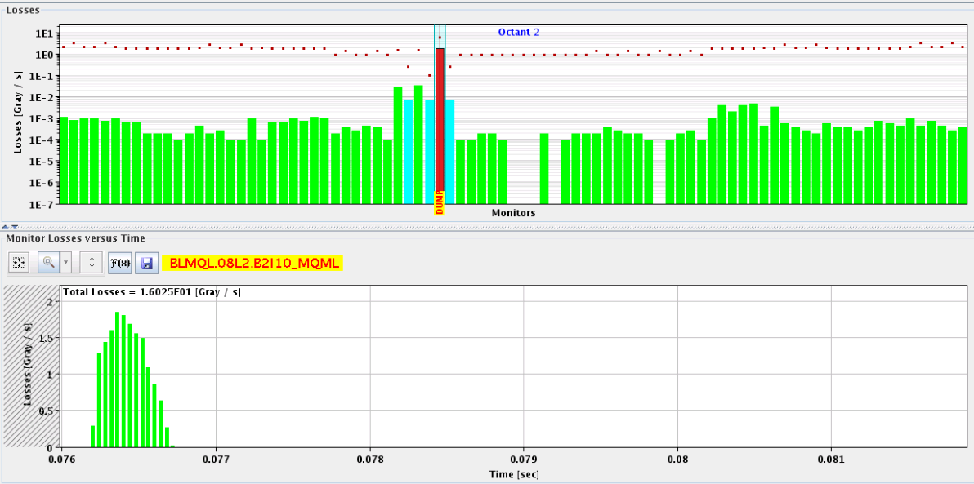
Ramp for testing of crossing through squeeze
First ramp lost at 3.8 TeV due to losses on BLMQL.O8L2. B2I10_MQML
Not really explained, unusual loss pattern
It is on the msec time scale, could be something UFO-like
B2

Slide 7
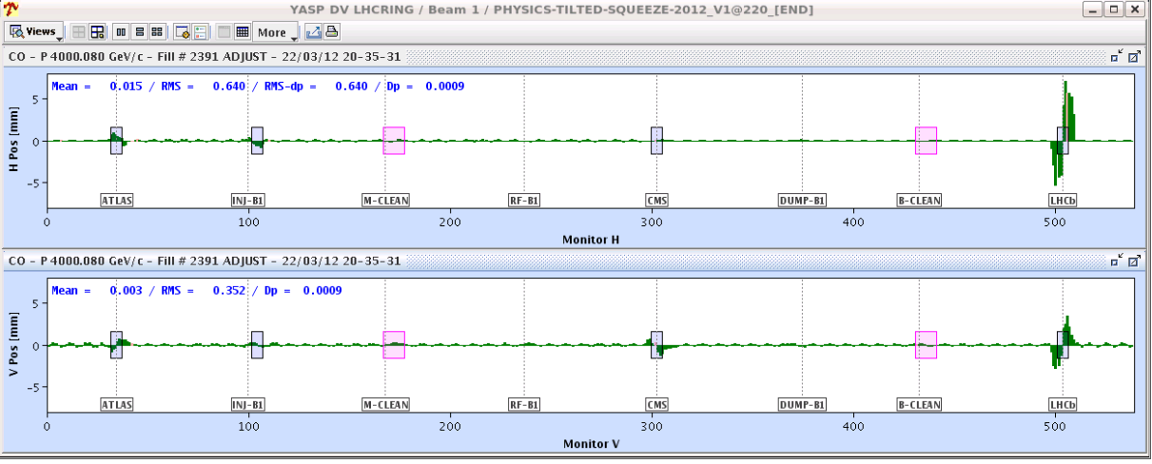
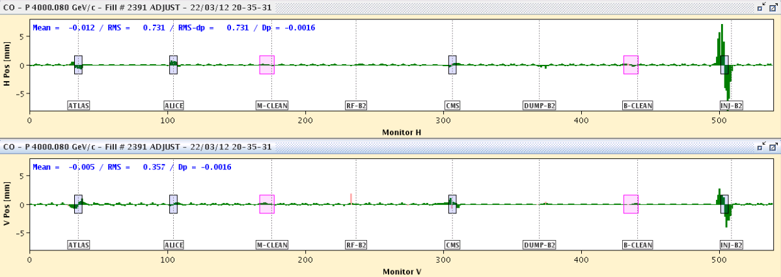
Next Ramp
Orbit difference between end of squeeze and collisions:
one can see the collapsing of the separation
the V crossing angle that comes in during the collision process (0 urad)
the H crossing that is removed during the collision BP.

Slide 8
Crossing into collision, with pilot
The squeeze was executed for the first time with nominal crossing and separation to the end. The orbit was corrected (in H) at a couple of steps (3, 2 and 1 m) to remove local structures at the IRs (mainly IR5/8).
The orbit FB worked fine and jumped correctly from one reference to the next. We must however introduce another reference orbit for the 7 m stop point, mostly because of the shape change in IR8.
There is a tune shift of 10-3 to 10-4 depending on the beam and the plane ... that could be due to the tilted crossing angle effect in IP8. To be further investigated.
No lumi measured

Slide 9
TCDQ set-up at 450 GeV – not easy
B1: Angular alignment for TCDQ:
put angle on TCDQ from -200 to +200 urad and scraped the beam down
record jaw position for full beam loss
minimum gives correct angle and beam centre
we find a minimum at -100urad
Offset measurement between TCDQ and TCSG:
offset of 0.6 mm ==> the TCDQ is further out by 0.6 mm: OK
We had several times the problem that the offset between upstream and downstream corner became > 2mm
for a requested angle the jaw is blocked and we need to call Christophe to reset it. To be investigated.
We have to decide if we really want to apply this 100 urad angle with the risk of having the TCDQ blocked easily (unless this can be fixed) if we do not go for the 100 urad angle we have to redo the offset scan.
B2 not fully conclusive
Angular alignment for TCDQ.B2 - no minimum found for the angle range we can scan
within the measurement accuracy no offset found between the TCDQ and TCSG collimators
Jaw stuck because of drift of up and downstream LVDT beyond the 2mm allowed

Slide 10
TCDQ – TCSG relative position – B1

Slide 11
Access: 08:00 – 11:00
Need to clear the list!

Slide 12
The Plan

