Slide 1
Friday 16/3
08:30 – 10:15 Access for QPS and EPC (BI in point 4)
No problem found for dump resistor for RB.A81. Some more measurements will be taken.
RCBYV4.L1B2 power converter replaced
IMPACT delaying access start (new requests were not propagated to the access point fast enough) ➔ Requested to deactivate the check of the IMPACT for access to the LHC machine for the time being. ➔ Possible solution of being studied
Update for FGC during access ➔ RT input now take into account

Slide 2
Friday 16/3
11:30 Gateway at point 1 crashed. Lost communication for several power converters.
Problem with sub-converter of RQX.L2 required another access at ~ 12:00.
13:30-15:30 No beam from PS. PS Main power supply problem.
13:45 trip of ATLAS solenoid and toroid while ramping up.

Slide 3
Loss map by controlled transverse blow-up
16:00 – 21:30:
Setting-up of tune and orbit feedbacks and of radial modulation for chromaticity measurement
Setting-up of the damper for controlled transverse emittance blow-up for Beam 1 for aperture measurements and loss maps

Slide 4
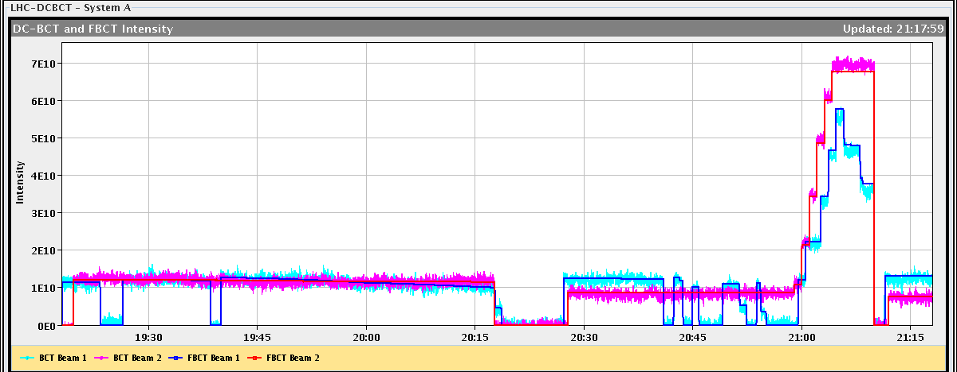
Loss map by controlled transverse blow-up

Slide 5
While preparing for the ramp. Vacuum spike due to gauge outgassing (between Q5 and Q6.L5) ➔ piquet opened vacuum valve.

Slide 6
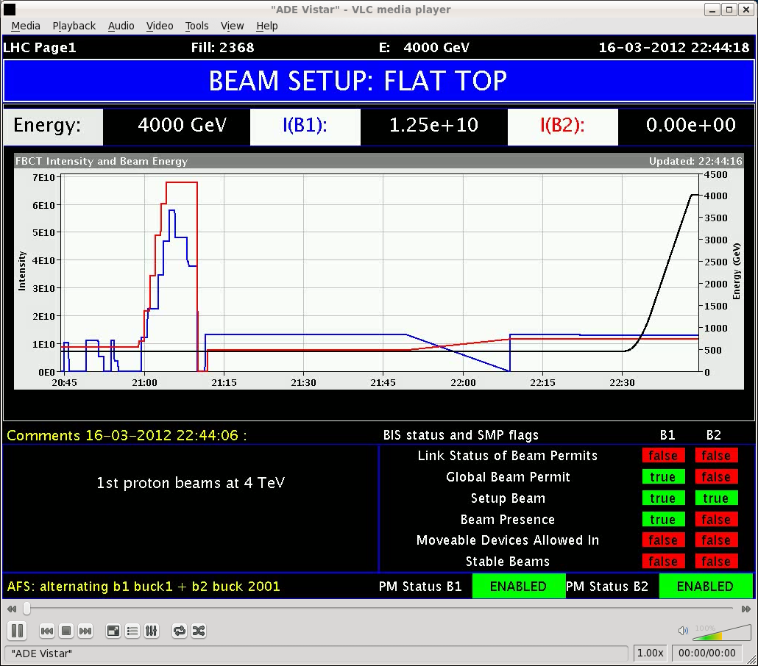
4 TeV!!!
Beam 2 dumped at flat top: glitch in the safe beam flag combined with a intermittent interlock on BMPSA.4R6.B2.

Slide 7
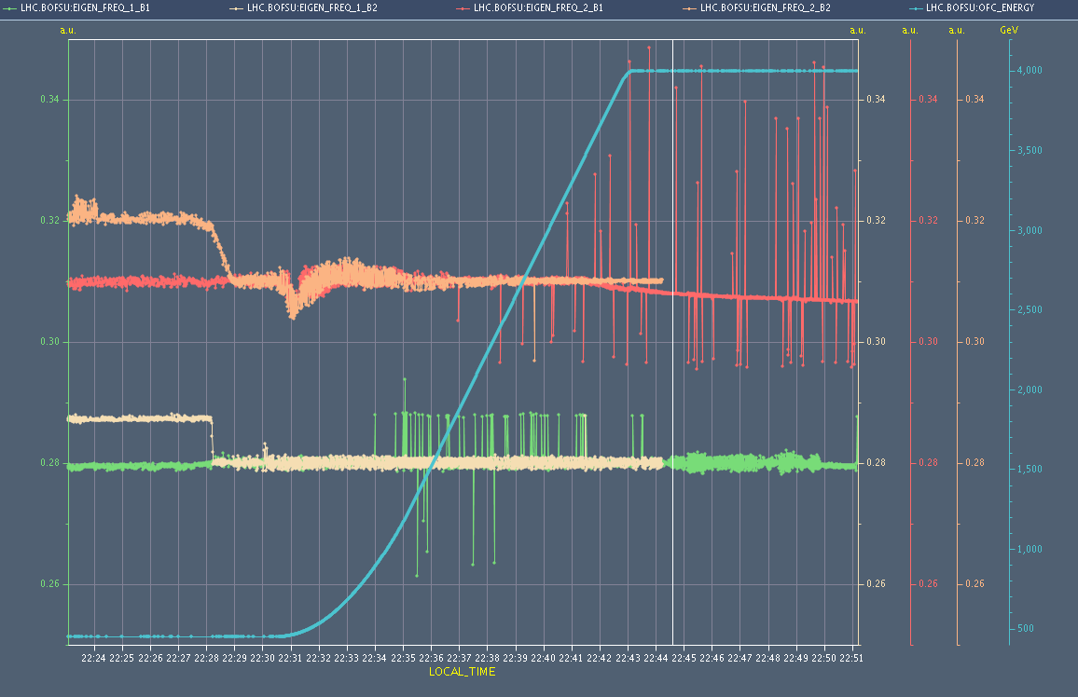
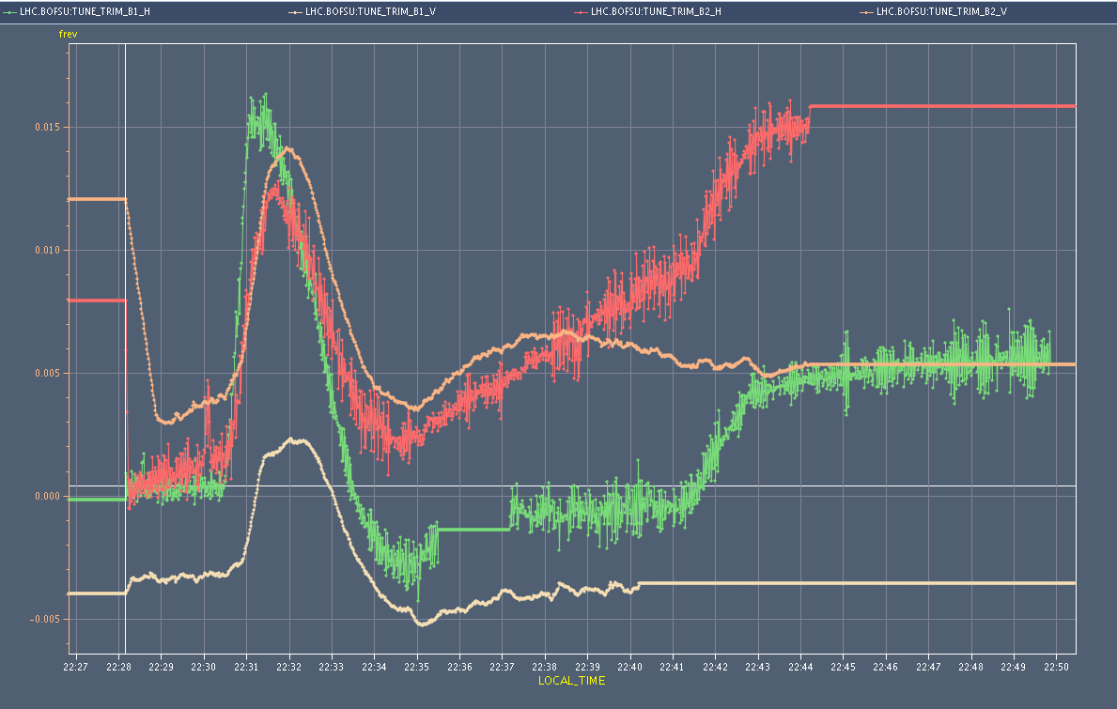
Ramp to 4 TeV
Tune, chromaticity, orbit, coupling measured ➔ feedforward to be done

Slide 8
Status and Plan
Preliminary global aperture measurements overnight and validation transverse blow-up for aperture and loss maps ➔ to be analyzed
Day | Shift | Time (h) | Activity | Breakpoint | System/topic | Beam
SAT | M | 8 | Squeeze to 0.6 m | First squeeze | Squeeze | Probe
SAT | A | 8 | Optics measurements - test dump at 4 TeV |  | Optics | Probe
SAT | N | 8 | Damper setup for controlled blow-up (B2) and for nominal bunch |  | RF | Nominal
SUN | M | 8 | Dump checkout |  | Dump | Probe
SUN | A | 4 | Orbit at injection with nominal bunch and bumps |  | OP | Nominal
SUN | A | 4 | Experimental magnets ON |  | OP | Nominal
SUN | N | 4 | Orbit feedback with dynamic reference in the ramp |  | Feedback | Nominal
SUN | N | 4 | Pre-cycle or ramp (no beam) - decay measurement at 450 GeV |  | Magnets | Probe

Slide 9
Pending issues
BPMSA.B4R6.B2. Noisy and giving spurious interlocks
Vacuum gauge outgassing between Q6 and Q5.L5
There is no fill number data stored in the logging DB since the beginning of this year ➔ fixed
Logged chromaticity data not correct yet
Issue with generation of the functions for trim quadrupoles
Suspected electrical problem on a fire detection unit in UX85

