Slide 1
Friday March 4th
08h32: Access for beam dump system.
09h10: Access finished. Beam dump tests without and with beam.
Q fixed display is displaying wrong info, need to be restarted.
injection prepulse was disabled for beam 1 probably during the test with RF-LBDS performed earlier this morning. Fixed by RF.
FBCT is displaying really wrong values since the precycle
16h00: Start of 2-shift “quiet” beam period for observing beam dump stability (pilot bunch only, ramp OK).
16h39: Understand effect of Q feedback on chroma.

Slide 2
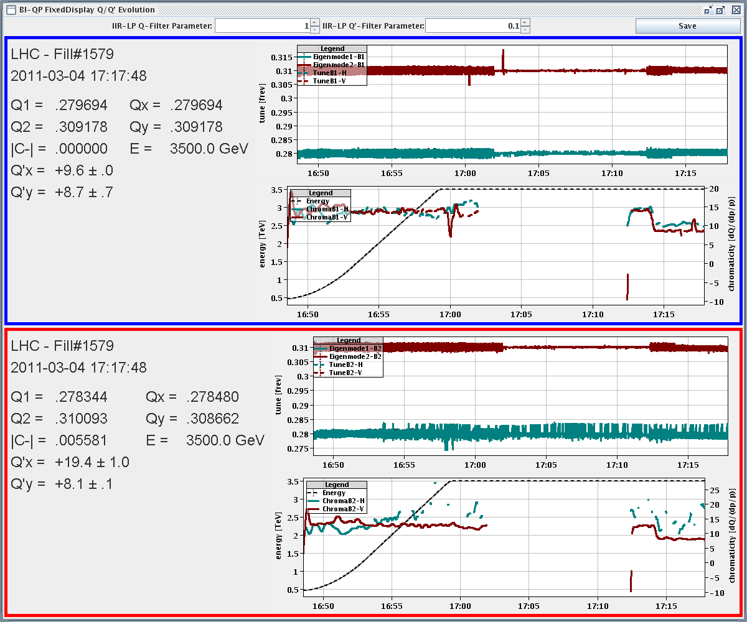
Tune feedback and chroma

Slide 3
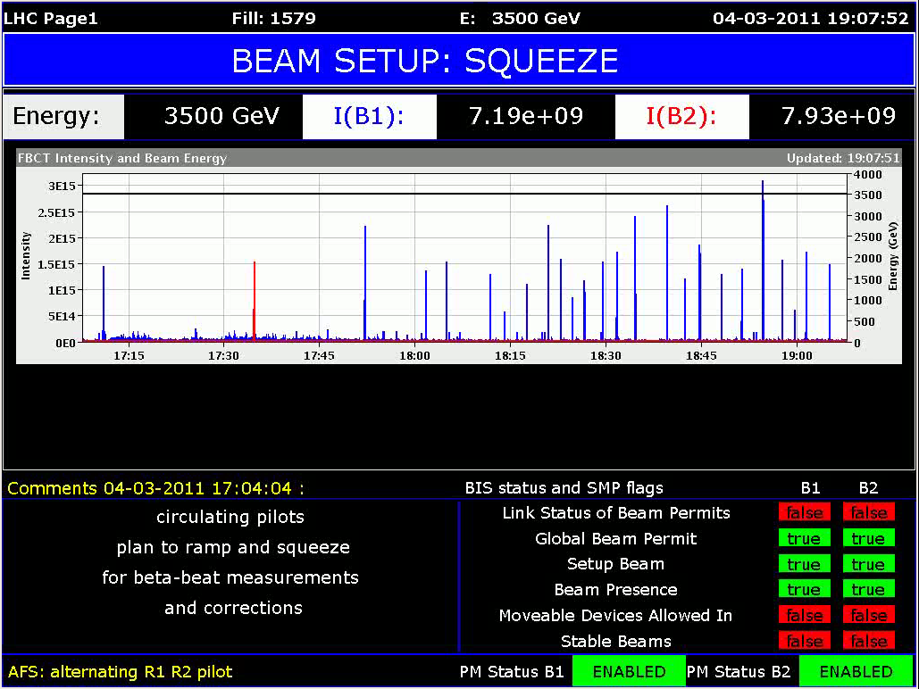
3e15 protons in?

Slide 4
Friday March 4th
16h48: Start ramp to 3.5 TeV. Squeeze steps for beta beat correction.
RQT12/13 in pt 1 for b2 were driven through the squeeze on Feb 25, but not today. Turns out, they are not in the hardware group DISP SUP QUADS where they should be... Nor for beam 1.
22h02: Lost both beams. Cryo gone for MSL4. And the undulator. RU.L4 QPS_OK lost.
00h09: Waiting for CMS to solve issue with one of their detectors. Continue as advised by CMS…
00h36: Sequence unclear - PREPARE OFB FOR RAMP subs are skipped. Tried to execute but failed. Continue.

Slide 5
Saturday March 5th
00h46: Start ramp to 3.5 TeV. Squeeze to 3.5 m.
03h06: Lost beams.
Two RQT circuits tripped (RQTD.A12B2 and RQTD.A67B2).
Tune feedback tries to correct for tune shift after AC dipole kick. RQT trips as result.
04h01: Injection.
Rearming the LBDS for B2 with sequencer → dump with PM
In contact with F. Castronuovo and E. Carlier
04h41: Dump problem solved.

Slide 6
Saturday March 5th
05h09: Controller problem DQAMG_4.RQTL11.R2B1.
Call QPS piquet.
06h36: QPS problem solved. Injection. Ramp. Squeeze.
Beta beat team still here after 16h and N nights before…
Most done (local beta correction b1&b2, global b1, coupling) and verified, except B2 global correction at 1.5m and beta* correction.
Finalization ongoing (B2 global correction)
Beta* probably only later.

Slide 7
Ahead
Sat 09:00 review dump status in 9am meeting. If OK: Sat 09:30 inject and ramp 1 nominal bunch to 3.5 TeV (no squeeze) Orbit correction Check RF blow-up Check beam (tune, coupling, chroma) Octupole check
Sat 16:00 Injection & dump protection at 450 GeV Sun 01:00 Loss maps at 450 GeV for collimation and protection Sun 07:00 inject and ramp 1 nominal bunch to 3.5 TeV (no squeeze) Establish final reference (Joerg will be in) Collimation setup at 3.5 TeV Sun 18:00 MPS checks at 450 GeV Mon 00:00 Transverse damper setup at 450 GeV (Daniel Valuch et al) Mon 08:00 Injection & dump protection Mon 16:00 Collimation setup at 3.5 TeV

Slide 8
Dump OK for nominal bunch at 3.5 TeV?
Discussion…

