Slide 1
Wednesday 23/2
Thanks CRYO!!!

Slide 2
Wednesday 23/2
08:00: Beam stop
09:00 – Access all over the machine (thanks to RP and all the team involved)
13:00 Cryo OK in point 2
13:00 – 18:45 Recovery and pre-cycle in the shadow of SPS magnet repair and interlock problems
Light re-commissioning of circuits affected by interventions (~15)
RQT13.L7B1 ➔ measurements indicate no abnormal resistance ➔ MP3 to analyze
18:45 Injection (pilot)
21:00 – 23:00 Injection of nominal bunch
23:00 – 02:00 Orbit at 450 GeV with nominal bunch
02:00 – 06:00 Damper set-up for B1 only due to problem with LBDS beam 2
06:00 – Access for LBDS

Slide 3
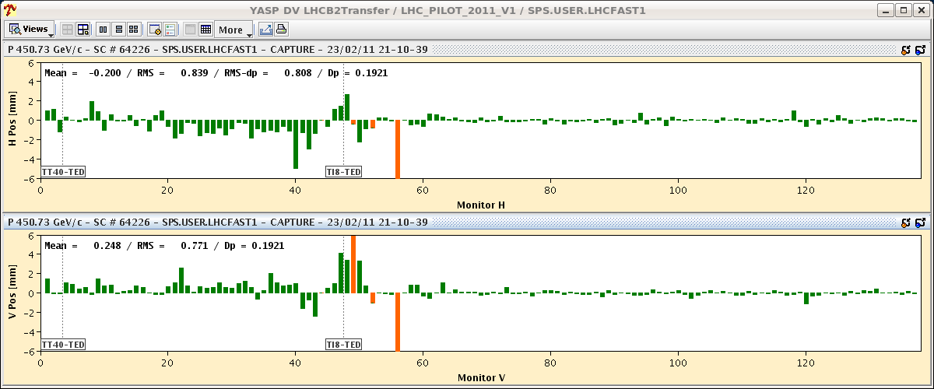
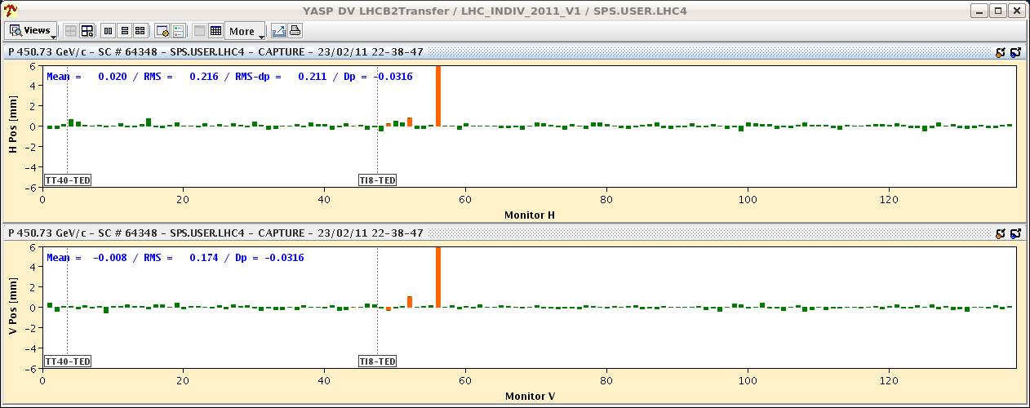
Injection of nominal bunch
Steering of probe beam as reference
Copied settings for nominal bunch ➔ good trajectory (difference)

Slide 4
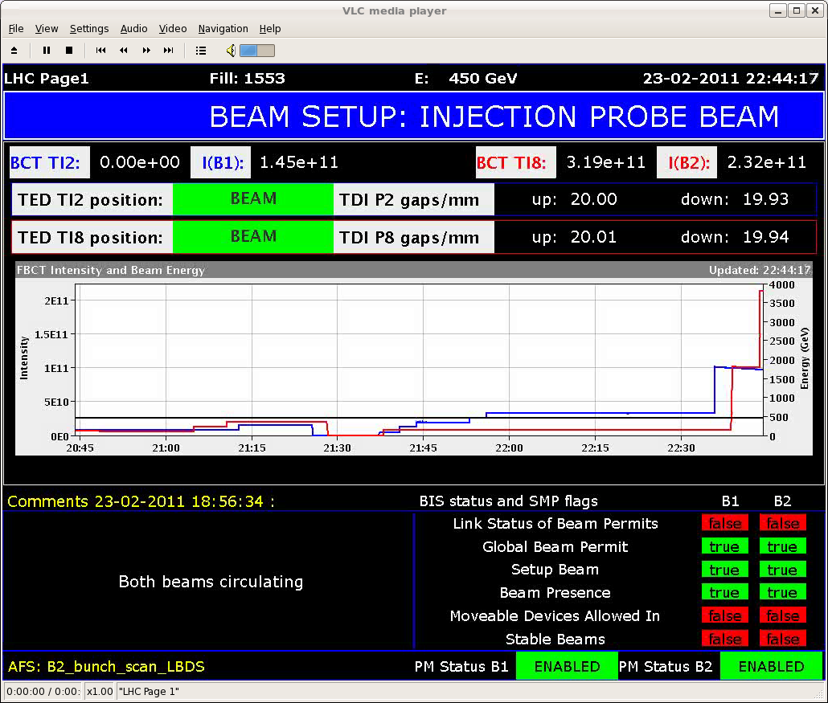
Injection
SUMMARY OF THE INJECTION SETTING-UP (W. Bartmann, M. Meddahi, J. Uythoven): - Using the LHC PROBE, injected both beams into the LHC and performed some injection oscillations optimisation - Saved the reference trajectory for both beam lines for the LHCPROBE - Send the LHC INDIV to the bottom TED of both lines and compared the trajectory with the LHCPROBE reference trajectory: for both lines, no difference between the LHC PROBE and the LHC INDIV. This is good news and different from last year. - Closed the TCDIs of both lines to ~7sigmas - Send LHC INDIV down both lines - same trajectories into the LHC as with the LHC PROBE - No losses in the BLM TLs and O.K. in the LHC

Slide 5
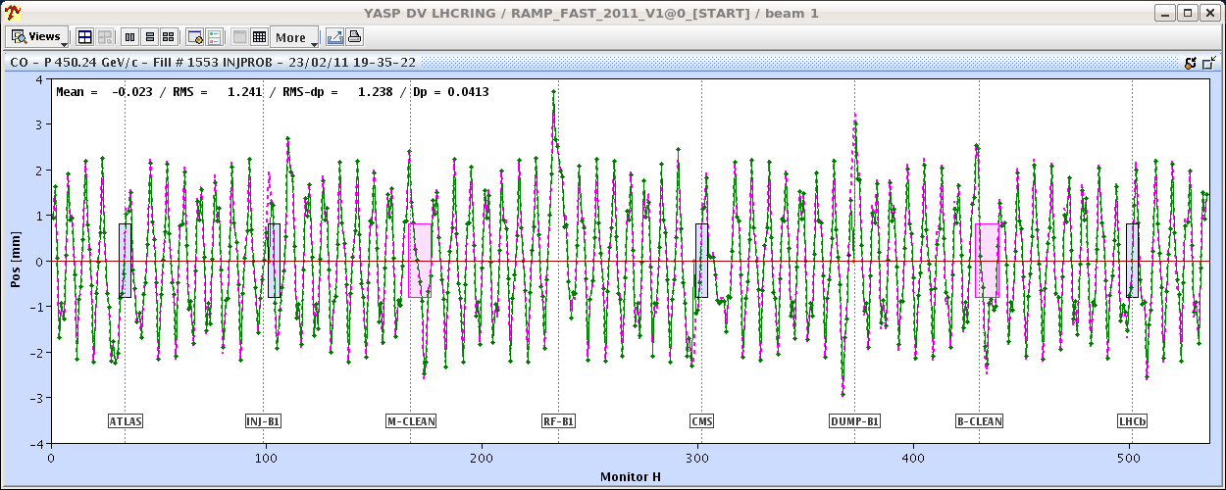
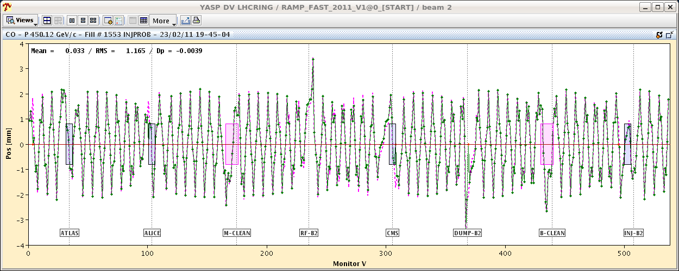
Orbit at 450 GeV
Kick response – in general very good. Some coupling observed. To be checked.

Slide 6
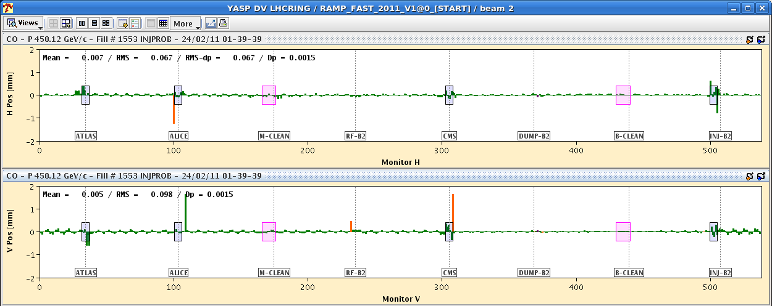
Orbit at 450 GeV
Offsets developing in some of the BPMs after a few hours. To be followed-up today with BI experts
Summary (J. Wenninger): - Base orbit defined. - Separations on, non-closure knob defined. - Xing in IR1,5,8 on, non-closure knobs defined. ALICE can only be done (Xing) when the solenoid is ON due to the coupling from the solenoid.
ALICE solenoid ramped over night
Spectrometers (ALICE and LHCb) to be switched ON during the day

Slide 7
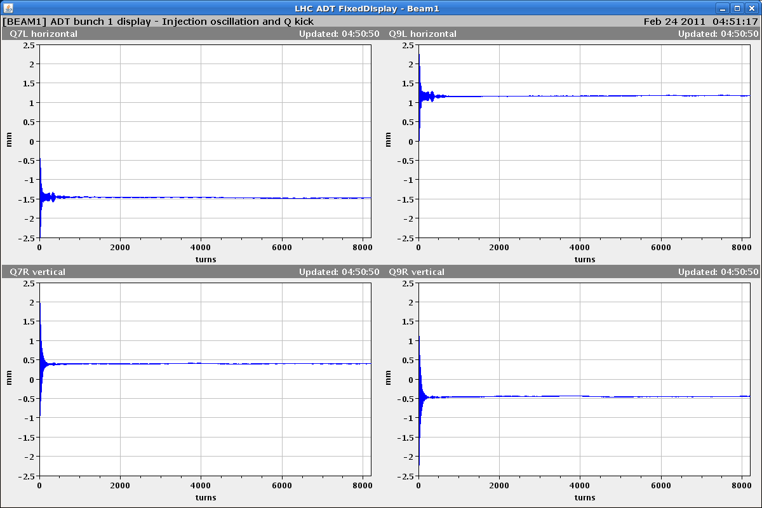
Damper
ADT setting up summary: Beam 1 set up for nominal bunch and long bunch spacing (hold time 500ns).
Beam 2 setting up needs to be completed at another time.

Slide 8
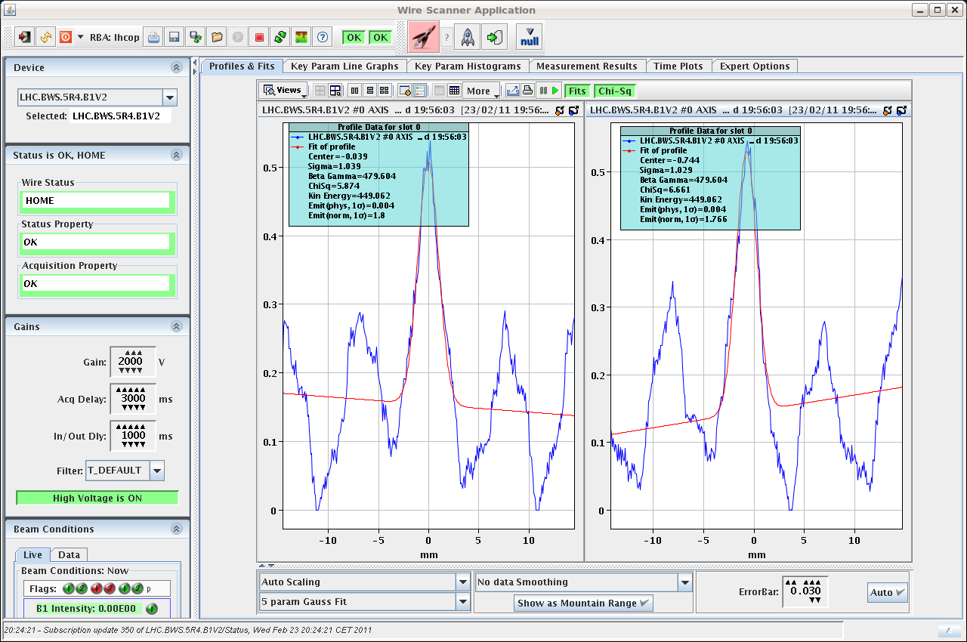
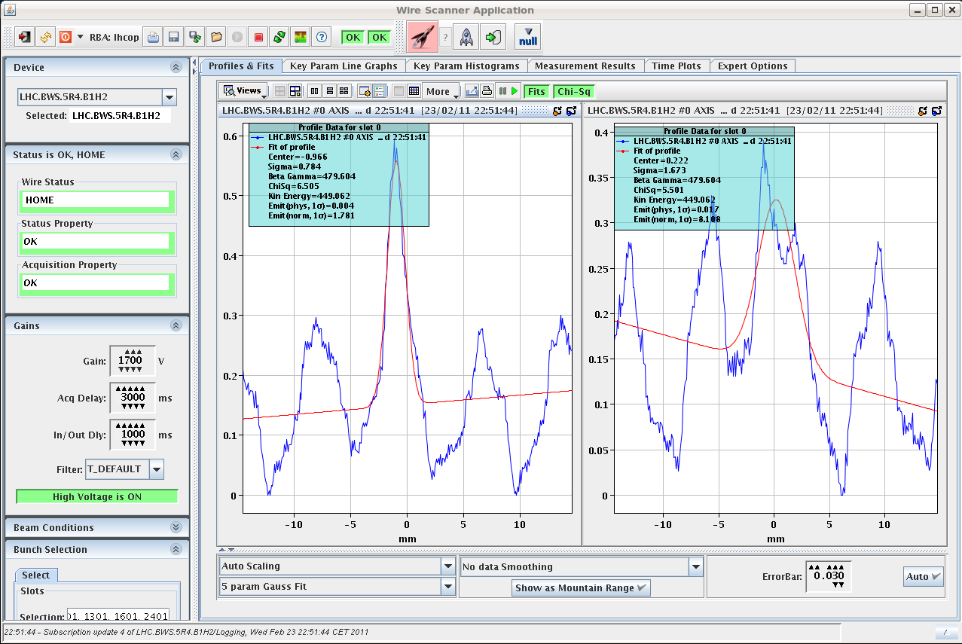
Pending problems
Wire scanner signal noisy. Settings? To be checked with expert.

Slide 9
Hump
Since the start-up we did not see any sign of the hump (for the first time)
...but we do not know what has changed that made it disappear
Monitoring to detect any change

Slide 10
Plan
Thu AM | Orbit at 450 GeV – BPM checks – ramp with OFB and reducing separation/crossing angles
Thu PM | Beta beating correction and measurement through the squeeze
Thu night | Ramp and squeeze tests

Slide 11
25 | FRI | M | 8 | Reference orbit at flat-top and during the squeeze with separation / crossing angle | nominal bunch
25 | FRI | A | 8 | Collimation setting-up - 450 GeV | nominal bunch
25 | FRI | N | 8 | Aperture at injection | pilot
26 | SA | M | 8 | RF with ramp for nominal bunch and cavity tuning | includes longitudinal blow-up (nominal bunch)
26 | SA | A | 8 | Collimation setting-up & Inj. & dump protection - 450 GeV | nominal bunch
26 | SA | N | 8 | Collimation and dump validation at 450 GeV | nominal bunch

Slide 12
Pending
LBDS test, trim of the energy at injection (W. Bartmann) without beam. Pre-cycle is required afterwards.
Determine the last bucket that can be injected outside the AGK. The SIS interlock on bucket number should be masked for these tests. If the AGK stops the injection one should see the beam being injected on the TED. The test should be done for B1 and B2. It is worth to check the status of the IQC at the same time.

Slide 13
Issues
Fixed display for separation at IP not working ➔ Reyes?
BSRT automatic gain to be commissioned
Wire scanners (issues with optics and energy data)
Problem with the OFSU occurred in the night between Tue and Wed during the squeeze

