Slide 1
Tuesday 22 November 2011

Slide 2
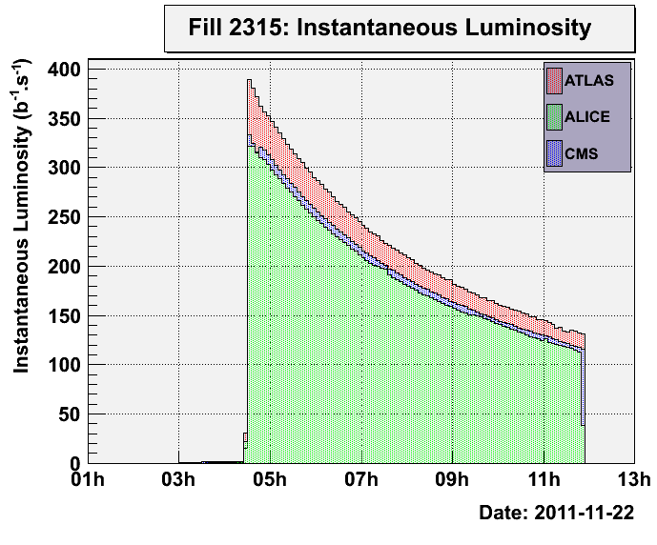
Fill 2315
Fill # 2315
Stable beams: 4:33 – 11:54 (programmed dump)
Integrated Luminosities:
ATLAS: 5.8 ub-1
ALICE: 4.9 ub-1
CMS: 5.2 ub-1

Slide 3
BLM problem with tests (settings changed due to pending installation of new monitors) (19’)
13:12 injecting probe beam
13:19 – 16:40 (3:20) no beam from PS: problem with POPS (PS magnet powering system)
Missing BLM data in XPOC (1h)

Slide 4
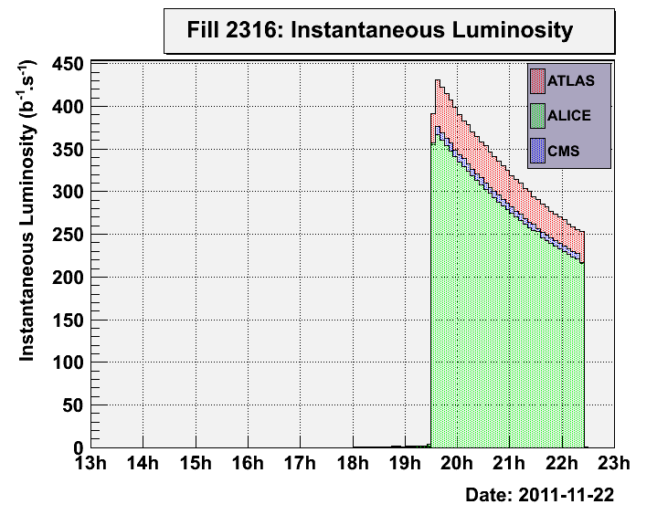
Fill 2316
Fill # 2316
Intensity: 3.6e12 charges injected
Stable beams: 19:35 – 22:25 (trip of the RF module 1 of B2)
Peak Luminosity ATLAS / ALICE / CMS: 470 / 373 / 392 (b s)-1
Integrated Luminosities:
ATLAS: 3.3 ub-1
ALICE: 2.9 ub-1
CMS: 2.9 ub-1
Feedback from RF (Pierre and Philippe): At 22:24 there was a Helium tank pressure alarm, which probably corresponded to a local overheating which then caused the RF interlock and tripped the sector. This was most likely a quench. Such a trip has occurred in this module (M1B2) before and is suspected to be related to the cavity 3B2 which is weaker than the others. The recommendation was to reset and restart. Note that Beam 2 RF had been reduced to 13MV prior to this fill.

Slide 5
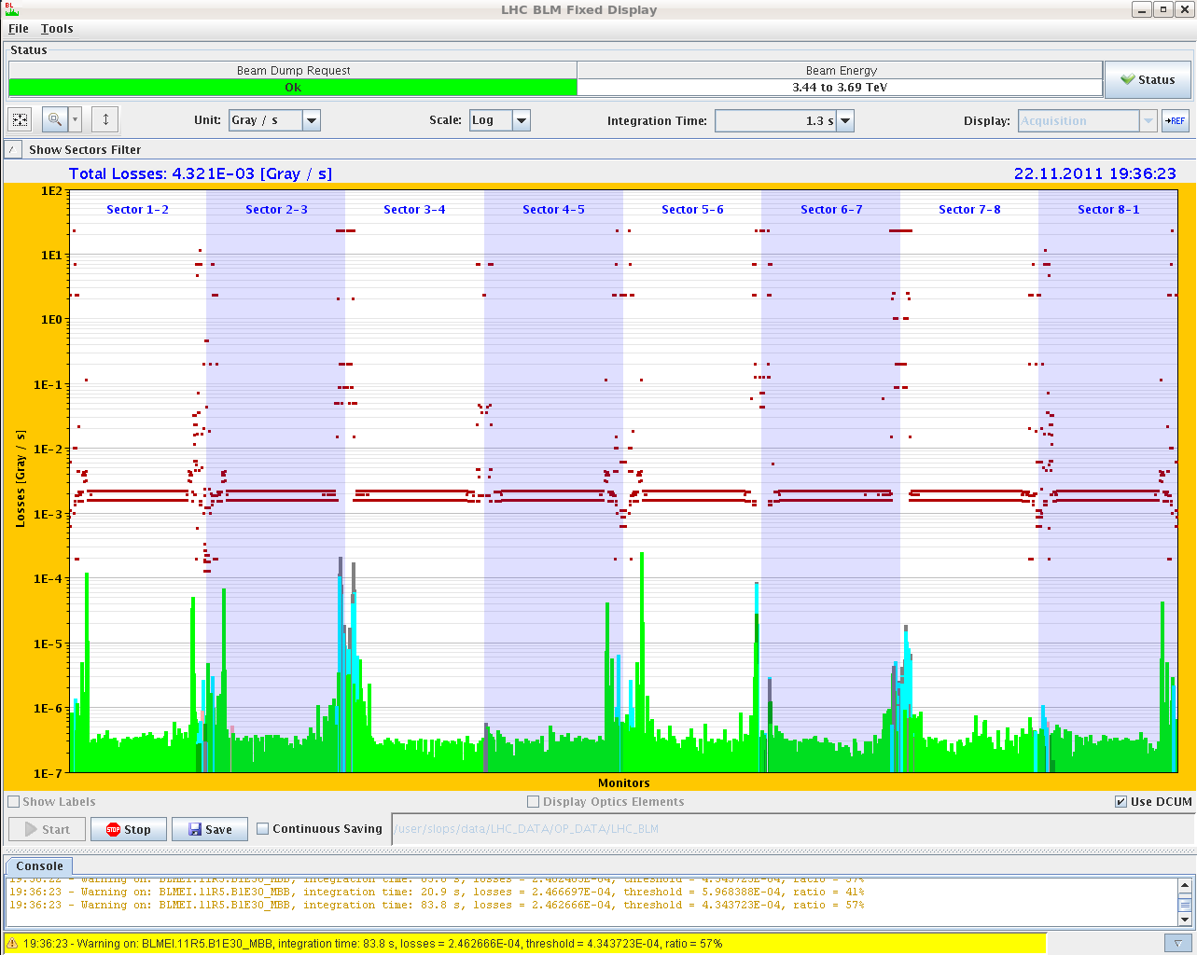
Fill 2316 – 11R5 57% of BLM threshold

Slide 6
Fill 2316 in stable beams

Slide 7
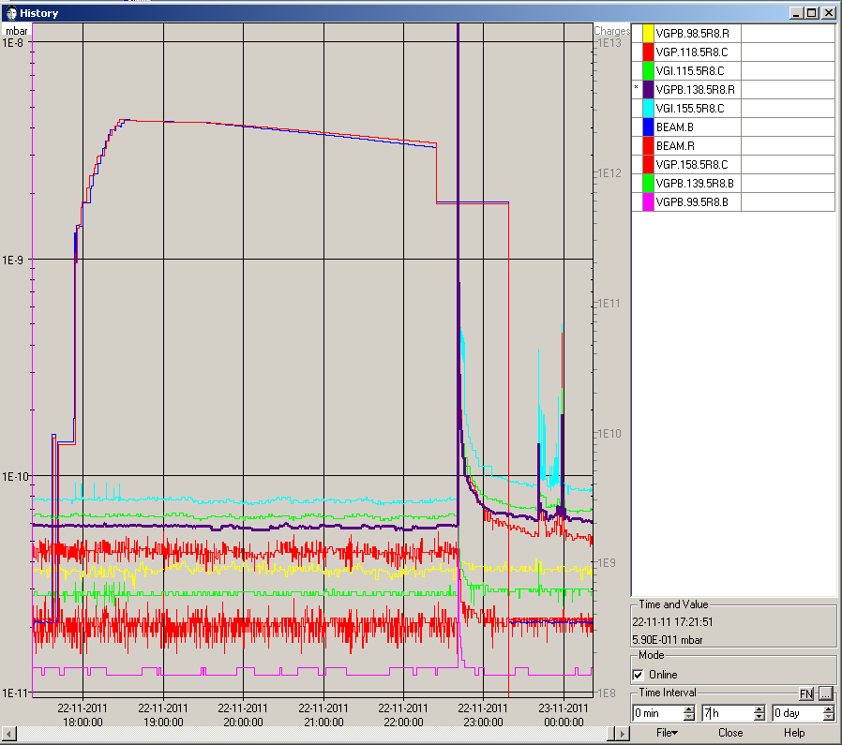
Injection Kicker MKI8
23:39 During kicker preparation sequence (‘softstart’): vacuum spike that caused the softstart to fail. Maybe electrical breakdown → extended softstart to recondition kicker (1:45)

Slide 8
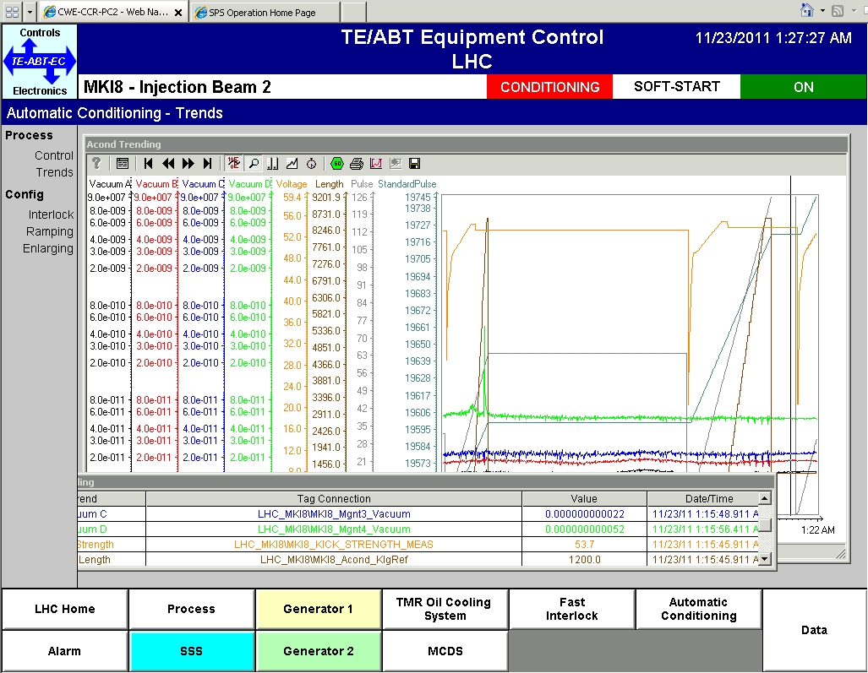
pressure in the MKI8 during the failed soft start and the following extended soft start

Slide 9
‘a little bit of history repeating’
1:35 injecting probe beams
1:42 No beam from PS, problem with POPS: two cells are down (EMD 303*6 and EMD 304*6 have over-current alarms and interlocks)
The power supply fault is a short circuit in an AC/DC converter, and is not immediately fixable. To recover we have to exchange one component in the converter ( ~1 day duration) or switch back to the old Siemens rotating power supply.
7:00 decision to switch to the old power
converter
→ estimated duration of work: 2 hours till 9:00
http://en.wikipedia.org/wiki/Shirley_Bassey

Slide 10
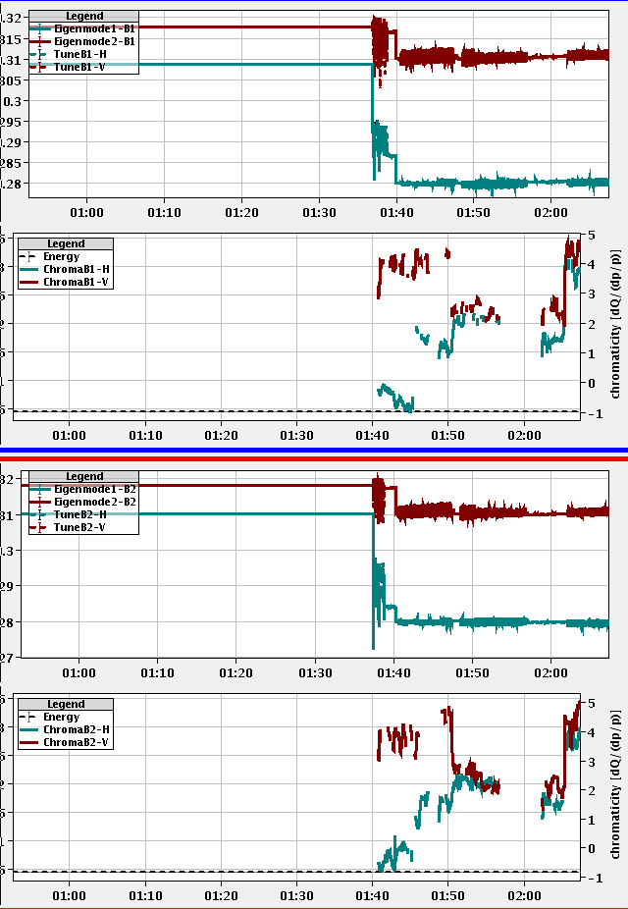
Others
When putting the dp/p modulation back to the standard value of 2E-4 (was 4E-4 before) chromaticity measurements doubled

Slide 11
Outlook
Physics for the rest of the week (VdM scan beginning of next week)
Source refill (between 6 and 30 hours) – Friday
ALICE polarity change – next Monday
Requires some preparation work this week

