Slide 1
Tue 15.11.11
08:25 Beams dumped due to RF vacuum interlock
Reset after checks with piquet
09:53 Triplet R2 power converter problem, access required
Replace sub-module
11:50 Access required for the RF vacuum point 4.
RF module tripped again: ion pump stop. Connector, PS changed.
In shadow of accesses:
CMS forward detector entering in UL55 to check a cable
trim the ramp function for RF total voltage to have 13MV at flat top
changed monitor factor on BLM’s → factor 2 relaxed BLM thresholds in cells 10 and 11 in DS’s of IR1/2/5 (MQ + MB).
Adjustment MKI8 IQC thresholds for delay and length after prepulse fine synchronisation.
13:50 Start pre-cycle

Slide 2
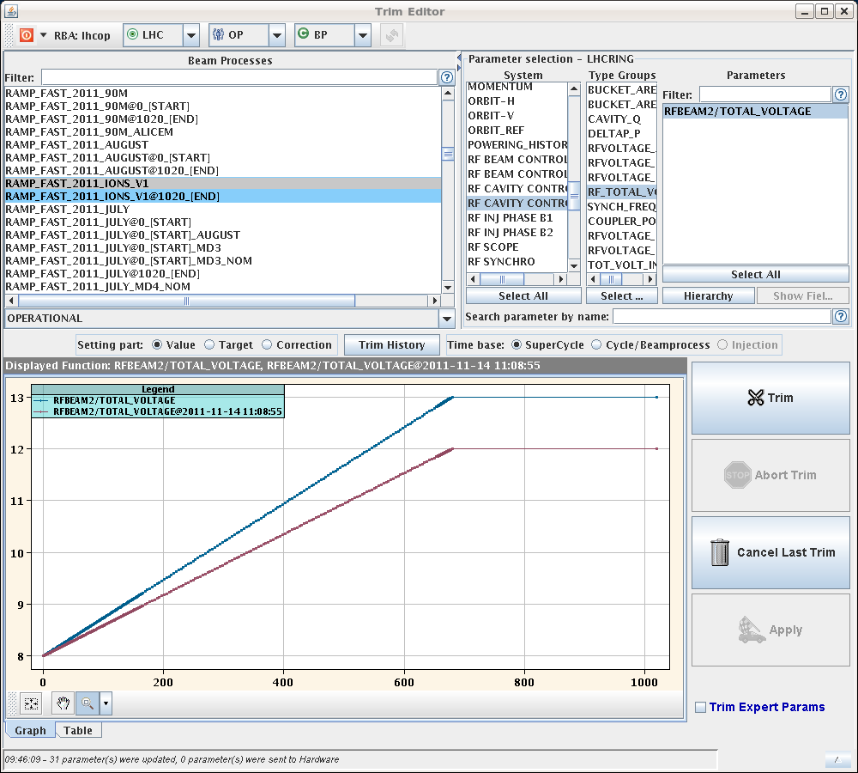
Adjusted RF voltage

Slide 3
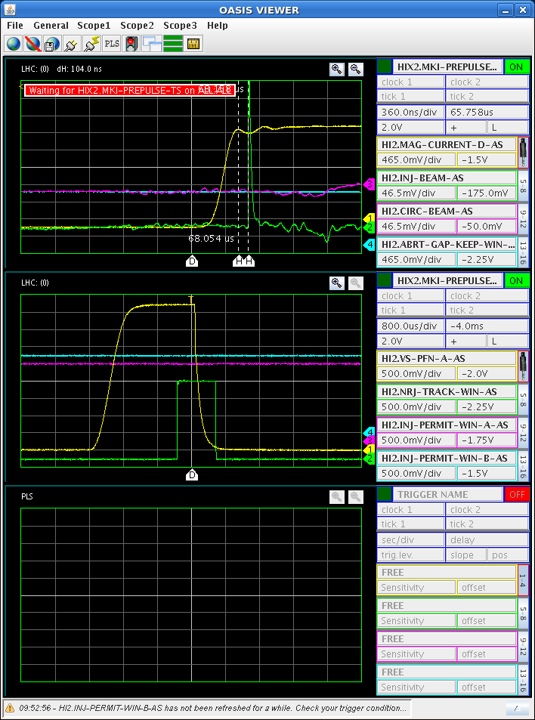
MKI8: BCT-TI8 - AGK - kick pulse synchronisation (bucket 5141)
Beam position difference w.r.t. kick pulse in comparison with 2010 nominal position: 104ns

Slide 4
Tue 15.11.11
16:20 Injection
17:15 Filled 358 on 358 bunches. Nominal ion intensity.
17:23 Ramp.
17:43 Squeeze.
18:22 Stable beams. Fill #2297.
Peak luminosity: 3.5e26 cm-2 s-1 (35% of 7 TeV design lumi)
1.8MJ of stored energy per ion beam.
BFPP losses OK (still 40% f dump threshold with 2.2 times higher luminosity and increased BLM thresholds). Fine.
22:29 G. Schneider is going to start the injection of gas in LHCb.

Slide 5
New Ion Intensity Record
200ns_358b_356_336_0_24bpi15inj_IONS
B2
B1

Slide 6
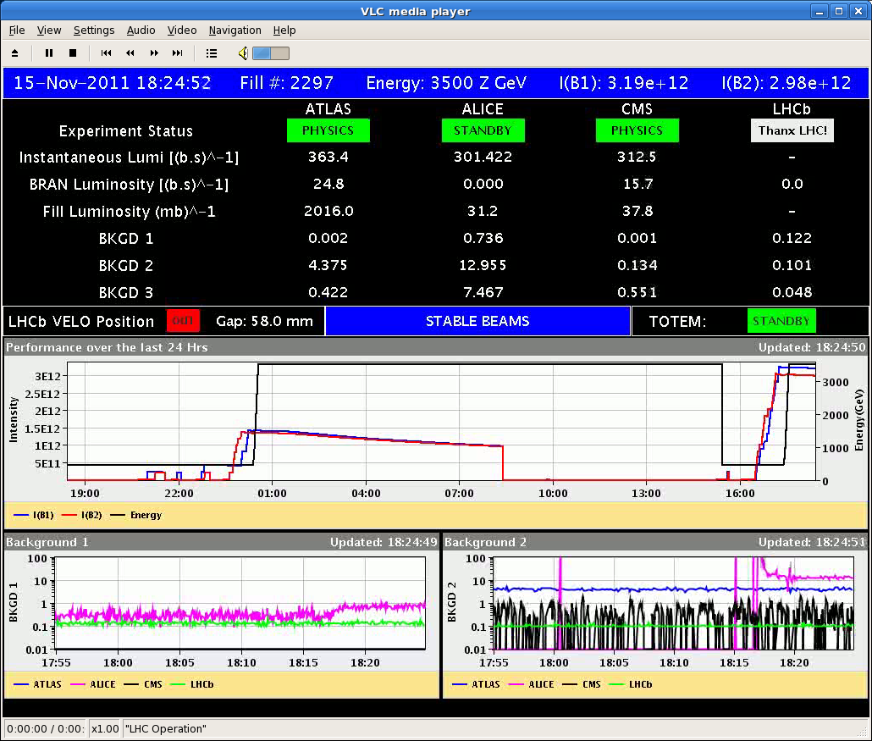
New Ion Luminosity Record

Slide 7
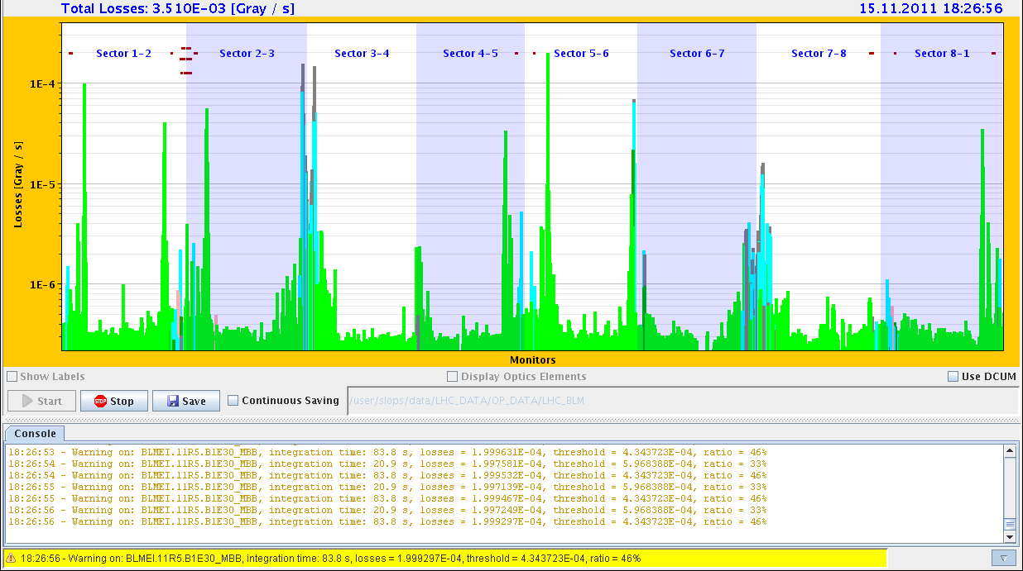
Losses in Collision

Slide 8
IR2

Slide 9
IR5

Slide 10
IR3

Slide 11
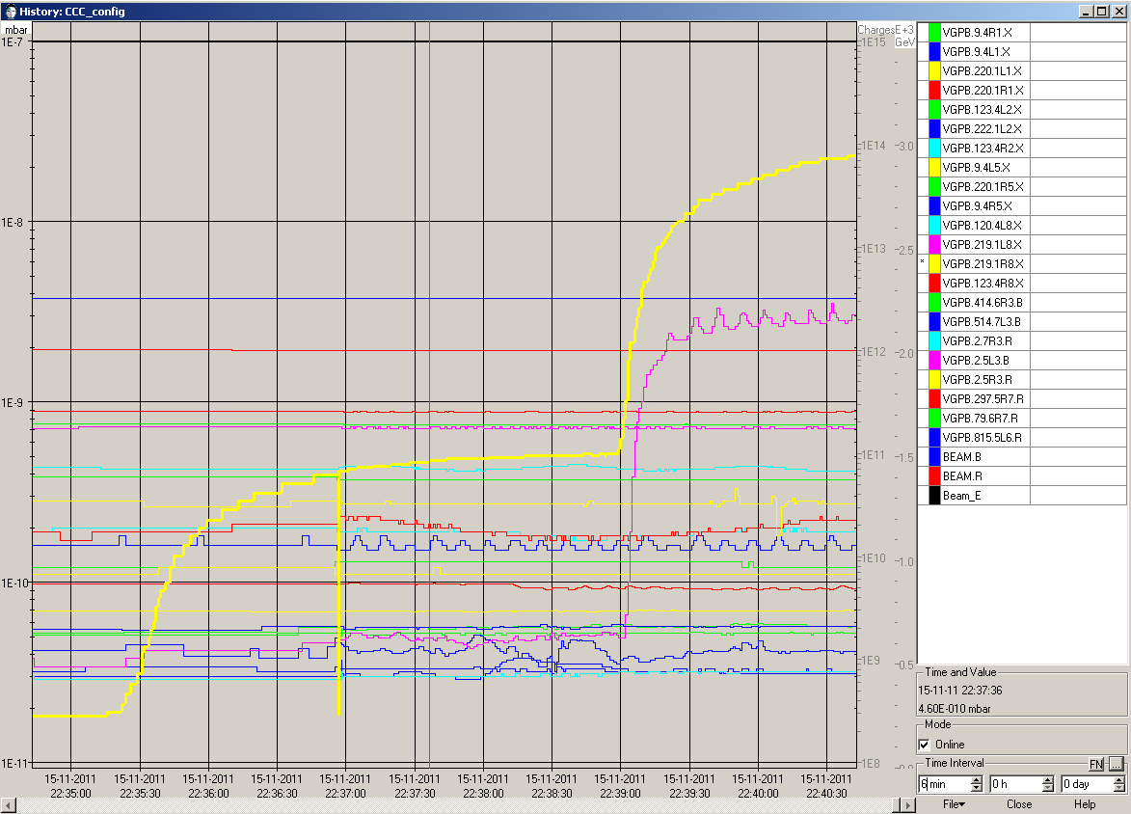
Vacuum evolution on VGPB.219.1R8X

Slide 12
Wed 16.11.11
00:05 Preventive beam dump due to cryo problem in 34.
Fault on the power converter for the cold compressor.
Collected 4-4.5 μb⁻¹ per experiment in fill #2297 (>40% of full 2010 run).

Slide 13
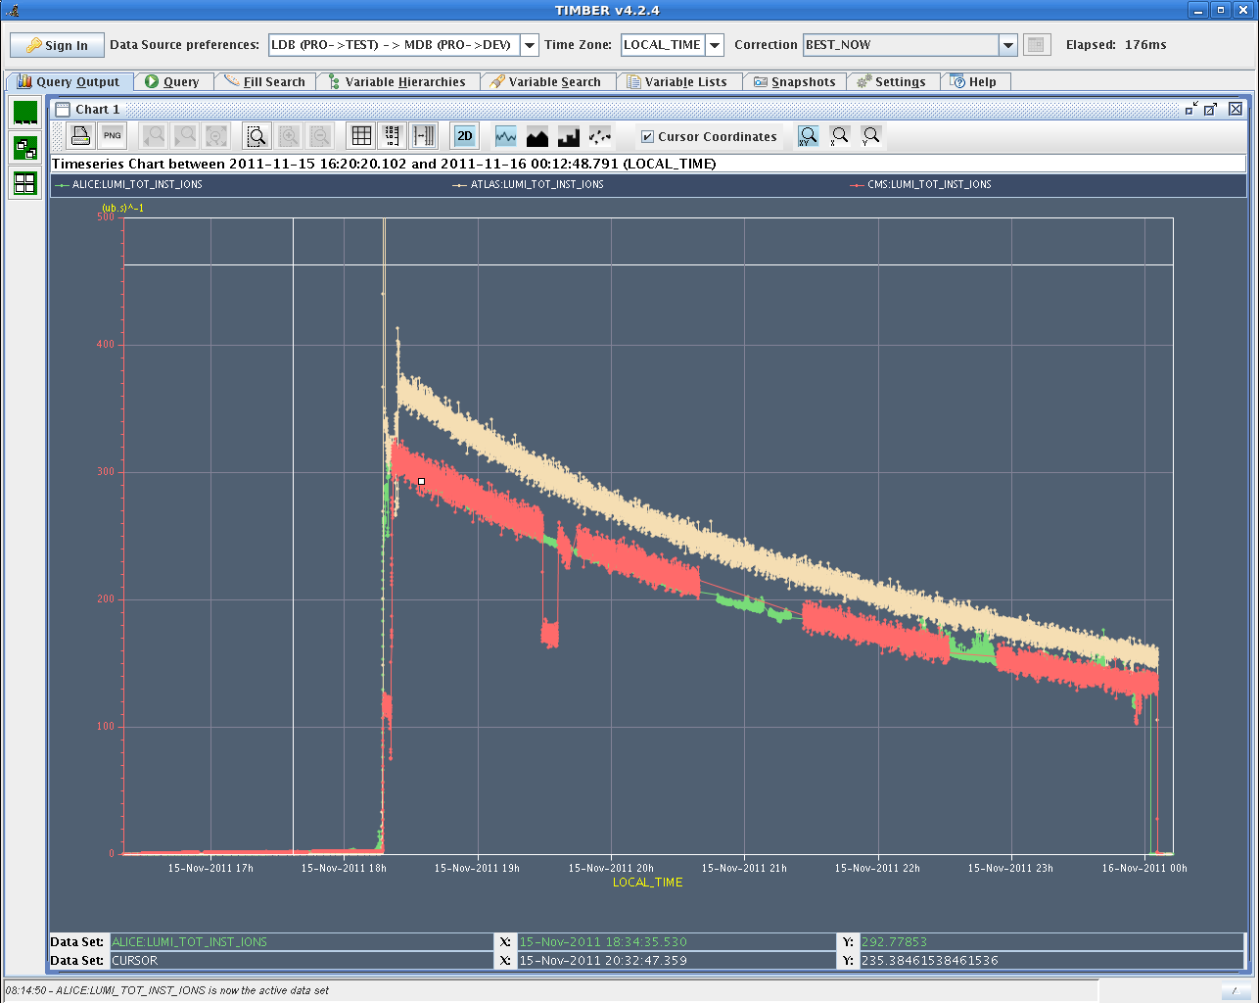
Peak Luminosity
3.5e26
cm-2s-1

Slide 14
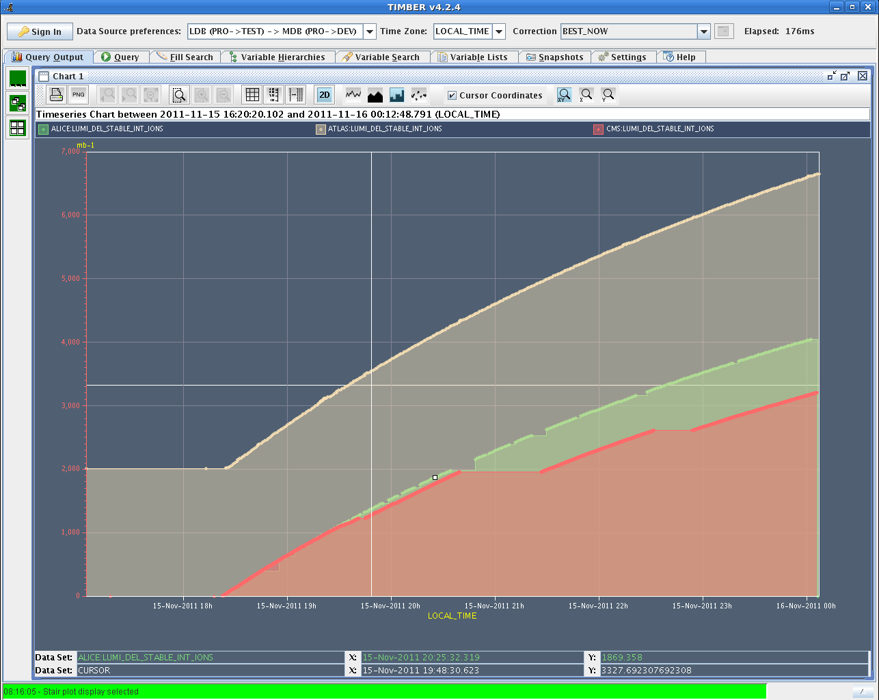
Integrated Luminosity
6 μb-1
4 μb-1
ATLAS
offset???
2 μb-1

Slide 15
Ahead
Today:
Cryo recovery: ~9:30
Ready for injection: ~11:00
Then: p-Pb MD plus pilot physics run
Afterwards (tonight, early morning):
Back to Pb-Pb physics.
Pending:
Some optional transverse damper work: see list from Wolfgang.
Access (if opportunity arises):
Installation of four BLMs for IP2 Aperture checks (4hours). Ready from Wednesday onwards.
LDM repair in tunnel, about 1 hour

Slide 16
LPC on p⁺ Pb

