Slide 1
LHC Week 44 and MD Block #4 - Weekly Report -
Machine Coordination: G. Arduini & R. Assmann
MD Coordination: R. Assmann, G. Papotti, F. Zimmermann

Slide 2
Overview
Sun 16:00 – Tue 11:00 MD program as planned 43 hours
Tue 11:00 – Wed 19:00 No beam: Cryo problem IR8 32 hours
Wed 19:00 – Thu 03:00 IR2 aperture (ion commissioning) 8 hours
Thu 03:00 – Fri 19:30 No beam: MKD problem SPS 40.5 hours
Fri 19:30 – Sat 14:30 Reduced MD program 19 hours
Sat 14:30 – Mon 06:00 Ion commissioning as planned 35.5 hours
MD: 62 hours (132 hours planned)
Ion commissioning: 43.5 hours (~as planned)
Major downtime: 72.5 hours

Slide 3
Difficult, but some highlights achieved…
Corrected optics at ½ integer tune (more space for BB tune spread)
Simultaneous storage and acceleration of proton and ion beams in LHC (towards p – lead physics)
Successful verification of tight collimation settings (towards lower beta* in 2012, factor 1.4 in luminosity?)
ATS pre-squeeze to 40cm successfully tested (towards 2012 test for pile up of ~100)
Data for TDI vacuum and UFO’s at MKI kickers
Shortened MD’s:
Beam shape data
Injection quench margin data
Beam instrumentation tests and calibration
Ion beams commissioned up to collision (→ John)
Injectors, sequences, hyper-cycle, RF, collimation, loss map qualification for stable beams, …

Slide 4
MD Planning Sun – Mon (30. – 31.10.)
Day | Time | MD | MP
Sun | 17:00 | Ramp down, cycle
 | 18:00 | 450 GeV → 3.5 TeV: Dry run ATS optics | A
 | 21:00 | Ramp down, cycle
 | 23:00 | 450 GeV: Tune working points – half integer WP, more space for tune footprint, lower crossing angle, lower beta*, … | A
Mon | 07:00 | 450 GeV → 3.5 TeV: Proton-Lead – feasibility of new physics scenario | A/B
 | 23:00 | Ramp down, cycle

Slide 5
MD Planning Tue (1.11.)
Day | Time | MD | MP
Tue | 01:00 | 450 GeV: TDI Vacuum – understand source of heating, check for HOM’s. Parasitically: UFO studies | C
 | 09:00 | 450 GeV: UFO studies - Understanding UFO’s and possible limitations. Parasitically: scraping setup & first tests (on other beam?) | C
 | 11:00 | 450 GeV: Scraping for beam shape - More accurate beam models for machine protection studies and beam loss simulations (high intensity tails)
 | 13:00 | 450 GeV → 3.5 TeV: LR beam-beam with 25ns – Assess required crossing angle and achievable beta* (performance) with 25ns | C
 | 21:00 | Ramp down, cycle
 | 23:00 | 450 GeV → 3.5 TeV: Beam instrumentation – Improvements of LHC beam measurements. One goal: calibrated BSRT emittance data for beam1 and beam2 at 3.5TeV | B
Wed | 07:00 | Ramp down, cycle

Slide 6
MD Planning Wed (2.11.)
Day | Time | MD | MP
Wed | 07:00 | Ramp down, cycle
 | 09:00 | 450 GeV → 3.5 TeV: ATS and tight collimation settings – Squeeze in IR1&5 to 40cm beta*. Optics correction. Collide (no crossing angle). Show adequate protection with tight collimation settings. Show full protection. Provides 2.5 times higher pile-up potential… | A
 | 19:00 | Ramp down, cycle
 | 21:00 | 450 GeV → 3.5 TeV: Combined ramp & squeeze - Feasibility of changing the LHC optics during the ramp. Gain ~7min (400s) per ramp initially. Higher efficiency for physics | B
Thu | 05:00 | Ramp down, cycle

Slide 7
MD Planning Thu (3.11.)
Day | Time | MD | MP
Thu | 07:00 | 450 GeV: Injection stability and losses – check steering constraints, define limits for correctors, operational procedure for more stable injection line steering | B
 | 15:00 | 450 GeV: Quench margin at injection – BLM thresholds required at injection, room for optimization | C
 | 19:00 | 450 GeV → 3.5 TeV: Quench margin at 3.5 TeV – apply transverse damper method, confirm May result, longer sustained losses, identify other possible limitations (know already about BLM power supplies); If any beam left Wire Scanner Quench Test | C
Fri | 03:00 | Ramp down, cycle. Access for MKA (preparation non-linear MD).

Slide 8
MD Planning Fri (4.11.)
Day | Time | MD | MP
Fri | 03:00 | Ramp down, cycle. Access for MKA (preparation non-linear MD).
 | 05:00 | 450 GeV: Non-linear dynamics – understand dynamic aperture in LHC, compare to models, experimental reference case for upgrade studies | B
 | 11:00 | Access for disabling MKA, followed by pre-cycle.
 | 13:00 | 450 GeV → 3.5 TeV: Longitudinal beam stability – Explore single and multi-bunch stability in longitudinal phase space, instability thresholds, optimal and required RF parameters | B
 | 21:00 | Ramp down, cycle.
 | 23:00 | 450 GeV → 3.5 TeV: ATS – Simultaneous squeeze to 0.1m in IR1 and IR5 with pilot beam, test of possible future upgrade optics for LHC | A
Sat | 05:00 | Ramp down, cycle.
 | 06:00 | End of MD #4

Slide 9
Machine Issues I
ODH alarm issue:
Saturday ODH alarm has been detected affecting half of sector 67 and 78. Investigation: alarm was not real and could be reset but the controller for the ODH detection located in TZ76 is not yet working.
Discussion with TI operator and fire brigade: in present situation there should be no issue for personnel safety - hardwired link is guaranteeing that ODH alarm will be properly transmitted to fire brigade and evacuation alarm will be triggered. The team responsible would be ready to intervene today at ~09:00 in TZ76.
Biometric reader issues:
Recurrent problem on the biometry reader in the underground area (6 are not working). Not possible to repair: the Deputy DSO has authorized to bypass the biometry in UJ23 and to continue operation and access in these conditions.
Bypass for all the readers not working when access is required and will stay till replacement of the reader.

Slide 10
Machine Issues II
IR2 aperture restriction with 1m beta*
Profited from long downtimes for radiation survey and survey checks in IR2
Nothing irregular found
Movable BLM’s for better diagnostics
Problem with collimator MDC in IR1 (~7h impact):
Sun 7.46 AM the power supply of MDC-2-WT-004 that controls the collimators TCTVA.4R1.B2 and TCTH.4R1.B2 failed.
Access 1: Change of power supply. Introduced additional problem (offset in motor to LVDT reading).
Access 2: Check of cabling. OK.
Reinitialization following agreed procedure.
Cryo problem IR8 (~32h impact.
MKD kicker problem (~40h impact).
Problems in moving of ALFA RP’s.

Slide 11
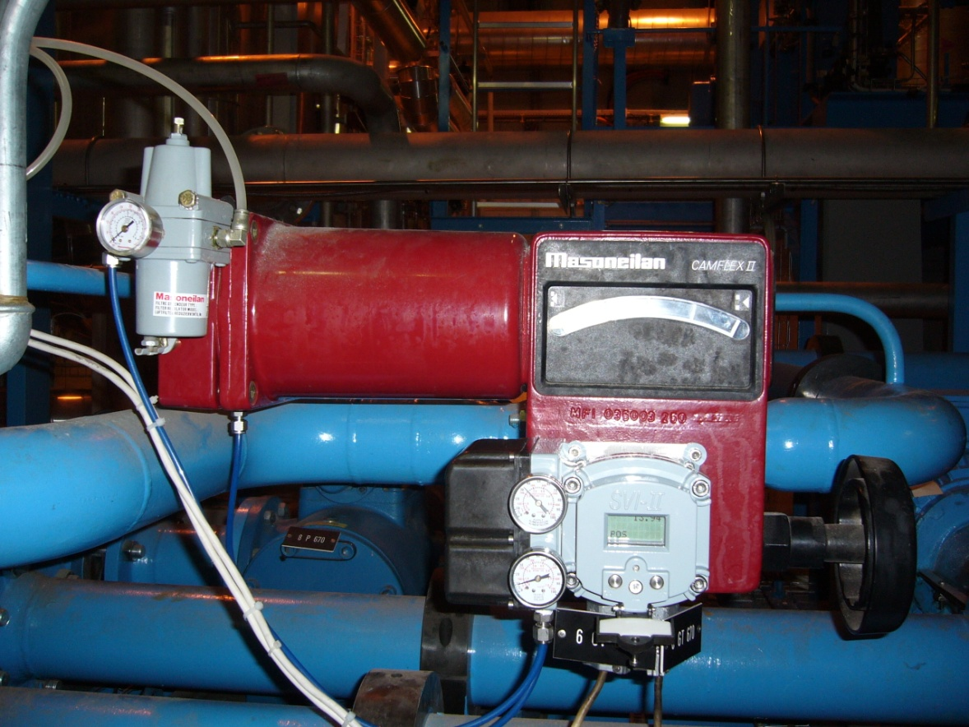
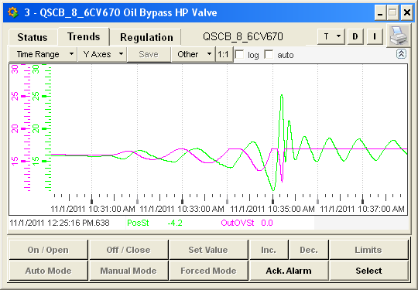
Cryo stop of P8 on 1st of November
Stop of warm compressor CP6 of QSCB on safety chain (oil differential pressure low) at 10:35AM
After investigation, problem of oscillations with the controller of 6CV670 which regulate the differential pressure of the oil injection of high stage compressors of the station LHCB
Problem of oscillations on this valve was already observed … and controller was due to be changed during next TS
New controller installed over lunch time
Restart of installations by 2PM
Recovery expected by Wednesday evening…
Faulty controller

Slide 12
MKD Stop in SPS – Corroded Feed-Through

Slide 13
Layout A4L2.C (vertical – zoom)
Tunnel checks (vacuum, survey, RP): no indication
Worry: change of IR2 layout over christmas stop – will reduce aperture…
TDI
ID800
TCT - TCD
Q3
IR2 Layout
TCDD
VGPB.120.4L2.X
LSS2L :
TCTVB
TCDD
VAB
BPMSX
D1L2
D1L2
Giuseppe Bregliozzi
VPIA.A151.4L2.X

Slide 14
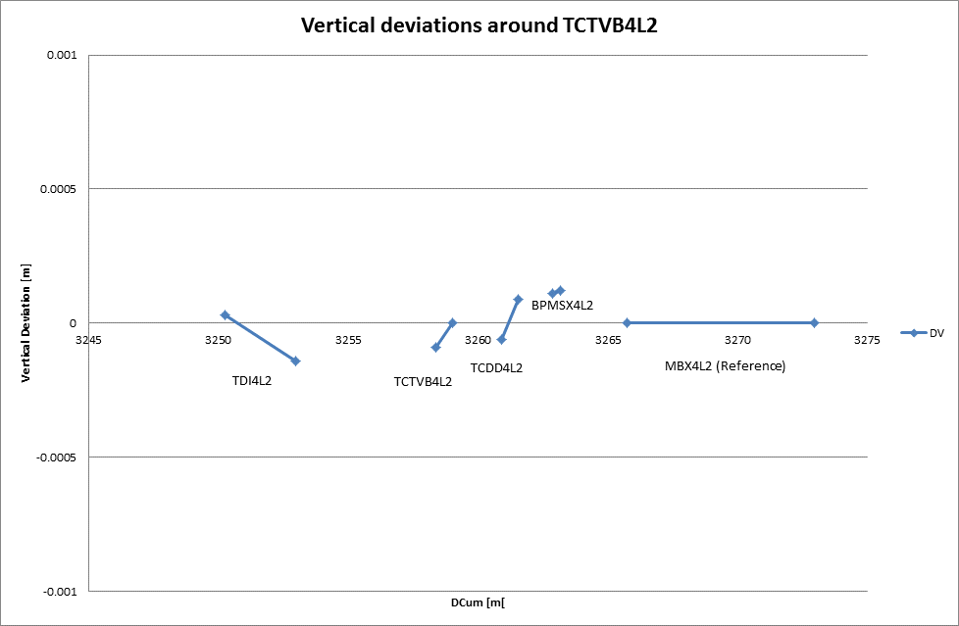
IR2L Aperture: Alignment checks
+ 0.5 mm
- 0.5 mm
P. Bestmann

Slide 15
IR2 Aperture: RP survey (L2)
K. Weiss

Slide 16
ALFA RP Movement Issue: XRPV.A7L1.B2
Tried to move RP to target position: 6.901mm/-7.099mm
Lower pot moved, upper pot did not move not. Tried to resend commands, disarmed in software trigger, …
Then ALFA colleagues realized that the proper initialization had been lost due to operation of override key before we started.
Tried re-initialization by moving to outer stop. Lower pot moved but only 20% of its way. Ended up with 28mm offset between motor and LVDT.
Trying to move out the RP to -20mm, it in fact moved towards the beam. Stopped at -8.6mm with stop all command (in time before moving into the beam).
Decided to stop with the ALFA RP's and do the loss maps. RP's are between physics position and further out.

Slide 17
ALFA RP Movement Issue: XRPV.A7L1.B2
(2) pot in reality moves IN
(3) stopped by emergency “STOP ALL” before hitting dump limit (masked?)
(1) request to move OUT to - 20 mm
Beam
Dump limit
Pot position (LVDT)
Position request
Motor setting
➔ Several important issues encountered. Improvements required!

Slide 18
MD Highlights

Slide 19
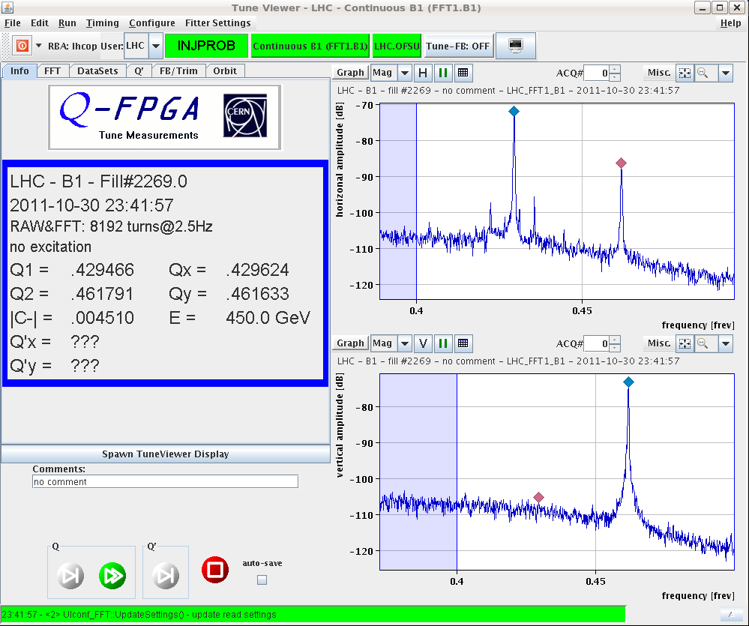
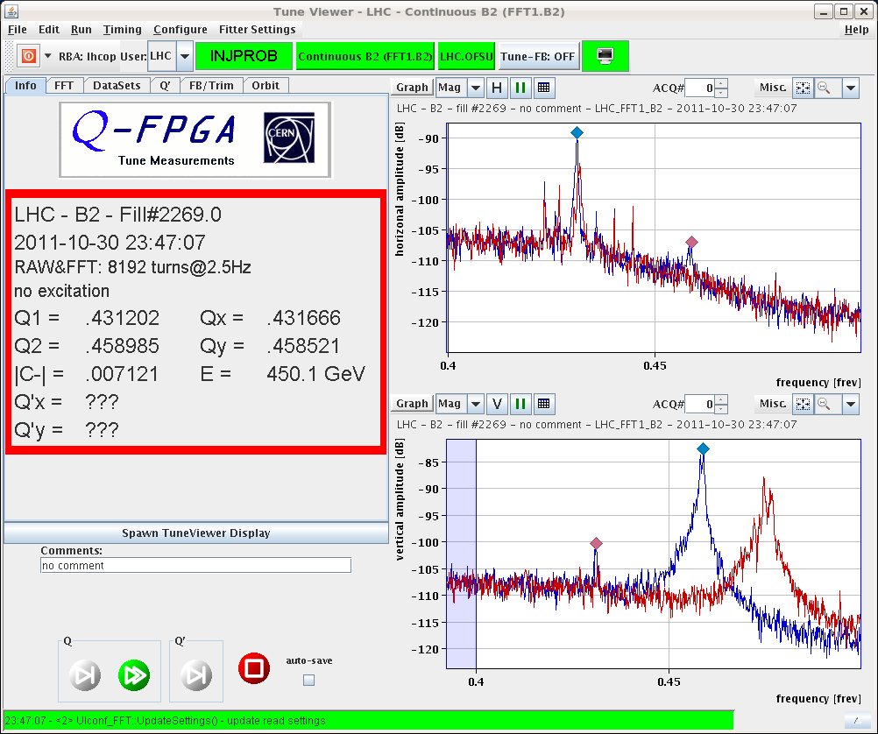
tunes near ½ integer
R. Steinhagen et al
Q_{x}=0.43, Q_{y}=0.46
Funny Big Sister Message: "... Attention, Orbit-FB has been on too long, consider switching it off..."

Slide 20
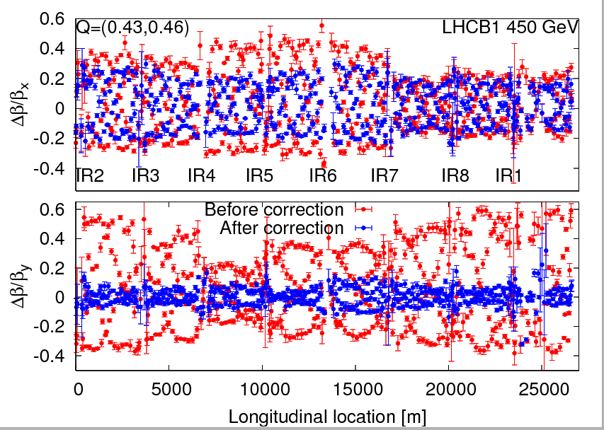
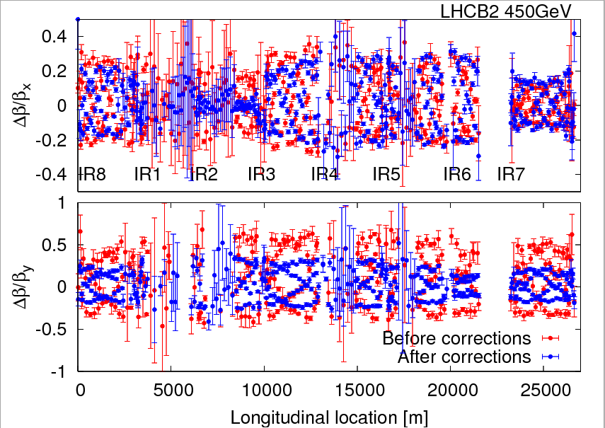
optics correction at ½ integer tune
beam 1: beta-beat ~50%,~60% → ~10%,~25% w 128 correctors
beam 2: beta-beat ~30%,80% → ~30%,~40% level w 96 correctors
iteration would be needed; data quality for beam 1 better than for beam 2; beam 2 misses some BPM's R1,L2,R4,L7.
R. Tomas, G. Vandervinckhove, et al

Slide 21
MD: p – lead 1) storage 2) ramp 3) phasing
Proton beam
First ion beams 2011

Slide 22
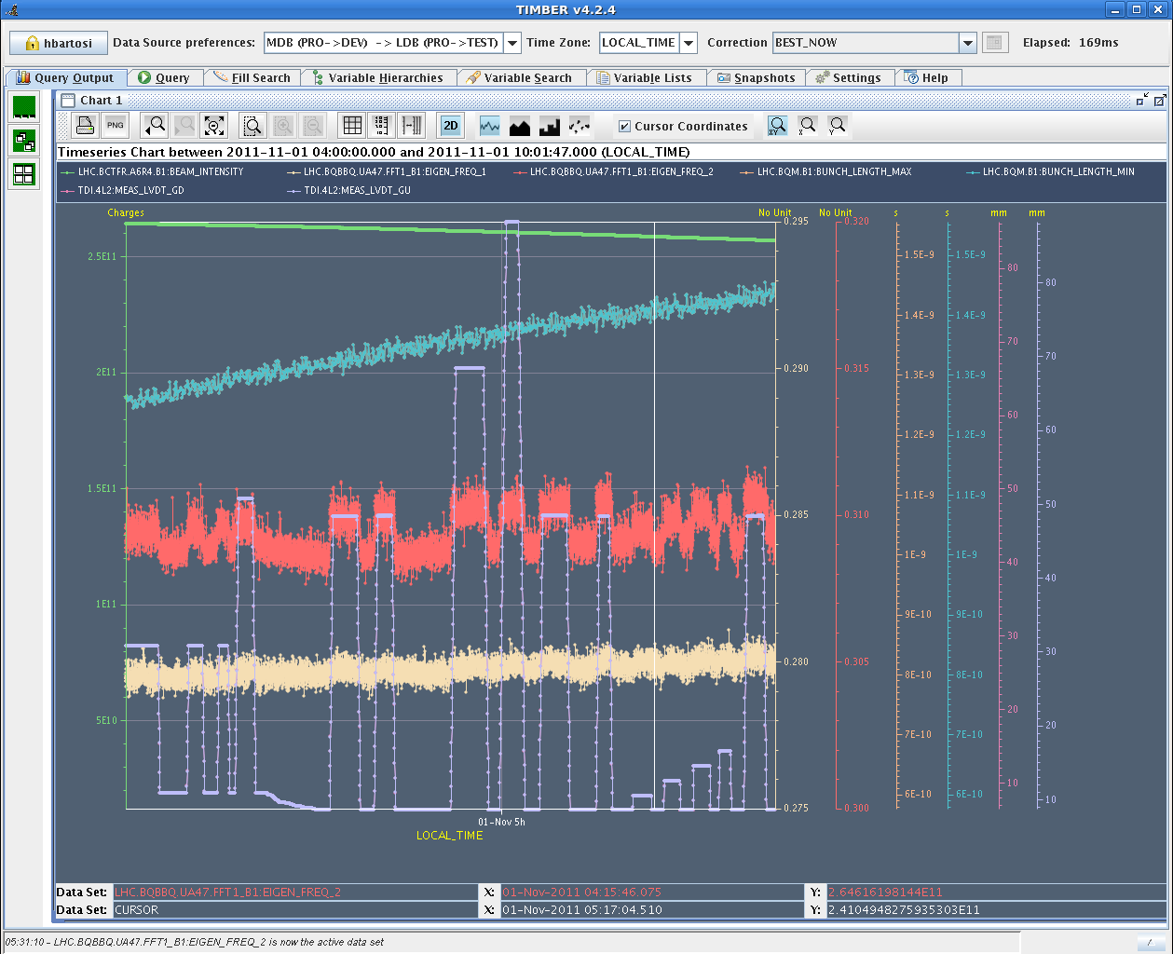
Tue 01/11 – TDI studies
Aim: Measure TDI impedance (mainly transverse)
Parasitically: UFO studies
Measurement of tune shift vs. TDI gap for high intensity bunch (~2.5x10¹¹ p).
Confirms 2010 measurements but still ~twice too high.
Measurement with multi-bunch not clean for impedance.
Vacuum data recorded.
H. Bartosik, B. Salvant, TE/VSC et al.

Slide 23
Tue 01/11 – UFO studies
Verification of procedure for kicking single MKI kickers and MKQ kickers with low intensity
Pulsed single MKI kickers and MKQ kickers in the last injection gap without beam after injecting 1236 bunches
Preliminary results from UFO buster / BLM data analysis:
Often candidate UFOs after MKI pulse in Pt.2 and Pt.8 found. Sometimes even several events (cf. e.g. events at 9:40 and 9:54)
Delay of first event to MKI pulse between 12.8ms and 128ms (for free fall t=sqrt(2*19mm/9.81ms^-2) = 62ms expected).
No UFOs at MKQ found

Slide 24
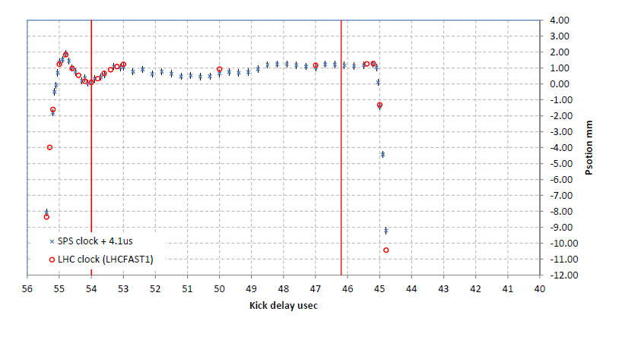
SPS MKE waveform calibration
10:37: Trip of cryogenics in point 8
Accesses
Measurements of the MKE4/6 SPS extraction kicker waveform
Preliminary summary:
Finished calibration of MKE4 kick waveform with LHC clock. Find a 4.1 us difference wrt the calibration made with SPS clock, but the same waveform (when a 0.4 mm static offset is accounted for). What is strange is that the 54 us delay for the pilot seems to be at a different location compared to the waveform measured with the individual bunch positions at injection into the LHC...we will come back to try and investigate with INDIV or 12b
B. Goddard

Slide 25
Tight Collimation: Ramp and Squeeze
some losses…

Slide 26
Example: Beam 1 H loss map → Very good
5 orders of magnitude
With April collimation setup → > 6 month validity

Slide 27
MD: Bunch shape measurements

Slide 28
Quench Test MD at Injection
Quench test:
closed TCLIB collimator to 1 mm gap and -3 sigma offset
Beam 2 inject and dump, pilot bunch of 3e10 p+
BLM monitors at TCLIB and Q6 in saturation (> 1000% ratio to dump)
We increased the current of Q6.L8 magnet in steps of 200 A until 2200 A (5 TeV operation) and recorded QPS signal
QPS didn't show any significant variation when increasing the beam current ==> NO QUENCH or QUENCHINO recorded.
Data analysis will follow but up to now it looks like the signal was just induced by showers on the electronics (TCLIB intercepts the full beam ==> too diluted energy deposition at Q6 to cause a quench).

Slide 29
BI MD: Influence beam position on FBCT reading

Slide 30
ATS optics: To 40cm beta* (S. Fartoukh et al)
Dry run without beam: 10cm without problem.
Squeeze with beam very smooth down to 40cm.
Measurements were conducted at β* 1m and 40cm. The beta-beat is increasing from 30% to 50% for beam 1 horizontal and from 20% to 40% for beam 2 vertical.
A correction was calculated and implemented for beam 1 at 40cm, this reduced the peak beta-beat from 50% to 20%. For beam 2 a correction will need to be calculated off-line, it is expected that because of the missing BPMs global correction could not calculate and effective correction.
For the correction only ~20 correctors around IP1 and IP5 were used.
Trip of trim quadrupoles when re-distributing the strength among sectors before telescopic squeezing → 10cm not reached this time!

Slide 31
ATS optics
R. Tomas et al.

Slide 32
Ahead
Technical stop…
Proposal to install movable BLM’s during this TS to have better resolution where losses in IR2 aperture measurements start. Repeat aperture measurement…
ODH intervention?
Ion commissioning → John

