Slide 1
MD#3 Progress
Ralph Assmann, Giulia Papotti, Frank Zimmermann
25 August 2011

Slide 2
MD Planning Wed – Thu (24. – 25.8.)
Day | Time | MD | MP
Wed | 04:00 | Ramp down, cycle
 | 06:00 | 450 GeV → 3.5 TeV: Head-on beam-beam + 1h data taking (stable beams) – for highest pile-up | B
 | 13:00 | Ramp down, cycle
 | 15:00 | 450 GeV → 3.5 TeV: Optics setup for β*=1m (1) – Pilots through squeeze, measure and correct Q, Q’, C, orbit, measure beating and local coupling | A
 | 19:00 | Ramp down, cycle
 | 21:00 | 450 GeV → 3.5 TeV: Long bunch length – RF setup at injection, test ramp for losses in IR3, voltage change at flat top | B
Thu | 03:00 | Ramp down, cycle
 | 05:00 | 450 GeV → 3.5 TeV: Beam Instrumentation | B
 | 13:00 | Ramp down, cycle.
 | 15:00 | 450 GeV → 3.5 TeV: LR beam-beam – 2 batches, effect of number of LR interactions, effect of emittance | C
Postponed to after TS

Slide 3
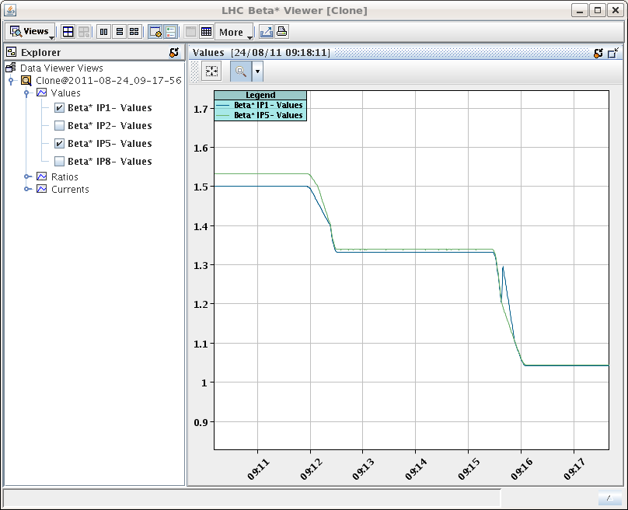
β*=1 m
“Squeeze to 1m beta star without problems.”
S. Redaelli et al
calibration for beta* curves not yet final

Slide 4
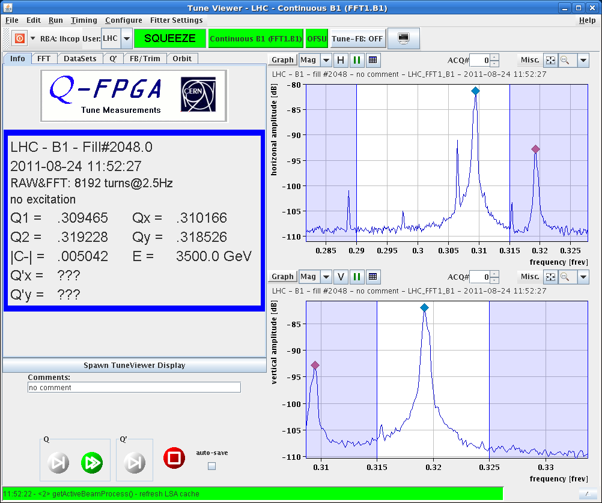
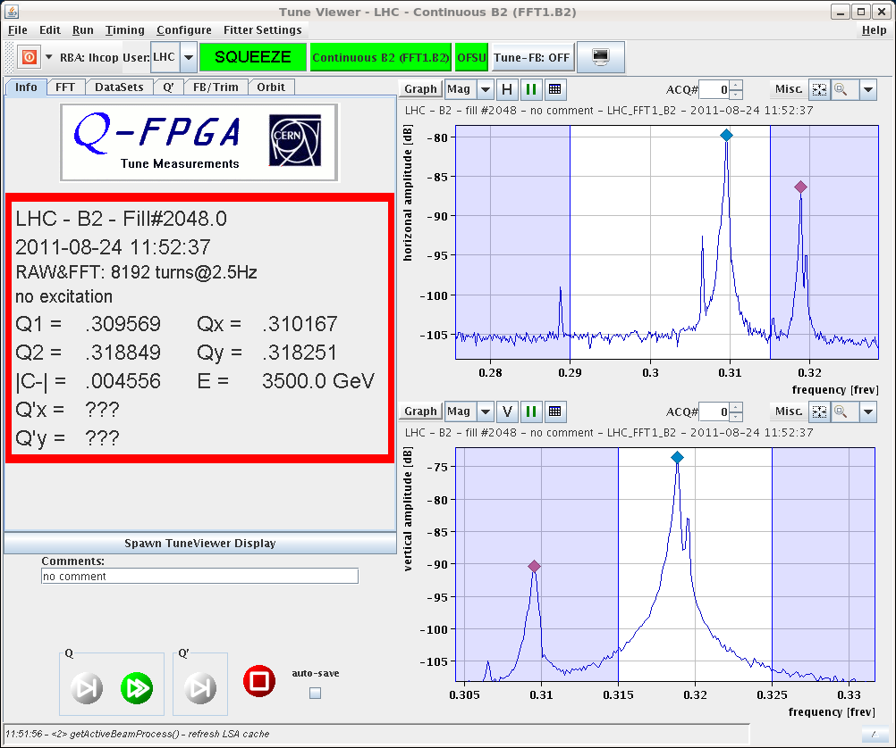
β*=1 m
tunes & coupling
later coupling corrected to below 0.002 for both beams

Slide 5
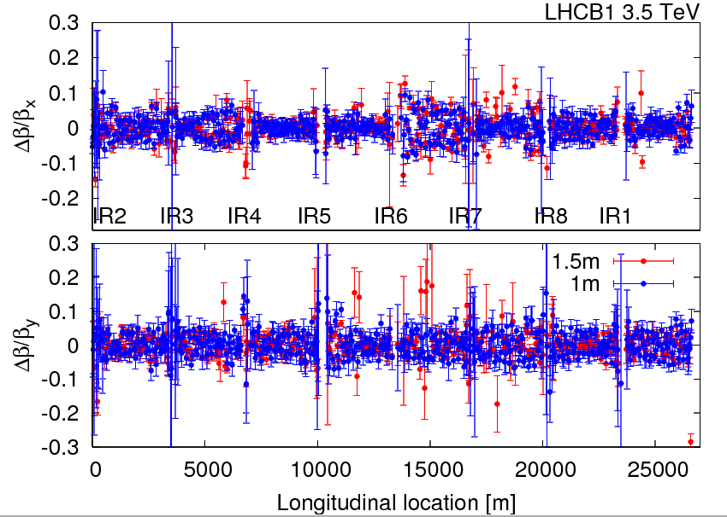
R. Tomas, R. Miyamoto. G. Vanbavinckhove
beam-1 beta beating at β*=1 m similar to β*=1.5 m
peak beta-beat of around 10%-15%

Slide 6
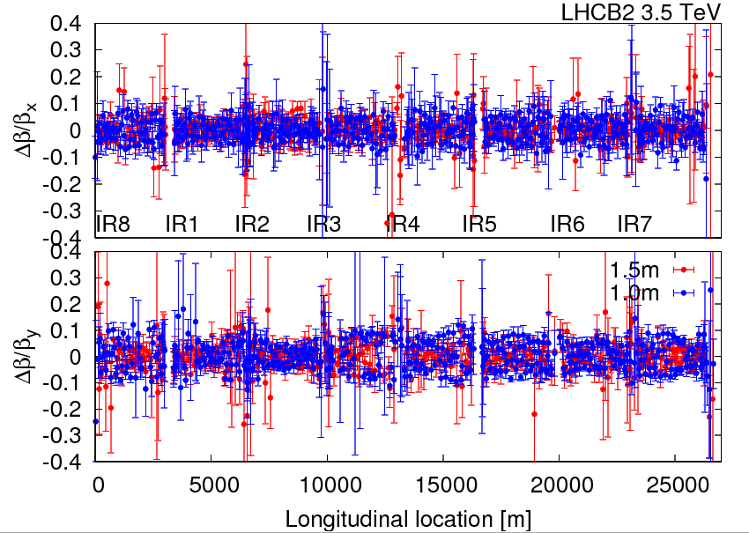
R. Tomas, R. Miyamoto. G. Vanbavinckhove
beam-2 beta beating at β*=1 m similar to β*=1.5 m
peak beta-beat of around 10%-15%

Slide 7
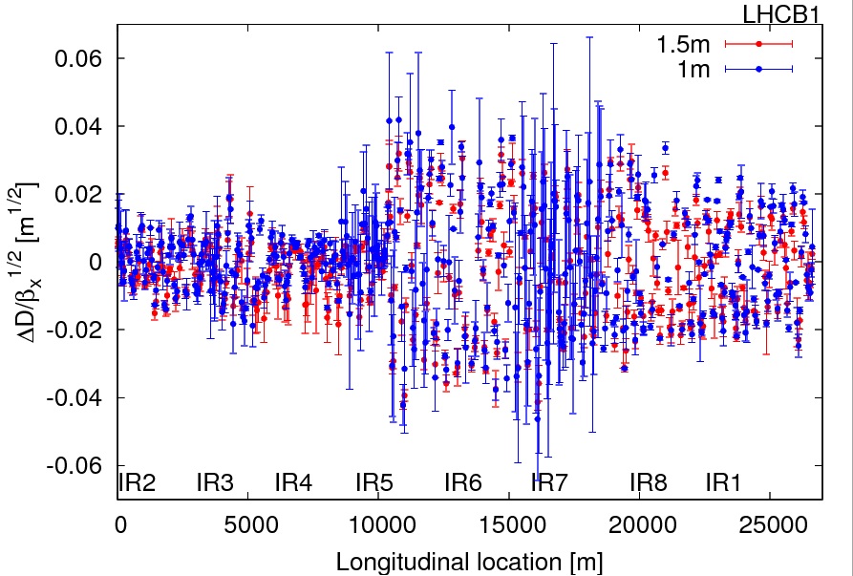
R. Tomas, R. Miyamoto. G. Vanbavinckhove
beam-1 normalized dispersion for β*= 1.5 m & 1 m comparable;
peak normalized dispersion beat of 0.04 m^(1/2); jump at IP5

Slide 8
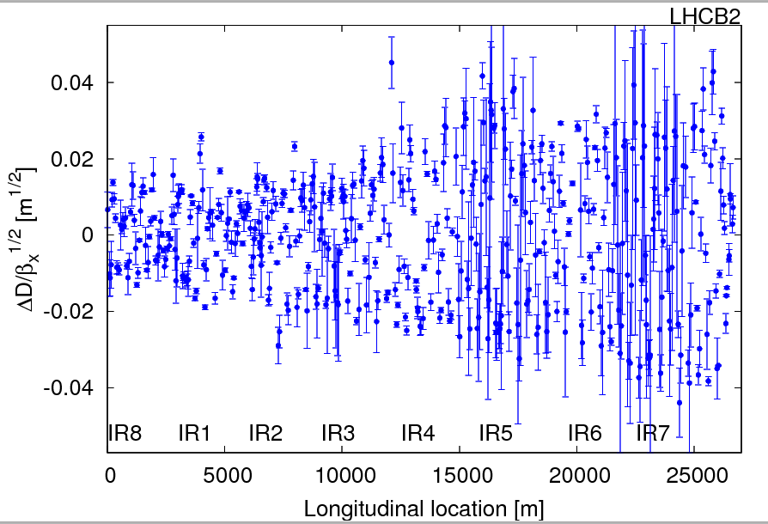
R. Tomas, R. Miyamoto. G. Vanbavinckhove
beam-2 peak normalized dispersion for β*= 1.5 m
peak normalized dispersion beat of 0.04 m^(1/2);

Slide 9
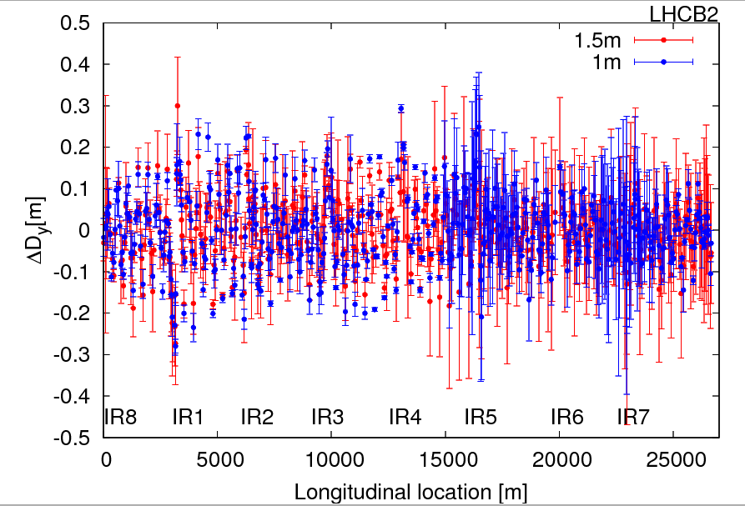
R. Tomas, R. Miyamoto. G. Vanbavinckhove
beam-2 vertical dispersion for β*= 1.5 m & 1 m comparable;
peak vertical dispersion beat of 20 cm; slightly larger at 1.5 m

Slide 10
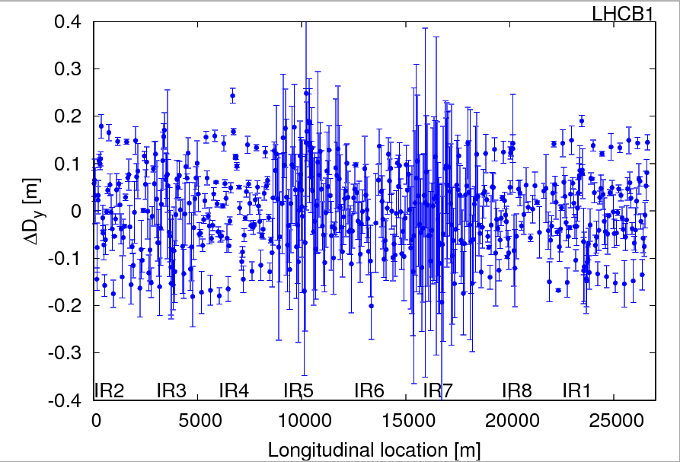
R. Tomas, R. Miyamoto. G. Vanbavinckhove
beam-1 peak vertical dispersion beat of 20 cm

Slide 11
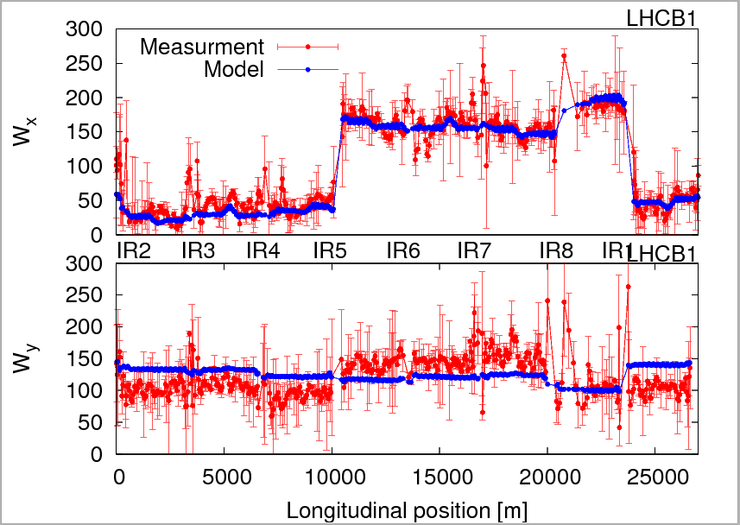
beam-1 chromatic beta-beat for β*=1 m (Montague function W): small discrepancy in y plane
R. Tomas, R. Miyamoto. G. Vanbavinckhove

Slide 12
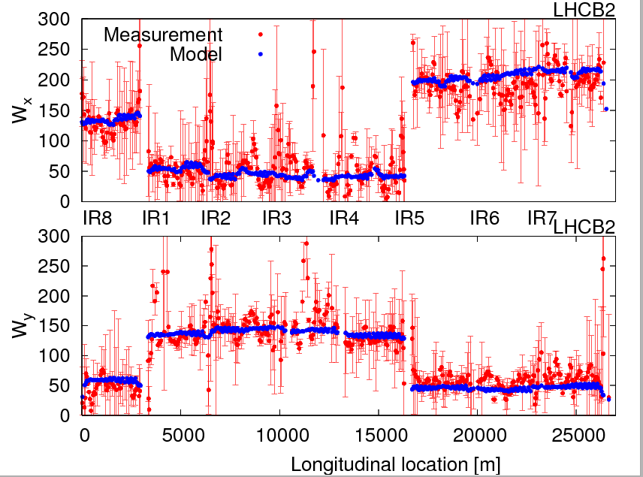
R. Tomas, R. Miyamoto. G. Vanbavinckhove
beam-2 chromatic beta-beat for β*=1 m (Montague function W): measurement and model agree

Slide 13
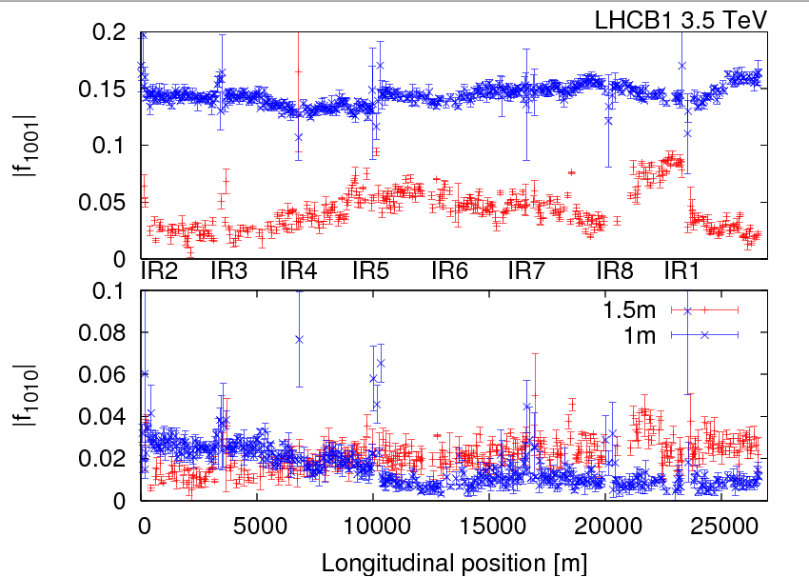
R. Tomas, R. Miyamoto. G. Vanbavinckhove
Beam-1 local coupling for β*= 1 m &1.5 m: No clear jumps are observed (to be confirmed with segment-by-segment technique) → local coupling knobs are performing well

Slide 14
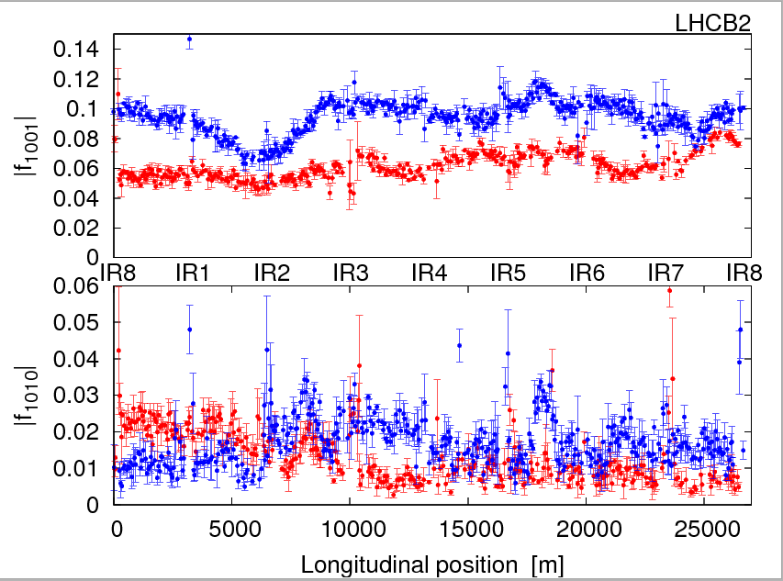
R. Tomas, R. Miyamoto. G. Vanbavinckhove
Beam-2 local coupling for β*= 1 m &1.5 m: No clear jumps are observed (to be confirmed with segment-by-segment technique) → local coupling knobs are performing well

Slide 15
R. Tomas, R. Miyamoto. G. Vanbavinckhove, et al
β*=1 m
Corrections: No extra corrections; the corrections implemented at 1.5 m were kept constant (local and global corrections for beta-beat and coupling) until 1 m. β* from K-modulation: Preliminary analysis indicated some important waist shift (?!), but after error propagation results are OK, e.g.
IP1 beta* err[m]
B1H 1.20 0.20
B1V 1.05 0.13
B2H 1.14 0.10
B2V 1.17 0.18

Slide 16
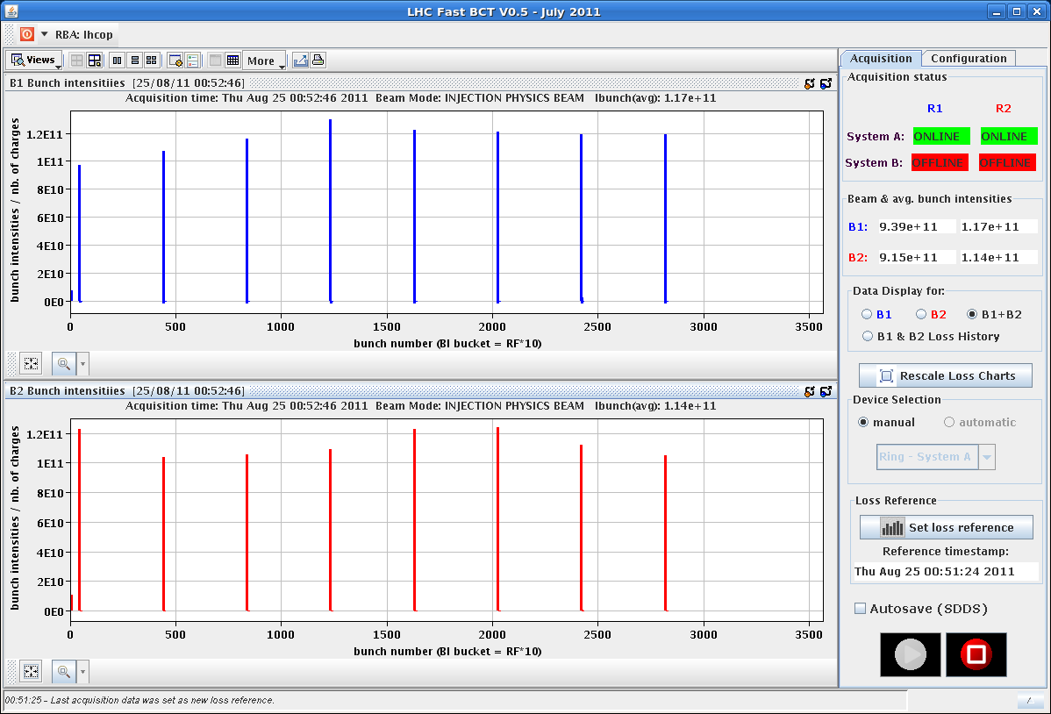
P. Baudrenghien,
E. Shaposhnikova
T. Mastoridis,
L. Ponce, et al
“long bunch length”
filling pattern

Slide 17
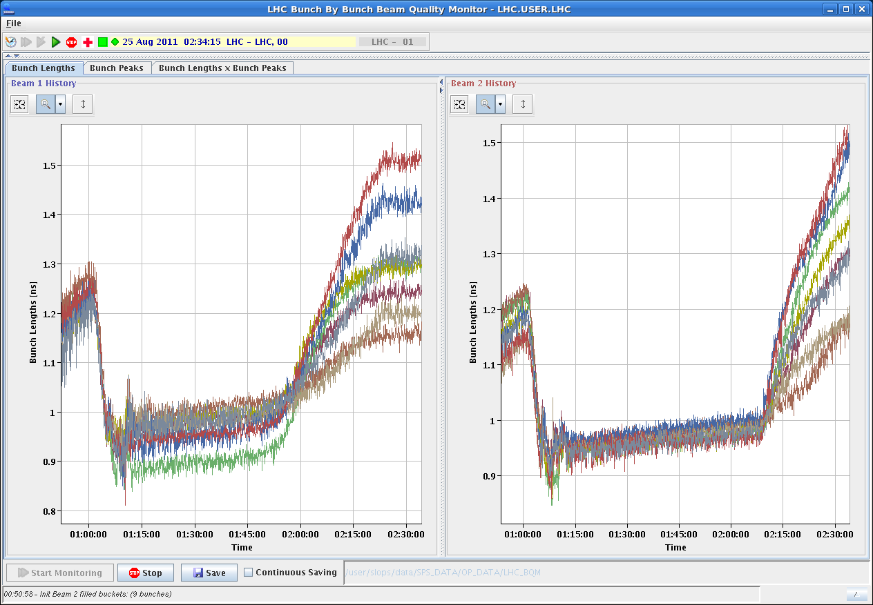
P. Baudrenghien,
E. Shaposhnikova
T. Mastoridis, et al
“long bunch length”
after Frev-amplitude modulated excitation
at flat top - max. bunch length >1.5 ns

Slide 18
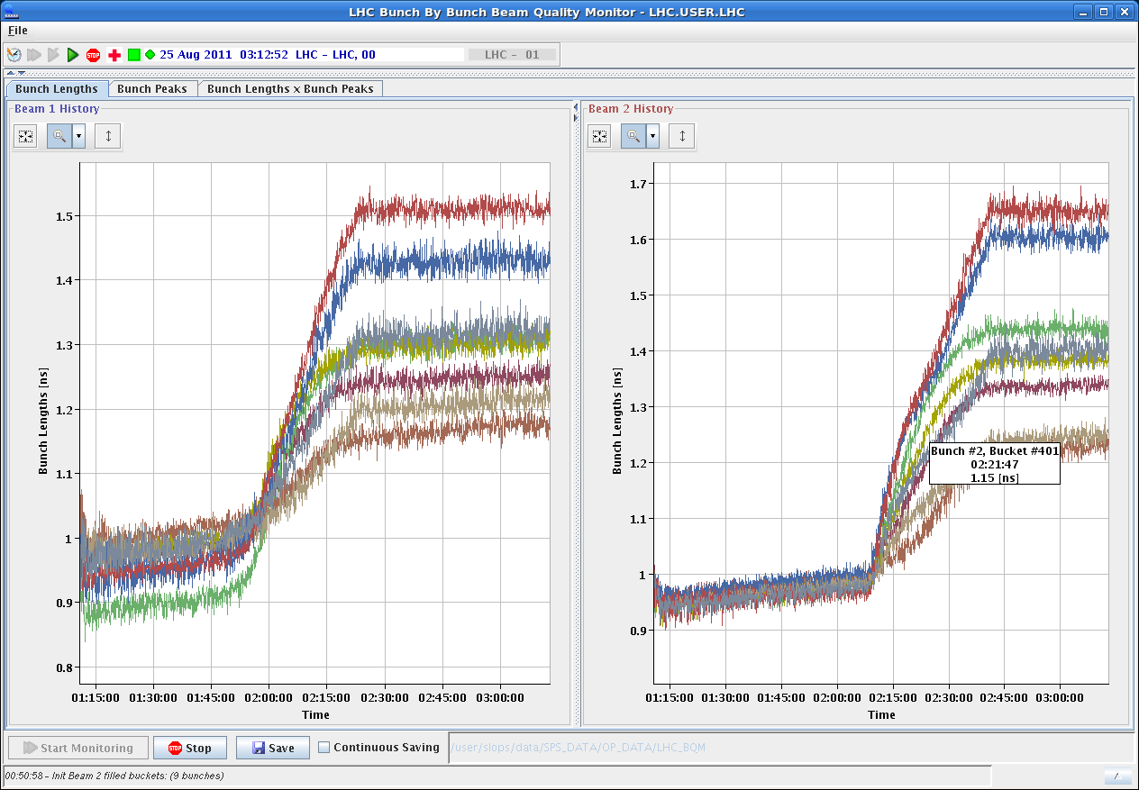
P. Baudrenghien,
E. Shaposhnikova
T. Mastoridis, et al
“long bunch length”
individual bunch lengths since start of flat top
from 1.15 to 1.65 ns

Slide 19
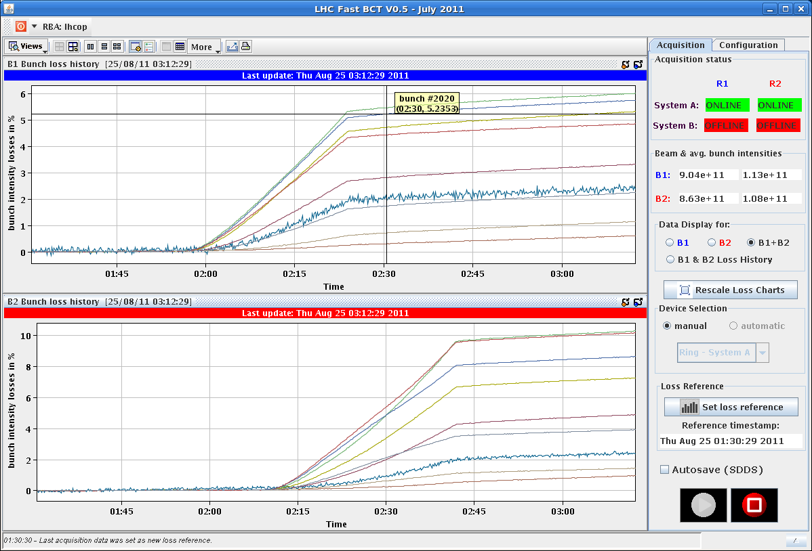
P. Baudrenghien,
E. Shaposhnikova
T. Mastoridis, et al
“long bunch length”
integrated losses since start of flat top

Slide 20
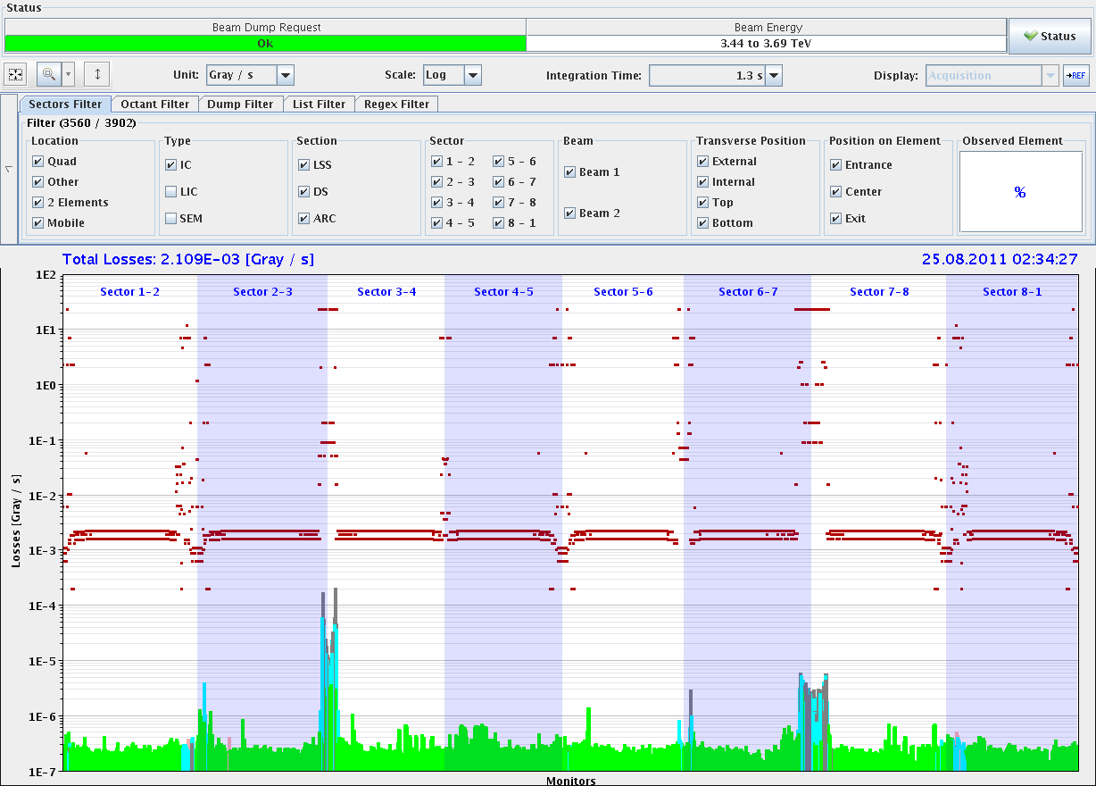
“long bunch length”
losses also in IR 7

Slide 21
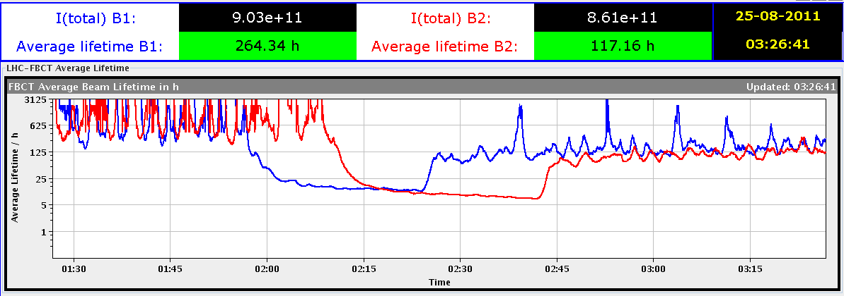
P. Baudrenghien,
E. Shaposhnikova
T. Mastoridis, et al
“long bunch length”
recovery of beam lifetimes after stop of excitation

Slide 22
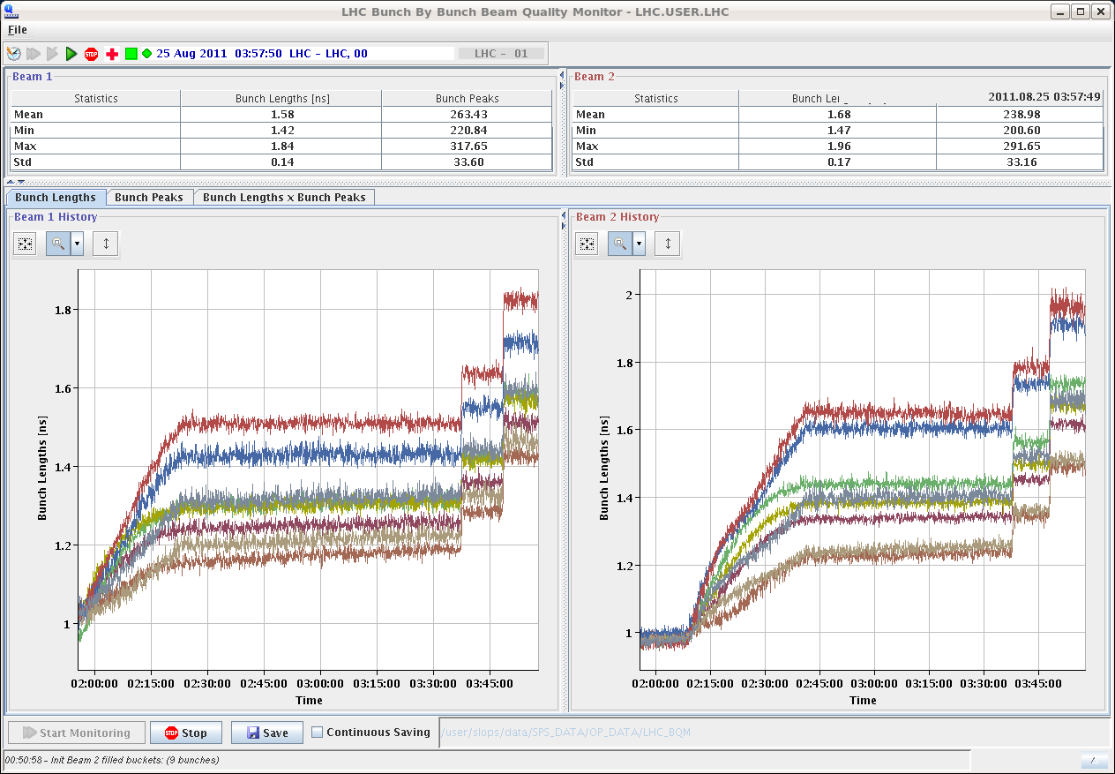
P. Baudrenghien,
E. Shaposhnikova
T. Mastoridis, et al
“long bunch length”
bunch length after two steps of
RF voltage reduction

Slide 23
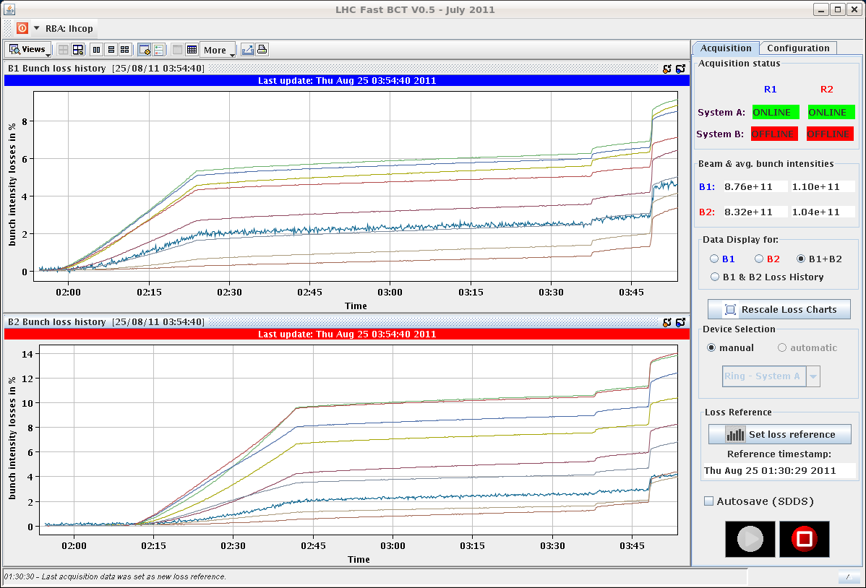
P. Baudrenghien,
E. Shaposhnikova
T. Mastoridis, et al
“long bunch length”
integrated losses after two steps of
RF voltage reduction

Slide 24
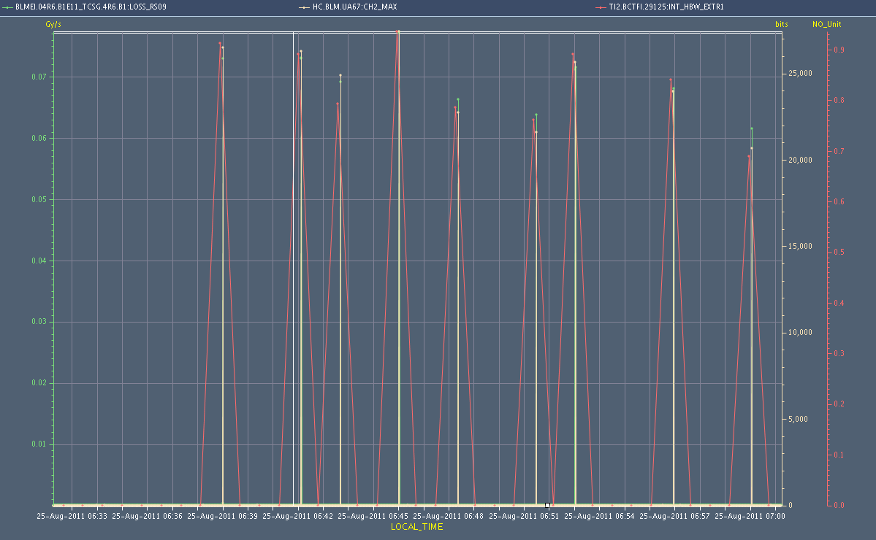
“beam instrumentation”
MD in progress – several studies in parallel
Direct Dump Calibration
shots on closed TCSG in IP 6
E. Nebot, et al
beam intensity
& BLM readings
for different shots

Slide 25
MD Planning Wed – Thu (24. – 25.8.)
Day | Time | MD | MP
Wed | 04:00 | Ramp down, cycle
 | 06:00 | 450 GeV → 3.5 TeV: Head-on beam-beam + 1h data taking (stable beams) – for highest pile-up | B
 | 13:00 | Ramp down, cycle
 | 15:00 | 450 GeV → 3.5 TeV: Optics setup for β*=1m (1) – Pilots through squeeze, measure and correct Q, Q’, C, orbit, measure beating and local coupling | A
 | 19:00 | Ramp down, cycle
 | 21:00 | 450 GeV → 3.5 TeV: Long bunch length – RF setup at injection, test ramp for losses in IR3, voltage change at flat top | B
Thu | 03:00 | Ramp down, cycle
 | 05:00 | 450 GeV → 3.5 TeV: Beam Instrumentation | B
 | 13:00 | Ramp down, cycle.
 | 15:00 | 450 GeV → 3.5 TeV: LR beam-beam – 2 batches, effect of number of LR interactions, effect of emittance | C
Postponed to after TS

Slide 26
MD Planning Wed – Thu (24. – 25.8.)
Day | Time | MD | MP
Wed | 04:00 | Ramp down, cycle
 | 06:00 | 450 GeV → 3.5 TeV: Head-on beam-beam + 1h data taking (stable beams) – for highest pile-up | B
 | 13:00 | Ramp down, cycle
 | 15:00 | 450 GeV → 3.5 TeV: Optics setup for β*=1m (1) – Pilots through squeeze, measure and correct Q, Q’, C, orbit, measure beating and local coupling | A
 | 19:00 | Ramp down, cycle
 | 21:00 | 450 GeV → 3.5 TeV: Long bunch length – RF setup at injection, test ramp for losses in IR3, voltage change at flat top | B
Thu | 03:00 | Ramp down, cycle
 | 05:00 | 450 GeV → 3.5 TeV: Beam Instrumentation | B
 | 13:00 | Ramp down, cycle.
 | 15:00 | 450 GeV → 3.5 TeV: LR beam-beam – 2 batches, effect of number of LR interactions, effect of emittance | C
Postponed to after TS

Slide 27
Draft MD Planning Fri – Sat (26. – 27.8.)
Day | Time | MD | MP
 | 23:00 | Ramp down, cycle.
Fri | 01:00 | 450 GeV: Transverse damper – beam blowup at injection | B/C
 | 07:00 | 450 GeV → 3.5 TeV: Aperture – scraping pilot beam tails in triplets, maybe test global aperture measurement with transverse damper | B
 | 15:00 | Ramp down, cycle.
 | 17:00 | 450 GeV: 25 ns studies – injection of up to 144b/288b, damper | B
Sat | 00:00 | 450 GeV: 25 ns studies – vacuum, ecloud, RF | B
 | 07:00 | 450 GeV → 3.5 TeV: Optics setup for β*=1m (2)– apply proposed beating and local coupling corrections; at 1m: measure beating and coupling, verify corrections, test collision beam process; check LR beam-beam with new β* & reduced crossing angle | A
 | 15:00 | Ramp down, cycle.
 | 17:00 | 450 GeV → 3.5 TeV: Collimator setup for β*=1m– tight collimation settings, set up TCT’s in IR, loss maps. Asynchronous dump, if time left. | B

Slide 28
Draft MD Planning Sun – Mon (28. – 29.8.)
Day | Time | MD | MP
Sun | 01:00 | Ramp down, cycle. | B
 | 03:00 | 450 GeV → 3.5 TeV: p-p rephasing – debunching during ring rephasing with nominal emittances
 | 09:00 | Ramp down, cycle.
 | 11:00 | 450 GeV: UFO studies – generation mechanism at MKI’s, statistics, MKQA tests (p-Pb interlock test in the shadow) | C
 | 19:00 | 450 GeV: Quench margin at injection – observation with special QPS instrumentation, losses from TCLIB collimator | C
 | 22:00 | 450 GeV → 3.5 TeV: Quench test at 3.5 TeV – test losses in other dispersion-suppressors – dropped if extra time needed for β*=1m | C
Mon | 06:00 | Technical Stop
Needs from experiments:
-Luminometers on during beam-beam MDs and in the second slot of β*=1 m

