Slide 1
Monday 15th August
Cryogenics recovery
Accesses
Tests

Slide 2
Accesses
RF - crowbar problem on module 2B1 – fixed
Noise problem on RF 4B2 – more access today
CMS, ATLAS
Collimators
Beam Dump
QPS
ISRM (Internal Splice Resistance Measurement) on RD2.R8, RQ4.R8 and RQ5.R8 done.
Fiber optics for access system
BLMs and CO for BLM timing crate

Slide 3
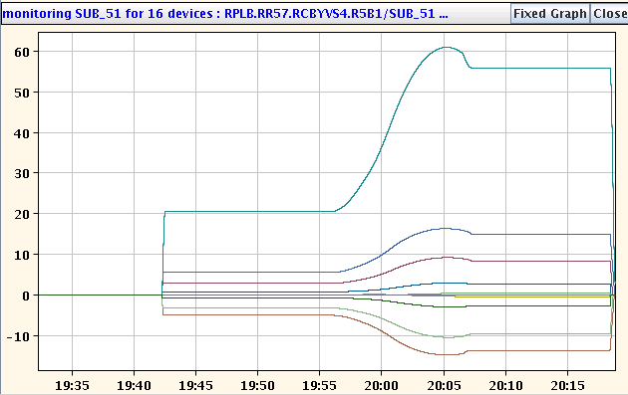
Dry-run of new functions for combined ramp & squeeze
Allows to reach 3.5m in Ip1 and IP5 at flat-top. Test only IP5 (both sides).
The functions were successfully executed until the end of the ramp!
Interesting shapes for the orbit correctors (energy scaling combined with the change of strengths during the squeeze) that will be interesting to check with beam!

Slide 4
Plan for today
Blowing fibres in preparation of TS
Access in points 7 & 8
Coordinate access in Point 4:
Access UA for RF, RF noise problem on 4B2
Access BI
11:00 – 14:00 TI2 tests – SPS Q20 optics extraction
Close 1-2 and 2-3
Cryo conditions expected ok at 15:00
Pre-cycle
Fill 1380 with slightly reduced bunch intensities
LHCb same polarity as last week – flip when no issues

Slide 5
Outstanding
LHCb polarity change
TOTEM & ALFA moving in during stable beams
‘End of fill’ tight collimators
After about 10 h of stable beams and during day time
In Adjust

