Slide 1
Friday
Fill 2022 – very high losses on TCTVB.4R8 – up to 60% of threshold.
Correlated with rising vacuum 4R8, few E-8.
10:40 Dump – SUE on RCBXV2.R1.
Prepare for loss maps at 3.5 TeV.
14:00-15:00 Loss maps with TOTEM & ALFA.
Small losses at TOTEM RPs.
Looking good – waiting for final cleaning figures from collimation team.

Slide 2
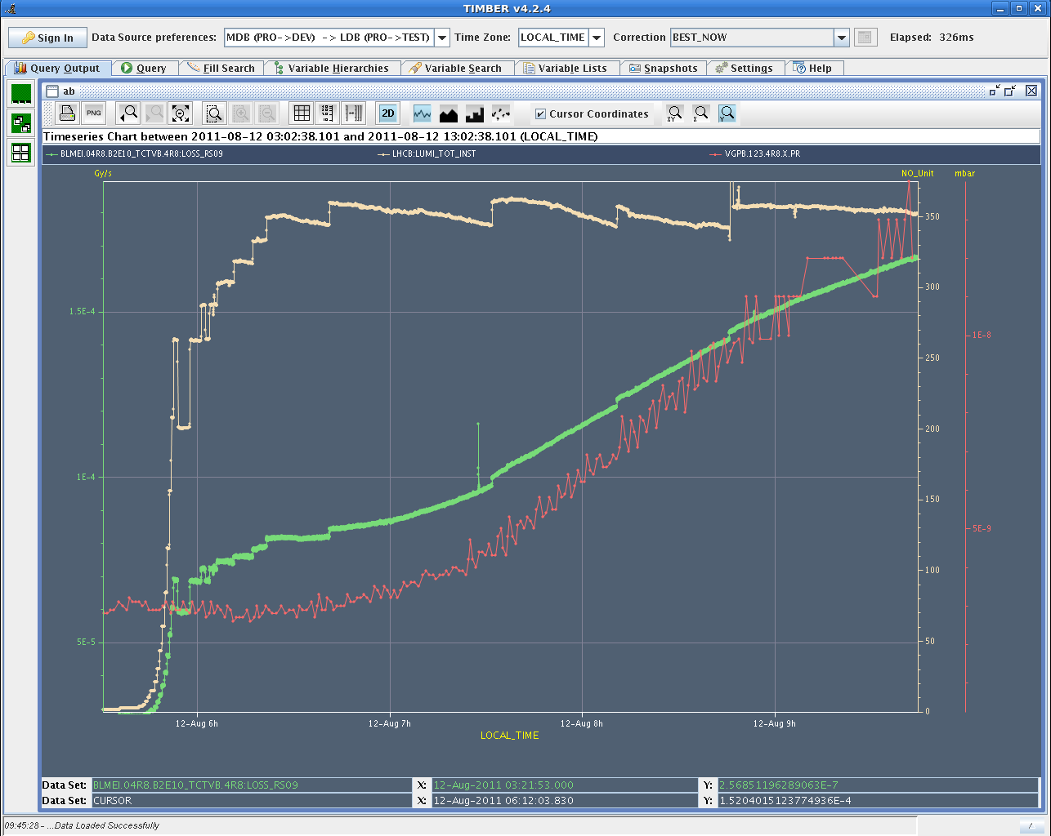
Vacuum, Lumi and losses TCTVB.4R8
Lumi LHCb
TCTVB
Vacuum

Slide 3
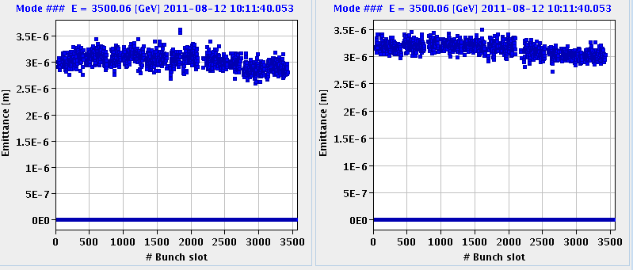
Emittance in fill 2022 larger than usual – explains lower L. No bunch-by-bunch effect.
B2H
B2V

Slide 4
Injection beam2
Strong modulation (~ 1 mm) of the injection oscillations along the batch in H plane for fills 2011 and 2022.
Not present on B1 → not beam instability in SPS.
Some change with time. Present since??
SPS MKE4 kicker checked – apparently no change.

Slide 5
Injection beam2
… modulation of oscillations along batch disappeared in fill 2025 ??

Slide 6
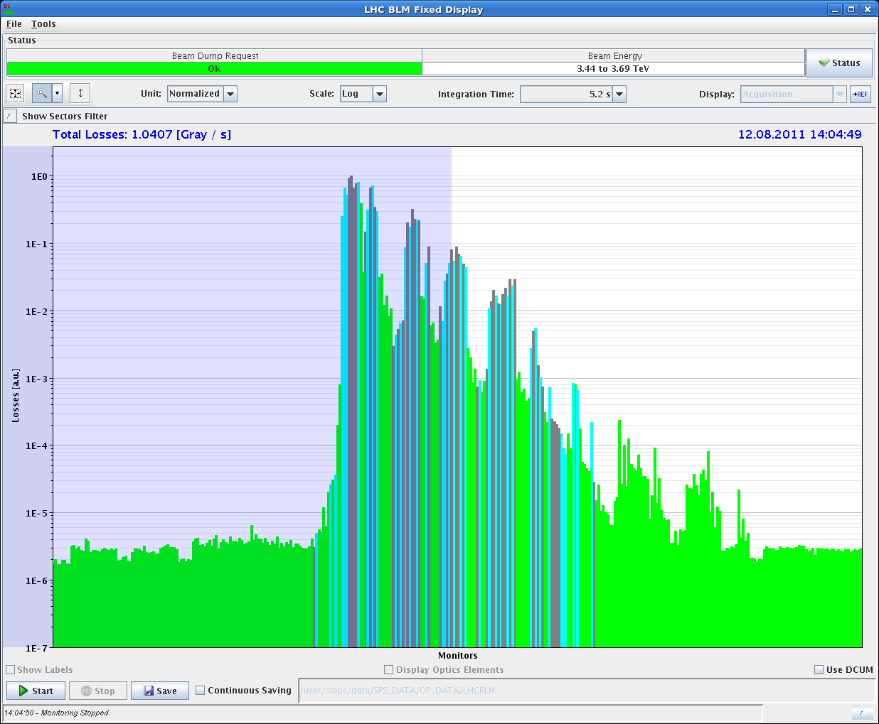
Clean loss map – B1V

Slide 7
Friday afternoon
Refilling and checking steering in lines.
Structure along batch on B2 in H has disappeared…
Fill 2025, 1.35E11/b, 104 MJ.
Nice lumis…
Problems with DIP data on page1.
03:30 EOF – cold compressor Pt8 trip.

Slide 8
04:30 Access for cryo in Pt8.
Problem to restart the compressor. Interlock on the speed. They are trying a crate reset now.
Cryo recovery estimate: > 24h.

Slide 9
To do
LHCb polarity
Tight collimator settings at EOF.

Slide 10
Fill Overview
Fill | Phase | Peak L [10³³ cm⁻²s⁻¹] | Length [h] | Int. L [pb⁻¹] | Dump cause
2009 | STABLE | 2.1 | 15.3 | 76 | Sector 81 trip (QPS quadrupoles)
2010 | STABLE | 2.05 | 18.8 | 85 | RQT12.R7B1 (QPS-SEU?)
2011 | STABLE | 2.1 | 8.5 | 45 | SIS interlock (comm. To RF FEC)
2022 | STABLE | 1.95 | 5 | 30 | SUE on RCBXV2.R1
2025 | STABLE | 2.2 | 8.5 | 52 | Cold compressor Pt8

