Slide 1
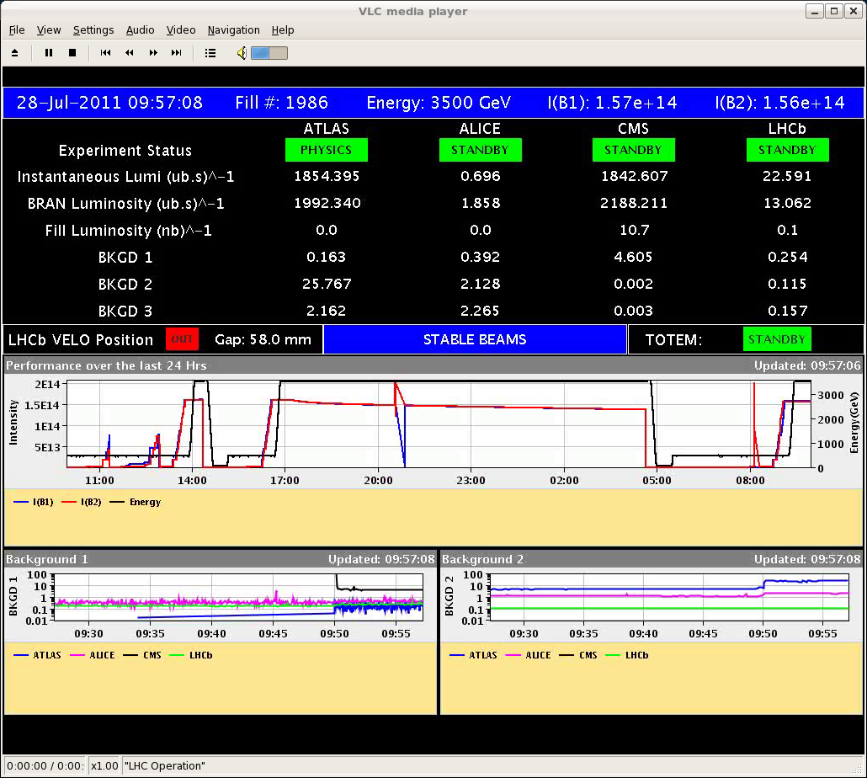
Thursday
10:00 Fill 1986 in stable beams.
Blow-up switched OFF in the SPS.
Emittance in collision ~2 um, a bit less beam than in previous fills.
Very smooth.

Slide 2
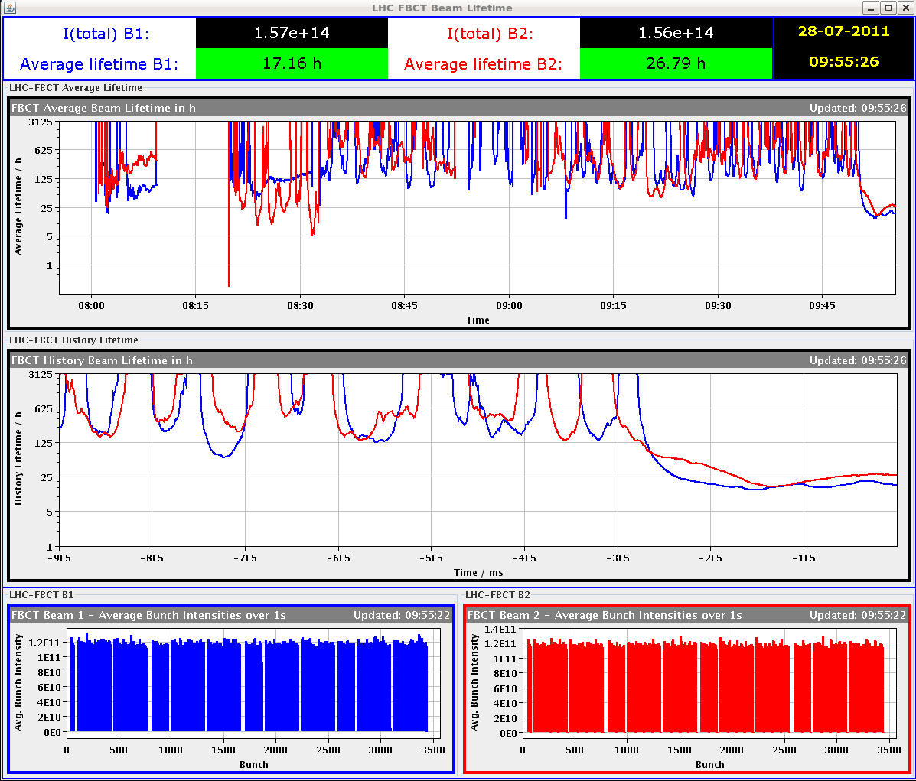
Lifetime dip only to ~10-20 hours, similar for both beams

Slide 3
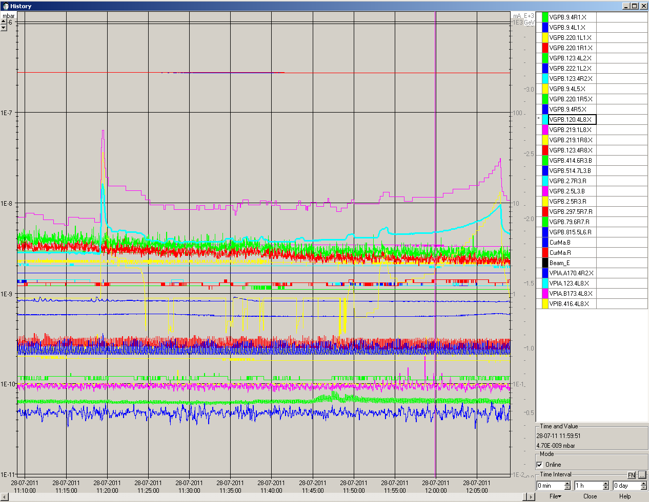
Some vacuum spikes in L8.

Slide 4
12:30 Dump due to vacuum spike on klystron of B2. Integrated 14 pb-1.
Injection delayed due to beam steering problems between PSB and PS.
And then came the kickers…

Slide 5
MKI2 event no. 1
16:30 Injected beam of 144b dumped on TDI in IR2.
Main switch erratic on PFN C.
Injected beam was not kicked, erratic was too late to prevent the extraction.
Circulating beam was not hit.
Heavy losses in IR2, but NO quench.
Vacuum spike, valves closed.

Slide 6
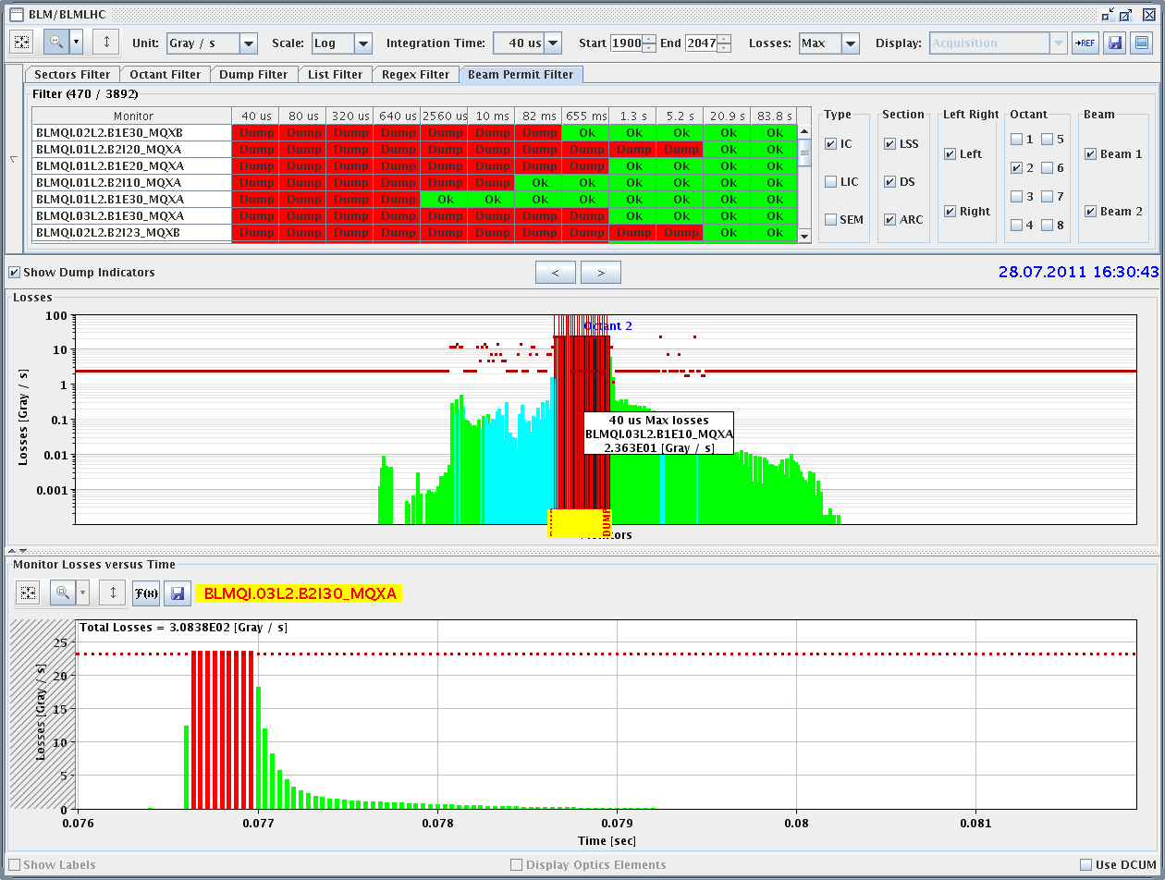
MKI2 event no. 1
BLMs

Slide 7
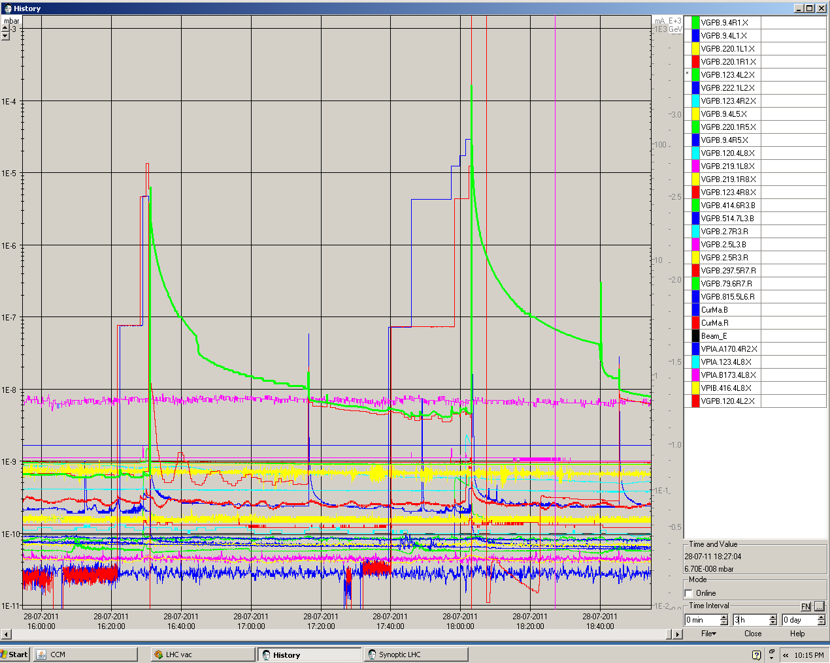
MKI2 event no. 1

Slide 8
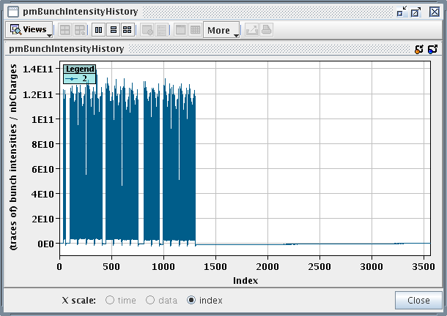
MKI2 event no. 2
17:00 Following investigations by ABT expert, OP got green light to resume injection.
Valves re-opened, vacuum pressure back to ‘normal’.
17:30 Resuming filling for physics.
18:02 Requesting 4th injection from 36b SPS cycle : 144b.
Circulating B1: 12+2x144+72+144 ~500b, 6E13 p.

Slide 9
MKI2 event no. 2
18:03 Massive beam loss during injection process.
Main switch erratic again.
D1.L2, triplet L2, D2.R2 quenched.
Massive losses in IR2.
Vacuum spike and valves closed again.
ALICE hit (again).

Slide 10
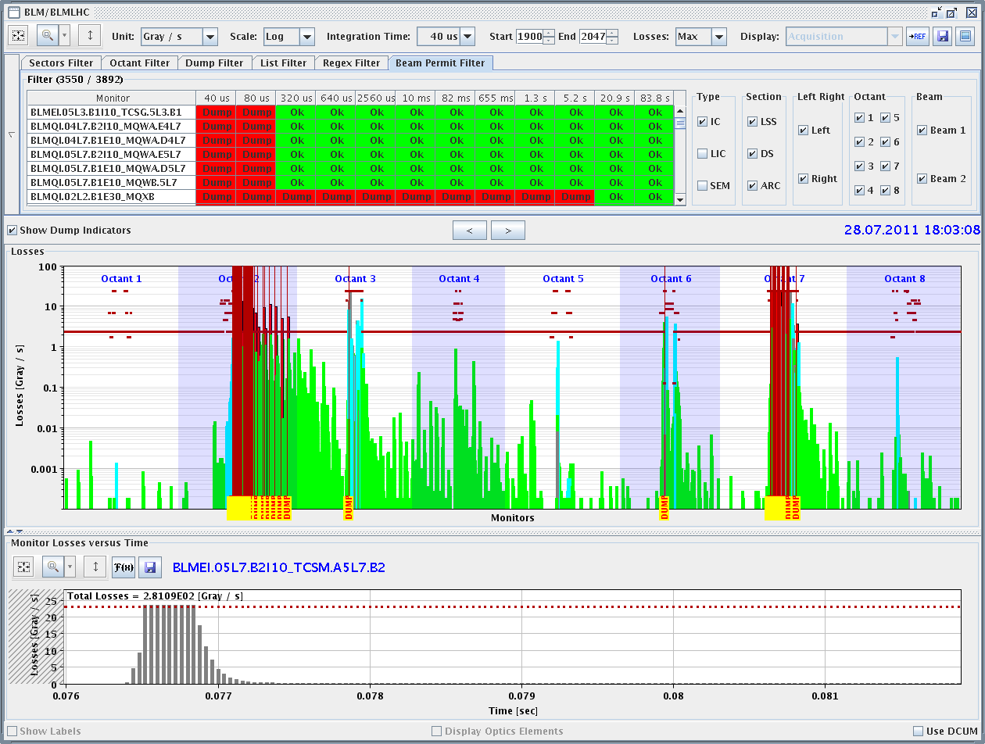
MKI2 event no. 2
BLMs: important leakage to S23 (but no quench) and IR7.

Slide 11
MKI2 event no. 2

Slide 12
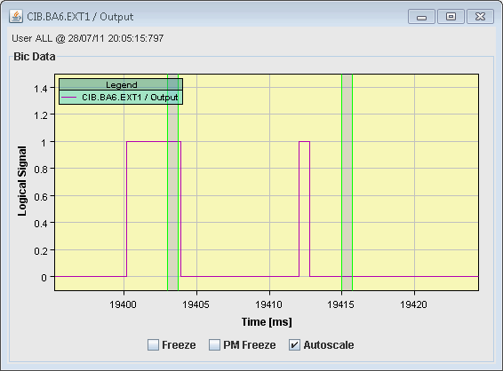
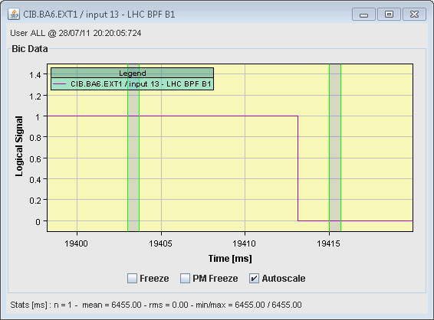
MKI2 event no. 2 – SPS extraction analysis
SPS LSS6 extraction interlock signals:
BPF of LHC to FALSE ~2 ms before extraction time.
MKE6 inhibited ~2 ms before extraction.
Extraction conclusion:
Event occurred ~2 ms before extraction.
144b were not extracted from the SPS – the losses are coming from badly kicked circulating LHC beam.
Also confirmed by TI2 BCTs and BPMs – saw no beam.
MKE6 PFN charging
Extraction
Extraction
Extraction permit
LHC BPF

Slide 13
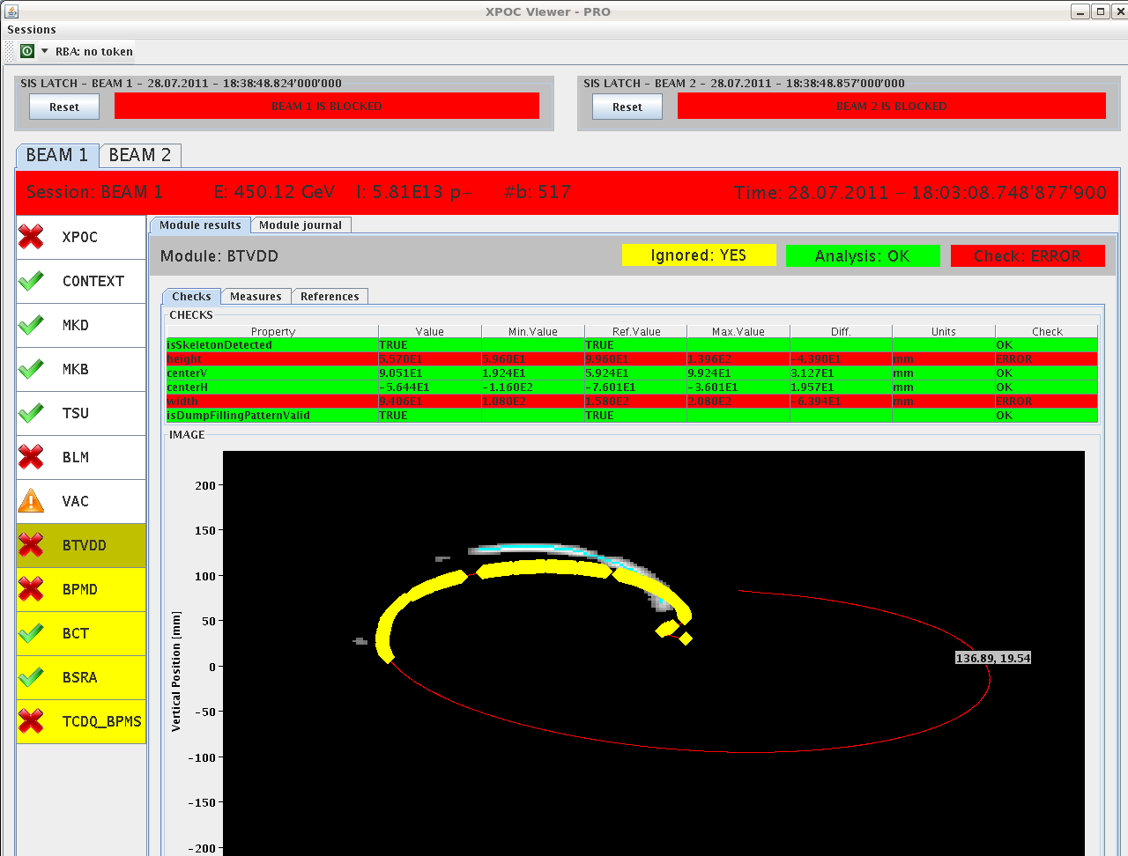
MKI2 event no. 2 – dumped beam
BTVDD and dump line BCTs indicate that ~ 200 bunches of the circulating were not dumped → to TDI.
Beam kicked to TDI

Slide 14
MKI2 event no. 2 – beam observation summary
Erratic on MKI2 ~ 2 ms before extraction from SPS.
SPS beam was not extracted (ouf !).
~200 circulating bunches were kicked towards the TDI.
Bunches grazing on TDI quenched D1.L2, triplet L2 and D2.R2 and hit ALICE.

Slide 15
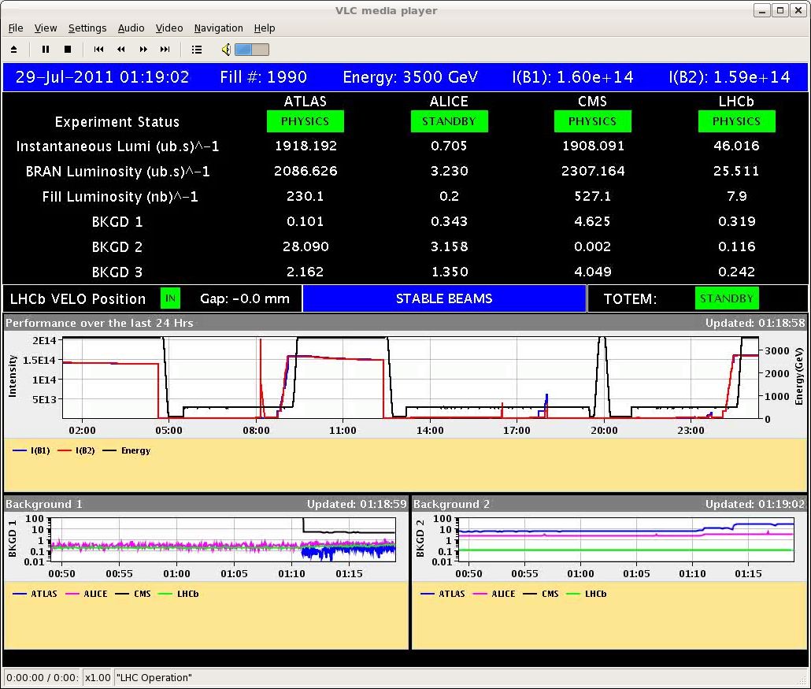
Recovery
22:00 Start inject and dump mode with probes for B1.
80 injections – no problems.
23:00 Injected probe, corrected circulating beam.
Injection line steering with 12b injections.
24:00 Filling for physics again.
01:00 Stable beams #1990, 1.9E33 cm-2s-1.

Slide 16
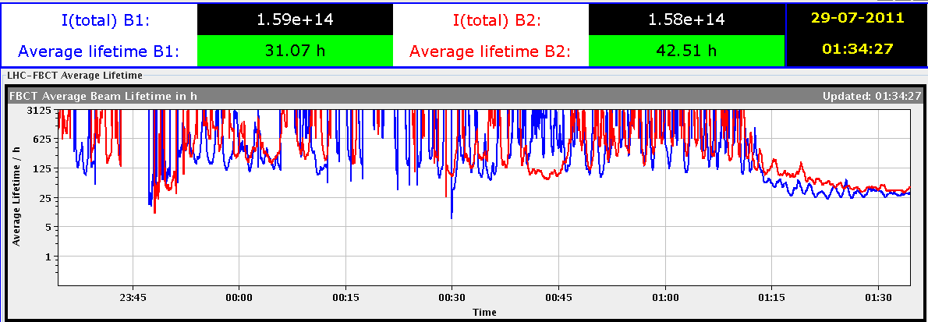
Again very nice lifetimes.
Bbb Shottky Q measurements.

Slide 17
Fill list
Fill | Termination | Peak L (cm⁻²s⁻¹) | Length (h) | Int. L (pb⁻¹) | Dump cause
1975 | STABLE | 1.6E33 | 2.5 | 13 | Cryo valve PROFIBUS (SEU?)
1976 | ADJUST | 1.6E33 | - | - | BLM TCSG.L7
1977 | SQUEEZE | - | - | - | RF Module trip
1979 | STABLE | 1.3E33 | 6 | 23 | QPS RCO
1980 | RAMP | - | - | - | QPS RQTL7
1985 | STABLE | 1.75E33 | 11 | 50 | El. net
1986 | STABLE | 1.85E33 | 2.5 | 14 | RF klystron vac
1990 | STABLE | 1.85E33 | 7.5 | 41 | PC trip RCBXV3.R1

