Slide 1
ROCKY XXIX
Coordinators week 29: Eva Barbara Holzer, Ralph Assmann, Mike Lamont

Slide 2
Week & Weekend
SPS MKD
1092b
Cryo
Cryo

Slide 3
Fills above 450 GeV 1/2
Date | Mode | Fill | SB | pb⁻¹ | Cause of dump
MON 18 | STABLE BEAMS | 1955 | 6h8m | 18.3 | QPS trigger, trip of RQTL7.L7B1
MON 18 | STABLE BEAMS | 1956 | 17m | .4 | Cryo lost S56, SEU on a thermometer at a current lead
MON 18 | ADJUST | 1957 | 0 | 0 | Dumped by SW interlock on BLM HV channel (1.3e11/bunch)
MON 18 | STABLE BEAMS | 1958 | 21m | 1.1 | Loss of cryogenic conditions in Sector 34 – PLC crash
WEDS 20 | STABLE BEAMS | 1960 | 1h9m | 5.2 | Problem on valve on DFB in arc 8.1 Possible SEU
WEDS 20 | STABLE BEAMS | 1961 | 2h7m | 8.2 | QPS - blown fuse in WorldFIP repeater
THURS 21 | STABLE BEAMS | 1962 | 15h26 | 46.3 | CMS BCM2
FRI 22 | SQUEEZE | 1963 | 0 | 0 | QTF trip: QFB versus QPS
FRI 22 | RAMP | 1964 | 0 | 0 | RCBXH.R1 tripped, PC changed
FRI 22 | STABLE BEAMS | 1966 | 8.56 | 34.6 | CMS BCM2
SAT 23 | STABLE BEAMS | 1967 | 11.4 | 41.7 | Valve controller IT.R1 – possible SEU

Slide 4
Fills above 450 GeV 2/2
Date | Mode | Fill | SB | pb⁻¹ | Cause of dump
Sat 23 | STABLE BEAMS | 1968 | 46m | 4.0 | Electrical network glitch
Sat 23 | ADJUST | 1969 | 0 | 1.8e33! | Vacuum spike 4L8
Sun 24 | STABLE BEAMS | 1970 | 1h37m | 9.5 | Vacuum spike 4L8
Sun 24 | STABLE BEAMS | 1971 | 1h8m | 6.2 | Controller IT5 Possible SEU
Sun 24 | STABLE BEAMS | 1972 | 46m | 4.4 | Cryo – R1 24V supply Possible SEU
Sun 24 | FLAT TOP | 1973 | - | - | QPS communication problem
Sun 24 | STABLE BEAMS | 1974 | 5h15 | 25.5 | Electrical network glitch

Slide 5
W29: time-outs
22:40 Monday lost cryogenics S34 – PLC crash point 4
Back 21:00 Tuesday
Wednesday: QPS problem
15:00 Beams dumped - lost sector 81
QPS experts identified the problem in S81 - blown fuse of a WorldFIP repeater, beam back ~21:00
Thursday evening: SPS MKD switch change and conditioning (6 hours)
Friday morning: Cryogenics DFB measurement glitch – access in PS – Booster MPS
Sunday afternoon – Cryo 24V supply R1

Slide 6
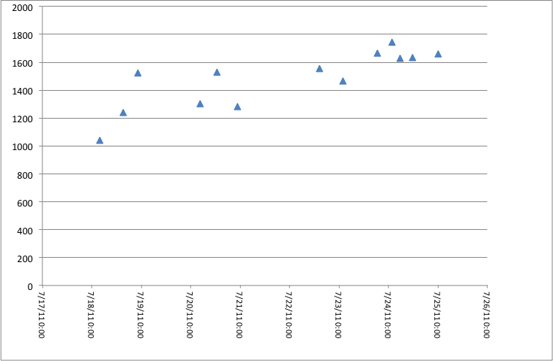
Peak luminosity

Slide 7
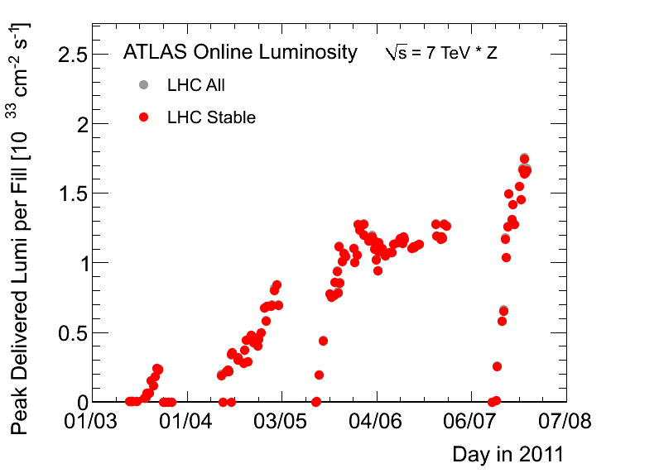
From a distance…

Slide 8
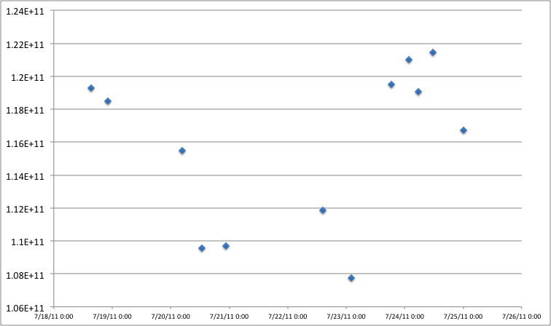
Bunch intensities

Slide 9
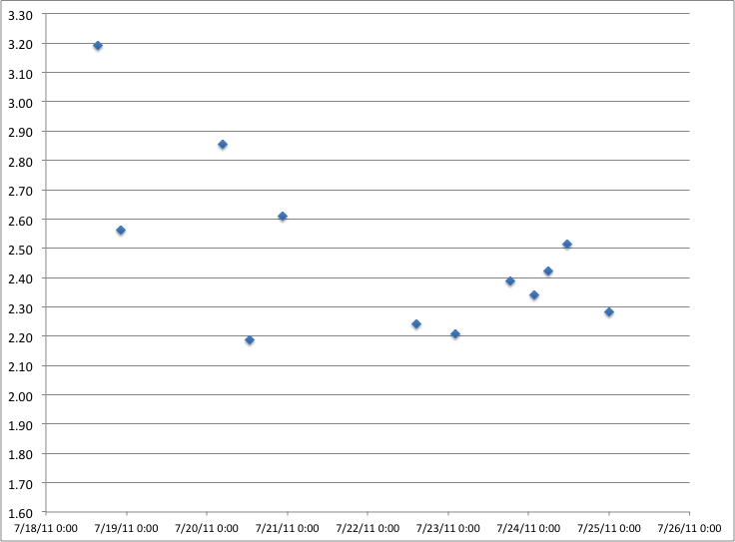
Emittances – start of fill

Slide 10
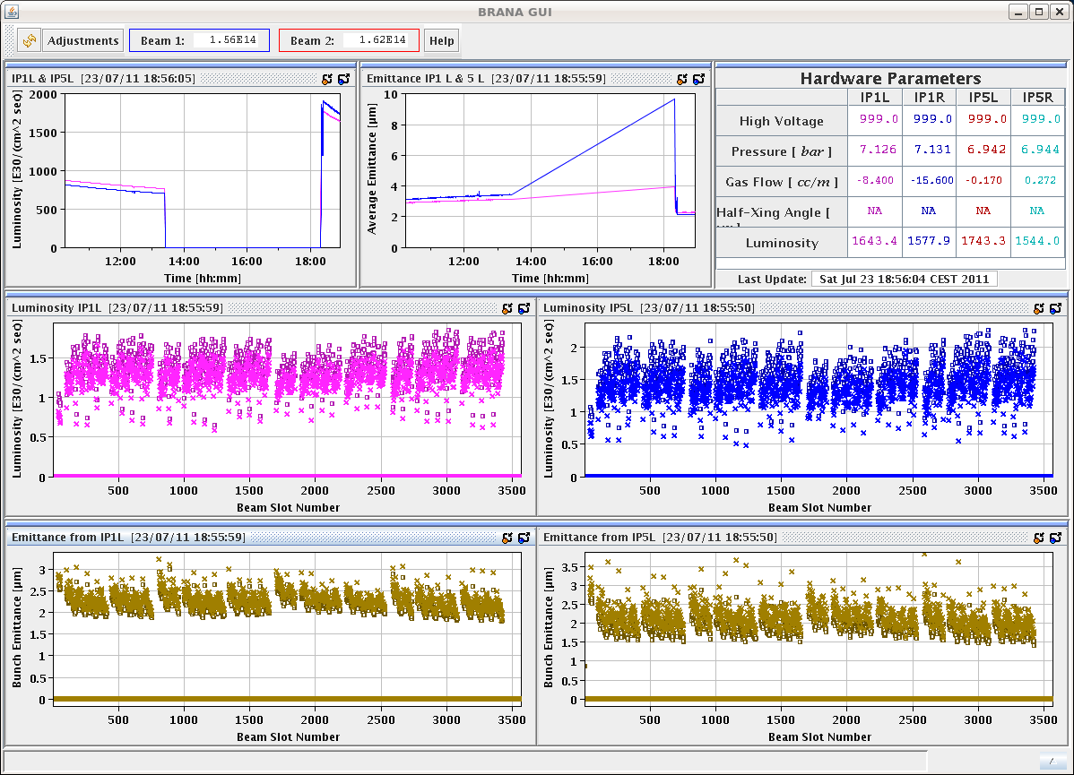
Emittances from BRAN

Slide 11
Comments
With 1.3e11 vacuum kicked off spectacularly around the ring
1.25e11 bunch gave 1.8e33
Lost in ADJUST to vacuum spike 4L8
Emittance from SPS ~2 microns as measured by SPS wire scanners
Similar values in LHC wire scanning first 144 bunch (some scatter)
Getting between 2.2 – 2.5 microns into collisions

Slide 12
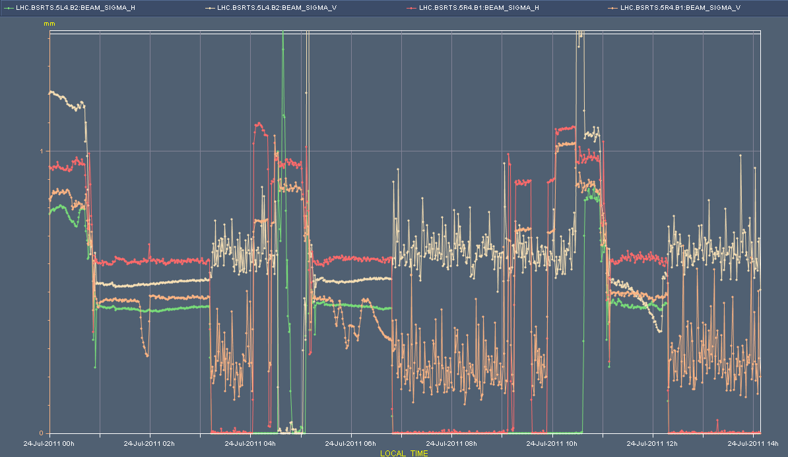
Emittance increase?
See blow-up between SPS and collisions – difficult to ascertain where in cycle emittance increase is taking place. Beam 1 worse

Slide 13
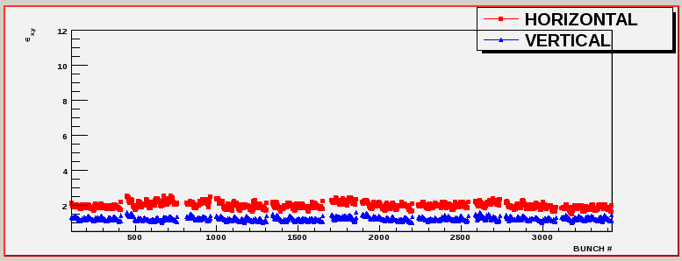
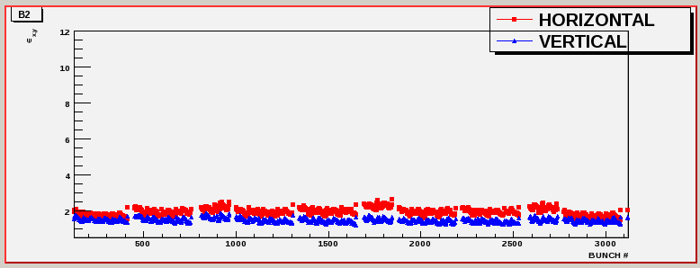
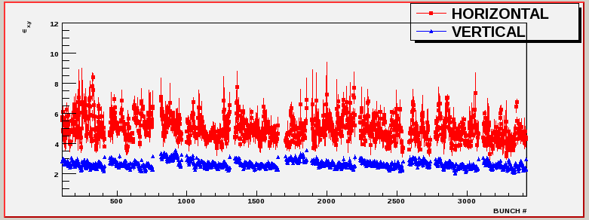
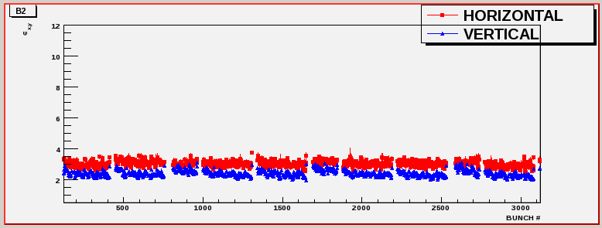
Ditto – BSRT plots
Beam 1
Beam 2

Slide 14
VACUUM

Slide 15
Beam intensity and vacuum (4L8)
Already kicked off on Wednesday (injection, ramp)

Slide 16
Summary vacuum - Tues to Weds
Dump at 450 GeV

Slide 17
Mores spikes in ramp...

Slide 18
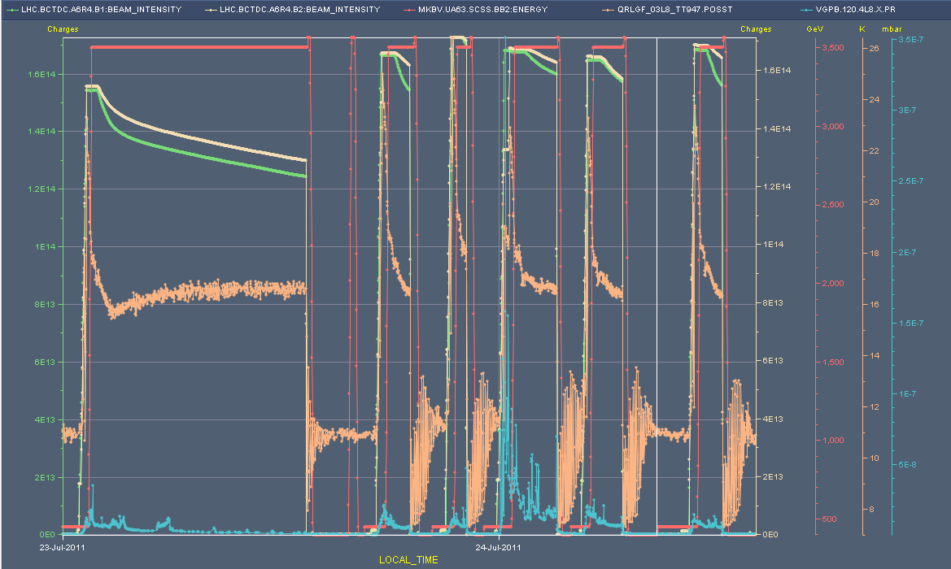
Vacuum spikes – Saturday - Sunday

Slide 19
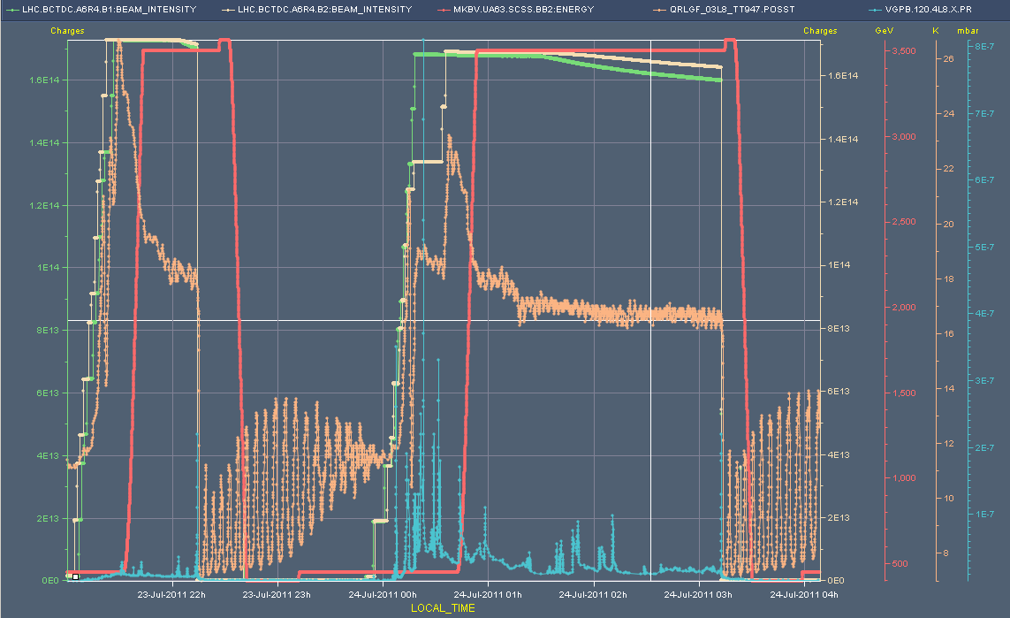
Vacuum spikes - zoom

Slide 20
TS 10
During the “distillation process”, most of the gas desorbed during the scrubbing run was either pumped out or flushed to the cold bore :
Hydrogen, methane and carbon monoxide were pumped out
Carbon dioxyde was flushed to the cold bore
Water remained at its original location
Of course, during this process, gas was redistributed in all the vacuum sector
So, we could expect some minor reconditioning ….
Moreover, in order to gain time, we decided not to bake the turbo molecular pump
Therefore some back streaming of water towards the vacuum sector (at the position of the gauge) cannot be excluded … requiring also conditioning
Vincent Baglin

Slide 22
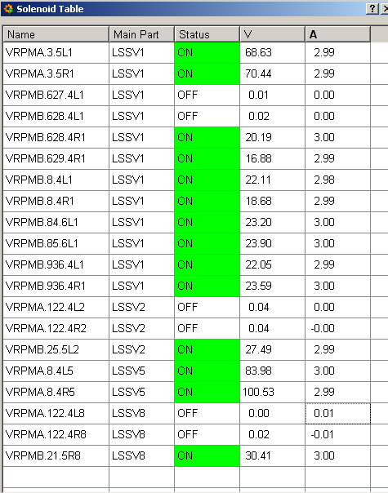
Switching e-cloud solenoids off
And leaving them off for cleaning (V. Baglin)
Location | Pressure increased by [mbar]
D1L8 | 1E-10
Q3L1 | 4E-9
Q3R1 | 6E-9
D1L2 | 9E-9
D1R2 | 2E-9
D1R8 | 13E-9

Slide 23
1.3e11 per bunch
Things really kick off

Slide 24
Other Issues

Slide 25
Collisions
Losses going into collision
1 & 5 – pushing above warning on secondaries in IR7 (long running sum) during optimization
now doing points one at a time
LHCb optimization can provoke additional lifetime dip
Levelling now performed very carefully
Beam one lifetime down to around ~5 hours versus ~30 hours for beam 2
Also visible in cleaning asymmetry – IR7

Slide 26
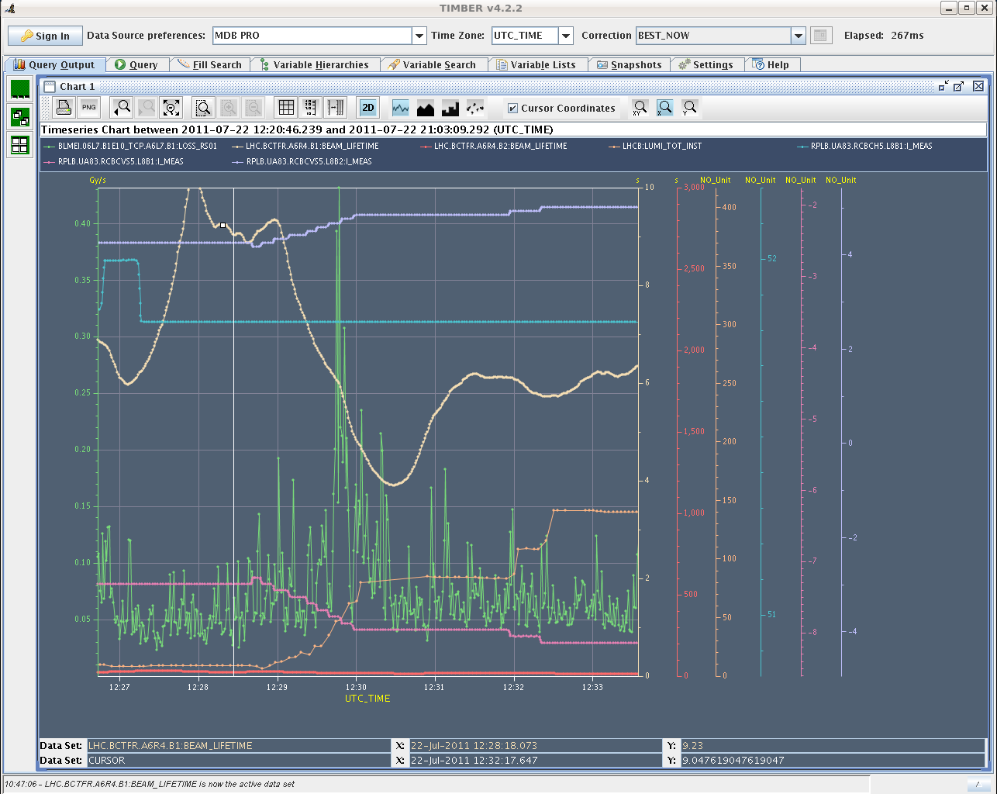
losses in IP7 when bringing LHCb into collisions

Slide 27
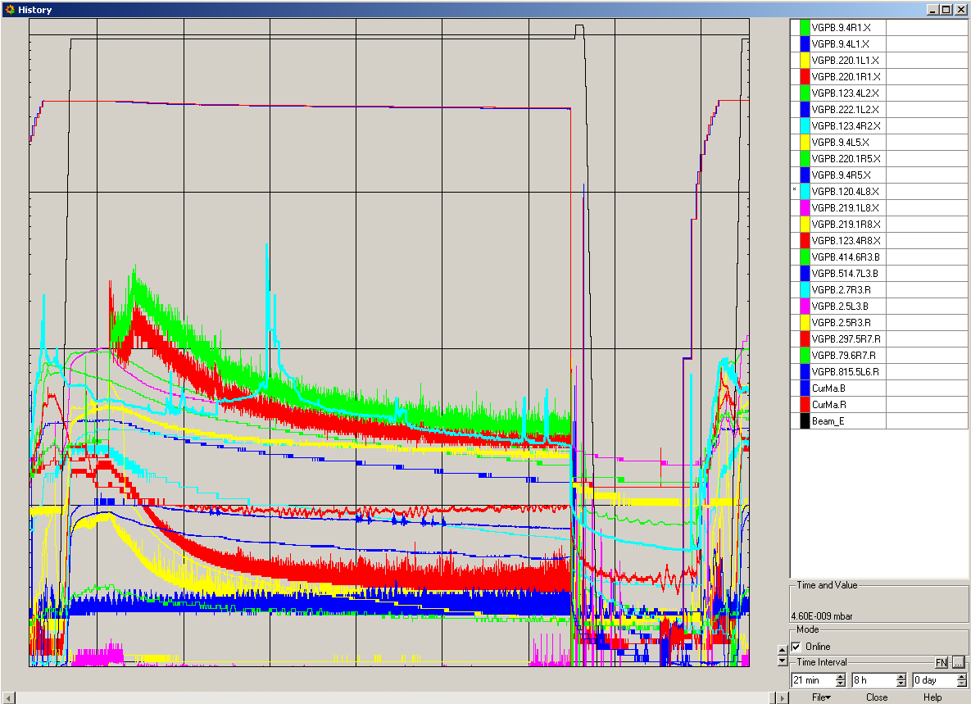
Last night

Slide 28
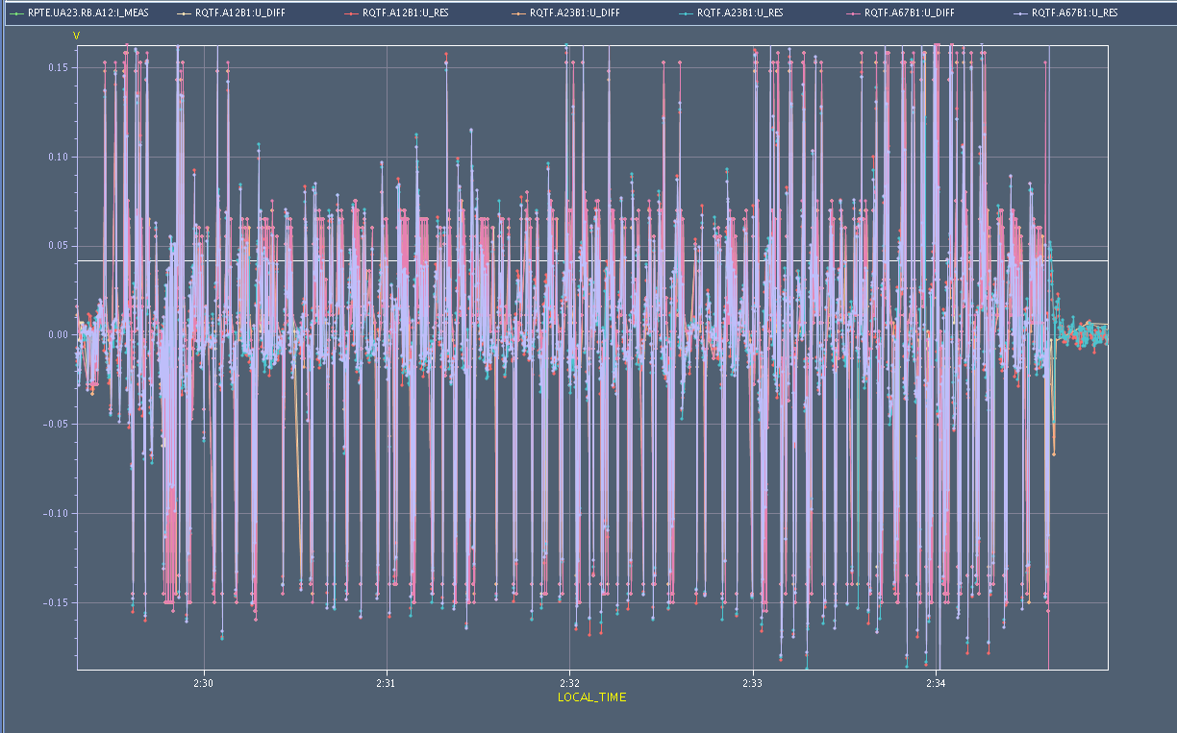
Voltage on RQTFs during squeeze
Beams dump twice in last two weeks QPS/tune feedback interplay
Feedback jumping between 50 Hz harmonics and tune and sidebands, QTF/QTD bouncing around… potential solution – change threshold change current of QPS (move tune, get rid of 50 Hz, check Q’…)

Slide 29
Issues
TIM communication with ventilation doors
BLM monitoring factor increased for the TCTVB.4L8 by a factor 2 (BLM monitor factor application released);
D. Valuch working on the ADT in SR4 while there is no beam, functions loaded in the correct beam process for the ADT blow up, to be tested some day;
QPS communication fault yesterday?
- CMW lost for the QPS controller of several circuits (see picture from PIC);
QPS trip for the RCO.A56B1; RCD.A56B1 tripped consequently (see picture from PM); no data coming from QPS due to the communication problem;
6 min later CMW lost on the RCSs (see PIC);
trip of the QPS - no data available from QPS due to comm fault.

Slide 30
Conclusions
UFOs down
rate up with bunch intensity but lower magnitudesthese days
Cryo related SEUs up
Vacuum spiking
Emittances down
Bunch intensity
Up to 1.2e11 OK
Above kicking off vacuum – particularly WC transition 4L8
Coordinators W30: Gianluigi & Jorg

Slide 31
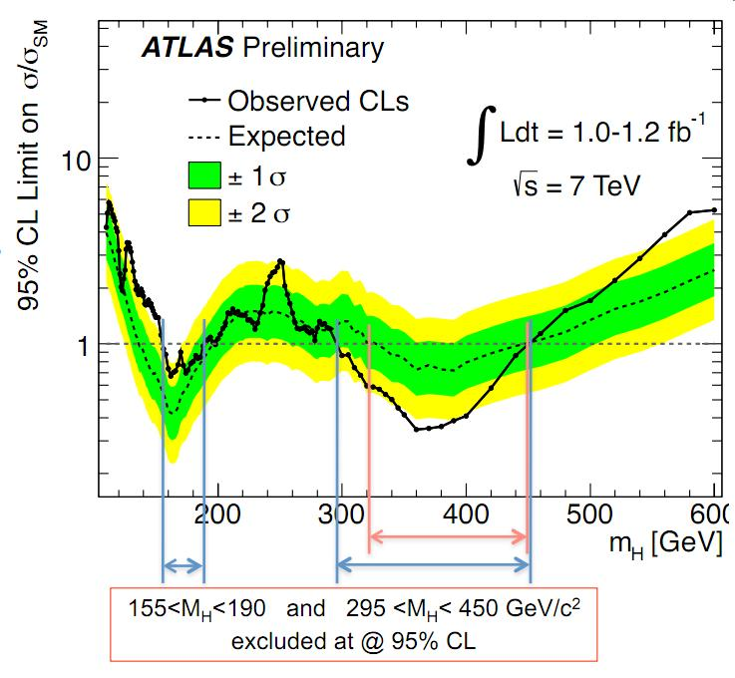
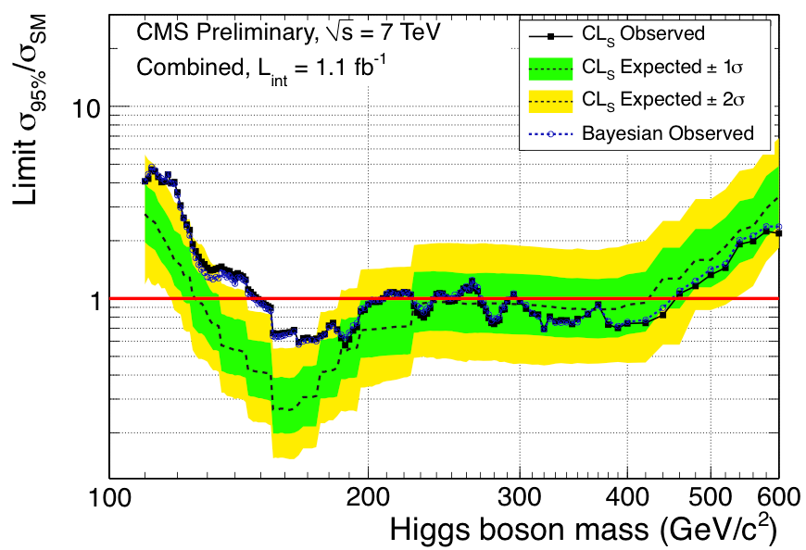
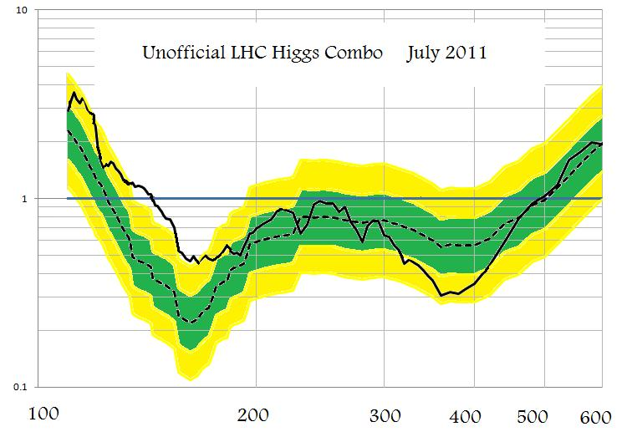
Other stuff this weekend

