Slide 1
MD Report 30.6. (R. Assmann, F. Zimmermann, G. Papotti)
Day | Time | MD | MP
Wed | 04:00 | Ramp down, cycle
 | 06:00 | No beam: ATS optics checks w/o beam
 | 08:00 | Ramp down, cycle.
 | 10:00 | 450 GeV: Injection 25ns – different SPS parameters, first look, transverse damper first look (no detailed setup for 25ns) | B
 | 16:00 | 450 GeV: RF setup for high bunch intensity | A
 | 22:00 | 450 GeV: 450 GeV → 3.5 TeV: Beam instrumentation – high bunch intensity, … | B/C
Thu | 06:00 | Ramp down, cycle. Short access for wire scanner b1 and AC dipole.
 | 08:00 | 450 GeV: Head-on beam-beam limit – up to 3e11p per bunch, coherent modes. BI parasitically. | A
 | 16:00 | 450 GeV: Injecting nominal emittances, MKI & UFO’s – 50ns, blow-up in SPS, SPS scraping and losses, injection into LHC, nominal emittance. | B

Slide 2
ATS Optics checks w/o Beam (S. Fartoukh et al)
new injection settings successfully generated together with the test of a few new knobs.
ramp successful.
pre-squeeze to 1.2 m and correction knobs:
functions successfully loaded with the exception of RQS.l4b1 and RQS.a34.b2 (defined with zero settings in the ramp process but not defined in the squeeze process). --> now fixed.
pre-squeeze successful.
all knobs successfully tested: nominal & "ATS specific" tune, chromaticity, coupling, crossing-scheme/dispersion correction, RQSX, Q2 trim (triplet), A2 and A3 correction based on mag. measurements, but for A3 of beam1 → unavailability of the RSS.A81.b1: NC opened beginning 2011 (related to cryo regulation problems or electronics). -> can it be fixed for the next MD block: ATS scheme foresees to blow the beta-functions by a factor of up to 4 in s81 and s12.

Slide 3
ATS Optics checks w/o Beam (S. Fartoukh et al)
pre-squeeze to 1.2 m and correction knobs continued…
squeeze down to beta*=30 cm in IP1
function successfully loaded.
squeeze successfull but for RQ4.L2b2 and RQ4.R8b1 which tripped for beta* in between 48 cm and 42 cm, due to a high 1/tau= dI/dt /I during the last steps of the squeeze.
squeeze process to be regenenerated by increasing by 50% up to 100% the step duration at the end of the squeeze (leading to a total increase by about 2 mins for the total duration of the squeeze).
a few minor items identified and still missing (e.g. RF settings not yet defined for the squeeze process) in order to reach an optimal level of readiness for the MD with beam, in particular perform and incorporate RF trim during the squeeze.

Slide 4
ATS Optics Checks w/o Beam (S. Fartoukh et al)
Squeeze w/o beam from 1.2m to 30cm

Slide 5
Injection 25ns (B. Goddard et al)
scope: injection of 24b at 25 ns spacing
SPS and extraction towards LHC:
25 ns batches extracted to TI8 and TI2 TEDs after some setting up in SPS, and trajectories checked against 50ns references
problems with settings in TI8 with several elements; solved by experts (LTIM issues and in settings copy needed a 'drive' afterwards to get back to reference trajectory)
scraping in SPS was about 7-10%
emittances in SPS were about 2.8 um
bunch intensity in SPS was about 1.1-1.2e11

Slide 6
Injection 25ns (B. Goddard et al)
Injection into LHC:
injected 25ns batches into LHC for both beams
first injection to B1 was dumped after ~2000 turns, due to horizontal excursions - dampers were on with 50 ns settings.
with dampers off 25 ns injections were good for both beams
transverse beam losses low (lower than 12b 50ns, although lower single bunch intensity)
longitudinal losses seemed a bit worse than for 50ns, and worse for B1 → residual longitudinal stuff coming down the line?
did not need any TL steering or TCDI adjustment
injected 9 batches of 24b per beam (216b) at 25ns
dampers switched on from injection 2-3 onwards - the first bunches had emittances of 2.7 um in the LHC from the wire scanner.
RF capture checked by experts

Slide 7
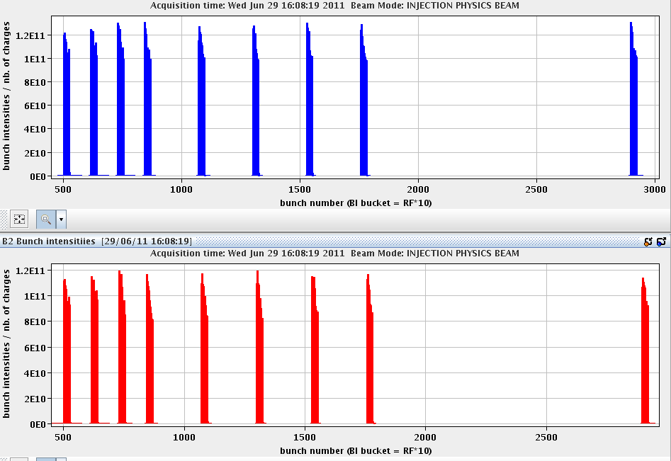
First 25 ns Injection Test

Slide 8
Injection 25ns (B. Goddard et al)
Injection into LHC continued…
some vacuum activity began to manifest (5L2, ...)
some onset of beam screen heating seen by cryo guys in the arcs
saw rather large cleaning losses in IR7 for few s after each injection
saw blowup of bunches along trains in H&V for both planes, for batches 2-3 onwards.
inter-batch spacings of 2, 4 and ~40 us were used - blowup did not seem to depend on distance to preceding batch
injected 4-5 batches per beam with abort gap cleaning off, to check capture - saw some increase in the abort gap population
saw a systematic effect on the orbit: values increasing for H&V for both beams
some issues with LDM profiles seen for B2; not confirmed by RF
some losses observed in the second part of the train
Data taken with BBQ, damper pick-up and head tail monitor, Fast BCT to be further analyzed.

Slide 9
25 ns – Emittance Blowup
Fine…
Later batches with blow-up of trailing bunches!

Slide 10
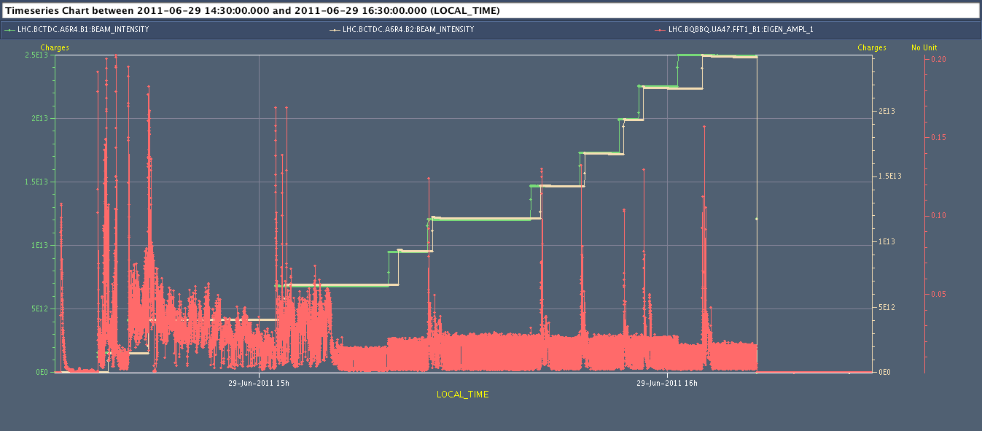
1st batches of 25 ns bunches injected in the LHC! (9/?)

Slide 11
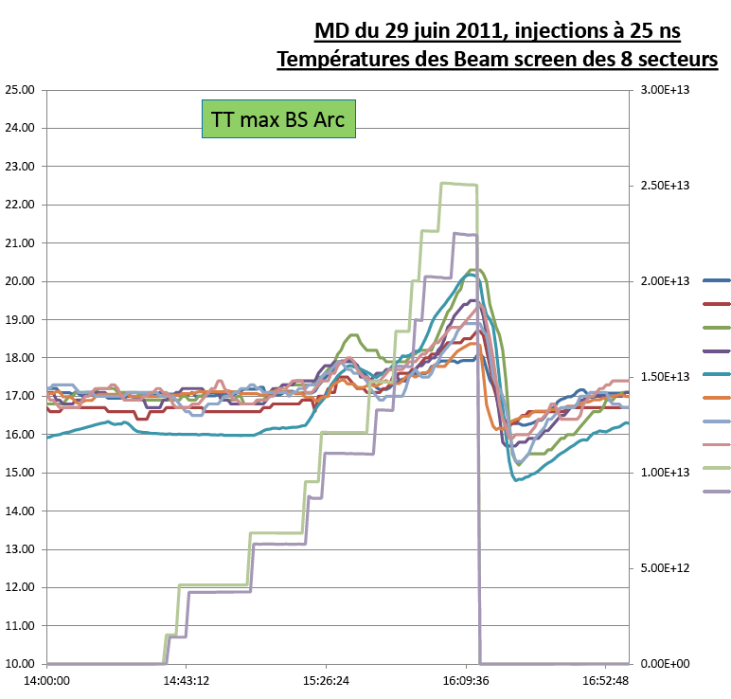
Injection 25ns
Beam screen temperatures (S.Claudet):
"From operations point of view nothing dramatic has been observed.
Ttmax arcs only at about 20K, so nothing serious
For triplets very smooth tempe- rature bump, maxi L1 probably due to ATLAS field down.”
All e-cloud solenoids off!

Slide 13
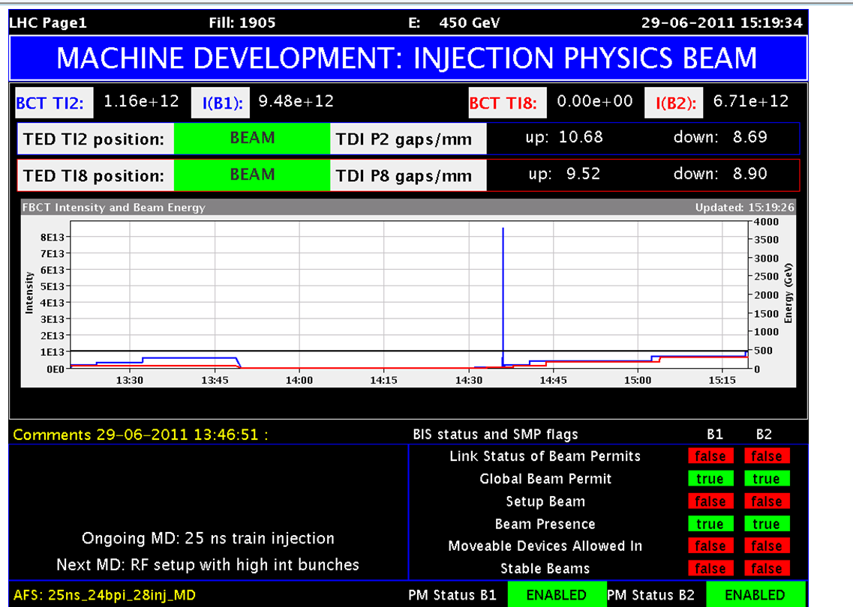
Filling Scheme with distance between each trains
Total bunches = 228
Bunch spacing = 25 ns
Bunch intensity about 1E11 p/b
10.85 us
2.28 us
2.28 us
2.28 us
5.13 us
5.13 us
5.13 us
5.13 us
27.93 us
12b
24b
24b
24b
24b
24b
24b
24b
24b
24b

Slide 14
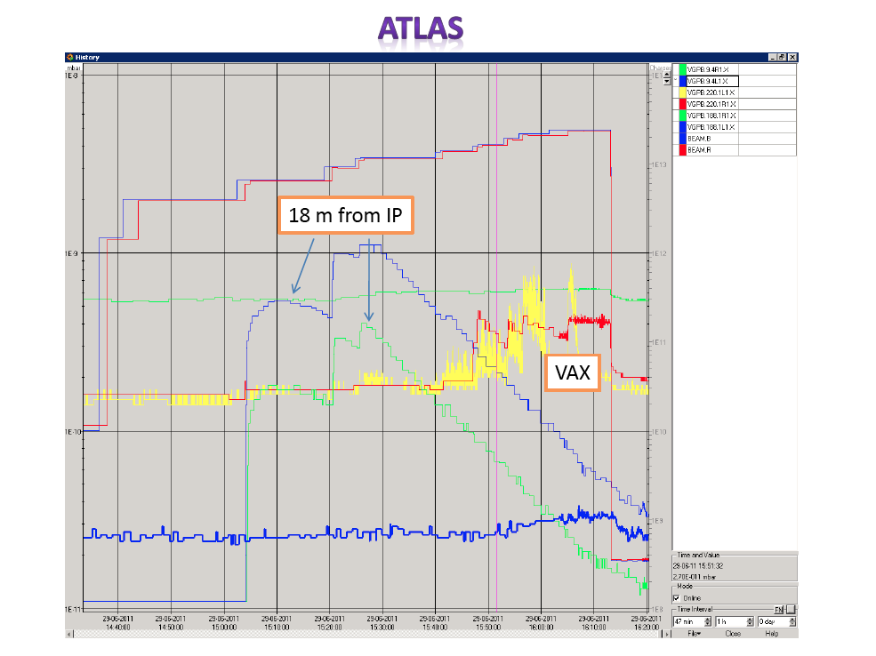

Slide 15
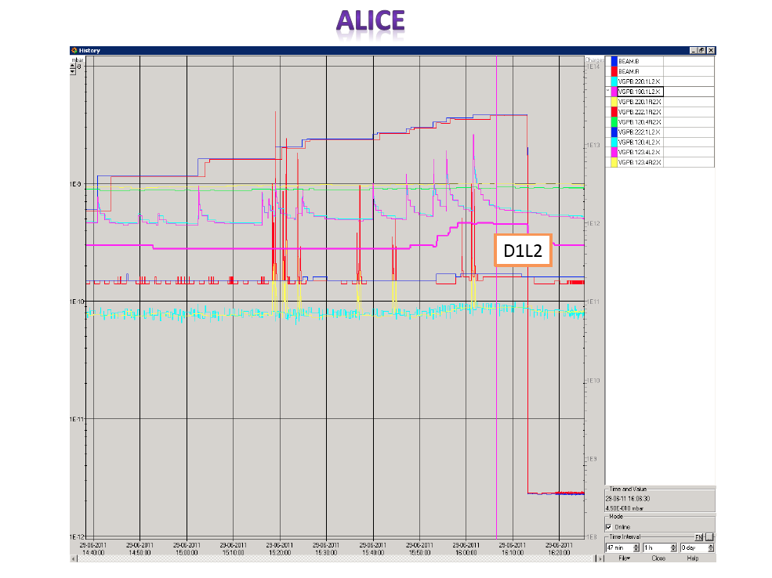

Slide 16
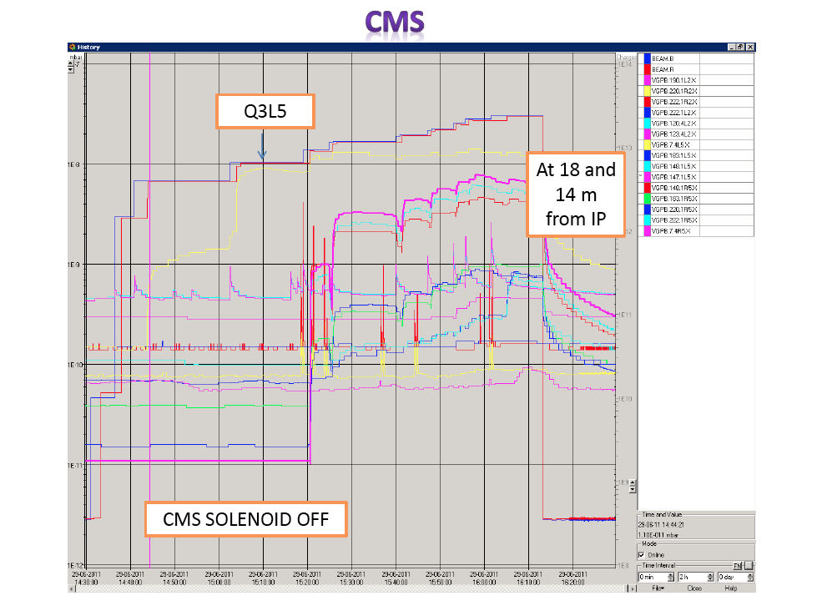

Slide 17
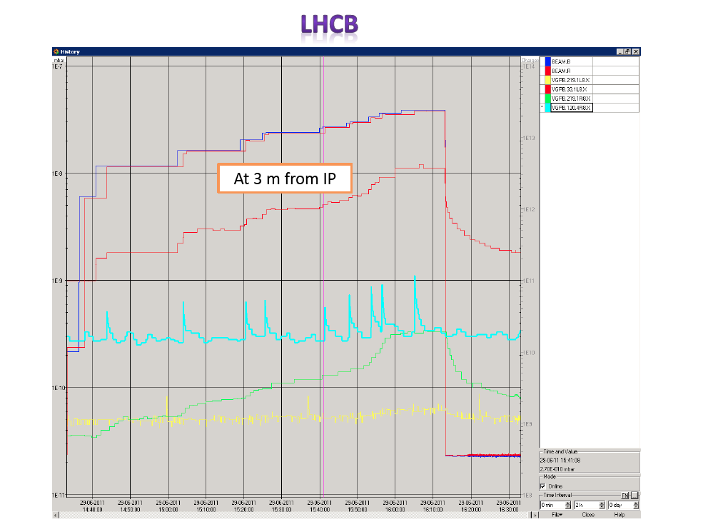

Slide 18
Setup High Bunch Charge RF/BI/OP/Injector Teams
High-intensity test of head-tail and BI-WCM setups (R. Steinhagen):
Systems are fine for intensities of about 2.5e11p/bunch and lengths of about 1.1 ns (attenuated peak voltage of just below 10 V).
For the head-tail system the bunch peak voltage is about 2.5 V after 46 dB attenuation!
Provided the 'bunch charge/length' product is not exceeding this by more than 20-30% the installation is not expected to break. Excessively exceeding this limit may provide some risks to the HW.
FBCT saturating at 2.4e11 protons?
Intermediate summary of RF setting up for very high intensity bunches: 1 BUNCH PER RING (P. Baudrenghien et al):
Bunches with injected bunch length of 1.5 ns (emittance of 0.5 eVs with controlled emittance blow-up in the SPS) with intensity up to 2.85E11 p/b are stable on the flat bottom with both phase loop on and off.

Slide 19
Setup High Bunch Charge RF/BI/OP/Injector Teams
Summary on ADT setting up for for high intensity bunches (Daniel Valuch and Wolfgang Hoefle):
BeamPos module settings (gain, phase, delay) were prepared and tested for high intensity bunches.
The Sum signals saturate between 3e11 and 3.6e11 (bunch length as at injection).
Delta signals were set up to saturate between 3e11 and 5e11 for 2mm transverse displacement.
Commutation between high intensity and nominal intensity settings was tested by injections of high/nominal intensity beams.
All BeamPos modules are left in external observation freeze mode for the morning's head on beam-beam limit MD.
Expert tool to program 150/50/25ns settings and pilot/nominal/high intensity settings is available now. Call ADT experts to change the settings for different MD sessions.

Slide 20
Setup High Bunch Charge RF/BI/OP/Injector Teams
2.45e11 p / bunch
2.6e11 p / bunch

Slide 21
Setup High Bunch Charge RF/BI/OP/Injector Teams
Very high beam lifetime:
FBCT in saturation → no reasonable values
However, no losses at collimators…

Slide 22
Setup High Bunch Charge RF/BI/OP/Injector Teams
Emittance in the LHC:
B1H: 3.3, 3.5 μm
B1V: 3.1, 3.2 μm
B2H: 3.7 μm
B2V: 3.9 μm

Slide 23
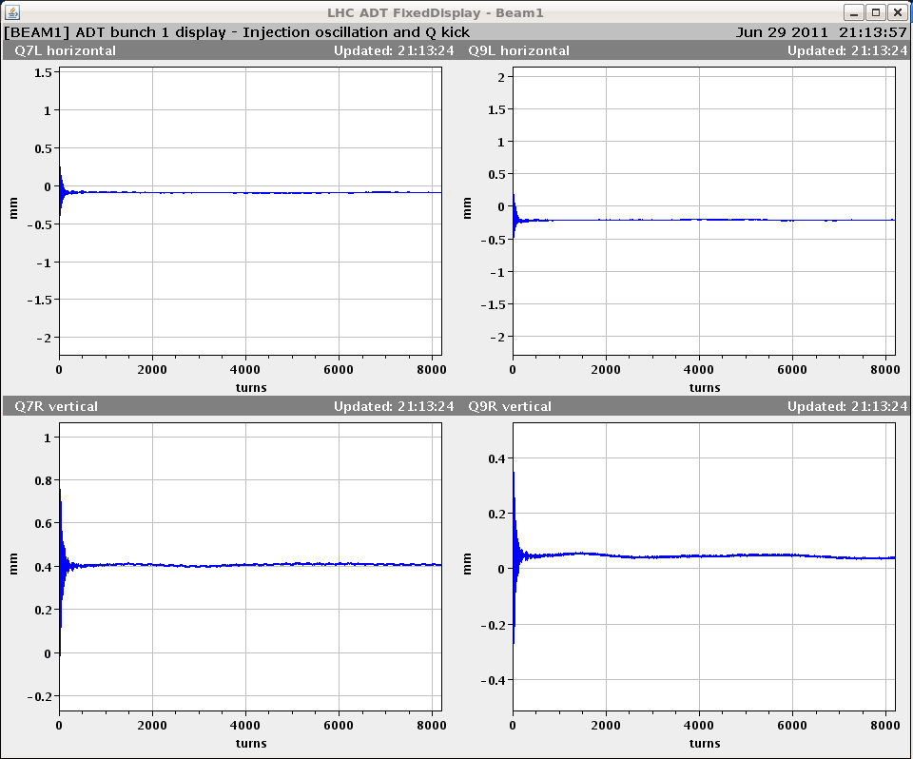
Setup High Bunch Charge RF/BI/OP/Injector Teams
Injection oscillations:

Slide 24
Beam Instrumentation F. Roncarollo et al, BI Team
BPM Studies
BPM linearity with intensity tested by scraping nominal bunches in both sensitivity modes. Data to be analysed.
AWPL:
calibration data taken for wall current monitor to compensate for baseline droop.
Wirescanner Summary
Synchronous measurements performed at injection from PSB to LHC in vertical plane. Results to be analysed.
BCT Summary:
System B modified with 75MHz low pass filters was verified for both B1 and B2 and showed excellent agreement with the DCCTs during bunch scraping. No dependence on bunch length was observed. However, the dependency on beam position is still there, but is negligible under normal conditions where the orbit is well controlled. Both A systems will therefore be upgraded during the technical stop.

Slide 25
Beam Instrumentation F. Roncarollo et al, BI Team
Schottky Summary:
Signal dependence on beam position observed with orbit bumps. A strong dependence on saturation observed, but no conclusive reason for the difference in B1H signals (usually very good) wrt to other signals (generally poorer) was found. See BI logbook for more details.
BSRT studies summary. DONE:
bumps 450 GeV both beams, with cameras at focus max and min (data to be analyzed)
measurements during scraping and RF off, nice comparisons with WS
BSRT NOT DONE:
B1 BSRT vs WS at 3.5 TeV, due to WS power supply failure before the ramp
Investigate ultimate resolution with small emittance bunch at 3.5 TeV. We tried by injectiong small probes just before the start of the ramp, but also according to WS the bunch was not so small (more analysis to see if it arrived big form the SPS or it blown up during the ramp

Slide 26
Beam Instrumentation F. Roncarollo et al, BI Team
BSRA test summary
Period 1: scraping with 4 bunches >2E11 (parasitic) BSRA linearity checked against fast and slow BCTs for both beams placing the gate on a bunch. Data to be analysed, preliminary results show good agreement over an extended range of intensities
Period 2: Scraping on 1 beam, RF off on other (4.78E11 tot .int.) With the RF off verified the calibration with unbunched beam (closer to real conditions) against DCBCT. The DC recovery algorithm seems to work and no major differences observed between the calibration done with a bunch and with DC beam.
Period 3: bumps at 450GeV (parasitic) Verification of dependency on beam position: data to be analysed. No major effect noted except for b1H with 4mm positive bump.
Period 4: ramp (parasitic) Data to verify the calibration Vs. Energy and the new FESA. Even with small problem during ramp with auto BSRT steering error on the calibration remained at ~10% over full energy range.

Slide 27
Comparison Fast BCT and DC BCT
Agreement below 1%...

Slide 28
Beam Instrumentation F. Roncarollo et al, BI Team
RF OFF: Debunching of beam – seen with FBCT

Slide 29
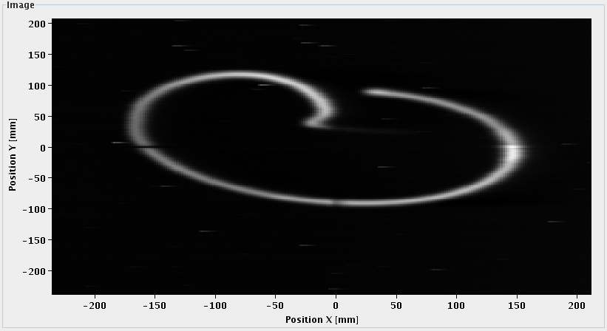
Beam Instrumentation F. Roncarollo et al, BI Team

Slide 30
MD Planning Thursday (30.6.)
Day | Time | MD | MP
 | 22:00 | 450 GeV: 450 GeV → 3.5 TeV: Beam instrumentation – high bunch intensity, … | B/C
Thu | 06:00 | Ramp down, cycle.
 | 08:00 | 450 GeV: Head-on beam-beam limit – up to 3e11p per bunch, coherent modes. BI parasitically. | A
 | 16:00 | 450 GeV: Injecting nominal emittances, MKI & UFO’s – 50ns, blow-up in SPS, SPS scraping and losses, injection into LHC, nominal emittance. | B
Fri | 01:00 | Switch back to operational injection settings. Verification.

Slide 31
MD Planning Fri – Sat (1. – 2.7.)
Day | Time | MD | MP
Fri | 01:00 | Switch back to operational injection settings. Verification.
 | 03:00 | 450 GeV → 3.5 TeV: RF – longitudinal beam stability. | B
 | 16:00 | Ramp down, cycle.
 | 18:00 | 450 GeV → 3.5 TeV: Long-range beam-beam limit – lifetime, emittance versus beam-beam separation. Collimation with changing crossing angle. | C
Sat | 02:00 | Ramp down, cycle.
 | 04:00 | 450 GeV: Non-linear dynamics – Dynamic aperture, non-linear chromaticity and frequency map. | A
 | 12:00 | If needed: Precycle.
 | 14:00 | 3.5 TeV: Collimation – combined cleaning, faster setup. | A
 | 22:00 | Ramp down, cycle.

Slide 32
MD Planning Sun – Mon (3. – 4.7.)
Day | Time | MD | MP
Sun | 00:00 | 3.5 TeV: ATS – correction & pre-squeeze. | A
 | 08:00 | Ramp down, cycle.
 | 10:00 | 450 GeV: Beam distribution in LHC – scraping, halo, tails, BLM limits, … (high intensity) | B
 | 14:00 | 450 GeV: Quench margin at injection – observation with special QPS instrumentation, losses from TCLIB collimator, TCDQ checks in parallel | C
 | 22:00 | 450 GeV: R2E – slow controlled losses (1e13p on Q14.R2.B1). | A
Mon | 06:00 | Technical Stop
Needs from experiments:
30.6., 08:00 to 16:00 – Luminometers on in ATLAS and CMS
01.7., 18:00 to 02:00 – Luminometers on in ATLAS and CMS

