Slide 1
Thu 16/6 – Fri 17/6
07:20 STABLE BEAMS #1872. Initial luminosity ~1.1×10³³ cm⁻²s⁻¹
14:50 14:50 Trip of Sector 81 (new QPS - QF11.R8). End of physics #1872. ~22 pb⁻¹ in 7.5 h. >1 fb⁻¹ delivered in 2011 at 3.5 TeV
15:00-18:00 Access for:
QPS reset Sector 12
RF arc detector filters on main coupler (15/16)
Repair of BIW in point 5
LHCb
19:00-21:00. Second access required for QPS in point 2.
01:13 STABLE BEAMS #1873. Initial luminosity ~1.1×10³³ cm⁻²s⁻¹
Longer injection due to inequalities in bunch intensity.
02:06 Beam dump. LBDS internal trigger. End of physics #1873. ~3 pb⁻¹ in 50 min.
Following fill #1874 lost at the very beginning of the squeeze due to trip of RQTF.A78B1
06:15 STABLE BEAMS #1875. Initial luminosity ~1.05×10³³ cm⁻²s⁻¹

Slide 2
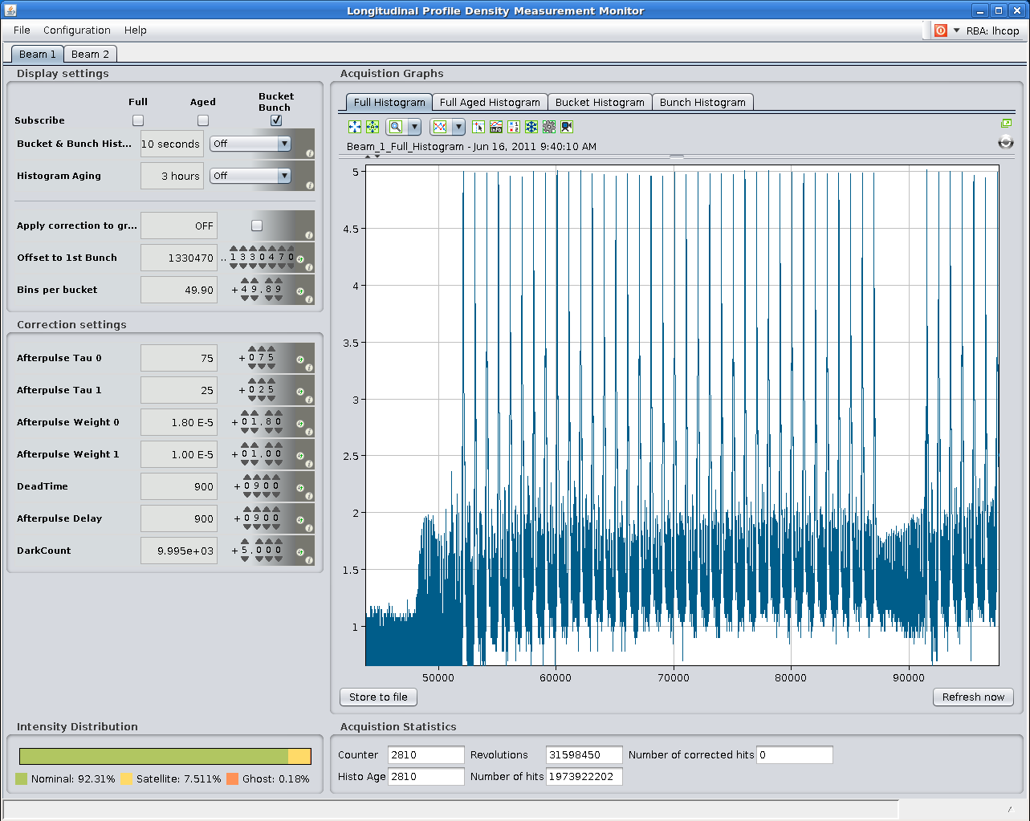
Beam quality
Some plot from LDM - we are looking for satellite bunches. Satellites at 5 ns spacing but with intensity in the order of 10⁻³ likely generated in the SPS as we see 5 ns spacing. Thorough check by RF SPS in the afternoon.

Slide 3
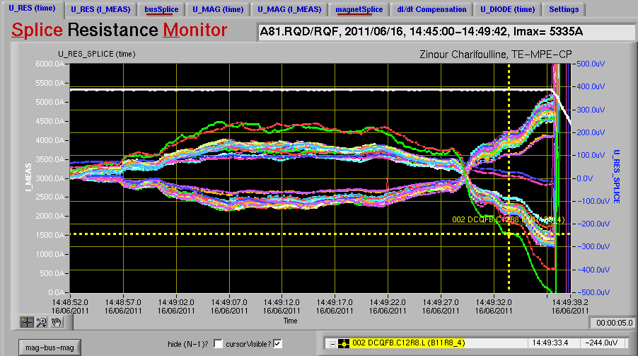
Quadrupole trip in Sector 81
B11R8_RQF crossing the threshold of 0.5 mV ➔ should have been 0.6 mV ➔ Increased threshold back to its original value and written in flash memory (second occurrence)

Slide 4
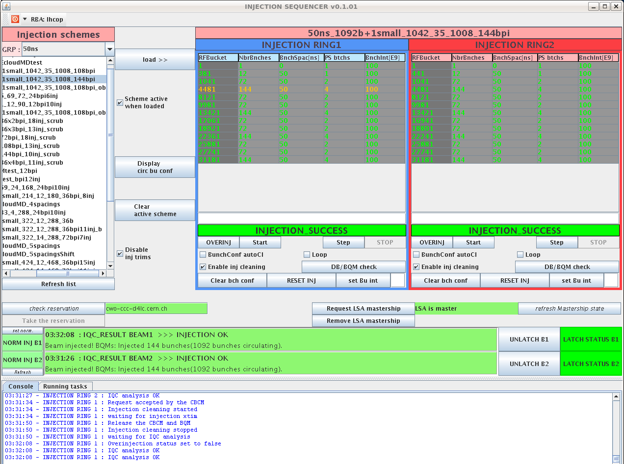
Injection quality
injections finished. We have a good quality, almost all injections green on IQC!

Slide 5
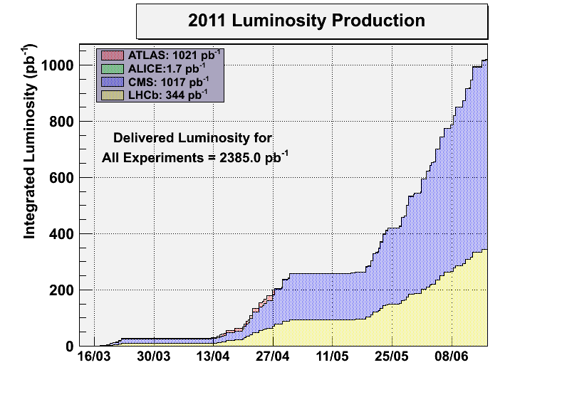
Recorded luminosity getting closer to 1 fb⁻¹ as well.

Slide 6
Plan
Today:
CMS Van der Meer scan now
Connect RF interlocks to beam dump at the end of the fill
Physics with 1092
Saturday and Sunday
Physics with 1232 bunches

