Slide 1
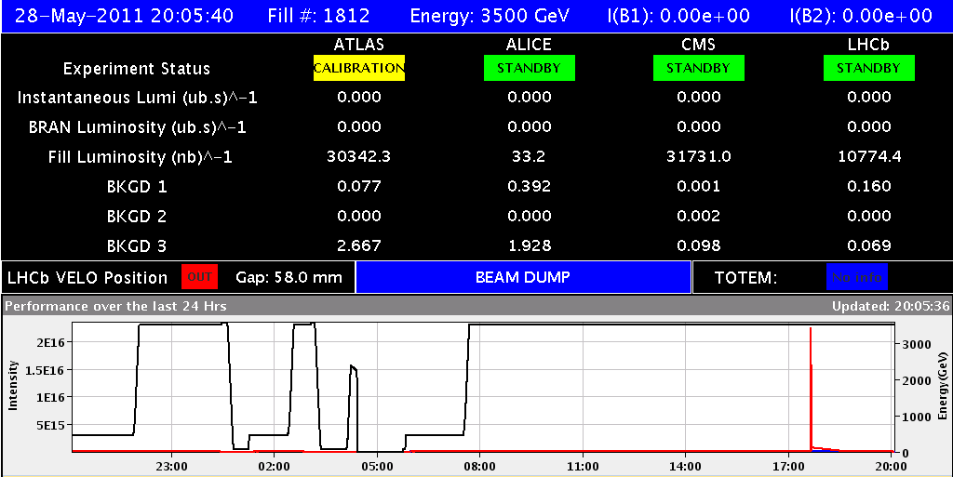
Saturday 28th
08:17 Fill #1812: Stable beams, peak luminosity ~1.1x1033 cm-2s-1
19:00 Go to adjust for RF-checks; Record fill lumi of 31.7 pb-1 for CMS
20:00 Beam Dump
Access for QPS, UPS, timing and other problems...
01:00 Injection for physics fill #1813
03:15 Stable beams, peak luminosity ~1.0x1033 cm-2s-1
04:45 Beam dumped by an UFO in 28.L8
07:00 Fill and ramp for loss map and test new betastar limits for collimator gaps
08:30 Dump with loss map and recycle for filling

Slide 2
Fill #1812.... and afterwards...
First hours: Problems with DIP-, TMG-servers and lumi levelling
Switch TMG to spare B system
8:40 Lost the QPS of the main quads of S67
Will probably need access when beams dumped
13:40 Be-CO first line has arrived and started the intervention on the timing server A (CPU to be changed)
After the dump
SIS interlock on RF power at 3.5 TeV tested ok, but not yet activated for the night
Access:
“(another) problem with the timing controller, was trying to get a table without start event”
UPS US85 is not working. Experts are in US85 and tried to switch it back, but it gives an electric arc.
UPS US85 not redundant any more BUT ONLY SERVES CRYOGENICS (mp)
QPS specialists in points 6 and 8
One LL RF module does not switch back on again

Slide 3
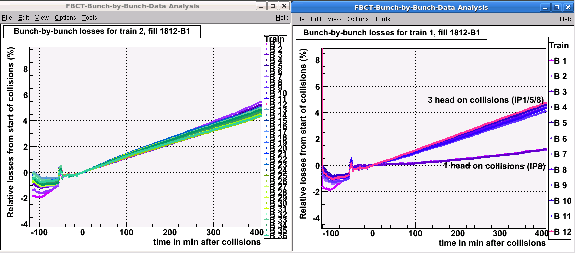
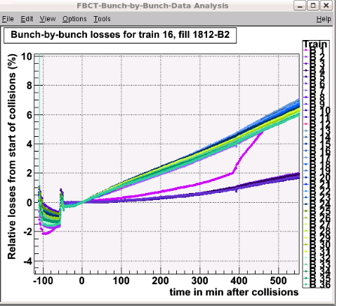
Fill #1812
Relative losses of bunch current after 3.5 hours
Clear effect of number of collisions
B2 increasing losses of one bunch when levelling IP2 and LHCb at the same time

Slide 4
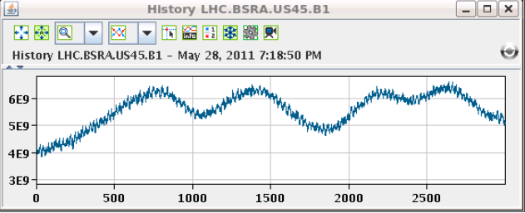
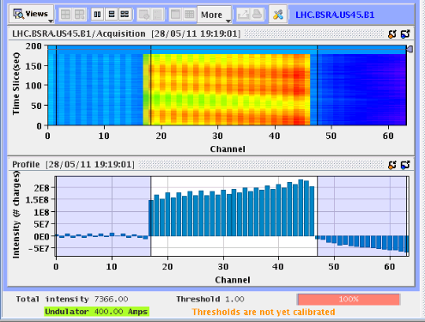
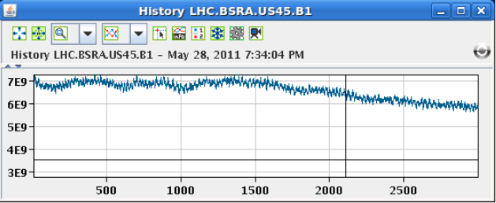
Switching off one RF cavity
After 5 minutes see the “bunches” passing the abort gap
After 20 minutes abort gap population starts to decrease

Slide 5
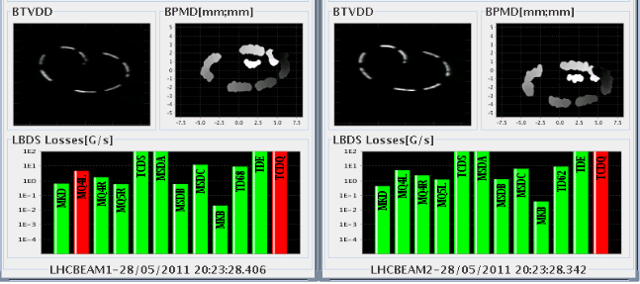
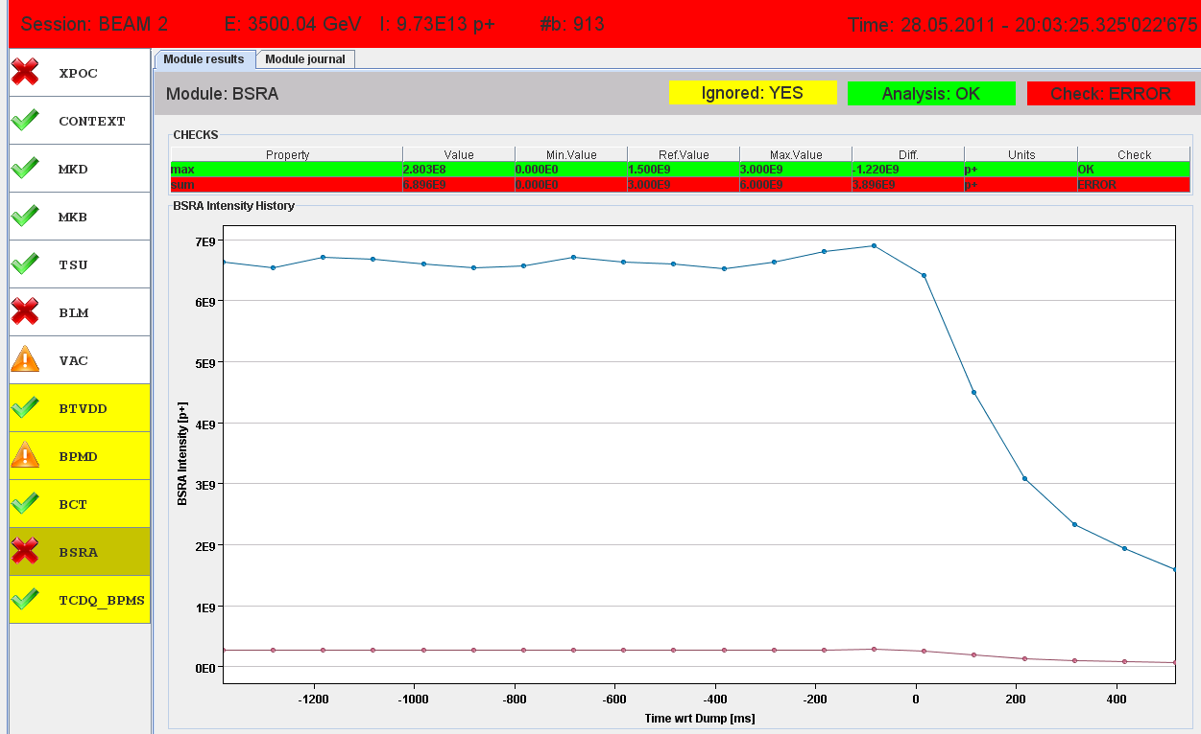
Dump with one cavity off
Still enough beam in the abort gap to get a false XPOC

Slide 6
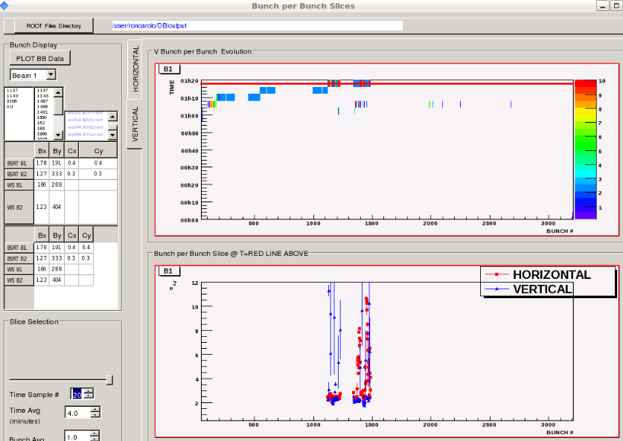
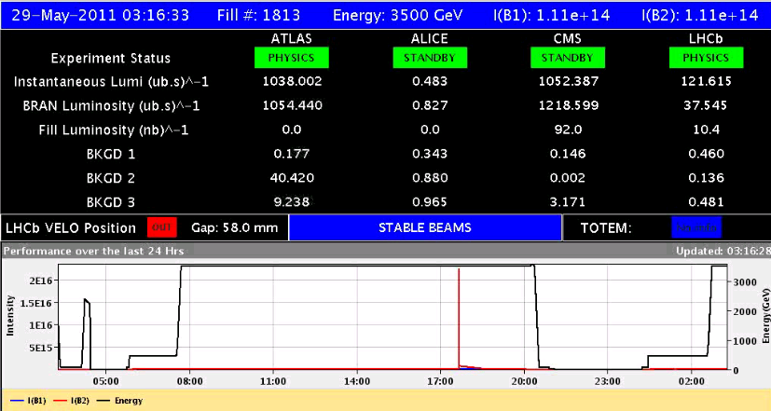
Fill #1813
Some bunches blown up and intensities not very flat
However lumi ok

Slide 7
04:45 Beam dumped by an UFO in 28.L8

Slide 8
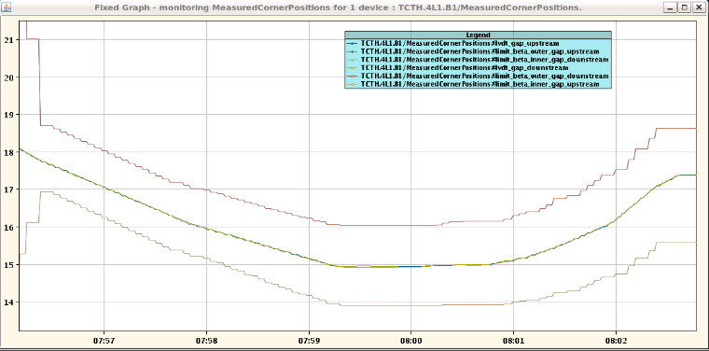
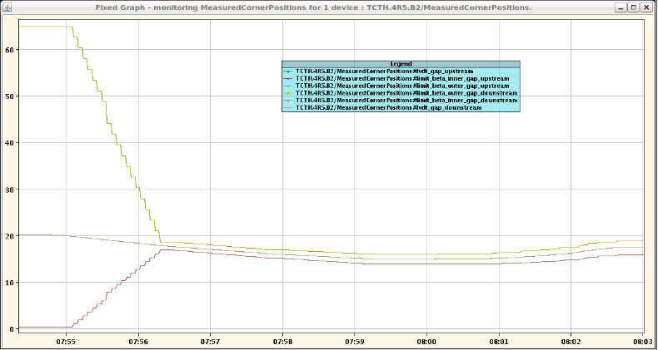
New betastar limits for collimator gaps worked as expected.

Slide 9
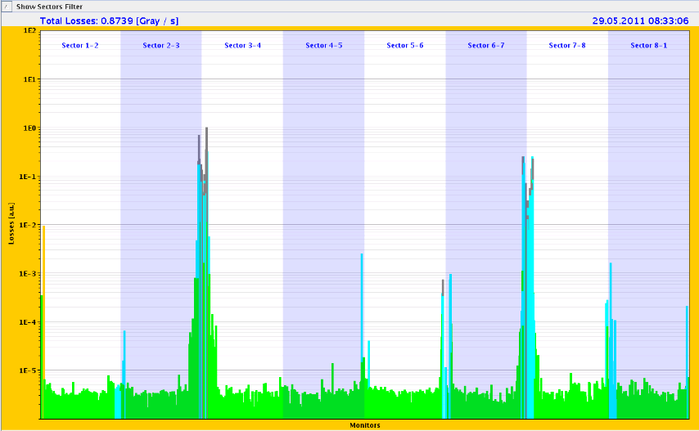
Off energy loss map (-500 Hz): SR says OK

Slide 10
Plan
Sunday
Loss map off-energy at 3.5 TeV: done!
No rMPP surprises.... Fill 1092 x 1092 bunches
Outstanding
Asynch dump test @ 3.5 TeV for Roman Pots
End of fill: TCL adjustment
Measure chromaticity for FIDEL over the ramp
TCLIB adjustment before going to 144 bunch injection

