Slide 1
Tuesday 24/5
02:00 Stable beam fill #1804 912 bunches
Initial lumi 1x10³³ cm⁻²s⁻¹
12:20 beam dumped fill #1804
RF interlock beam 1, initiated by UFO point 4
Integrated luminosity 29 pb-1
Access – “planned for one hour”
Transverse damper amplifier, increase RF arc detection threshold and quench resistors cooling
17:30 Loss maps with injection protection in
Fill #1805
18:30 Start injection
Some problems with BPM calibration, injection losses & blow-up
23:25 Stable Beams
Initial lumi 1x10³³ cm⁻²s⁻¹
02:43 Beam dump, RF cfv-sr4-allfo1 power supply down
Fill # 1806
08:20 Stable beams, Initial lumi 1x10³³ cm⁻²s⁻¹

Slide 2
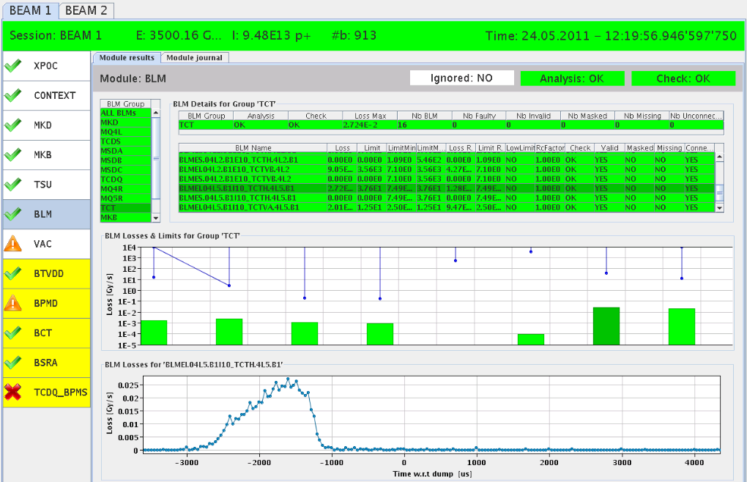
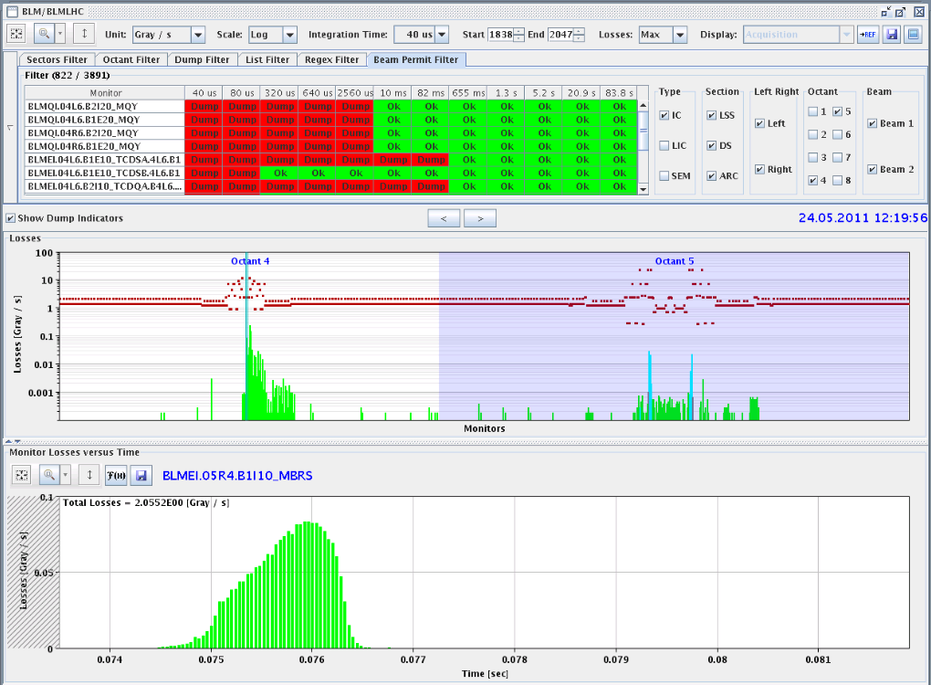
UFO point 4
Dumped by RF arc detection – following a UFO in point 4
XPOC TCT.4L5.B1
PM TCTV.4L5.B1

Slide 3
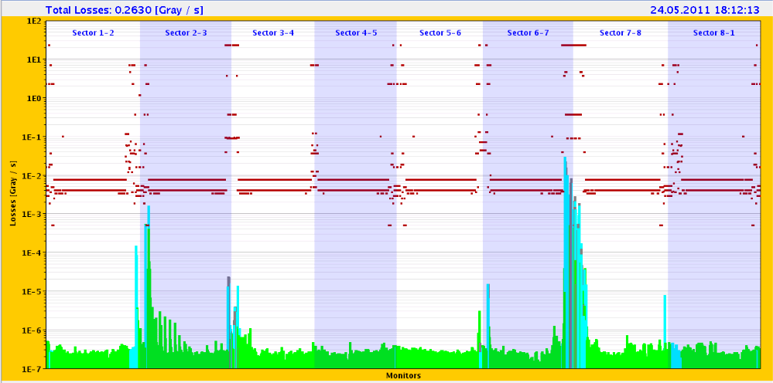
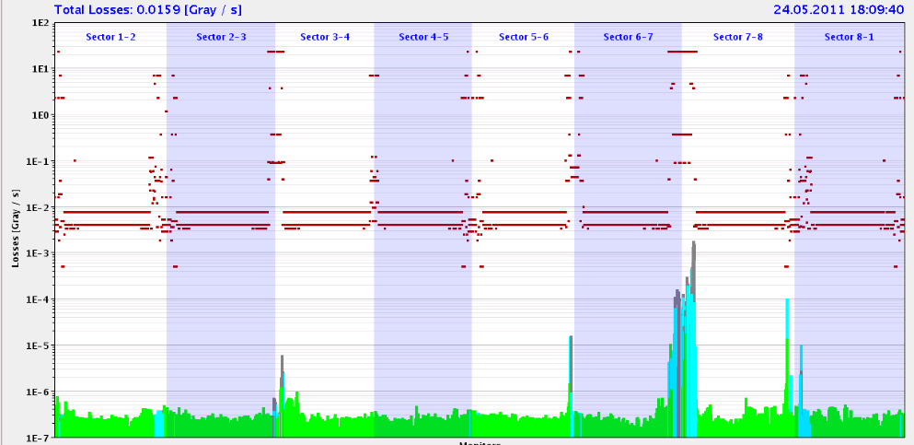
Loss Maps at injection
With injection protection in, to check ratio TDI / TCP
B1 – V:
TCP
TDI
B2 – V:
TCP
Looks OK
TDI

Slide 4
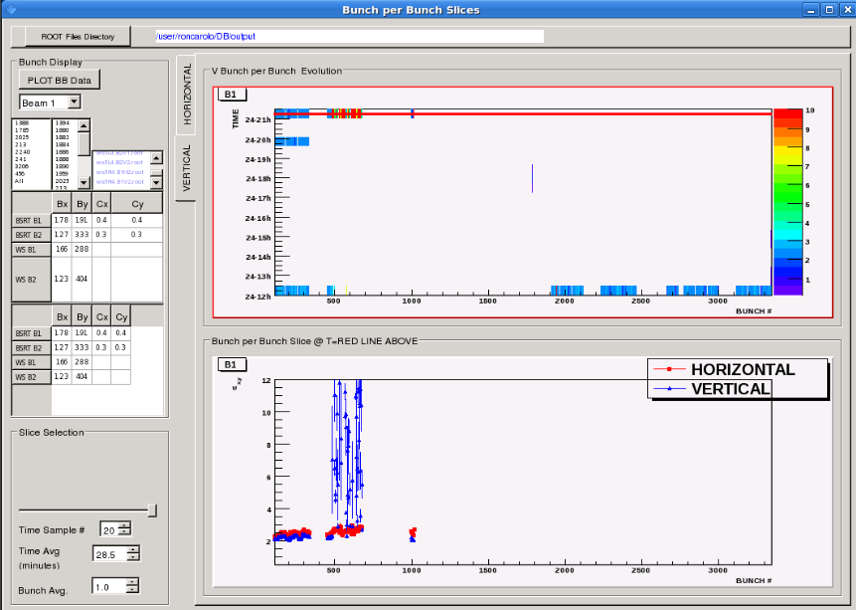
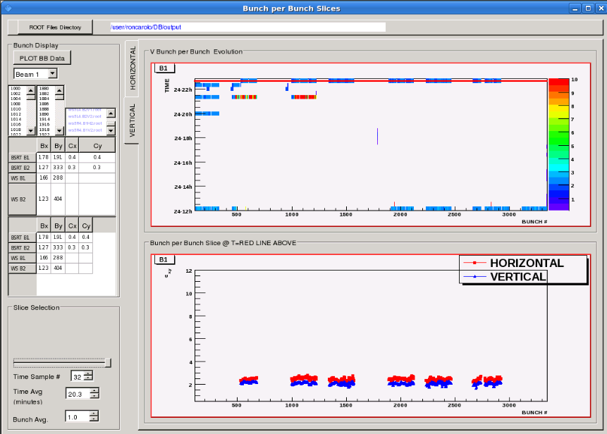
Injection
Injection oscillations and losses for B1
OK after trajectory correction
First, Beams blown up at injection as well
OK for final injection

Slide 5
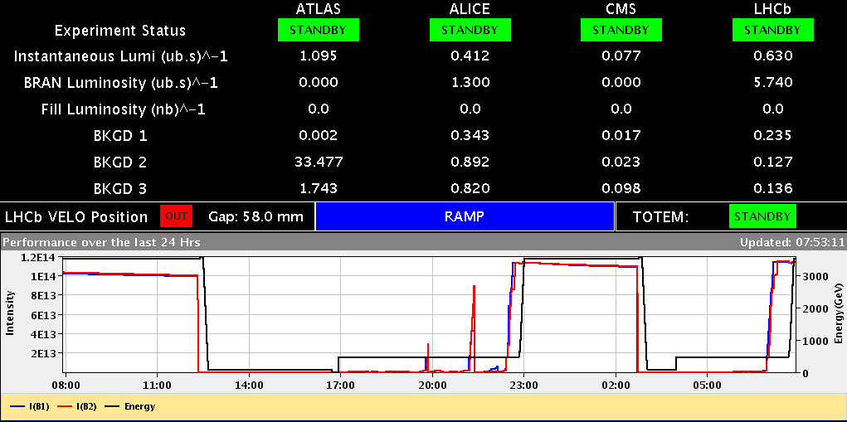
Fill # 1805: 23:25 Stable Beams
Going into physics now
02:43 cfv-sr4-allfo1 power supply down -> RF clock down Missing RF-frequency for beam dump: LBDS triggers as it should RF LL piquet changed the crate – no CO-FE first line

Slide 6
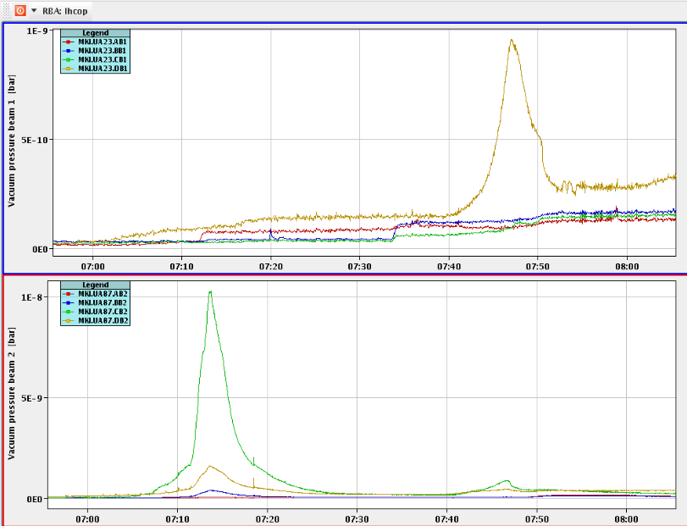
Injection kickers MKI Point 8 vacuum
Vacuum increase during end of filling stopping injection for a few minutes
Most likely e-cloud of interconnects between the injection kickers
Vac reading MKI-C stopping injection

Slide 7
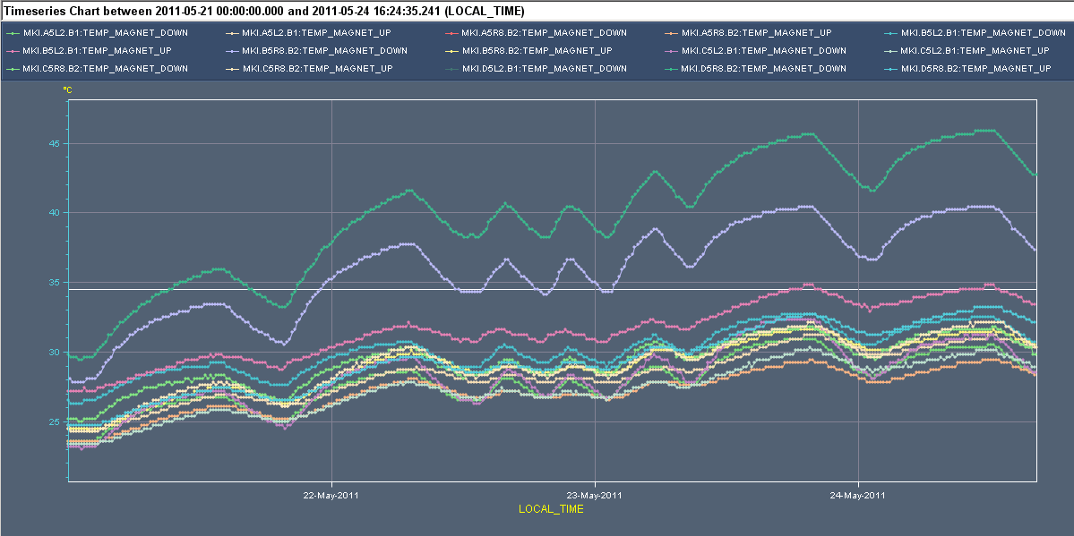
Injection kicker MKI warming up by the beam
Injection interlock set to 55 °C measured magnet temperature
After checks this interlock level can most likely be increased until Curie temperature of magnet ferrite has been found
Above Tcurie (around 120 °C) kicker magnet will loose strength rapidly
Difficult to perform reliable temperature measurement of ferrite which is under HV. Measured temperature ≠ Ferrite temperature.
45 °C
25 °C

Slide 8
Plan
Wednesday
Fill #1806 going into physics right now
End of fill: RF tests switching off one cavity
Test of RF power interlock
TCLIB alignment
Thursday
Physics
End of fill: TCL adjustment
Asynch dump test @ 3.5 TeV for Roman Pots
Measure chromaticity for FIDEL over the ramp
Fri – Sun
Physics

