Slide 1
Preliminary MD Report
R. Assmann, G. Papotti, F. Zimmermann
MD program worked well.
Thanks to machine coordinators Jan and Bernhard.
Thanks to the excellent preparation of all involved.
Thanks to EIC’s and OP for extremely efficient machine setup and handling.
Thanks to all for sticking to allocated times.
Will later review lessons and possible improvements for next MD. Comments welcome…

Slide 2
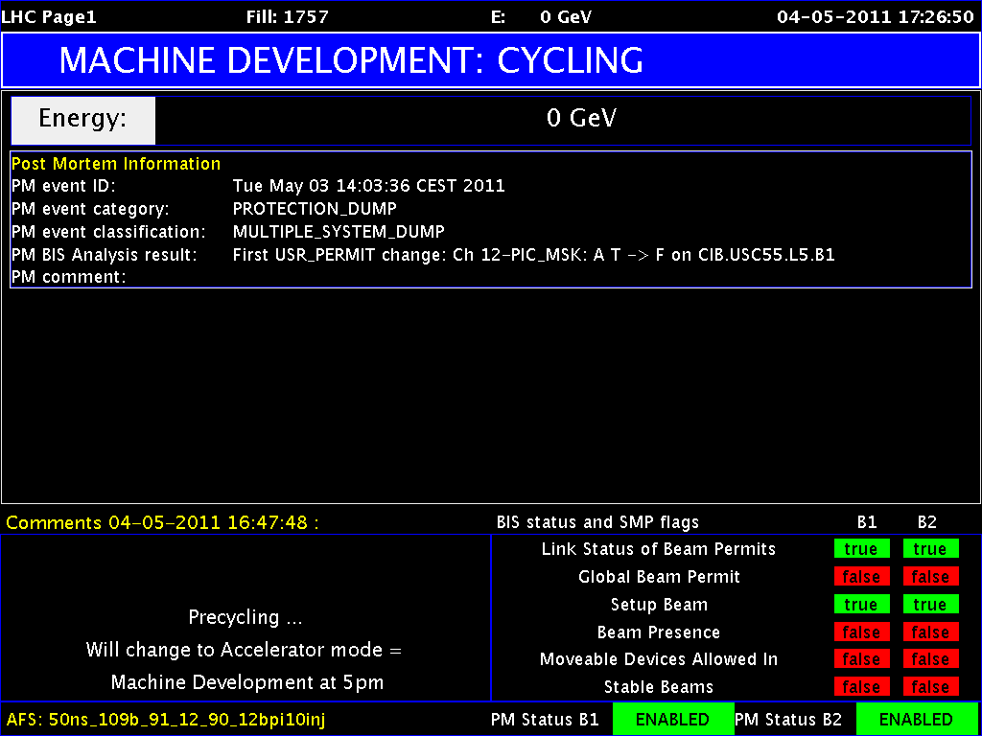
1st LHC MD Period Started Last Wednesday

Slide 3
Getting busy…

Slide 4
MD Wed – Sat
Status 9.5.2011, 08:00
Day | Time | MD
Wed | 06:00 | UPS repair, ATS optics checks w/o beam
 | 12:00 | Cycle, test ATS optics w/o beam
 | 16:00 | 0.45 TeV: BPM offset determination for triplet BPMs
Thu | 00:00 | 0.45 TeV: Alignment TCDQ/TDI and injection losses (other beam)
 | 08:00 | 0.45 → 3.5 TeV: RF single-bunch instabilities
 | 14:00 | Ramp down, cycle.
 | 16:00 | 0.45 → 3.5 TeV: 90 m optics unsqueeze
Fri | 00:00 | Ramp down, cycle
 | 02:00 | 0.45 → 3.5 TeV: Cross calibration of BSRT/WS/BGI
 | 10:00 | Ramp down, cycle
 | 12:00 | 0.45 TeV: Collision tunes at injection + ramp down, cycle
 | 20:00 | 0.45 TeV: Beam-beam limit
Sat | 04:00 | 0.45 TeV: Investigation on CODs

Slide 5
MD Sat – Mon
Status 9.5.2011, 08:00
Day | Time | MD
Sat | 10:00 | 0.45 TeV: ATS (including cycle to new injection settings)
 | 20:00 | 0.45 – 3.5 TeV: Nominal collimation, single bunch tune shift
 | 04:00 | Ramp down, cycle
Sun | 06:00 | 0.45 TeV: RF multi-bunch instabilities
 | 10:00 | 0.45 → 3.5 TeV: Coupled-bunch instability rise times
 | 18:00 | Ramp down, cycle
 | 20:00 | 0.45 → 3.5 TeV: Quench test in the DS of IR7
Mon | 06:00 | Technical Stop
Lost | 6h | 3.5 TeV: Tune scan – beam-beam optimization, lifetime, losses

Slide 6
Some highlight lessons…
MD’s prove excellent performance potential of LHC:
No head-on beam-beam limit encountered with 3 times nominal brightness. Total tune shift: 0.03 with ATLAS/CMS collisions.
ATS injection optics with different integer tunes fine to 3.5 TeV.
Collimation system reached tighter settings with better cleaning efficiency. Limited by setup accuracy and stability.
Collimation system (operational physics settings) reached 500 kW primary beam loss without quench in dispersion suppressor.
Impedance and instabilities under control.
Operational improvements:
K-modulation for better orbit and aperture.
90m optics for ALFA and TOTEM works fine.
First test of bunch blowup with transverse damper.
Emittance cross-calibration data collected.
Shielding transfer lines for more tolerant injection.
Data for some suspected dipole correctors.

Slide 7
K-Modulation
MD was successful (Jorg, Kajetan, Tobias)
lot's of good data was collected.
about 3 1/2 hours of efficient MD time.
We took data for four quadrupoles:
Q6.L5B2, Q6.L7B2, Q9.R6B, QX1.L5
Preliminary analysis was done for Q6.L5B2 and Q9.R6B2 vertical:
For Q6.L5B2 we found a very good alignment of the BPM with the quadrupole, while we found that the beam was off-center by -0.2mm, as indicated by the BPM.
The preliminary analysis for Q9.R6B2 indicates an offset between quadrupole and BPM of 0.2mm, while the beam was really off-center by about 1.5 mm!

Slide 8
K-Modulation Result

Slide 9
TCDQ angle alignment and TI8 shielding MD
TI8 shielding studies (Chiara, Wolfgang, Annika):
B2, use probe bunch, opened all TCDIs to +/-15 mm
for one after the other close left jaw to 3 sig across zero to dump beam on this jaw
3 shots per collimator, analysis to check shielding effect offline
Completed successfully.
TCDQ angle alignment (Chiara, Wolfgang)
B1, use probe bunch
TCDQ maximum angle corresponding to 2mm discrepancy between up and downstream corner ==> 300 urad
measure angle of TCDQ
Stopped by problem with an SPS kicker. Not complete. B2 to be done.

Slide 10
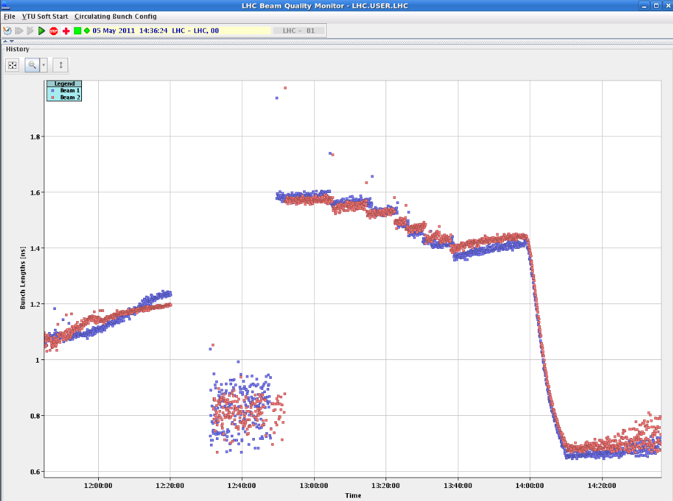
RF Single-bunch instabilities MD (Elena et al)
Loosen limits on interlocked BPMS IP6 and test
Inject beams with different longitudinal emittances, expect some of them to go unstable during the ramp
1.6e11 ppb, .35eVs single bunches are stable in the LHC at injection energy.
Ramp to 3.5 TeV
“Bunches became unstable on the flat top with phase oscillation amplitude increasing for bunches with smaller injected longitudinal emittance. Beam 2 was more unstable than beam 1. Only the first bunch with injected emittance of 0.9 eVs was stable. To see instability during the ramp (if any) bunch profile data should be analysed.”
Bunch length
Inj.
Ramp
Unstable at flat top after a while

Slide 11
90 m Unsqueeze (Helmut et al)
Demonstrate feasibility of simultaneous un-squeeze of IPs 1 & 5 with external tune compensation using main quads.
Orbit and tune feedbacks were kept ON for all the beta* changes.
Coupling measurements, corrections, incorporated into functions.
Chromaticity & orbit adjusted (real-time trims into the LSA ).
Everything worked as expected. Few minor hiccups.
B-beat measurements with AC dipole carried out at flat-top, at 30m and (more extensively) at 90m.
Primary collimators were closed to 10 sigma’s as a safety measure prior to the AC dipole measurements.
At flattop local & global coupling corrections: local jumps in IP1,IP2,IP5 and IP8 are reduced.
Beta-beat beam1H is ~25% and ~20% for beam1V at 90m.
Beta-beat for beam2 is ~30% at 90m.

Slide 12
90 m: Intensities and Beta*
Intensities
beta-star

Slide 13
90m Beta Beat

Slide 14
Cross calibration of BSRT/WS/BGI (Federico et al)
No summary in logbook…
Program completed at 450 GeV
B1 lost at ramp → ramp and 3.5 TeV data for B2 only.
To be analyzed offline.
Ramp with 2 trains of 12 bunches , but lost beam 1 at the very beginning of the ramp because of an energy interlock on the TCDQ.
Problem came form a glitch at the start of the movement which was converted into wrong energy reference (440 GeV whereas we were at 452 GeV).
Bump scans around the BGI for beam 2 and did blow-up few bunches of the first train with the tune kicker. with collision tunes.

Slide 15
Collision tunes at injection
Local coupling corrections implemented.
Nominal tunes ramp for further coupling measurement and correction along the ramp with pilot bunch. Fine.
Tune scan from nominal to collision tunes at injection. No effect on lifetime. Ramped with collision tunes.
A second ramp: coupling corrections from ramp 1. Improvement of about factor 2 observed in C-. Coupling correction is valid for nominal injection tunes too.
3rd ramp nominal bunch, lost half intensity at start of the ramp: chromaticity could be negative. Vertical oscillations 1 minute after start of ramp. Transverse dampers were off.
No difference in beta-beat for collision and injection tunes.
Small difference observed in the beta-beat for injection compared with 4-4-2011 (for both beams).

Slide 16
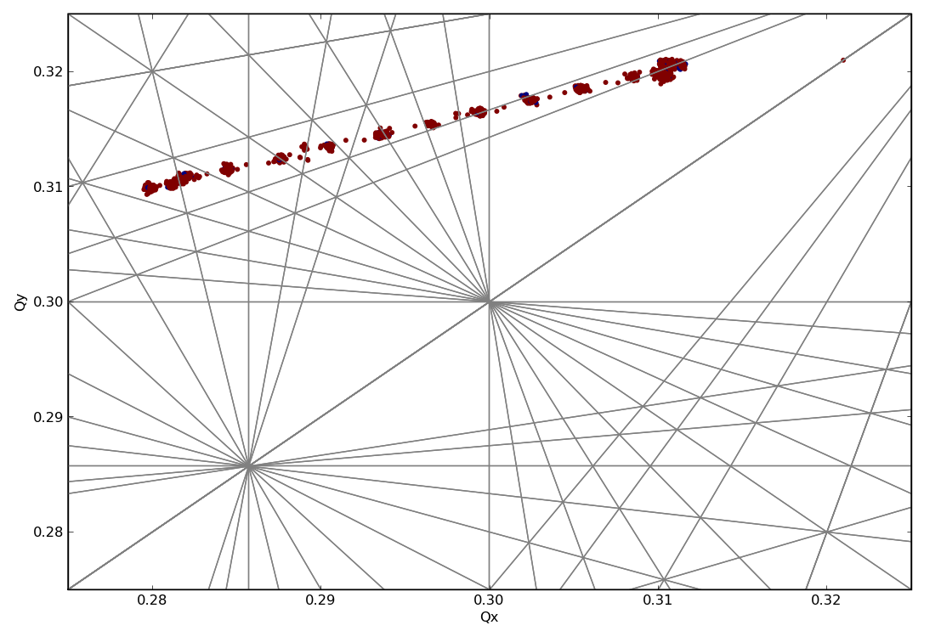
Coupling correction & Tune Scan

Slide 17
Tune Amplitude: Beam Loss Ramp #3

Slide 18
Beam-beam limit (Werner et al)
Collided high intensity beams (1.7 E11) and small emittances (smaller than 1.5 um) in IP1 and IP5.
First attempt achieved tune shifts 0.01 per IP, vertical blowup of emittance.
Blowup most likely due to 10th order resonance.
In final attempt reduced vertical tune to end up below 10th order after putting beams in collision. No more blowup observed, tune shifts per IP in excess of 0.015 (with initial emittance below 1.2 um).
Collisions in IP1 and IP5, optimized and no more blowup.
No limit found for head-on beam-beam effects for the intensities investigated so far (no long range yet).

Slide 19
B1: IP1, IP5, 450 GeV, tune shift > 0.015 per IP

Slide 20
B2: IP1, IP5, 450 GeV, tune shift > 0.015 per IP

Slide 21
0.45 TeV: Investigation on CODs
Nuria, Matteo, et al
Investigation done on the following CODS:
1 - RCBYHS5.R8B1
2 - RCBYV5.L4B2
3 - RCBYH4.R8B1
4 - RCBYHS4.L5B1
5 - RCBCV8.L1B2
Procedure:
Bump with each of the correctors observing leakage to machine.
Data acquired at 25Hz has to be analyzed online, but some hints suggested good results (especially the corrector 2 showed a large dynamic response).
Further analysis has been done on correctors 1 and 5 sending a sinusoidal current at different frequency.
Results to be analyzed. Ongoing.

Slide 22
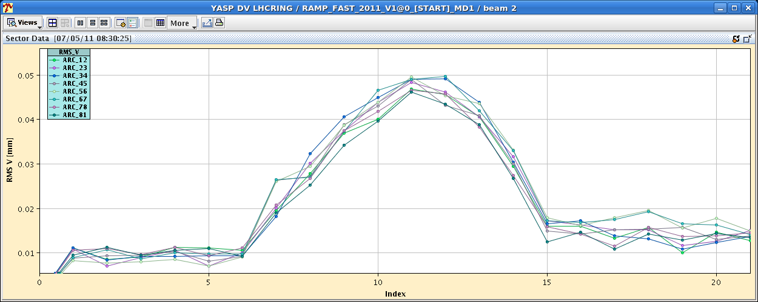
0.45 TeV: Investigation on CODs
Nuria, Matteo, et al
Dynamic orbit effect while ramping bump with correctors.

Slide 23
New ATS Optics
S. Fartoukh et al
New injection optics (ATS optics) tested and ramped successfully up to 3.5 TeV
crossing scheme off (TCT, TDI, TCLI opened with probe beam
successfull inject and dump test
damper new settings OK (with new phases of the ATS optics)
no emittance blow up during the ramp
new integer tunes measured at injection 62/60 (instead of 64/59)
CO, tune, coupling, chromaticity measured and corrected at injection and flat top
new tune, chroma and coupling knobs operational
orbit and tune feed-back successfull during the ramp.
beta-beat measurement
30% at injection, 10-15% at flat top w/o any specific correction
H and V dispersion measured
H: +/- 50 cm (compared to 2 m) for Dx at injection, +/- 20 cm at flat top.
V: 15-20 cm peak at injection, about 10 cm at flat top.

Slide 24
New ATS Optics
S. Fartoukh et al
Next steps:
inject and ramp with crossing scheme (170 murad, 2 mm in all IP's kept constant during the ramp).
pre-squeeze to bstar=1.2 m w/o crossing scheme.
measure/correct the off-momentum beta-beating, and non-linear chromaticity.
switch on the crossing scheme at bstar=1.2 m and measure/correct the spurious dispersion.

Slide 25
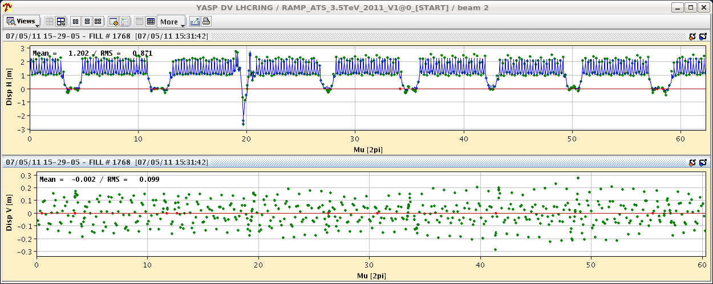
ATS New Injection Orbit – Ramp, Dispersion
Excellent transmission of intensity through the ramp.
Dispersion B2.

Slide 26
Nominal collimation, single b tune shift (Coll, Imp.)
Initial blow-up tests with transverse damper.
Injection scraping during short delay from injectors.
Nominal 3.5 TeV collimation settings achieved for b1 &b2:
TCP = 5.7 sigma (nom), TCSG = 6.7 sigma (nom)
TCLA = 9.7 sigma (nom), IP6 = 7.2/7.7 sigma (nom)
Octupoles trimmed to 350A for beam 1.
For b1 moved towards nominal 7 TeV settings. Limited by TCSG losses close to IP7. Valid setup reached:
TCP = 4.0 sigma (nom), TCSG = 6.0 sigma (nom)
TCLA = 8.0 sigma (nom), IP6 = 7.0/7.5 sigma (nom)
Smallest gap: 2.2 mm
Beam lifetime: > 100 hours
Tune shift measured: ~2e-4
Efficiency measured: 3e-5 – 1e-4

Slide 27
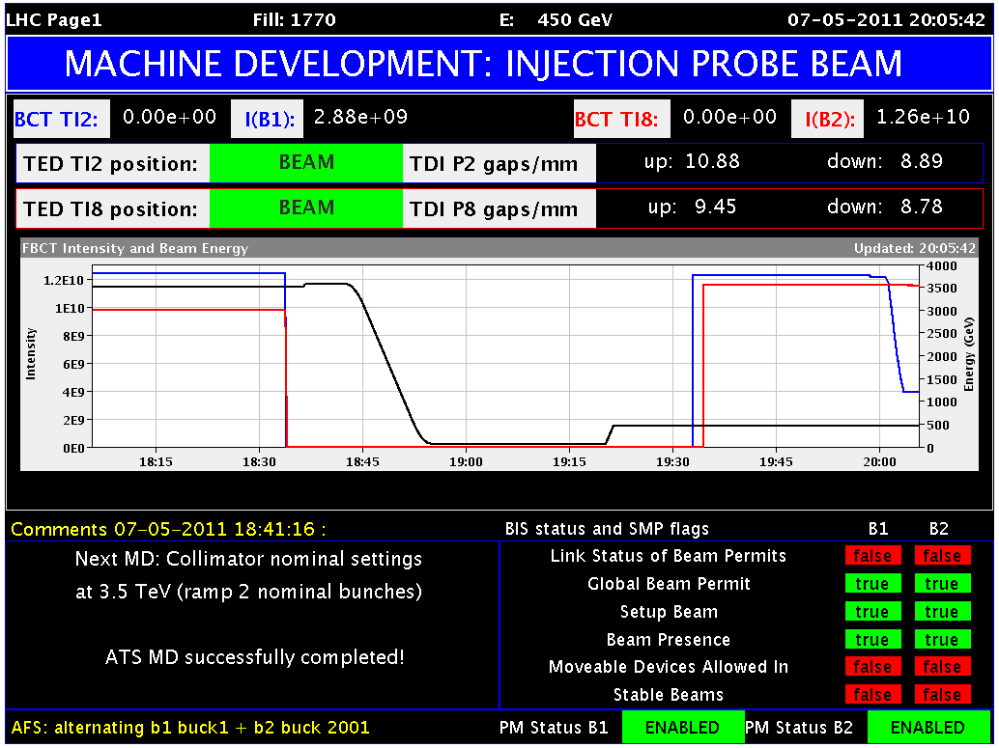
Blowup Test Transv. Damper (Wolfgang, Daniel)

Slide 28
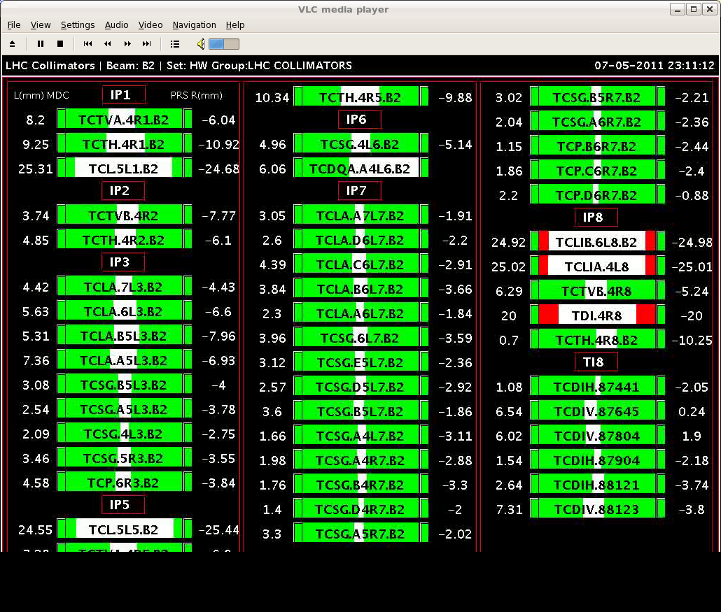
Settings b1 first loss-maps

Slide 29
Vertical tune shift – collimator movement
Clearly seen in vertical plane when moving collimtors out by 4 sigma and back in, etc…
Magnitude: ~0.0003

Slide 30
Efficiency measured – here b1, horizontal
4e-5

Slide 31
RF multi-bunch instabilities (Philippe et al)
Studied VERY slowly damped oscillations of bunches at injection. 3 different fillings, all nominal bunch parameters.
Varied batch spacing and the nbr bunches per batch.
Fill1: 12b, then 36b at 0.875 us spacing, then 36b at 0.875us
Fill2: 12b, then 36b at 0.875 us spacing, then 36b at ½ turn spacing
Fill3: 12b, then 36b at 0.875 us spacing, then 72b at 0.875 us
Measured:
bunch profiles (25 ps/sample) to see whether oscillation is pure dipole or higher-order and the b-by-b stable phase to measure damping.
Plot shows damping of the dipole oscillation for fill3
The figure is similar for the other fills: an oscillation growing for the first 5-10 min, then damped with a 30-40 min damping time.
Further analysis will tell whether batch spacing and nbr bunches/batch have an influence on the damping time. The BQM data will also be analyzed to see whether quadrupole oscillations are present.

Slide 32
RF multi-bunch instabilities (Philippe et al)
damping of the dipole oscillation for fill3:
12b batch (avg over all bunches) in green
36b batch (avg) in red
72 b batch (avg) in blue.

Slide 33
Coupled-bunch instability rise times (Elias et al)
Injection energy, 12+36 bunches:
switch off transverse feedback (both planes) for up to 2.5 s, triggering acquisition at the same time on ADT pickups, LHC-BPM and headtail monitor, first for B2 only (up to ~14h00), then for both beams
B2: instability visible in the ADT pickups, in vertical only, around 13h18 (Q'H=-1, Q'V=-0.5, feedback off for 1 sec),
B1 & B2, both planes: instability visible in ADT pickups and LHC-BPM around 14h46 (chromaticities at 0, feedback off for 2.5sec) and around 15h04 (chromaticities at -1, feedback off for 1.5sec)
Ramp 12+36 b to flat top, no squeeze, chromaticities ~ 0
trim octupoles to 300A, then trim down by step. At each step, we switched off the transverse damper for 1 second. No instability until 100A, then "feedback off" window increased to 3s.
Octupoles trimmed down again by steps of 10A. Instability begin visible in B2 vertical at 60A (17h54). We continued to trim down until 0A; no other instability than B2 V was seen, until we dump around 18h23.

Slide 34
Coupled-bunch instability rise times (Elias et al)

Slide 35
Losses in Dispersion-Suppressor (Coll+BLM+MP)
BLM thresholds adjusted on 120 BLM’s, based on old data.
Created fast (~2 s) beam losses at primary collimators.
3 bunches, b2 loss
Loss rate: 1.5e11 p/s
20 times below BLM limits, 10 times below assumed quench limit,
16 bunches, b2 loss
Loss rate b2: 2.5 – 3e11 p/s, 6e11 p/s
Reached 505 kW loss
Beam dump after damper switched on, b2 still on 1/3 resonance.
16b (b1) and 21b (b2):

Slide 36
Beam Loss with 16 bunches, 3.5 TeV
Loss rate:
9e11 p/s @ 3.5 TeV → 505 kW

Slide 37
Losses into DS (beam 2): No quench!
505 kW – Primary beam loss
IR7
peak in 1 s
no correction BLM response
IR6
336 W – Q8
35 W – Q11
Power load [kW]
5 W – Q19

Slide 38
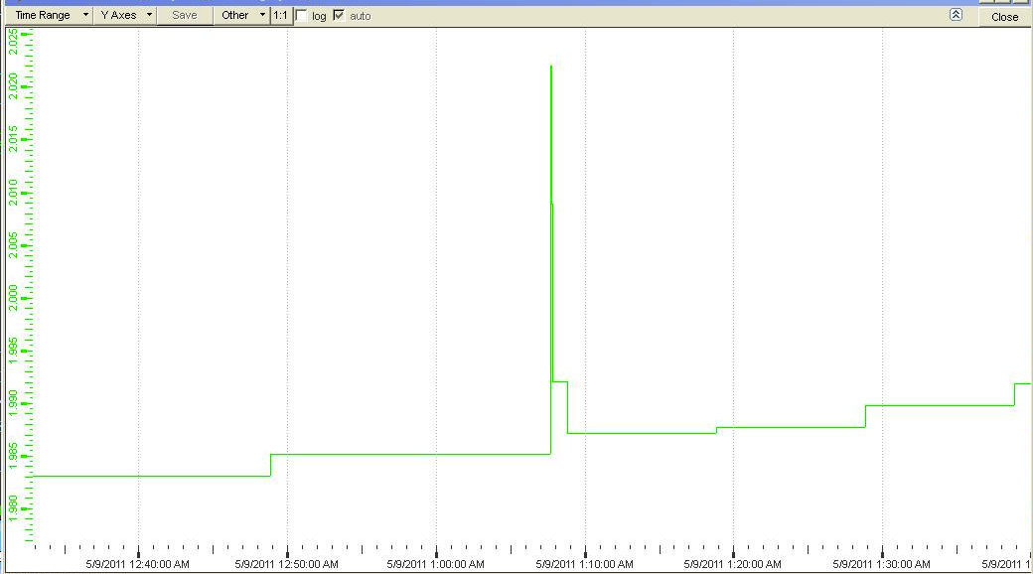
Cryo observation: 505 kW beam loss
36 mK in Q11 empty cryostat, cooling down within 10s
Available margin:
~ 205 mK cryo start lost ~ 215 mK cryo condition lost

Slide 39
MD Note Publication
Use ATS Note MD LHC format.
Contact secretary for number which is available immediately through the web.
No formal approval of MD notes. The responsibility is with the author(s).
Deadline for MD notes: 1 week after end of MD period. This means 16.5. for MD’s of last days.
Submit MD note through secretary but also upload a copy on LHC MD web site, into shared documents.
http://www.cern.ch/lhc-md

