Slide 1
Thursday 5th May
7:00 Access RQTF.A23B1 water fault
9:45 injecting, start of MD on RF single bunch instabilities
14:45 Dump beam and try 90 m unsqueezed optics without beam
16:15 During ramp down and pre-cycle load new timing tables for dampers (MD) and Fidel, restart timing system
18:00 Injecting beam for MD on 90 m unsqueezed optics
21:45 b* = 90 m at IP1 and IP5
24:00 Lost sector 81 because of the QPS DQAMG in odd side tripped
01:30 Switches cold, pre-cycle
02:45 Injected beams. Start MD cross calibration of BSRT/WS/BGI
06:00 Beams dumped, power glitch. RB.A56 tripped with slow abort. Precycle.
06:45 Beams back again after manual pre-cycle
07:45 Start ramp. B1 lost due to TCDQ position interlock. Continue B2.
Plan to dump and cycle at 10:00
06/05/2011

Slide 2
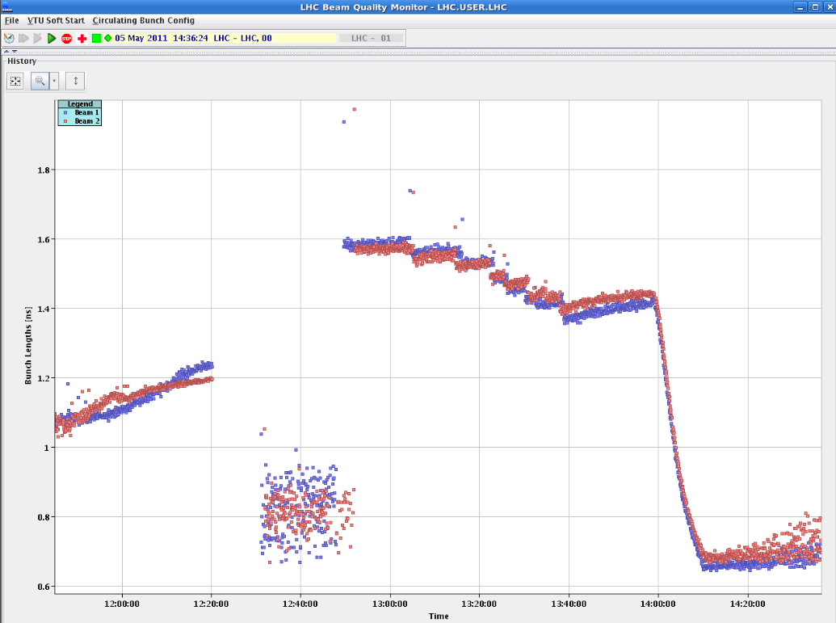
RF Single-bunch instabilities MD
Loosen limits on interlocked BPMS IP6 and test
Inject beams with different longitudinal emittances, expect some of them to go unstable during the ramp
1.6e11 ppb, .35eVs single bunches are stable in the LHC at injection energy.
Ramp to 3.5 TeV
“Bunches became unstable on the flat top with phase oscillation amplitude increasing for bunches with smaller injected longitudinal emittance. Beam 2 was more unstable than beam 1. Only the first bunch with injected emittance of 0.9 eVs was stable. To see instability during the ramp (if any) bunch profile data should be analysed.”
Bunch length
Inj.
Ramp
Unstable at flat top after a while

