Slide 1
Tuesday 26th April – morning shift
08:00 Great news, cryo is back!
Unluckily it was followed by many other problems, one after the other one. So, spent most of the morning in access, for the following reasons:
LBDS MKD card had to be changed;
Alice had a quick access in the shadow;
Observations done for the water leak in 30L4;
cryo accessed PM25 for verifications following the morning trip,
unfortunately the usual problem had the patrol lost (sectors 1 and 4);

Slide 2
Tuesday 26th April – morning shift
Zinur found out that the RB.A34 switches had not opened once when they should have.
Tests were done, an access was given to change a card (which will be studied offline). All RB switches have been tested and work now correctly.
The events following the 400 kV power disturbance on Sunday morning at 06.22.20 (Fill # 1732) leaves a number of issues to be properly addressed.
The basic problem was that the discharge request issued for the RB circuit in sector 34 (following a UPS interlock in IR3) didn’t result in the expected switch opening procedure due to a lack of complete current extinction in the quench loop.
DQQLC board has been exchanged in UJ33 and RB.A34 retested (as all other circuits to trigger correctly from the Odd side) – OK to continue for now, additional verifications need to be done during the upcoming TS.
Then, finally, prepared for injection. Left the machine with probes in and the SPS checking the beams (problem on excessive transverse emittance).

Slide 3
“usual problem in PM25”
Access finished in pt 2. Patrols were lost at 10:18, sectors 1 and 4. Trying to find someone from the access system to check, it looks like the patrol was lost when people were accessing the PAD normally (usual problem in PM 25). Found Serge (Di Luca), who's on holidays, he'll get someone else to have a look. Also informed the coord. de site, Decombaz, for the patrol. He's by himself, probably GHH will go with him.

Slide 4
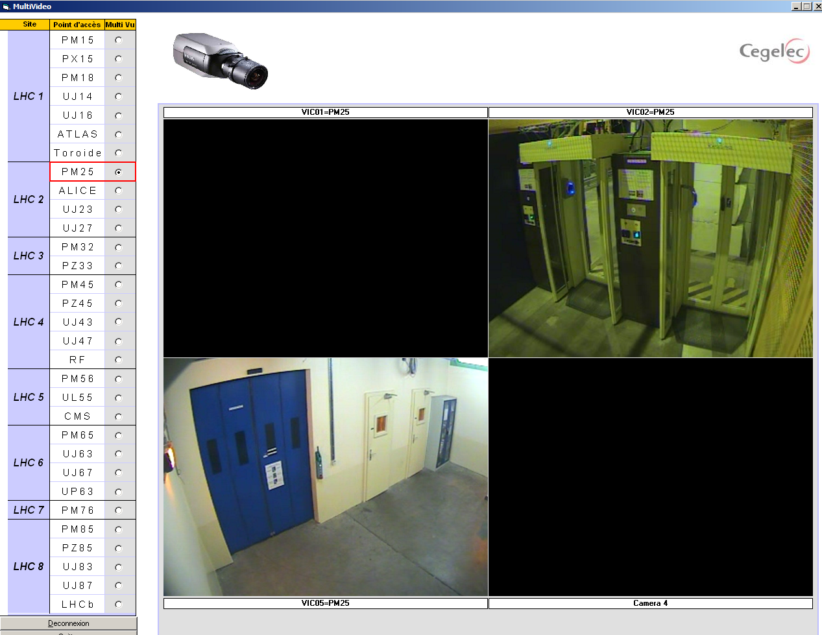
Camera PM25 entrance not working

Slide 5
Tuesday 26th April – afternoon shift
16:02 Start ramp – 480 bunches
16:07 beams dumped by operator - most BPM crates for B2 were down – flying blind
called Lars Jensen mostly B2 front-ends crashed or noted with 'out of memory' Lars recommended to reboot the affected front-ends and to continue. Possible concentrator/cmw problem
Back round
Switch LHCb polarity
18:43 dumped to allow access for cryo to de-ice a filter
21:45 pilots back in after access and pre-cycle
22:55 Start ramp
23:30 Stable beams #1739

Slide 6
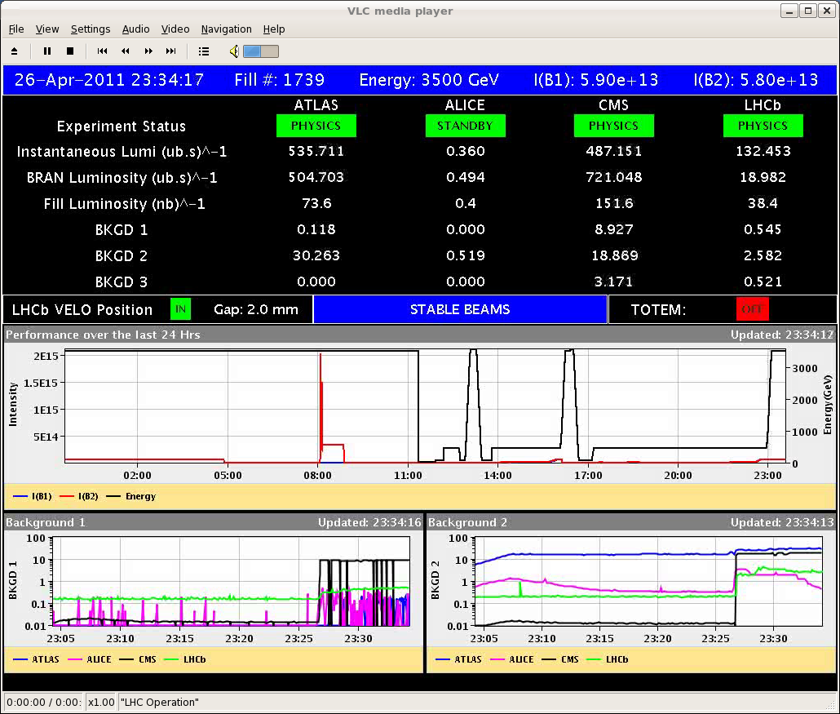
#1739
5.2e32 cm⁻²s⁻¹ in Atlas

Slide 7
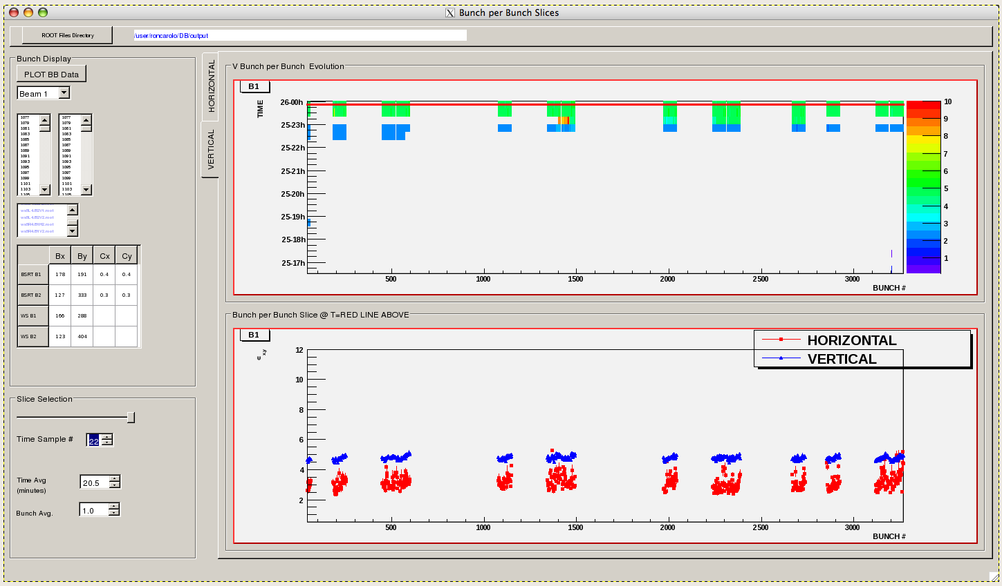
1739 – beam 1 -

Slide 8
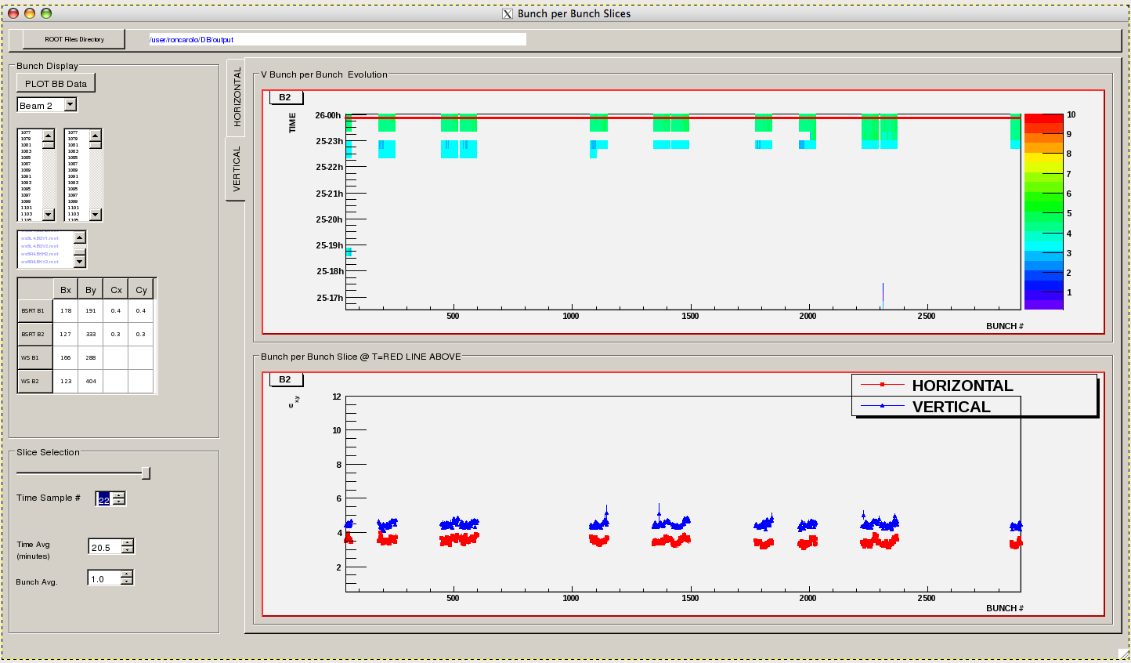
1739 – beam 2 – flat top

Slide 9
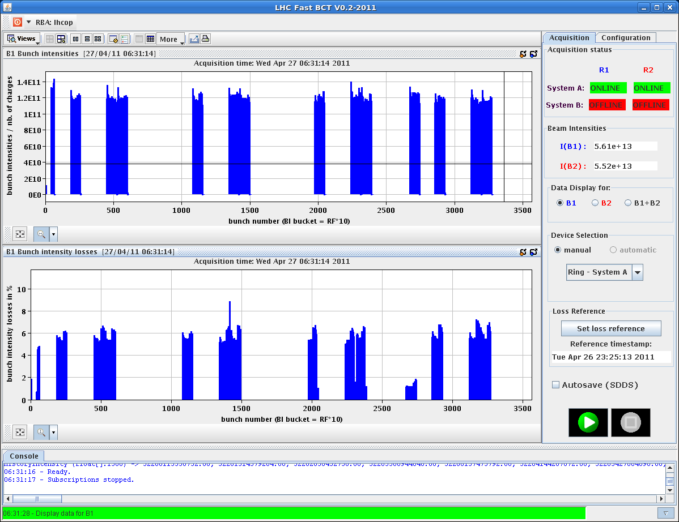
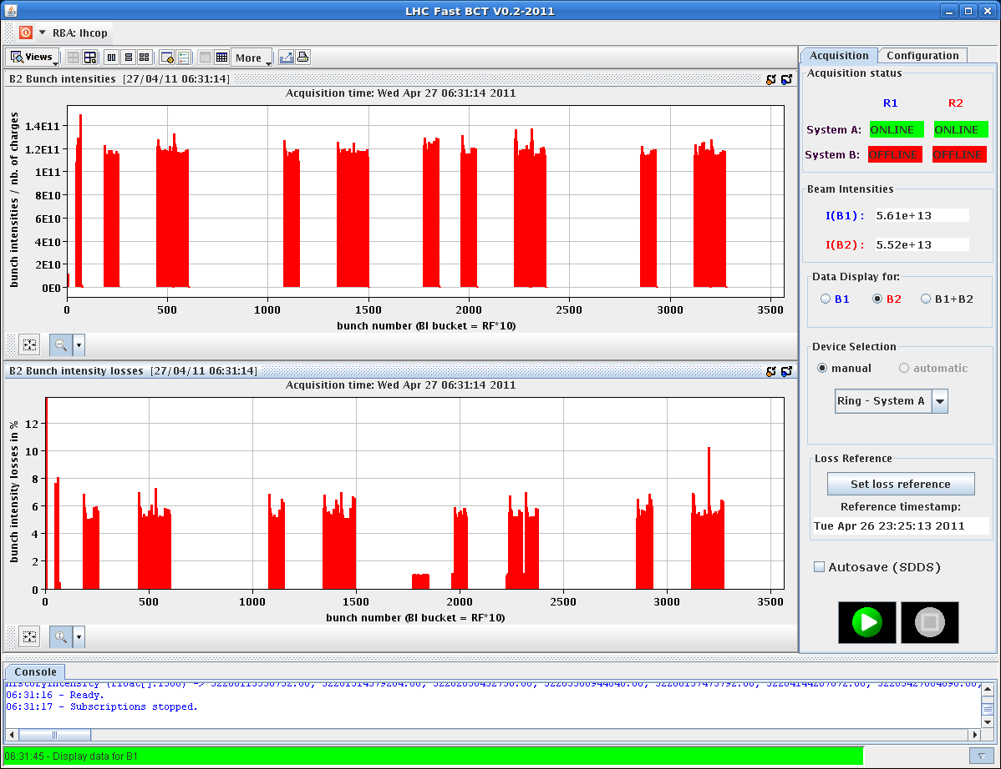
Beam intensity evolution

Slide 10
This morning
07:08 Cryo maintain lost - caused by fault on cooling of turbine – fast recovery foreseen
A problem with a PXI that controls the motors of 2 tertiary collimators in IP1-L – being checked now
Injection adjustment (Verena & Malika)
Injection oscillation out of tolerance
Dynamic b3 correction deployment
test ramp
Physics with 624 bunches

