Slide 1
Friday
07:00 Fill 1729 dumped.
Movement device allowed flag switching to FALSE.
From the logs, it seems the energy went to FFFF/7860 GeV. To be confirmed by more a detailed analysis.
11:30 Fill 1730 in stable beams with 336 b / 72 b per injection.
Initial luminosity ~3E32 cm-2s-1.
Rather smooth.
16:10: Beam dumped. PC fault on RSD2.A67B1.
4.3 pb-1 in 4 ½ hours for fill 1730.
19:10: 1731 in stable beams with 480 b / 36 b per injection.
Slightly higher current and luminosity: 33 MJ/beam.

Slide 2
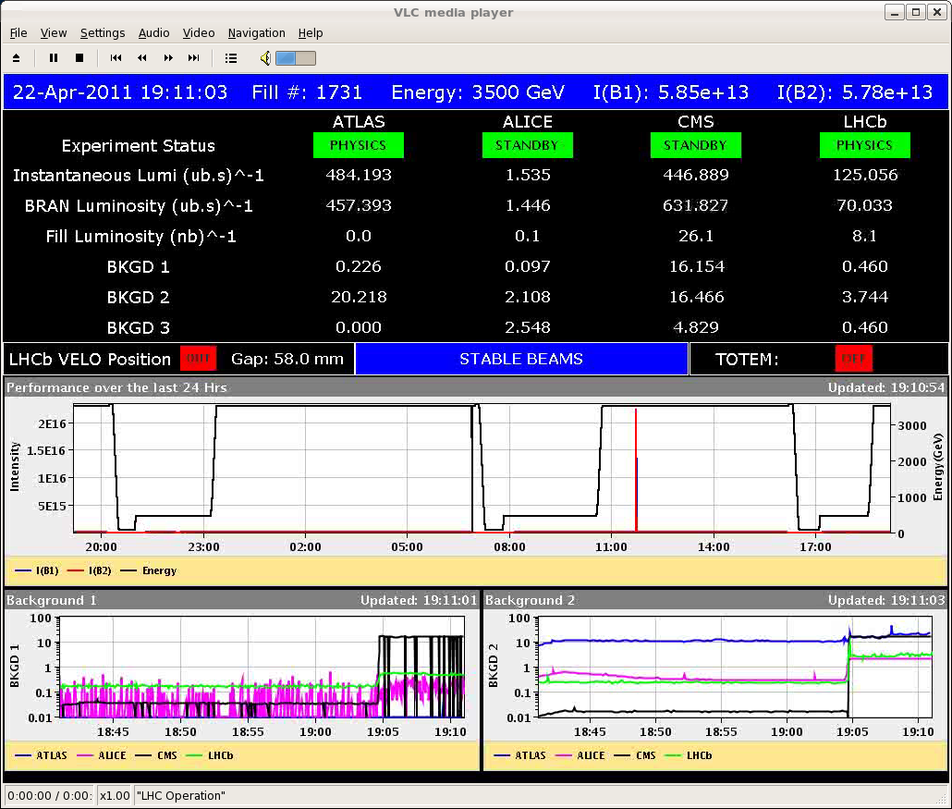
Fill 1731

Slide 3
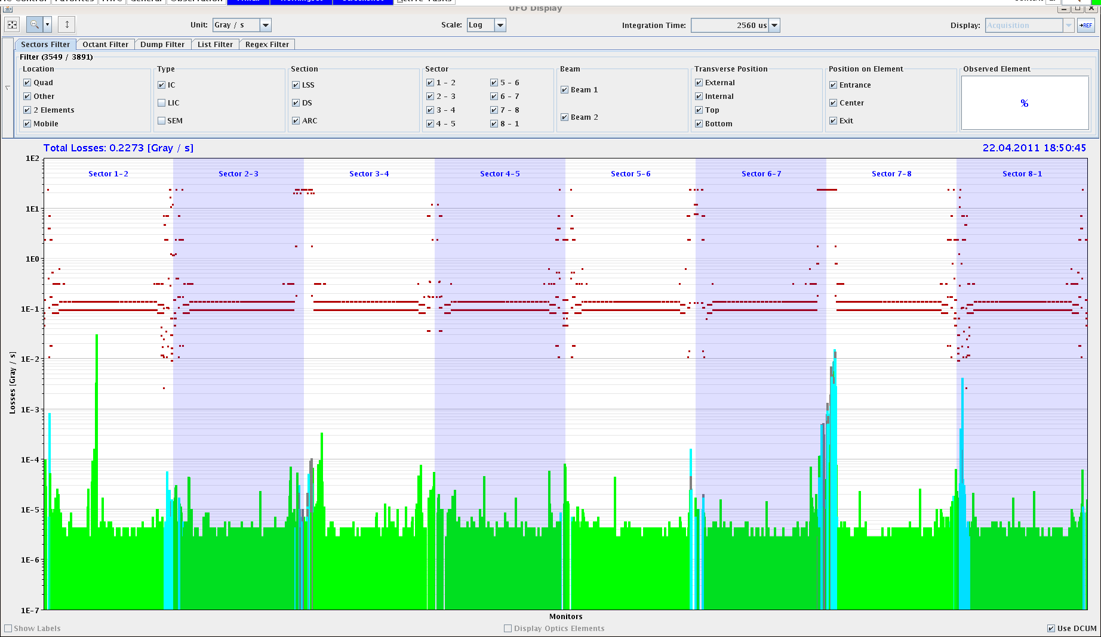
20% of threshold UFO

Slide 4
07:40 dump. Integrated lumi 15 pb-1 (new LHC record).
Bunches in the last trains suffer more during collisions than the ones in the first trains.
Integrated lumi > 100 pb-1 in 2011.

Slide 5
Today
Physics with 480b / 36b per injection. Fill lengths of 10 hours or so – avoid when possible fill/ramp/squeeze at transition of shifts.

