Slide 1
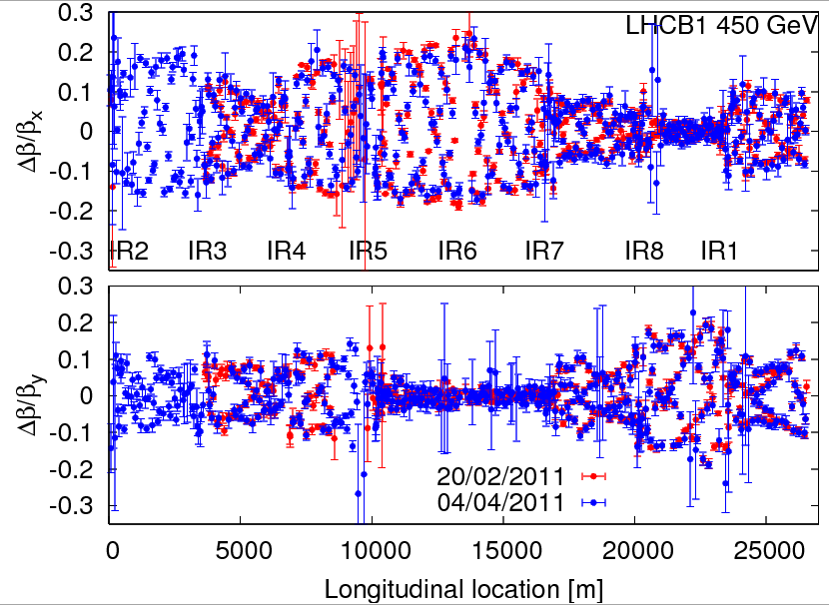
Monday 4th April – beta beat
Beta-beat at injection consistent with earlier measurements.
Does not seem to explain collimator hierarchy violation observed last Saturday. Not orbit, not beta-beat..

Slide 2
Injection setup with 75 ns
Injection of up to 96 bunches from SPS (4x24).
Injection of 75 ns trains: 8 - 24 - 48 - 72 and 96 b for both beams.
After scraping was tuned in the SPS (‘deeper’ scraping), injection was clean.
With 96 bunches, the loss levels in the injection regions reach ~15% on the Q6 and 5-10% on TDI.

Slide 3
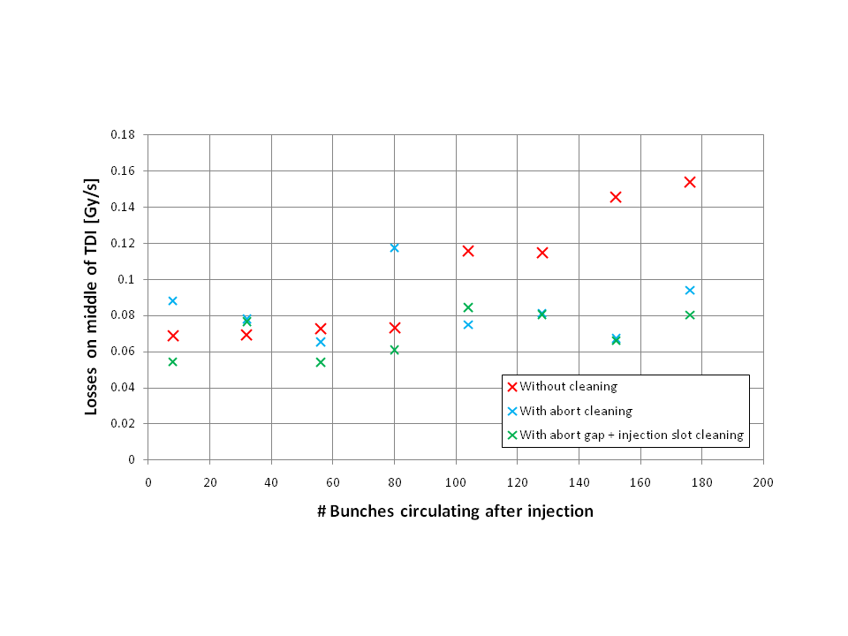
Injection setup
Injection and abort gap cleaning.
Injected 176 bunches for B1 without any cleaning, with abort gap cleaning only and both abort gap and injection gap cleaning on.
Losses on TDI are small this year because of good RF capture (higher voltage).
Losses are reduced by ~ a factor 2 with abort gap cleaning on. Injection gap cleaning does not seem to give further improvement.

Slide 4
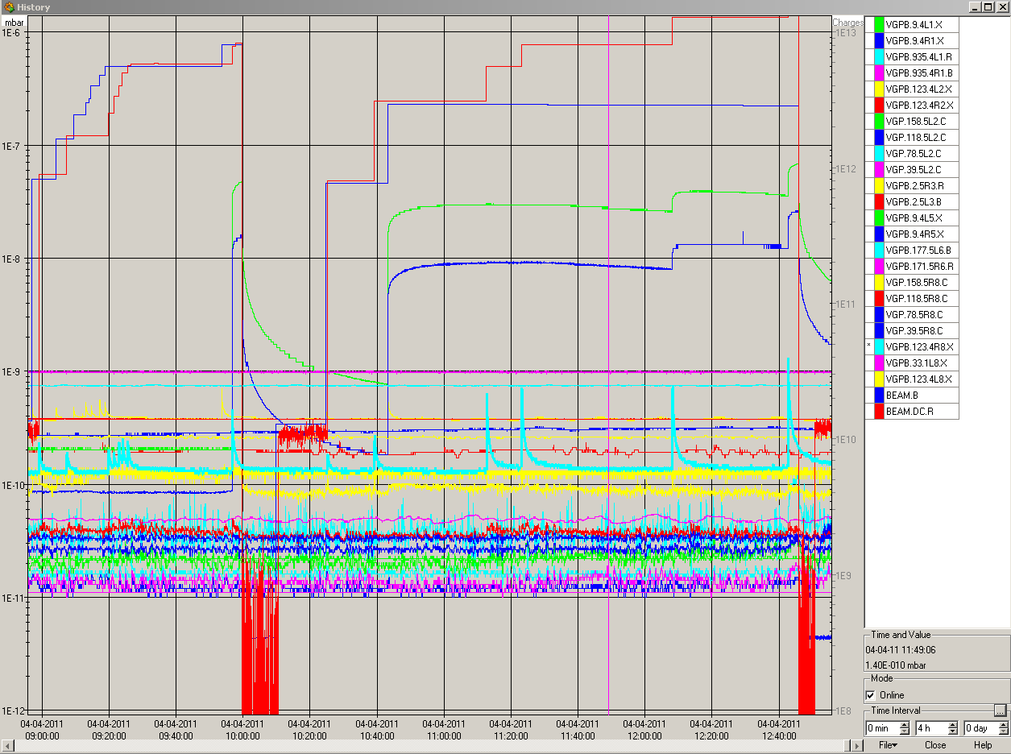
Injection setup - vacuum
Vacuum activity in the presence of BOTH beams in the common regions.

Slide 5
Monday 4th April – TCT setup
TCTH.4L2.B1 setup at end of squeeze and in collisions.
new center squeezed: -0.92mm (delta -0.490mm to previous values)
new center colliding: -0.765mm (delta -0.605mm to previous values)
Loss maps H and V, and dp/p < 0.
Results:
TCTV in IR1 triggered dump during dp/p loss map.
Similar losses have been seen in March on dp/p loss maps.
Only V absorber in IR3, therefore V losses intercepted at TCTVs (or any other V aperture limit).
Otherwise no un-expected losses: - B1h leakage: TCTs in IR8: ~2e-3; IR6: ~3e-3; DS R7: ~4e-4 - B1v leakage: TCTs in IR8: ~1e-3; IR6: ~8e-4; DS R7: ~2.8e-4 - B2h leakage: TCTs in IR1: ~2.5e-3; IR6: ~5e-3; DS L7: ~5-e4 - B2v leakage: TCTs in IR1: ~3e-4; IR6: ~1.5e-3; DS L7: ~1.8-e4

Slide 6
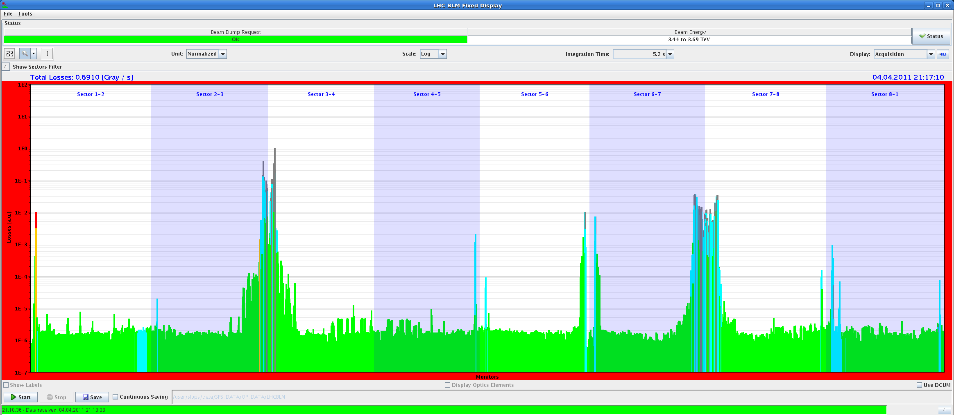
Off-momentum loss map (collisions)

Slide 7
Night
Trip of RB.78.
Access to repair temperature bridge.
Loss maps at injection – repeated twice.
Latest settings of the collimators (tbc).
First loss map: again signs of hierarchy issue in B1H.
Re-open and close all collimators, minor orbit correction (tbc).
Second loss map: looking better…
Why are we presently ultra-sensitive to minor orbit effects?

Slide 8
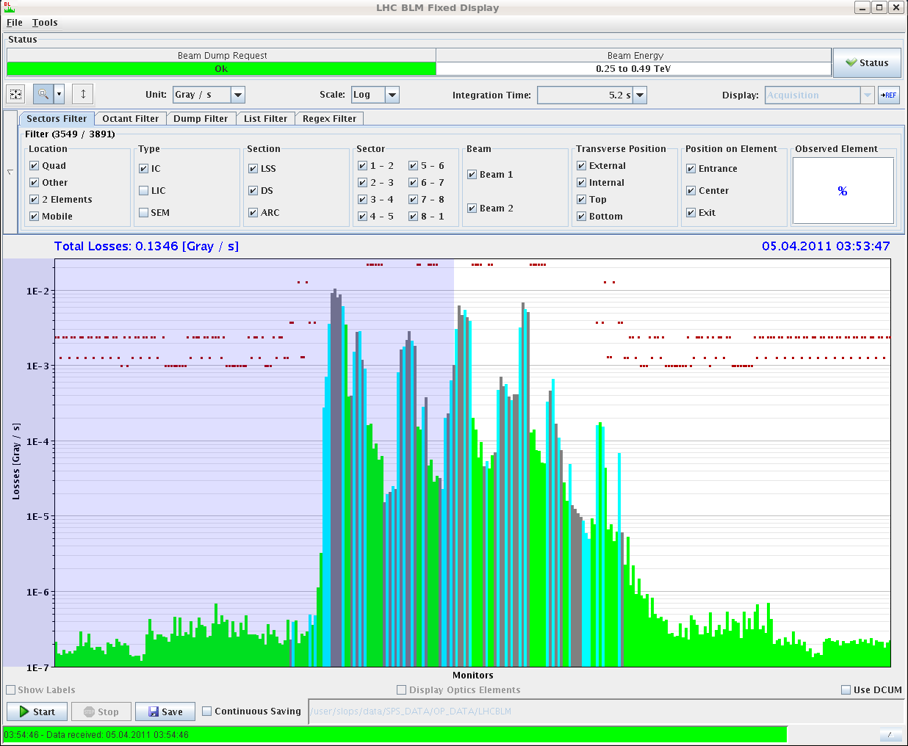
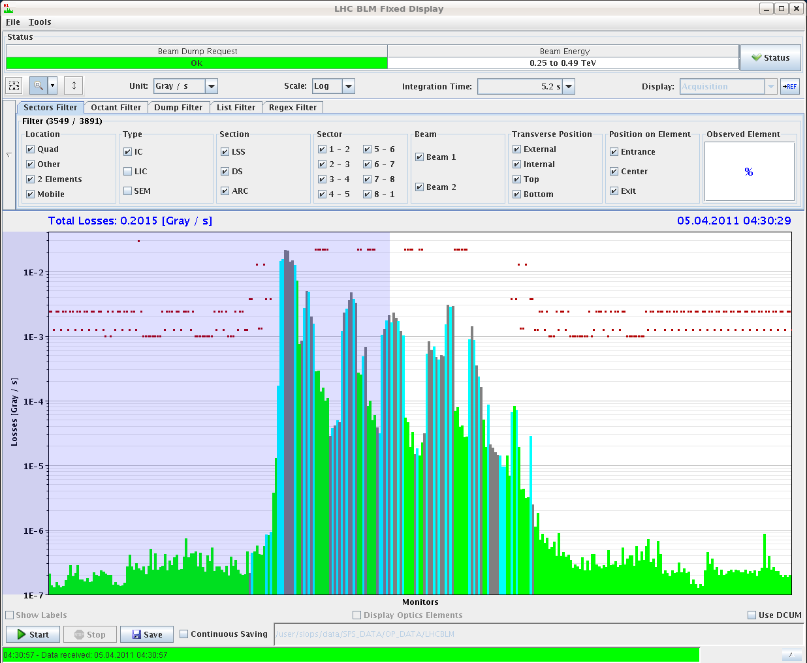
Loss maps B1H
First loss map
Second loss map

Slide 9
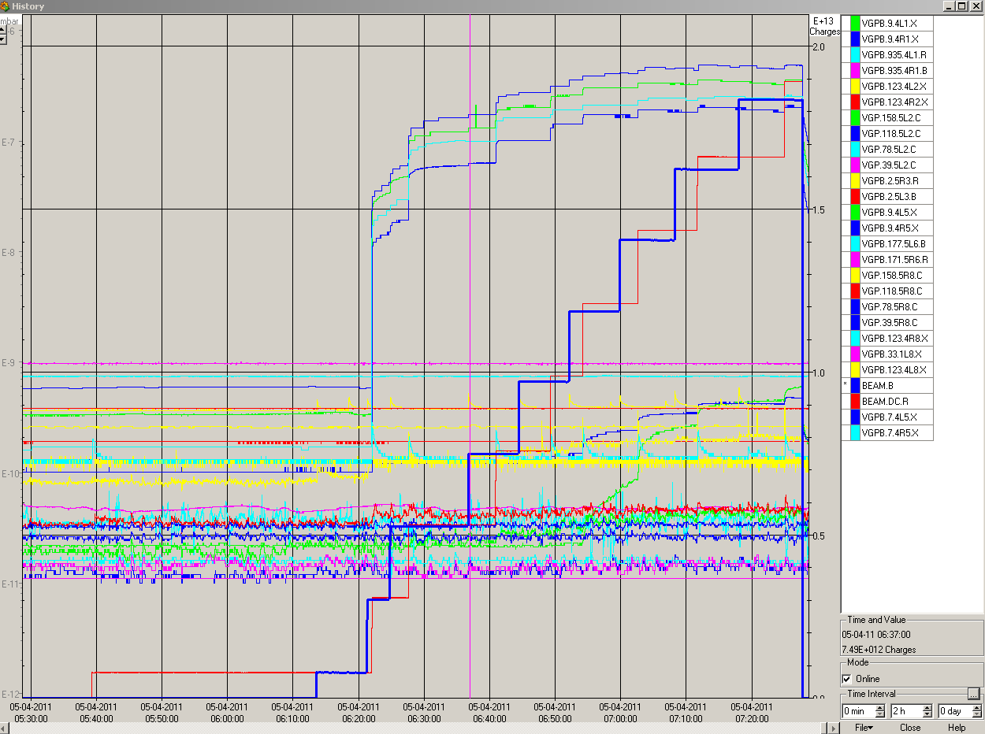
75 ns ‘scrubbing’
06:00: Injection of 75 ns beam (max ~200 b).
Vacuum – pt5

Slide 10
Today
Injection setup with 50 ns.
Collimation at 450 GeV?
RF studies/observations 75/50 ns at 450 GeV.
Start of scrubbing with 50 ns.
To be noted: both LHC MTGs are now running with the new firmware version.

